Slide 1
ORACLES forecasting briefing Meteorology for 15-09-2016 – 17-09-2016
14-09-2016
Lenny Pfister

Slide 2
Summary
Deal with operational viability of tomorrow’s flight this PM
Trough approaching tomorrow enhances middle cloud tomorrow. Also see greater moisture tomorrow than Friday.
Front penetrates into Sc Region Friday, but plenty of “regular Sc” near end of routine track.
Saturday TO: S at 10 knots CAVOK; Saturday landing, SSW 15-20, CAVOK (maybe some dust). Possible crosswind (96 hour fcst)

Slide 3
Tomorrow and Friday

Slide 4
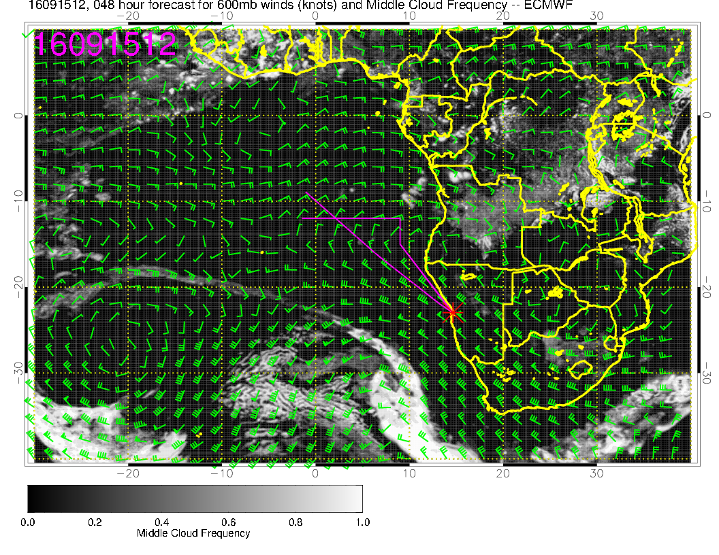
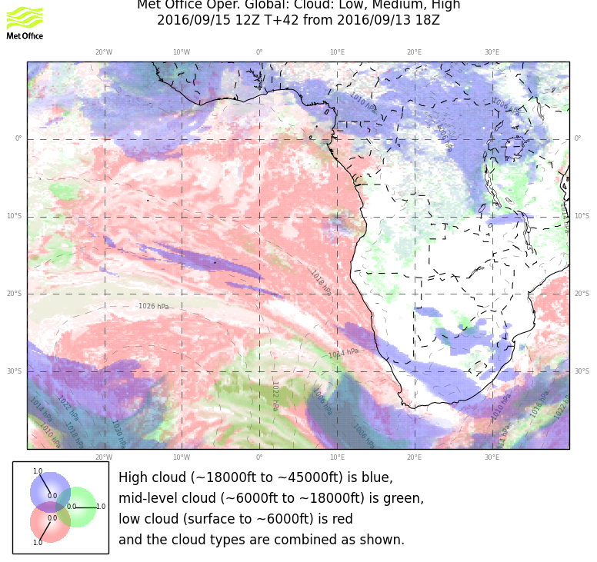
Hint of middle cloud SW of routine track in UKMO. Based
on presence of trough, something in the region is likely.
Little dot is on routine flight track in EC.

Slide 5
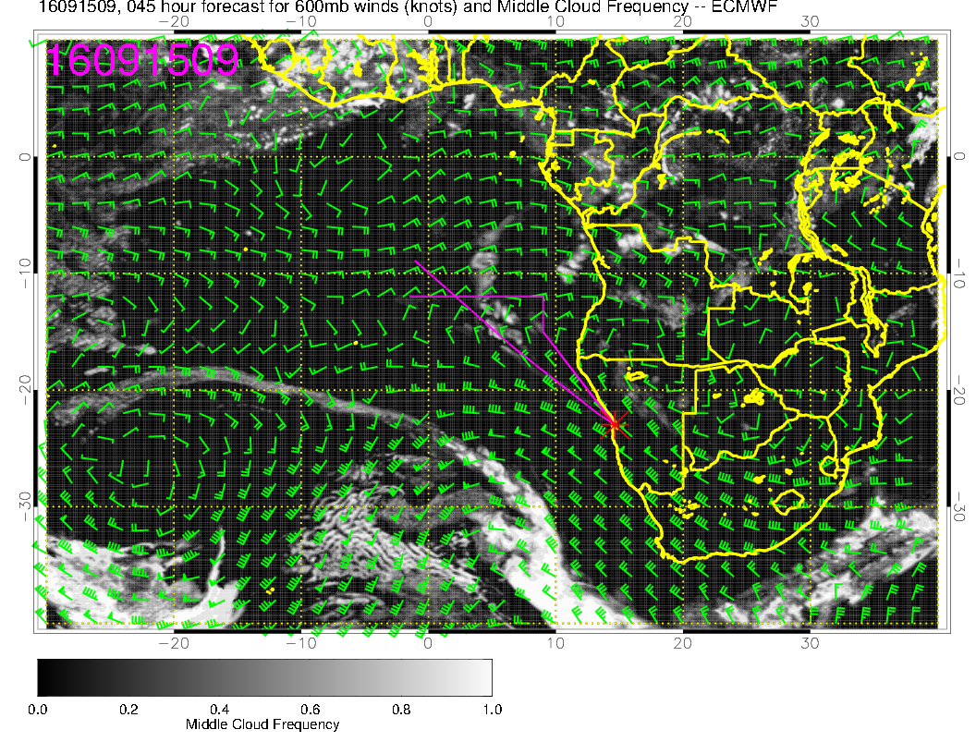
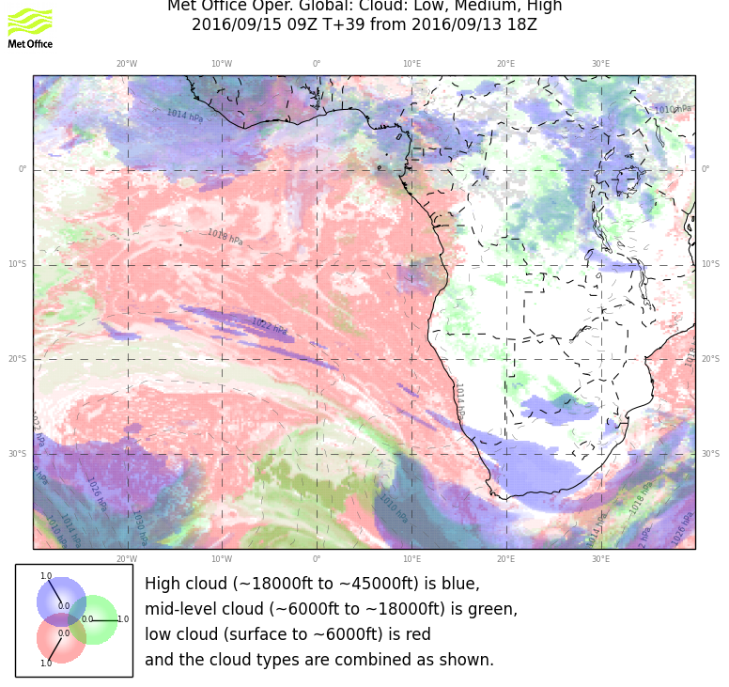
Diurnal variation in these things, so 9 Z (11 AM) is much
more aggressive in both models. Details are important
and models disagree. Part of routine track may well have
middle cloud

Slide 6
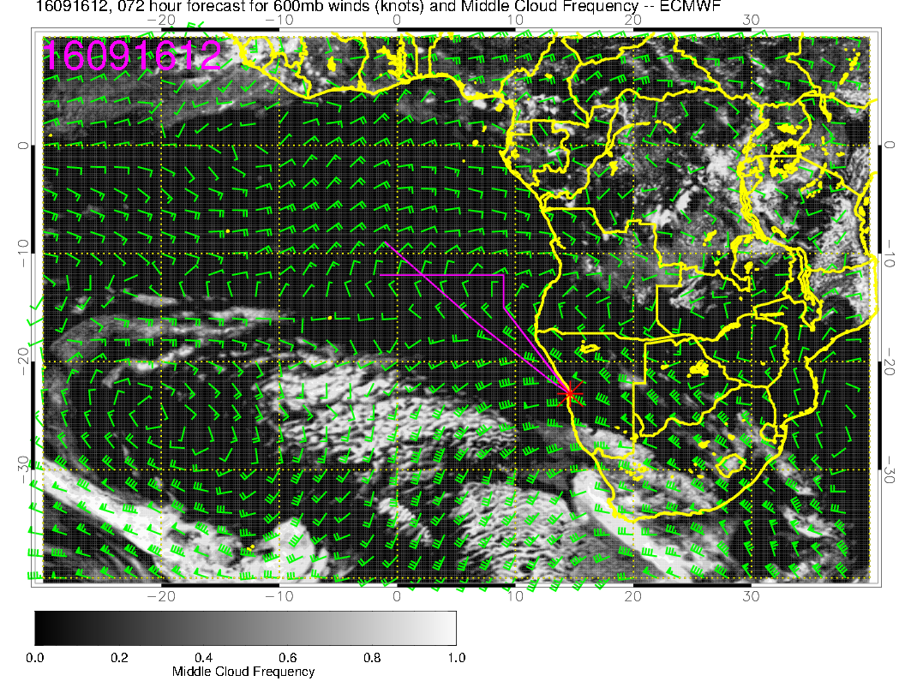
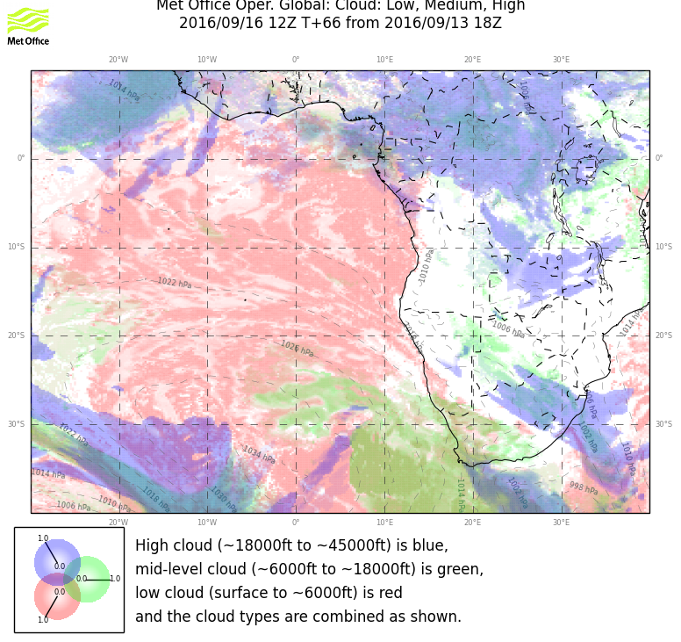
Absence of trough is responsible for reduced middle cloud coverage
on Friday.

Slide 7
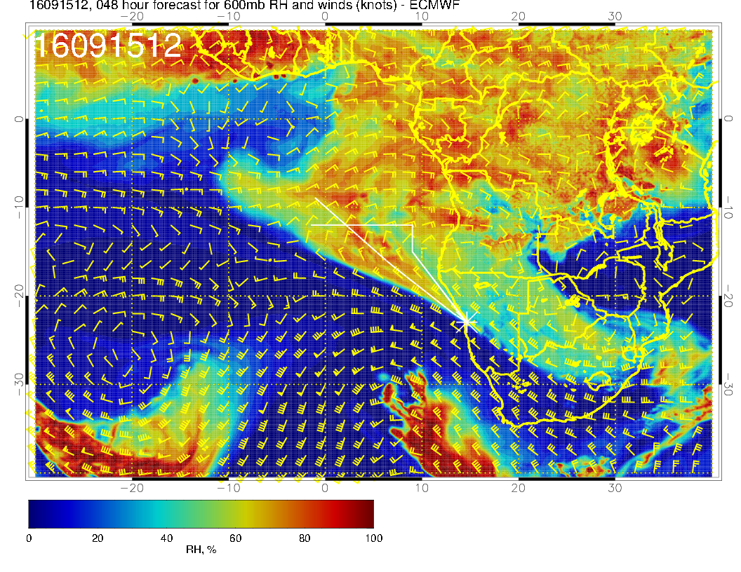
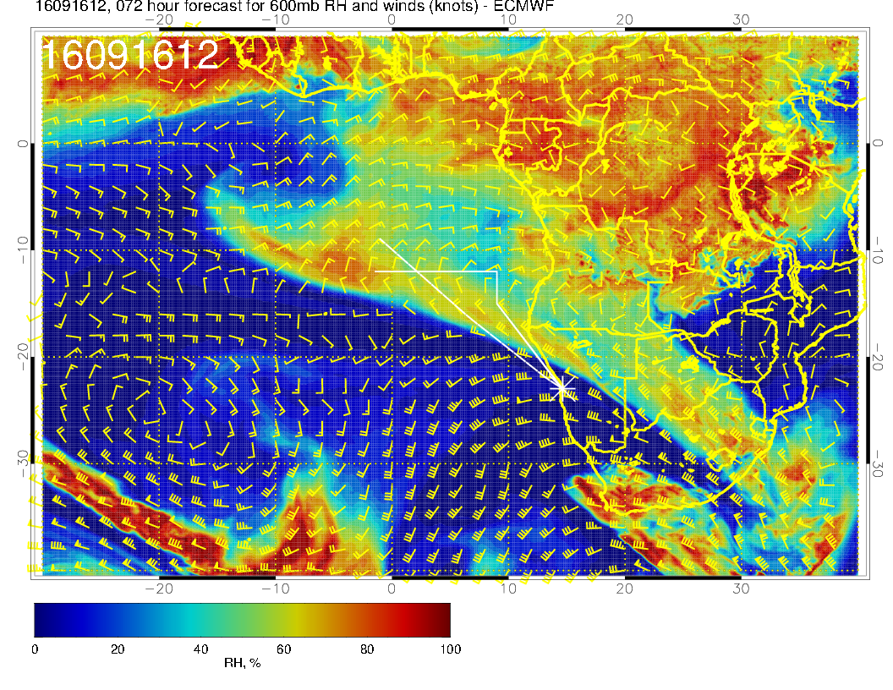
Drying apparent at 600mb between
the two days

Slide 8
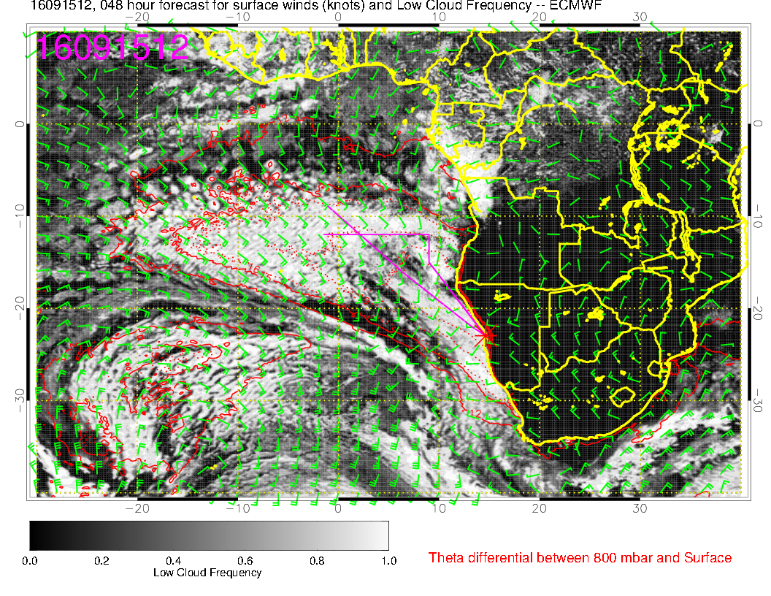
Favorable SC situation for both models.

Slide 9
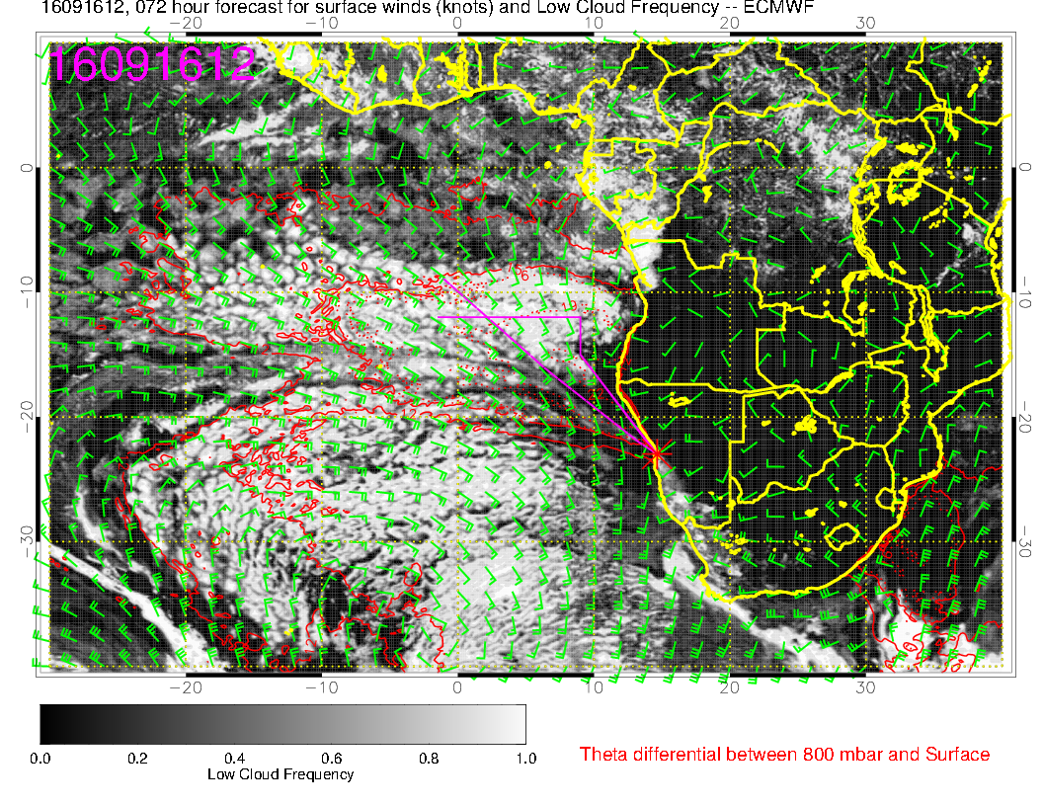
Expect front to influence Sc region to 18S

Slide 10
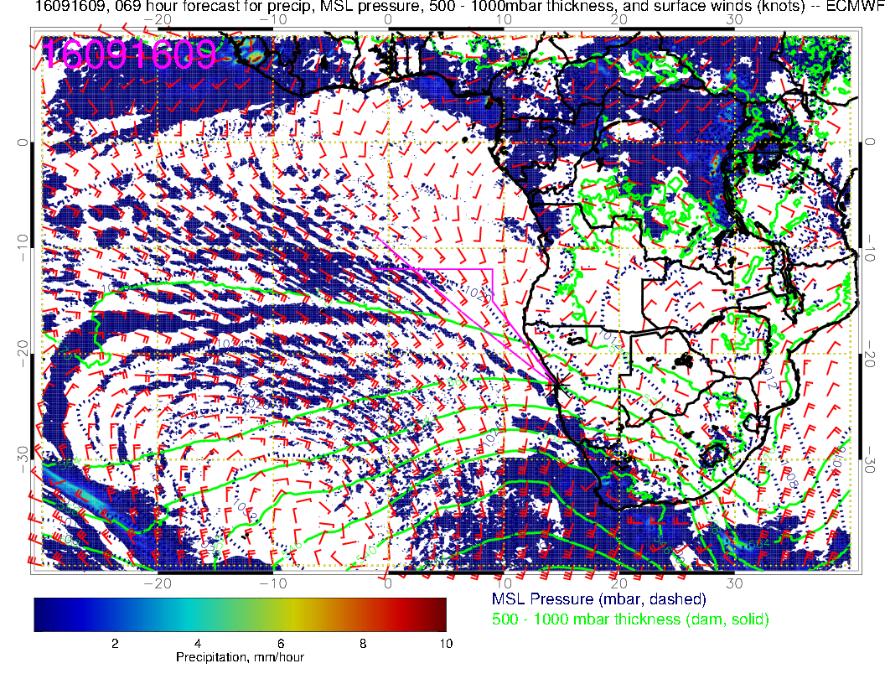
Front remnants advanced to near 18S

Slide 11
RH plot again. Indicates
we should get into
plume at end of routine
track

Slide 12
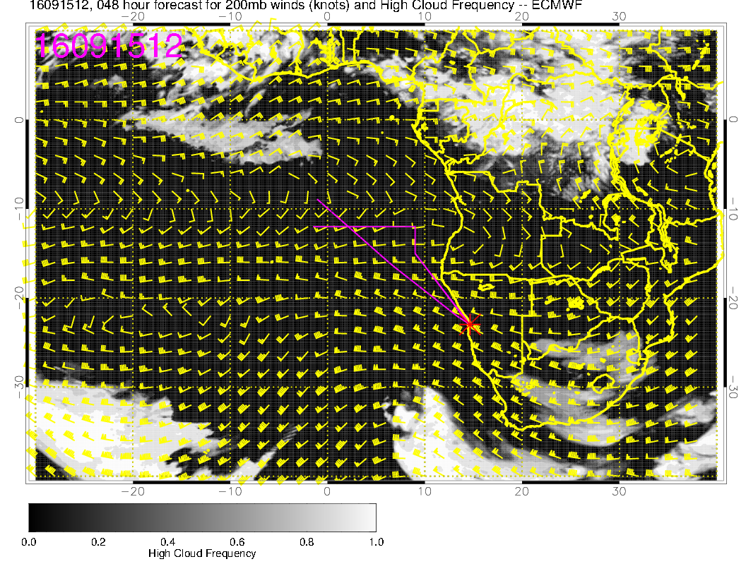
Thursday, 20160915: Models not in complete agreement on high cloud (blue in UKMO).
Might expect some near YWB in association with trough

Slide 13
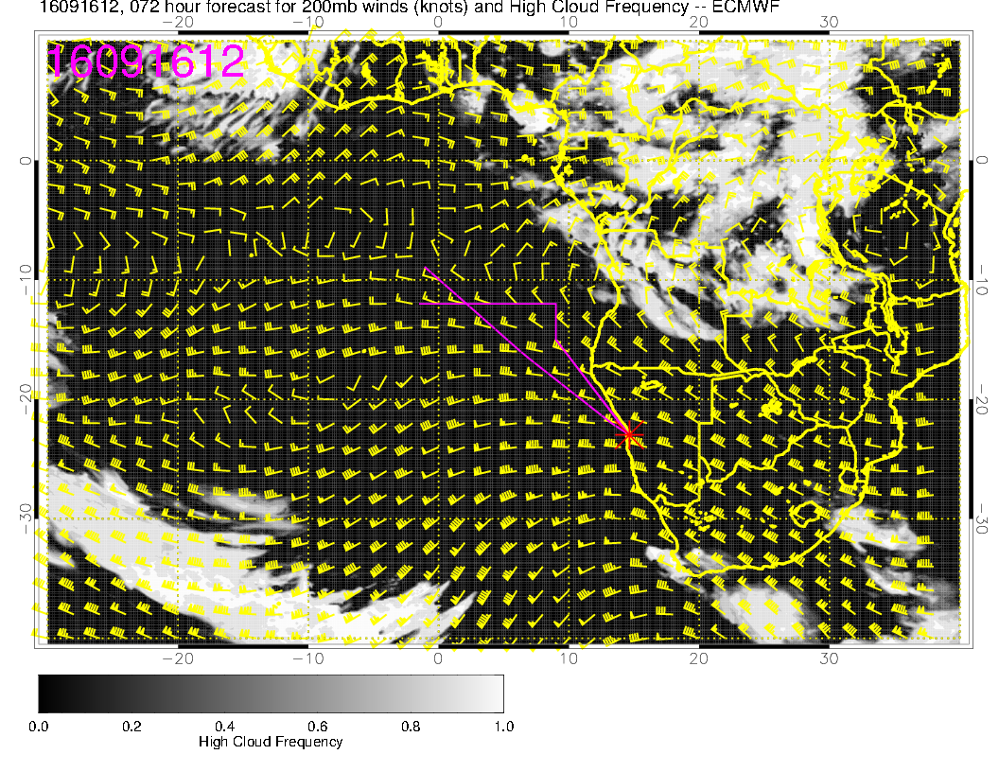
Friday, 20160916: High clouds are unlikely except in NE corner.
Trough moving on.

Slide 14
Saturday

Slide 15
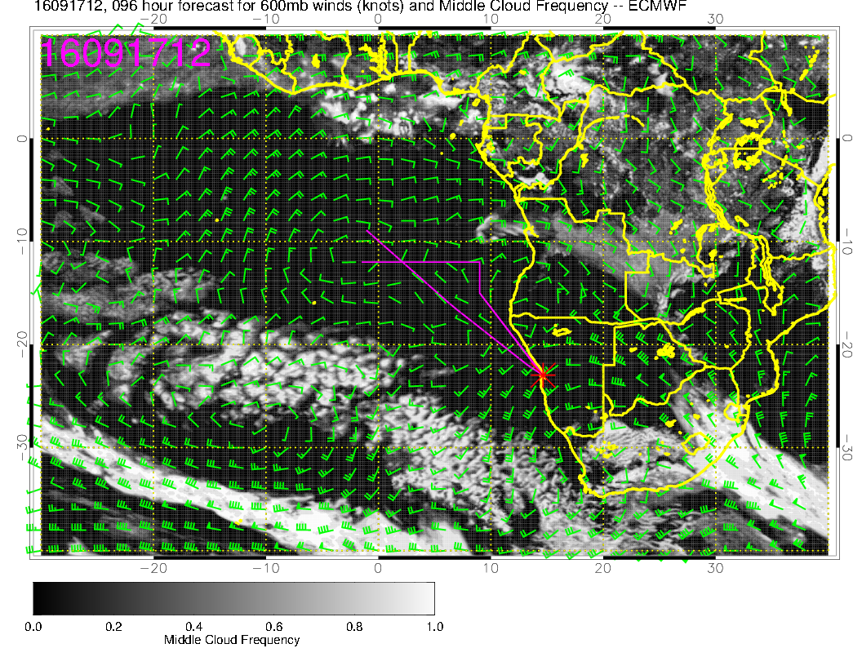
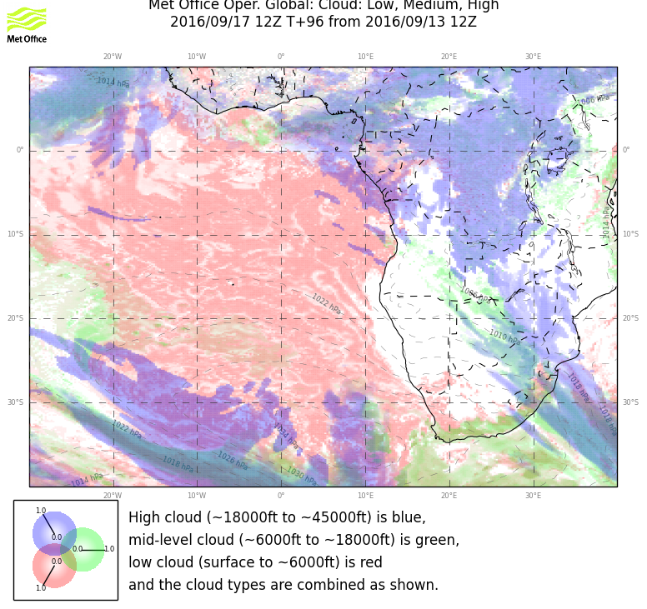

Slide 16
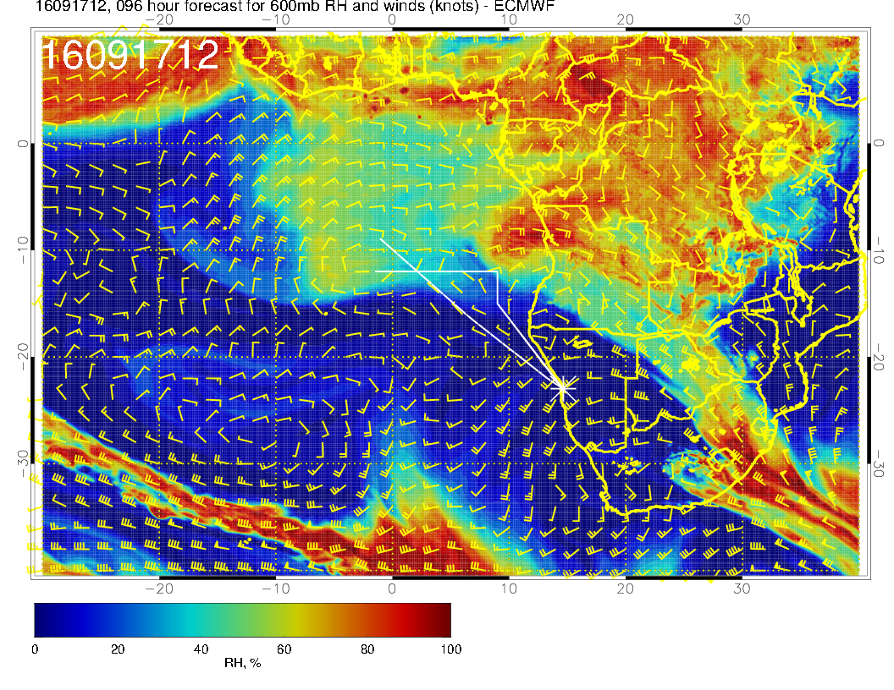
Relatively dry at
600mb except
in NE corner.

Slide 17
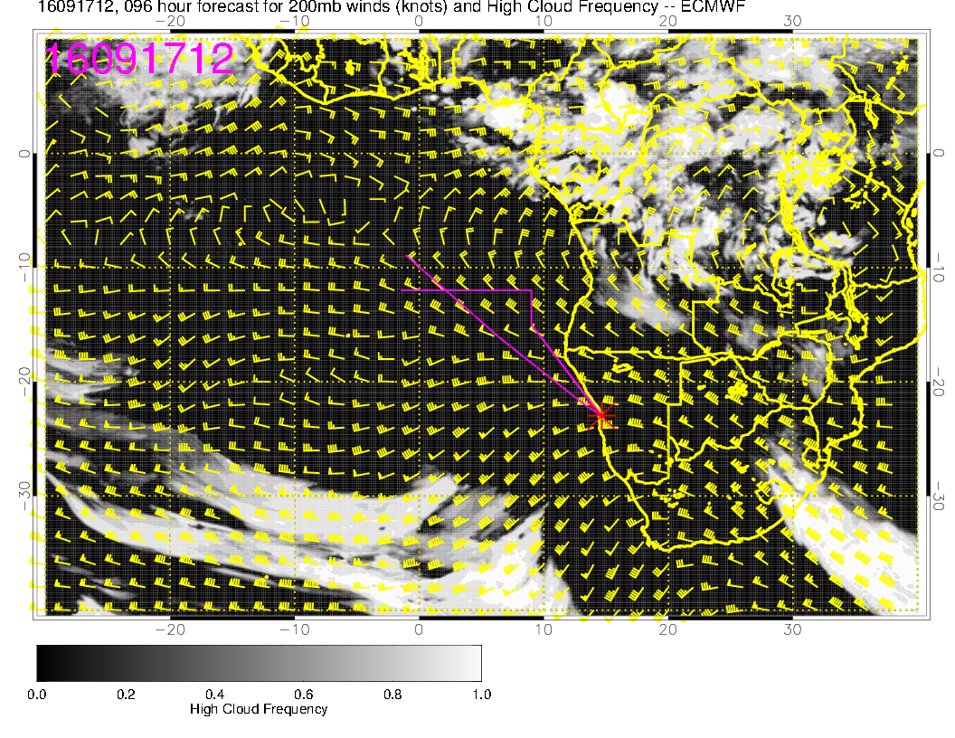

Slide 18
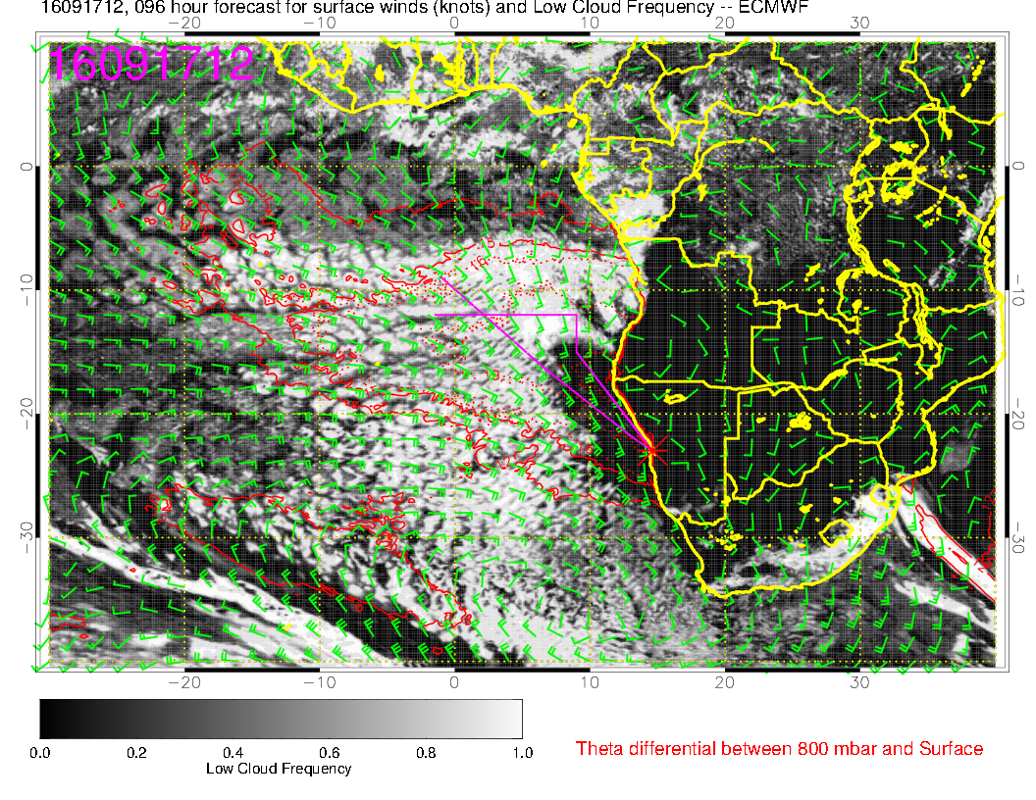
Both models predict clearing near the coast. Sc region expanded southward.
Post-frontal situation.

Slide 19
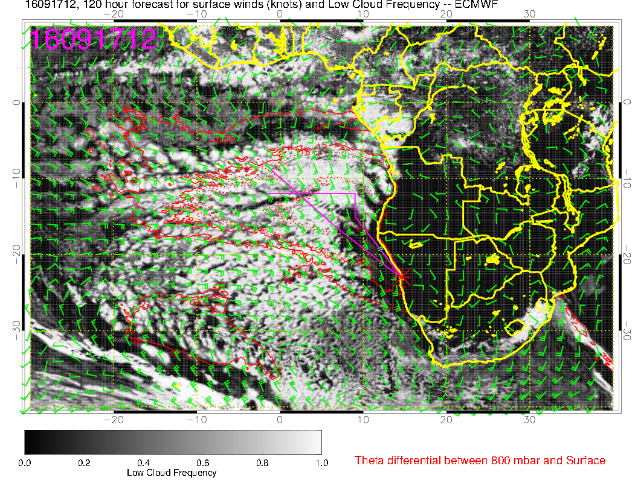
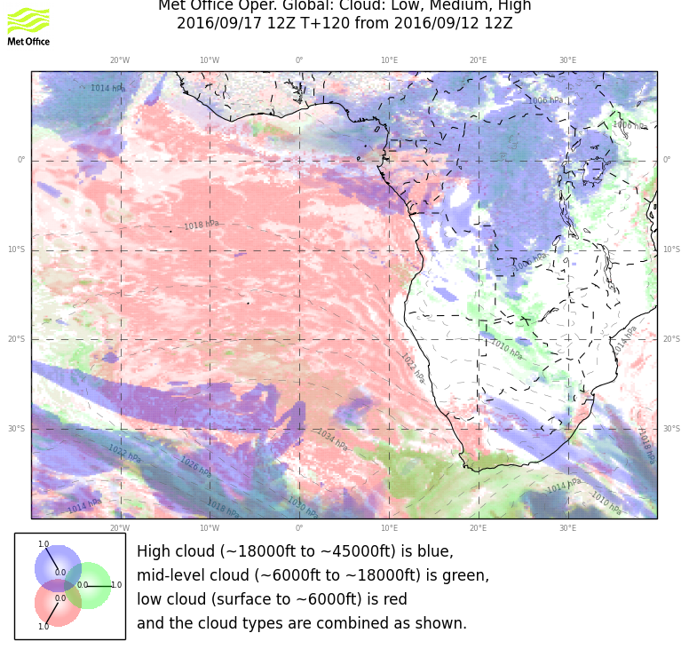
Yesterday’s slide on this.
Starting to restore Sc region, strong winds still, clearing near the coast.

