Slide 1
September 13 Science Tag-up
ORACLES status update (Jens Redemann)
ER-2 ERF01 and ERF02 Flight Report (Rich Ferrare)
HSRL-2 (Sharon Burton)
P3 PRF07, PRF08 Flight Support (Greg McFarquhar)
Outlook for Wednesday and Thursday P-3/ER-2 plans (Jens Redemann)
Science debrief: AirMSPI (Mike Tosca)
Science debrief: eMAS (Kerry Meyer/Steve Platnick)
Science debrief: water vapor isotopes (David Noone)
Overview of Routine Flights to date (Paquita Zuidema)
Review of Science Objectives (Jens Redemann)

Slide 2
ORACLES (ObseRvations of Aerosols above CLouds and their intEractionS)
Review of P3 flights PRF01 – PRF08 ER-2 flights ERF01-ERF02
Date | P-3 flight # | P-3 Short description | ER-2 flight # | ER-2 Short description
Aug 30, 2016 | PRF01 | Aborted routine flight; ~1 hr of measurements near WVB | -
Aug 31, 2016 | PRF02 | Full routine flight towards towards 10S and 0E | -
Sep 2, 2016 | PRF03 | Target of opp flight, mostly North along 10E; 2 radiation wall modules | -
Sep 4, 2016 | PRF04 | Full routine flight to 10S and 0E | -
Sep 6, 2016 | PRF05 | Target of opp flight, mixing survey | -
Sep 8, 2016 | PRF06 | Routine flight to 10S and 0E | -
Sep 10, 2016 | PRF07 | Routine(ish) flight to 10S and 0E | ERF01 | 6.5hr mapping routine flight
Sep 12, 2016 | PRF08 | Routine(ish) flight to 10S and 0E | ERF02 | Full mapping routine flight
Sep 14, 2016 | PRF09 | Target of opp, radiation near aerosol gradient | ERF03 | Target of opp
Sep 15, 2016 | PRF10 | Routine flight to 10S and 0E | ERF04 | Full mapping routine flight

Slide 3
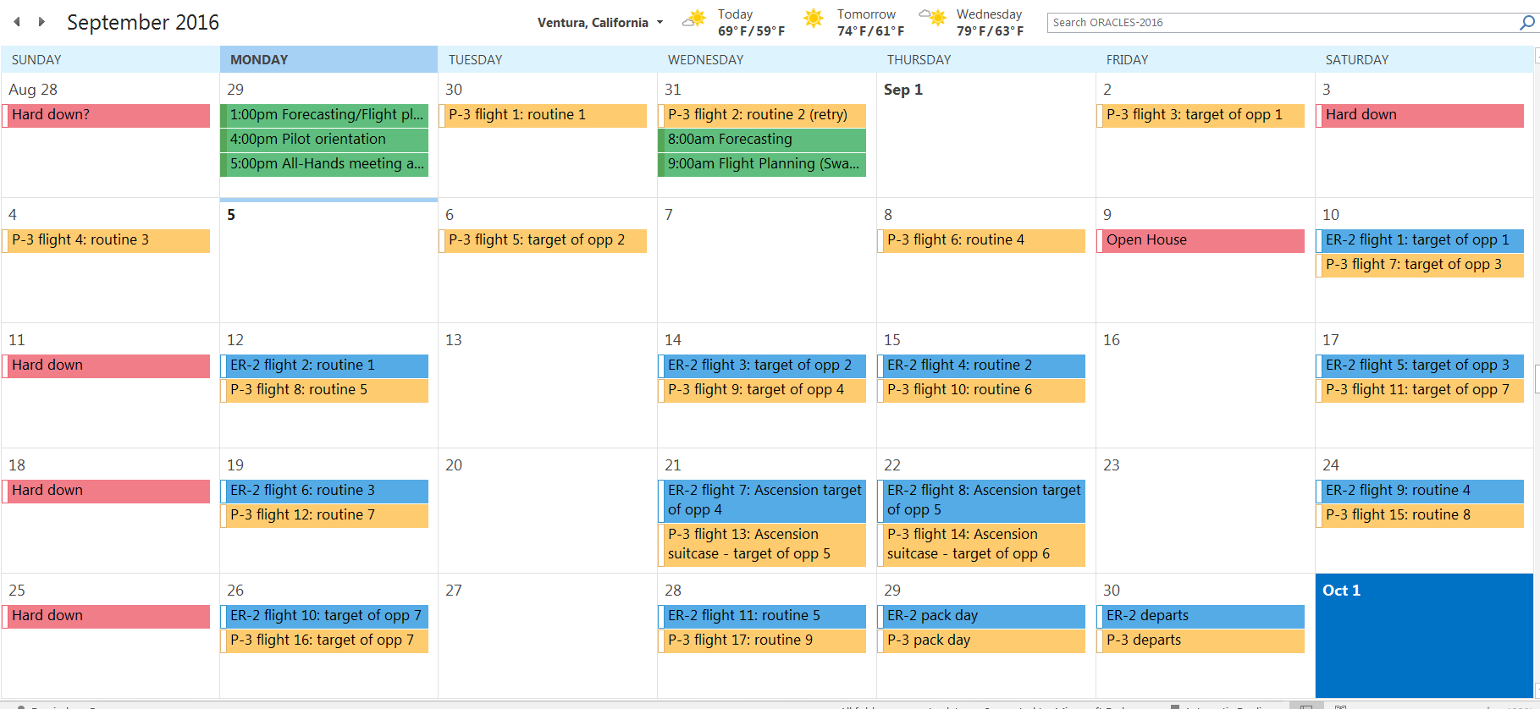
ORACLES (ObseRvations of Aerosols above CLouds and their intEractionS)
Flight schedule/calendar - Outlook

Slide 4
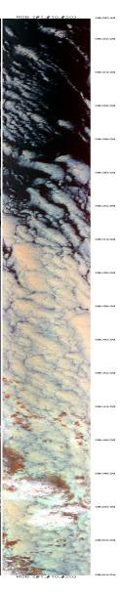
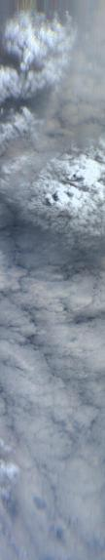
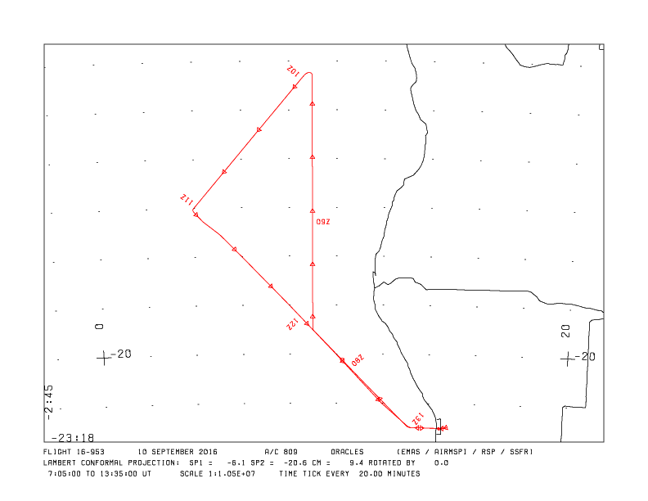
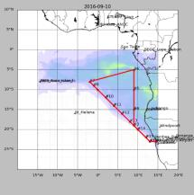
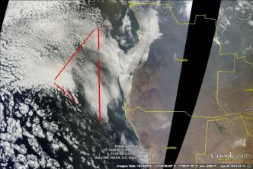
ER-2 RF-01 Saturday Sept. 10
AirMSPI
~0824-0900 UT
eMAS
~ 0820-0854 UT
Takeoff ~07:06 UT, Landing~13:30 UT (~6.5 hours)
Planned 9 hour flight to survey smoke transport
High level clouds in target area prevented original plan to work with P-3
RSP, AirMSPI, eMAS, SSFR worked well
HSRL-2 did not operate due to tripped aircraft circuit breaker which prevented pump from circulating coolenol
Circuit breaker reset after flight
Flight shortened to attempt coordination with P3 and allow problem troubleshooting
RSP, AirMSPI, eMAS obtained data for cloud retrievals
Planned
Actual

Slide 5
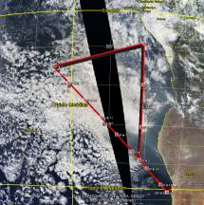
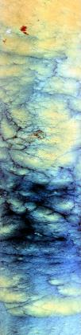
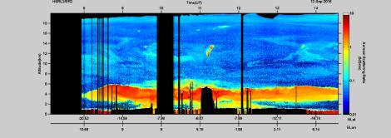
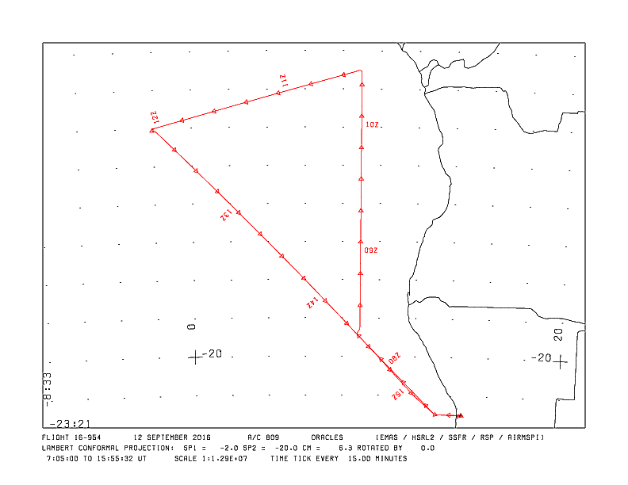
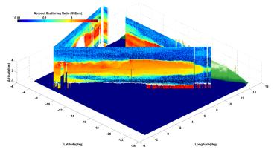
ER-2 RF-02 Monday Sept. 12
Takeoff ~07:07 UT, Landing~15:46 UT (~8.7 hours)
Planned 9 hour flight to survey smoke transport
Mid level clouds in target area prevented original plan to work with P-3
HSRL-2, RSP, AirMSPI, eMAS, SSFR worked well
Varying displacement of elevated smoke layer above low clouds
eMAS
08:57-09:30 UT

Slide 6
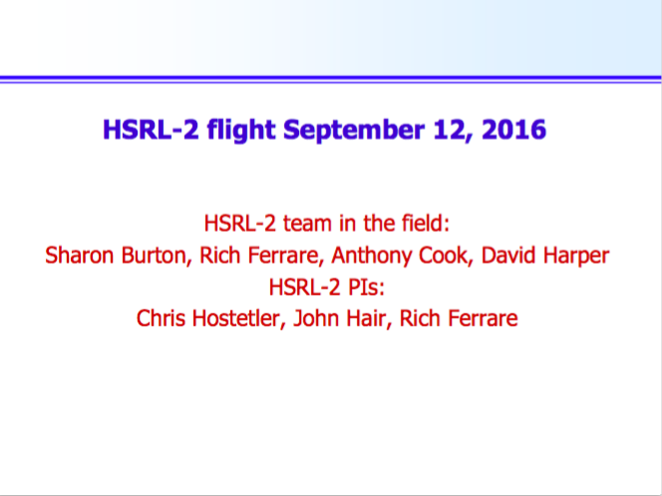

Slide 7
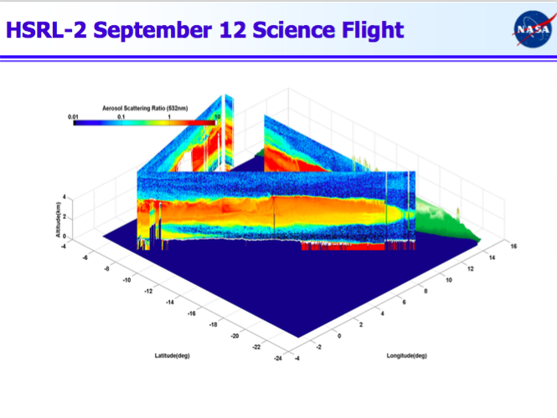

Slide 8
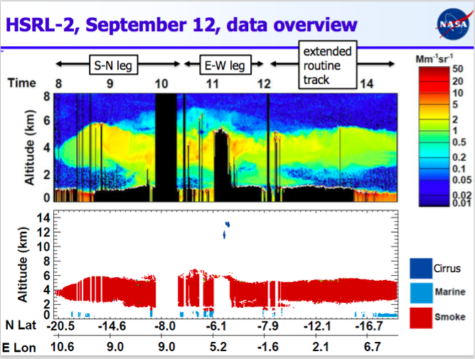

Slide 9
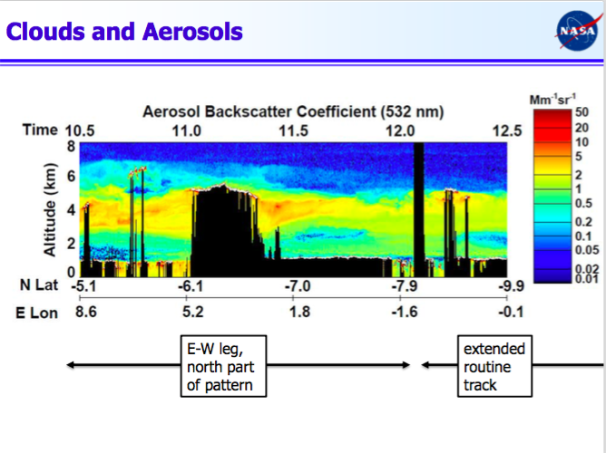

Slide 10
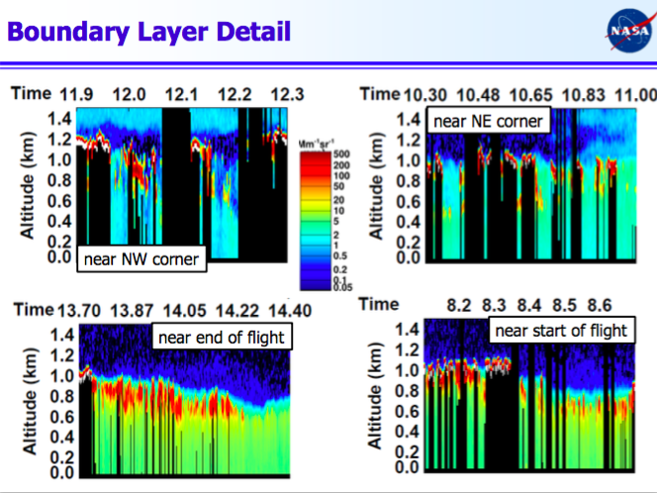

Slide 11
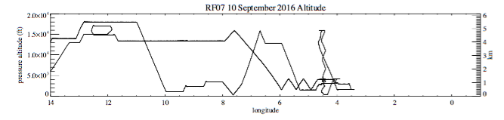
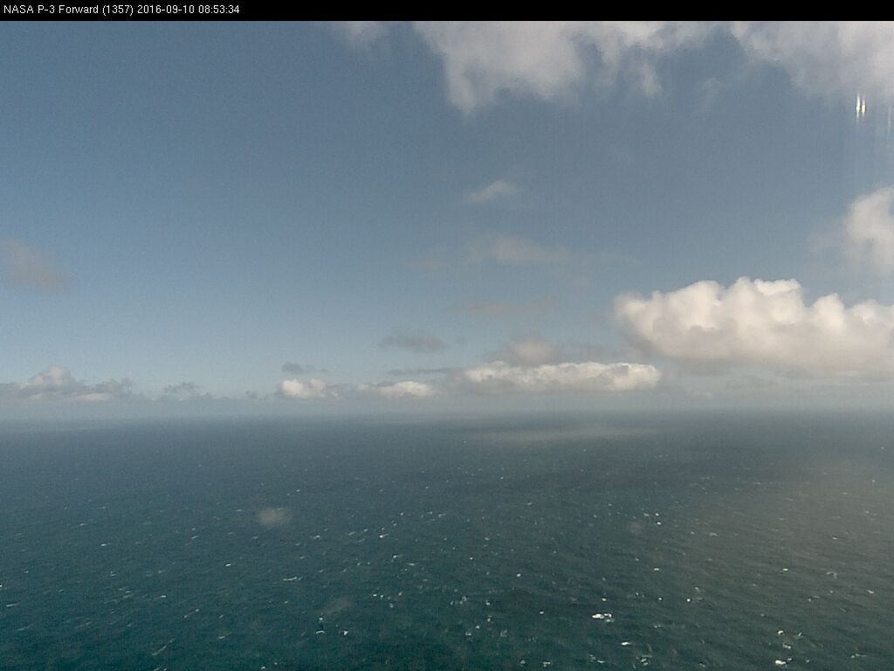
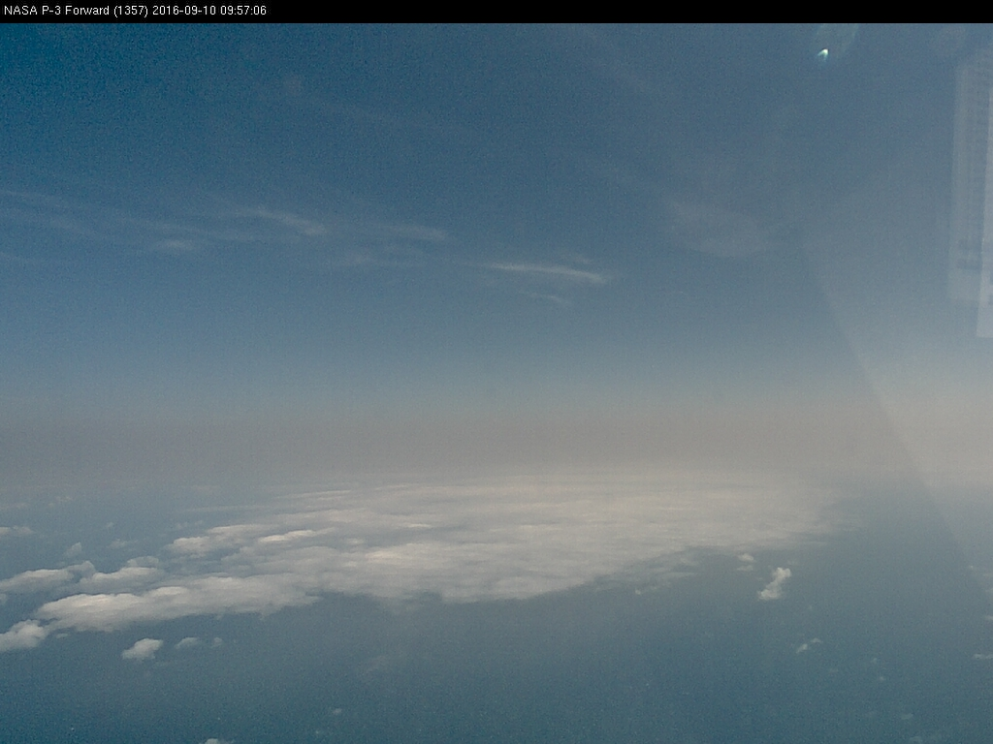
RF07: 10 Sept. 2016 “Routinish” Flight
RSP Reduced Speed
Radiation Wall
Water Vapor Calibration
Decrease in ft aerosols further south
Accomplishments: 2 boundary layer profiles; radiation wall (square spiral) at ER-2 location; free tropospheric profiling on transit home); forecast cirrus not seen on track
Highlights: 1) Both boundary layer profiles quite clean with large droplets and some drizzle; biomass burning plume not entrained into clouds; gradual decrease in intensity of plume with distance further south

Slide 12
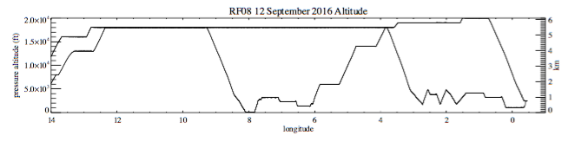
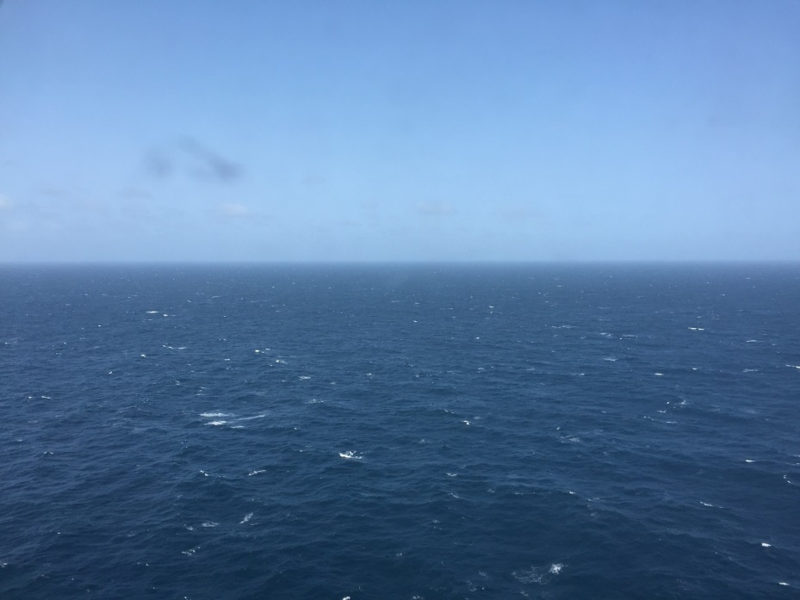
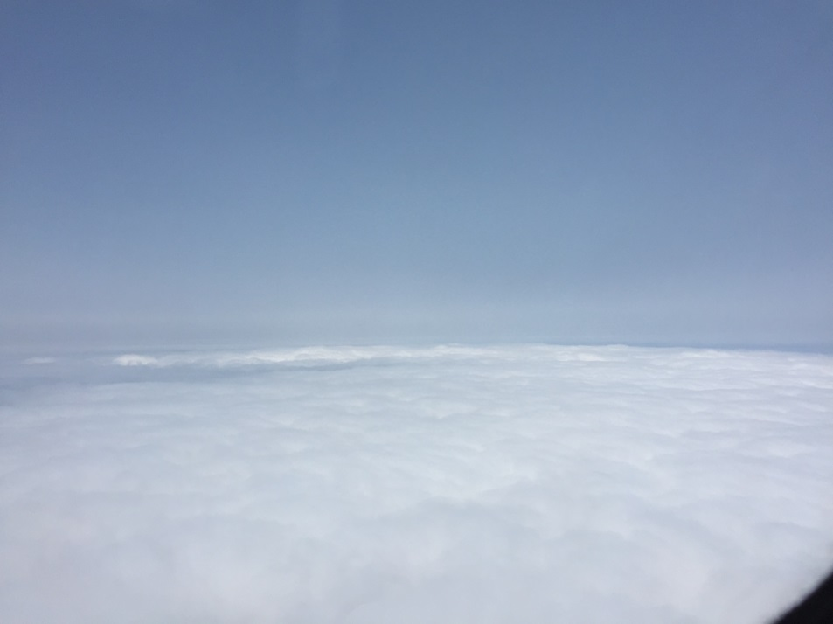
RF08: 12 Sept. 2016 “Routinish” Flight
Plume Above 18 kft
Profiles/Sawtooths
ER-2 Overpass & Clear Sky Profile
Accomplishments: 2 boundary layer profiles; 2 free troposphere profiles including one with ER-2; two legs through aerosol plume; aerosol plume higher further south; 200 knot runs
Highlights: 1) Boundary layer profiles quite clean again; clouds and precipitation reaching ground observed from APR; biomass burning plume not entrained into clouds, layers at 15-16 kft, 9 kft and above clouds; decrease in plume intensity southward; few mid/high clouds

Slide 13
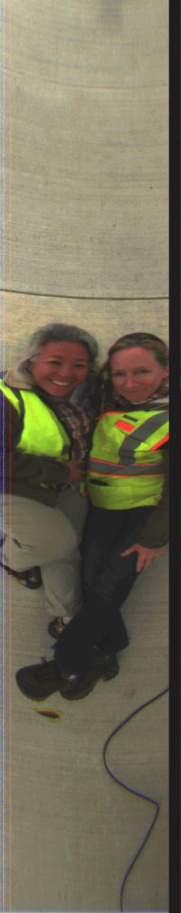
AirMSPI – ORACLES
First look imagery/data
Sept 10 “Routine” (ish) flight
Mike Tosca
Brian Rheingans
Gerard van Harten

Slide 14
AirMSPI – an overview
Multi-spectral (355, 380, 445, 470, 555, 660, 865, 935nm)
Polarization (470, 660, 865nm)
Multi-angle (currently 0, 29, 48, 59, 66 forward and backward)
Two modes:
  “step and stare”: 10km x 10km target w/ 9 angles
  “sweep” ~80-110km long swath with all angles

Slide 15
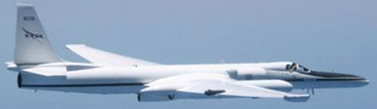
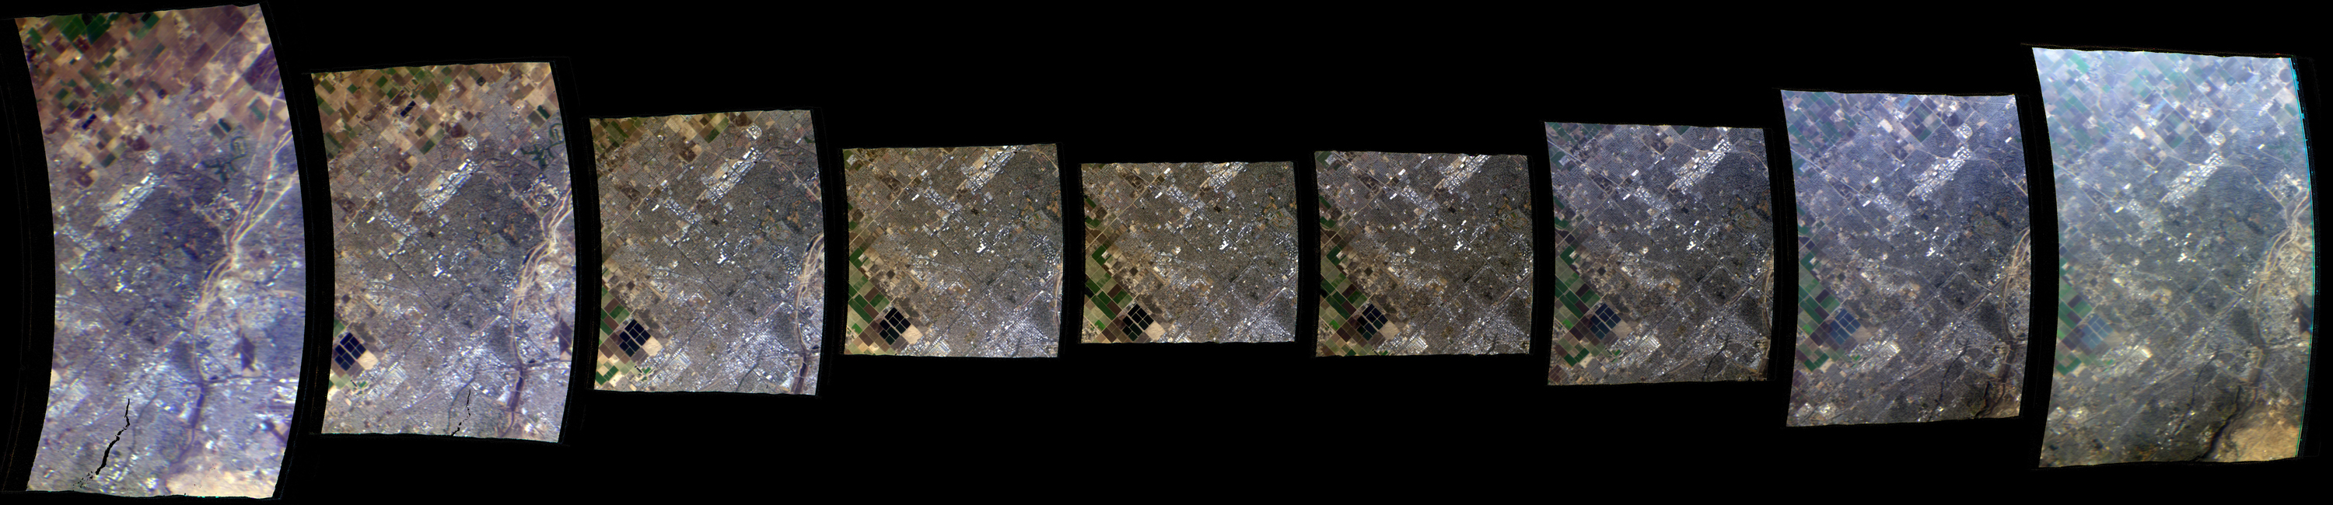
AirMSPI – Step-and-stare
10 m spatial sampling
10 km x 11 km swath
60 km
60 km

Slide 16
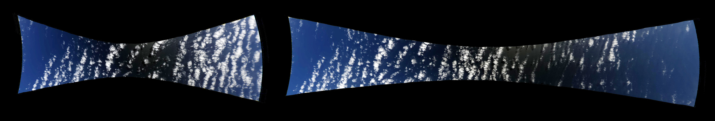
AirMSPI – Sweeps
25 m spatial sampling
~100 km target length
Backward sweep
Forward sweep

Slide 17
AirMSPI – retrieval capability
Context imagery (RGB, NGB, DOLP)
  high-resolution, true-color, in-field
Cloud droplet size
Aerosol Optical Depth
Aerosol size distribution, sphericity
Above-cloud aerosol (?)
Aerosol “index” (?)
Notes:
We can have IMAGERY within a day. Cloudbow – on the order of a day, Perhaps an Aerosol Index ratio – on the order of a day

Slide 18
And now…
Some pretty pictures.

Slide 19
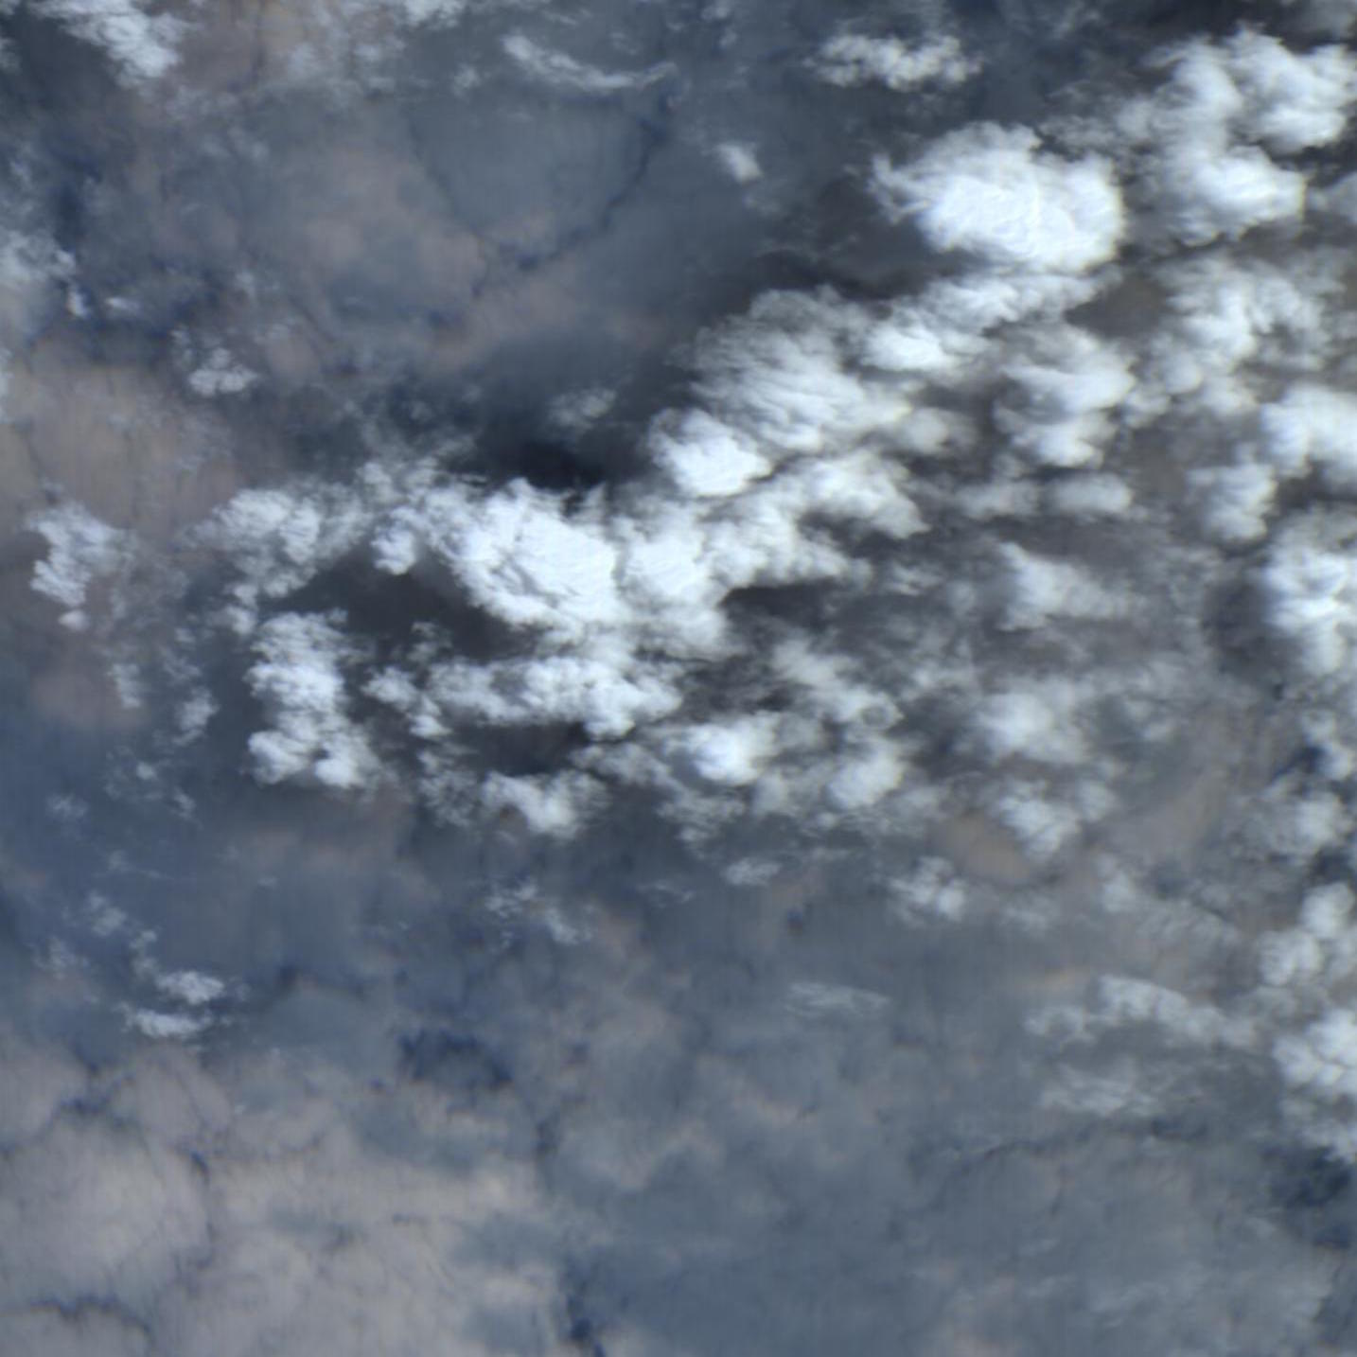
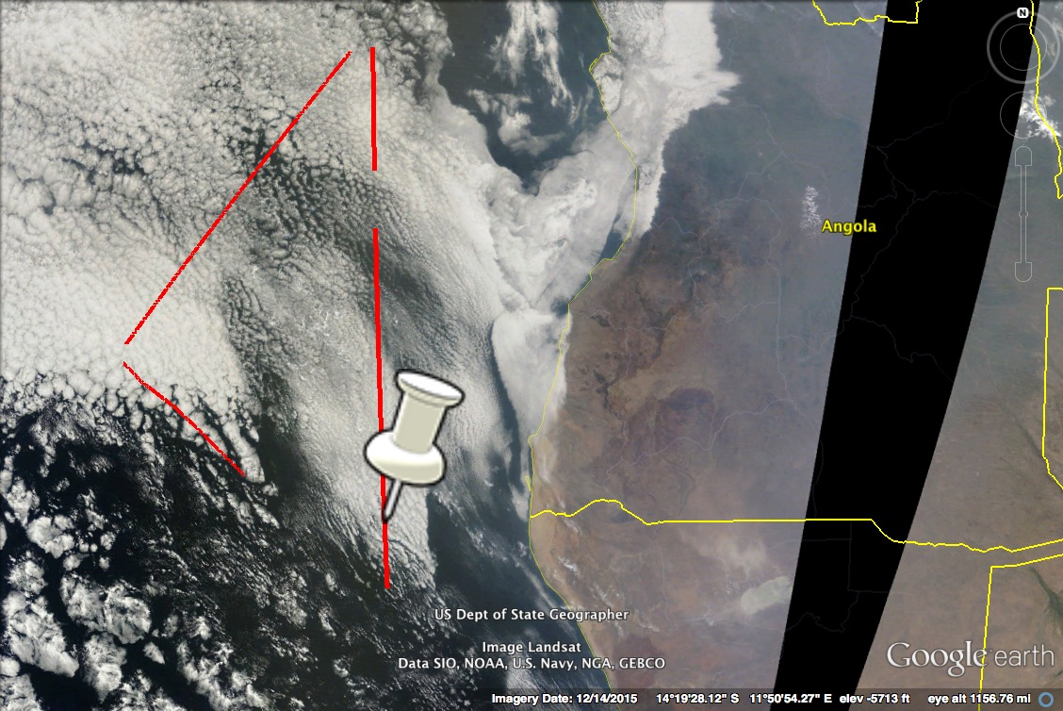
AirMSPI nadir image: Mid-level clouds sitting on top of an aerosol layer which appears decoupled from a low-cloud layer below.
10 km
10 km

Slide 20
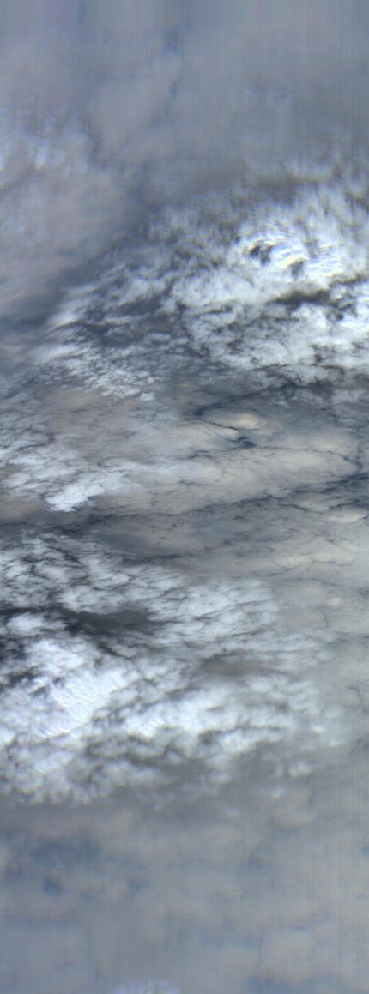
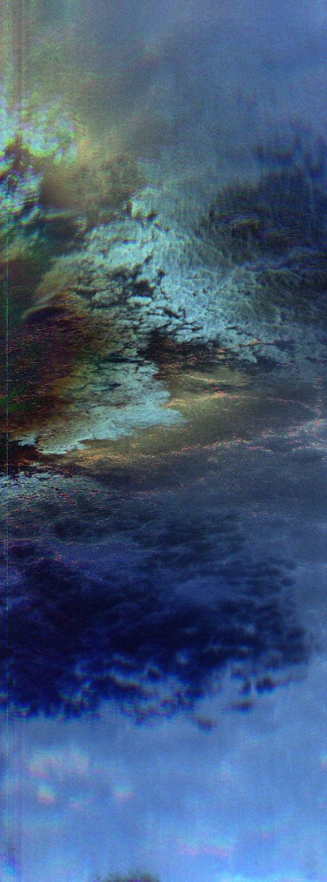
AirMSPI sweep of same scene: Mid-level clouds sitting on top of an aerosol layer which appears decoupled from a low-cloud layer below.
100 km
RGB image
DOLP image

Slide 21
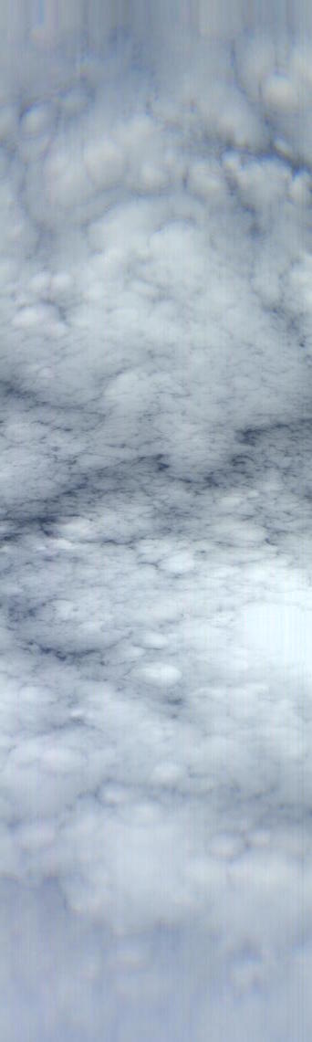
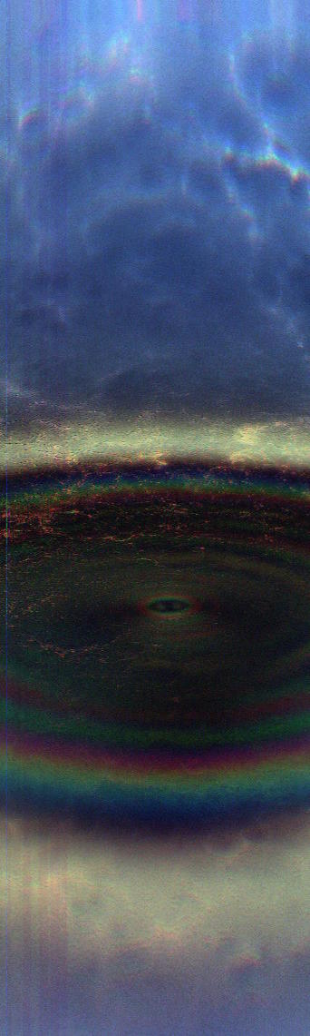
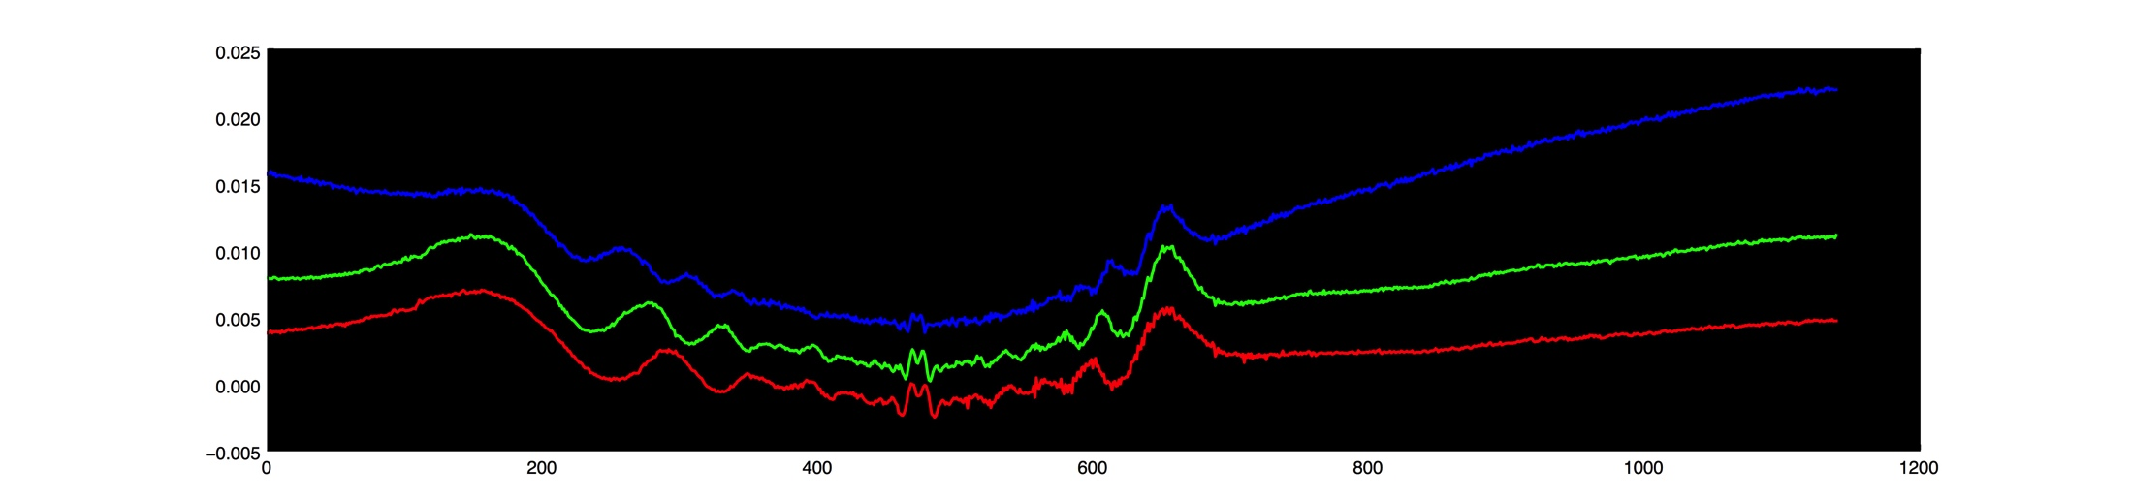
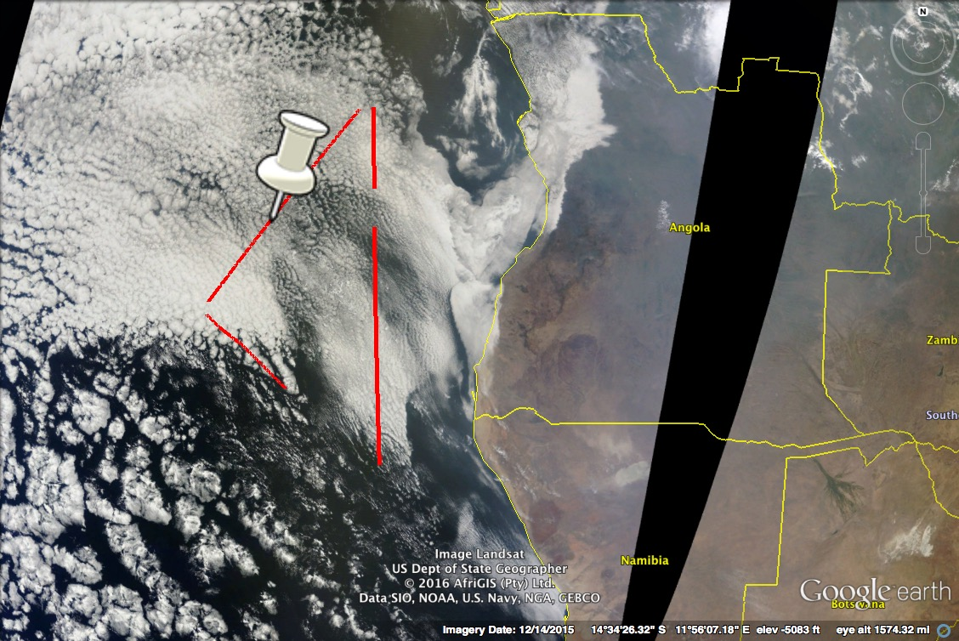
AirMSPI “sweep” image: Low-level clouds under layer of smoke (?) - no mid-level
RGB image
DOLP image
Notes:
anti-solar point (glory) – retrieve droplet size using the spacing between the bands
Center = glory
Rings = cloudbows

Slide 22
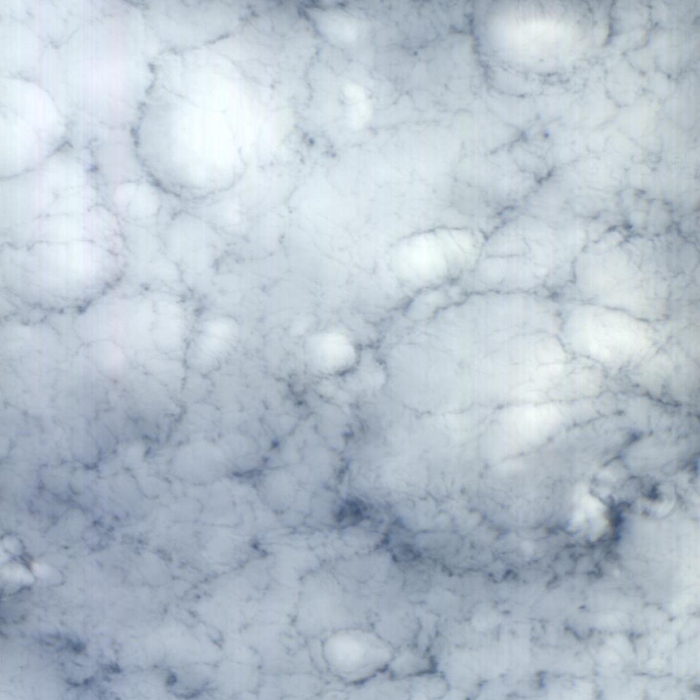
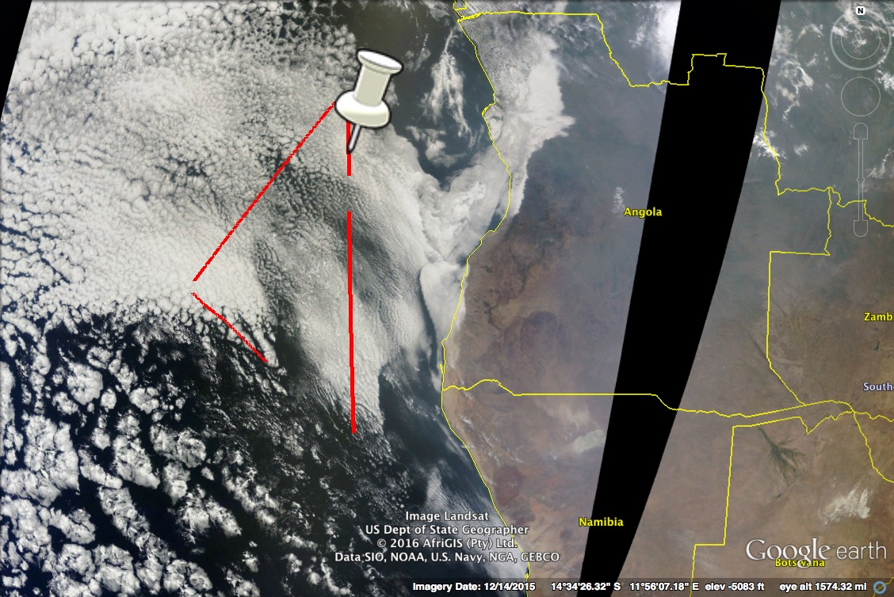
AirMSPI nadir image: Low-level clouds under layer of smoke (?) “step-and-stare”

Slide 23
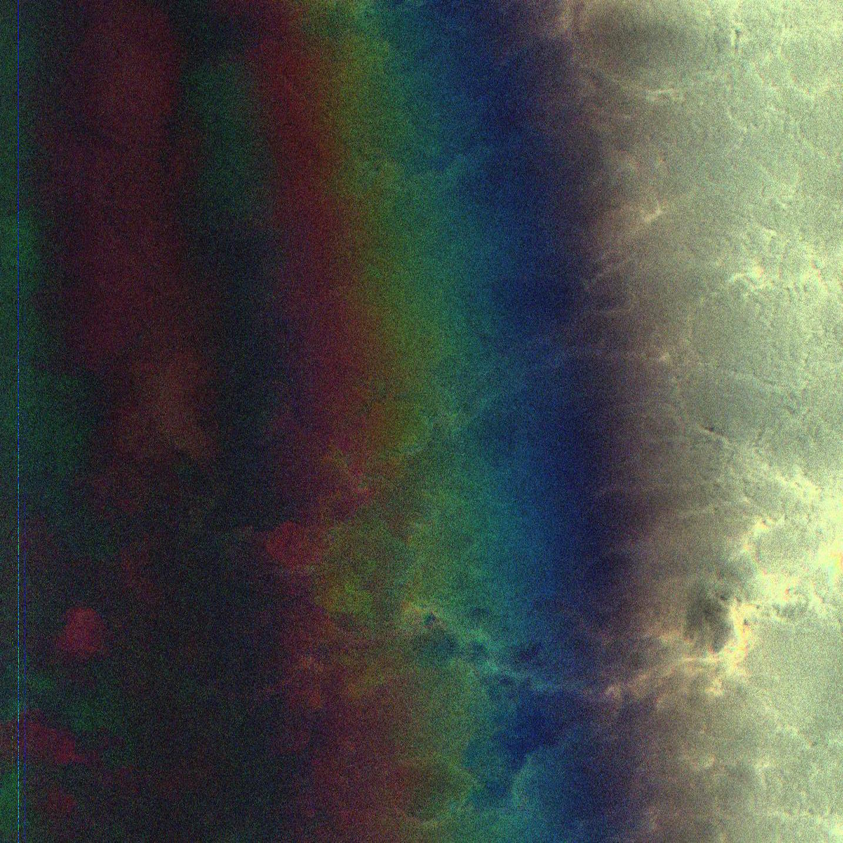
AirMSPI nadir image: Low-level clouds under layer of smoke (?) DOLP

Slide 24

RGB
355nm
AirMSPI oblique angles: An aerosol layer may be on top of a layer of stratocumulus clouds. Easier to see in oblique and UV
nadir
nadir
48deg aft
48deg aft

Slide 25
Idea to consider for in-the-field data processing
Two UV channels: 380nm and 355nm
Right: 355nm intensity (aerosol absorption?) vs. 660nm intensity (cloud ID)
355nm
660nm
Notes:
anti-solar point (glory) – retrieve droplet size using the spacing between the bands

Slide 26
Can we get the “aerosols” by taking the ratio?
Similar to OMI absorbing “Aerosol Index”
Need to account for Rayleigh atmosphere
355nm
380/355
Notes:
anti-solar point (glory) – retrieve droplet size using the spacing between the bands

Slide 27
Can we get at the “aerosols” by taking the ratio?
Similar to OMI absorbing “Aerosol Index”
Need to account for Rayleigh atmosphere
RGB
380/355
Notes:
anti-solar point (glory) – retrieve droplet size using the spacing between the bands

Slide 28
RGB
AirMSPI nadir image: Mid-level clouds sitting on top of an aerosol layer which appears decoupled from a low-cloud layer below.
660nm
355nm

Slide 29
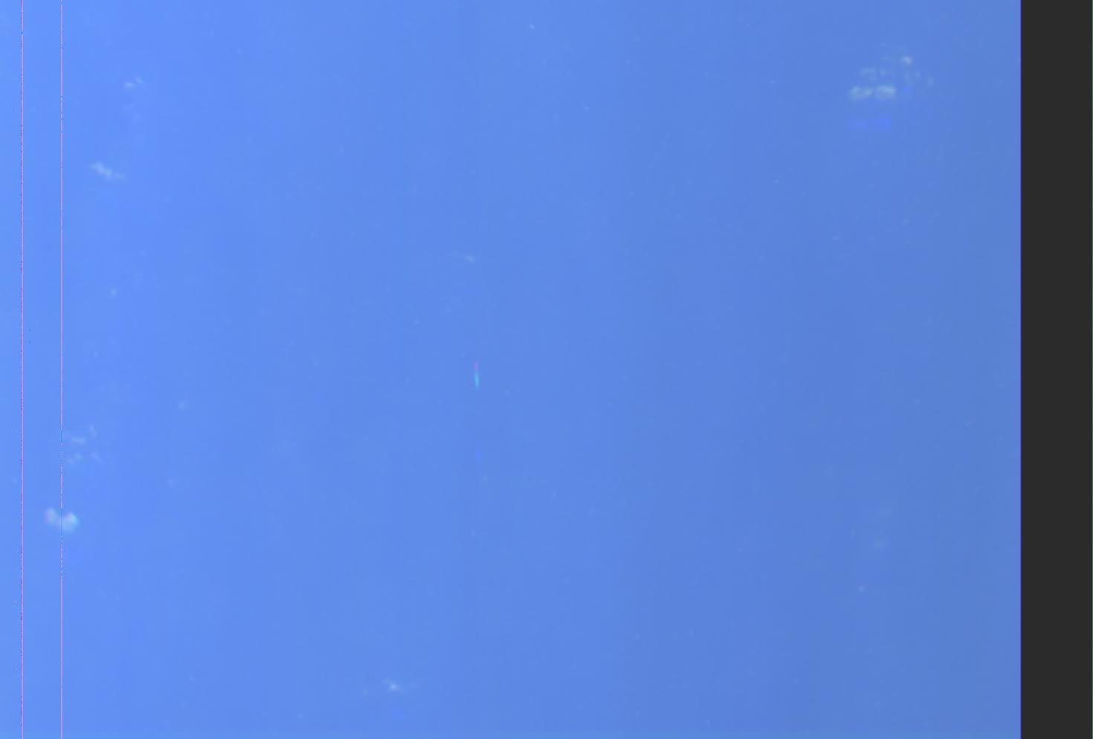
P-3? Boat? UFO?

Slide 30
eMAS, MODIS, SEVIRI:
Preliminary Cloud/Aerosol Retrievals
10 Sept 2016
S. Platnick, K. Meyer, T. Arnold, R. Dominguez, P. Grant, T. Hildum, K. Dunwoody [in the field]
+ G. Wind, J. Riedi (U. Lille), et al.

Slide 31
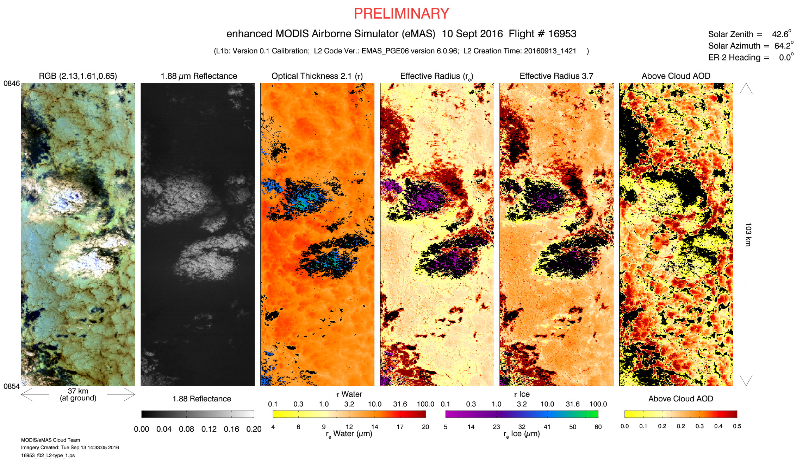
eMAS Cloud & Above Cloud Aerosol Retrievals: 10-Sept-16
http://mas.arc.nasa.gov/data/deploy_html/oracles_home.html
PRELIMINARY

Slide 32
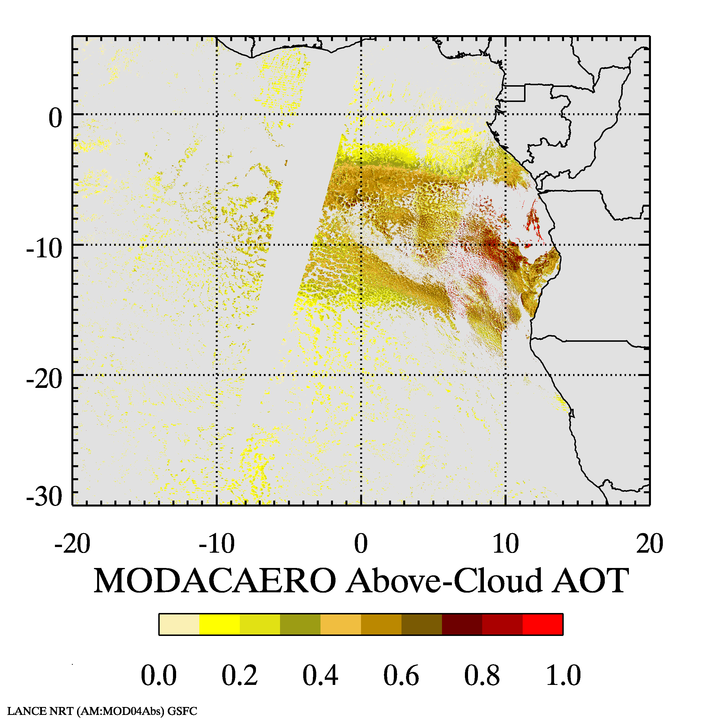
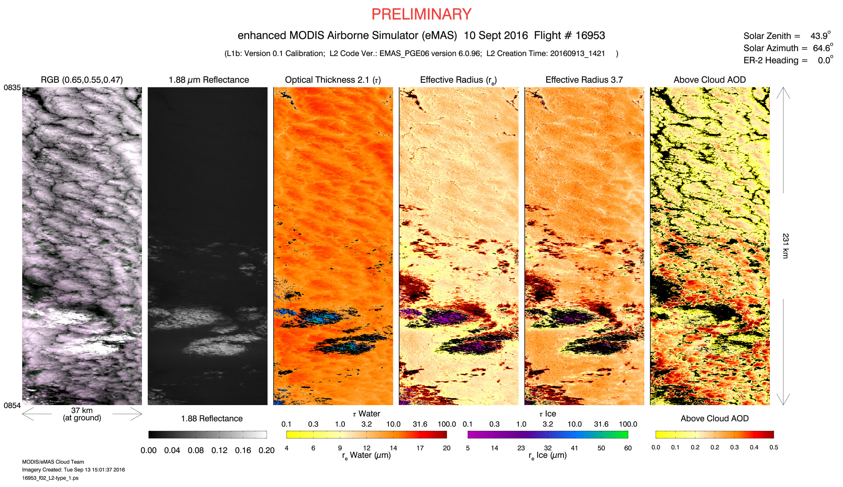
eMAS & MODIS Above-Cloud Aerosol Retrievals
(10 Sept. 2016)

Slide 33
eMAS & MODIS Above-Cloud Aerosol Retrievals
(10 Sept. 2016)

Slide 34
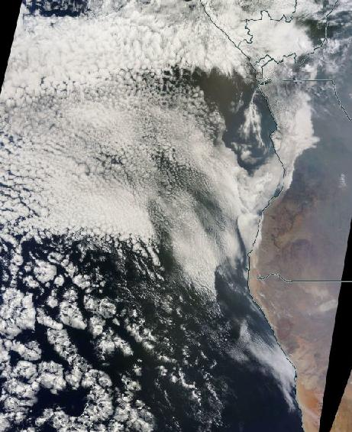
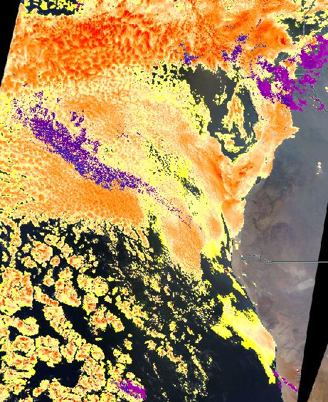
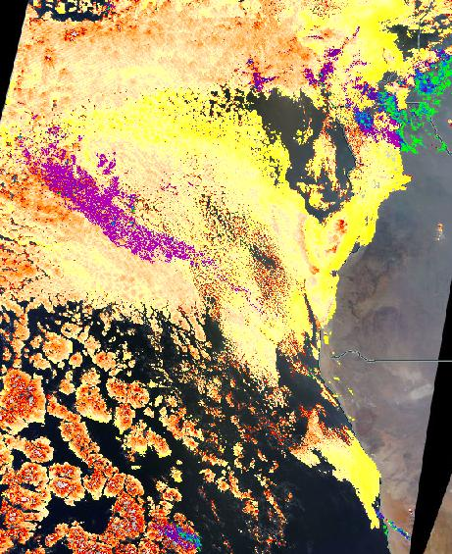
MODIS Terra: MOD06 WorldView, 10 Sept. 2016
True color
Opt. Thickness
Eff. Radius (2.1µm)
https://earthdata.nasa.gov/labs/worldview/

Slide 35

SEV06 (GSFC/ICARE): 10 Sept. 2016, 0500-1745 UTC
ftp://loa-ftp.univ-lille1.fr/SEV_06-CLD-NRT-L2.v2.00/2016/

Slide 36
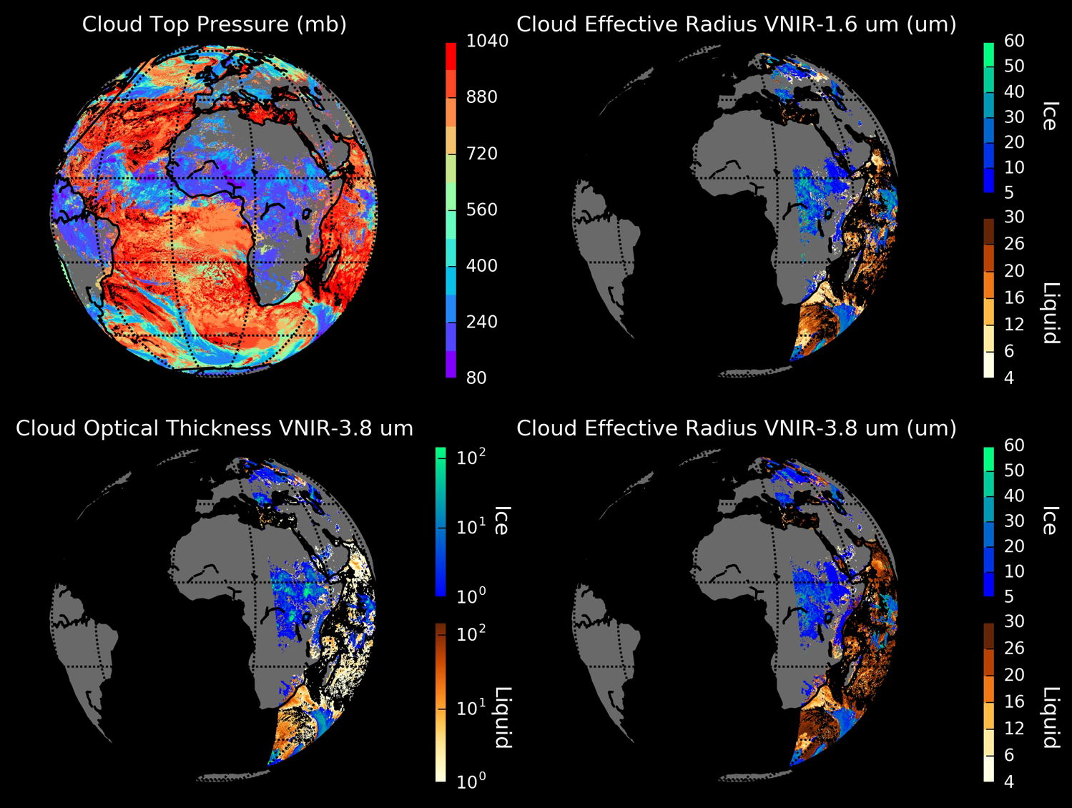
SEV06 (GSFC/ICARE): 10 Sept. 2016, 0500-1745 UTC
ftp://loa-ftp.univ-lille1.fr/SEV_06-CLD-NRT-L2.v2.00/2016/

Slide 37
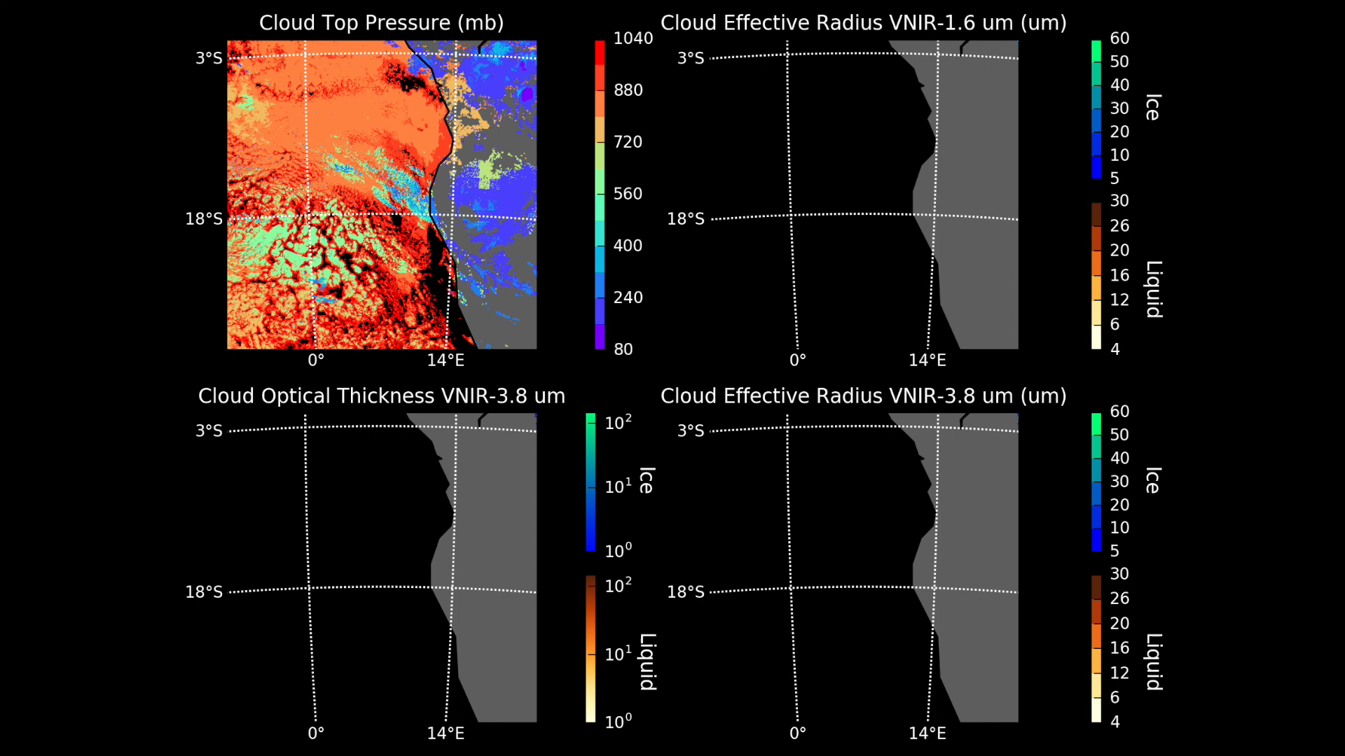
SEV06 (GSFC/ICARE): 10 Sept. 2016, 0500-1745 UTC
ftp://loa-ftp.univ-lille1.fr/SEV_06-CLD-NRT-L2.v2.00/2016/

Slide 38
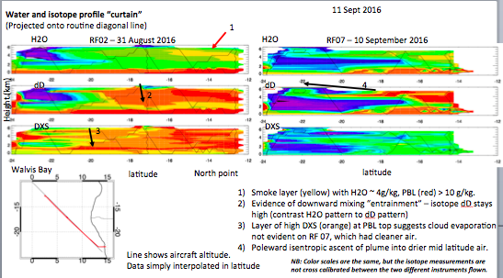
David Noone

Slide 39
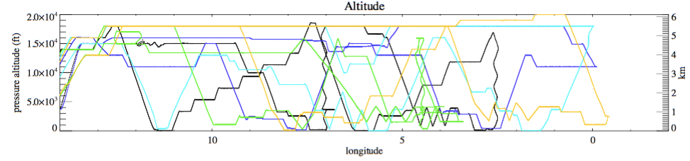
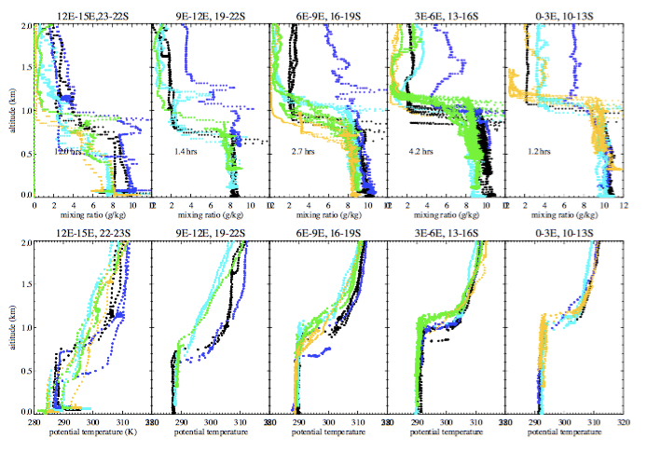
boundary layer
warms ~4K,
synoptic->sc transition
cloud top temperature
inversion clearly weakens
weaker cloud top T
inversion correlated
with less moisture
(& less aerosol?)
directly above cloud
top
cloud top never rises
above ~1.2km, less
variable further offshore
RF02 (31 Aug) RF04 (4 Sep) RF06 (8 Sep) RF07 (10 Sep) RF08 (12 Sep)
2km
water vapor mixing ratio
potential temperature

Slide 40
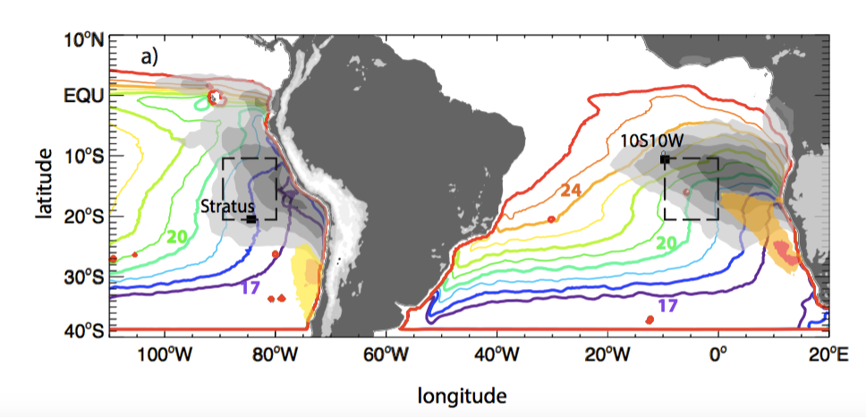

Slide 41

dramatic differences in
origin of cloud-top
air between
RF02 (land)
RF04 (“in place”)
RF07 (southern ocean)
Yemi Adebiyi

Slide 42


boundary layer AMS
Amie Dobracki
RF02 Aug 31: polluted
elevated organics
organics
nitrates
organics
nitrates
RF04 Sept 4: clean
-nitrates, organics ~0

Slide 43

good variability in
free-tropospheric
moisture (& aerosol)
4 sept most moist
mid-level clouds
31 Aug, 4 Sep
RF02 (31 Aug) RF04 (4 Sep) RF06 (8 Sep) RF07 (10 Sep) RF08 (12 Sep)
6km
mid-level
clouds
water vapor mixing ratio
relative humidity

