Slide 1
ORACLES (ObseRvations of Aerosols above CLouds and their intEractionS)
Confirmation Assessment Review – Score card tracking
 | SO1-1 | SO1-2 | SO2-1 | SO2-2 | SO2-3 | SO3-1 | SO3-2 | SO3-3
 | Evolution of BB aerosol [microphysical; spectral; near coast; aged] | Aerosol spectral radiative fluxes [clear sky; above clouds] | Vertical dist. of aerosol and cloud as a function of distance from shore | Aerosol heating rates | Cloud response to BB heating | Mixing survey | ACI | Precip. Suscept
Criterion 1 | within or below cloud; σ_{scat}>10Mm⁻¹ Or AOD >0.1 | time above cloud (~4.5 hours) |  | # of stacked radiation legs | Time in or above cloud | N_{days} of obs |  | Time with drizzle obs?
Criterion 2 | Plume age (Pablo?) | 4STAR AOD available
Criterion 3 |  | small z above cloud

Slide 2
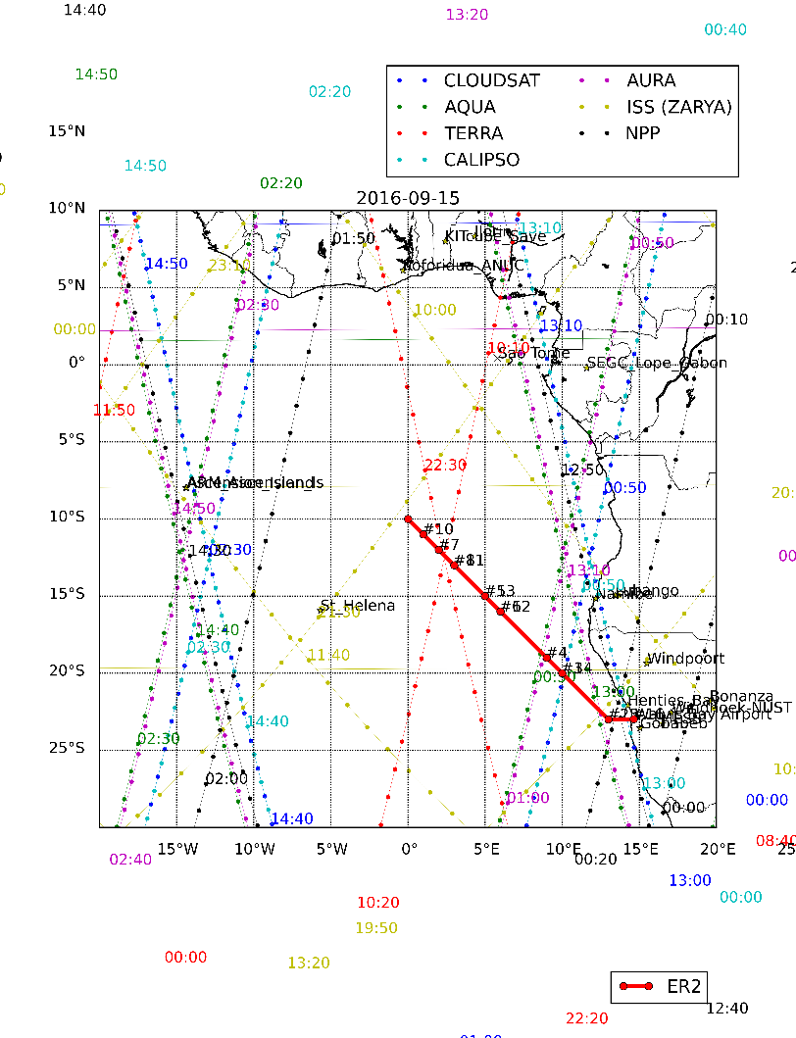
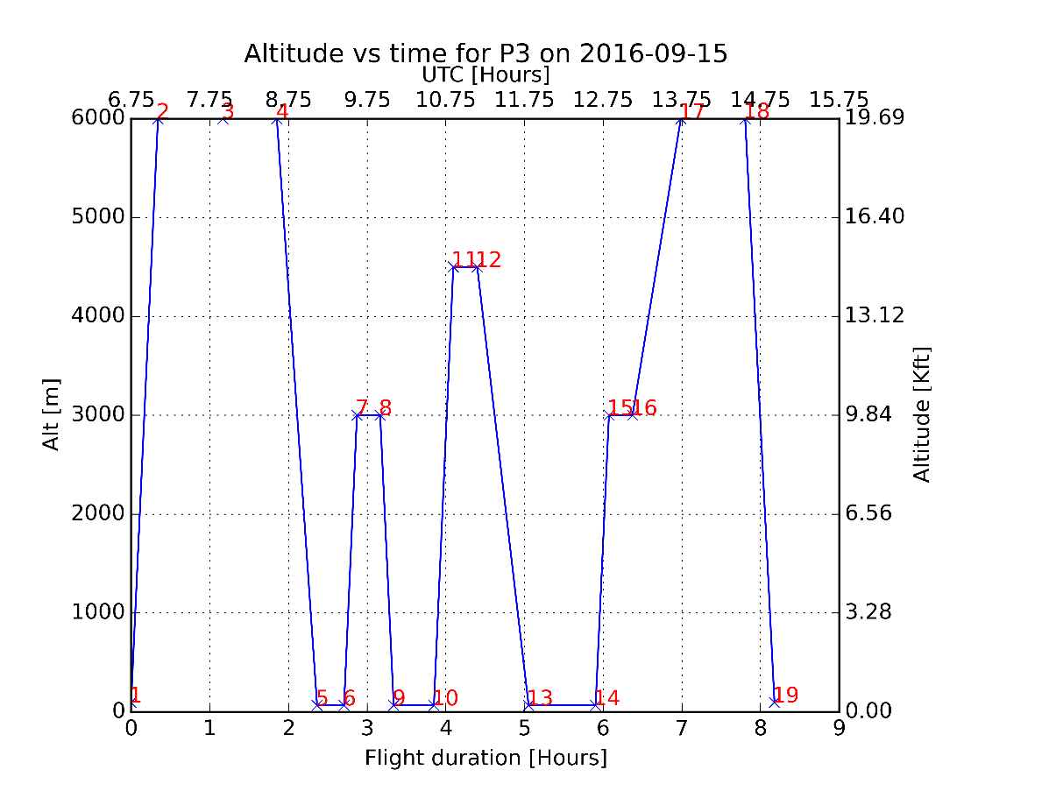
ORACLES (ObseRvations of Aerosols above CLouds and their intEractionS)
Thursday, Sep 15, routine flight

