Slide 1
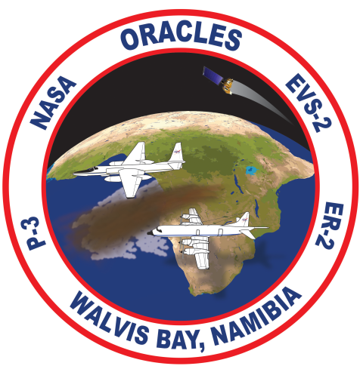
ORACLES (ObseRvations of Aerosols above CLouds and their intEractionS)
A NASA Earth-Venture-2 project
Jens Redemann¹, R. Wood², P. Zuidema³, J. Haywood^{4,5}, S. Piketh⁶, P. Formenti⁷,
T. L’Ecuyer⁸, M. Kacenelenbogen⁹, M. Segal-Rosenheimer⁹, Y. Shinozuka⁹,
S. LeBlanc¹⁰, M. Vaughan¹¹, S. Schmidt¹², C. Flynn¹³, B. Schmid¹³, B. Luna¹, S. Abel⁵
¹NASA Ames Research Center, Moffett Field, CA 94035, USA
²University of Washington, WA 98195, USA
³University of Miami, FL 33149, USA
⁴University of Exeter, UK ⁵Met Office, Exeter, UK
⁶North-West University, Potchefstroom, South Africa
⁷LISA, CNRS, Université Paris Est Créteil et Université Paris Diderot, Créteil, France
⁸University of Wisconsin-Madison, Madison, WI 53706, USA
⁹BAER Institute/NASA Ames, Moffett Field, CA 94035, USA
¹⁰ORAU/NASA Ames Research Center, Moffett Field, CA 94035, USA
¹¹NASA Langley Research Center, Hampton, VA 23681, USA
¹²LASP, Univ of Colorado, Boulder, CO, USA
¹³Pacific Northwest National Laboratory,Richland, WA, USA
Jens.Redemann-1@nasa.gov

Slide 2
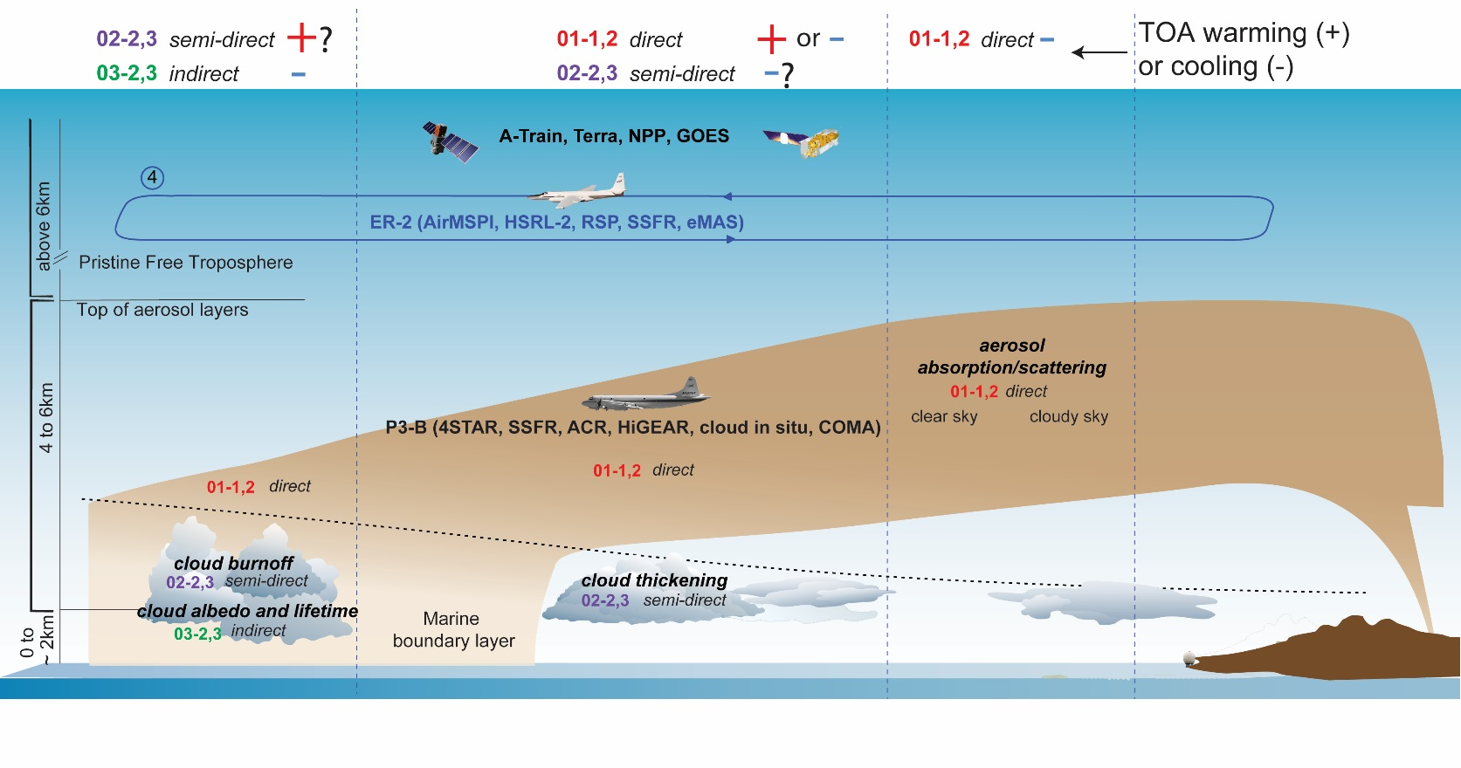
Aerosol-radiation-cloud interactions over the SE Atlantic – what we would like to know
→ The SE Atlantic basin provides a natural laboratory to study ARI (aerosol-radiation interactions) and ACI (aerosol-cloud interactions) incl. cloud adjustments
→ Many studies have assessed ARI and ACI for aerosol above cloud (e.g., Chand et al, 2009; Wilcox 2012; Sakaeda et al., 2011; Jethva et al., 2013; de Graaf et al., 2012; Anderson and Cermak, 2015; Min and Zhang, 2014; Meyer et al., 2013...) – all could benefit from additional information on aerosol and cloud properties and linking processes.

Slide 3
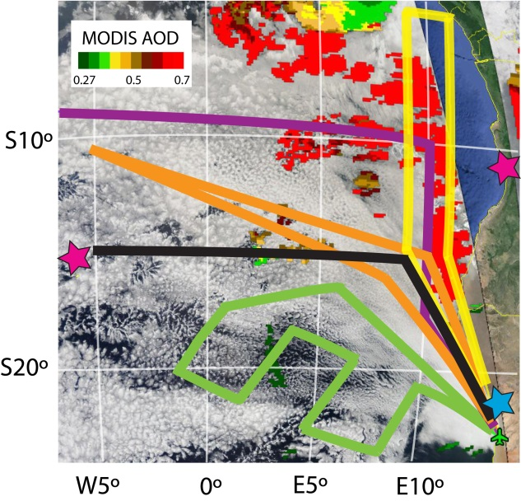
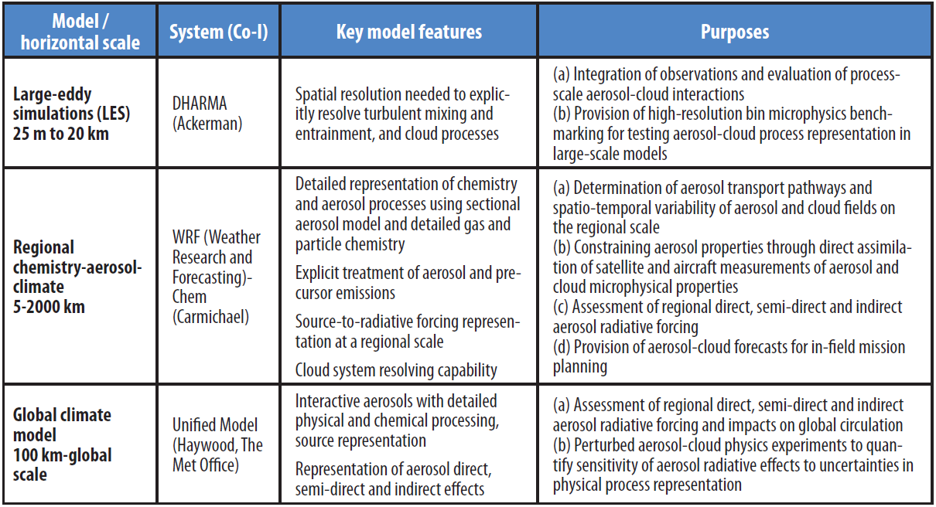
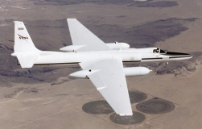
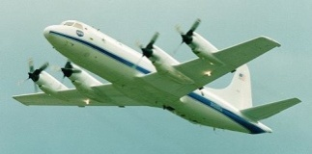
ORACLES (ObseRvations of Aerosols above CLouds and their intEractionS)
NASA Earth-Venture-2 project Redemann/Wood/Zuidema
Radio-polarimetric and in situ observations of radiation, aerosol & cloud microphysics above/below aerosol and clouds.
3 campaigns with P-3 (2016-2018), 1 with ER-2 (prob. 2016)
Coordinated with CLARIFY, LASIC, AEROCLO-SA, SEALS-SA
Involves 5 NASA centers, 8 universities
features flight strategies to facilitate easy comparisons to global models
Establishes 2 new AERONET sites (St. Helena & Angola)
Includes LES, WRF-Chem, and GEOS-5 modeling

Slide 4
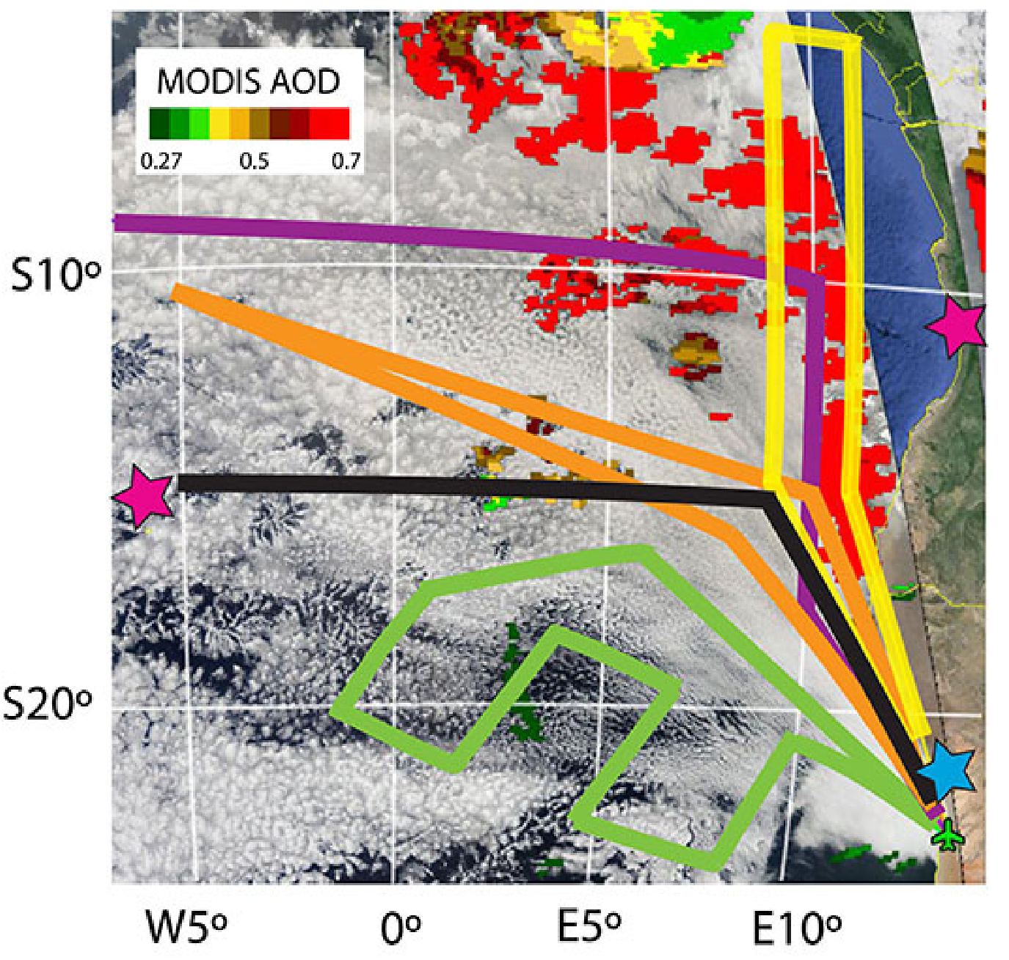
ORACLES (ObseRvations of Aerosols above CLouds and their intEractionS)
Confirmation Assessment Review – Science Investigation Plan
Five conceptual flight tracks
Routine flight plan
Suitcase flight to Ascension
Cloud field gradient flight
Plume axis flight
Across-plume survey

Slide 5
ORACLES (ObseRvations of Aerosols above CLouds and their intEractionS)
NASA Earth-Venture-2 proposal Redemann/Wood/Zuidema
Radiometric and polarization-sensitive remote sensing at high spatial resolution with airborne simulators of instrument concepts currently considered for ACE Decadal Survey Mission
→ ORACLES improves current and future satellite remote sensing of aerosols and clouds, by providing an in situ data set for testing current satellite retrieval methods and a remote sensing data set to investigate polarimeter retrieval sensitivity from state-of-the-art airborne simulator instrument designs.

