Slide 1
ORACLES forecasting briefing Meteorology for 14-09-2016 – 17-09-2016
13-09-2016
Lenny Pfister

Slide 2
Summary
Through Thursday, pressure gradient (sfc) weakens, with less subsidence and less low cloud clearing near the coast.
Influence of frontal passage on Thursday and Friday – possible weak crosswinds on landing and greater ceiling issues on Thursday. This is a strong spring storm, and there are significant changes in the low level circulation forecast.
High cloud is reduced as upper level trough has moved east, replaced by upper level anticyclone over SE Atlantic. This starts to break up at end of fcst period (Friday and Saturday – but high clouds still minimal on Friday)
Middle clouds waning through the week and should be much less of a problem through the forecast period.

Slide 3
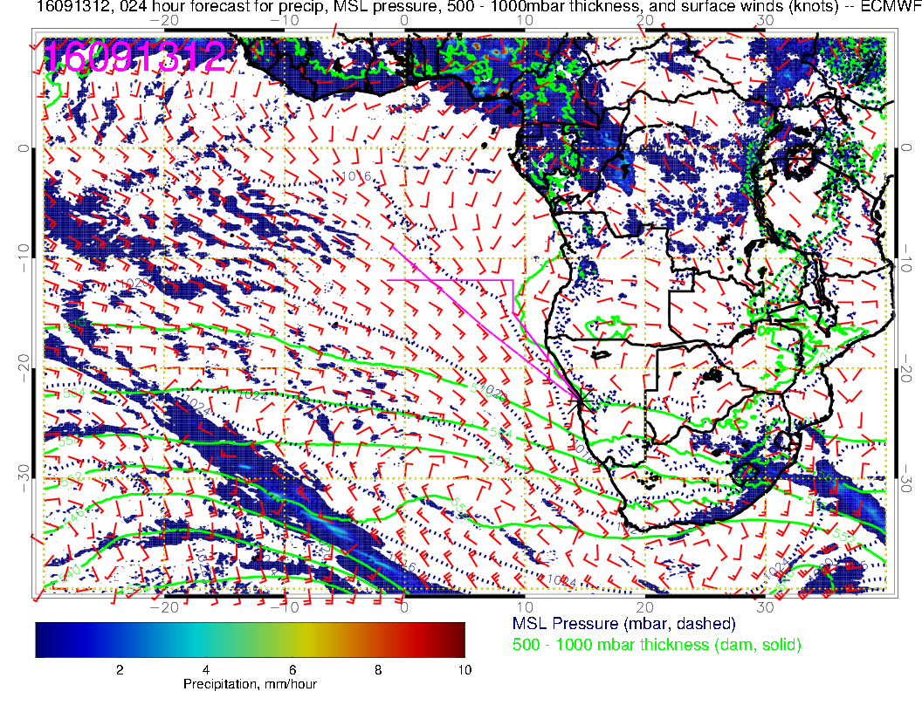
Today: Cold front near
Greenwich Meridian.
Still strong pressure
gradients and winds on east side of high

Slide 4
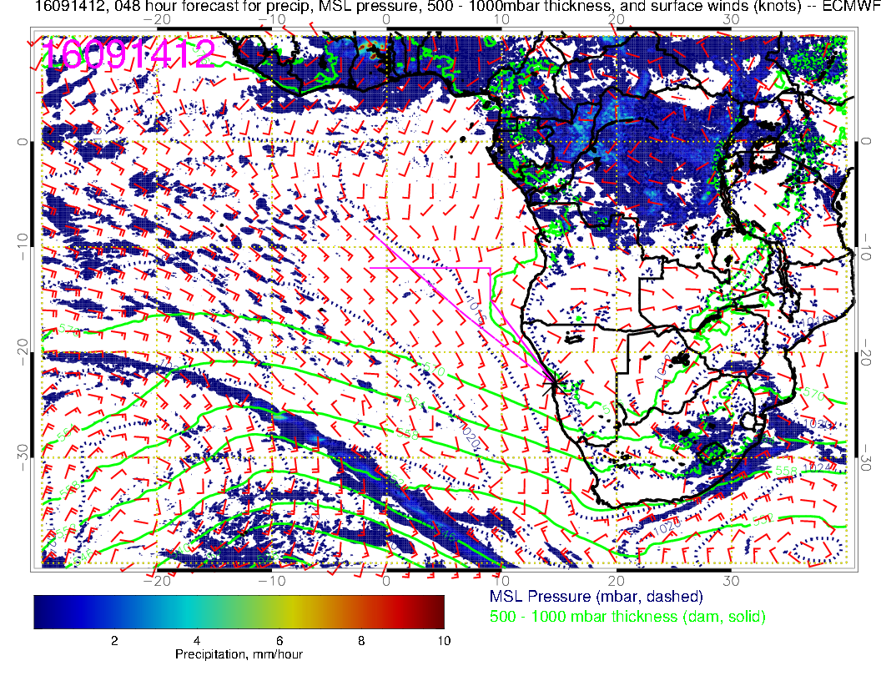
Wednesday:
Pressure gradients weaken as front approaches.

Slide 5
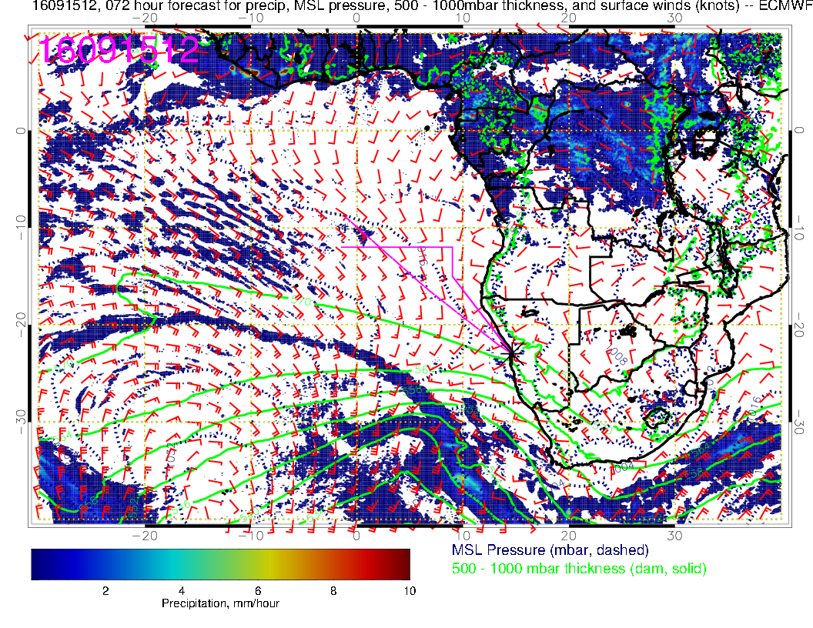
Thursday:
Prefrontal circulation changes. Direct onshore flow. A weak crosswind component. Expect late lifting of morning overcast and overcast on landing. Ceilings acceptable, but not a day for a > 8 hour ER-2 flight.

Slide 6
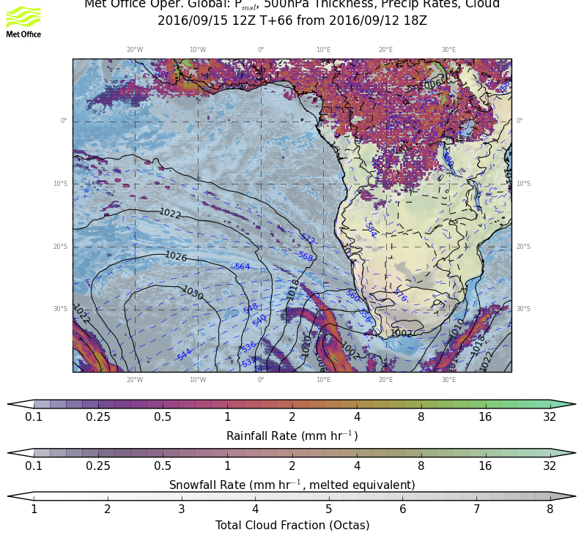
Timing an issue. Unified model is slightly ahead of EC on this front. If UK model is right, might want to try Fri-Sat btb??

Slide 7
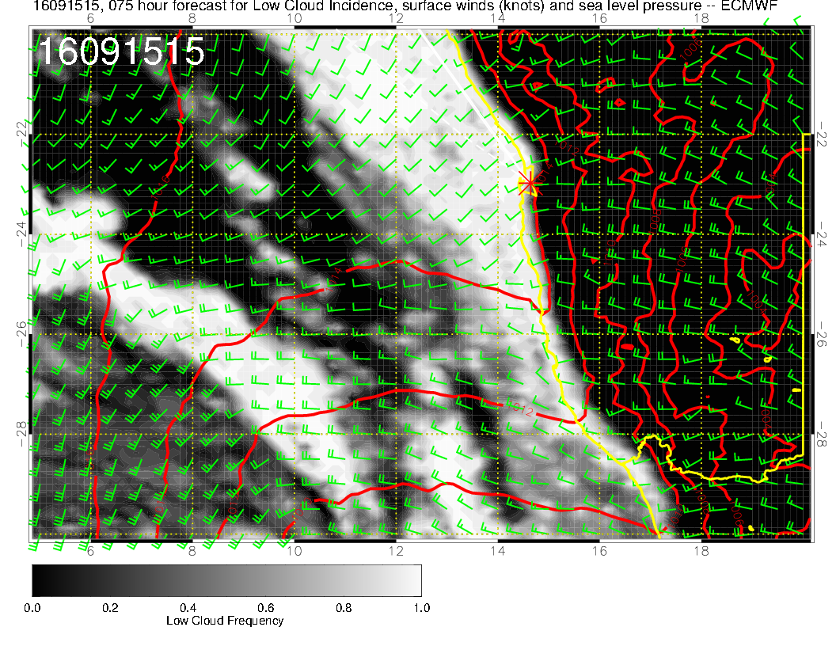
5 PM Thursday:
Decisive onshore flow, though winds are reasonable. Forecast ceilings are adequate, but so were Sep 4 forecast ceilings at 18Z and we were socked in.
Situation is not identical.

Slide 8
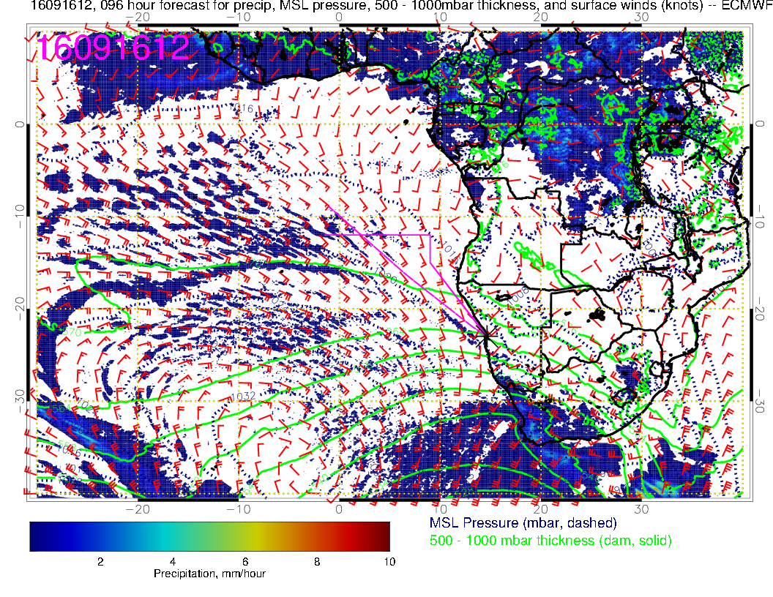
Friday:
Frontal passage occurs overnight. Starting to get back to strong pressure gradients as high moves eastward. Model suggests precip for Luederitz. A strong spring storm

Slide 9
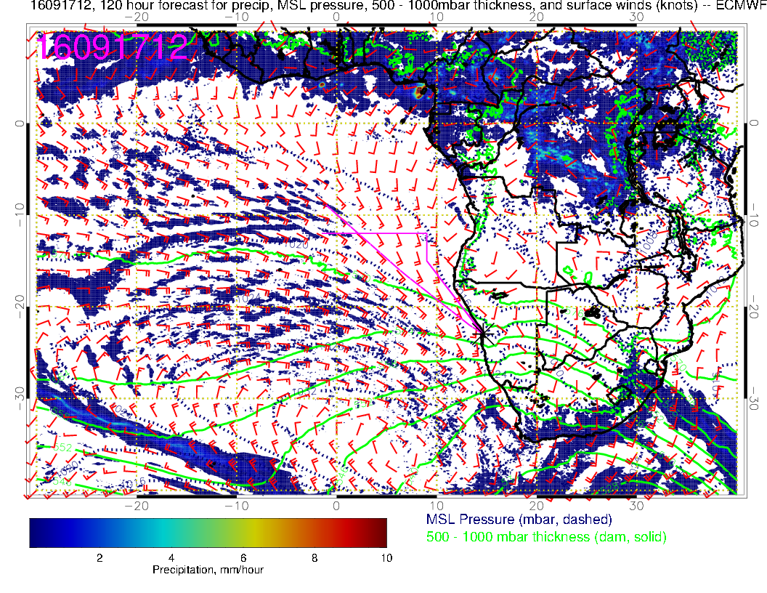
Saturday: Back to strong winds, eastward displaced high pressure system.
Good ceiling conditions, but south wind at 10knots (tailwind issue??)
120 hour fcst

Slide 10
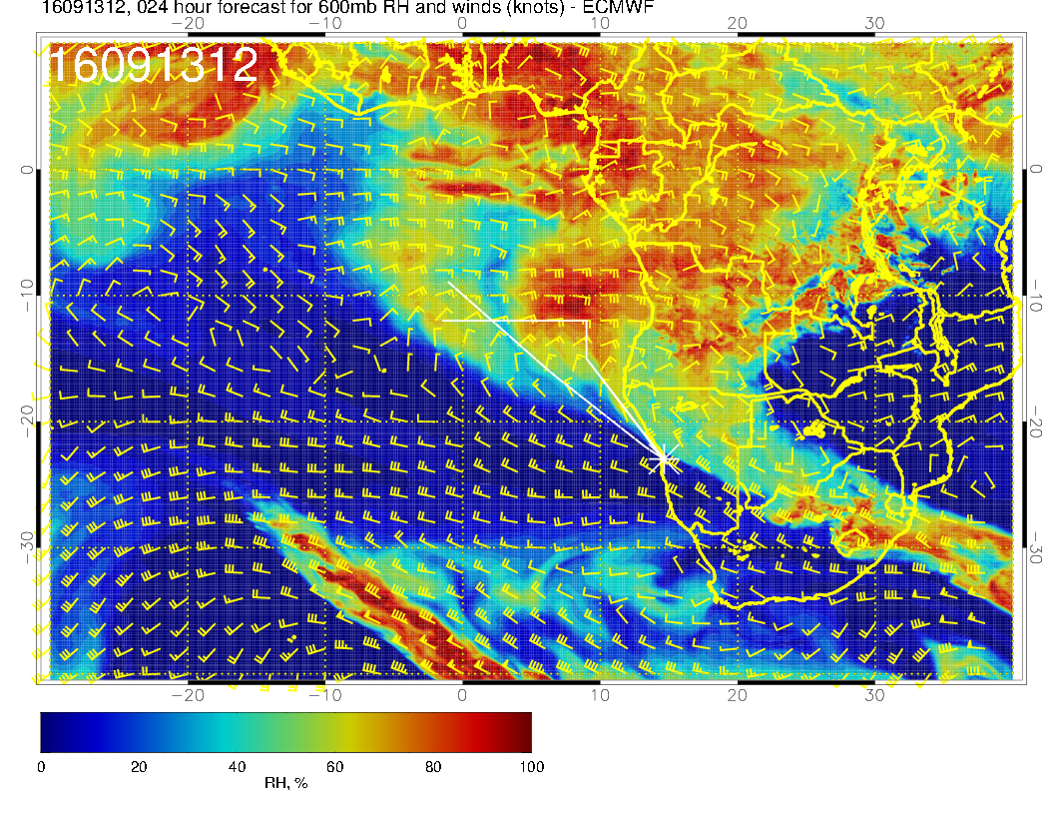
Sequence of 600mb flow.
Today: Another surge of humidity near 10S, winds strong (25knots) to 10W. Turning flow south of 10S near 0. Very stable forecast.

Slide 11
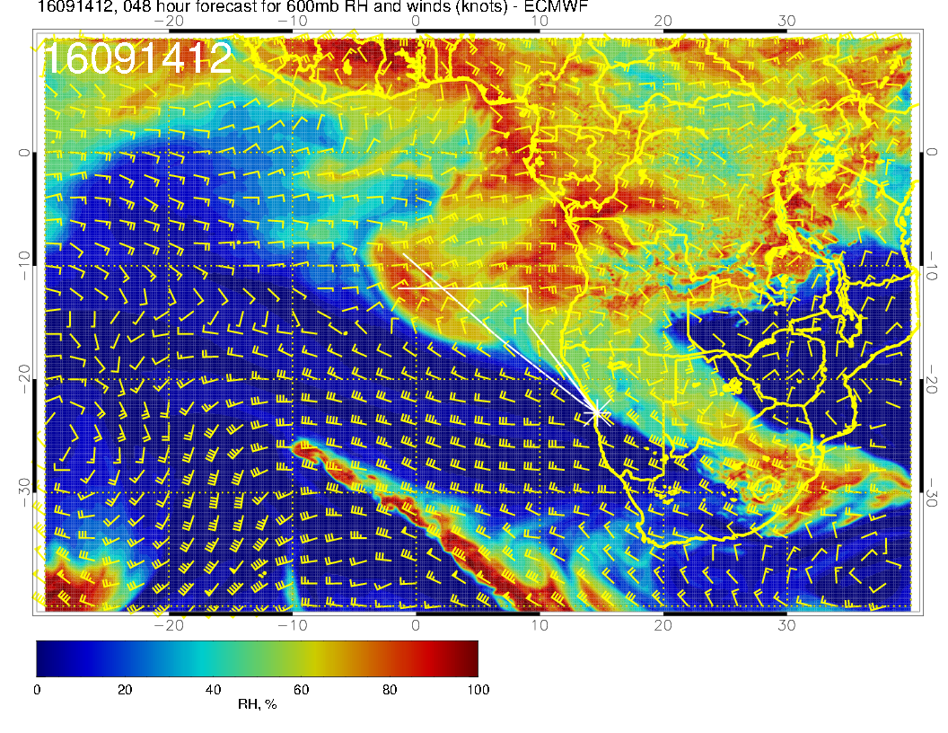
Tomorrow: Return flow
feature near [0.,-5] is
consistent with yesterday’s forecast.

Slide 12
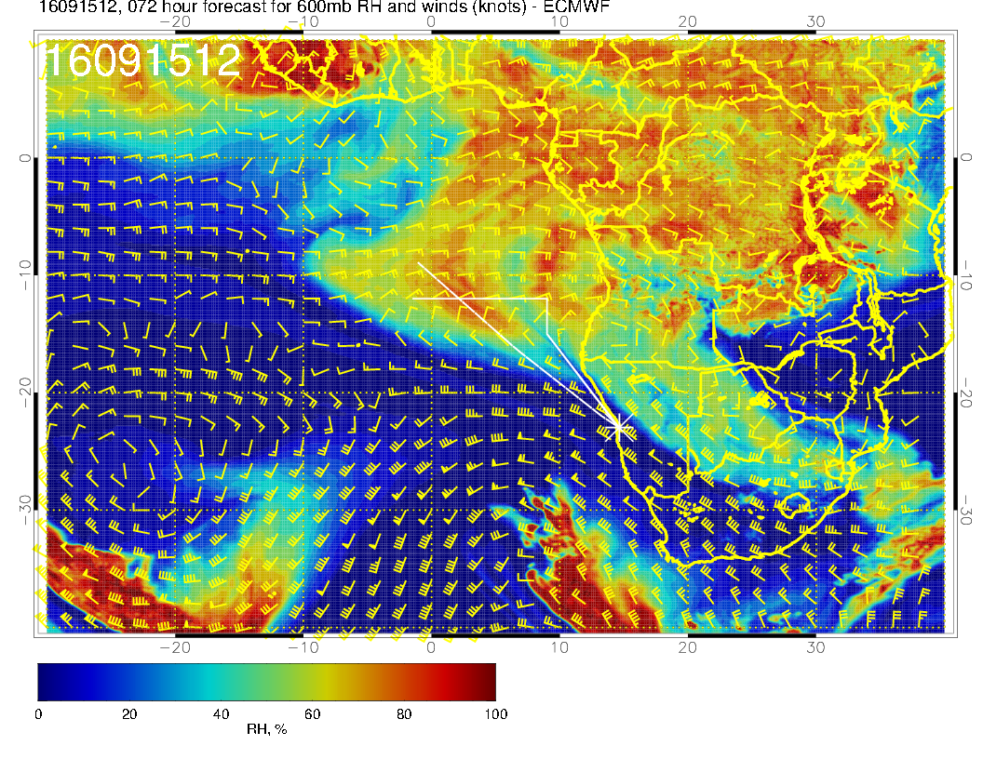
Thursday: Flow straight out to ascension. Midlatitude trough distorts anticyclone.

Slide 13
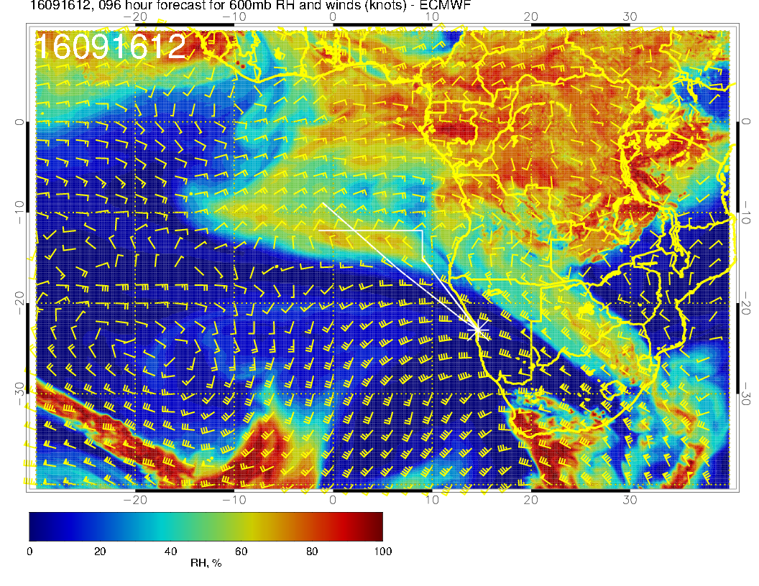
Friday: 600mb anticyclone, normally in 3 corners region is distorted. Boundary of humid region almost straight east-west

Slide 14
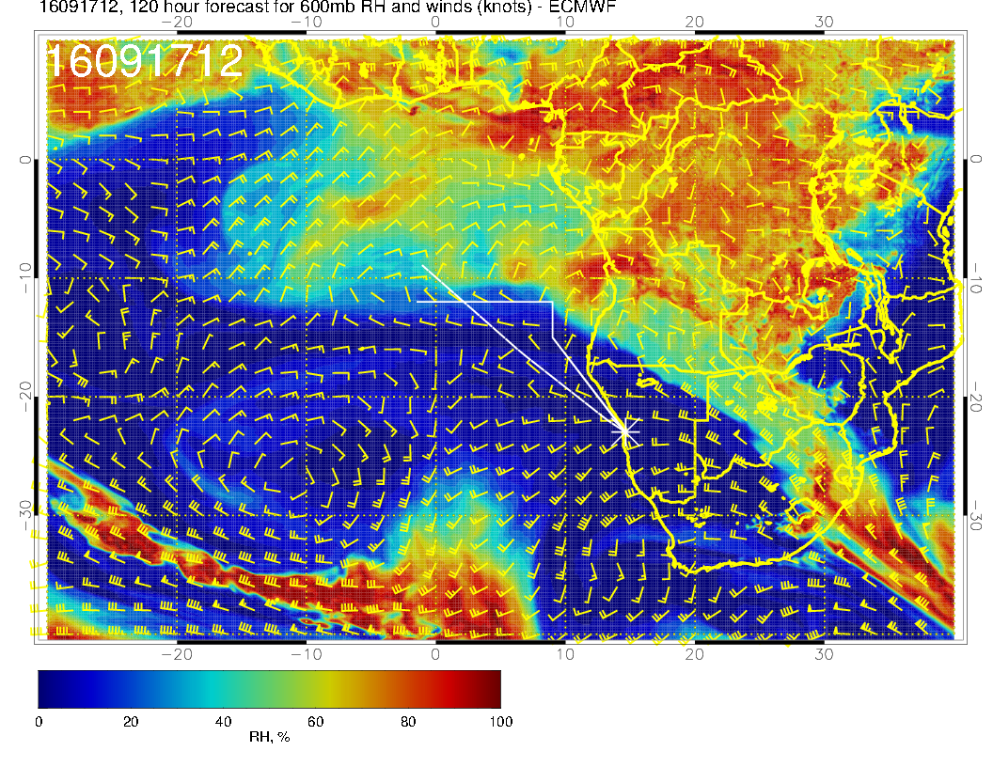
Saturday: Humid region
is pushed northward.

Slide 15
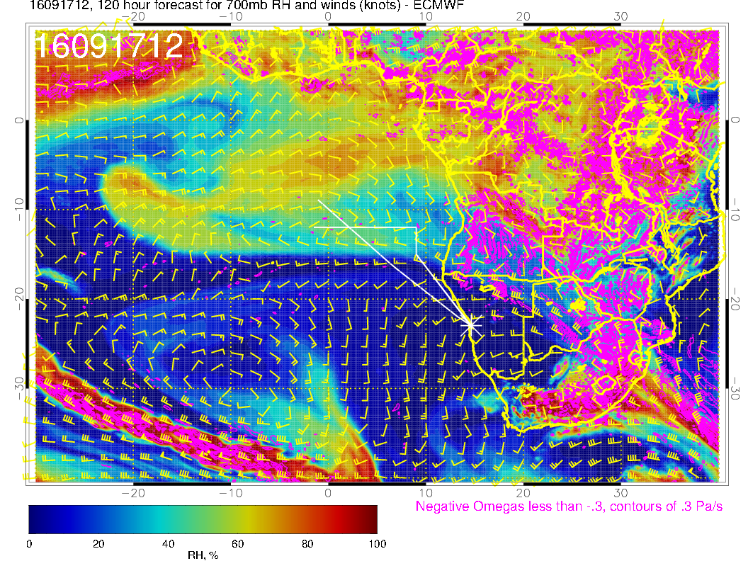
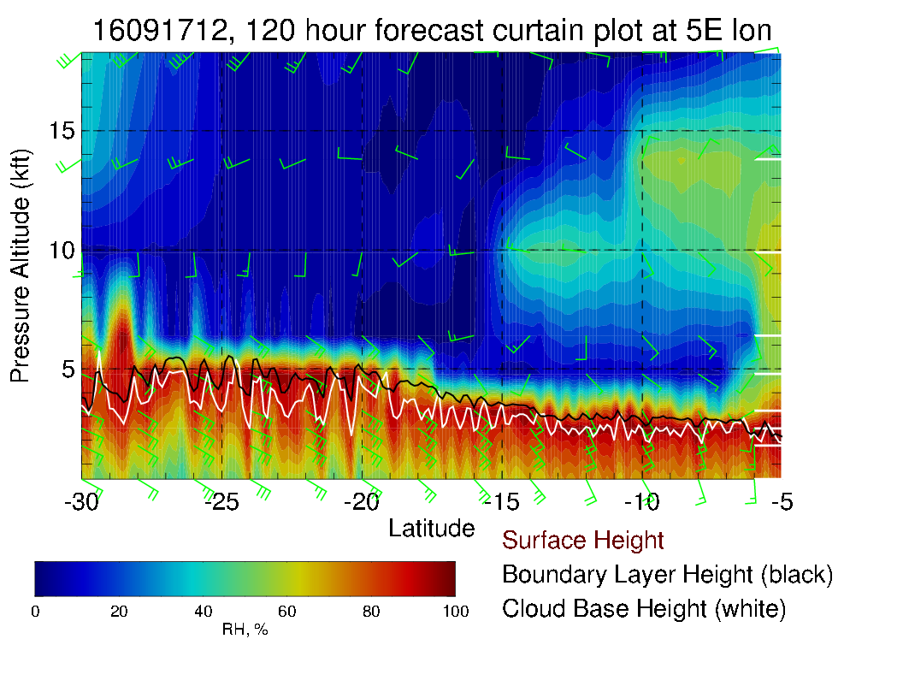
Maybe plume just different structure

Slide 16
Upper trop

Slide 17
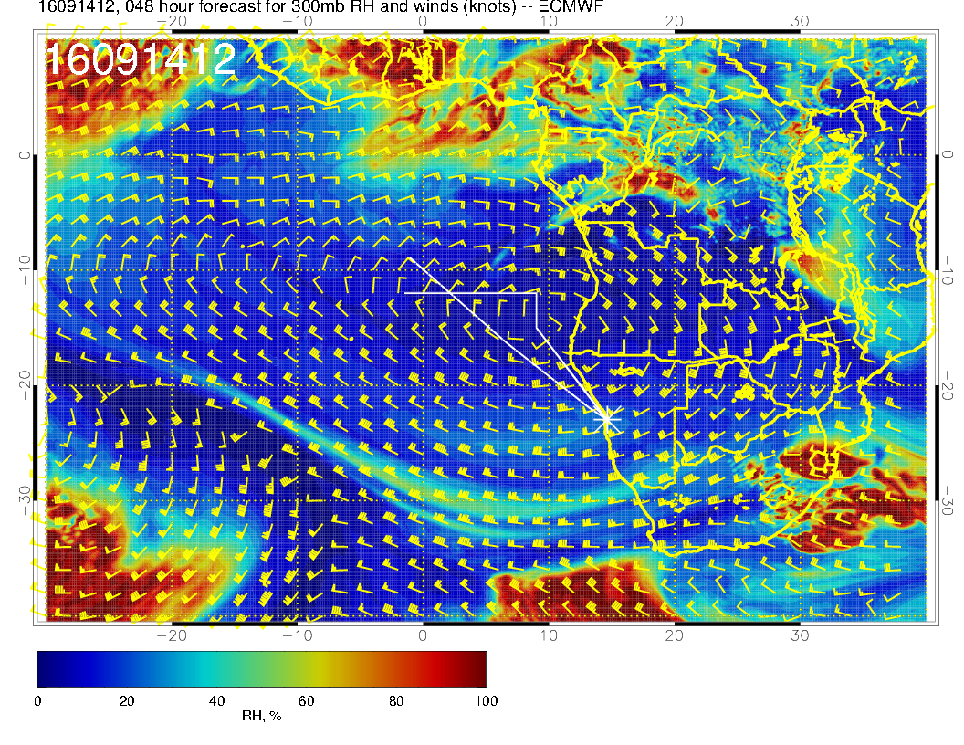
Through Wednesday have pronounced anticyclone that keeps high cirrus to a minimum.

Slide 18
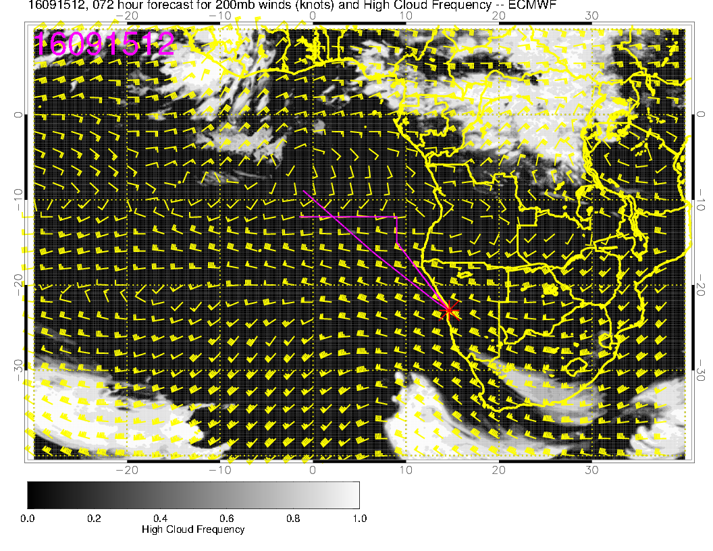
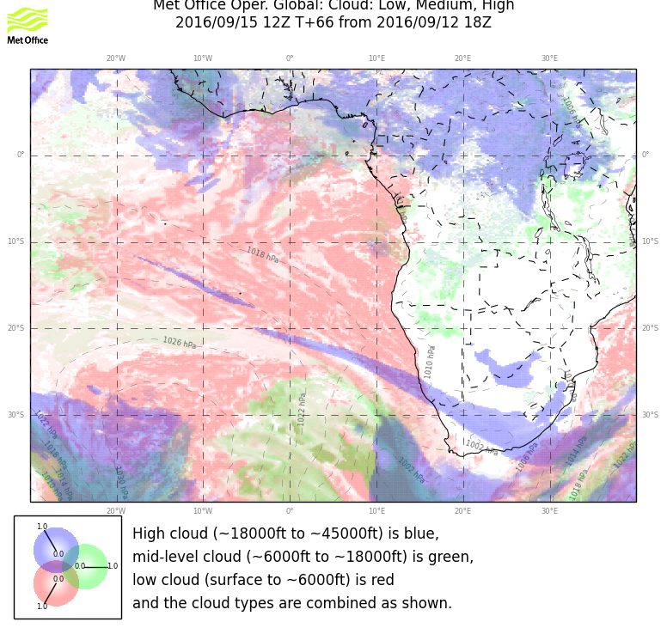
Neither model forecasts high cloud in our region for the trough passage. Some might be expected near YWB.

Slide 19
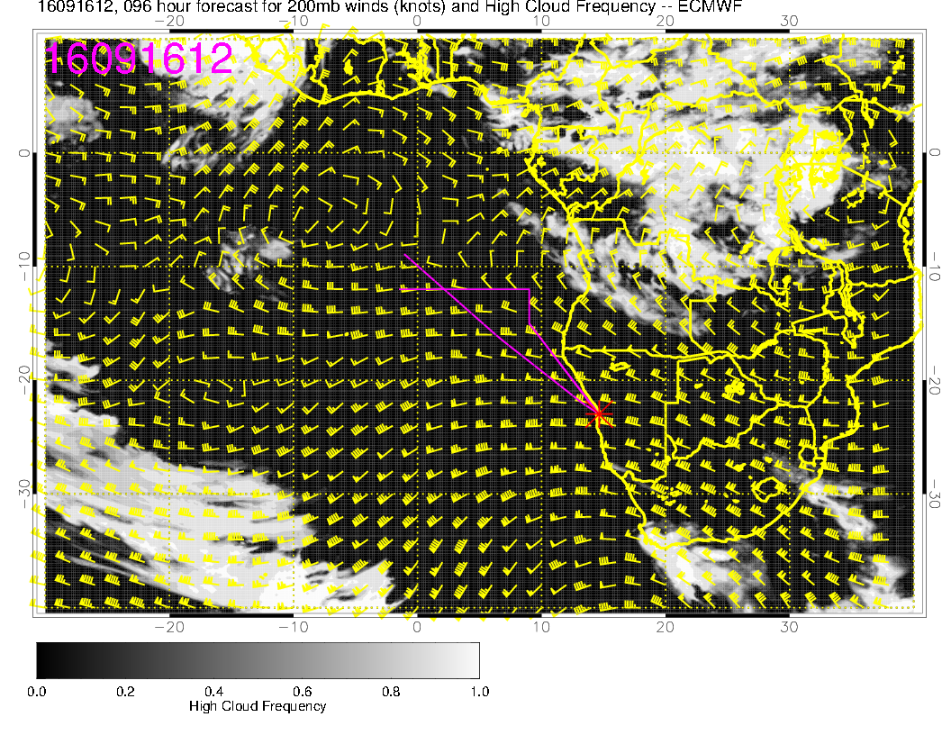
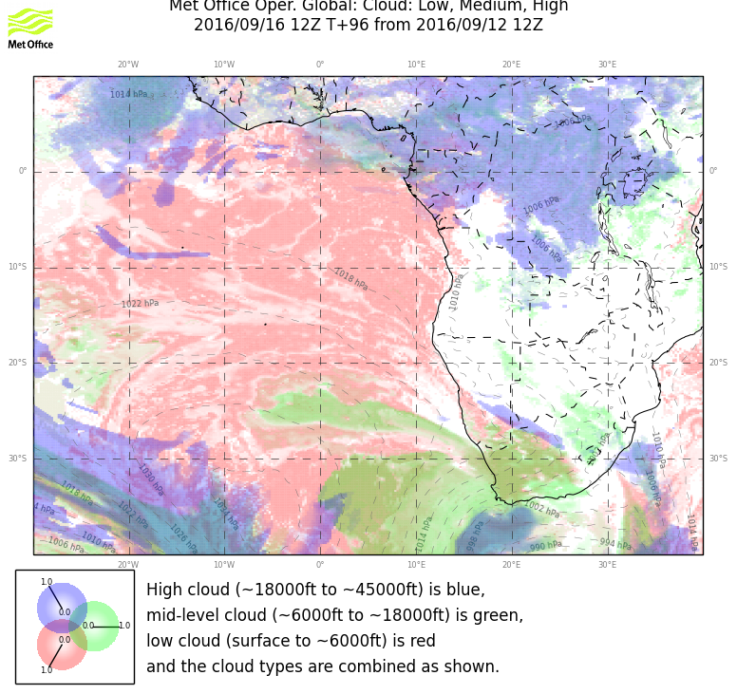
Friday: High cloud possible in extreme NE region –
advection from convective regions.

Slide 20
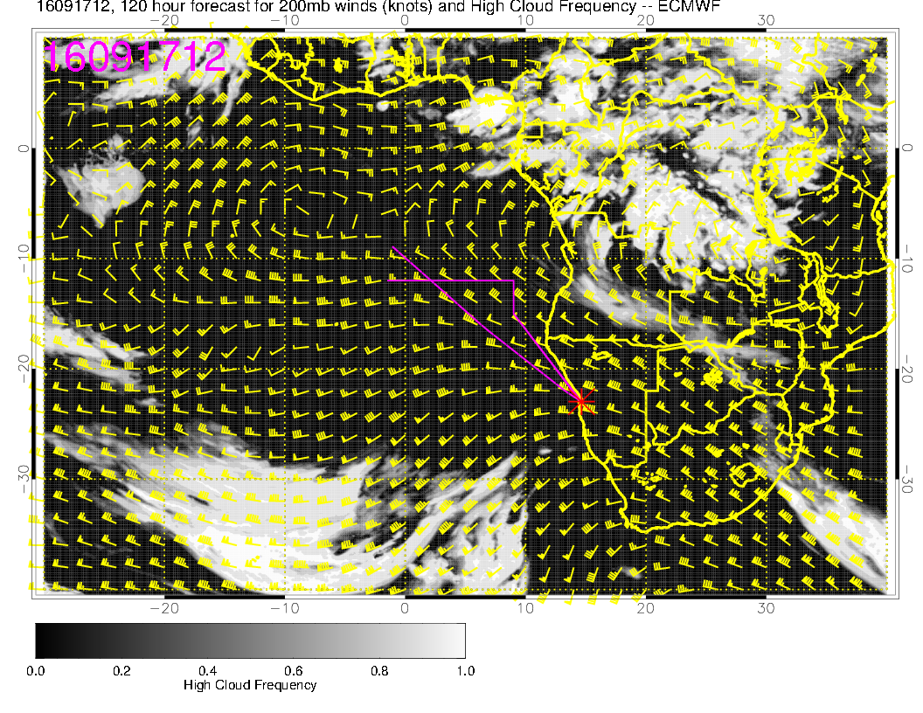
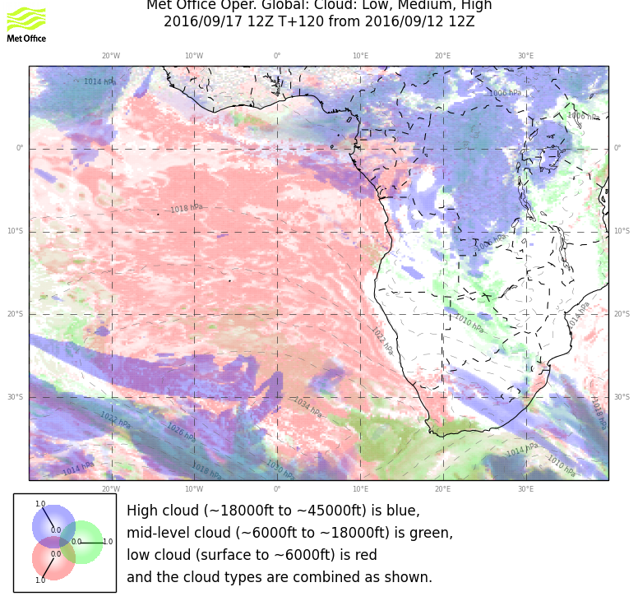
New trough moves
Saturday: Intrusion of tropical air starts in NE corner of our region in both models.

Slide 21
Mid level clouds

Slide 22
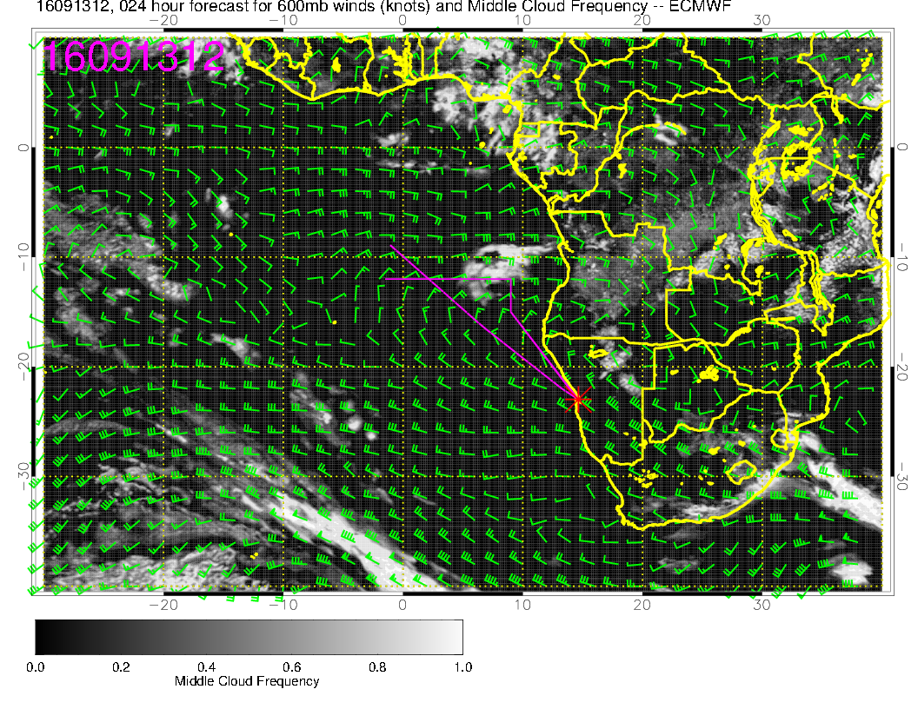
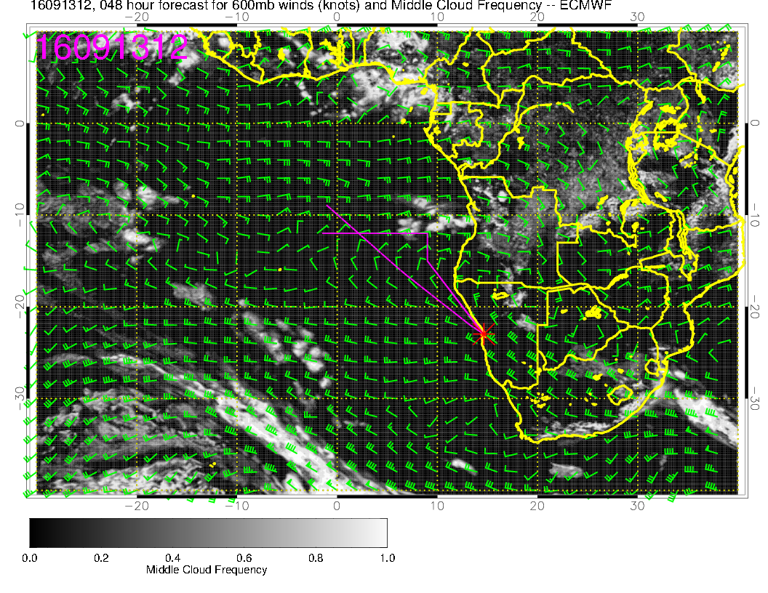
Fcst for today (24 hour above,
48 hour below. Stable, but if you want details, be wary

Slide 23
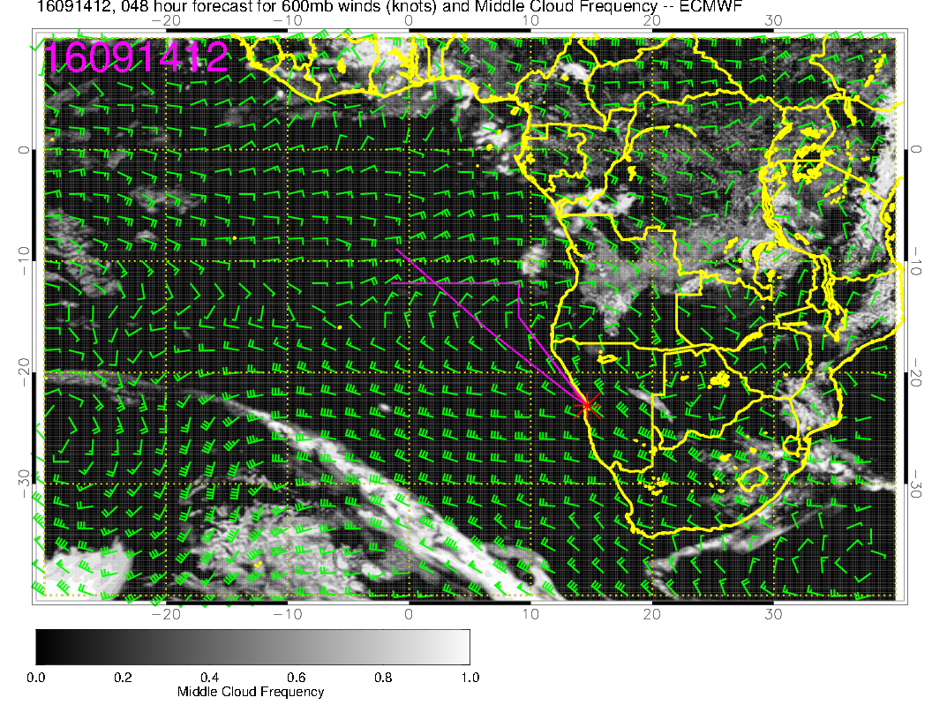
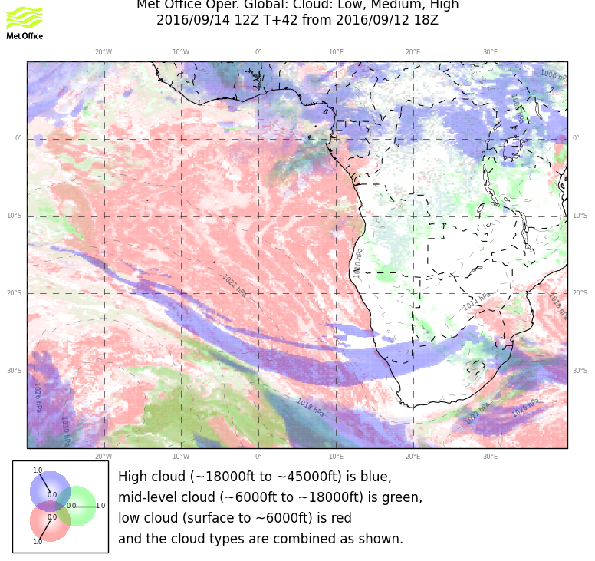

Slide 24
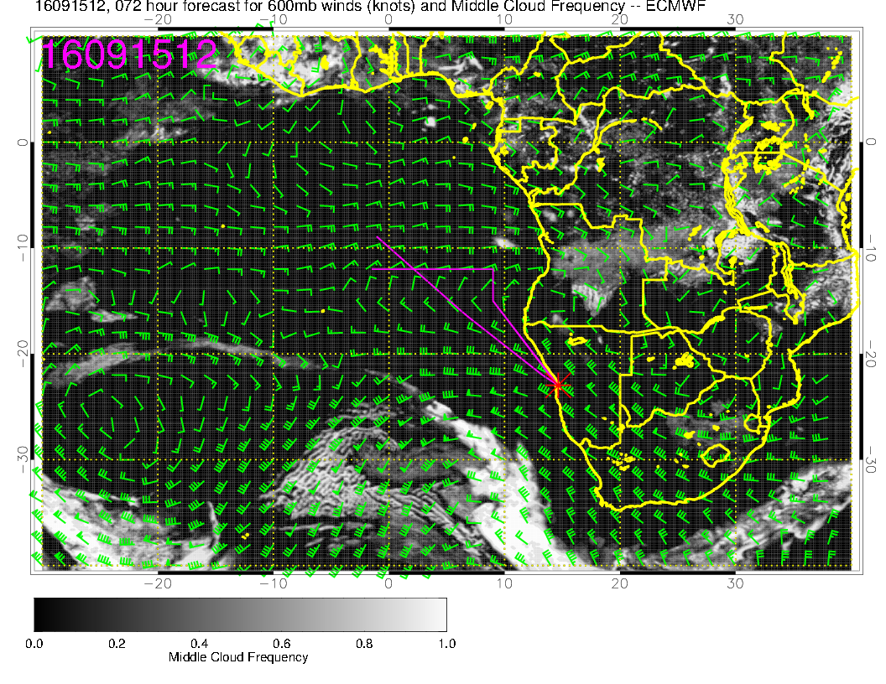

Slide 25
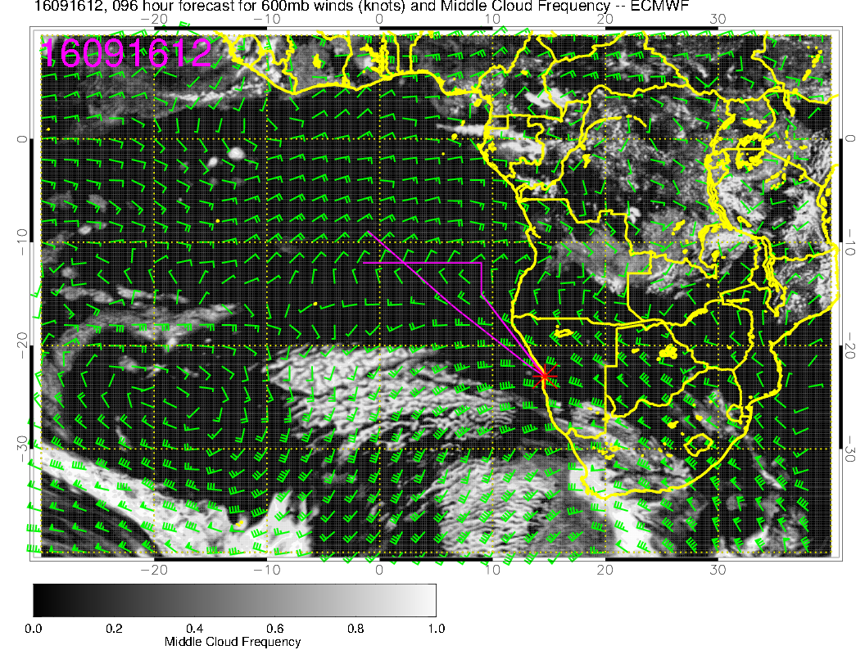

Slide 26
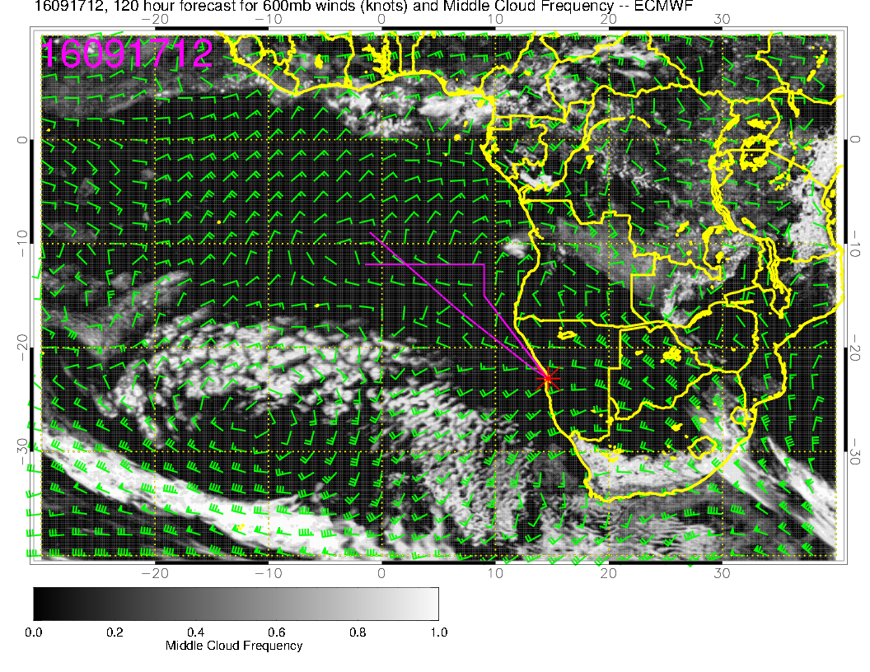

Slide 27
Low Clouds

Slide 28
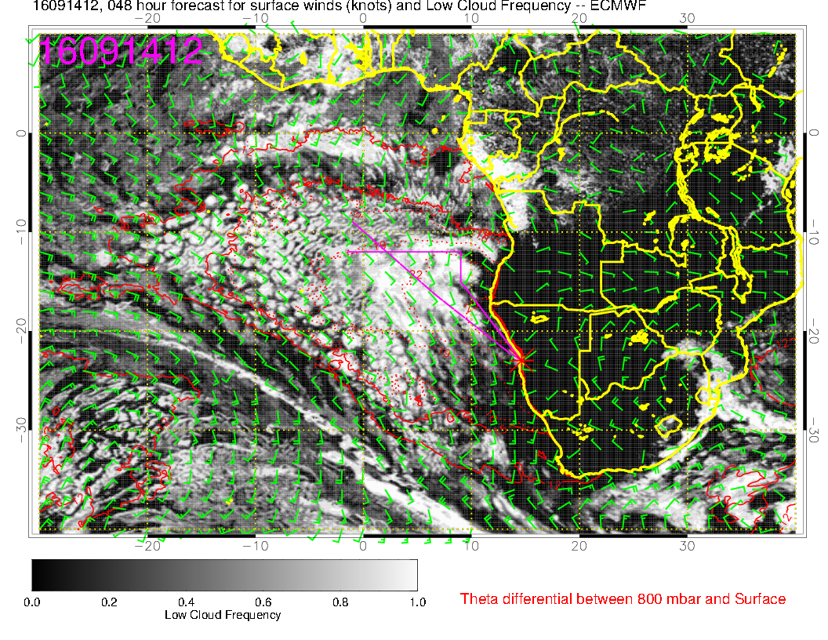

Slide 29
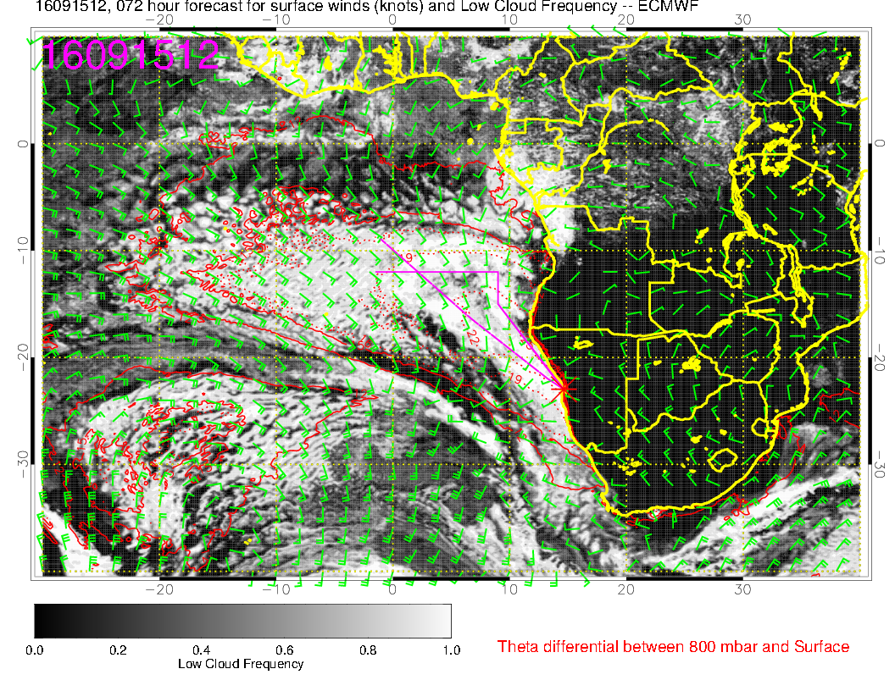

Slide 30
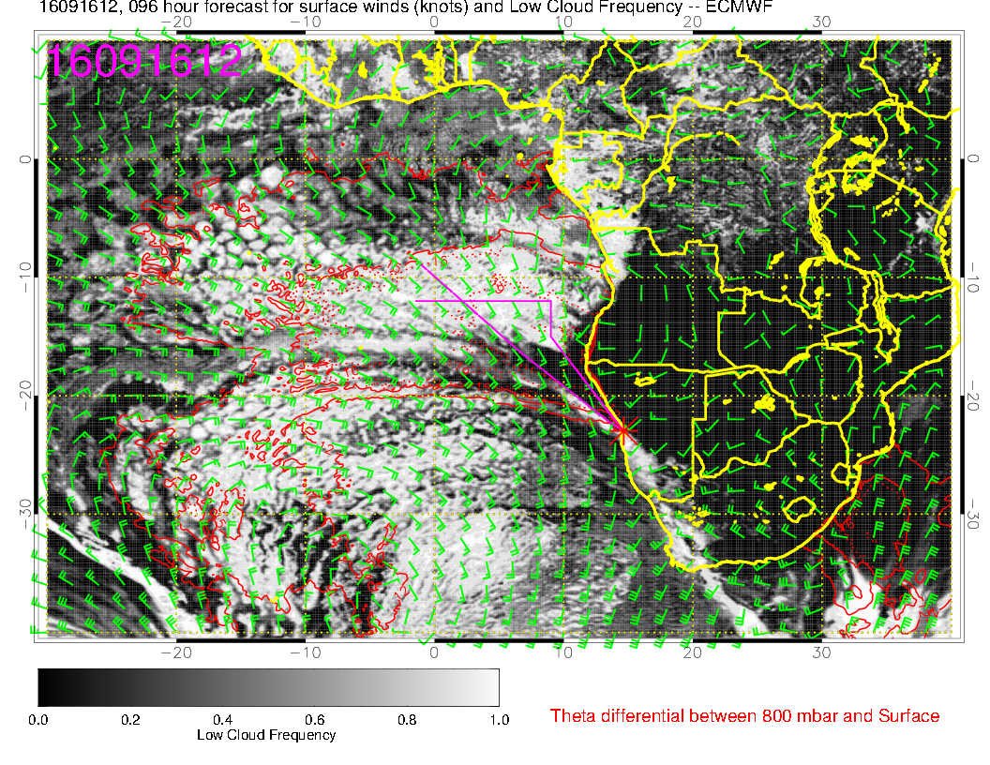
A lot of scrunching of the Sc region on this day due to front.

Slide 31
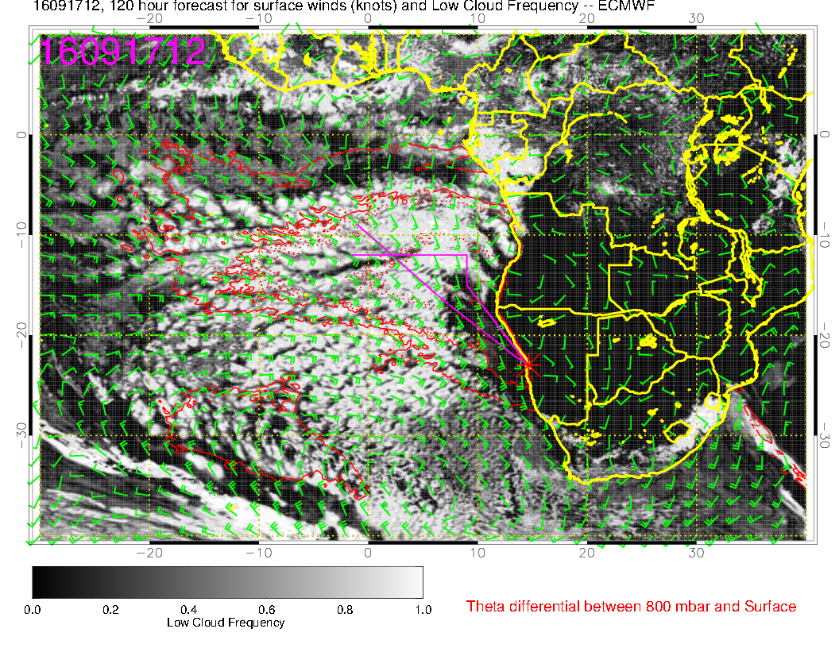
Starting to restore Sc region, strong winds still, clearing near the coast.

