Slide 1
ORACLES forecasting Briefing Aerosols
13-09-2016

Slide 2
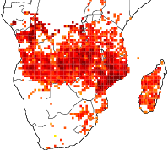
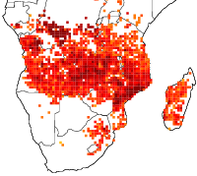
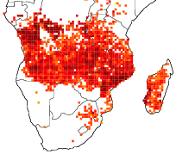
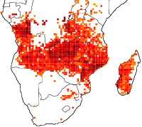
Biomass burning emissions (FINN) evolution
2016-09-07
2016-09-08
2016-09-09
2016-09-10

Slide 3
Sept 11 2016 (model evaluation)

Slide 4
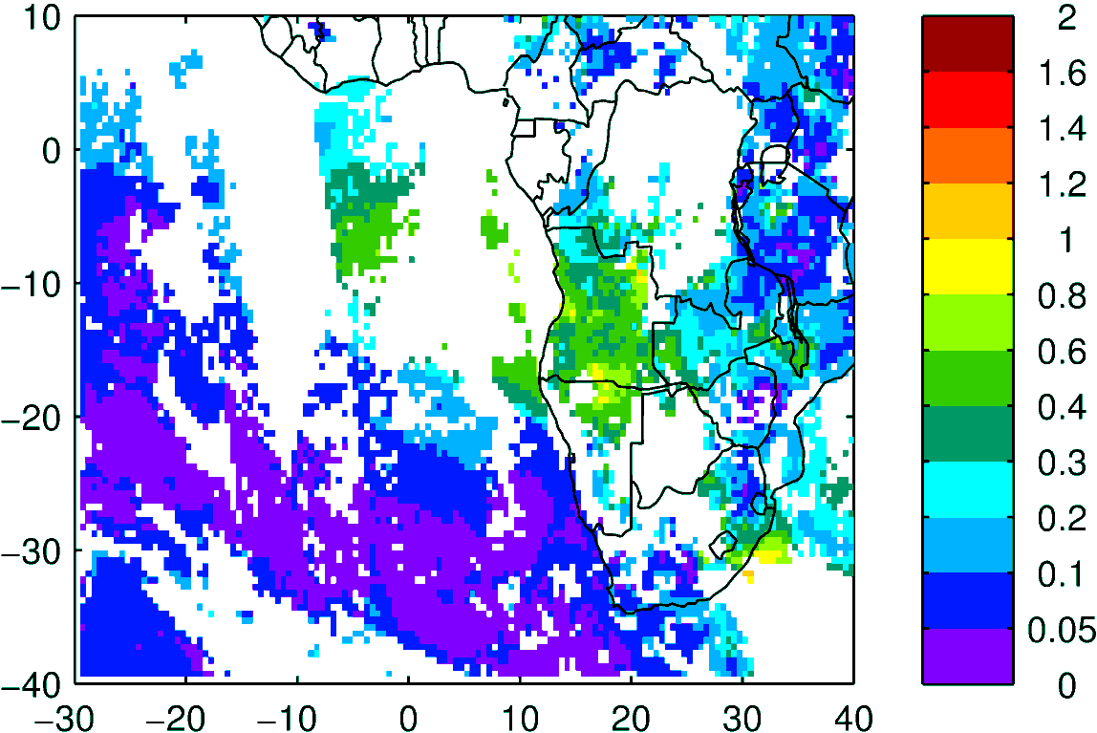
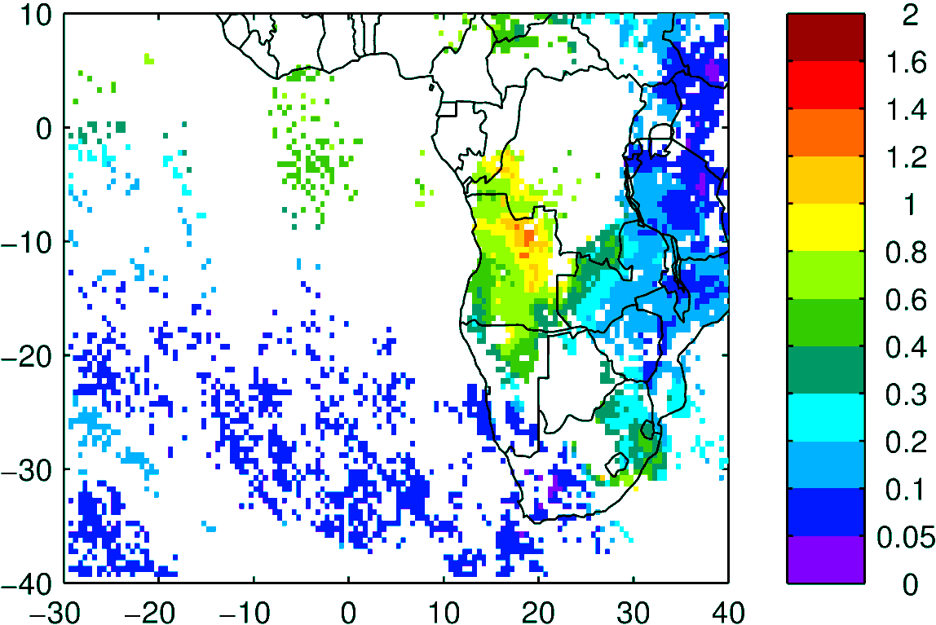
Terra & Aqua AOD (clear-sky)
MODIS NNR
WRF-AAM

Slide 5
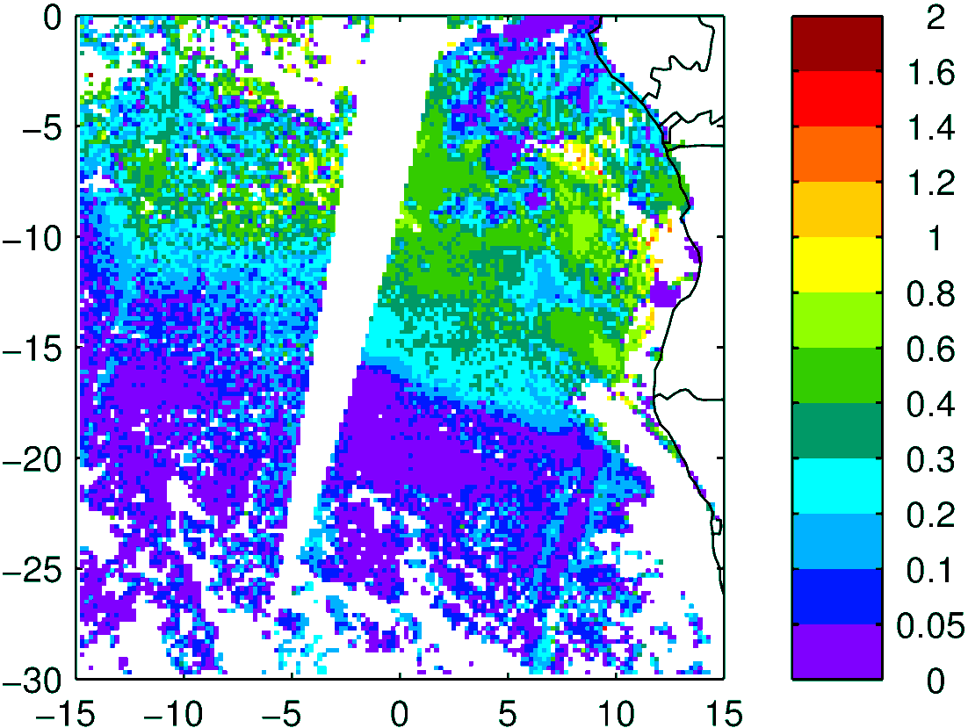
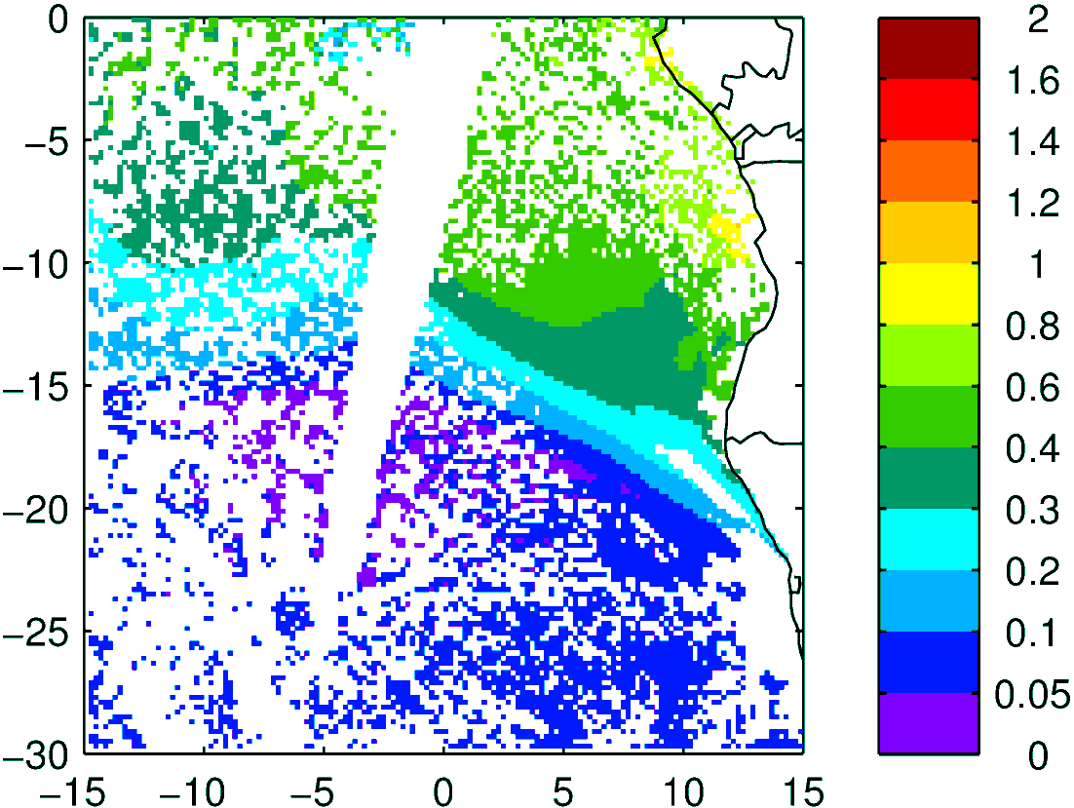
Above Cloud AOD
Observation
Model (WRF-AAM)
Terra

Slide 6
Sept 13 2016 (no flight day)

Slide 7
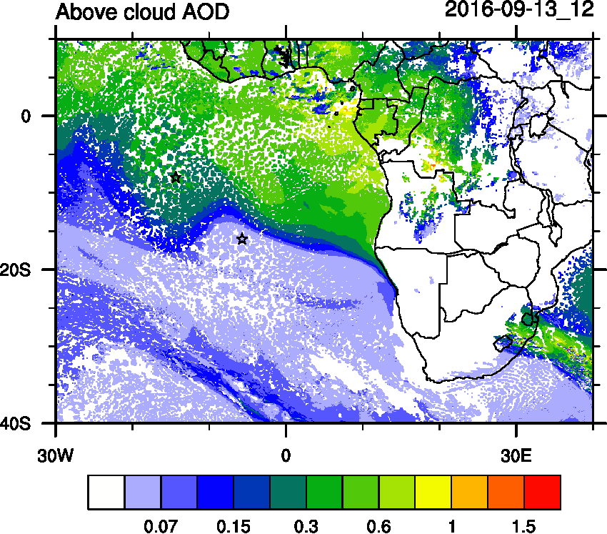
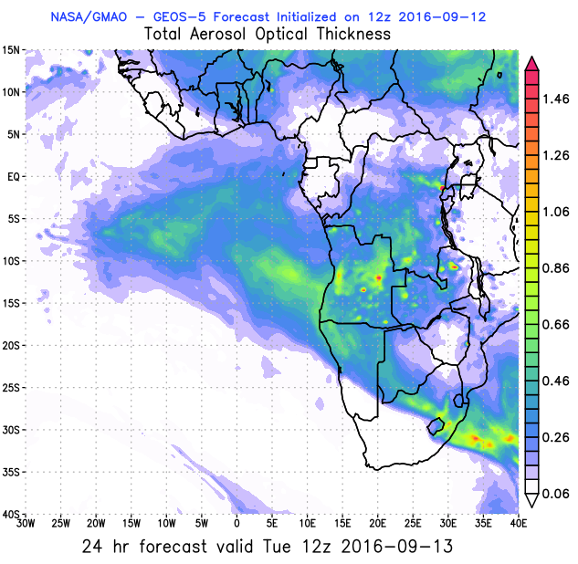
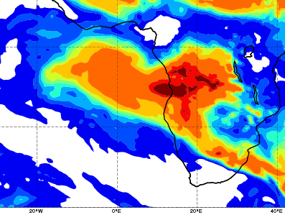
AOD 12 UTC
WRF
GEOS5
CAMS

Slide 8
Sept 14 2016

Slide 9
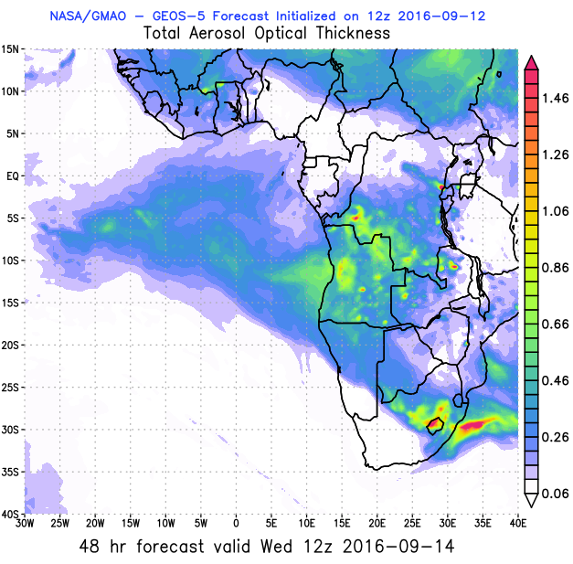
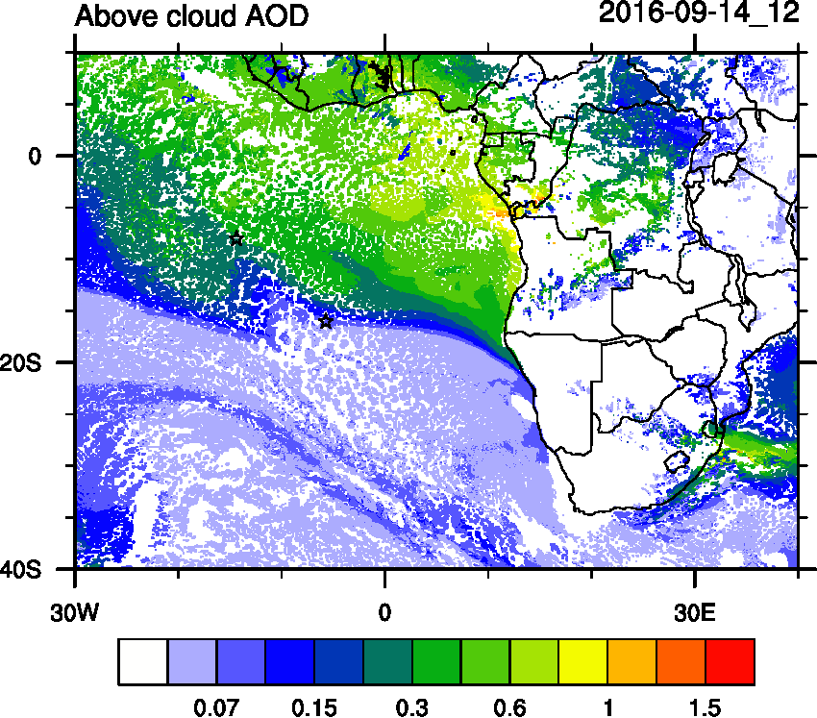
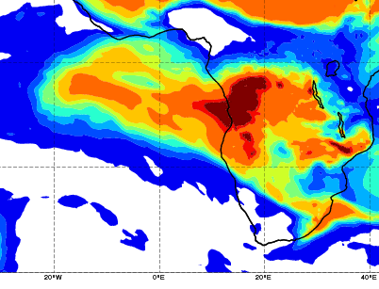
AOD 12 UTC
WRF
GEOS5
CAMS

Slide 10
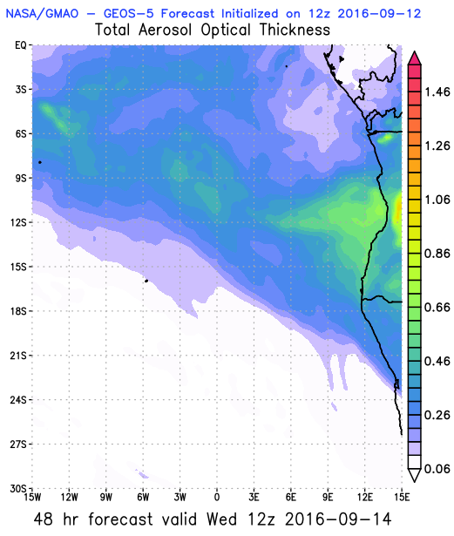
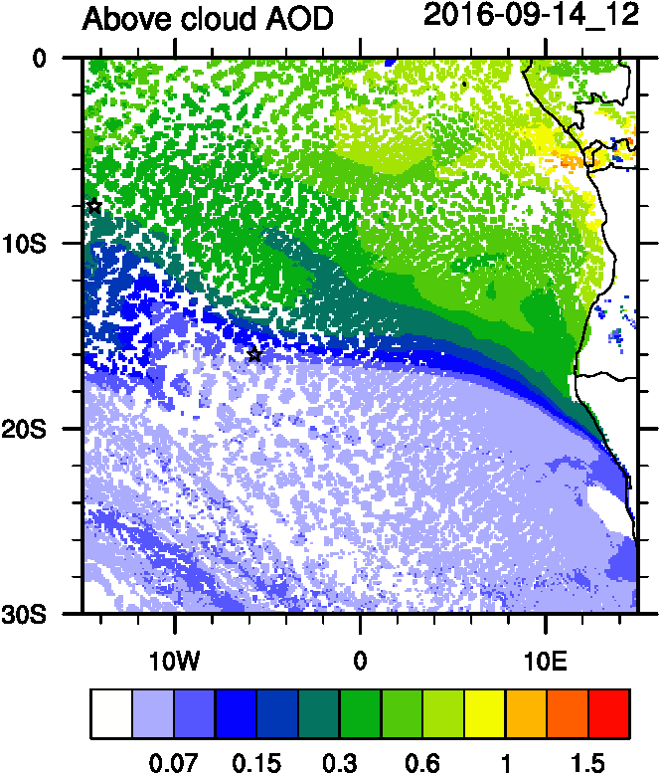
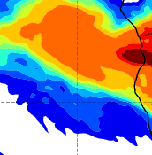
AOD 12 UTC
WRF ACAOD
GEOS5
CAMS

Slide 11
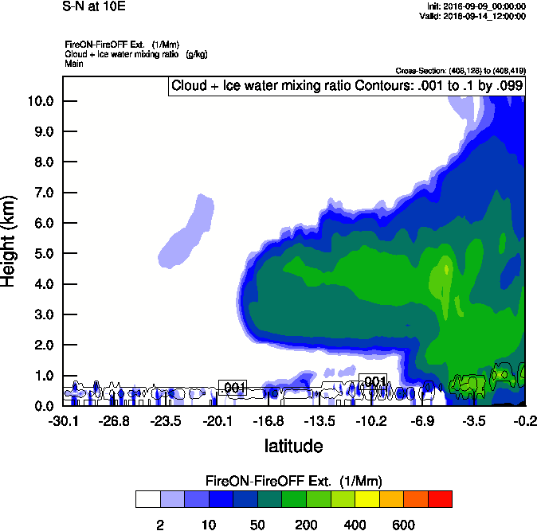
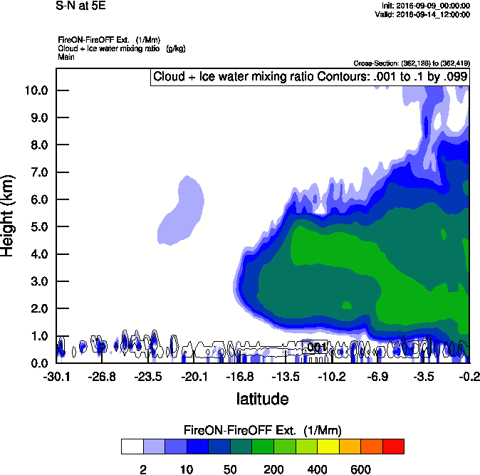
Vertical cross-section South to North
Smoke Ext WRF
Smoke Ext WRF
10 E
5 E

Slide 12
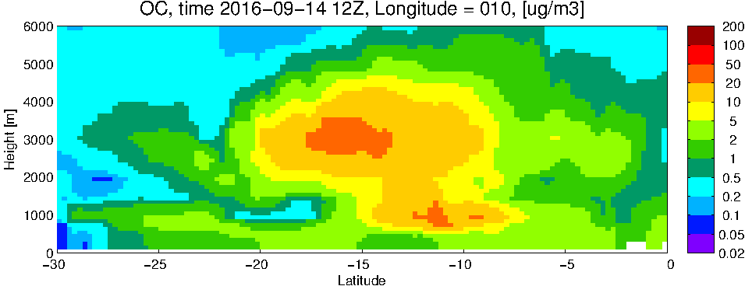
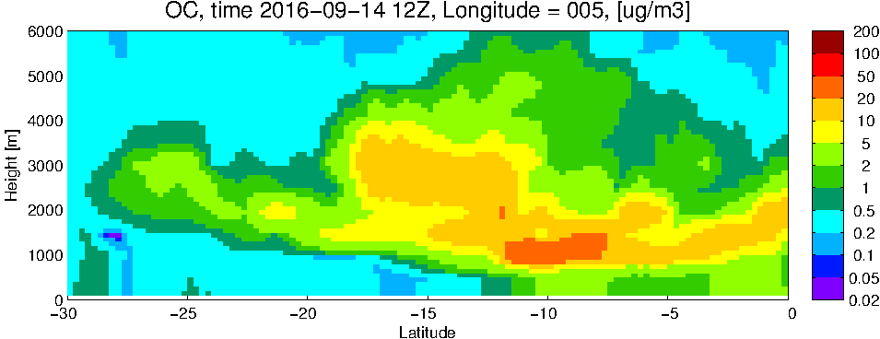
GEOS5 OC curtains
10 E
5 E

Slide 13
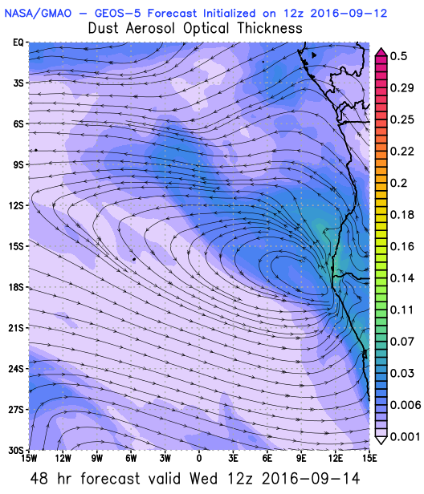
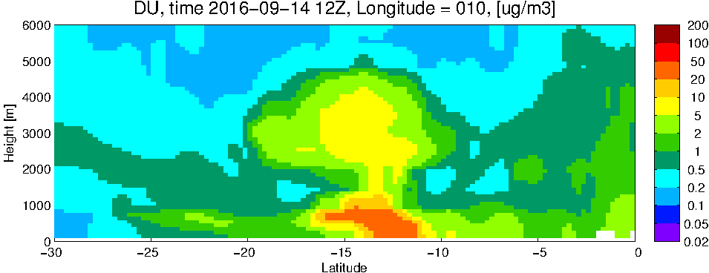
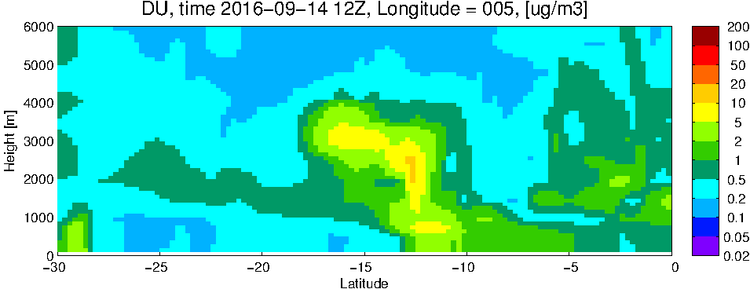
GEOS5 DUST curtains
10 E
5 E

Slide 14
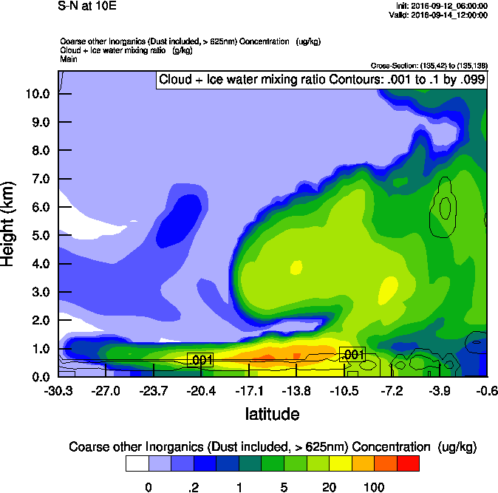
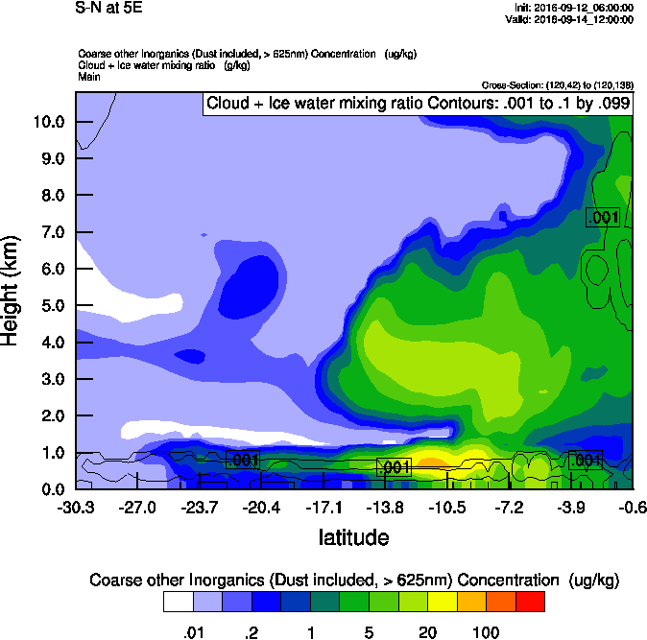
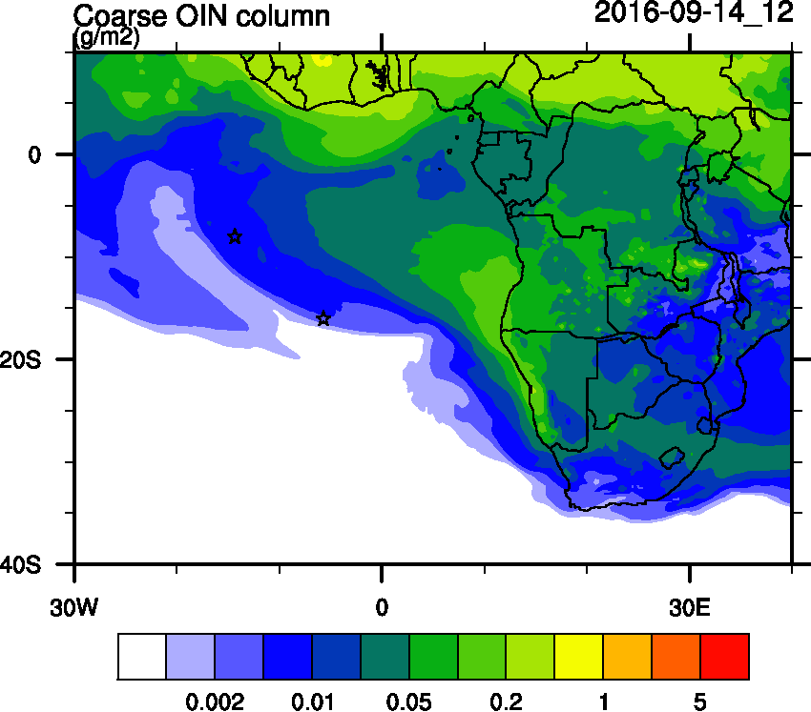
WRF-Chem Dust curtains
Dust WRF-Chem
Dust WRF-Chem
10 E
5 E

Slide 15
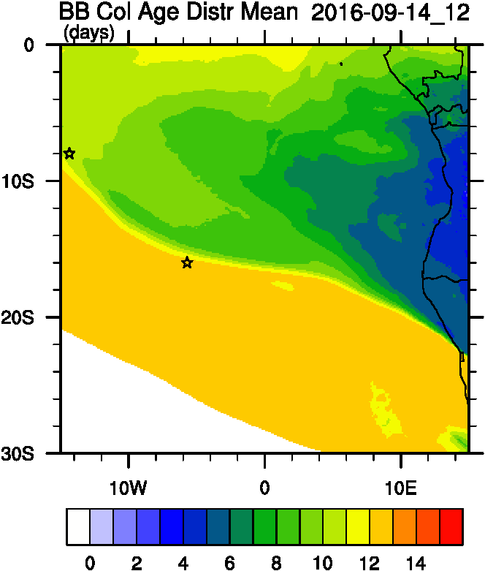
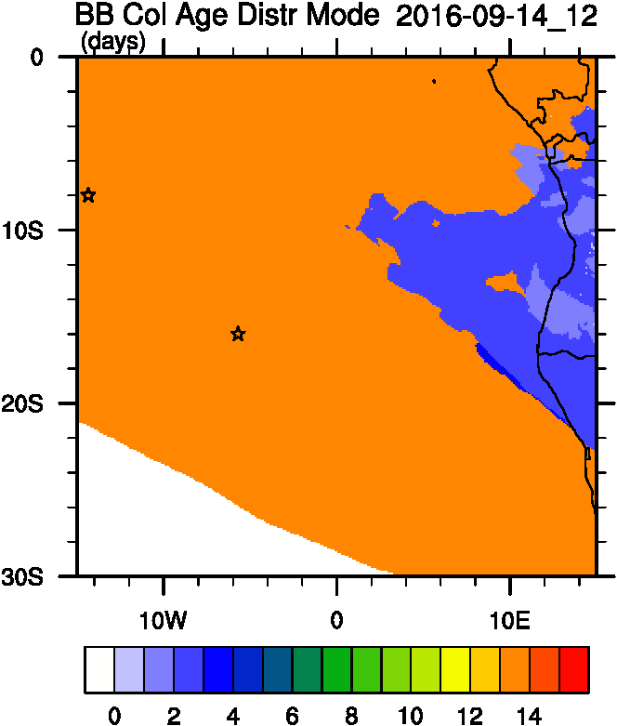
Smoke Age distribution
WRF ACAOD
Mean Age
Mode Age

Slide 16
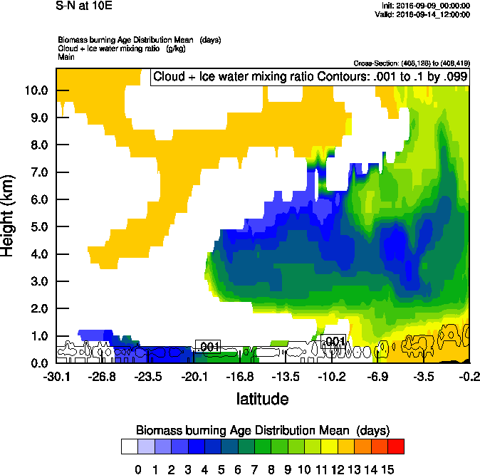
Vertical cross-section South to North
Smoke Ext WRF
Age mean
10 E

Slide 17
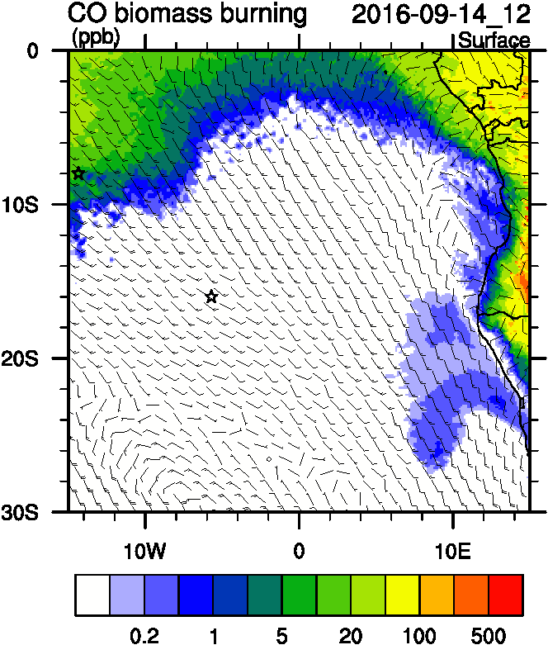
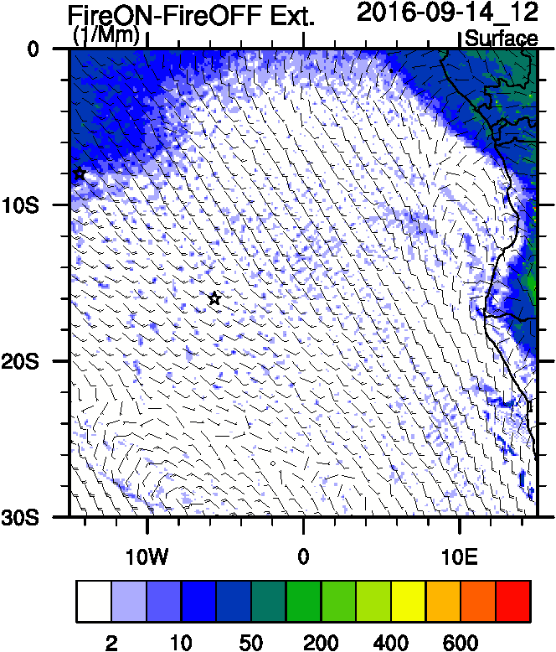
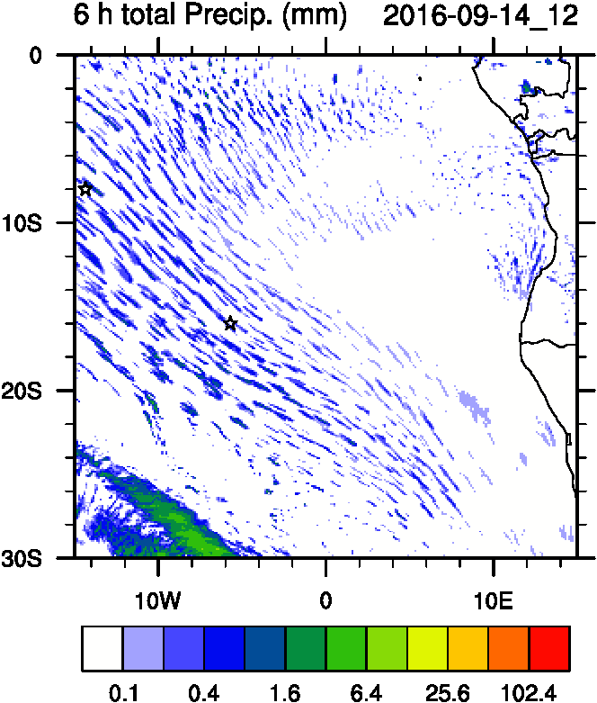
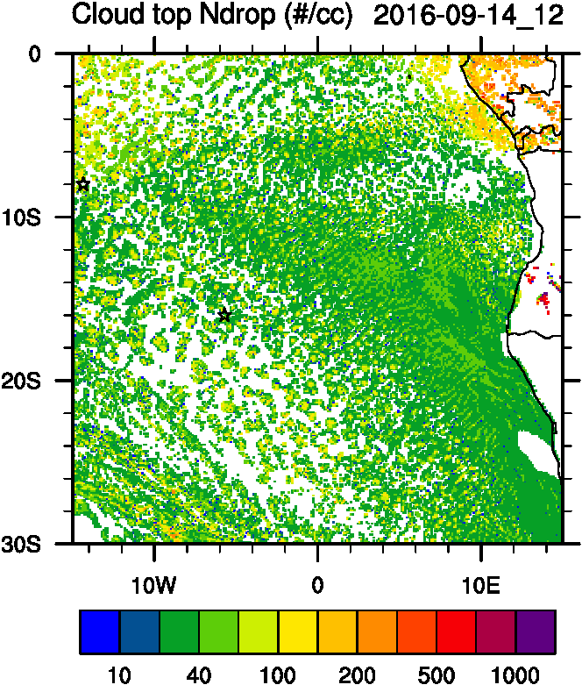
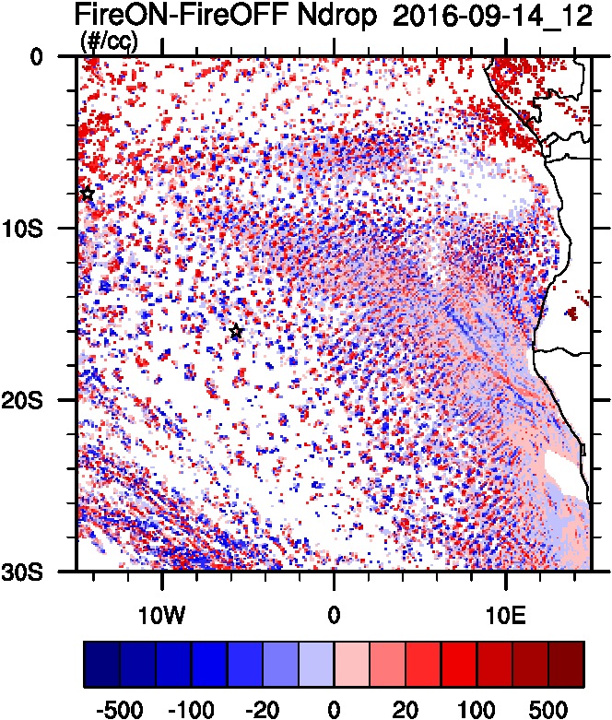
Aerosol-cloud interactions
Smoke Ext
AC AOD
tracer
Ndrop: Number droplet concentration
Diff: Differences between simulations turning on and off fires
Ndrop Diff
Precip
Ndrop

Slide 18
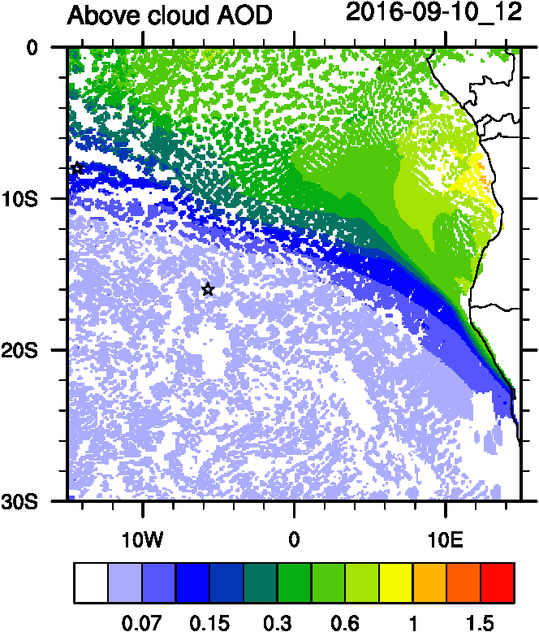
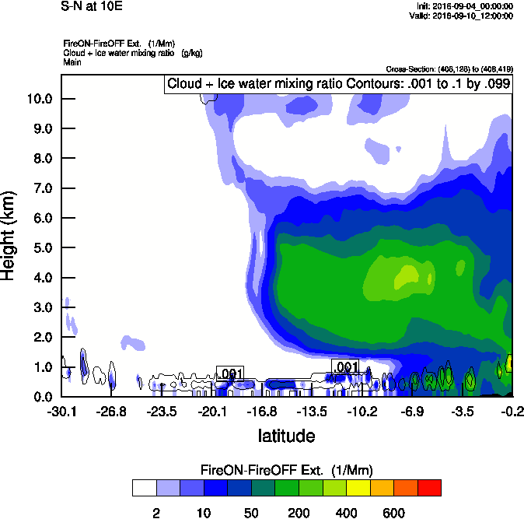
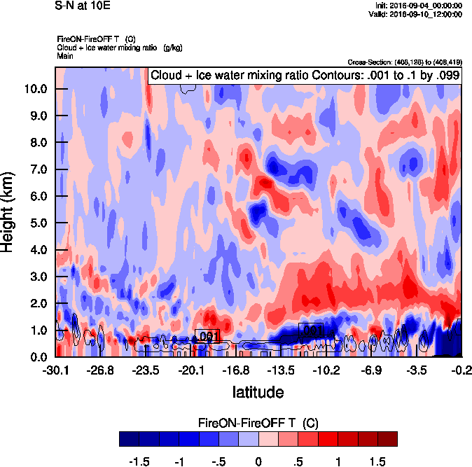
Vertical cross-section South to North
Smoke Ext WRF
T diff
10 E

Slide 19
Long term forecast

Slide 20
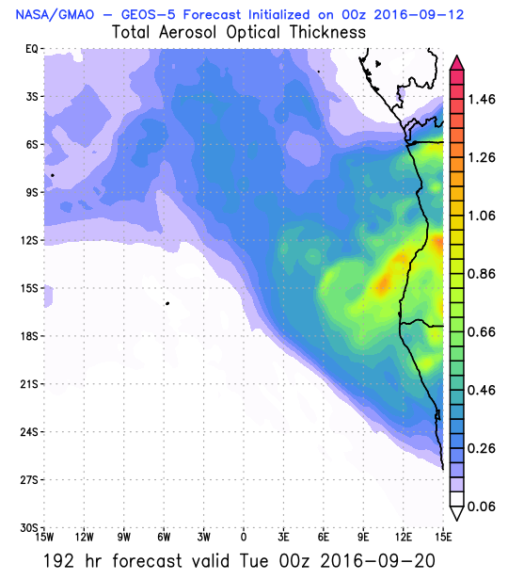
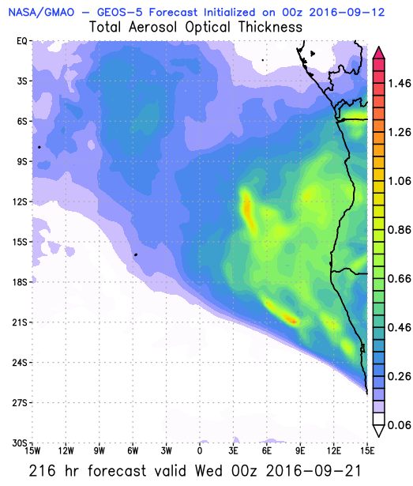
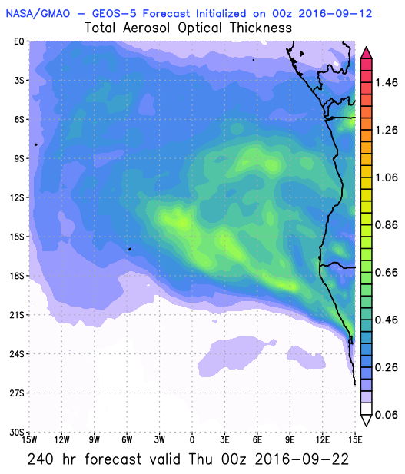
2016-09-20
Tuesday
2016-09-21
Wednesday
2016-09-22
Thursday

Slide 21
Satellite tracks

Slide 22
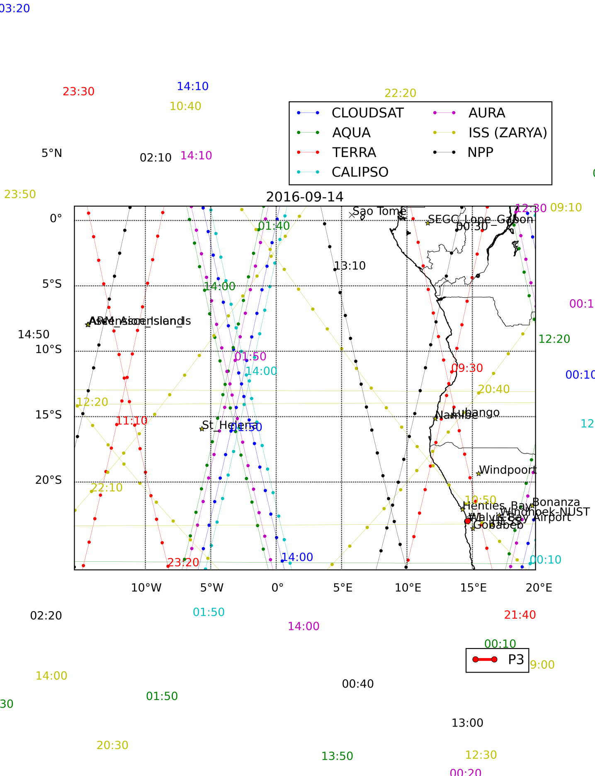
2016-09-14

Slide 23
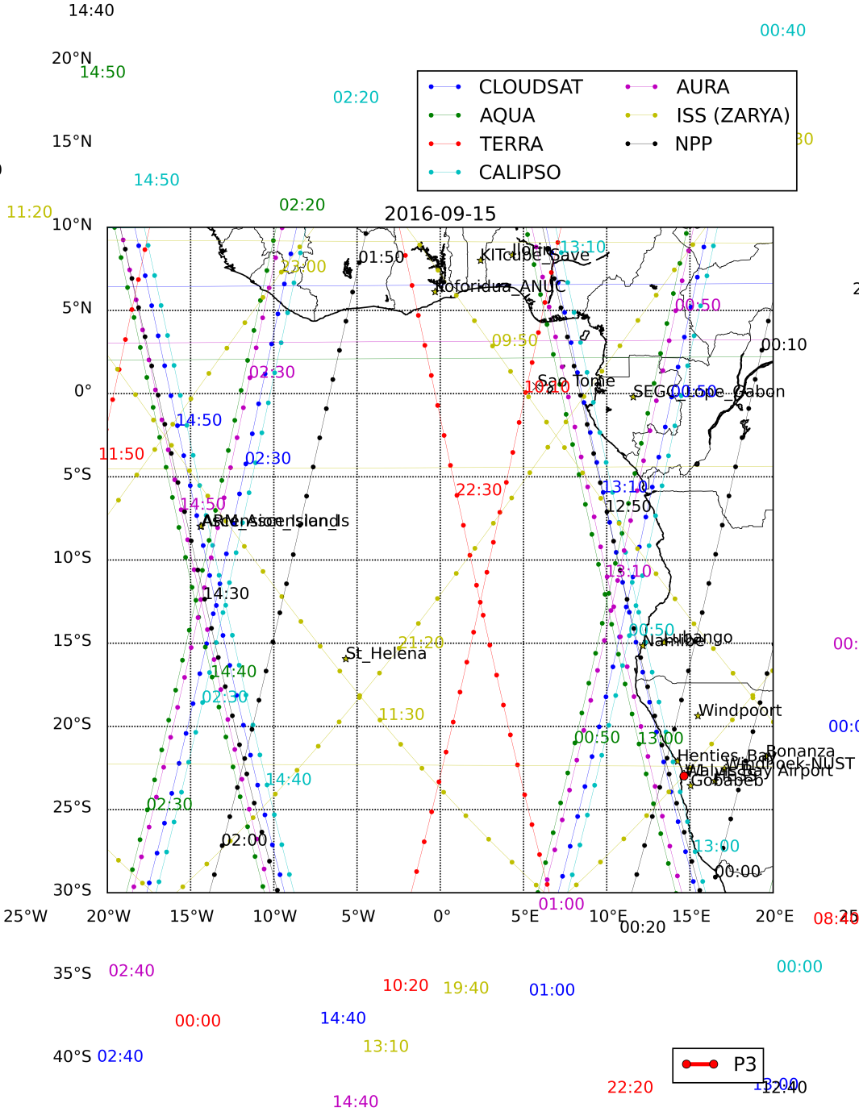
2016-09-15

