Slide 1
ORACLES forecasting briefing Meteorology for 13-09-2016 – 16-09-2016
09-12-2016
Lenny Pfister

Slide 2
Summary
Through Thursday, pressure gradient (sfc) weakens, with less subsidence and less low cloud clearing near the coast.
Influence of frontal passage on Thursday and Friday – possible weak crosswinds on landing and greater ceiling issues on both days depending on timing
High cloud is reduced as upper level trough has moved east, replaced by upper level anticyclone over SE Atlantic. This starts to break up at end of fcst period (Friday – but high clouds still minimal on Friday)
Middle clouds waning through the week.

Slide 3
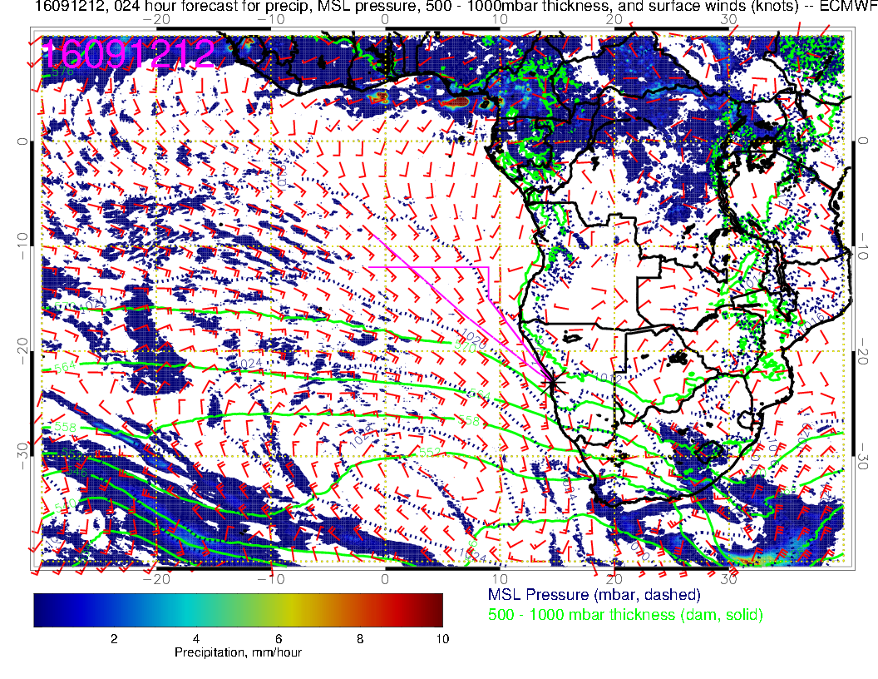
Today

Slide 4
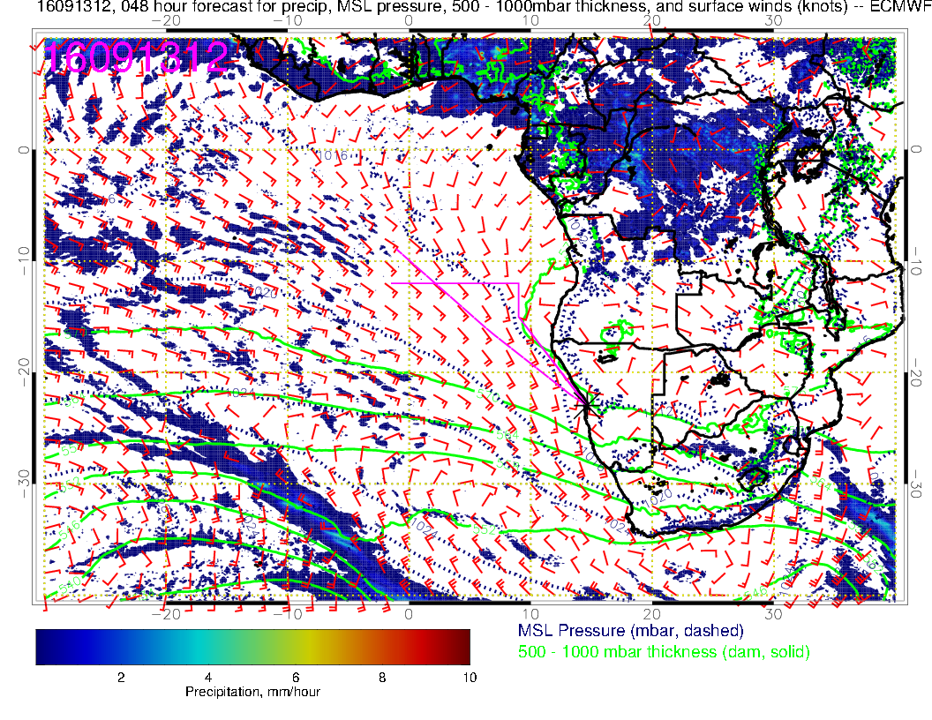
Tuesday

Slide 5
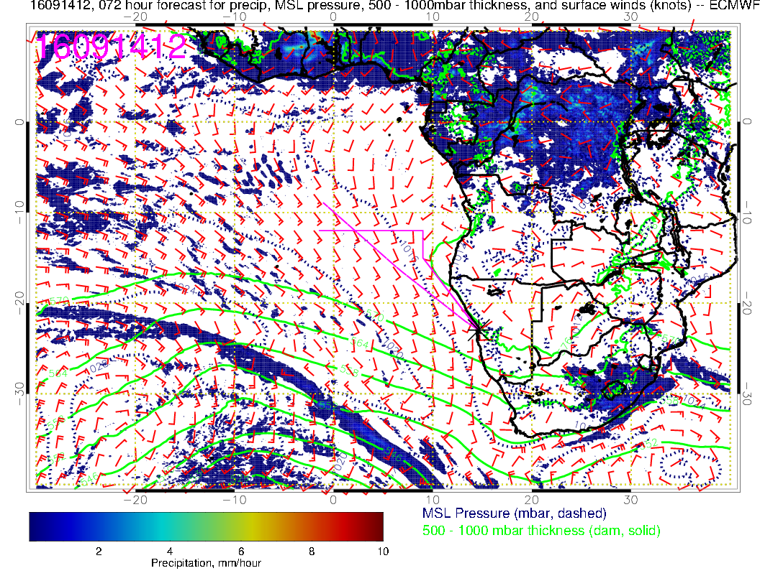
Wednesday
Note weaker pressure gradient, weaker winds, less subsidence
Cold front moving north

Slide 6
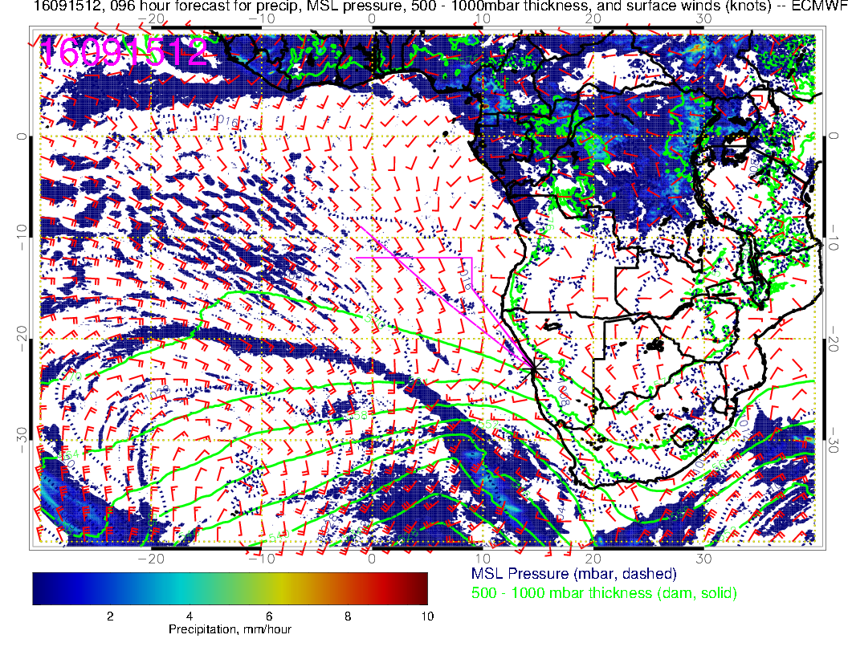
Thursday: note
cold front – impacts
size of Sc region.
Expect more low cloud
than typical at airport.
Depending on on timing
of low, might have a
bigger crosswind
component than typical.
Well under 15 knots.

Slide 7
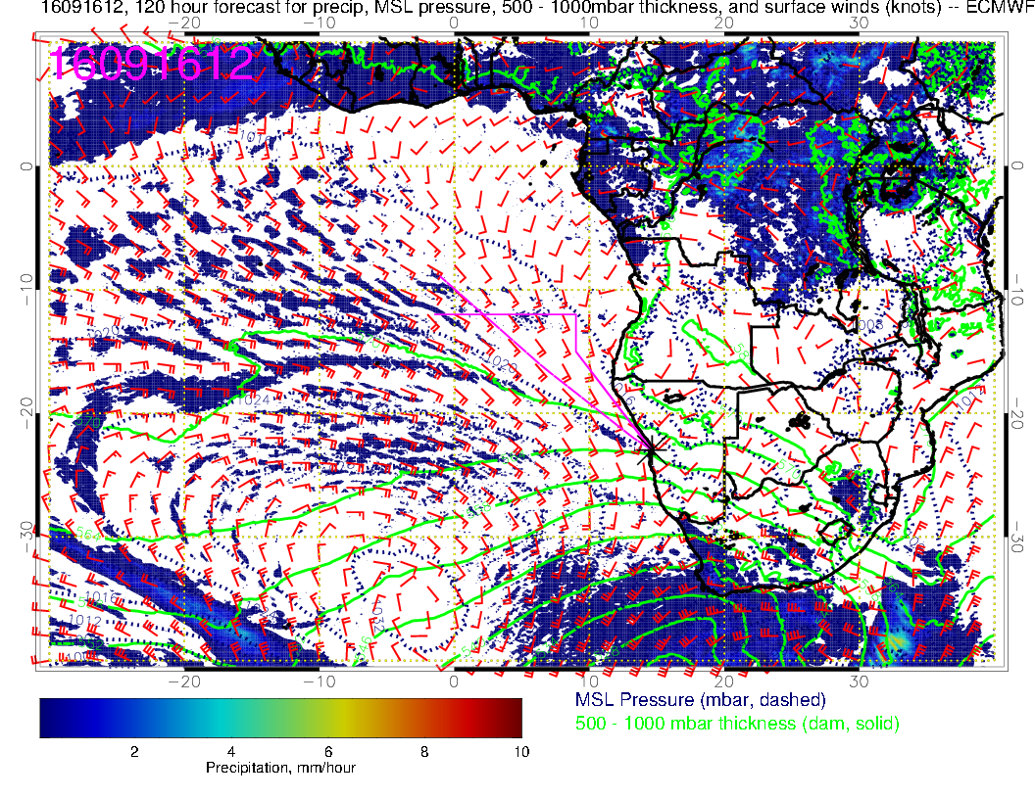
A small cyclonic distur-
bance passes over us
in the morning. Winds
weak, but depending
on timing, may create
ceiling issues.

Slide 8
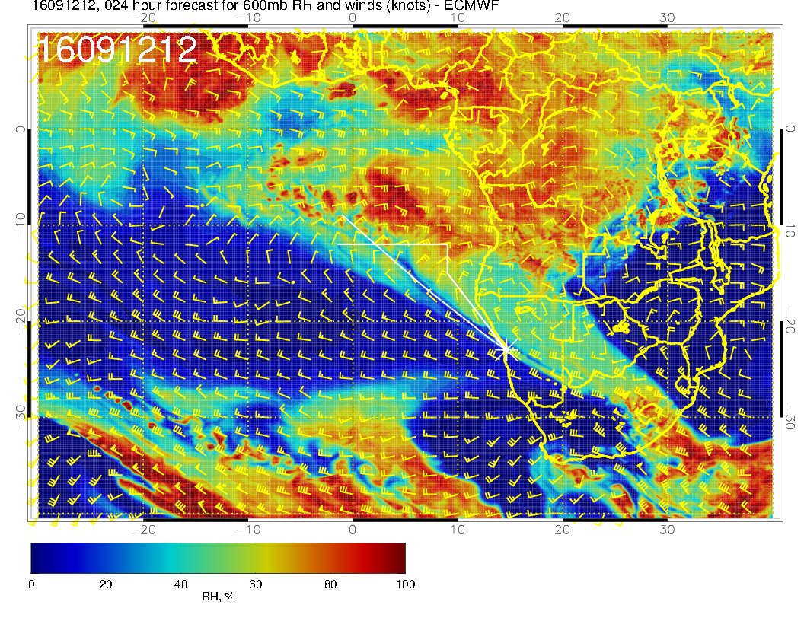
Sequence of 600mb flow. Star is climo center of 600mb anticyclone. Line represents position of anticyclone axis for each plot.
Today: high RH penetrating into our region

Slide 9
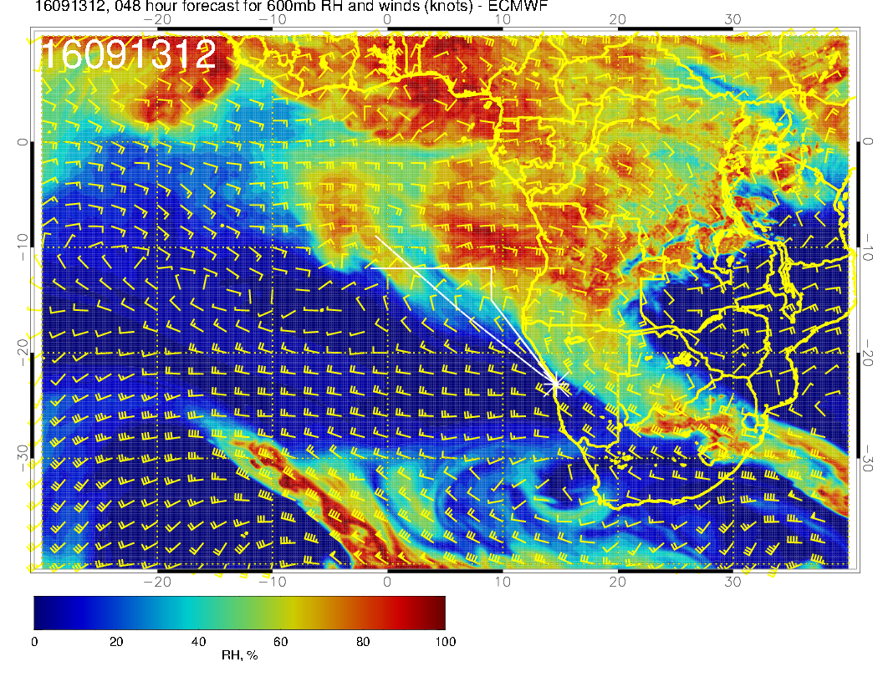
Tomorrow: I see
weaker return flow
and more straight flow into Atlantic

Slide 10
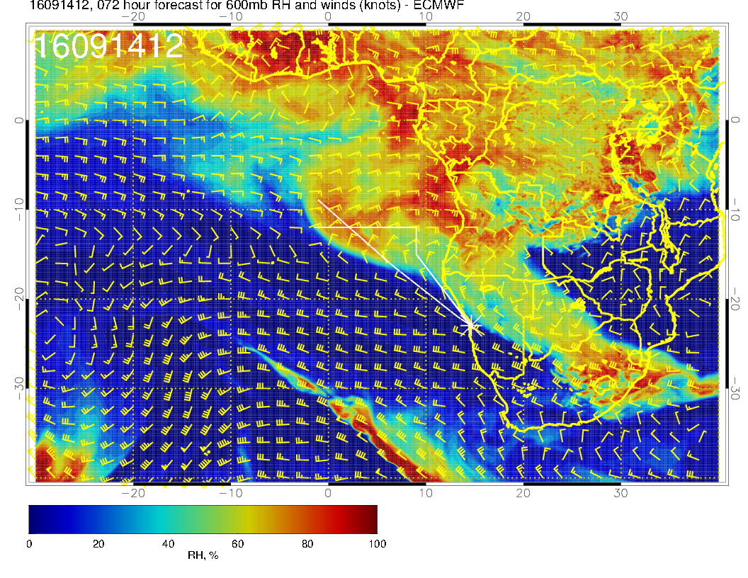
Wednesday: Turning
flow near end of routine
track – drying to 11S

Slide 11
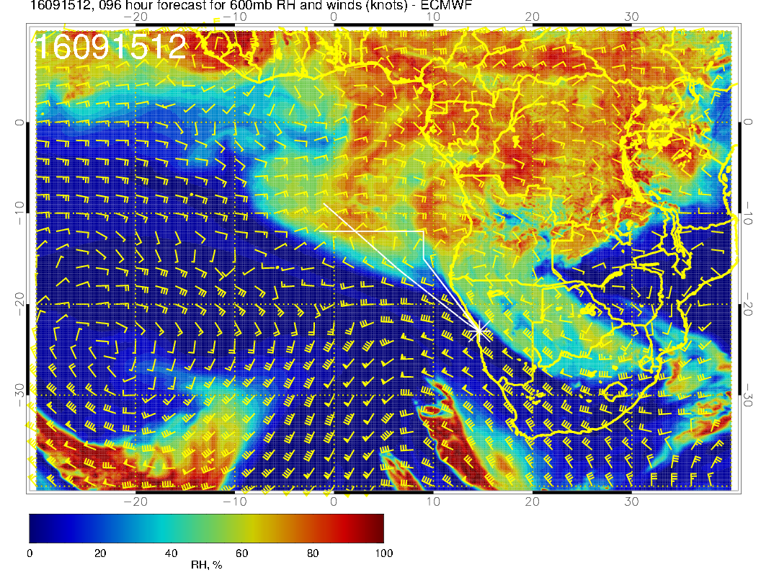
Thursday: midlatitude
trough moves in. Return flow appears weak

Slide 12
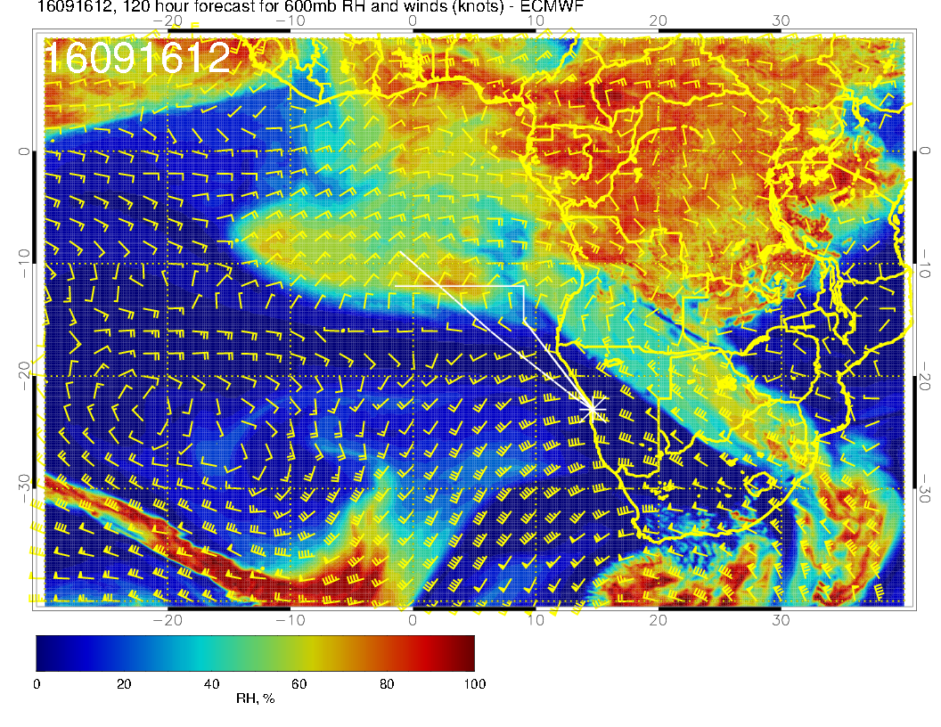
Friday: Midlatitude Trough deepens. Anticyclone has broken up or moved NWwrd. Return flow developing west of greenwich.

Slide 13
Upper trop

Slide 14
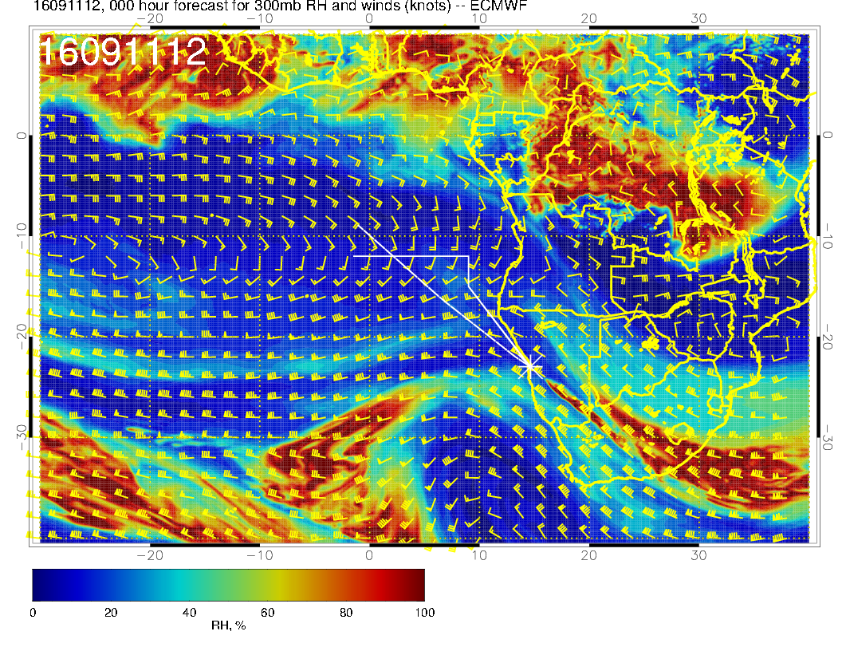
Yesterday, trough
over us gave us
some jet stream
cirrus

Slide 15
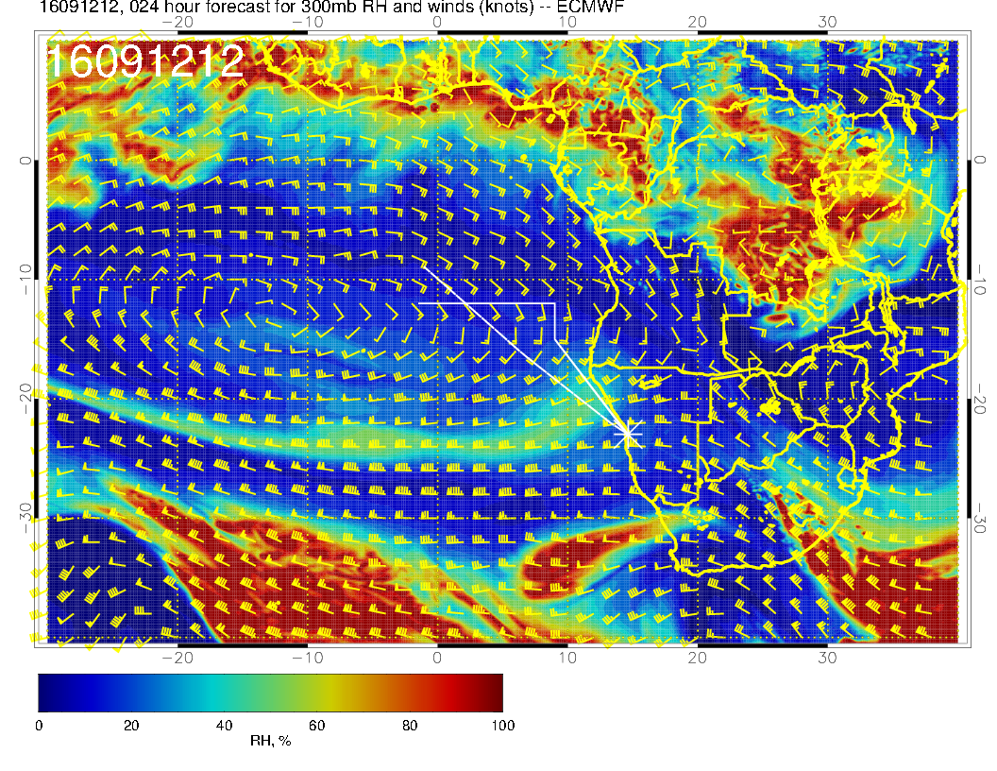
Trough passed to
east today, anticyclonic
circulation, cirrus not
expected

Slide 16
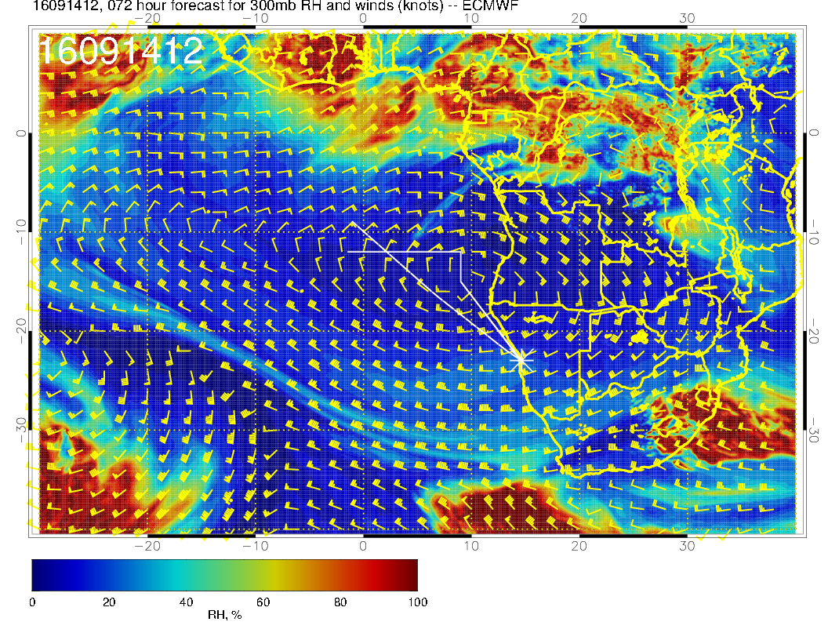
Strong anticyclone at
upper levels in our
area

Slide 17
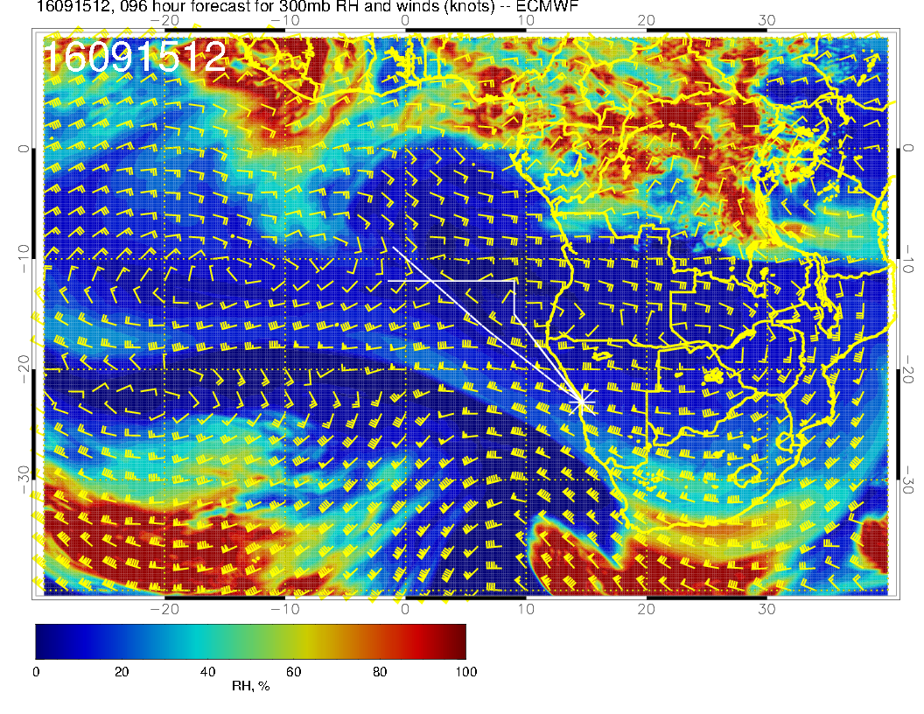
New trough moves
in. Not deep enough
to produce cirrus
in our area.

Slide 18
High clouds

Slide 19
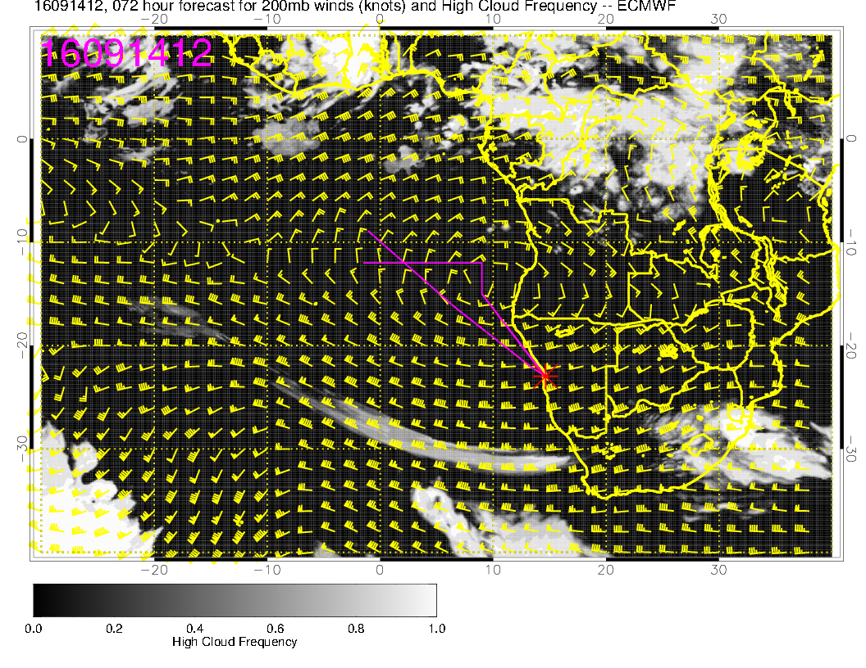
Large anticyclone
at 200mb keeps high
cirrus out of our area
for most of the week

Slide 20
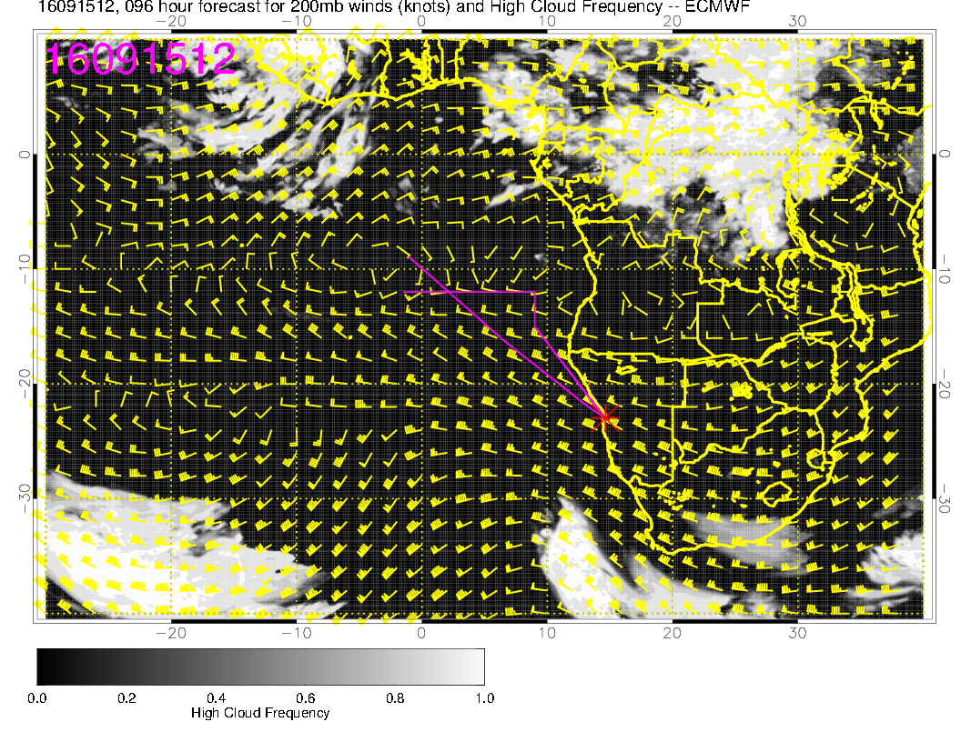
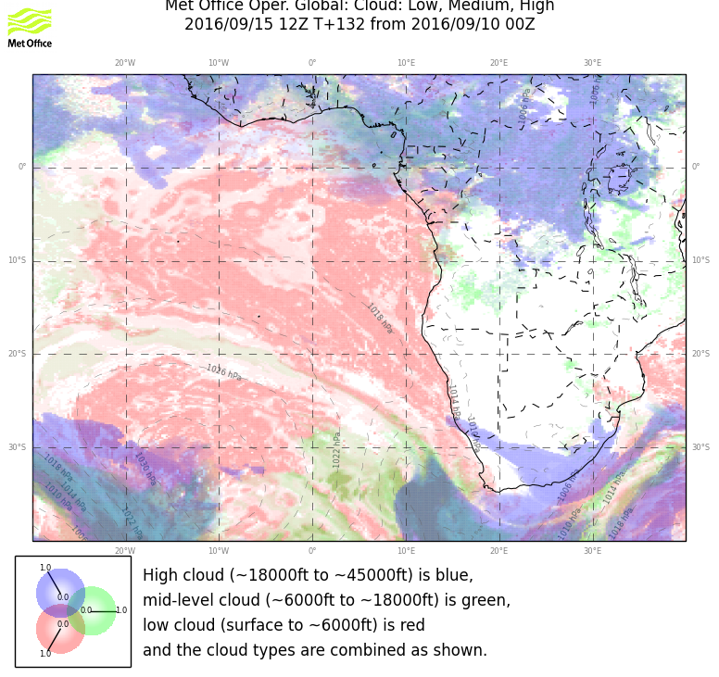
Cirrus associated with trough, but no moisture source in our area.

Slide 21
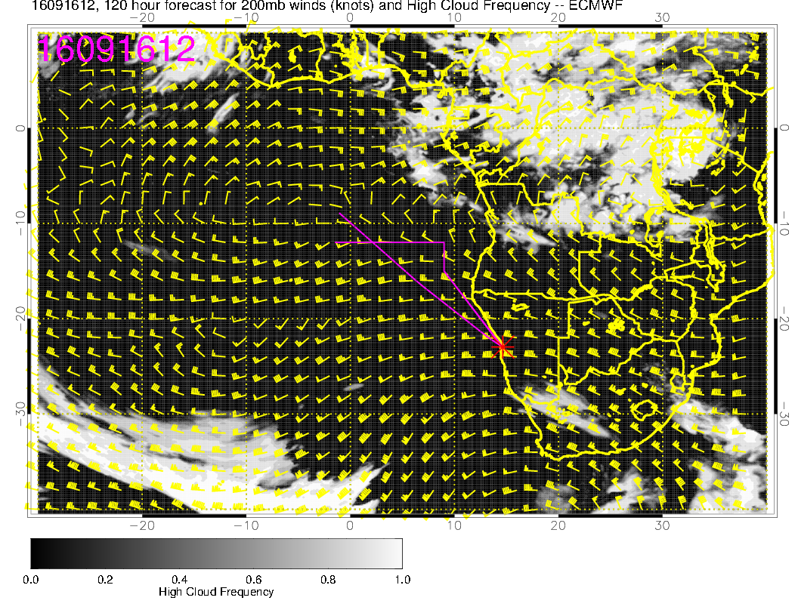
Anticyclone starts to
break up at end of
forecast period

Slide 22
Mid level clouds

Slide 23
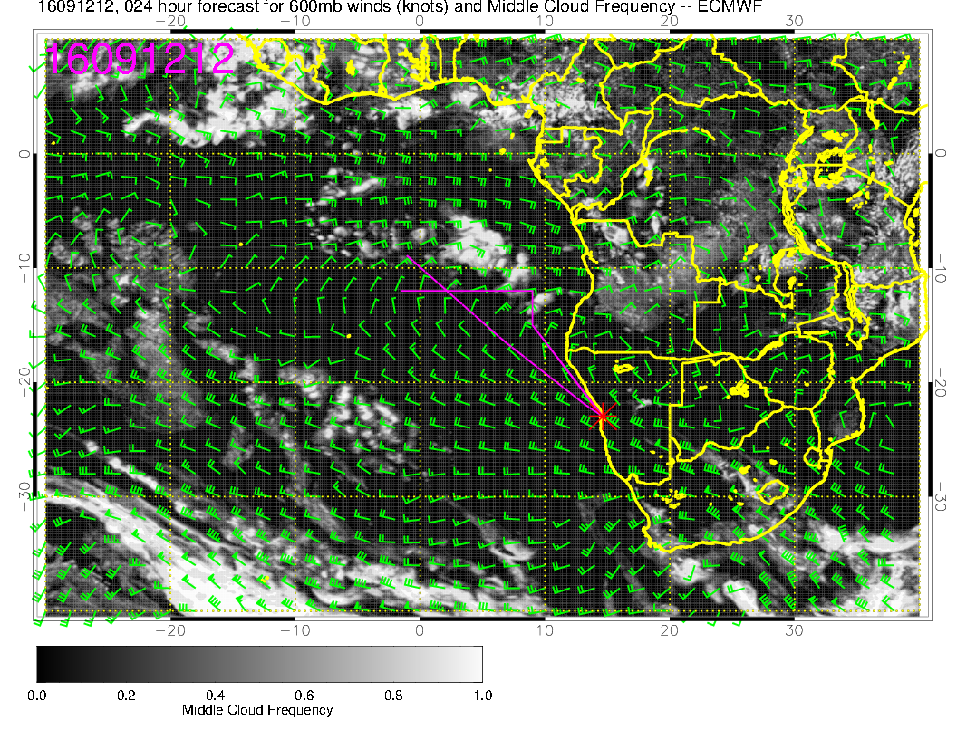

Slide 24
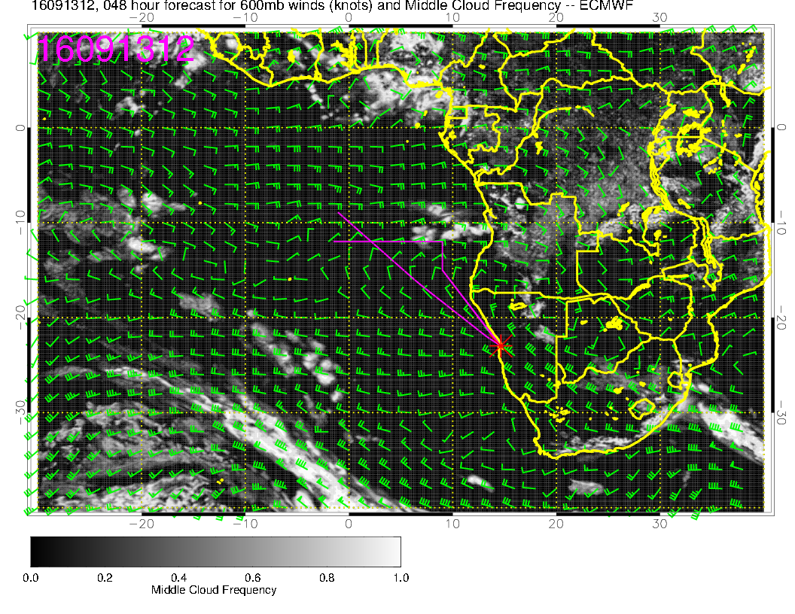

Slide 25
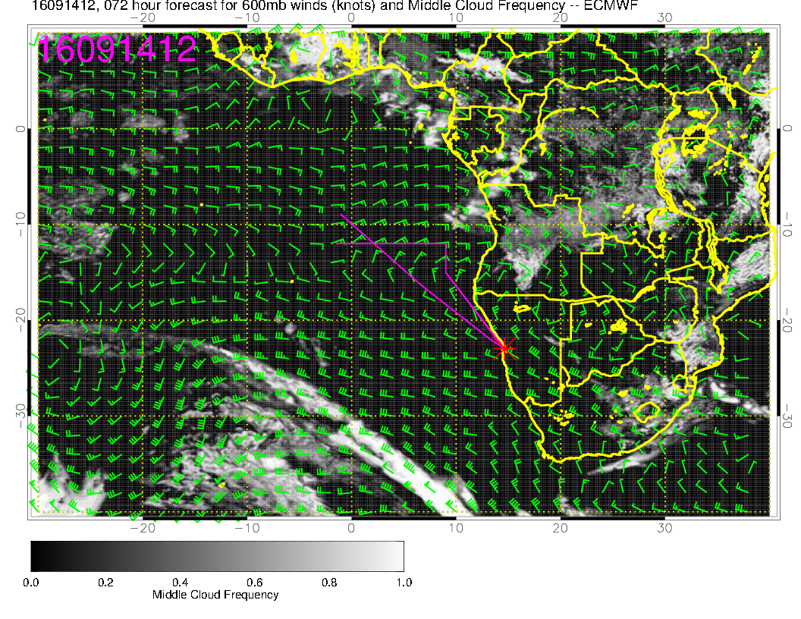

Slide 26
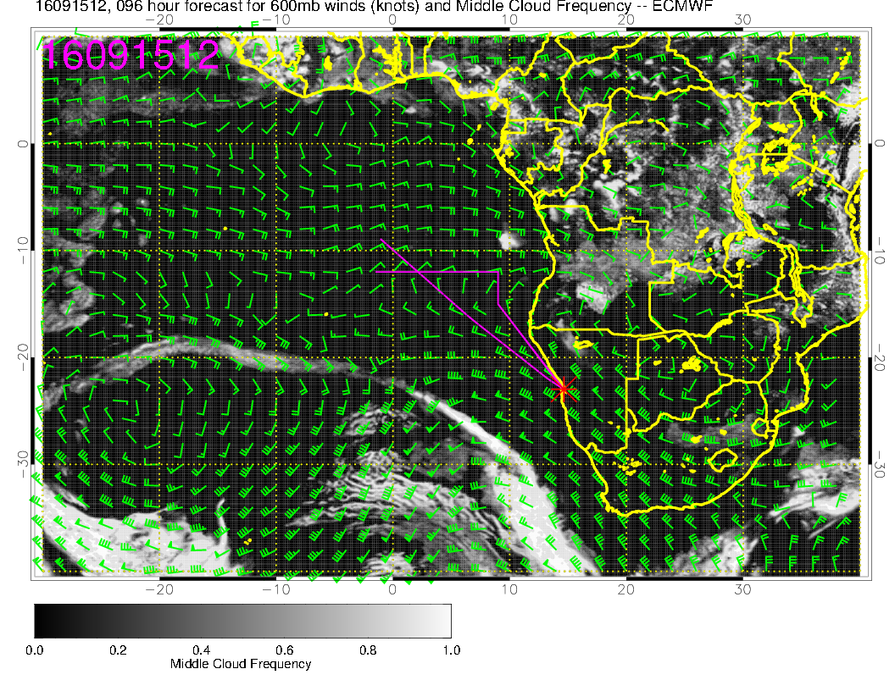

Slide 27
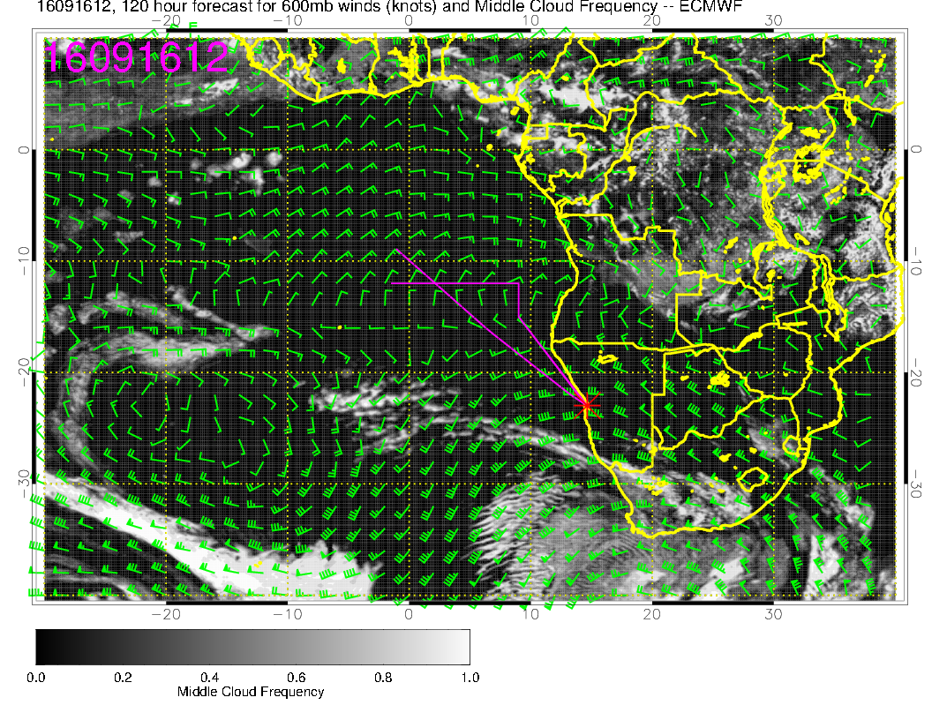

Slide 28
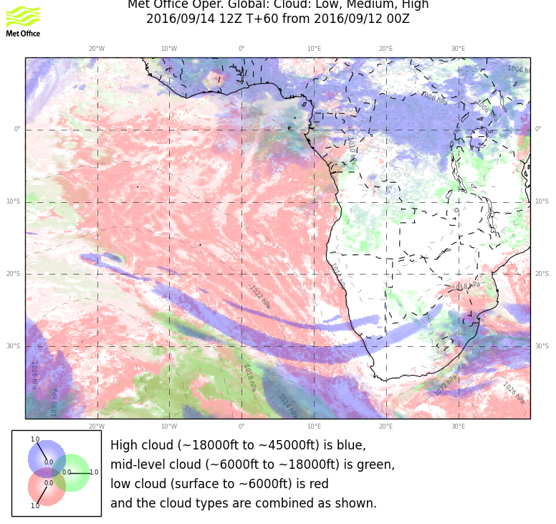
Wednesday some high-middle cloud north of 10S.

Slide 29
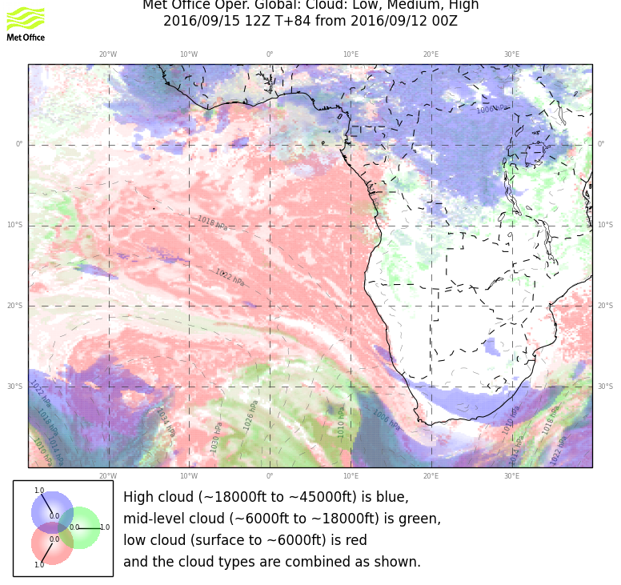
Thursday: Everything is either north of 10 or east of 20.

Slide 30
Low Clouds

Slide 31
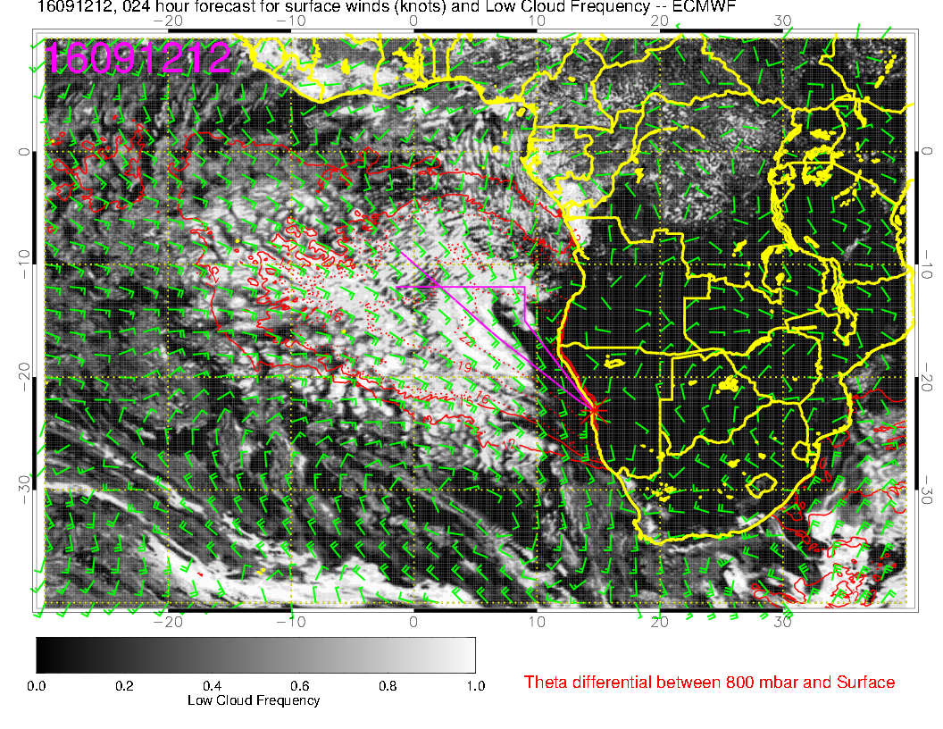
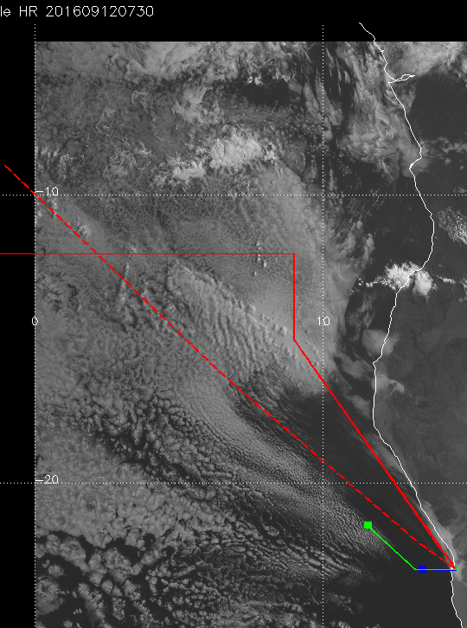
Today, fair amount of clearing

Slide 32
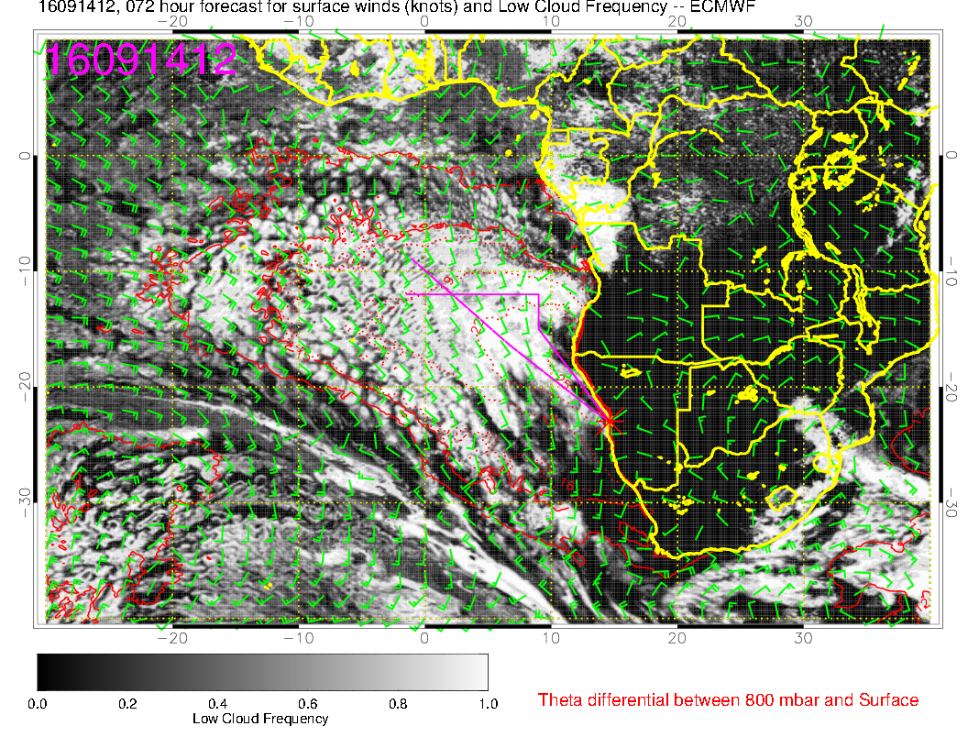
Less clearing on Wednesday

Slide 33
