Slide 1
ORACLES forecasting briefing Meteorology for 12-09-2016
09-12-2016
Lenny Pfister

Slide 2
Summary
Middle cloud behavior similar to flight of 20160910.
At early morning hours attm, show a bank of mid level cloud in all flight regions.
Both model forecasts are quite decent in getting this feature (EC arguably better) this AM.
Consistent with diurnal cycle we saw on 9/10, cloud is expected to wane by later in the day.
Will still occupy plan a and b region, but not routine region.
Expect clear opportunities in “center” of plume for ER-2
Forecasts for next two days are stable – show waning middle cloud
Airport weather – light winds this morning, overcast, adequate ceilings. PM winds higher than usual, about 20 knots down the runway.

Slide 3
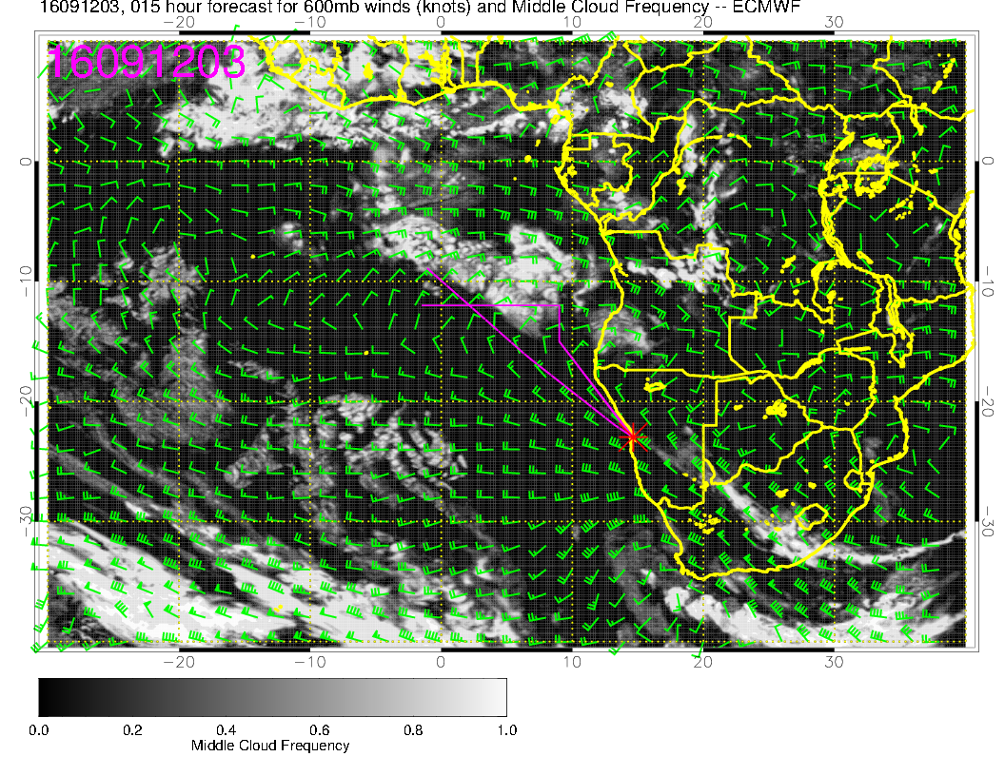
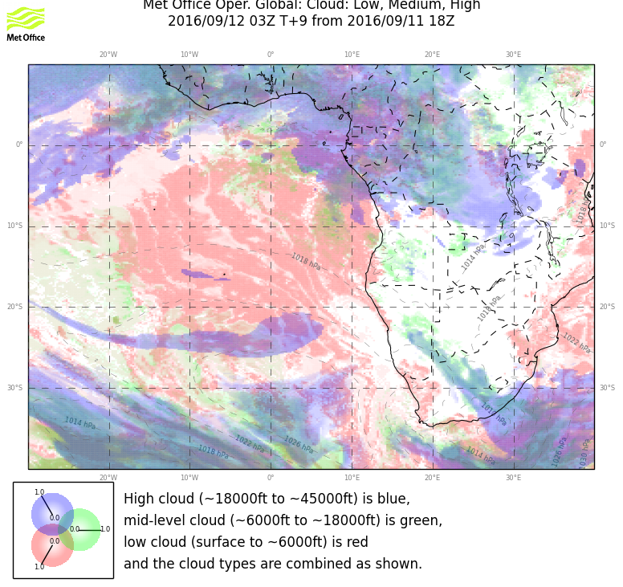
Forecast for now

Slide 4
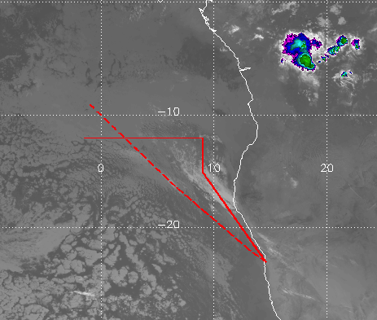
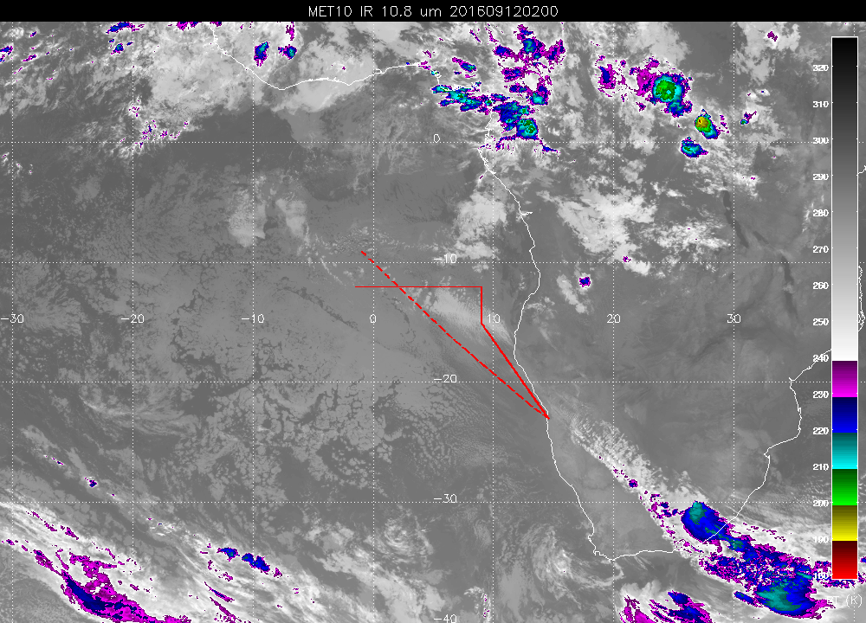
Sep 10, 3Z
Imagery for now (right) and Sep 10 at same time

Slide 5
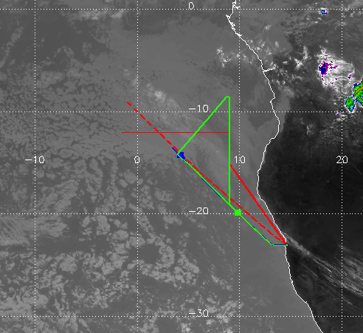
Sep 10, 12Z
Sep 10 at 12Z.
Clearly waning middle cloud
UKMO missed this whole thing,
EC misclassified as high cloud

Slide 7
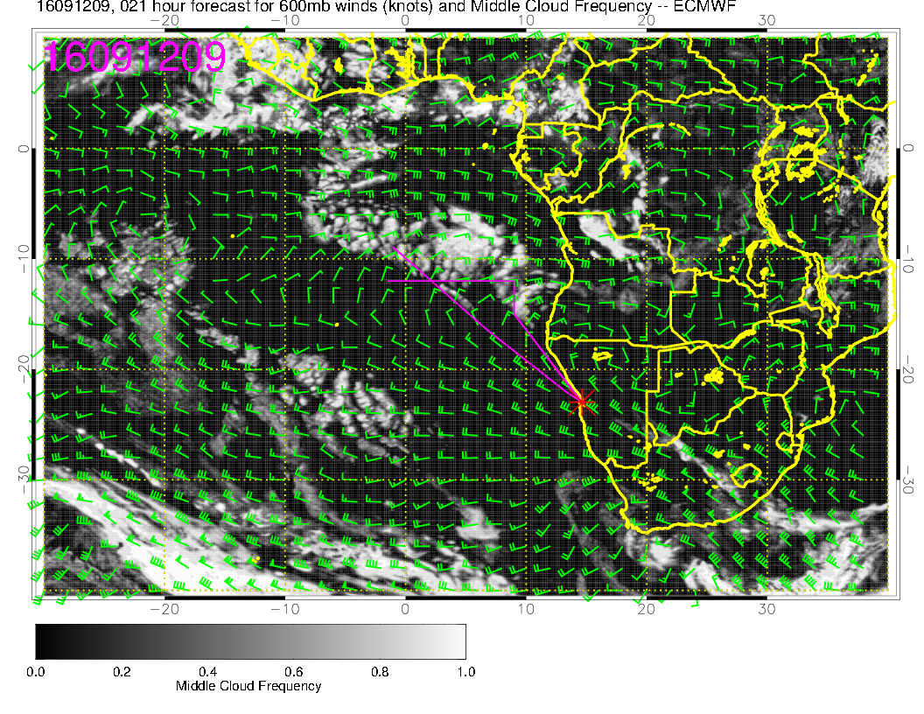
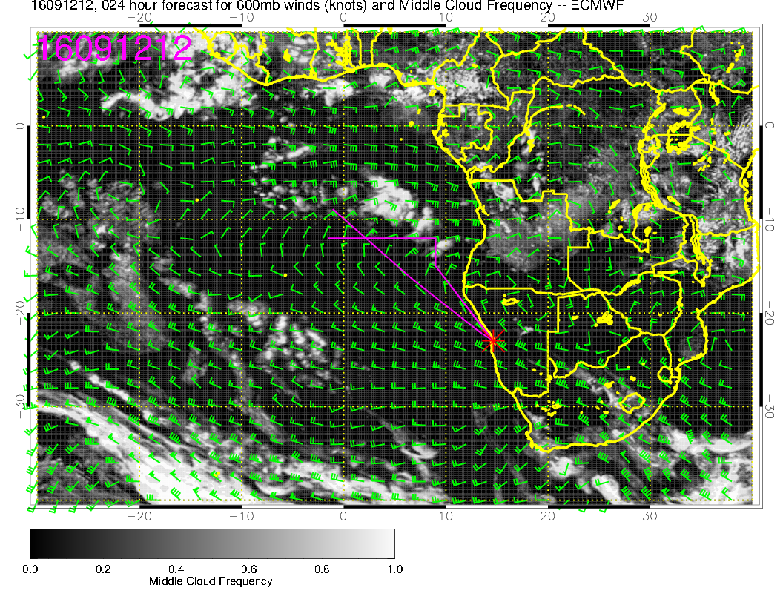
Forecasts for 11 AM and 2 PM local

Slide 8
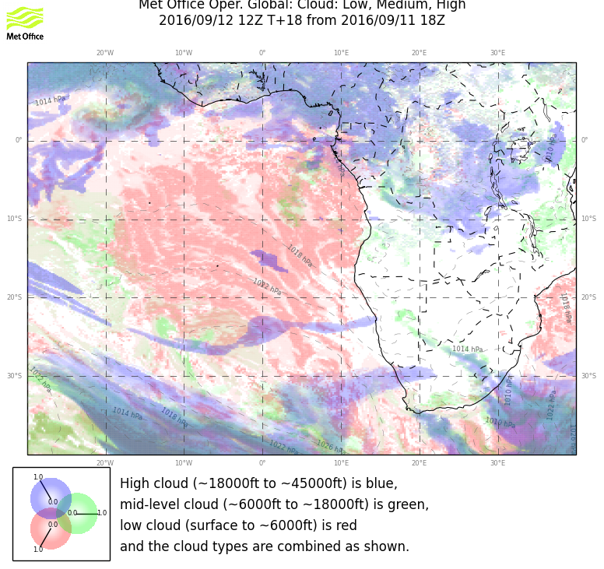
UKMO also shows a bit
just south of 10S.
This model tends to underpredict
the middle cloud.

Slide 9
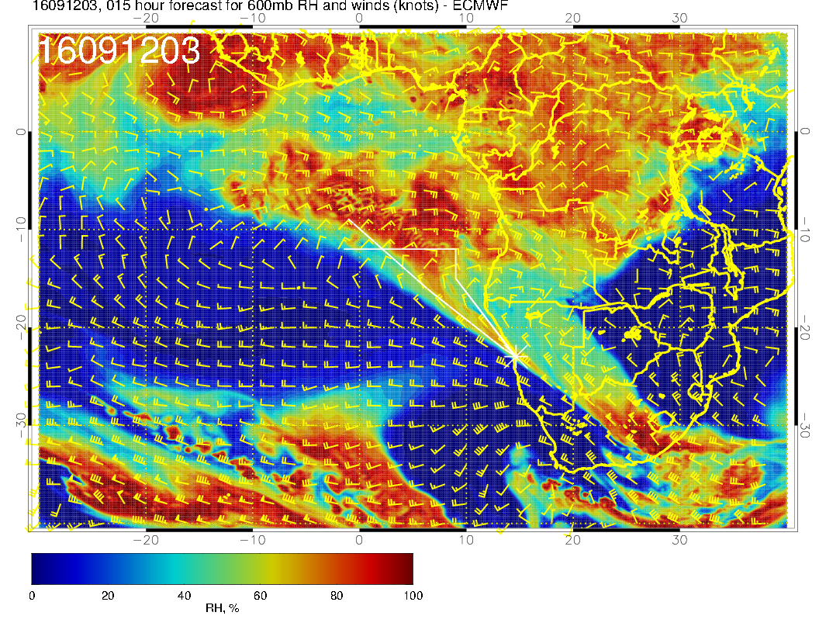

Slide 10
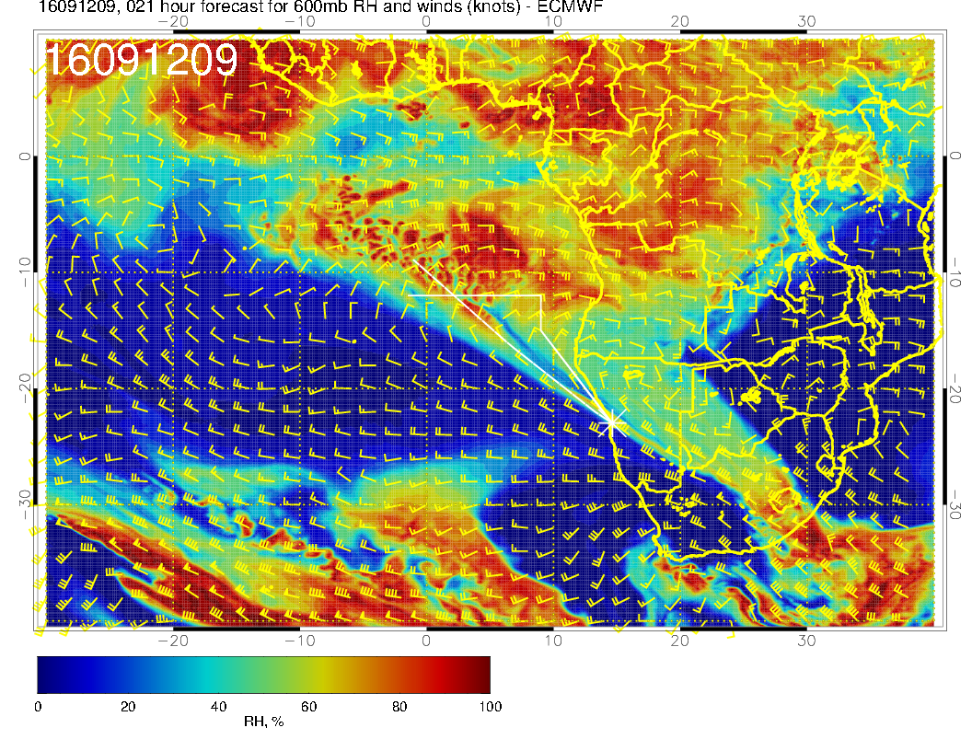
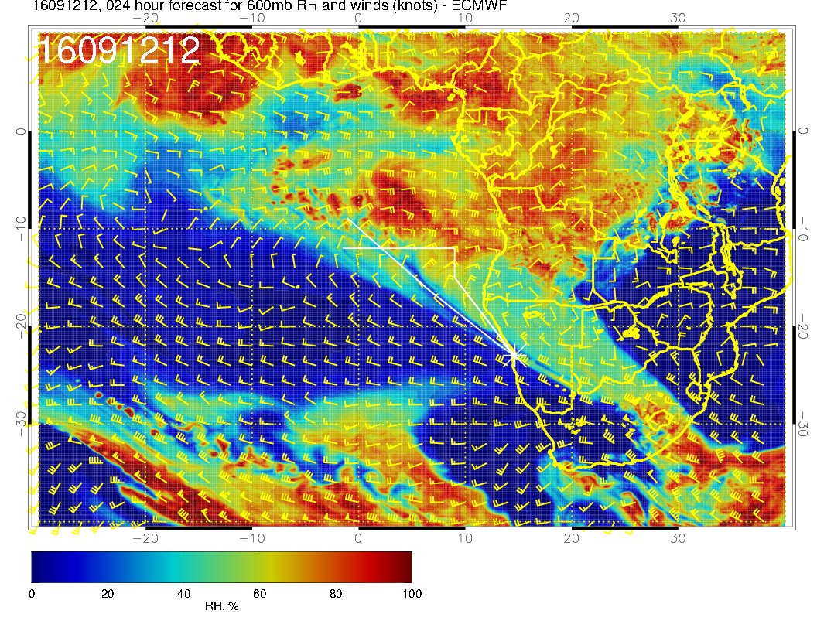

Slide 11
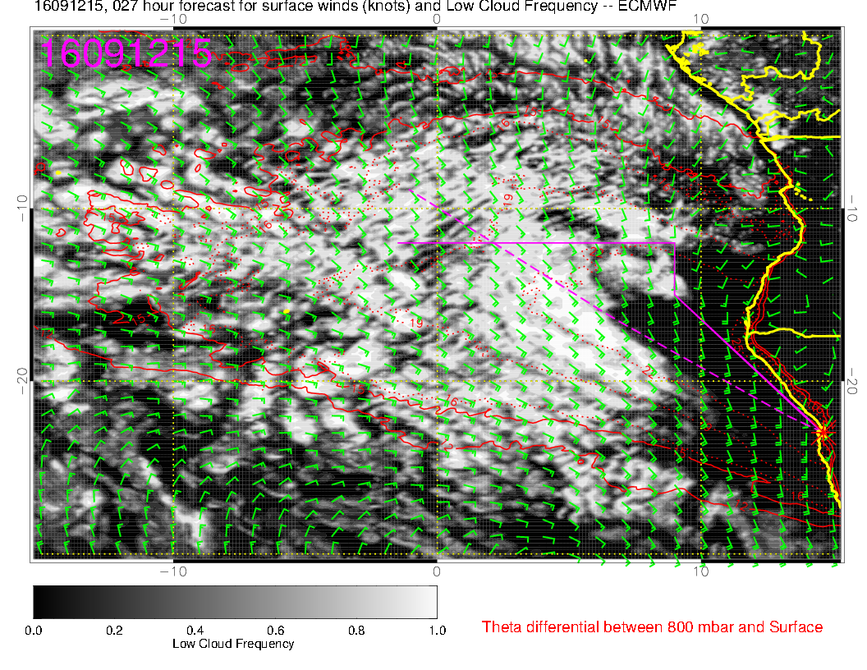
Low cloud forecast
is stable

Slide 12
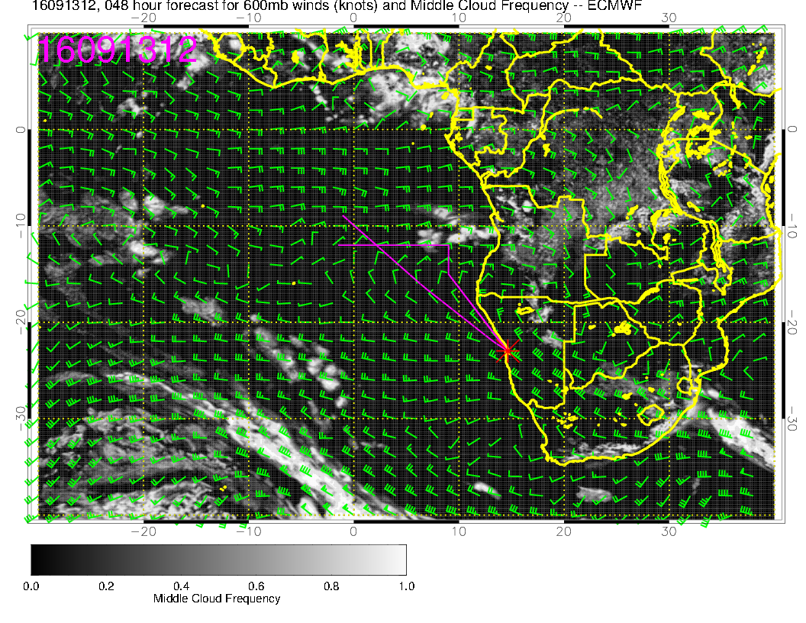

Slide 13
