Slide 1
ORACLES forecasting Briefing Aerosols
08-09-2016

Slide 2
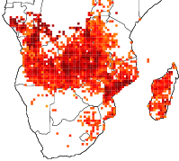
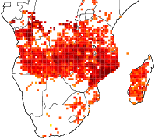
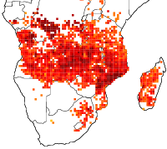
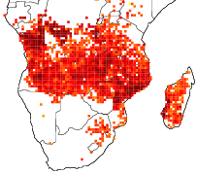
Biomass burning emissions (FINN) evolution
2016-09-07
2016-09-08
2016-09-09
2016-09-10

Slide 3
Sept 11 2016 (model evaluation)

Slide 4
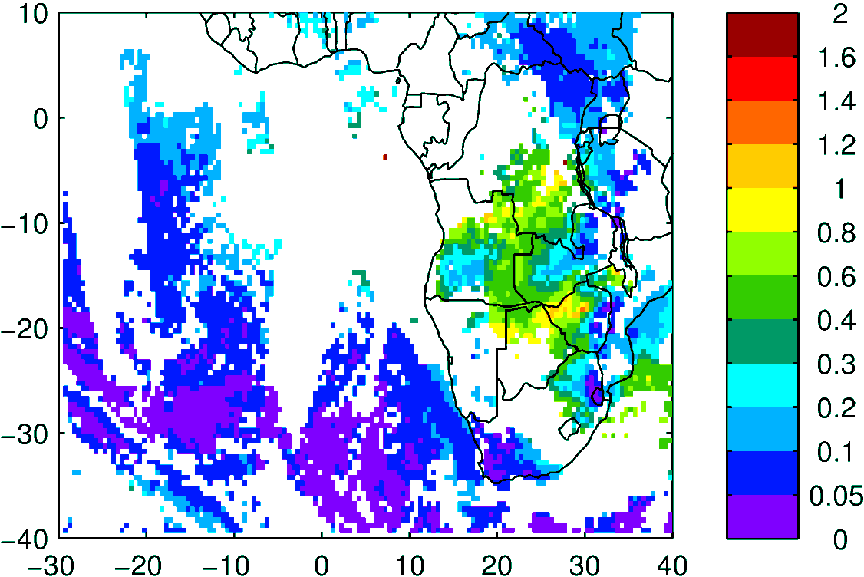
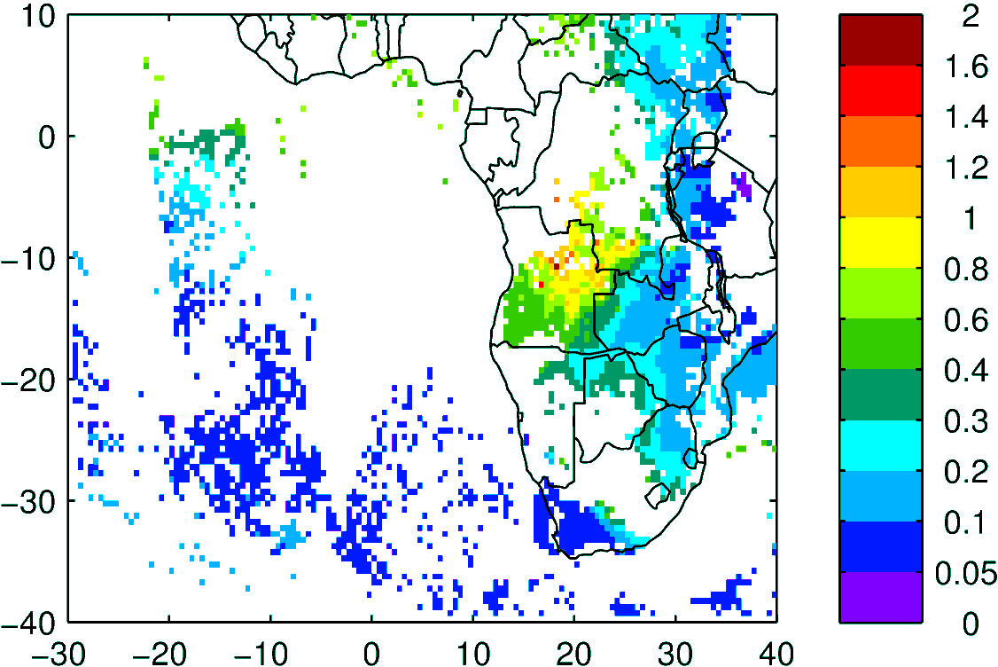
Terra & Aqua AOD (clear-sky)
MODIS NNR
WRF-AAM

Slide 5
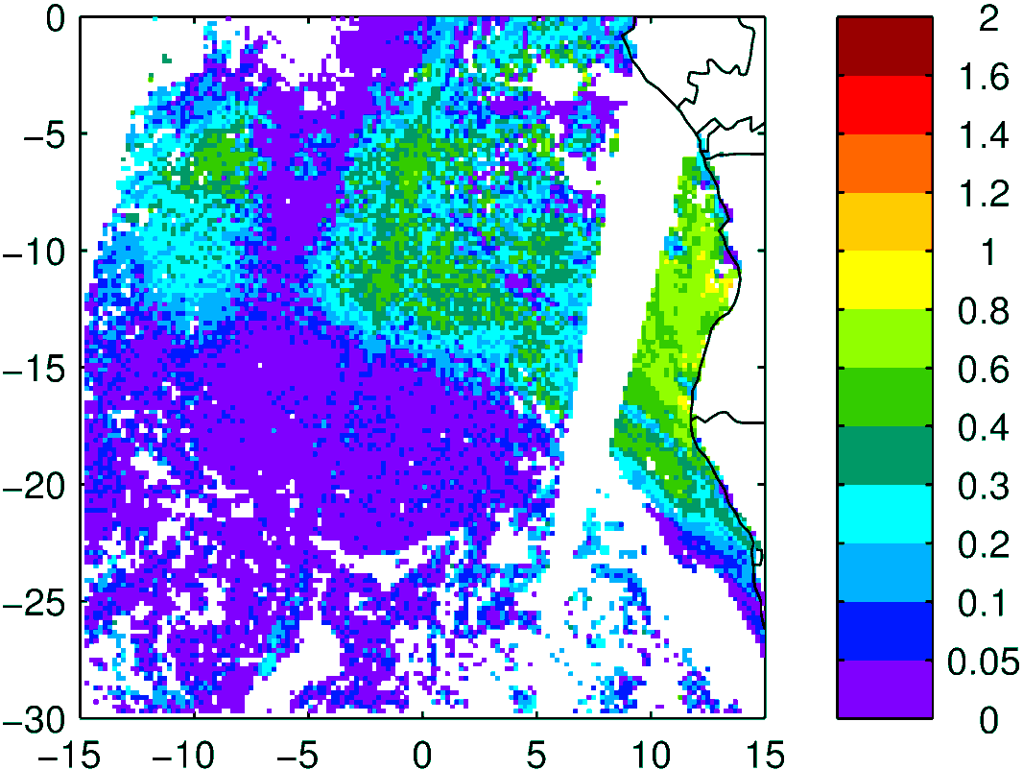
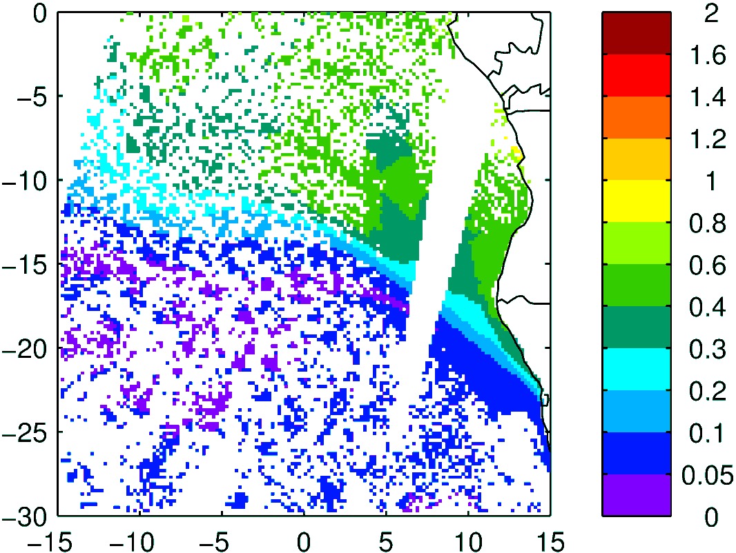
Above Cloud AOD
Observation
Model (WRF-AAM)
Terra

Slide 6
Sept 12 2016

Slide 7
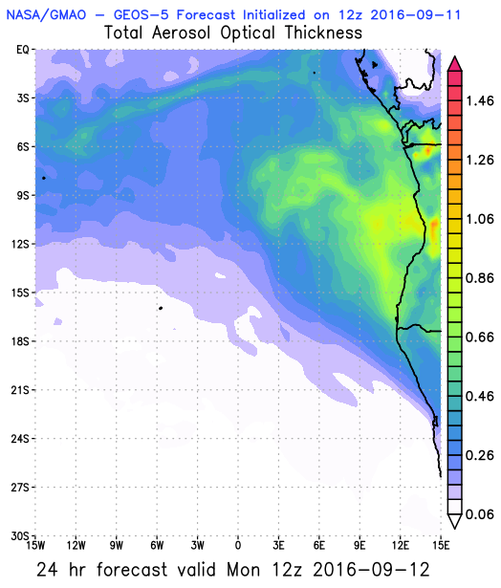
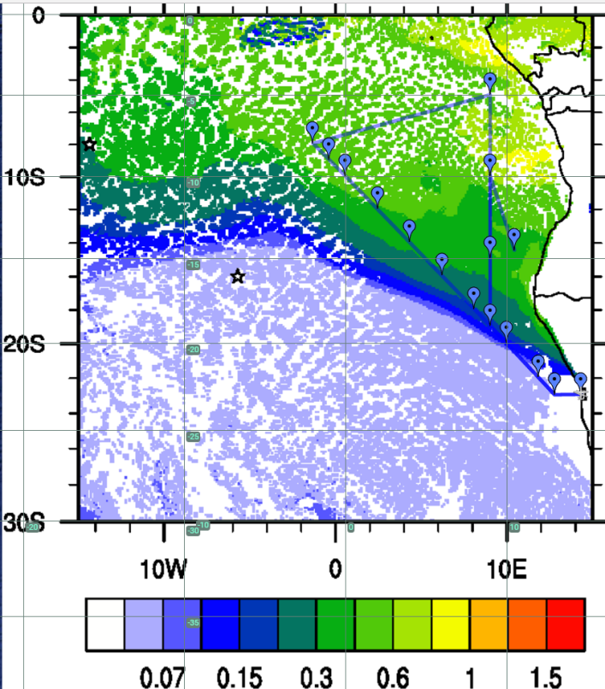
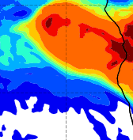
AOD 12 UTC
WRF
CAMS
GEOS5

Slide 8
Sept 13 2016

Slide 9
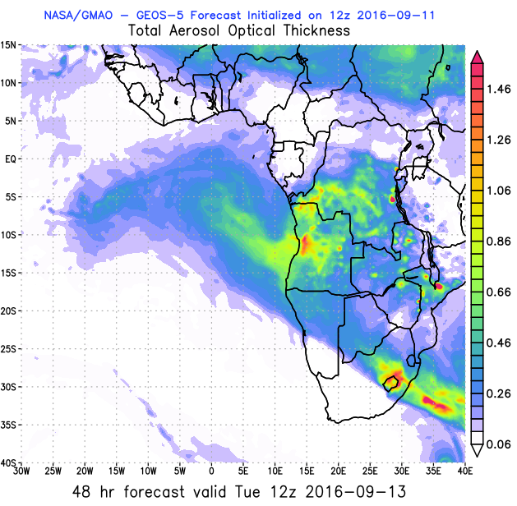
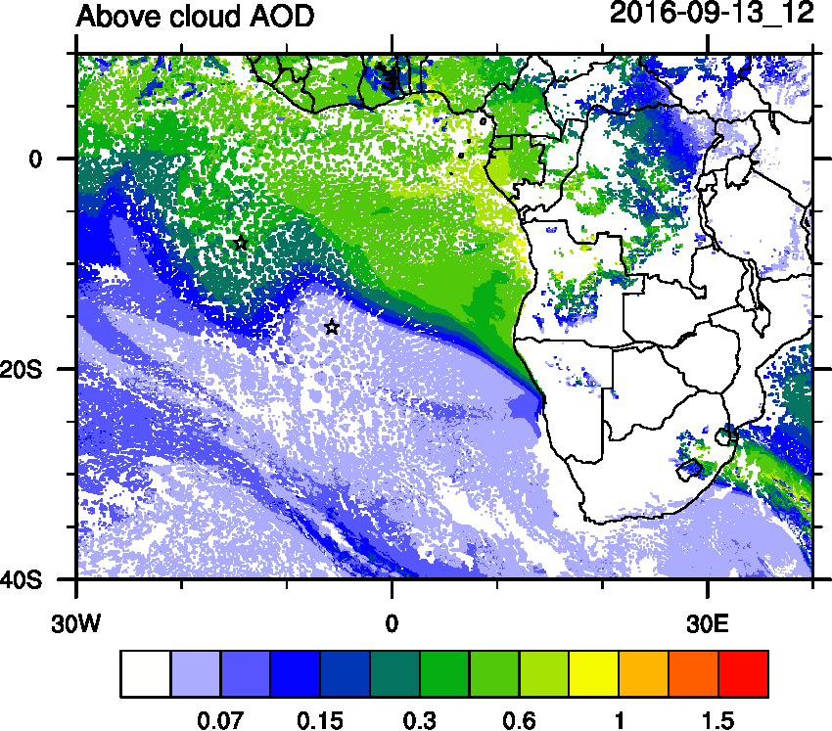
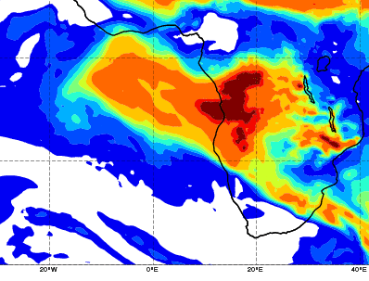
AOD 12 UTC
WRF
GEOS5
CAMS

Slide 10
Sept 14 2016

Slide 11
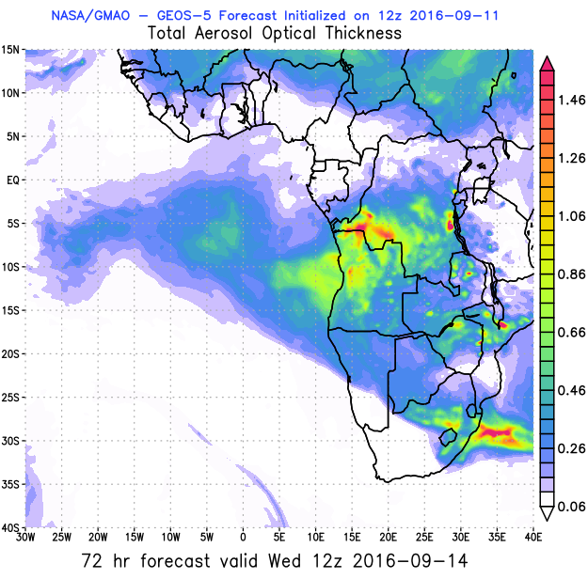
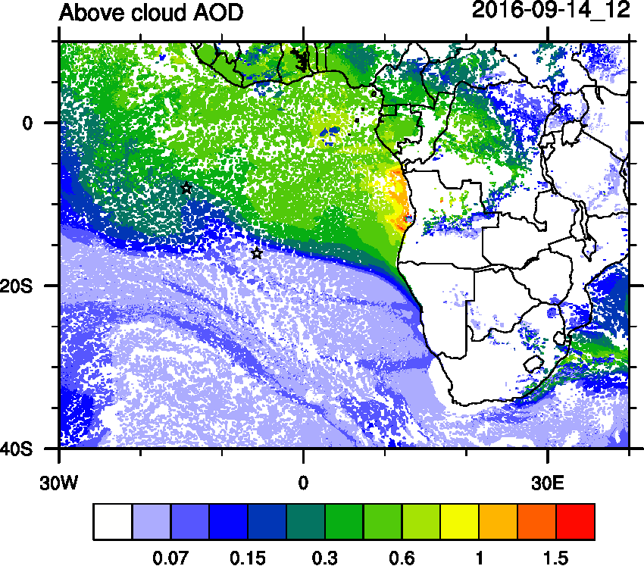
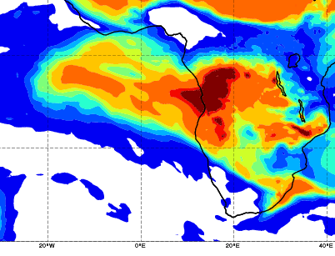
AOD 12 UTC
WRF
GEOS5
CAMS

Slide 12
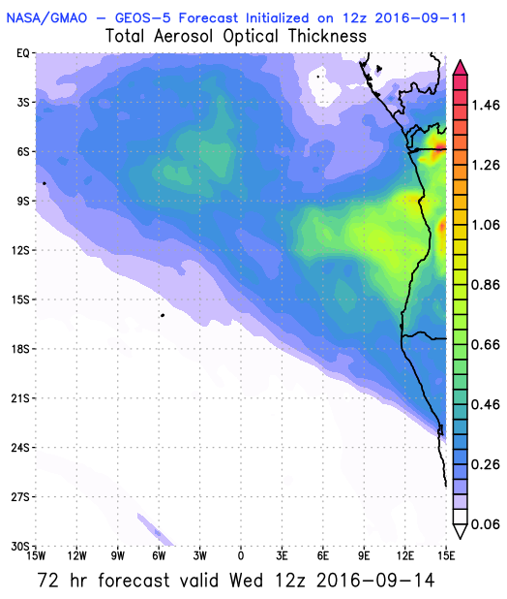
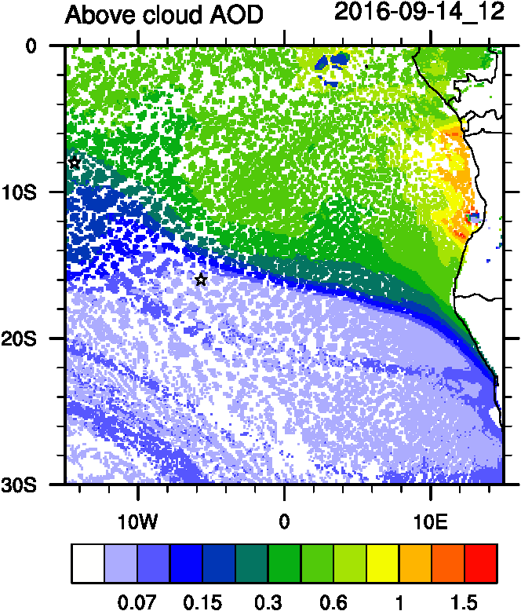
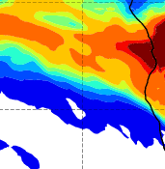
AOD 12 UTC
WRF ACAOD
GEOS5
CAMS

Slide 13
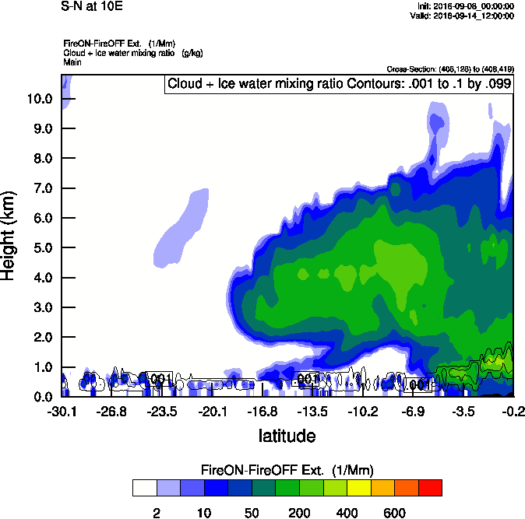
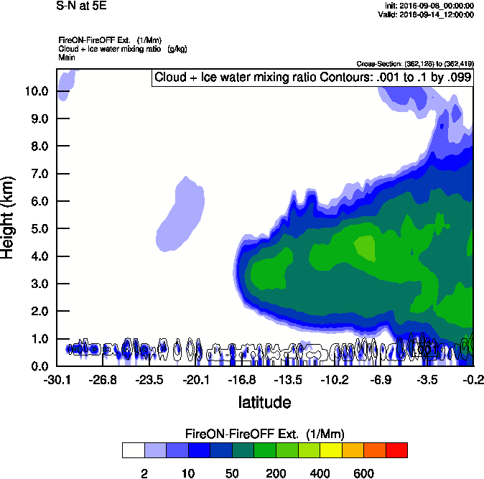
Vertical cross-section South to North
Smoke Ext WRF
Smoke Ext WRF
10 E
5 E

Slide 14
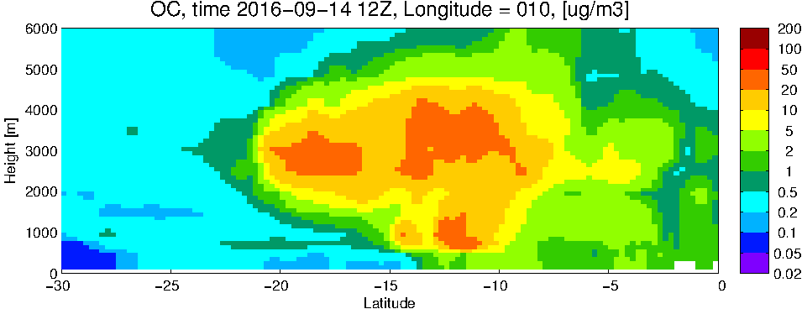
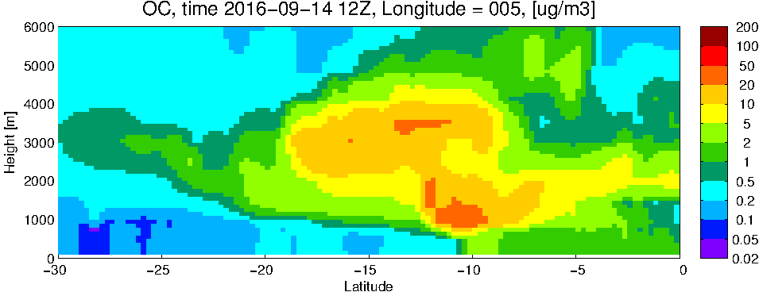
GEOS5 OC curtains
10 E
5 E

Slide 15
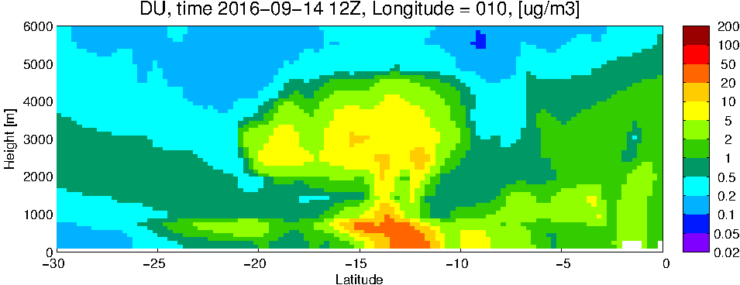
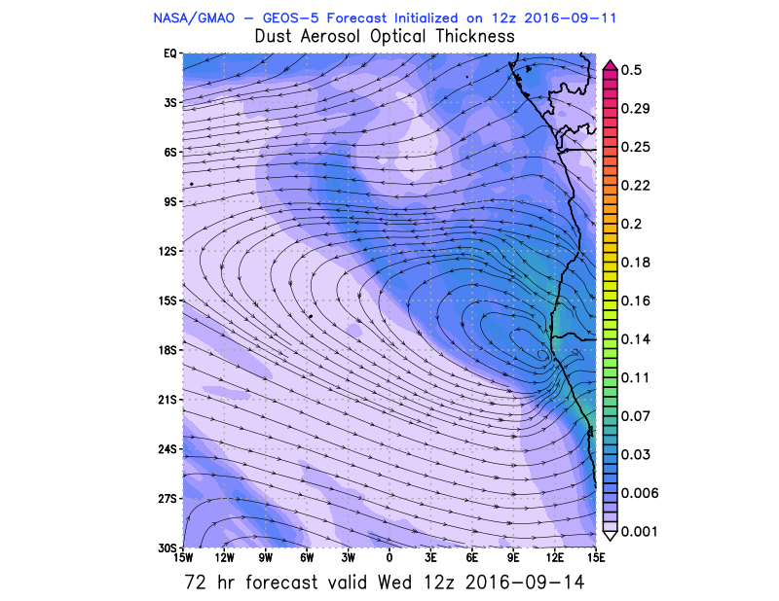
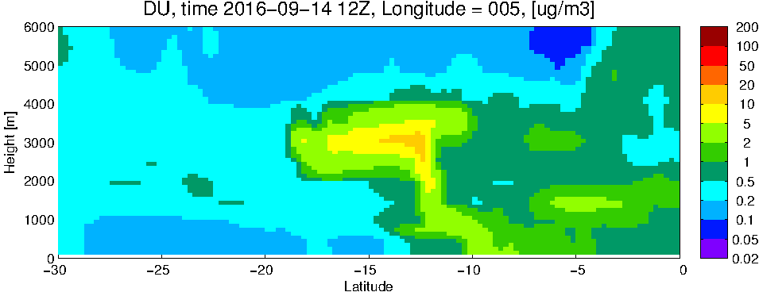
GEOS5 DUST curtains
10 E
5 E

Slide 16
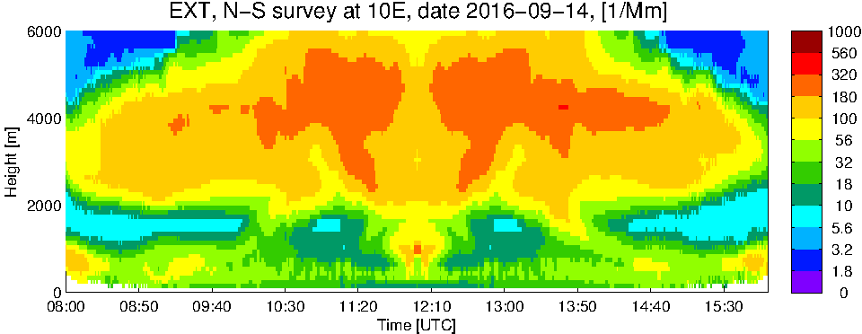
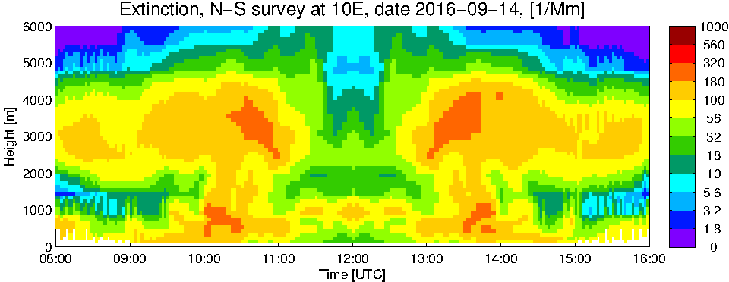
WRF
GEOS5
Dust

Slide 17
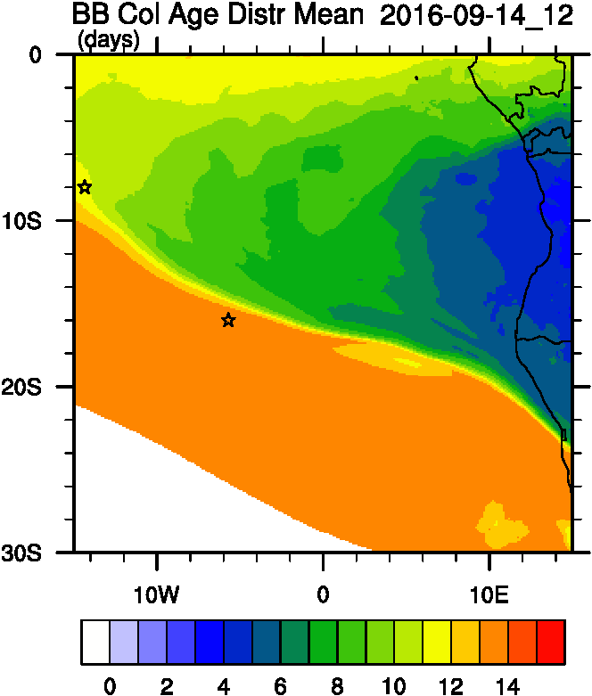
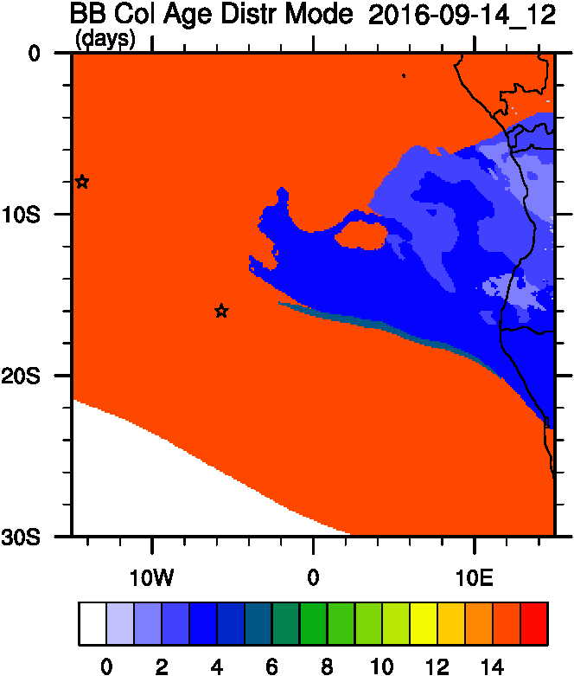
Smoke Age distribution
WRF ACAOD
Mean Age
Mode Age

Slide 18
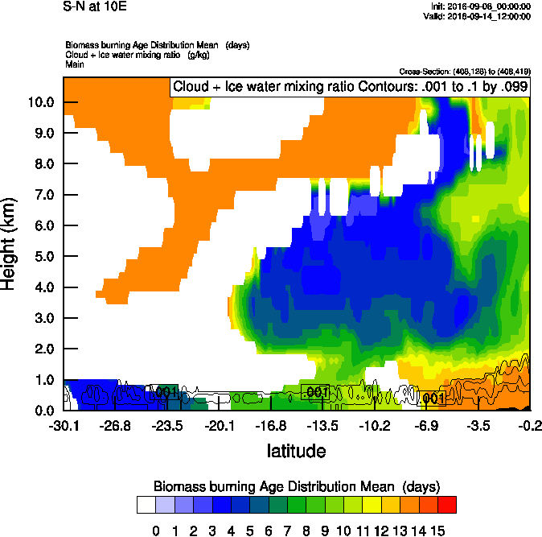
Vertical cross-section South to North
Smoke Ext WRF
Age mean

Slide 19
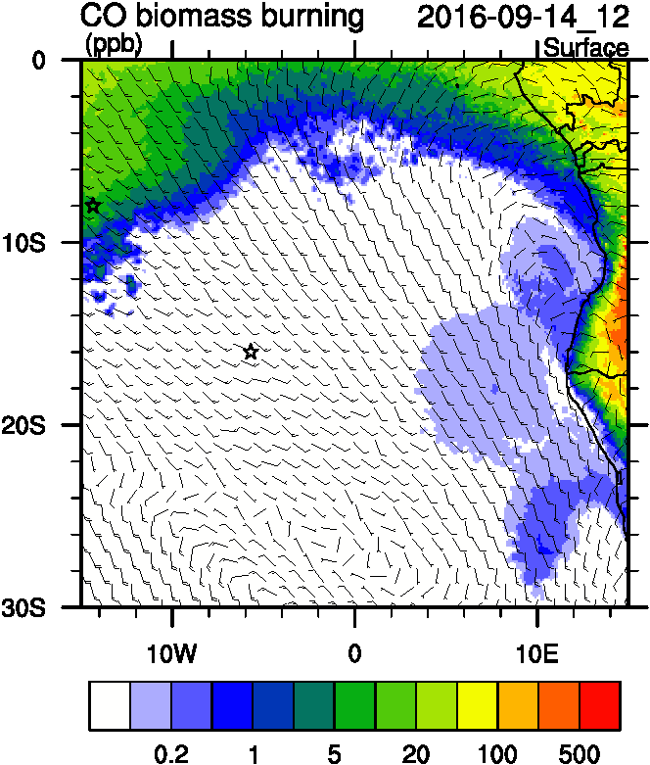
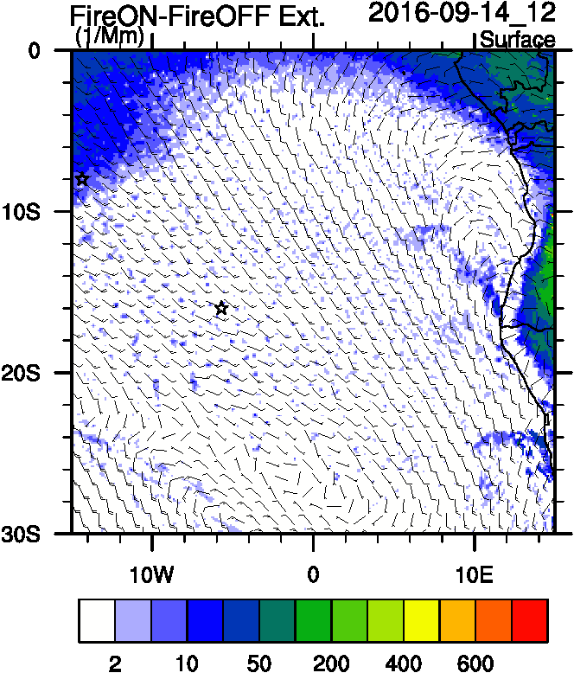
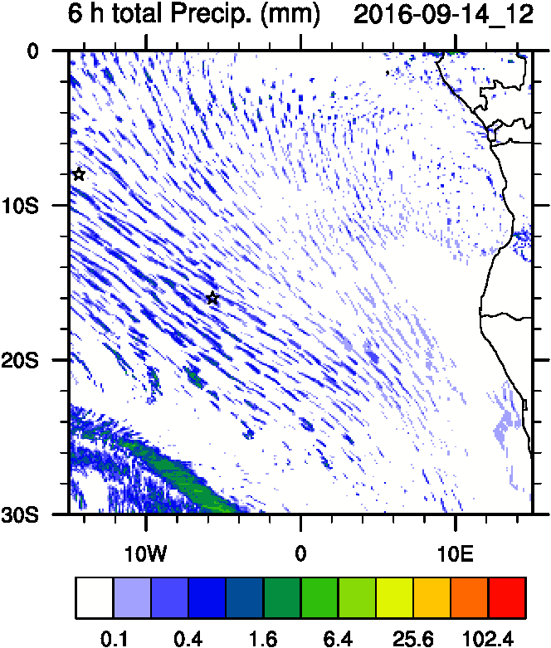
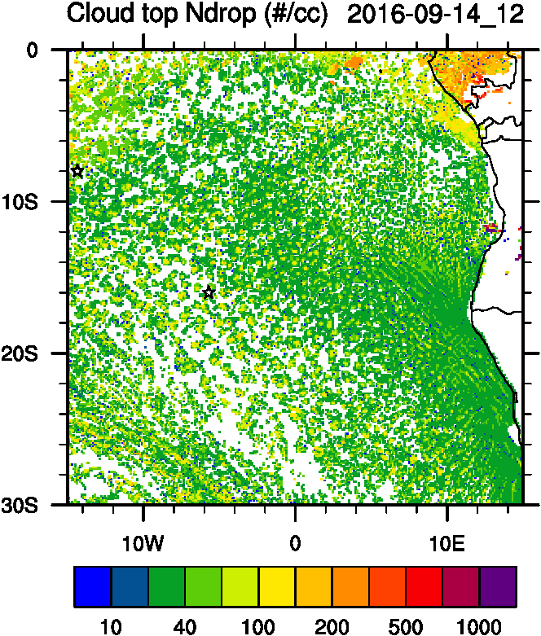
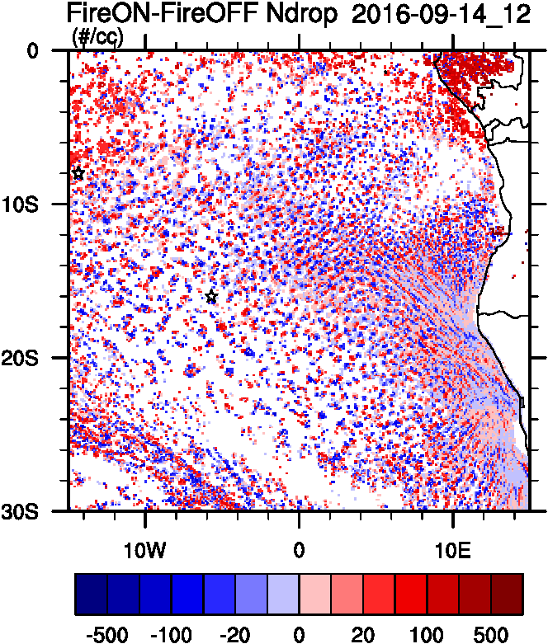
Aerosol-cloud interactions
Smoke Ext
AC AOD
tracer
Ndrop: Number droplet concentration
Diff: Differences between simulations turning on and off fires
Ndrop Diff
Precip
Ndrop

Slide 20
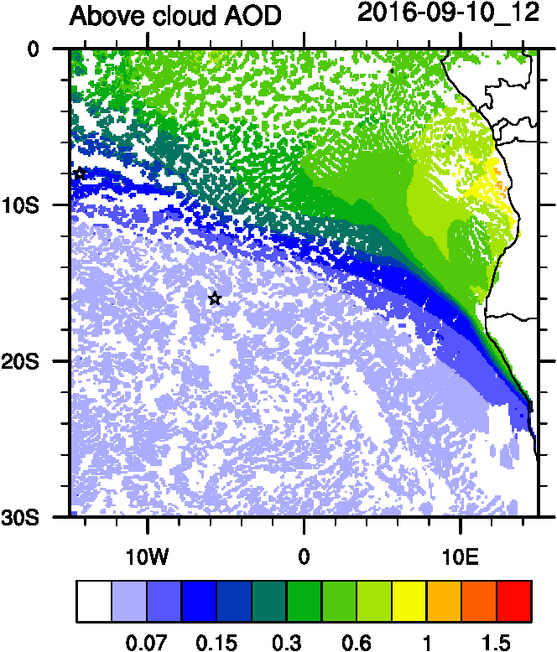
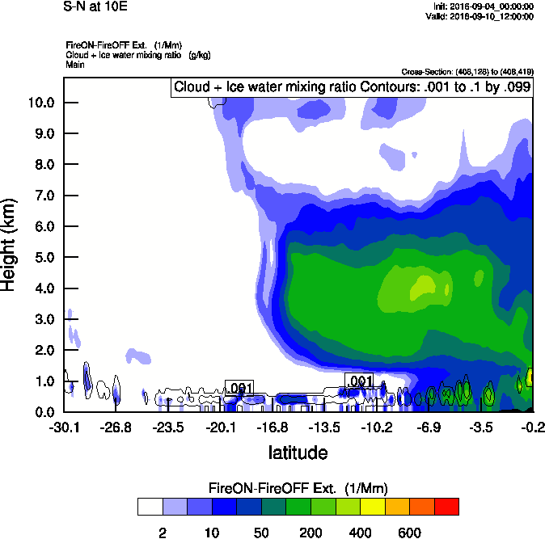
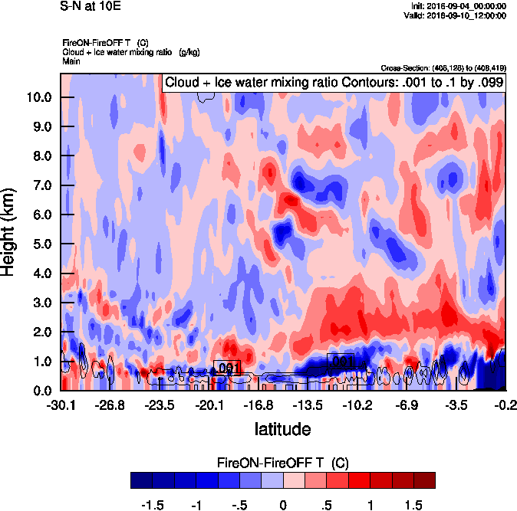
Vertical cross-section South to North
Smoke Ext WRF
T diff
10 E

Slide 21
Satellite tracks

Slide 22
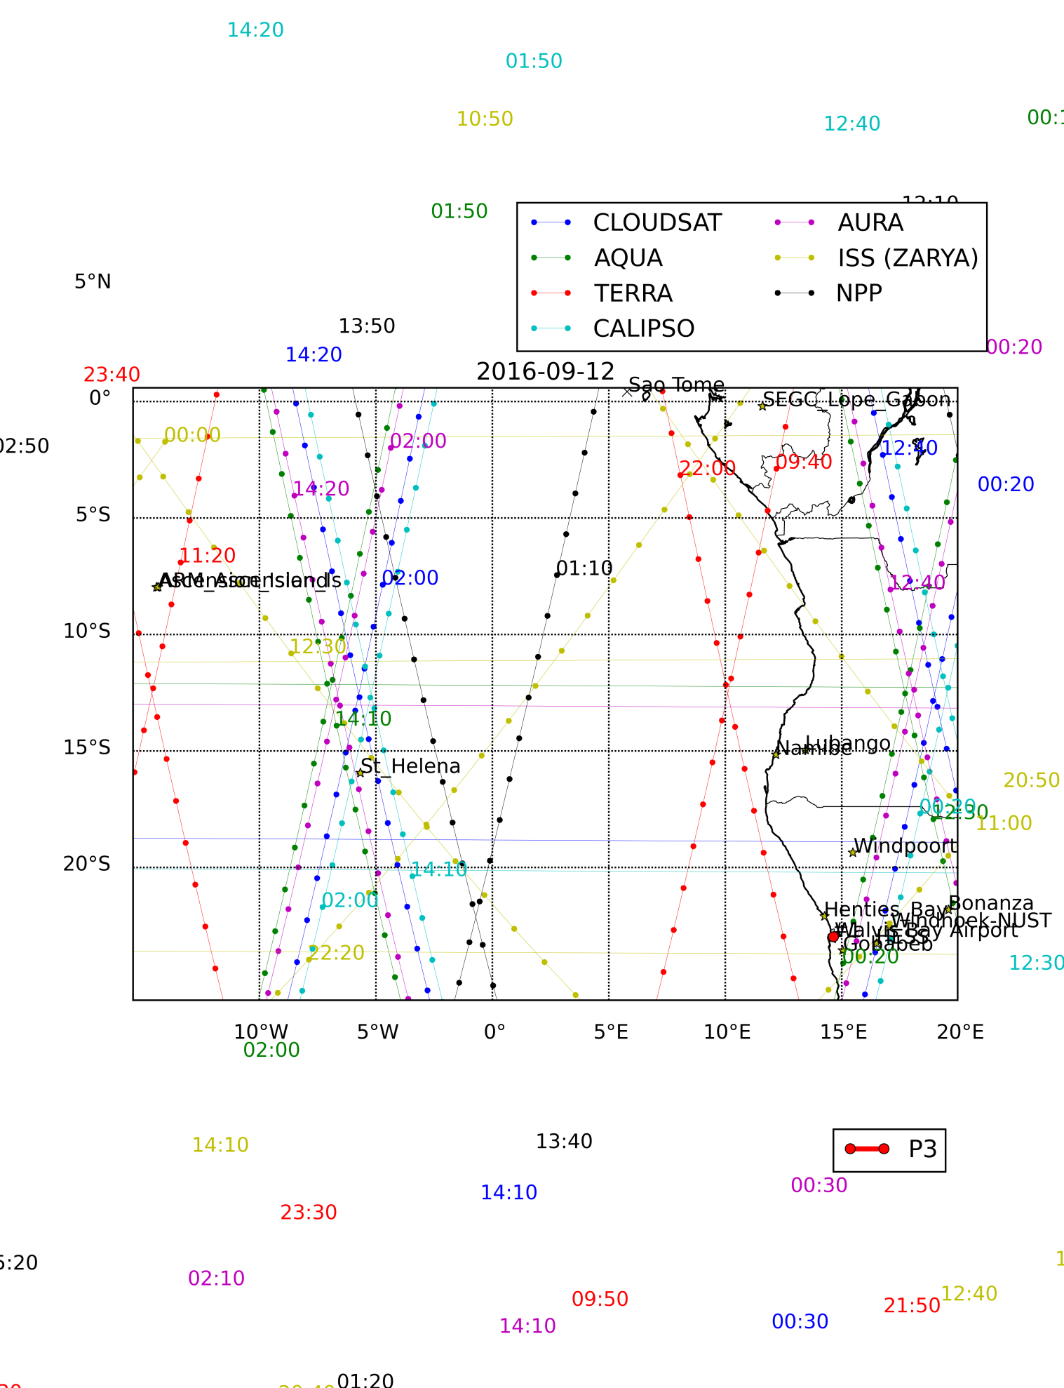
2016-09-12

Slide 23
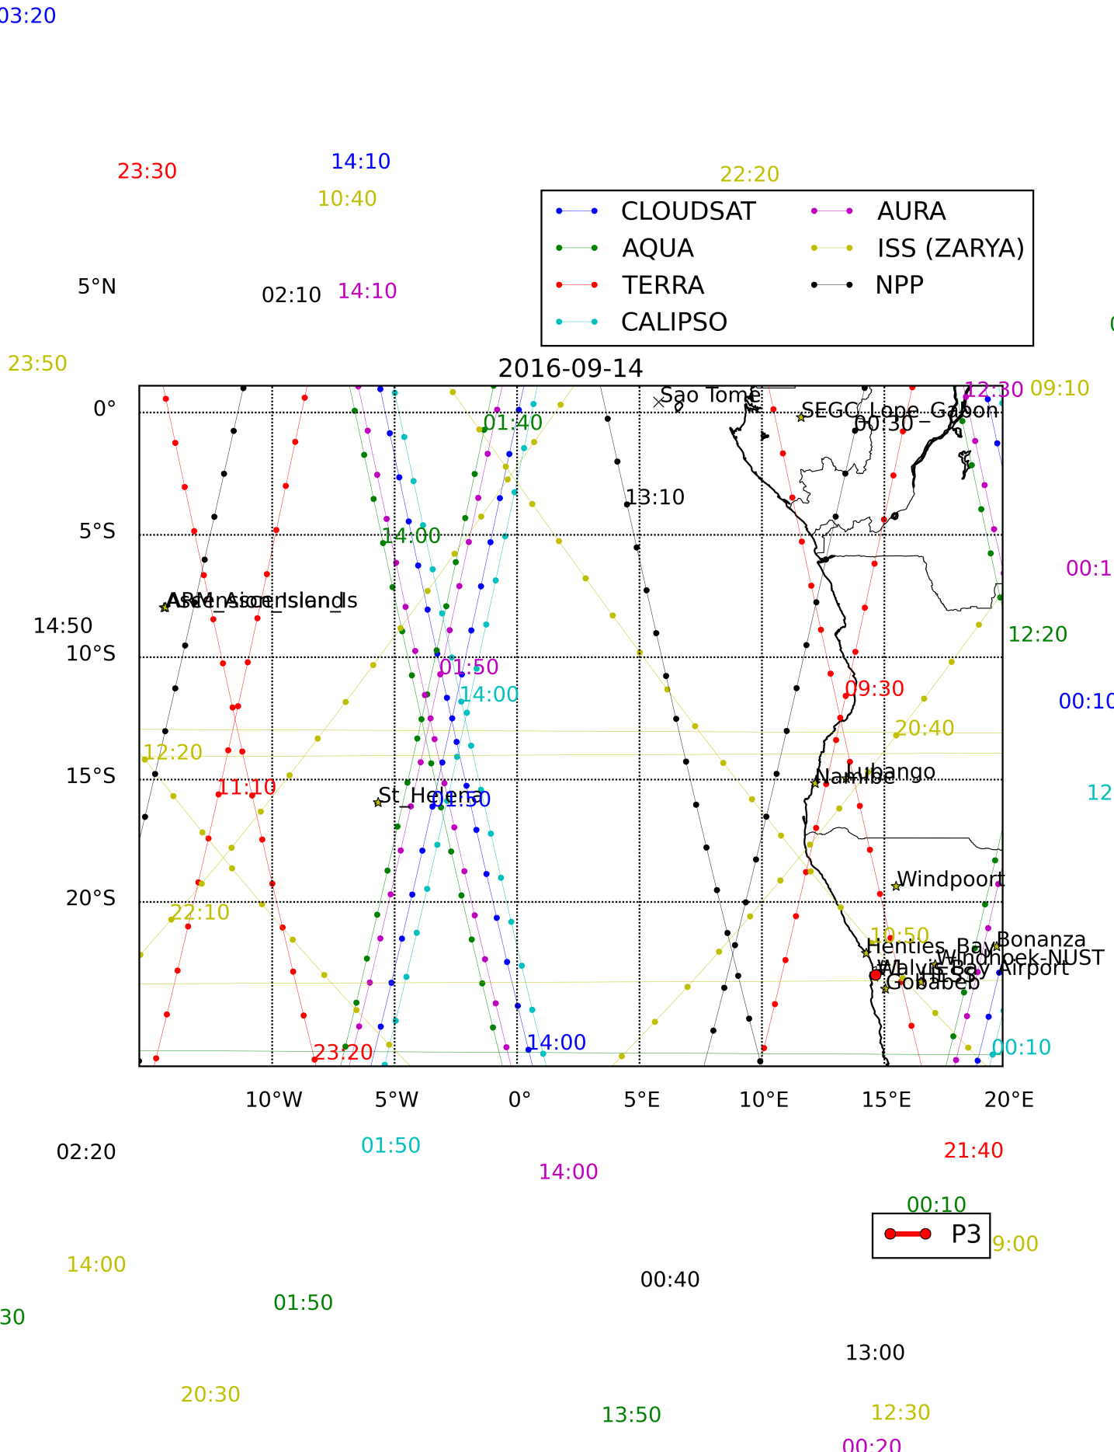
2016-09-14

Slide 24
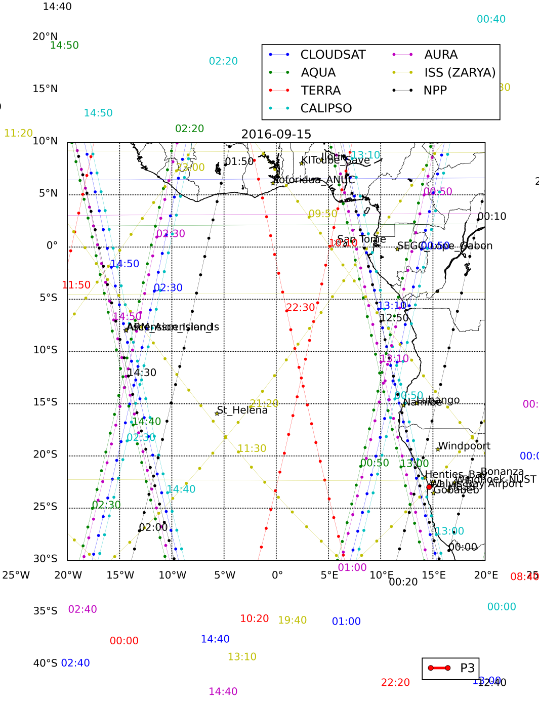
2016-09-15

