Slide 1
ORACLES Forecast Briefing (Aerosols)
12 September 2016

Slide 2
The Aerosol Week

Slide 3
GEOS-5 OC at 500 hPa

Slide 4
Thursday 15 September 2017
Flight

Slide 5
GEOS-5 6km AOD on Thu 2016-09-15 12Z

Slide 6
GEOS-5 AOD on Thursday 2016-09-15 12Z

Slide 9
PBL Height – Thu 2016-09-15 12Z
GEOS-5
WRF

Slide 10
Smoke Age Distribution: NW-SE
WRF Extinction
WRF Mean Age

Slide 11
Smoke Age Distribution: W-E at 15S
WRF Extinction
WRF Mean Age

Slide 12
GEOS-5
WRF

Slide 13
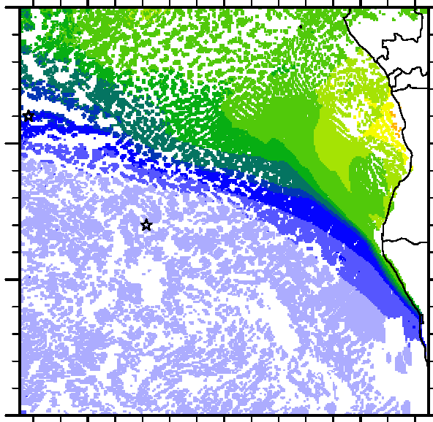
GEOS-5
WRF

Slide 14
GEOS-5
WRF

Slide 15
Friday 16 September 2017
No Flight

Slide 16
GEOS-5 AOD on Friday 2016-09-16 12Z

Slide 17
GEOS-5 6km AOD on Friday 2016-09-16 12Z

