Slide 1
Winds
Here are some forecast winds on takeoff and landing, and charts near cruise altitude

Slide 2
Forecast Winds on climbout
4.8kft S 10
9.9kft NW 30
18.3kft WNW 30
30.1kft W 65
38.7kft W 75
44.6kft WNW 70
53.1kft NW 40

Slide 3
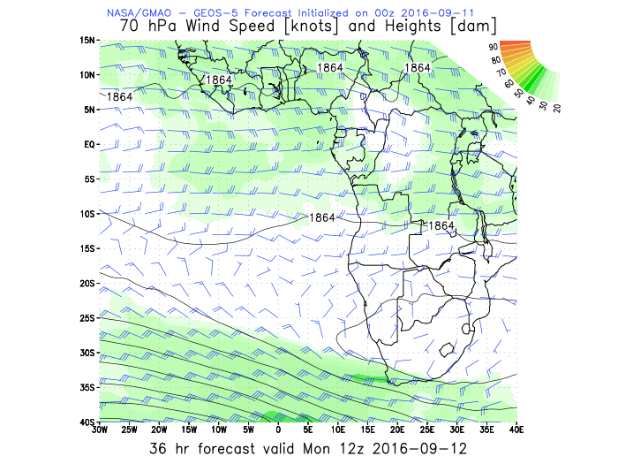
Winds at 60.5kft

Slide 4
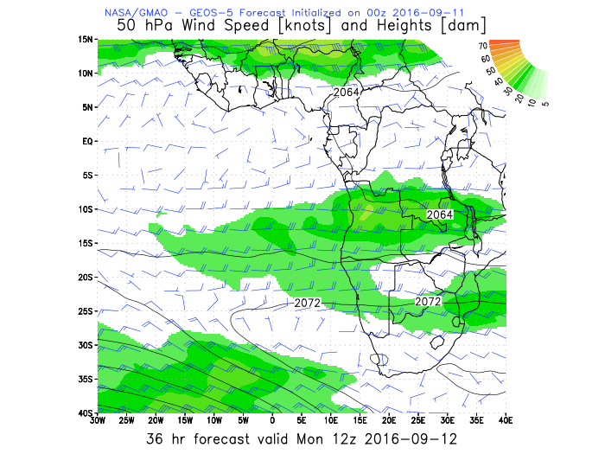
Winds at 67.5 kft

Slide 5
Forecast Winds on landing
4.8kft N 5
9.9kft WNW 30
18.3kft NW 30
30.1kft W 70
38.7kft WSW 80
44.6kft WNW 55
53.1kft NW 45

