Slide 1
ORACLES forecasting really brief briefing Meteorology for 12-09-2016
09-11-2016
Lenny Pfister

Slide 2
Summary
Upper level trough flattening tomorrow, so expect less mid-level and cirrus along routine path.
Convection from last few days has dumped moisture at 600mb.
Both models show a threat from this moisture moving into the plume area.
Middle cloud expected just north of plans a and b
Subsequent days show waning middle cloud in plume area

Slide 3
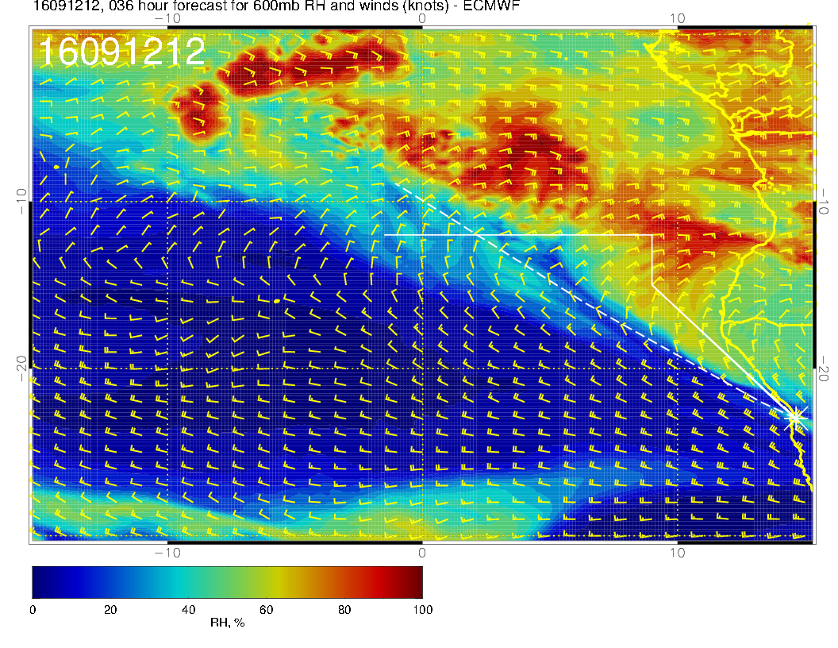

Slide 4
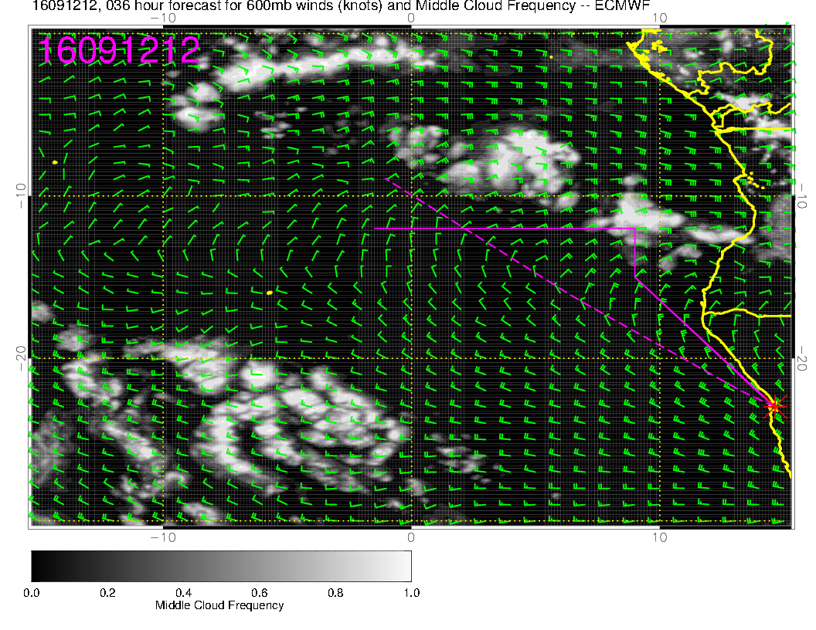
Something to 15S

Slide 5
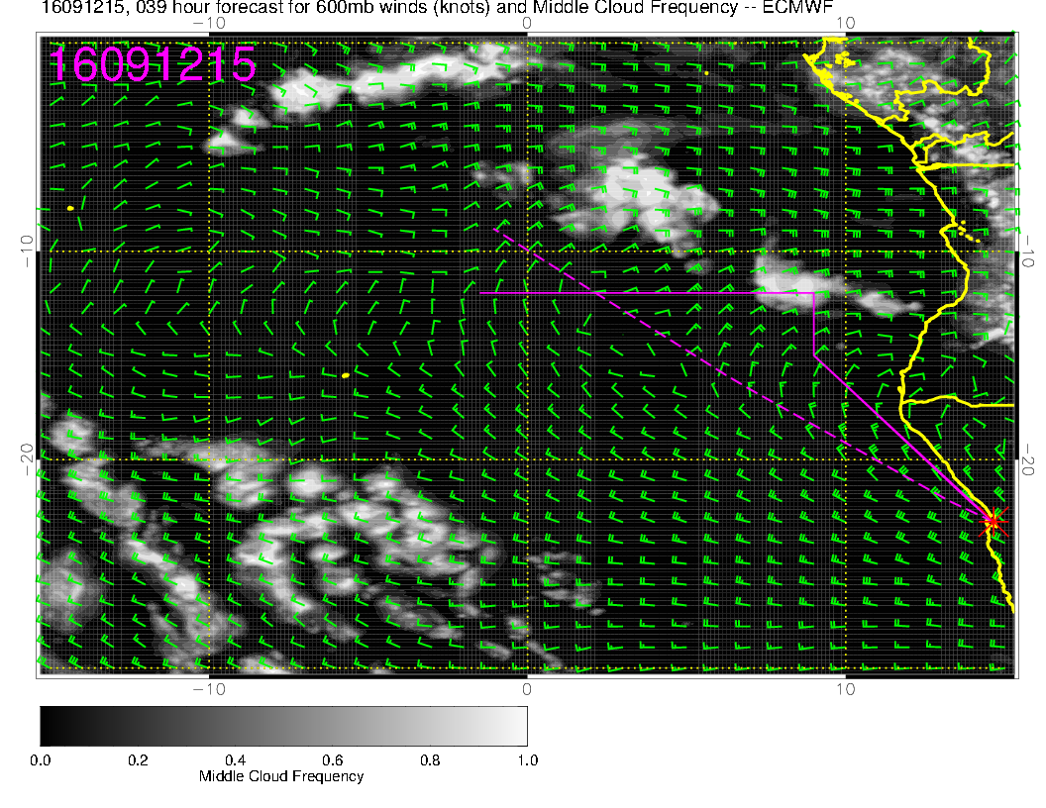
Some dissipation
suggested by 5 PM

Slide 6
