Slide 1
ORACLES forecasting Briefing Meteorology for 10-9-2016
09-10-2016
Lenny Pfister

Slide 2
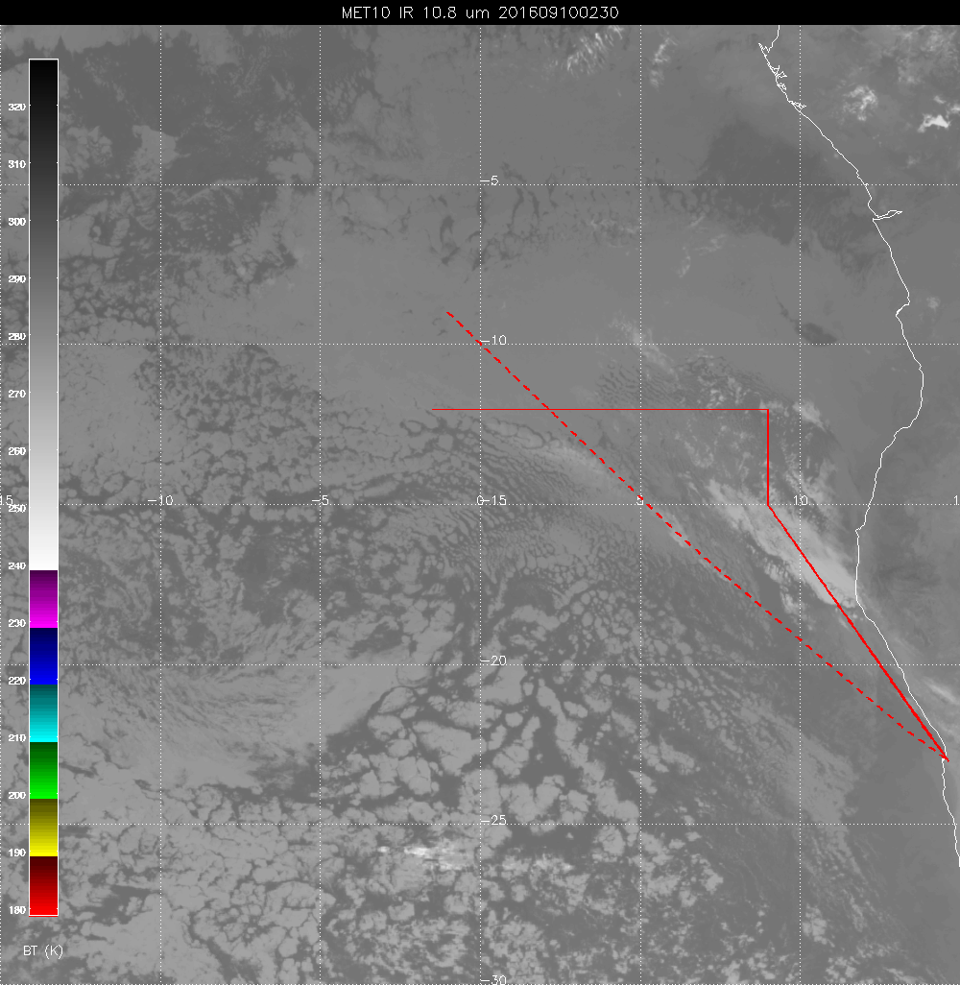
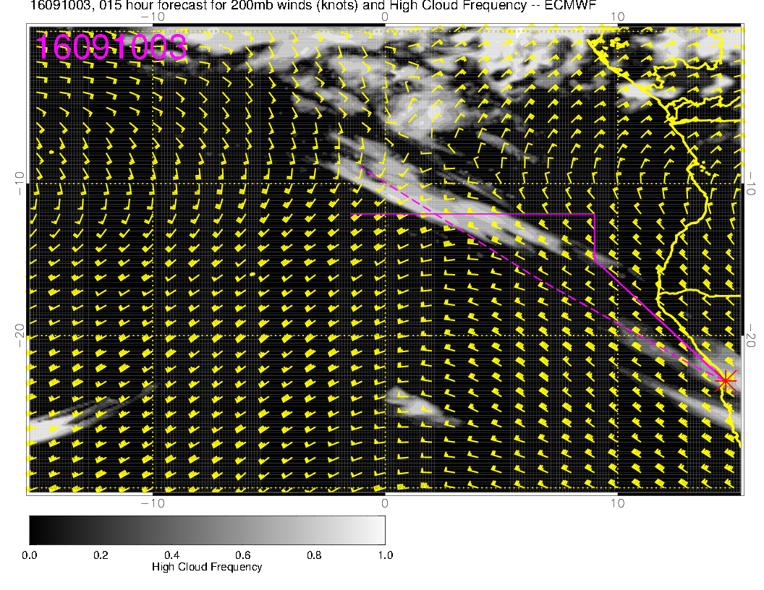

Slide 3
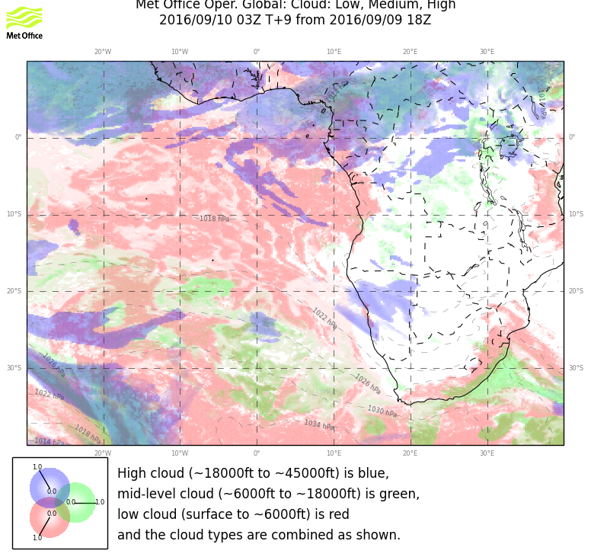

Slide 4
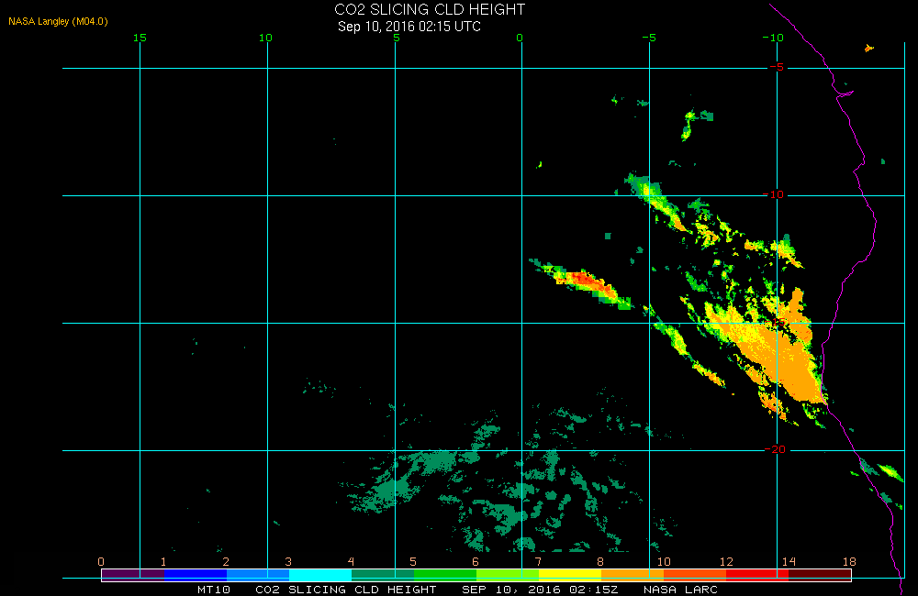

Slide 5
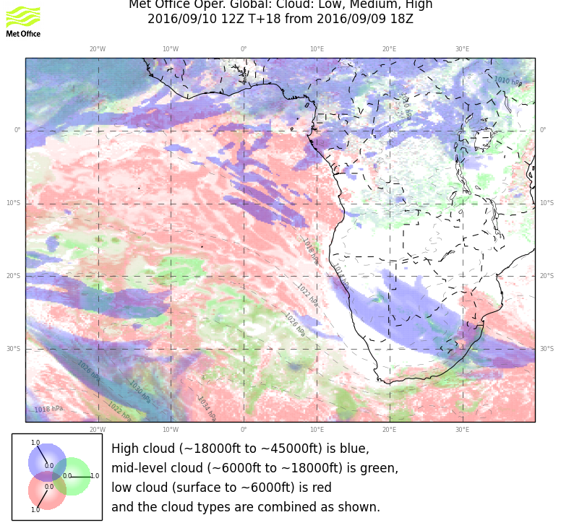
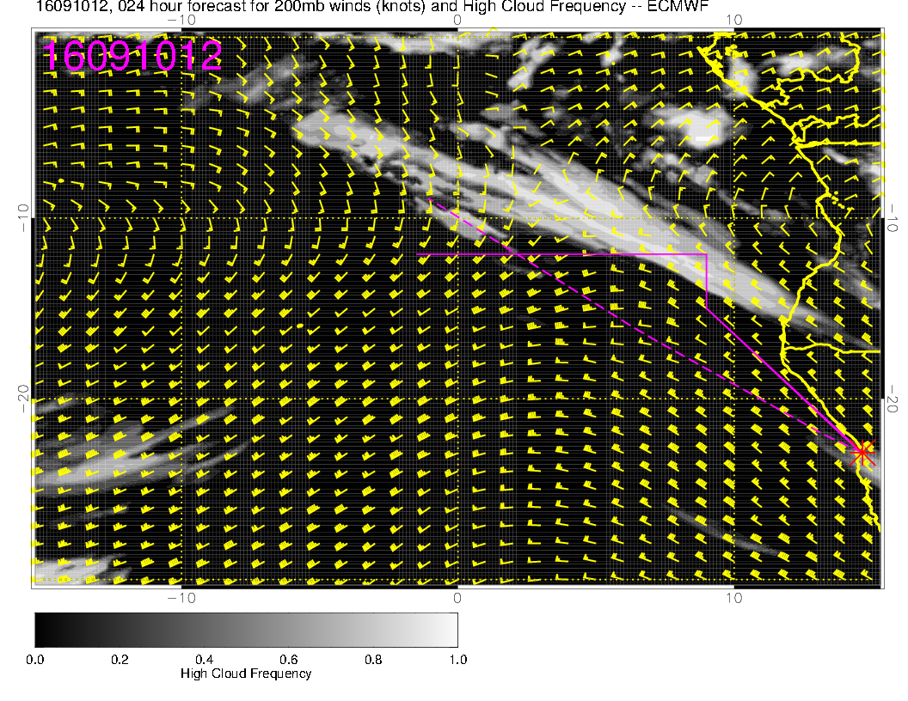

Slide 6
Go with the satellite image, not the progs

Slide 7
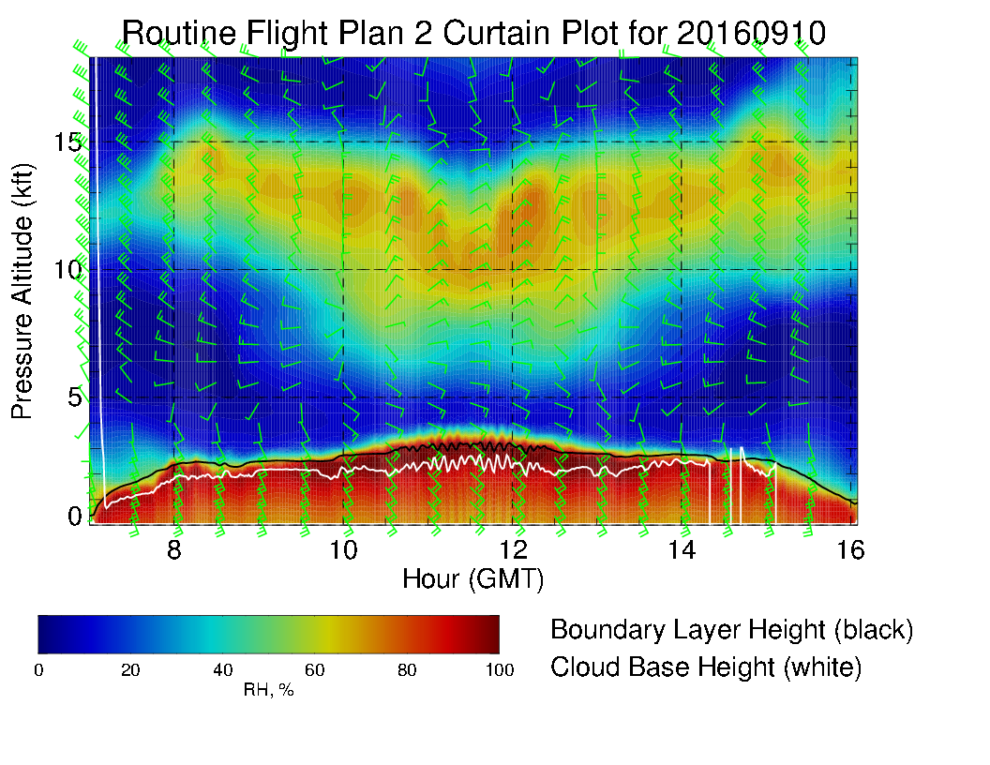

Slide 8
