Slide 1
ORACLES forecasting Briefing Meteorology for 10-9-2016
09-09-2016
Lenny Pfister, Susanne Bauer

Slide 2
Forecast issues for tomorrow
Cirrus and middle cloud in the north
UK and EC models still disagree (EC cirrus yes, UK no)
UK and EC models both got this morning right
All other models “agree” with EC
Conclusion – expect some cirrus north of 10S
Also, some jet stream cirrus near YWB.
Sc and low clouds
EC has backed off some on the cloud clearing north of us
YWB airport conditions
No cloud issues in the morning, winds SSE, weak, SW 10-15 on landing
Monday similar conditions (though Sunday expected to have morning
low clouds and low ceilings)

Slide 3
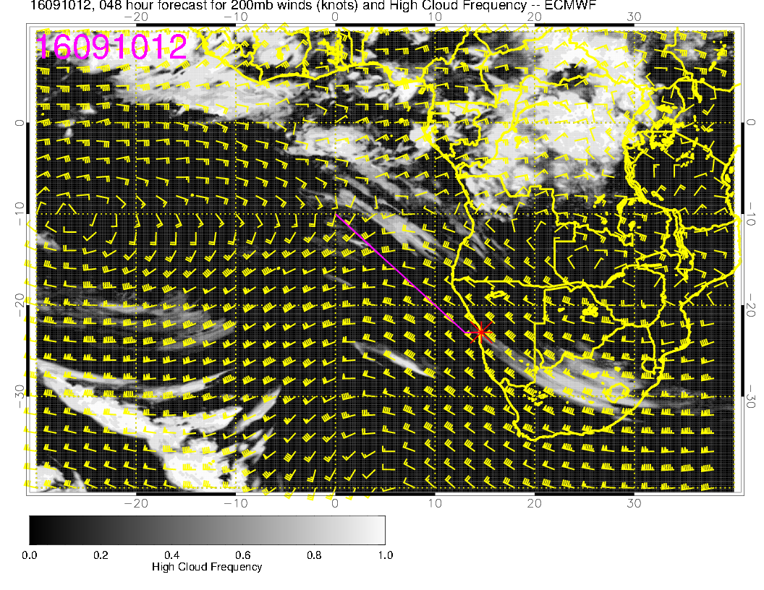
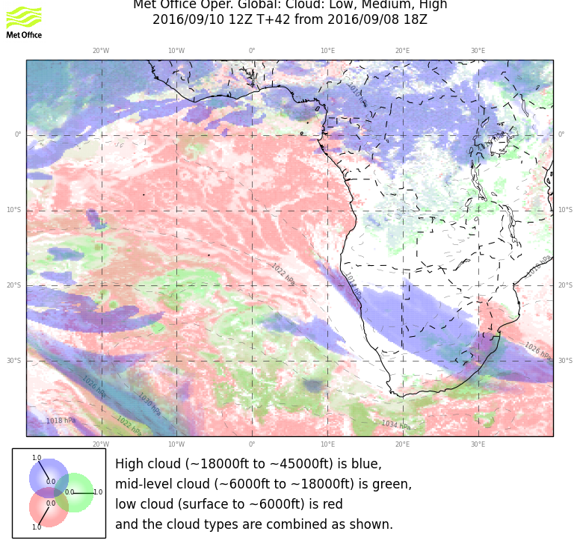
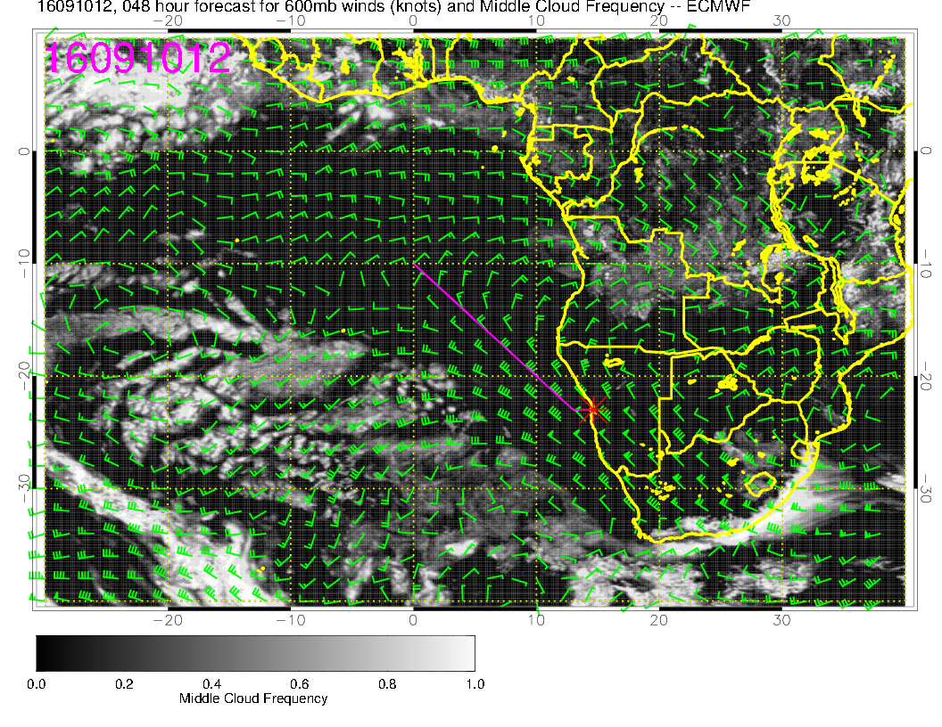
Most recent runs.
Neither model
is backing off
from its previous
forecast.
High cloud over
continent is similar
though EC penetrates
further south.
GEOS-5 and GFS both
put cirrus north of 10S

Slide 4
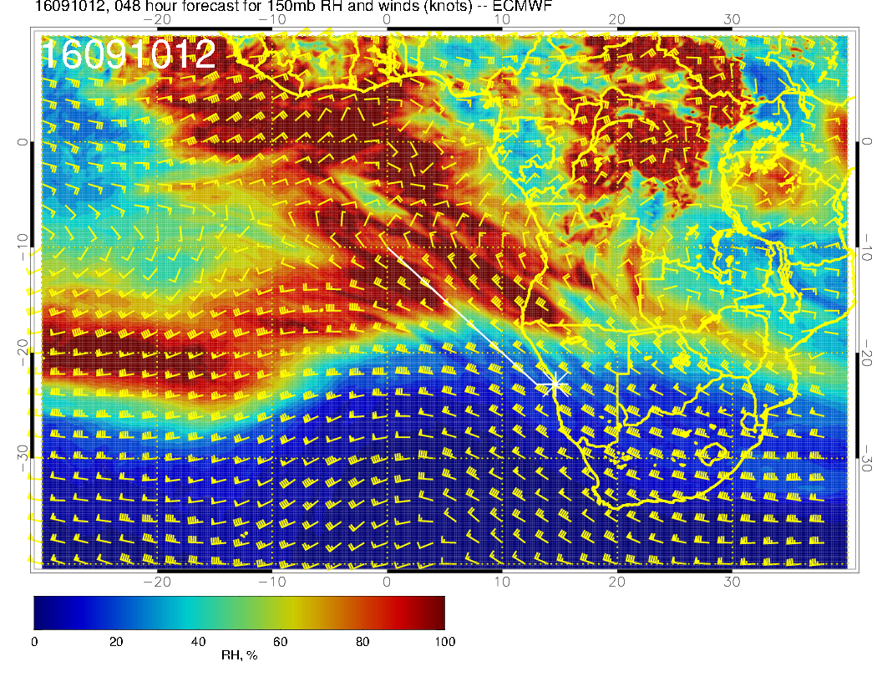
Previous slide shows both models
with ample high cloud over the
continent, comparably placed.
Convection is probably not the
difference.
Difference is likely due to varying
treatments of temperature/cloud
relationships at cold temperatures.
Past high cloud splotches in the deep
tropics have been excessive in the EC
model, but have usually “gone away”
in more recent forecasts. These are
not going away.
150mb anticyclone is south of its
climo position

Slide 5
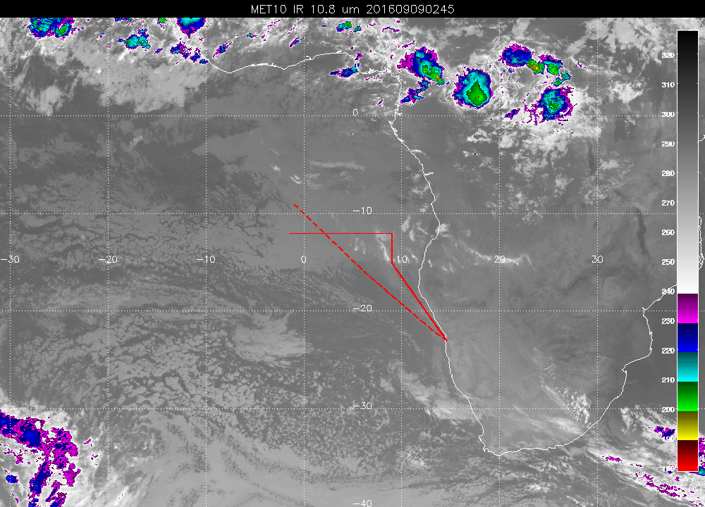
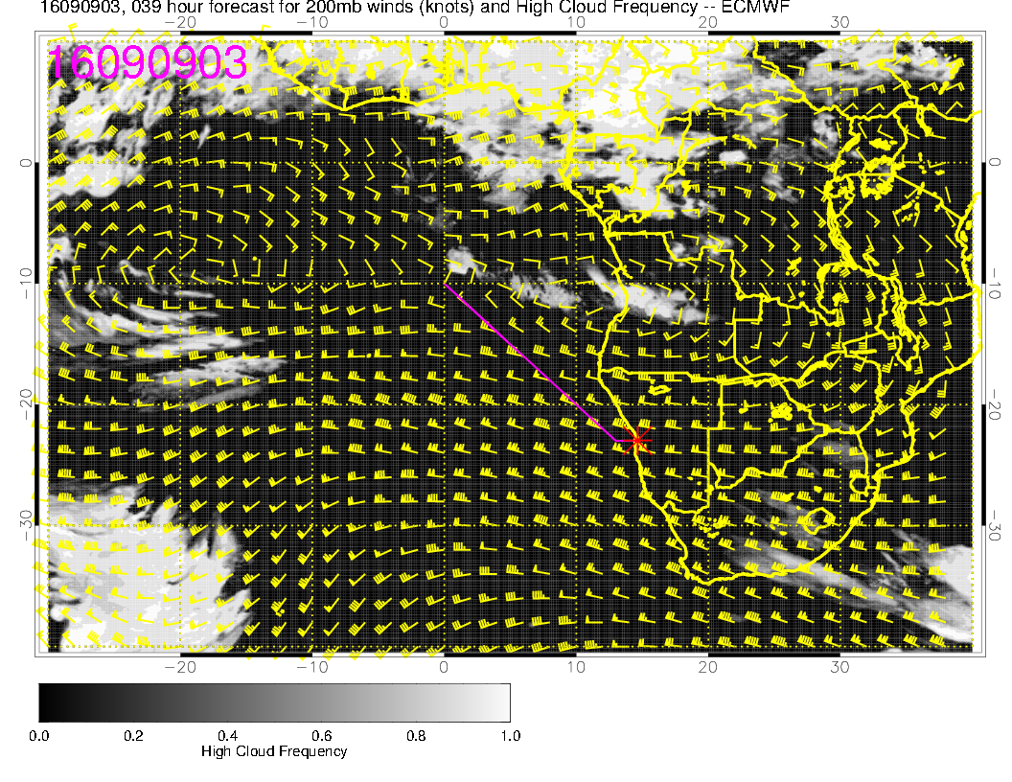
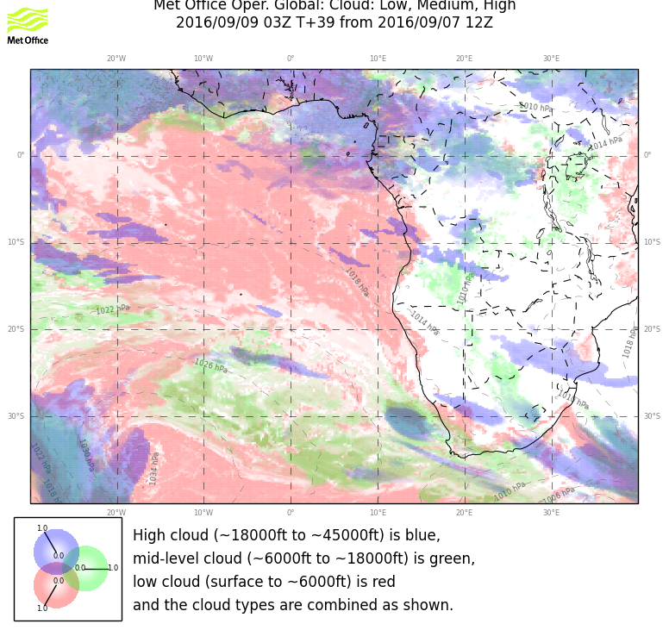
Forecast for this morning (same time horizon)
No mid level cloud in either model
General picture is right in both
models.

Slide 6
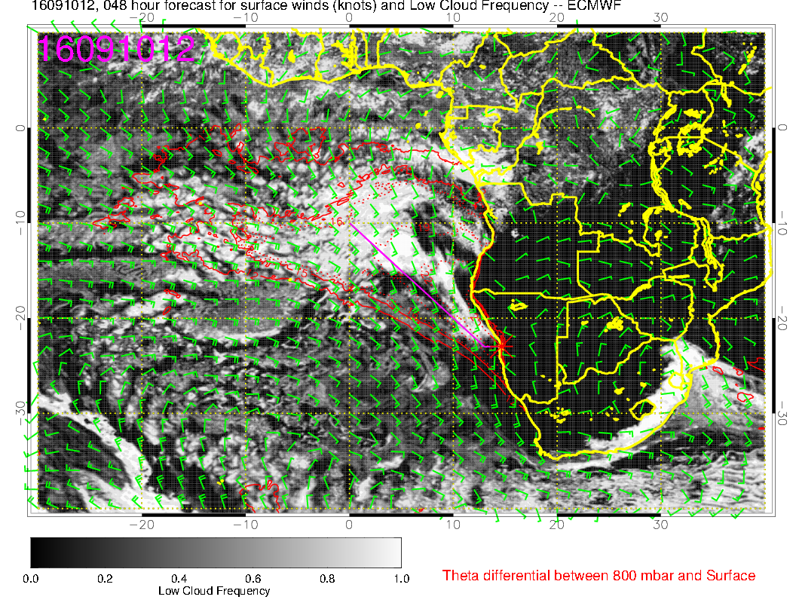
Two models have come into agreement for low clouds
for Saturday.

Slide 7
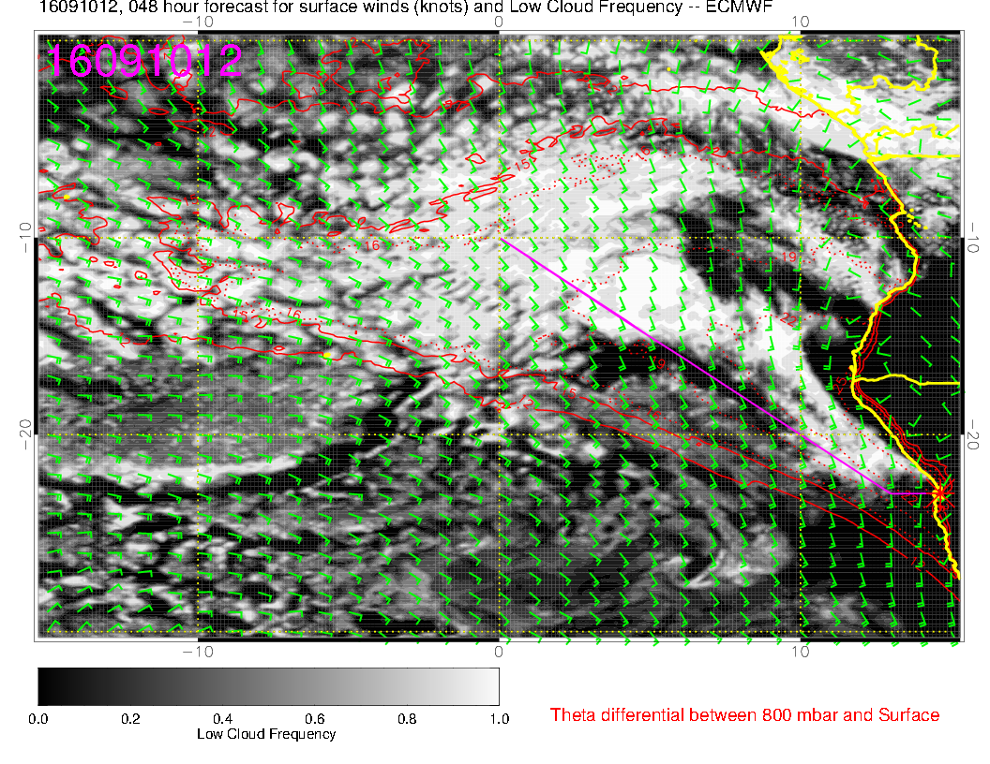
Looks more like
the older forecast
used Wednesday.
Clear region associated
with a region of
lower RH, and thinner
BL.
Low cloud to 14S
along our track

Slide 8
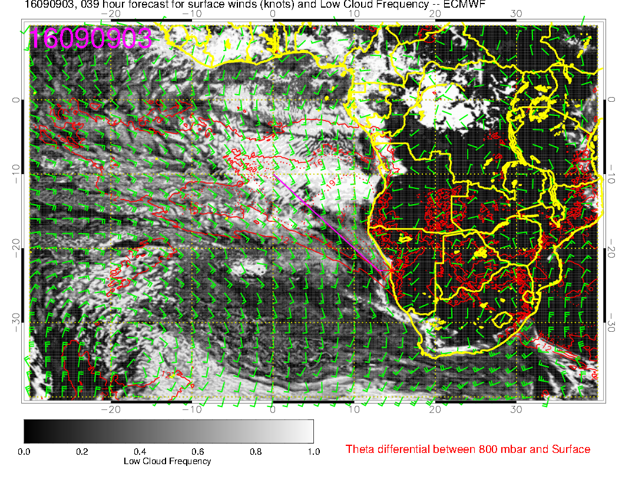
Forecast for this morning (same time horizon)
Check on
believability,
compare same
forecast cycle
for this morning.
Models have major features
right. Frontal effects too far
north in EC. Angola bay clearing
better in EC

Slide 9
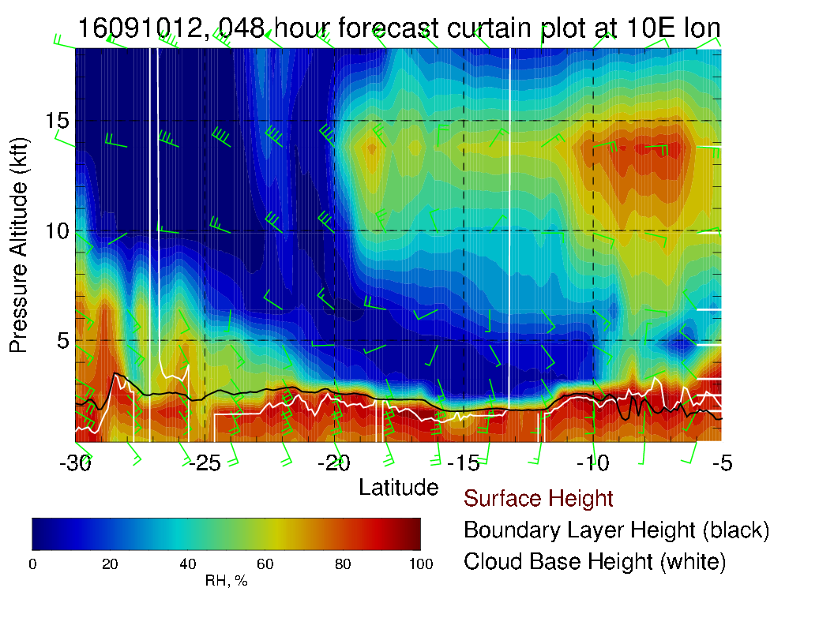

Slide 10
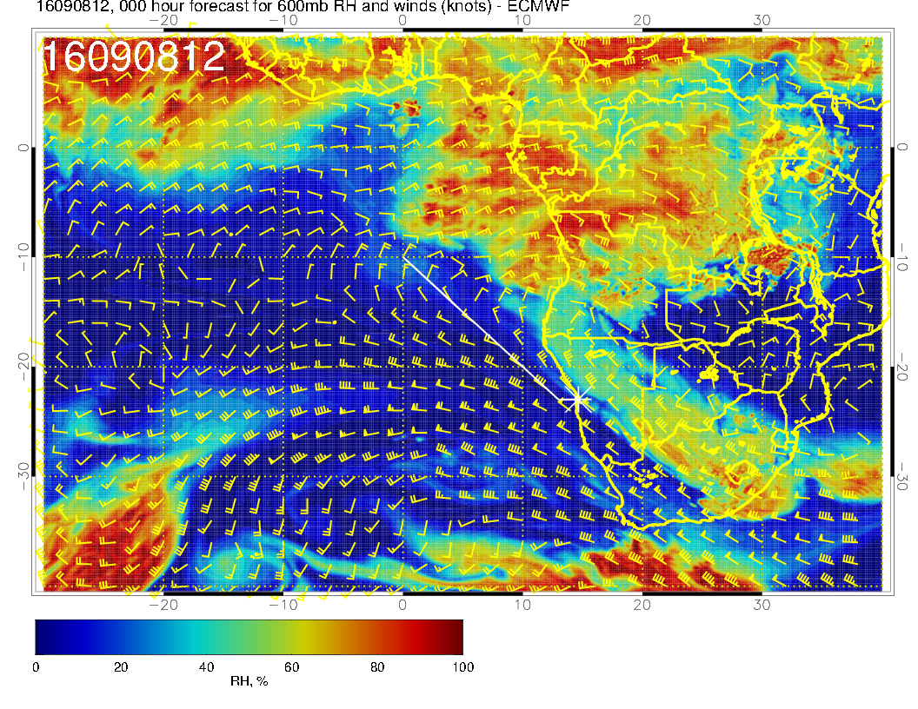

Slide 11
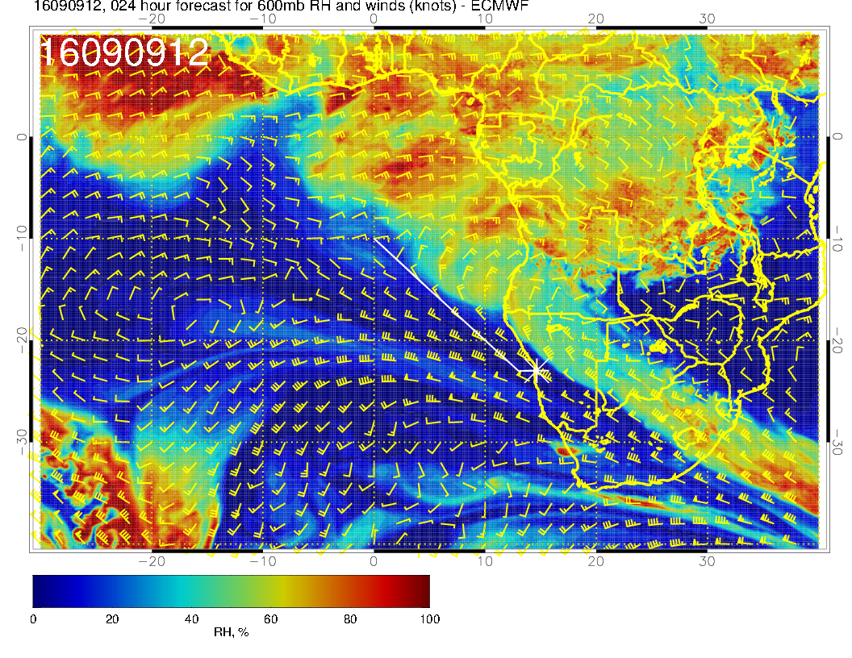

Slide 12
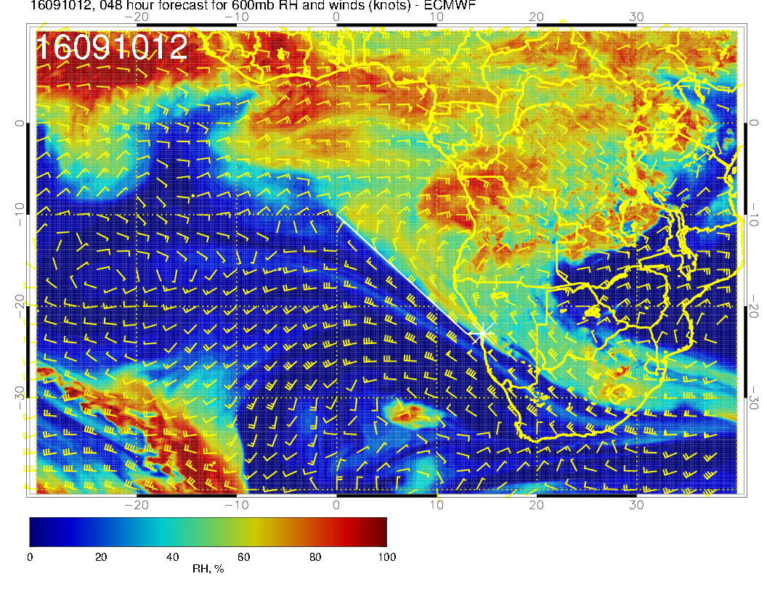

Slide 13
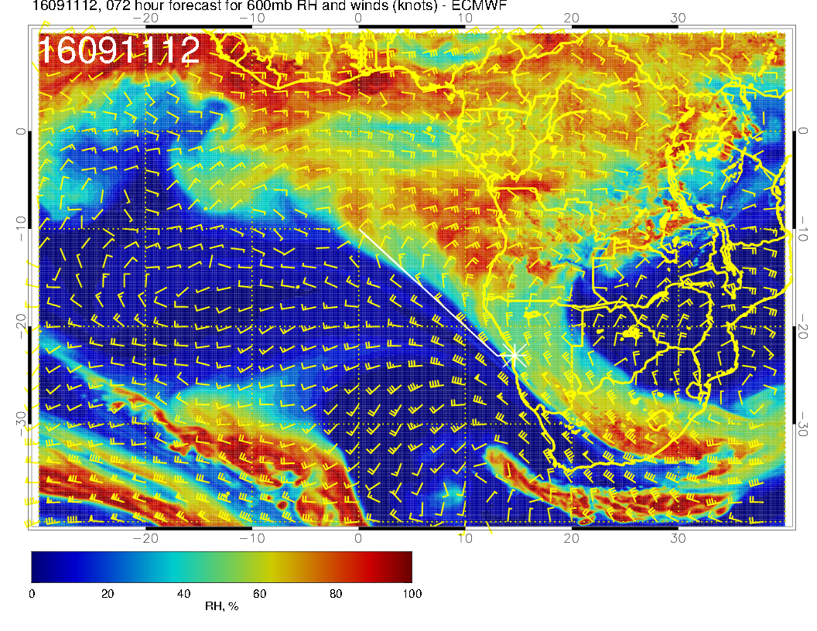

Slide 14
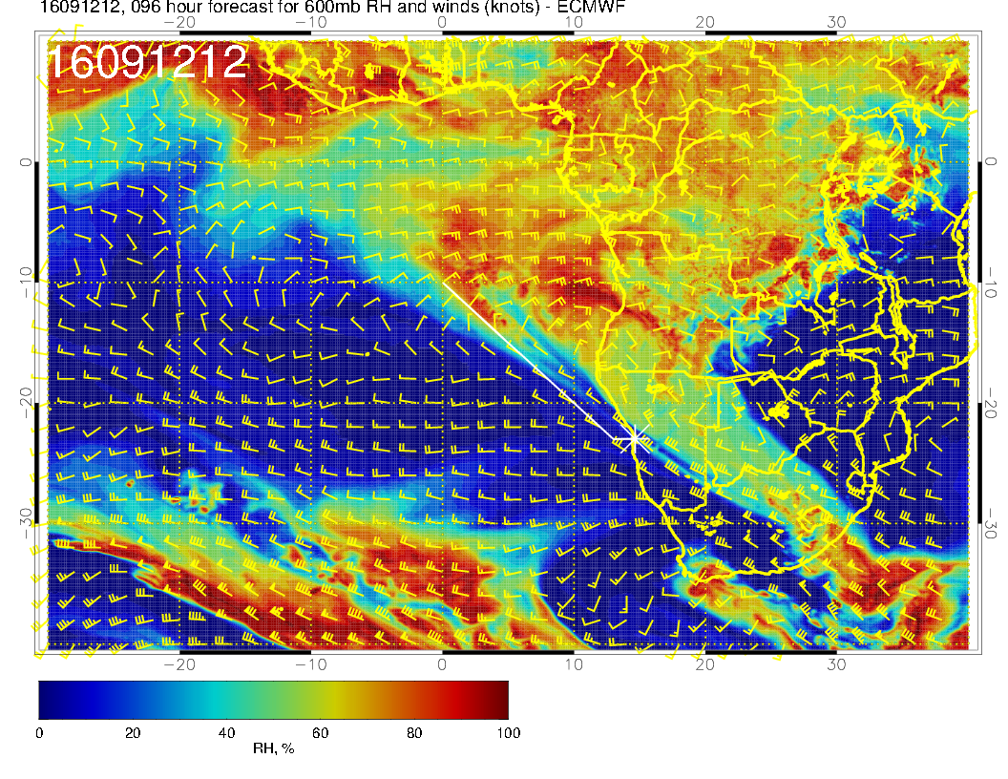

Slide 15
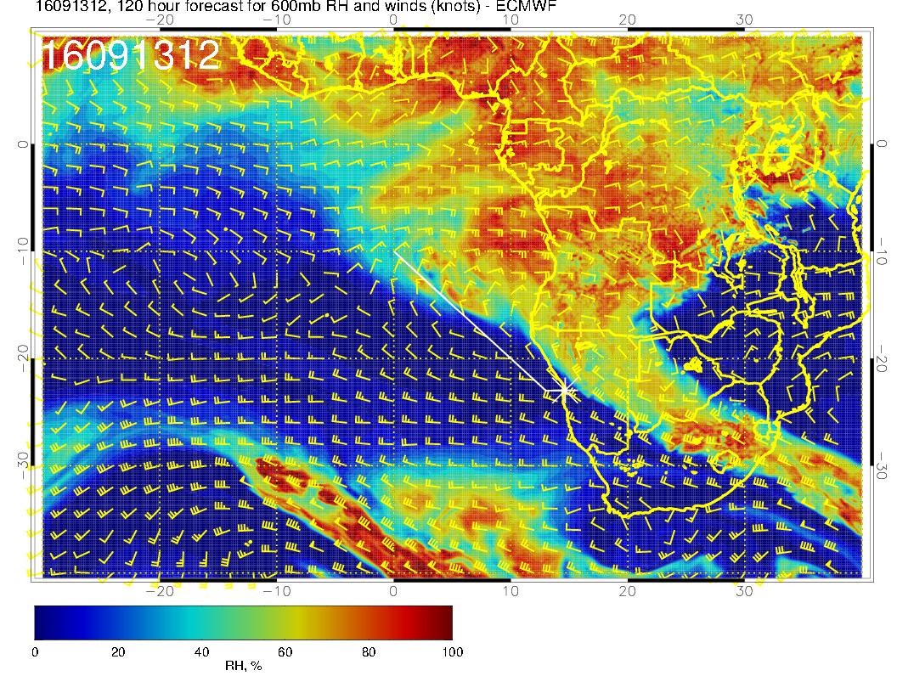

Slide 16
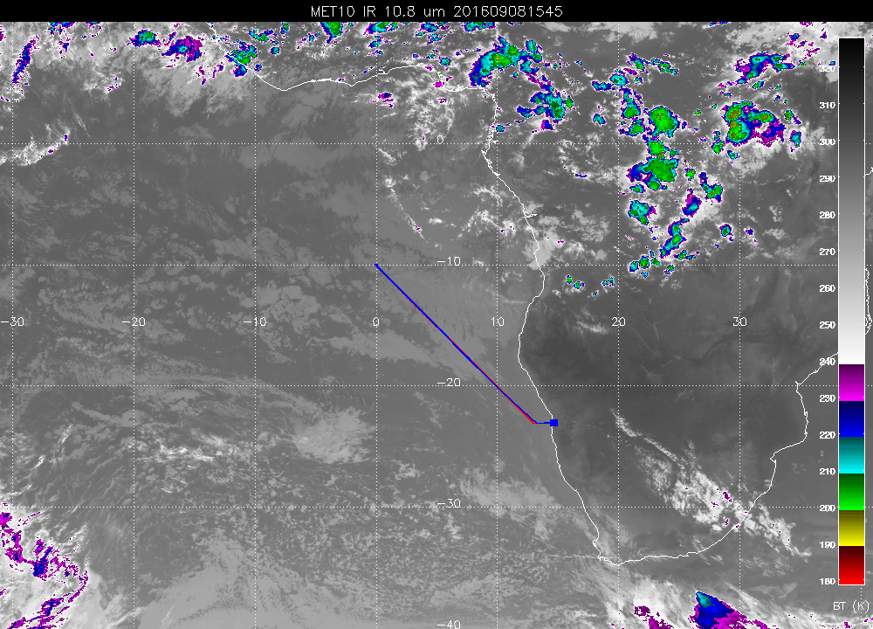

Slide 17
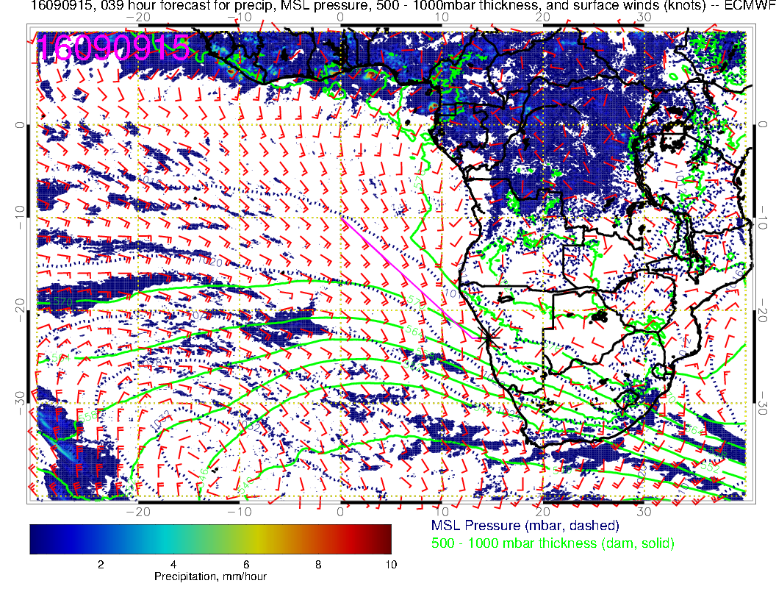

Slide 18
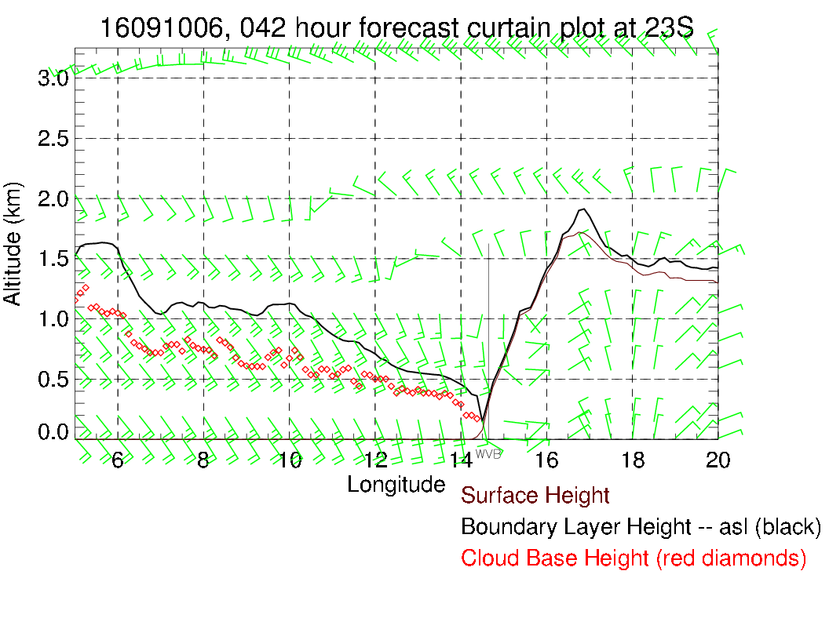
Saturday morning 8 AM.
Clouds just offshore, in
any case ceilings better
than 600 feet, weak SE
winds.
Note that pressure gradient is
increasing, more onshore push
than yesterday or today.

Slide 19
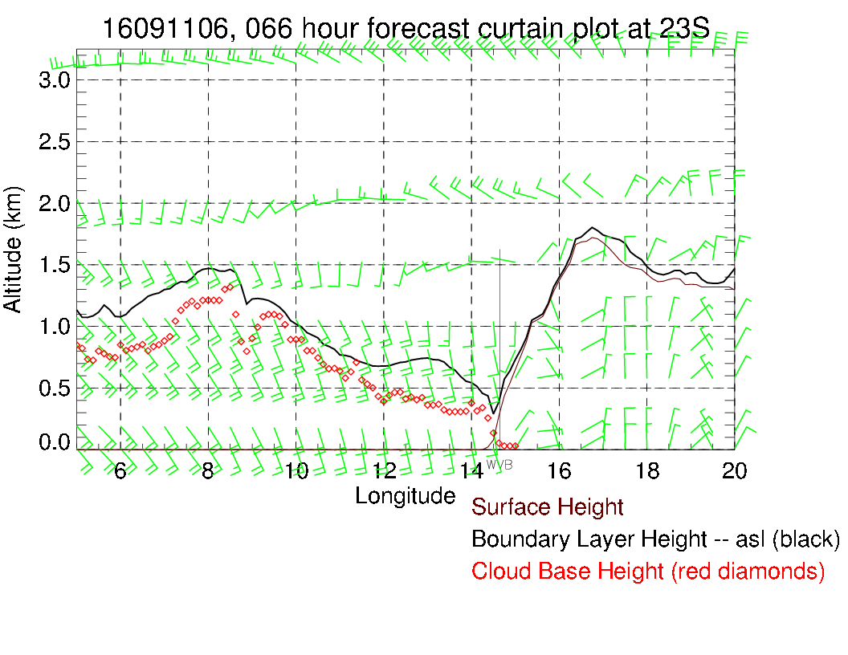
Sunday expect
more low cloud in
the morning.

Slide 20
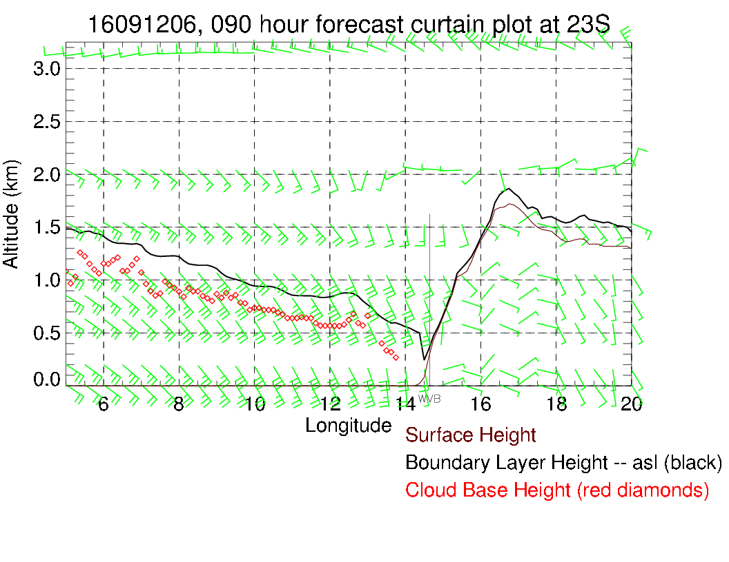
Monday looks
reasonable at 8 AM.

