Slide 1
ORACLES flight day and airport wx Briefing
08-09-2016
Lenny Pfister

Slide 2
Summary
Satellite movie included
Cirrus over YWB less than yesterday
Low cloud forecast we used yesterday reasonable
Watch for cirrus at north end, none there now
Strong winds at cruise altitude near beginning of flight

Slide 3
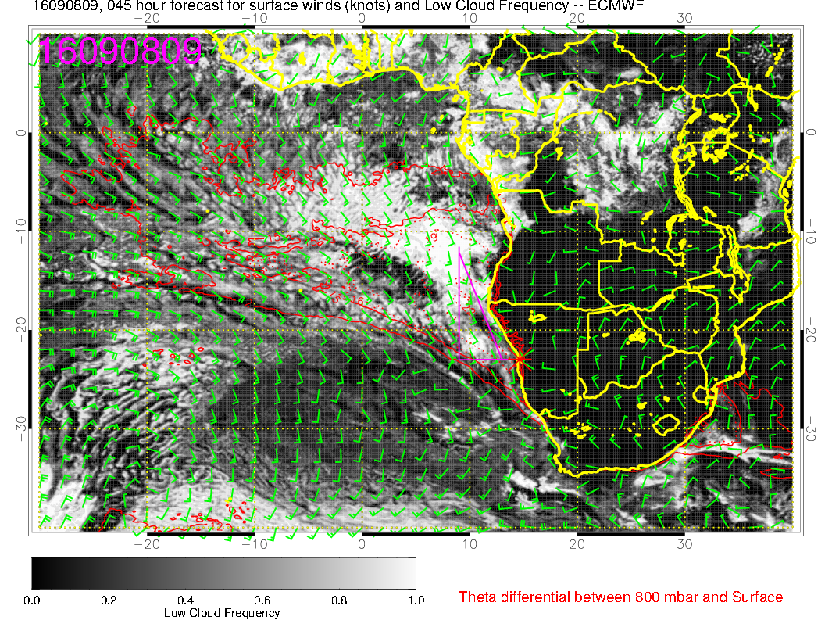
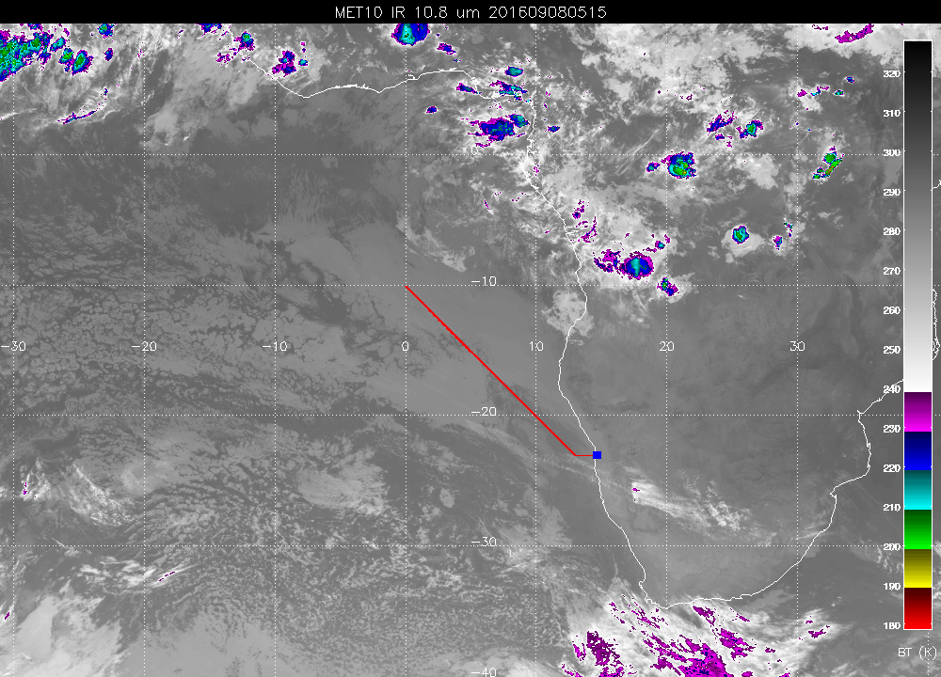
Overall pattern of location of perturbed region SW of flight track
apparent in forecast is apparent in current conditions.

Slide 4
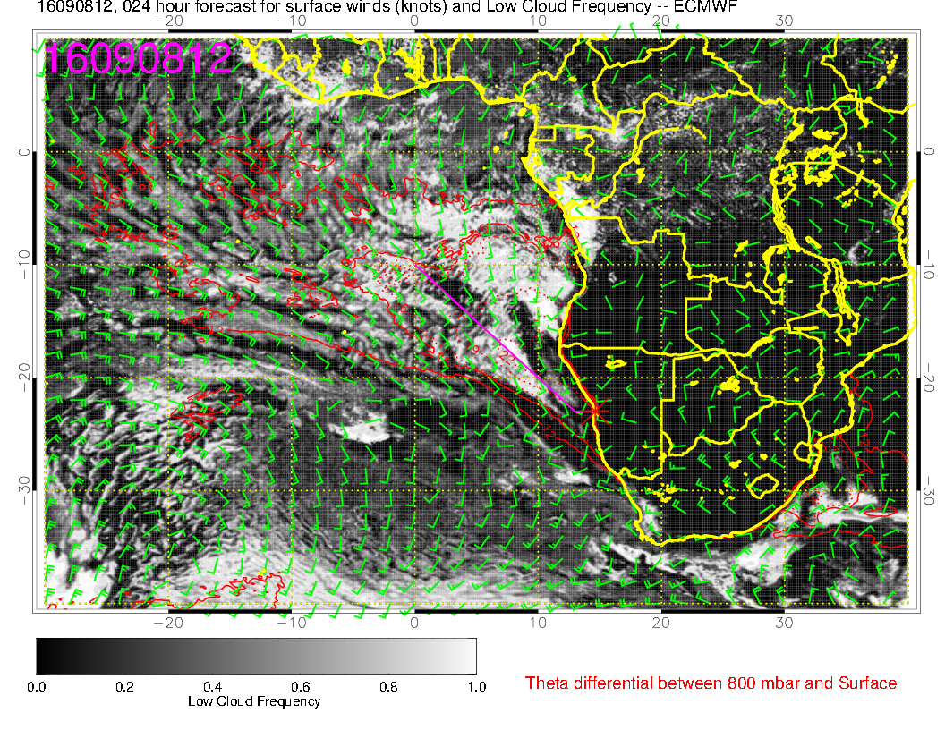
Forecast for 2 PM
today.
Perturbed region with
clearer spots propagates
northeastward in
association with moving
front

Slide 5
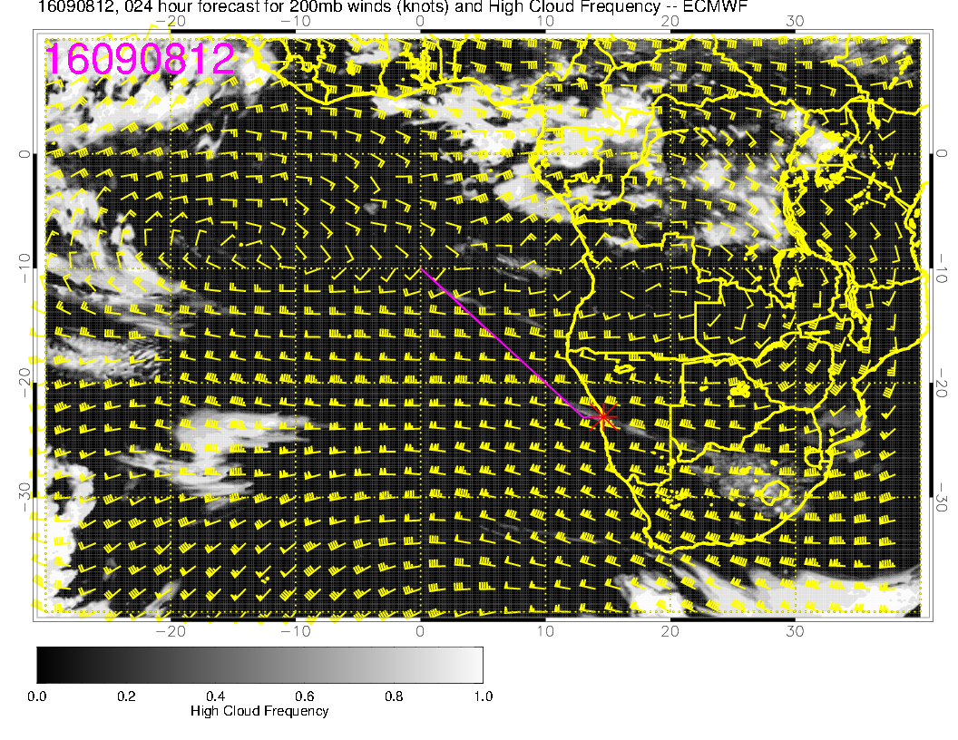
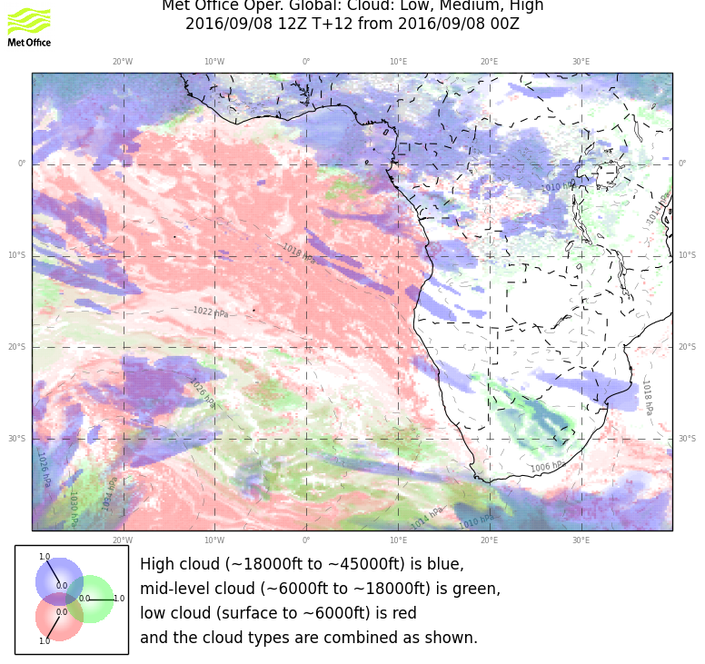
Some thin cirrus forecast in general
area of NW end of flight

Slide 6
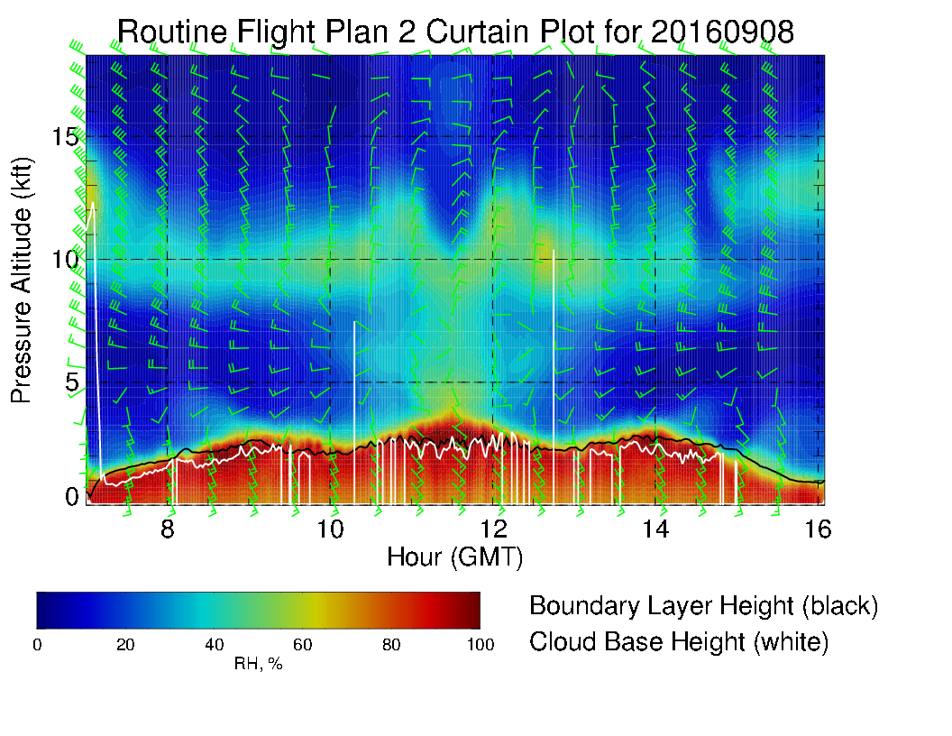

Slide 7
Airport conditions
Landing conditions today. No ceiling issues, winds SW at 15 knots.
TO today – no data yet, but I do not think the forecast fog materialized. 9 AM takeoff should happen.
Saturday – strong high moves in, winds offshore accelerate, clouds near shore reduced (slight offshore component)
TO – winds light, ceiling 600ft or higher
Landing – winds SW 15-20
Sunday – high pressure gradients reduced, more clouds, fog early, clearing between 8 AM and 11 AM. Afternoon, winds SW 10-15 knots
Monday – Better conditions than Sunday, less fog in the morning, winds OK

