Slide 1
ORACLES forecasting Briefing Verification
07-09-2016
Lenny Pfister

Slide 2
Summary for yesterday
EC model did very well on low and high cloud
Both models missed the middle cloud to the north (not a factor for the flight)
EC had the more accurate cirrus forecast

Slide 3
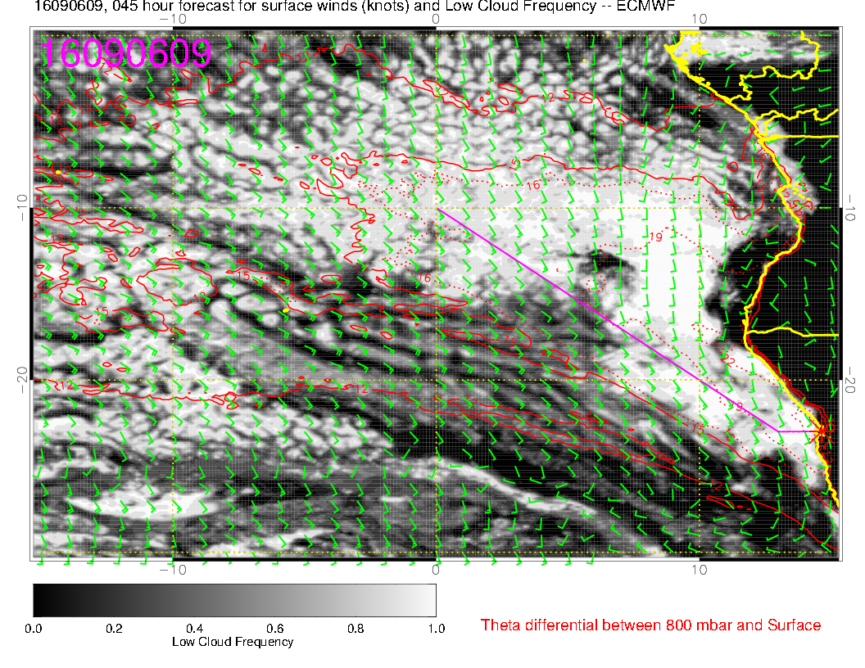
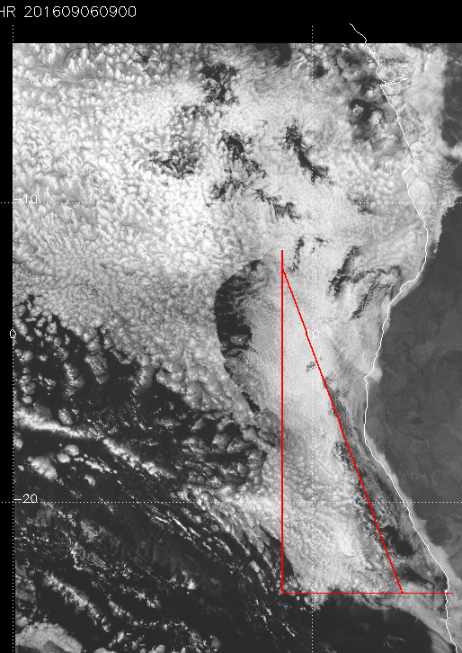

Slide 4
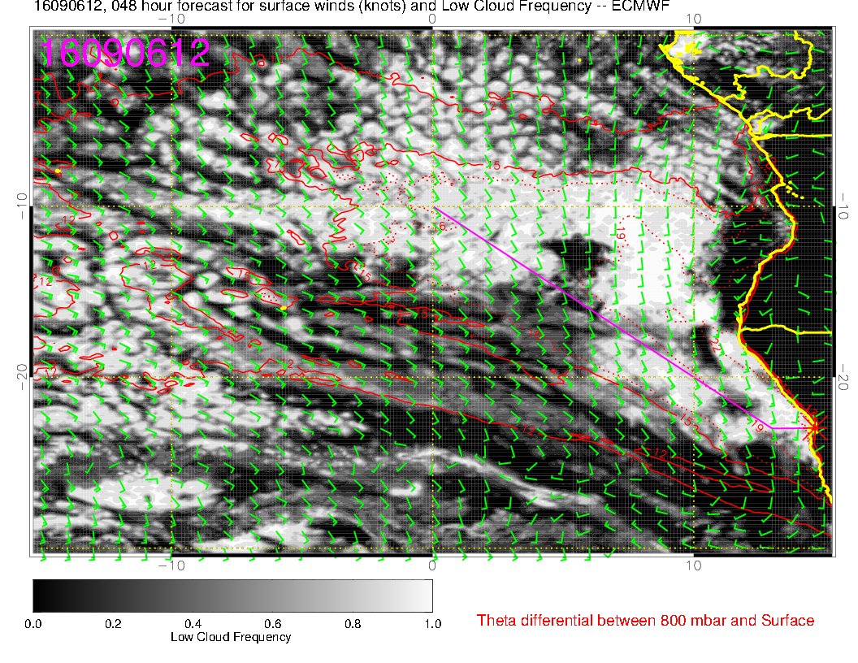
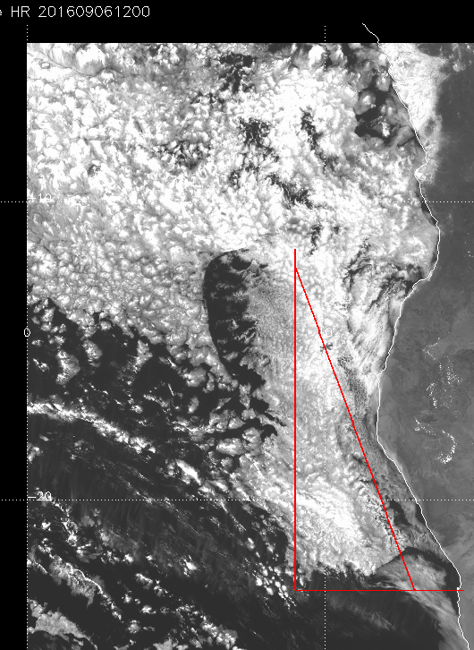

Slide 5
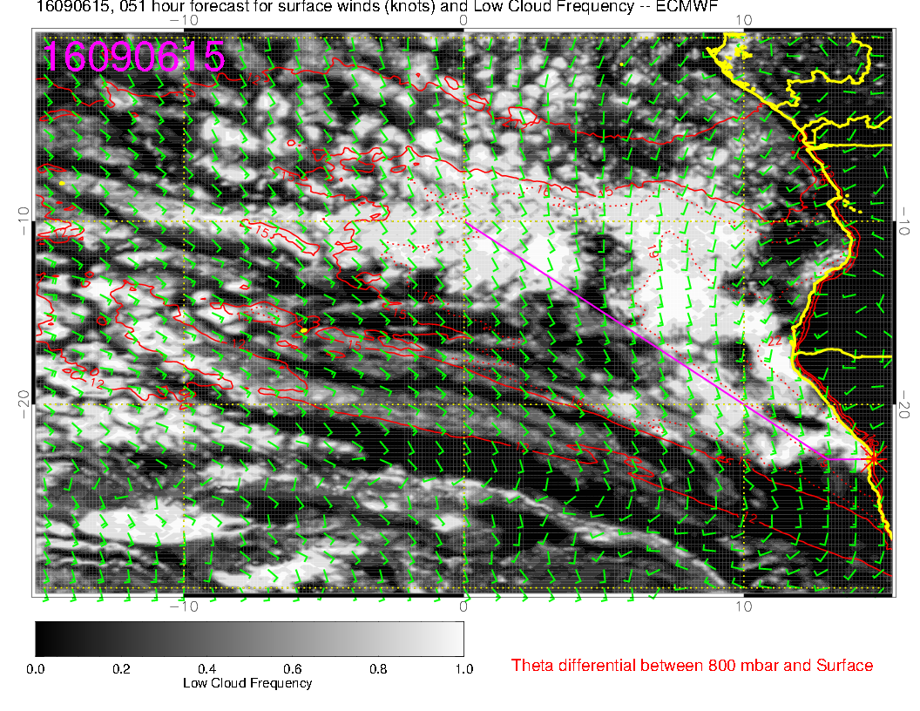

Slide 6
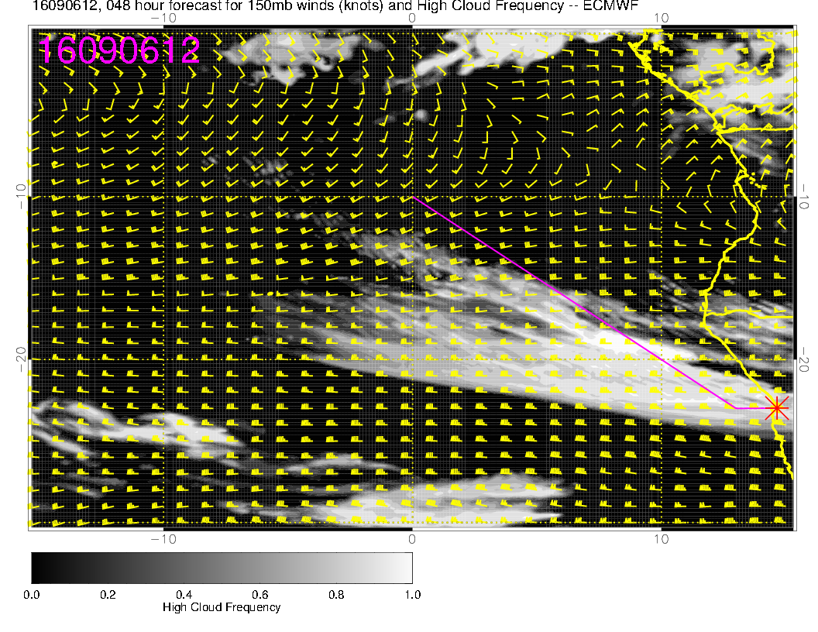
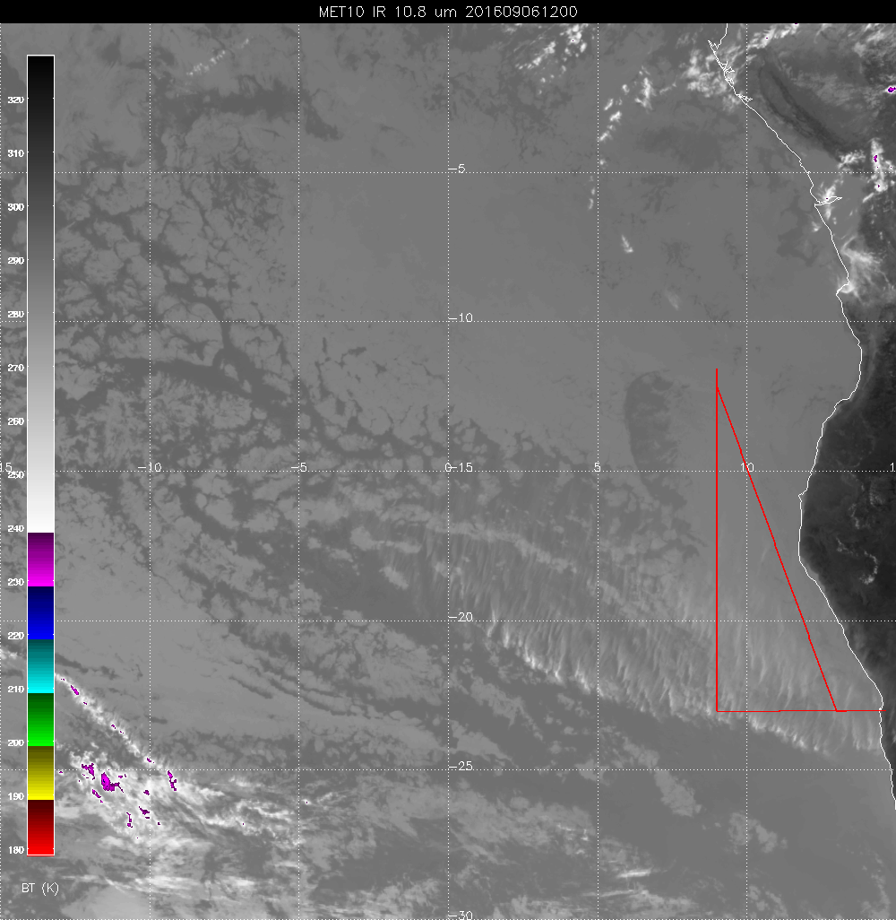

Slide 7
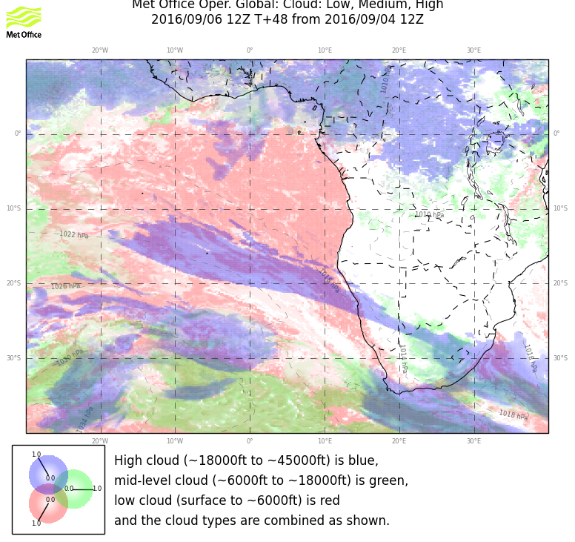

Slide 9
How well do we do on an earlier forecast cycle (as will happen for saturday’s flight)?
Look at this morning
Differences between forecast cycles are not large
Models capture major features in both runs – EC is actually better for the low cloud this time (not typical)
UKMO cirrus is too large
Note past experience
Models have trouble with mid cloud
EC will clear too much low cloud, but model cycles (66 vs 42) don’t have much effect.

Slide 10
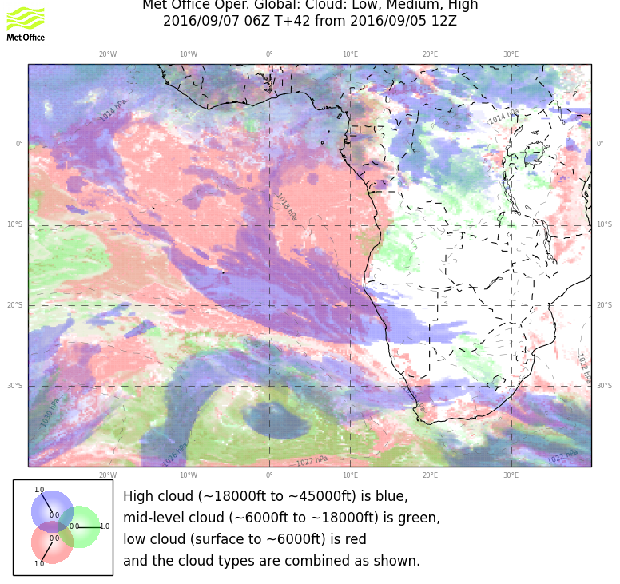
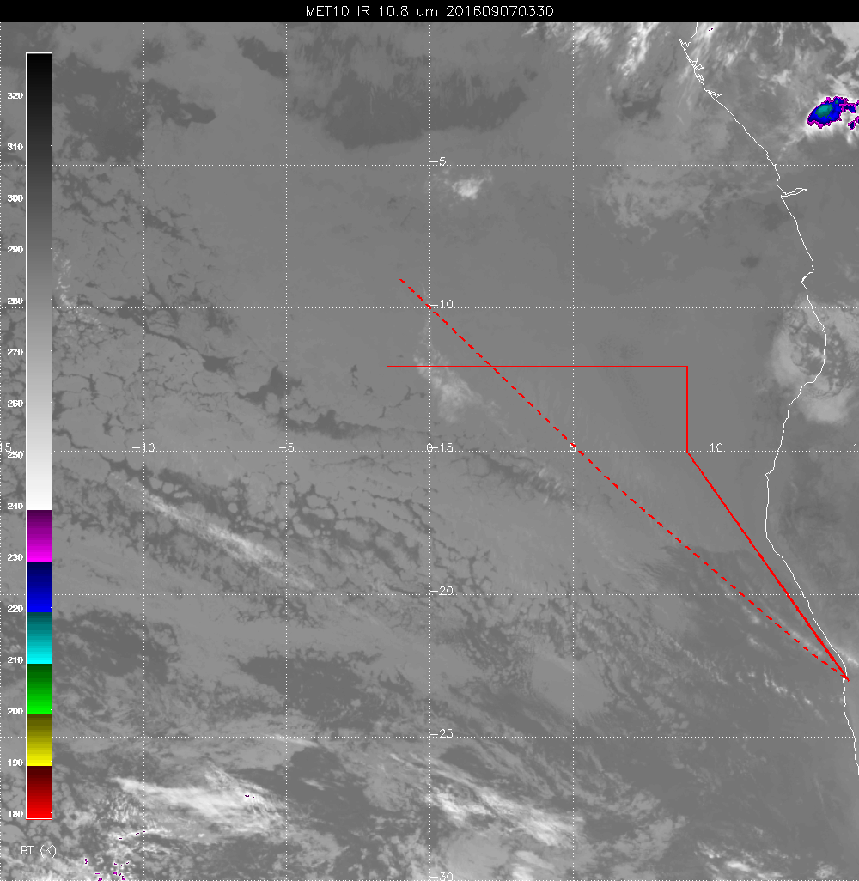

Slide 11
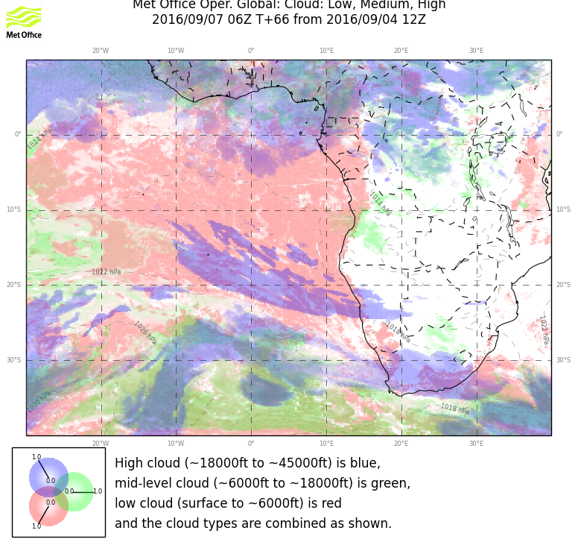

Slide 12
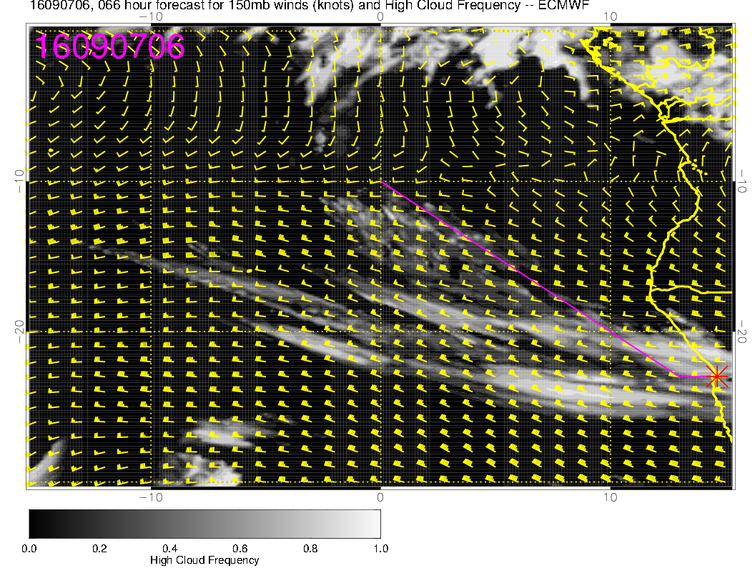
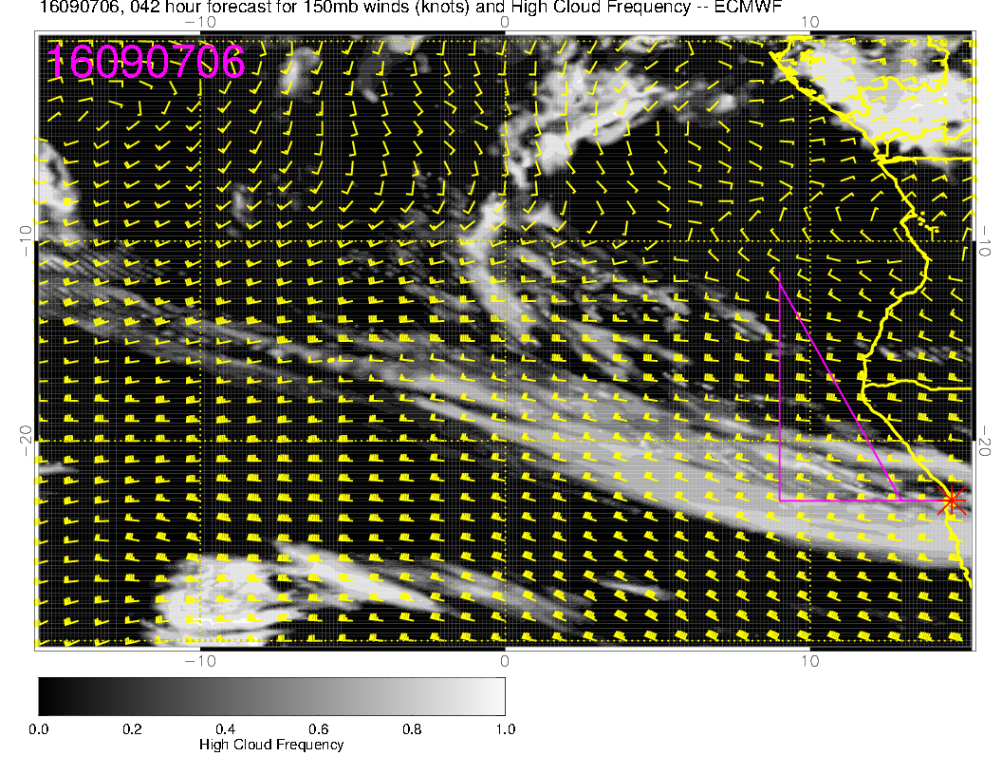
66 hour fcst
42 hour fcst

Slide 13
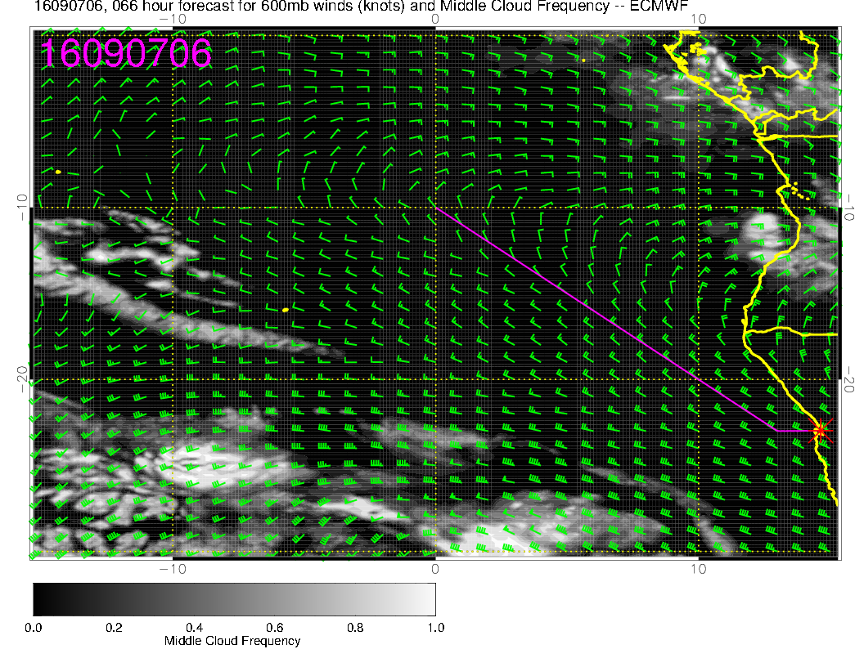
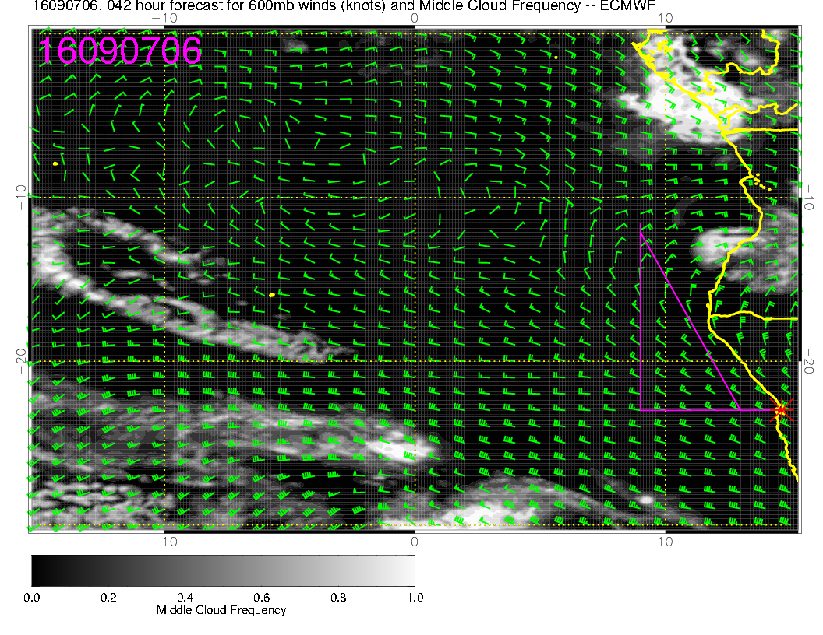
66 hour fcst
42 hour fcst

Slide 14
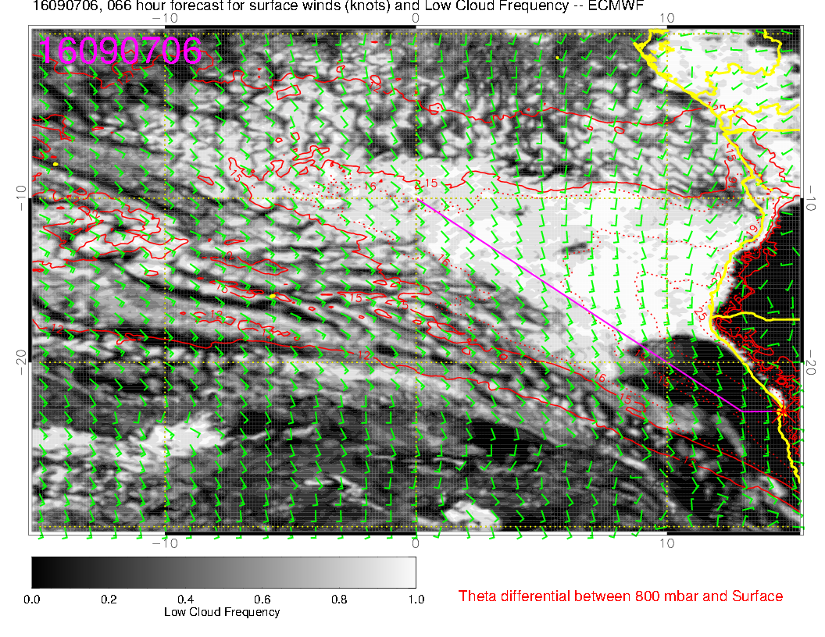
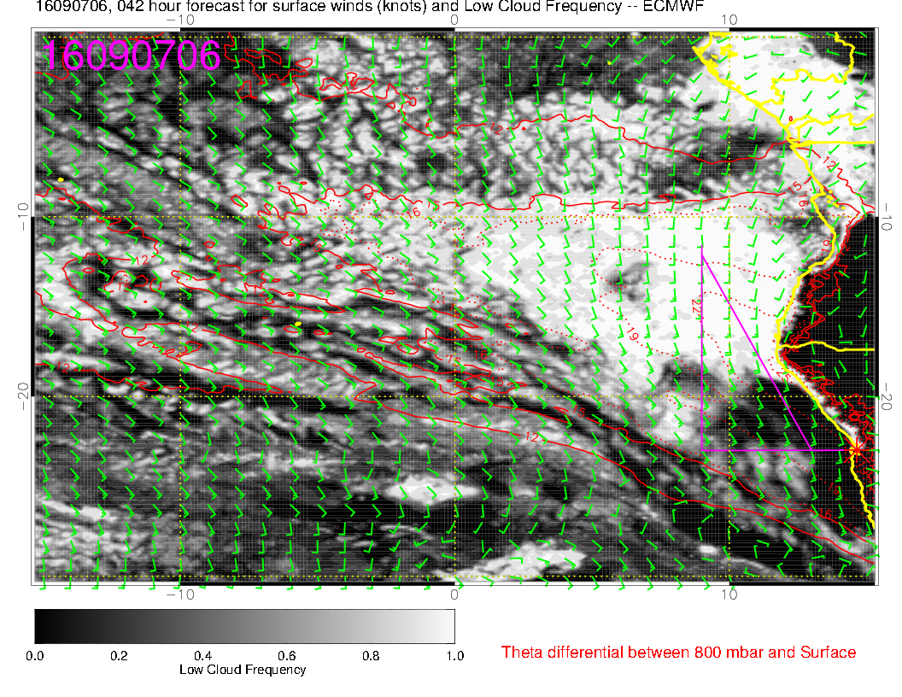
66 hour fcst
42 hour fcst

Slide 15
Airport conditions
Tomorrow TO: ceilings lift between 8 and 11 AM; light winds
Tomorrow Landing: no ceiling, winds SW 10 knots
Saturday TO: Front to our south, higher winds offshore, stronger pressure gradient, ceilings OK, winds south at 5-10
Saturday landing: no ceiling issues, winds SW 10-15
Sunday TO: Ceilings lift between 8 and 11 AM; south winds
Sunday landing: winds SW at 10, may close in sooner than typical (but OK at 5PM).

