Slide 1
ORACLES forecasting Briefing Aerosols
07-09-2016

Slide 2
Sept 6 2016 (model evaluation)

Slide 3
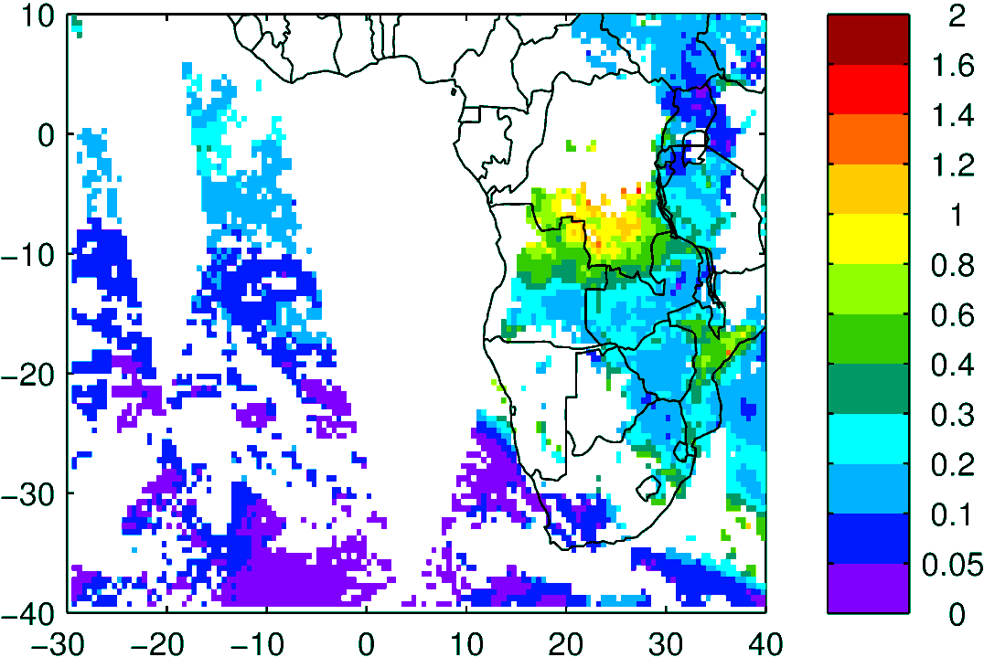
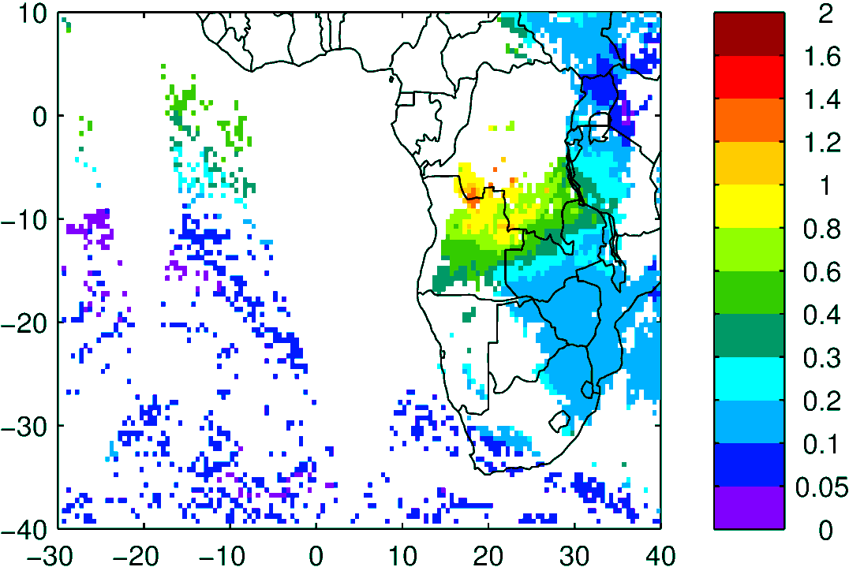
Terra & Aqua AOD (clear-sky)
MODIS NNR
WRF-AAM

Slide 4
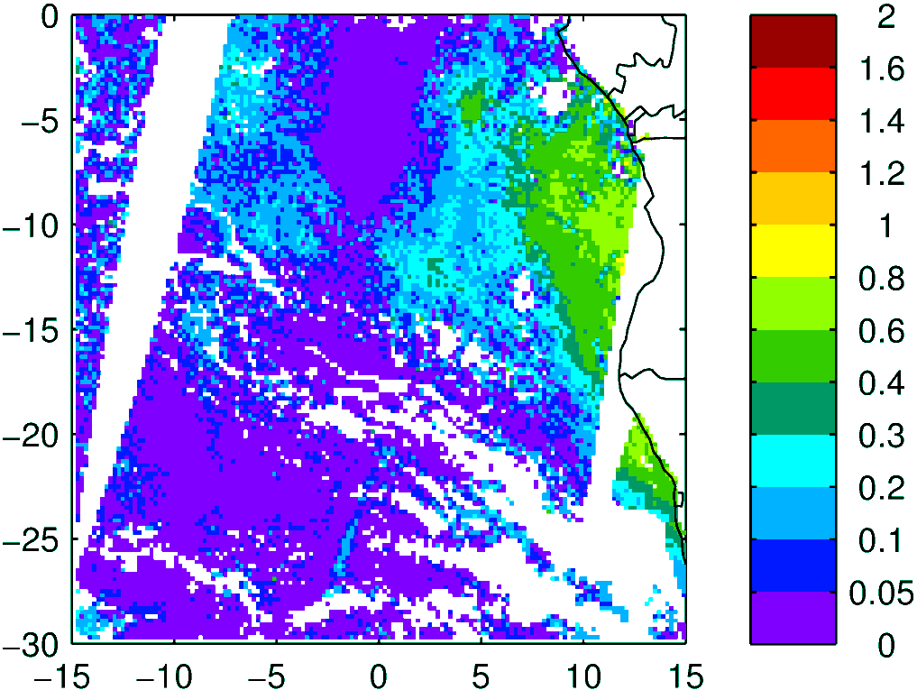
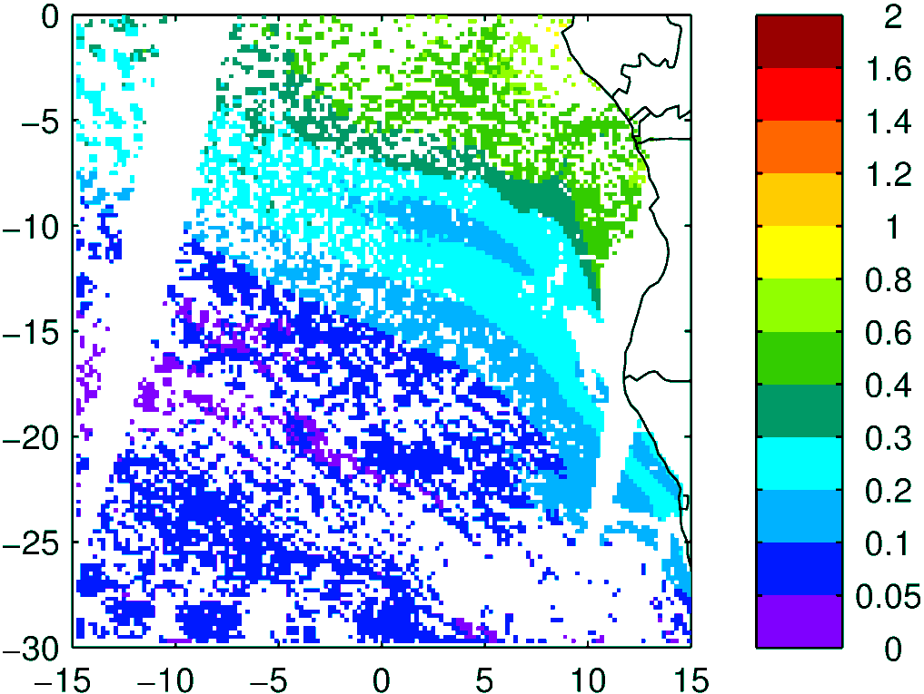
Above Cloud AOD (thanks Kerry!)
Observation
Model (WRF-AAM)
Terra

Slide 5
Sep 08 2016 Thursday (routine flight)

Slide 6
84 h – 08 Sep
72 h – 08 Sep
72 h – 08 Sep
48 h – 08 Sep
60 h – 08 Sep
48 h – 08 Sep

Slide 8
48 h – 08 Sep
72 h – 08 Sep

Slide 9
Sept 9 2016

Slide 10
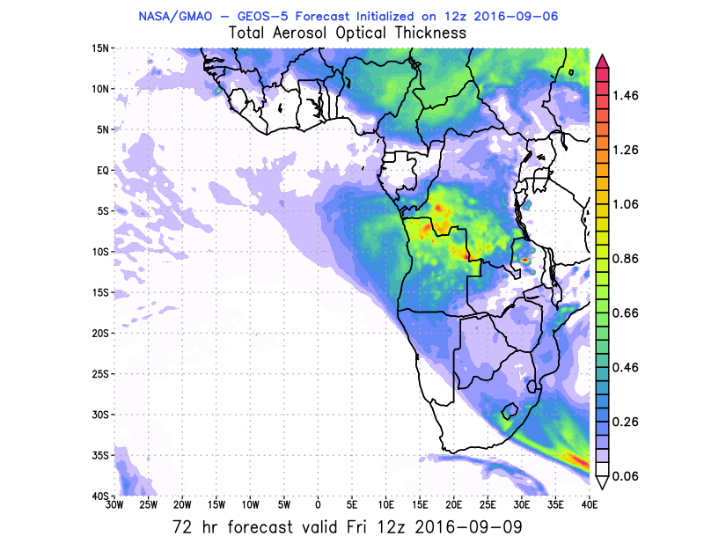
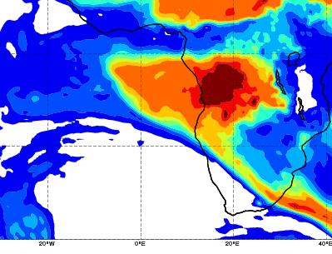
AOD 12 UTC
CAMS
GEOS5

Slide 11
Sept 10 2016

Slide 12
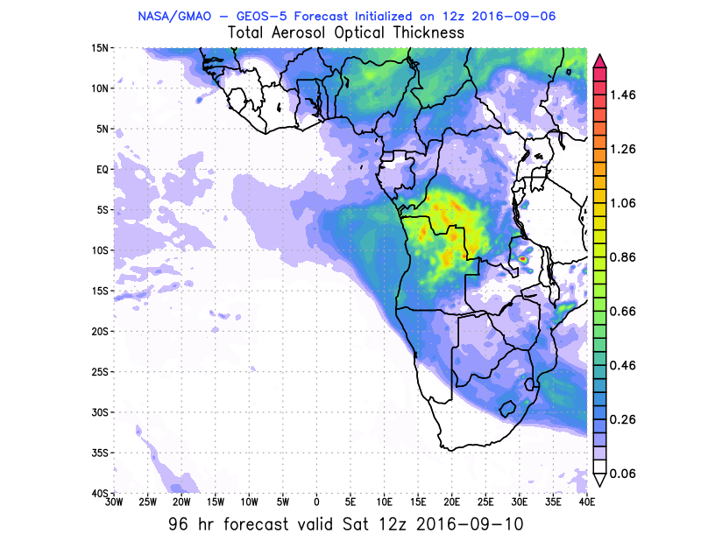
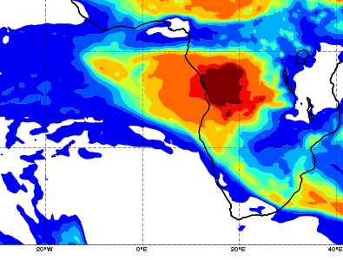
AOD 12 UTC
CAMS
GEOS5

Slide 13
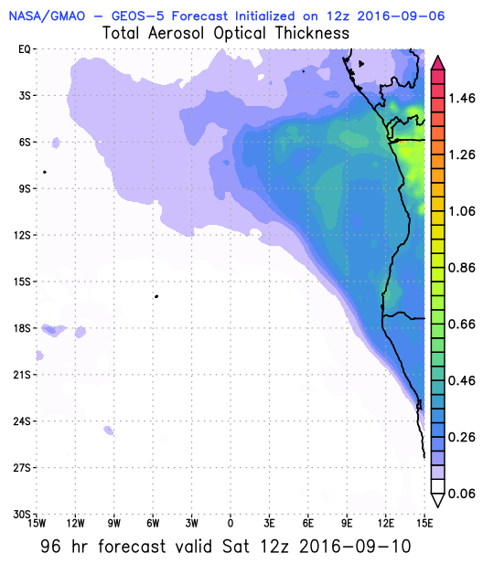
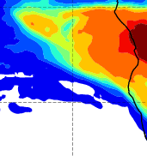
AOD 12 UTC

Slide 14
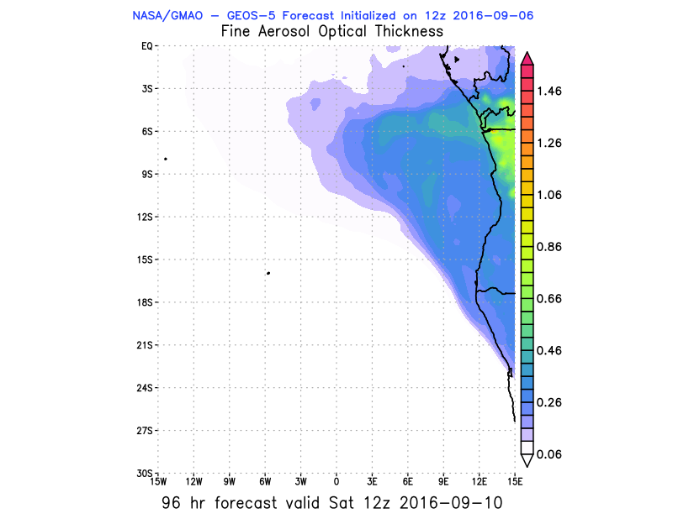
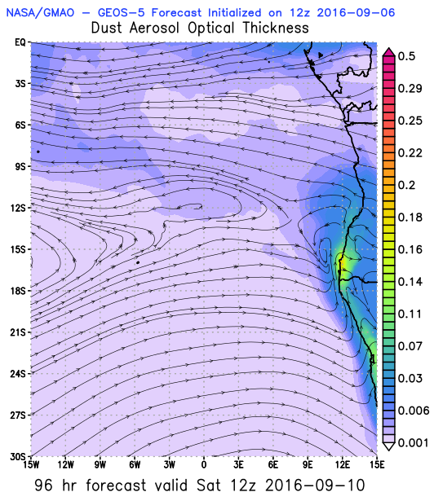
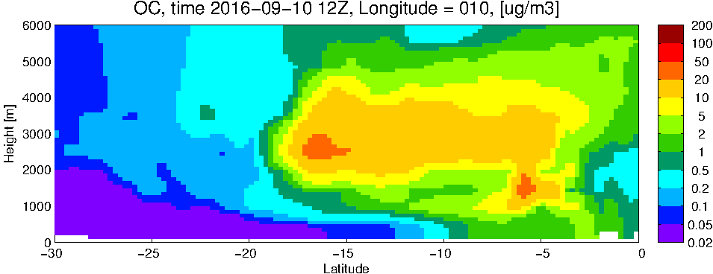
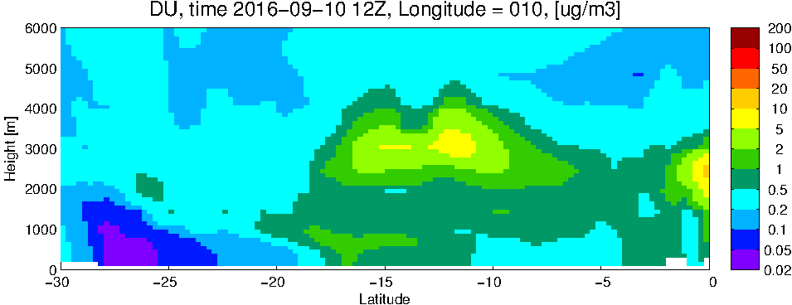
GEOS5
Fine AOD
Dust
OC
Dust

Slide 15
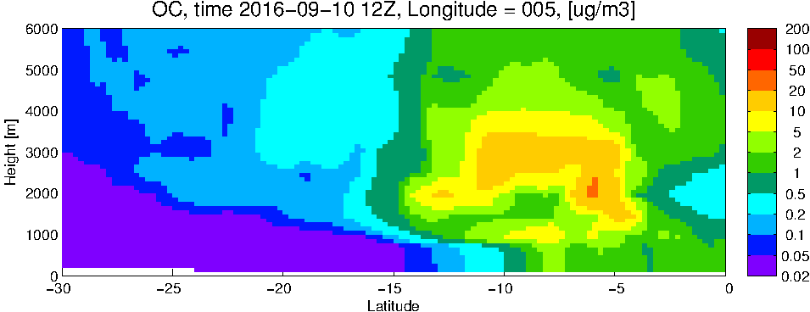
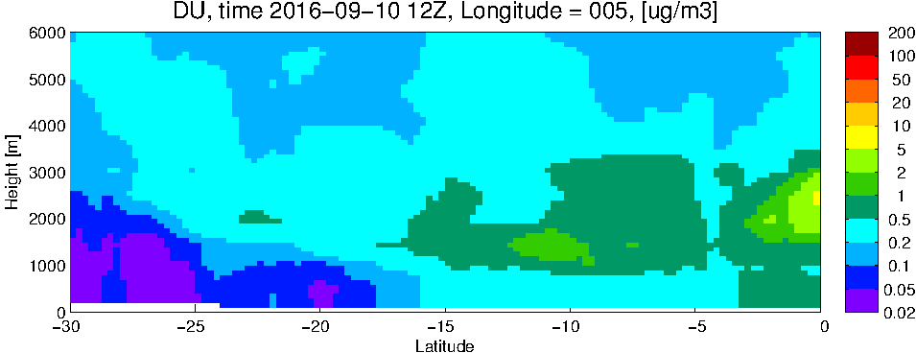
GEOS5
Fine AOD
Dust
OC
Dust

Slide 16
Sep 11 2016 Sunday (hard down day)

Slide 17
AOD 12 UTC
GEOS-5
120 h – 11 Sep

