Slide 1
ORACLES forecasting Briefing Meteorology – verif and today’s flt
06-09-2016
Lenny Pfister

Slide 2
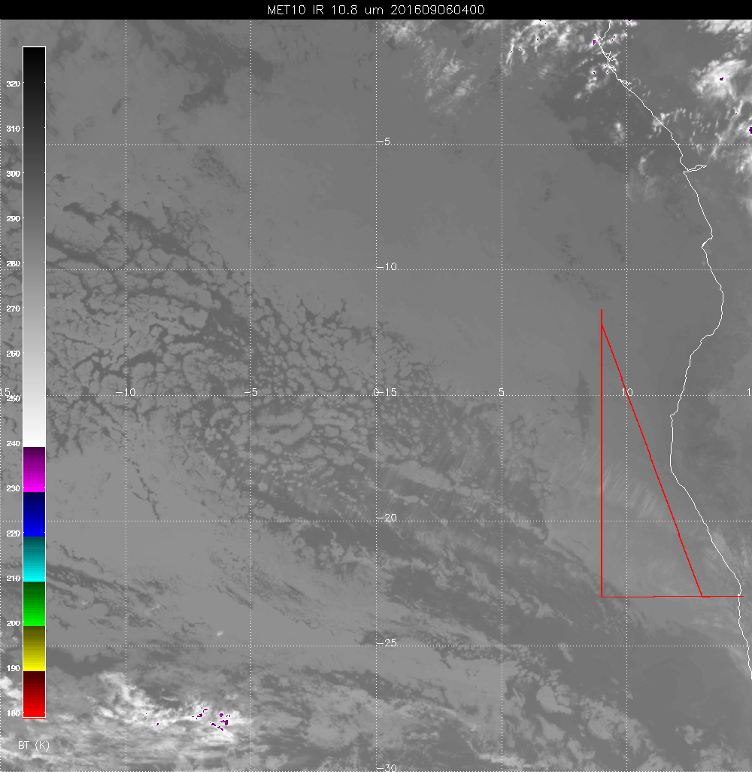
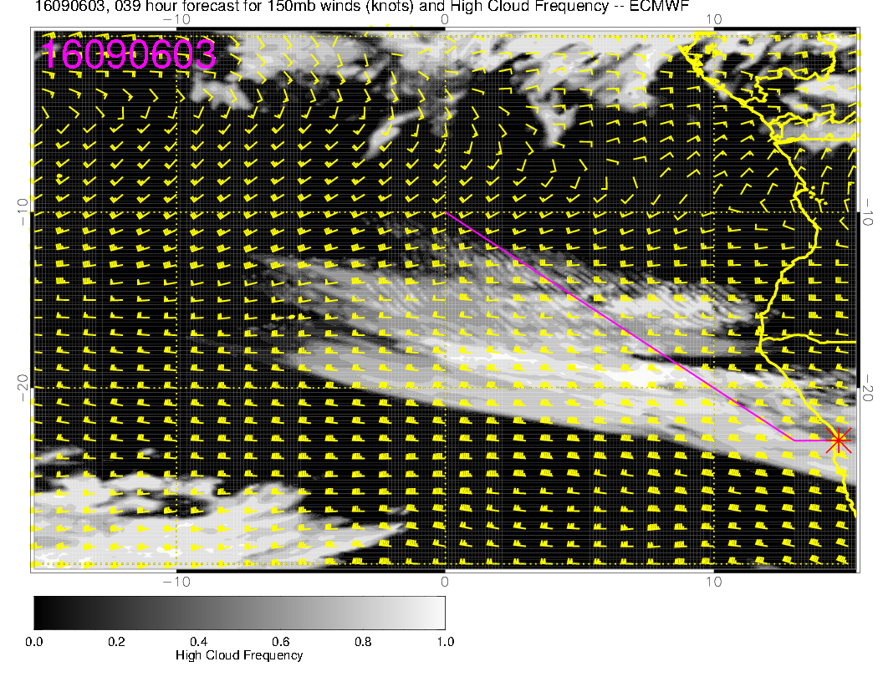
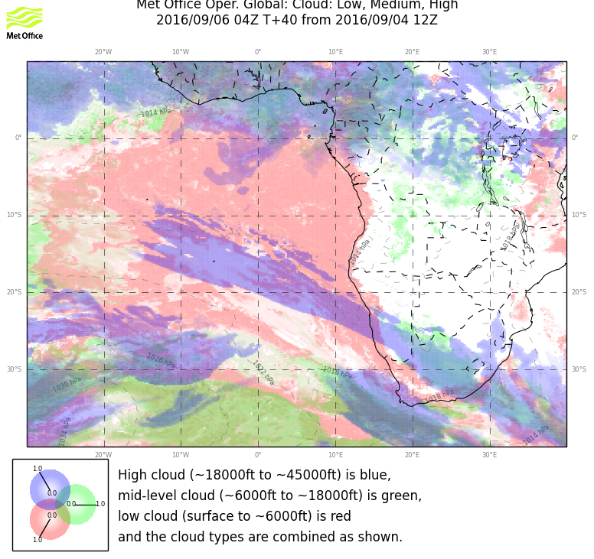
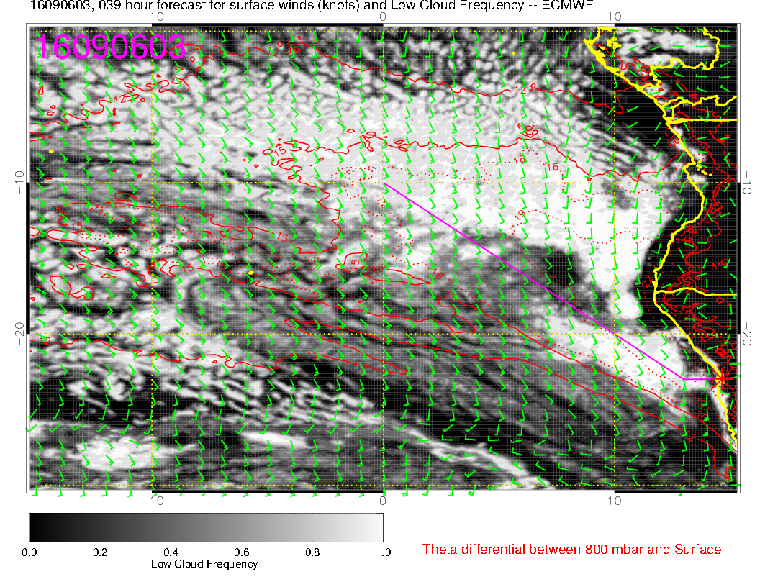
Forecast used
yesterday. Break in
low clouds overdone
by EC. Cirrus extending
too far north in EC.
Middle clouds up north
are not in any forecst

Slide 3
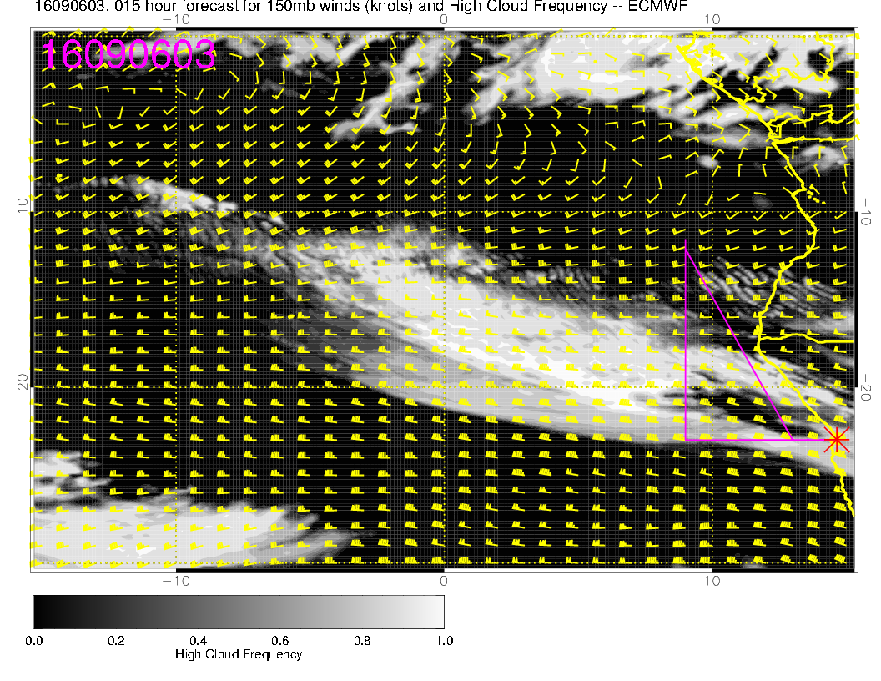
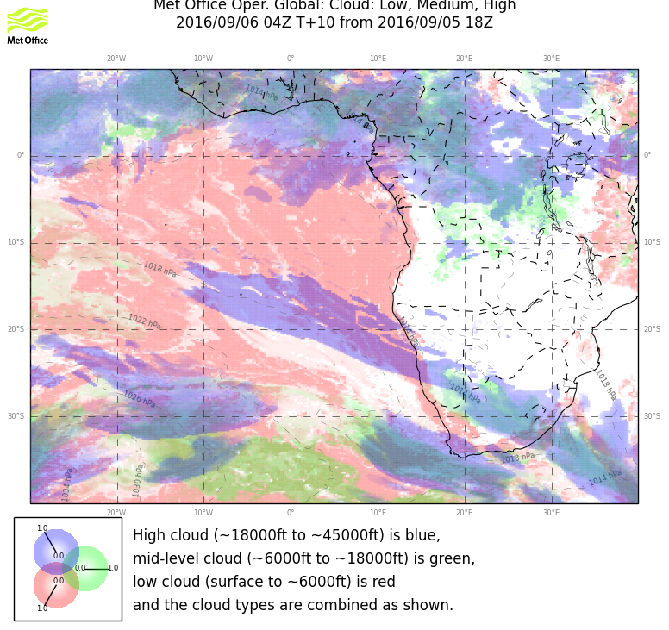
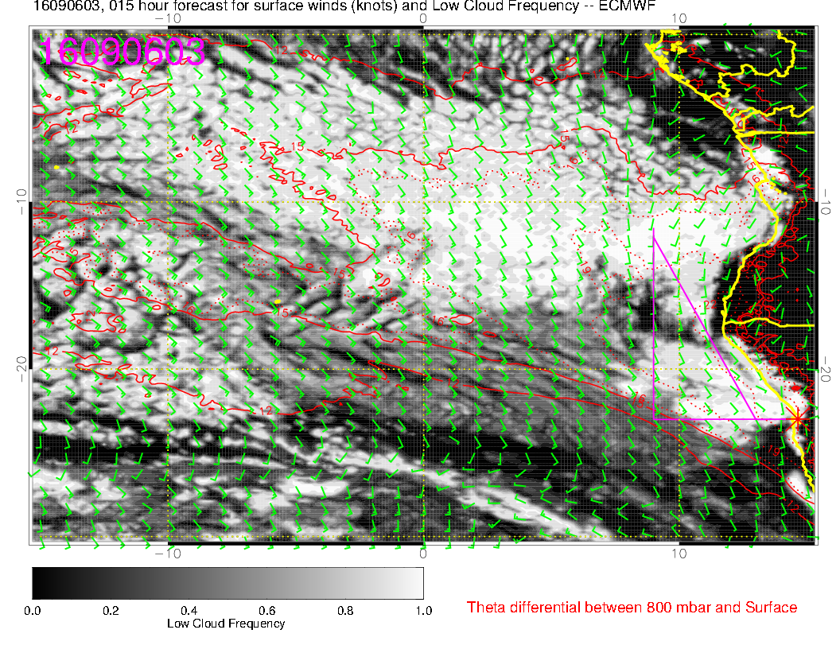
Latest run available. EC
a bit better on the cirrus.
Neither model has the mid
cloud in the picture.
Separation forecast by EC
not in the data
4 Z image

Slide 4
Today’s flight

Slide 5
Summary
Cirrus is about where it was forecast, 17S.
Likely to move northward by as much as 4 degrees during the flight (EC). Very thin.
EC model has low cloud, now fairly “solid” except for SW corner of flight, breaking up to 10E, 15S. Overdone, will go with UKMO more modest retreat.

Slide 6
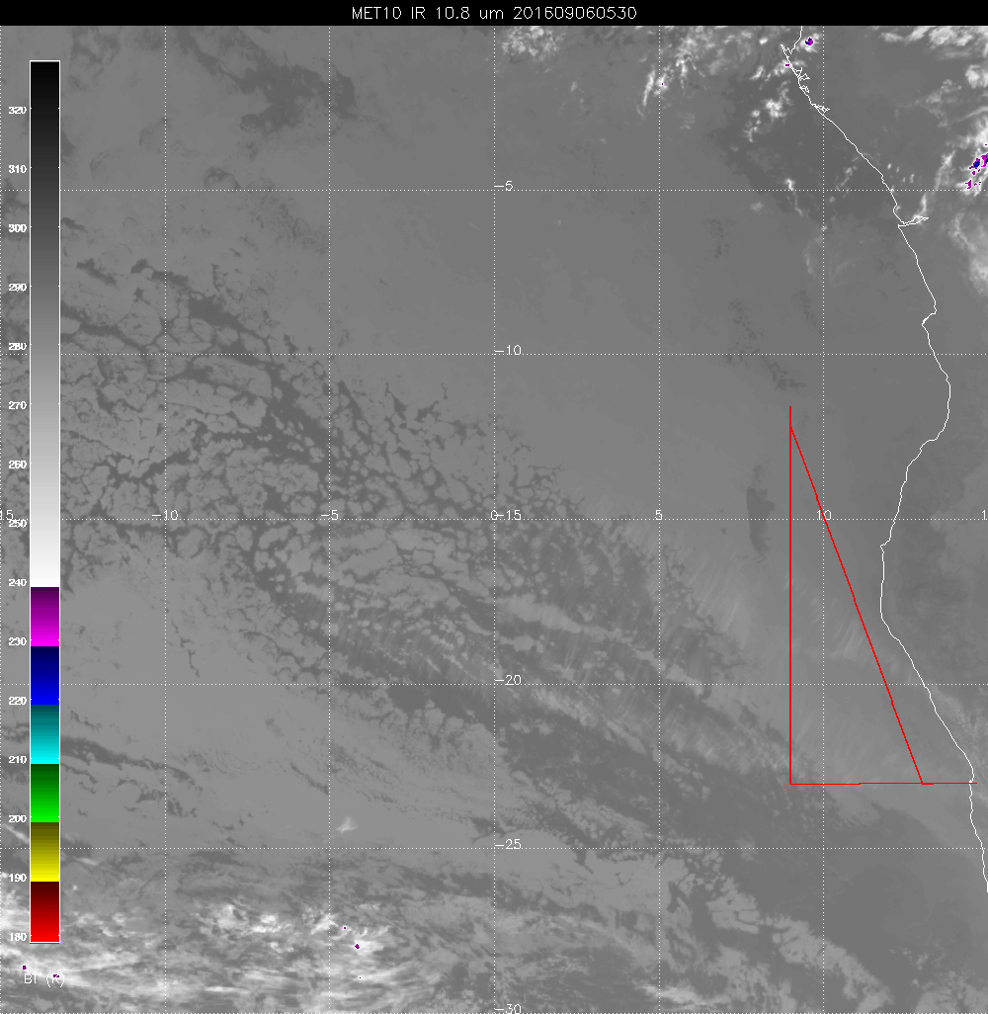
Break is moving NWrd with the
low level wind
Should watch mid-level cloud
propagating in from the north.
Could be at north end in 6-9 hours
Not in the forecasts.

Slide 7
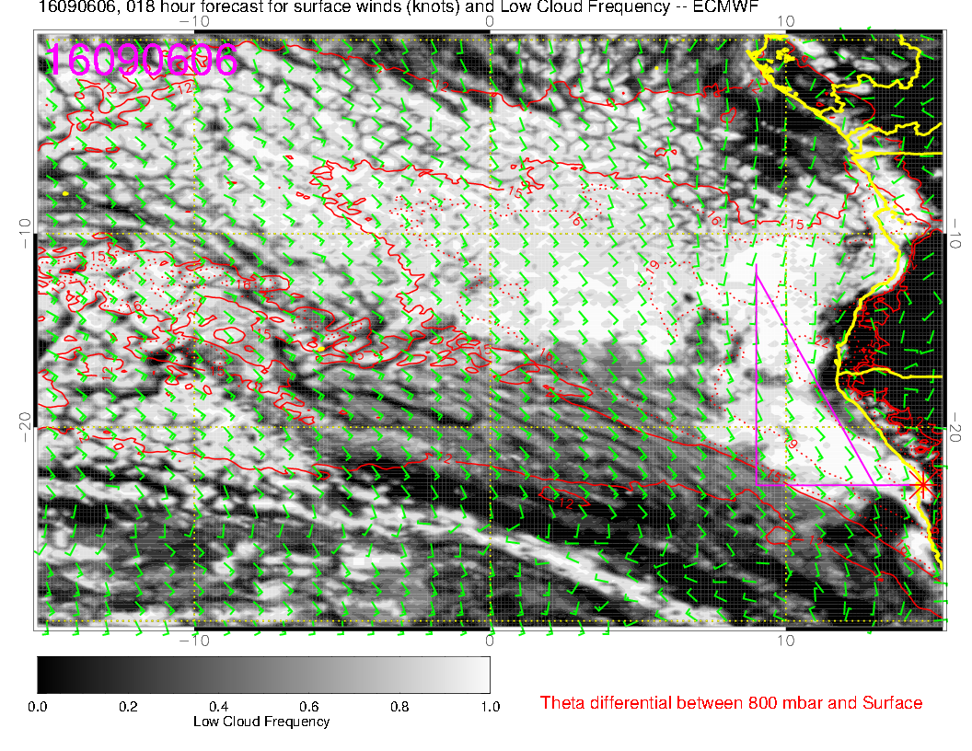
8 AM

Slide 8
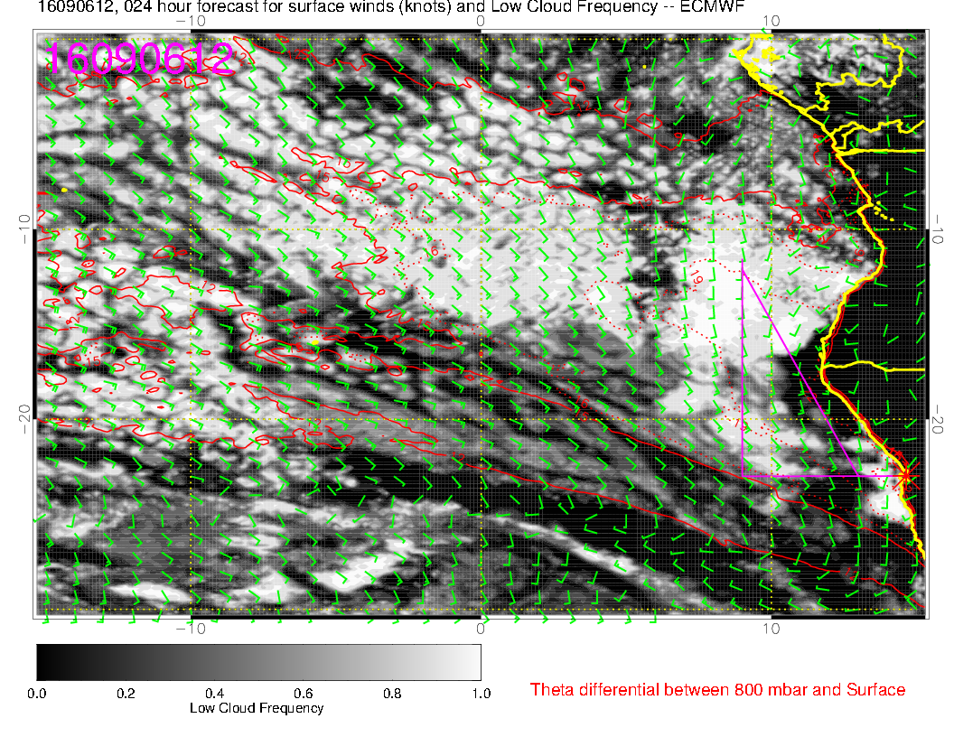
2 PM

Slide 9
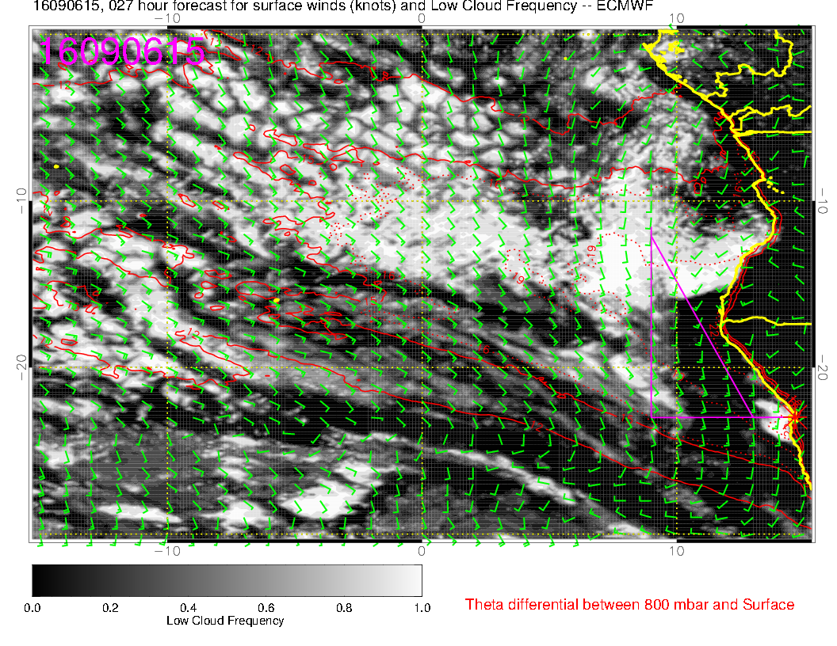
5 PM

Slide 10
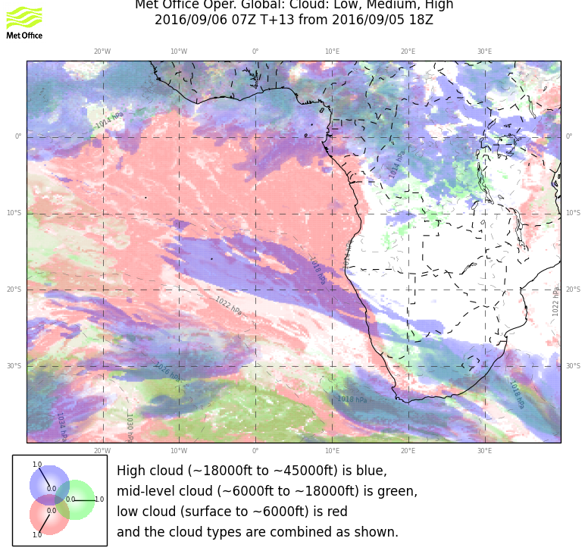
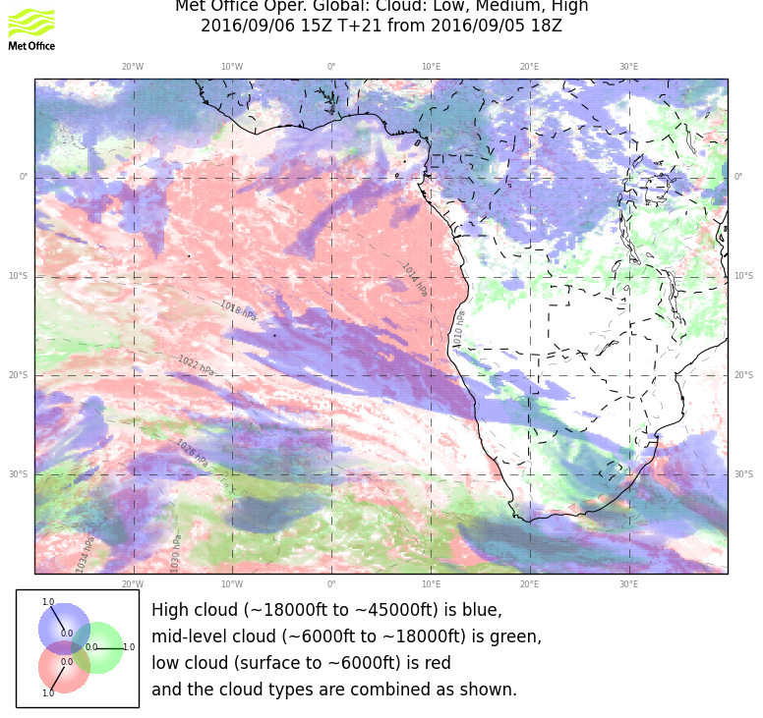
9 AM and 5 PM This more modest retreat
of low clouds is more likely

Slide 11
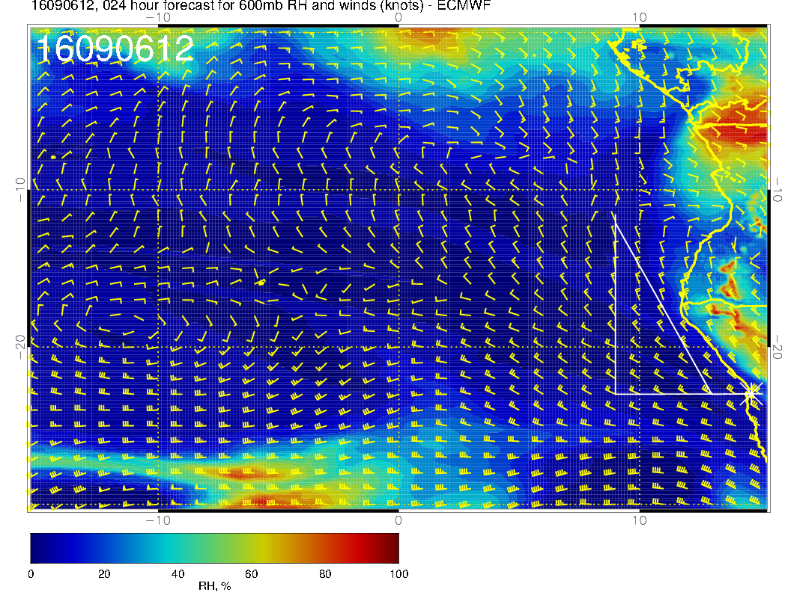
15-30 knots on
the way back
tailwind

Slide 12
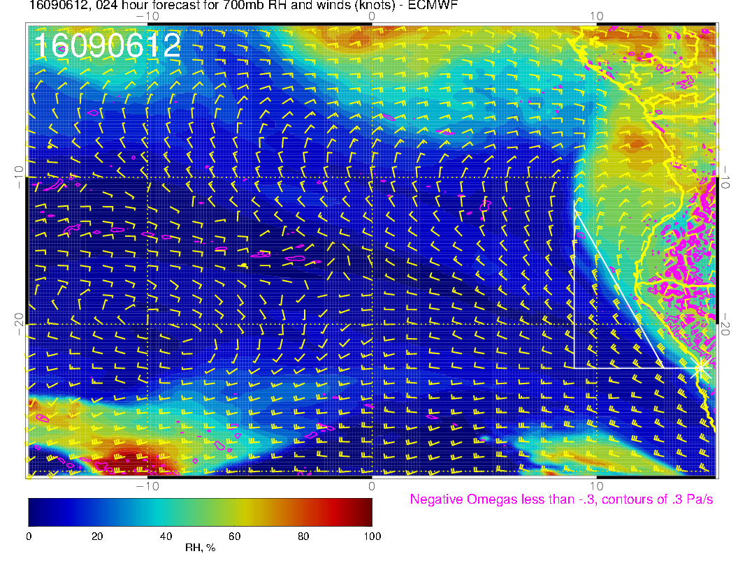

Slide 13
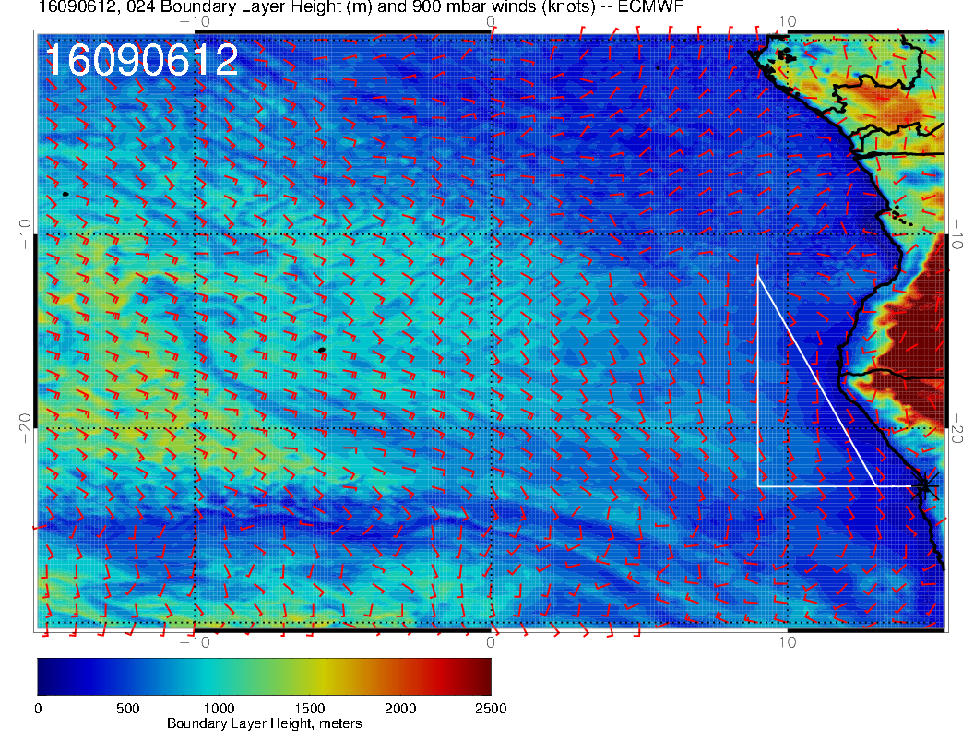

Slide 14
