Slide 1
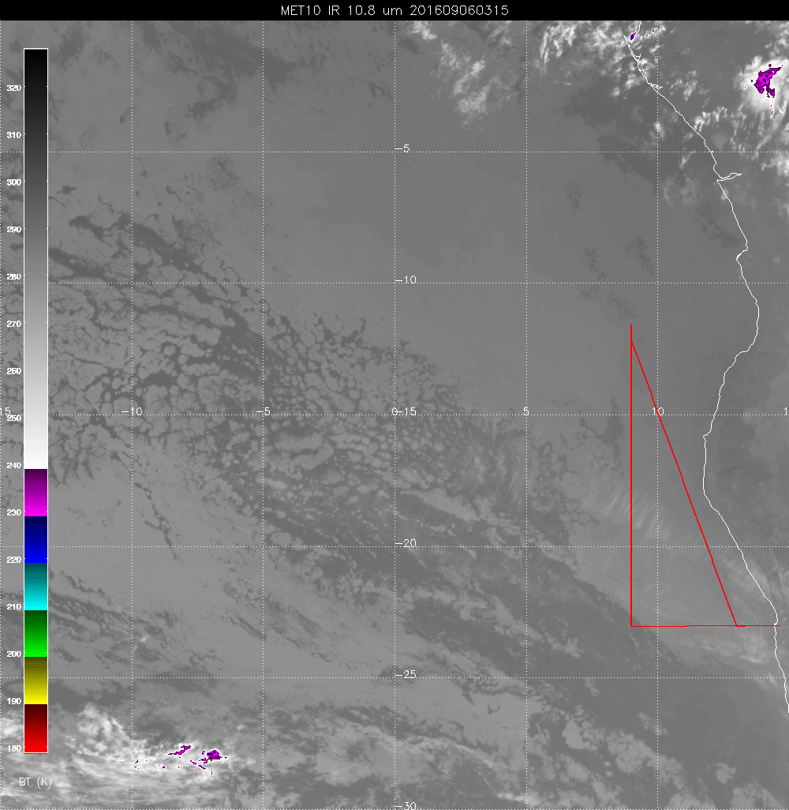
Less cirrus than expected
Thin cirrus to about
17S attm It is very
thin and not expected
to become thicker.
Northward movement
expected
during the flight.
As much as 4 degrees.

Slide 2
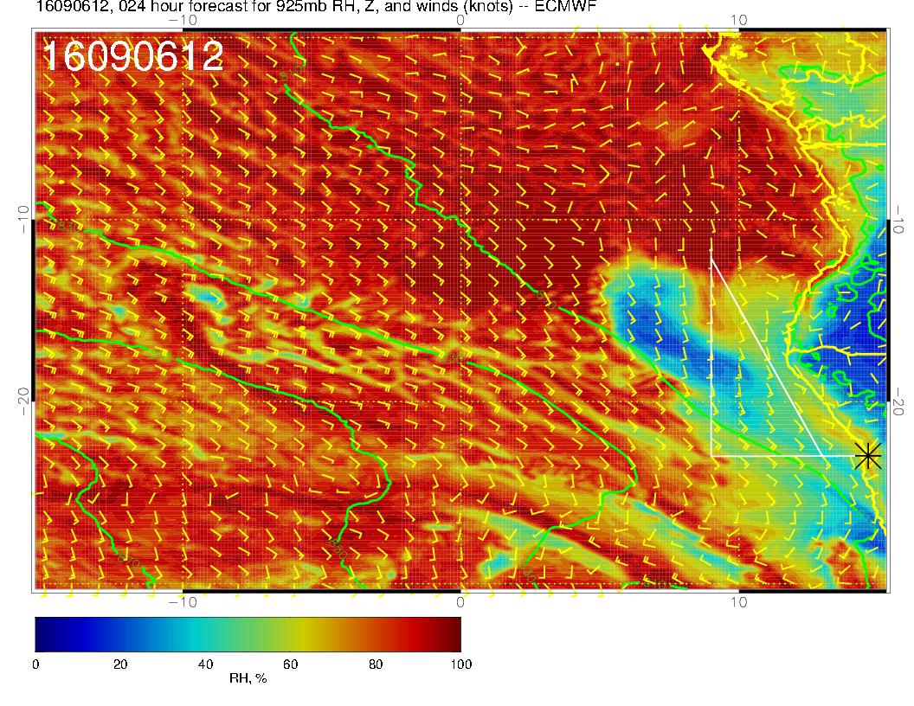

Slide 3
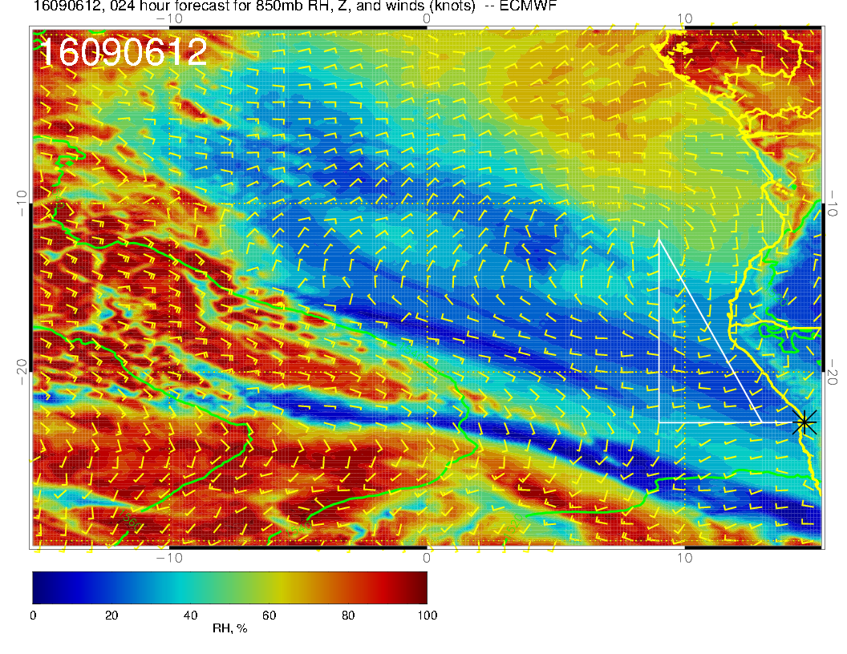

Slide 4
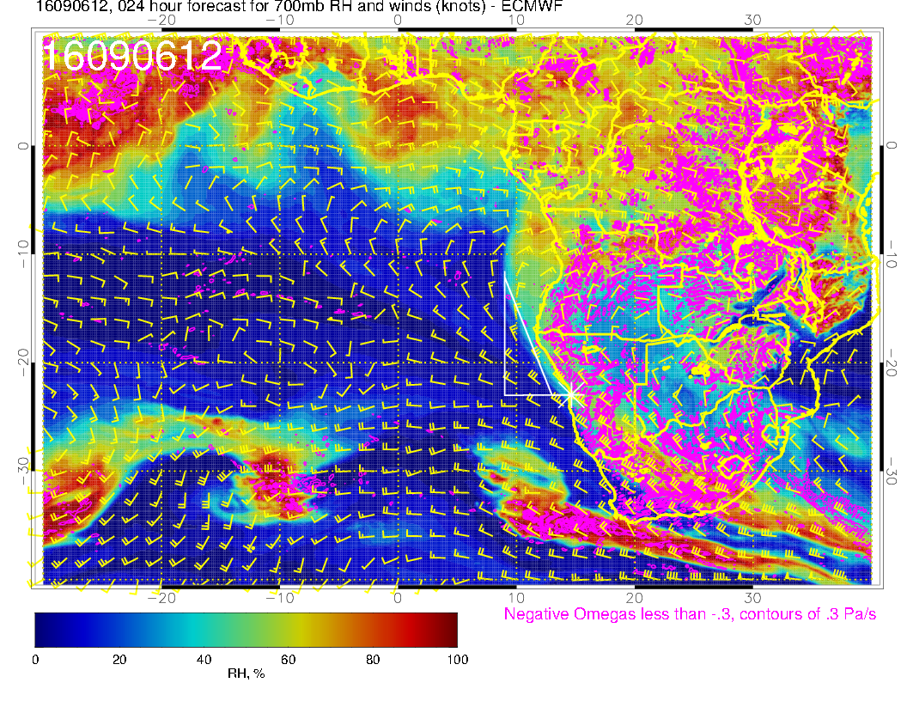

Slide 5
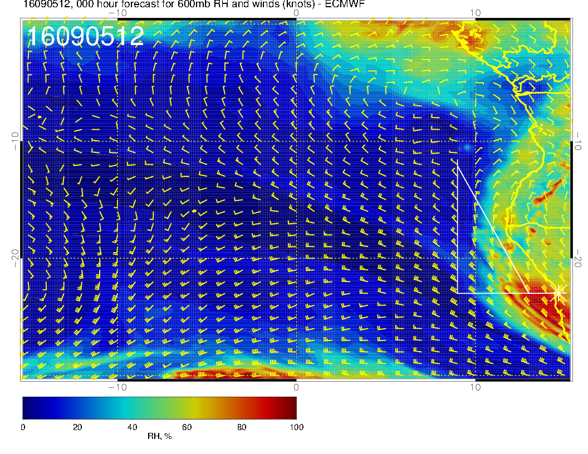

Slide 6
