Slide 1
ORACLES flight package for Greg Meteorology
06-09-2016
Lenny Pfister

Slide 2
Summary
Cirrus is about where it was forecast, 17S.
Likely to move northward by as much as 4 degrees during the flight (EC). Very thin.
EC model has low cloud, now fairly “solid” except for SW corner of flight, breaking up to 10E, 15S. Overdone, will go with UKMO more modest retreat.

Slide 3
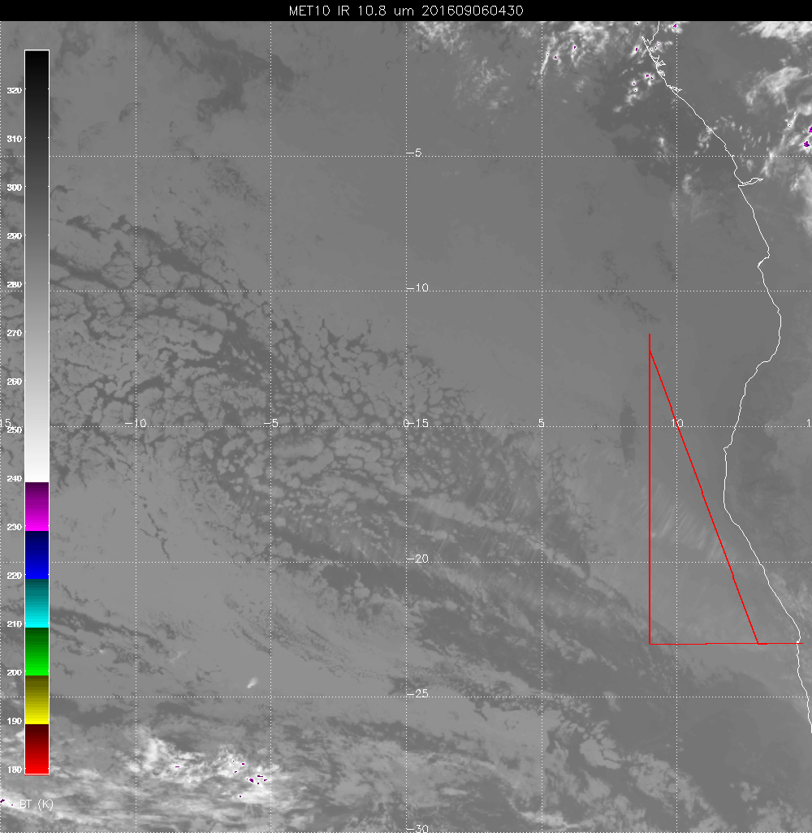

Slide 4
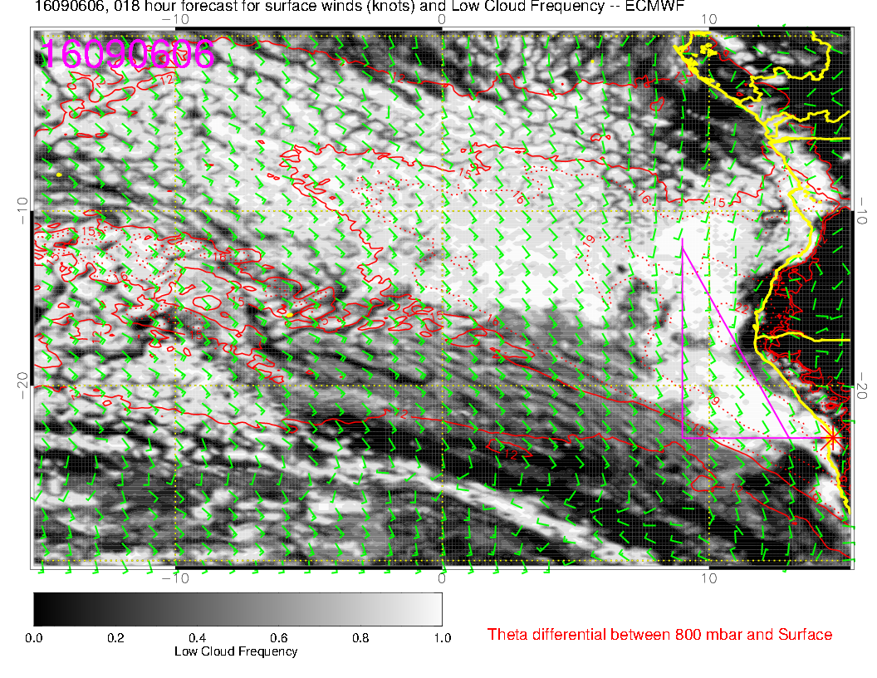

Slide 5
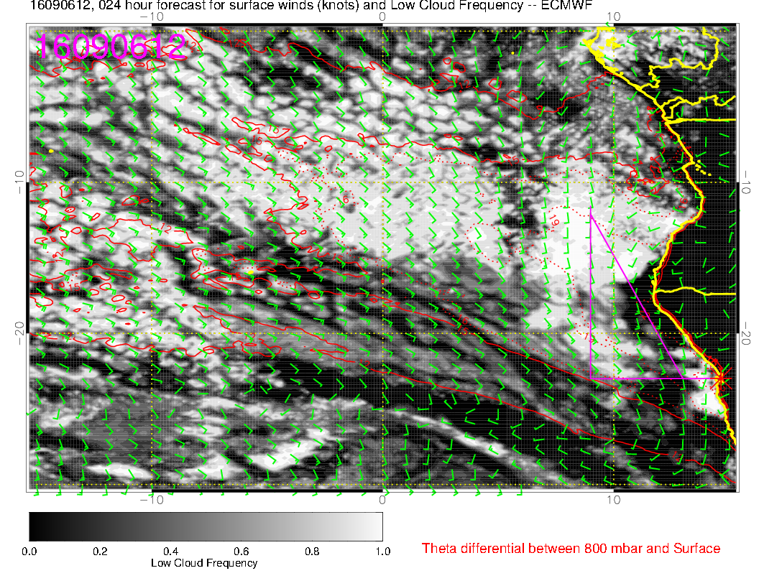

Slide 6
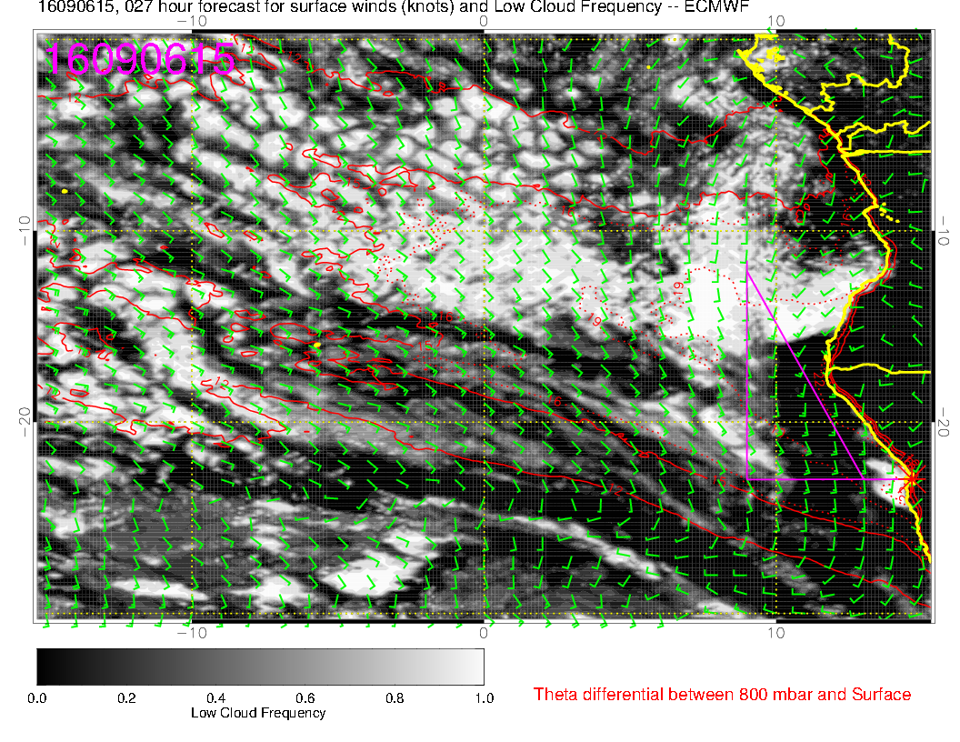

Slide 7
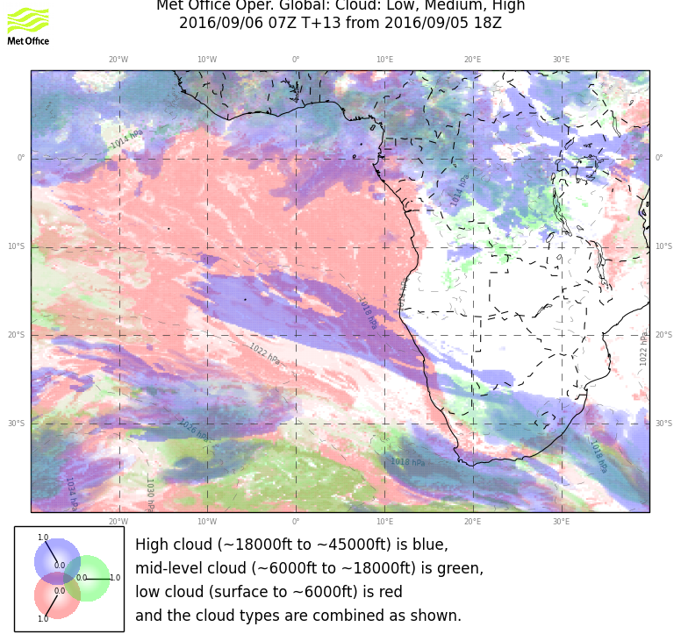
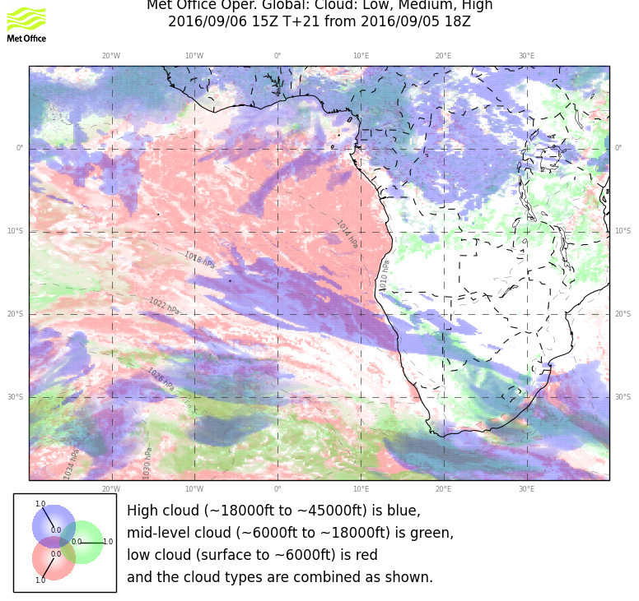

Slide 8
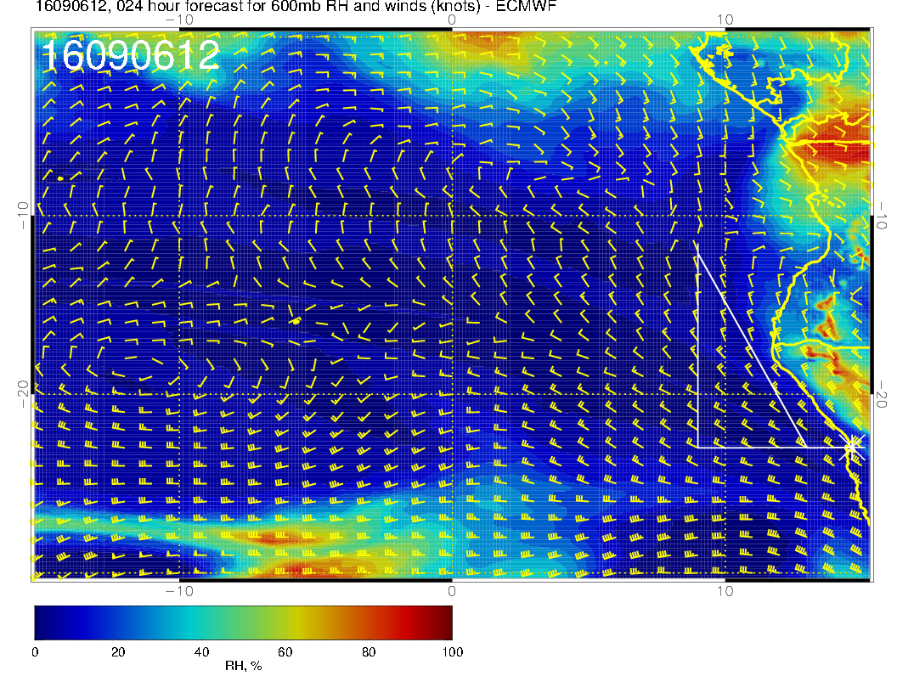

Slide 9
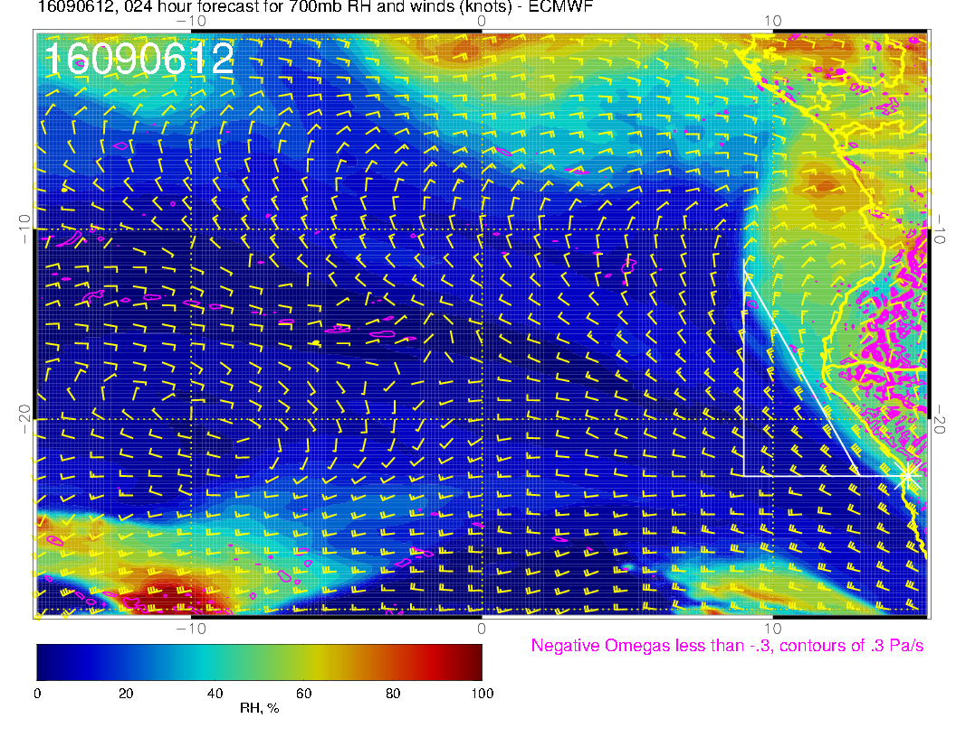

Slide 10
