Slide 1
ORACLES forecasting Briefing Meteorology
05-09-2016
Lenny Pfister, Susanne Bauer

Slide 2
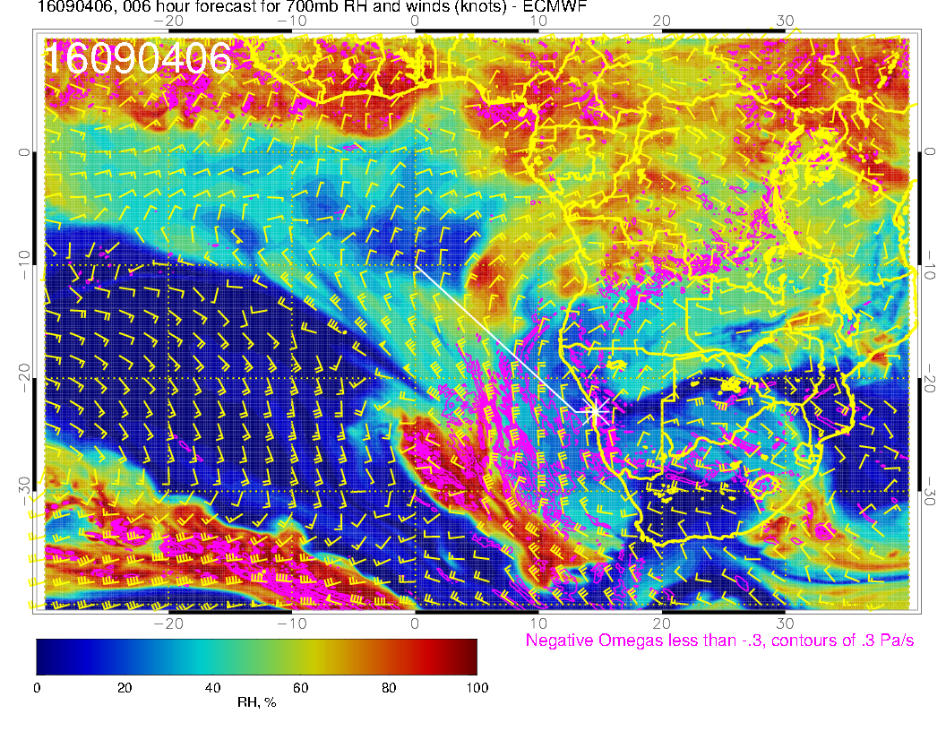
700mb vertical
velocity, RH, and wind
yesterday morning.
Strong wave disturbance
yesterday included some
convection, and a
“subtropical front”
Likely had strong downward
as well as upward motion.

Slide 3
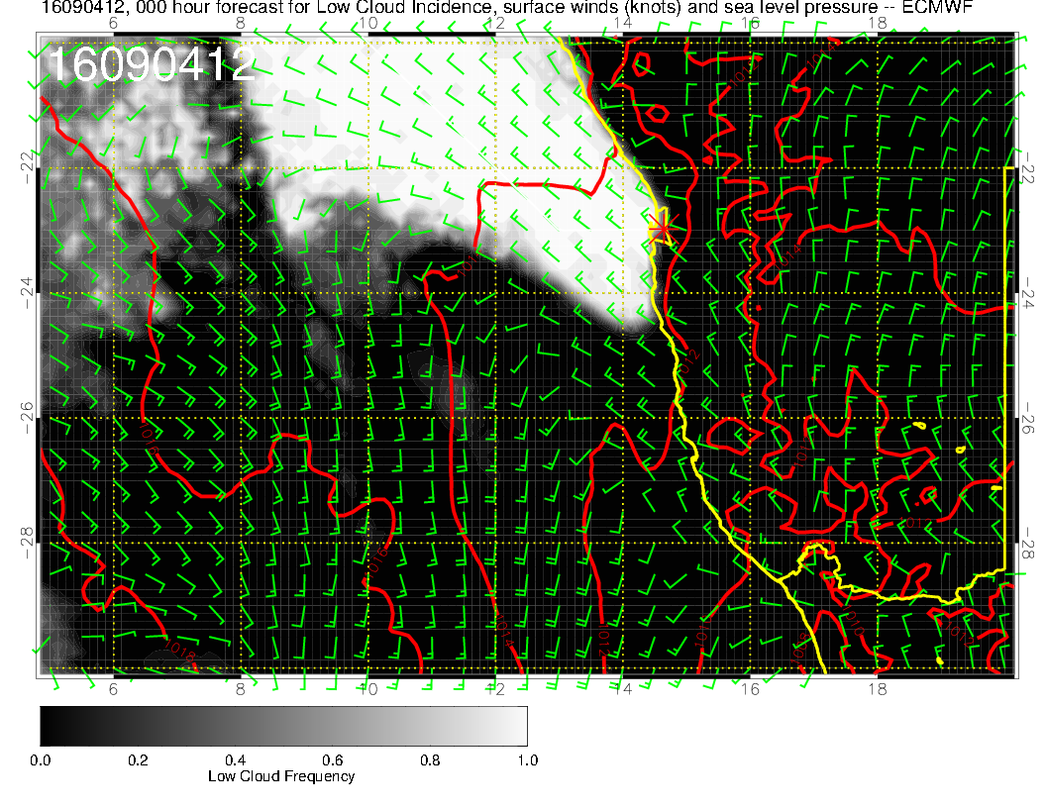
Surface cyclonic
circulation off the
coast, and lots of
drizzle. 15 knots
in the “wrong”
direction.

Slide 4
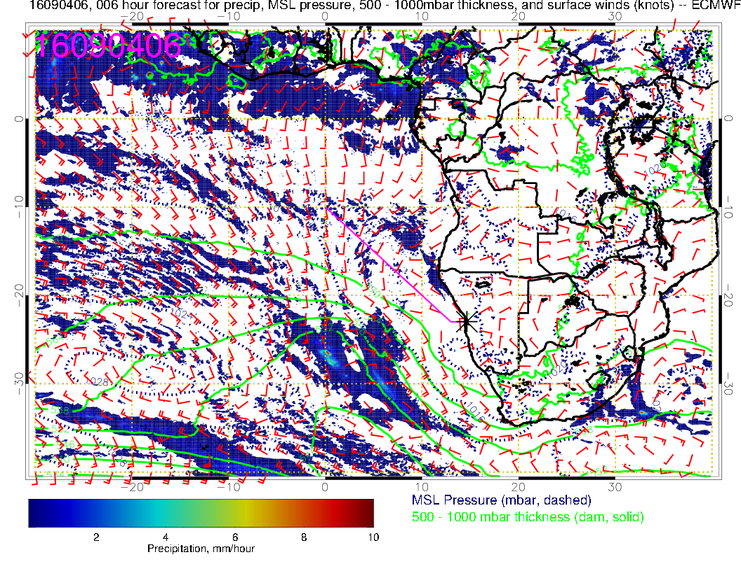
Not wave in
lower tropospheric
temperature
(thickness), with two
regions of precip.
(expect some rain today
from this in Capetown).

Slide 5
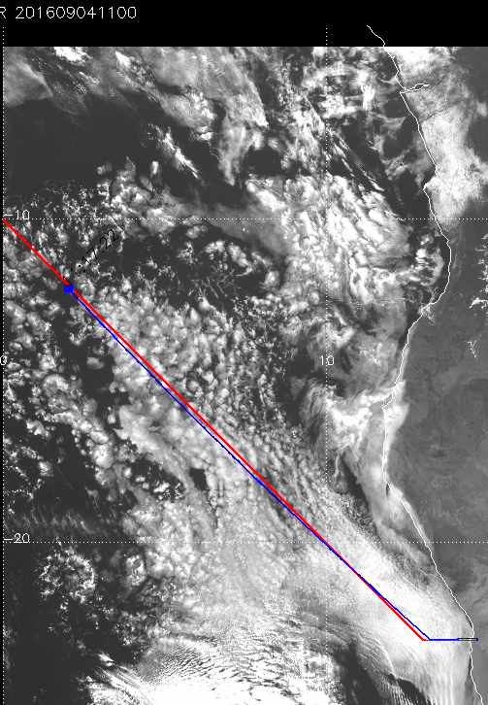
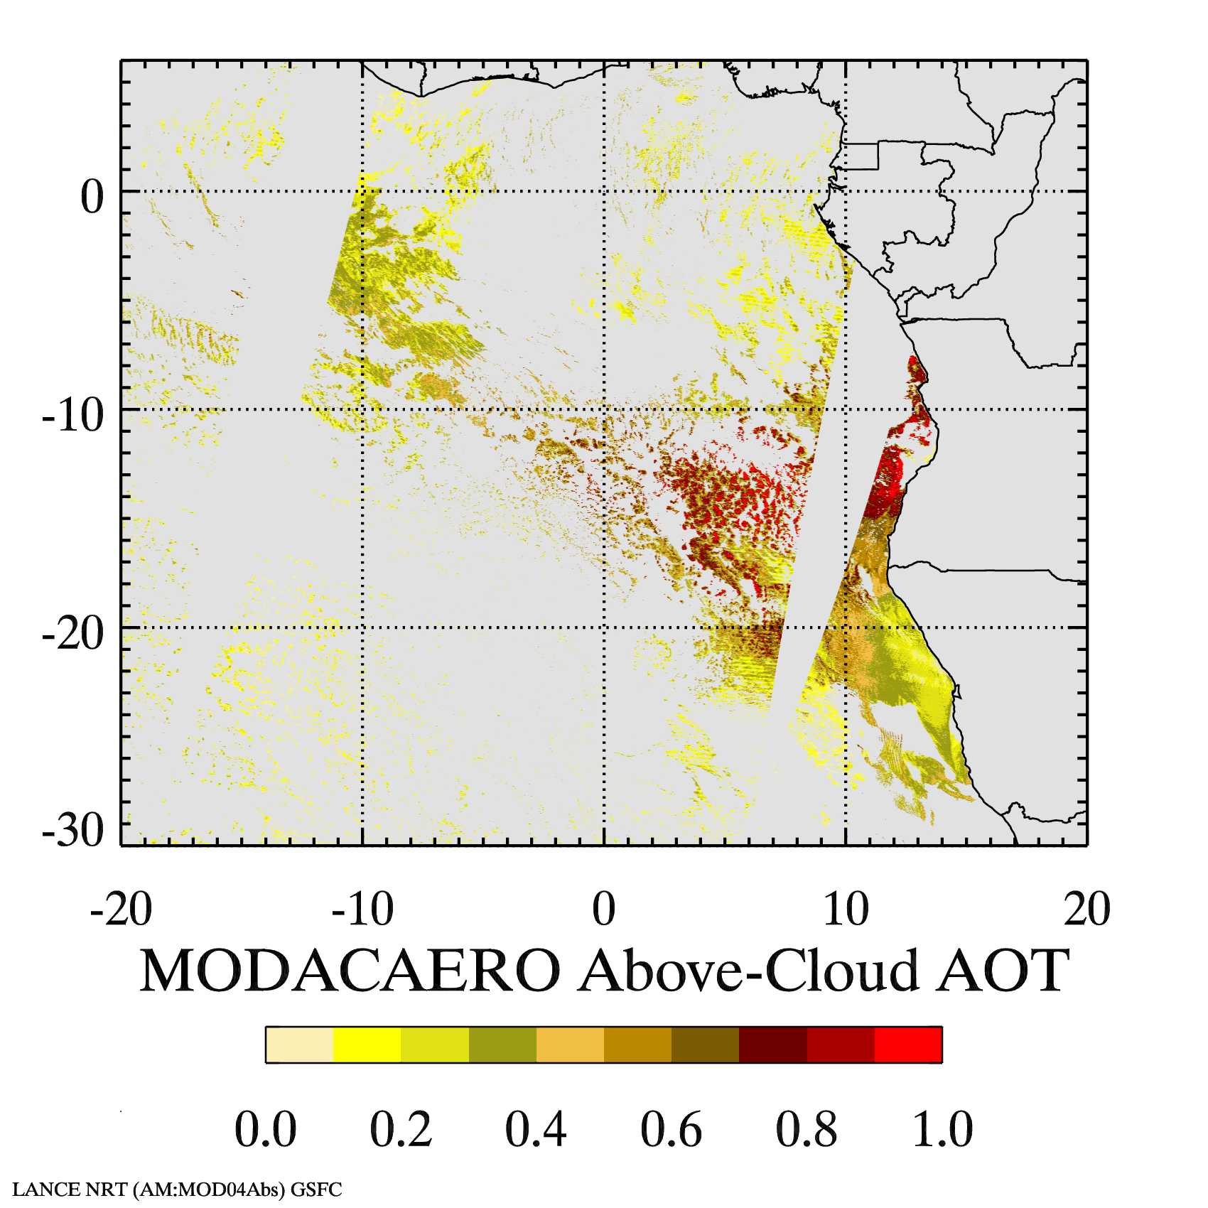
Sunday Flight RF04

Slide 6
LOW
HIGH
THIS MORNING: 4:30 AM T51 FORECAST

Slide 7
THIS MORNING: 4:30 AM T40 FORECAST

Slide 8
Forecast for Tomorrow
Low level low has moved off and basic southerly surface flow is reestablishing itself. Associated mid level trough will be over Easter SA.
Expect significant cirrus from south of YWB to Angolan border, out to 0 longitude.
Suppressed Sc (but not clear) south of 15S. No midlevel cloud.
Low cloud is affected by dying cold front at 25S.

Slide 9
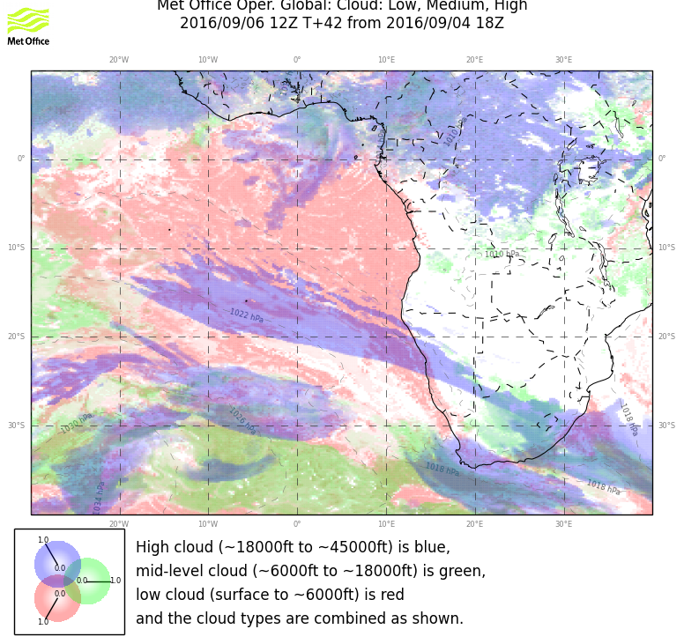
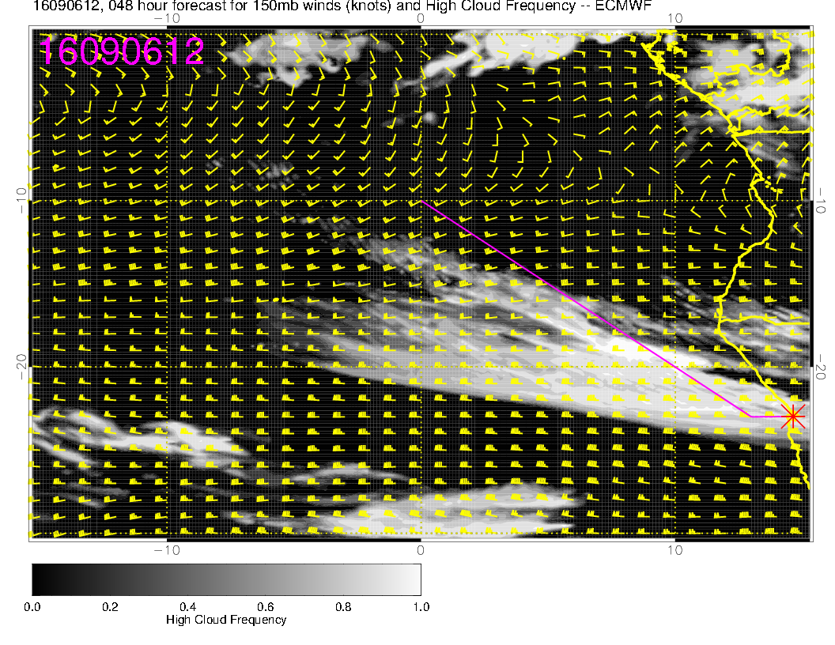
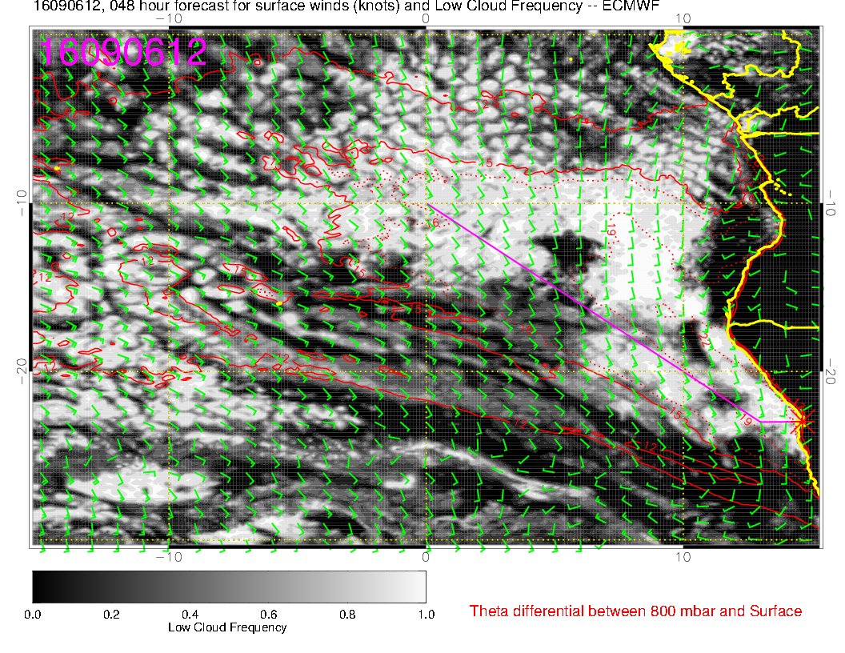
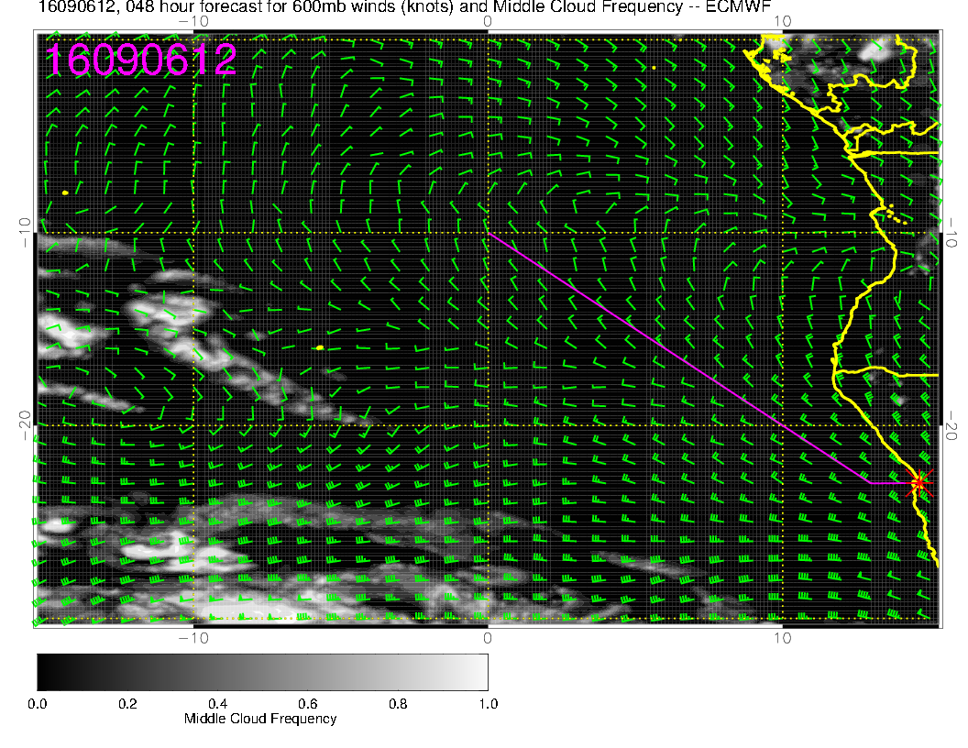
20160906, 12Z (14 local)
HIGH
Remarkable agreement
on the major features
in our region.
Angle of low level flow
in clearer region south
of 15S is clearly
more easterly than
north of 15S.
MIDDLE

Slide 10
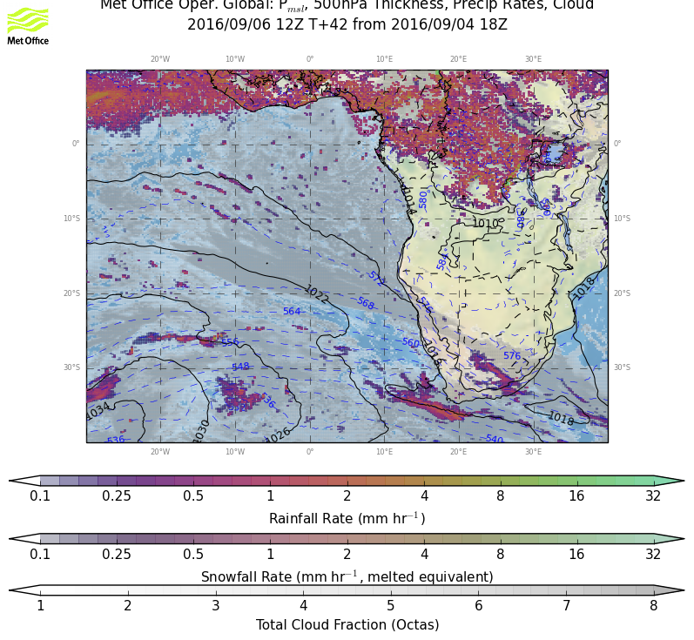
Cold front has anticyclonic
motion ahead of it, likely
subsidence and some suppression
of low cloud

Slide 11
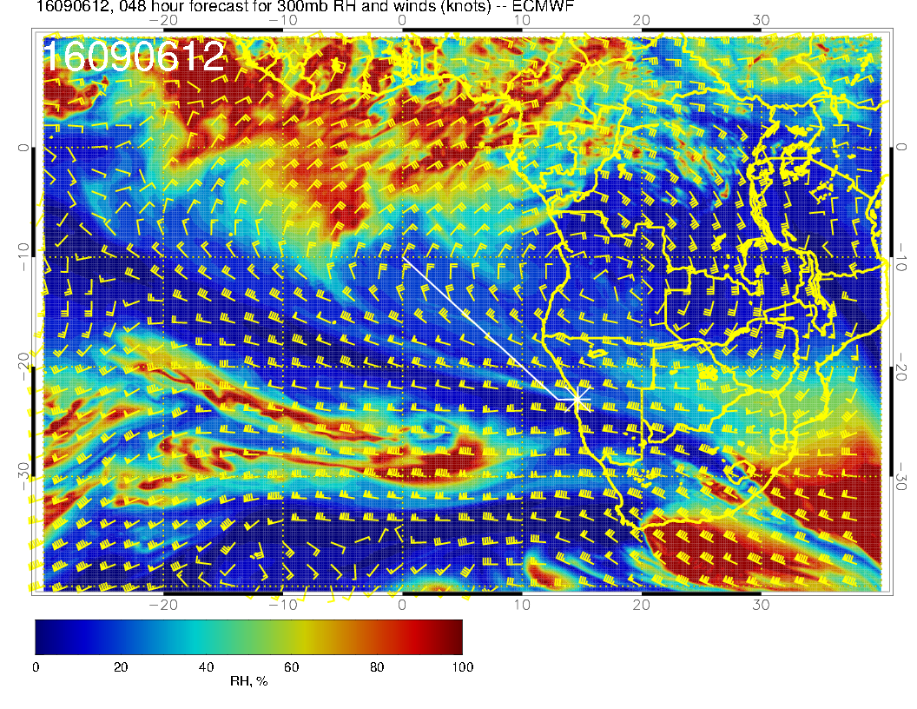
Upper trop: 300mb anticyclone is
shifted eastward. Climo cross-
equatorial flow from NH
convection is usually near
Brazilian coast.

Slide 12
Forecast for Wednesday
Expect significant cirrus from south of YWB to Angolan border, out to 0 longitude. Models say less than Tuesday, but upper cross equatorial flow remains strong.
Low cloud still affected by dying cold front at 25S.
Some mid level cloud off of Angolan Coast

Slide 13
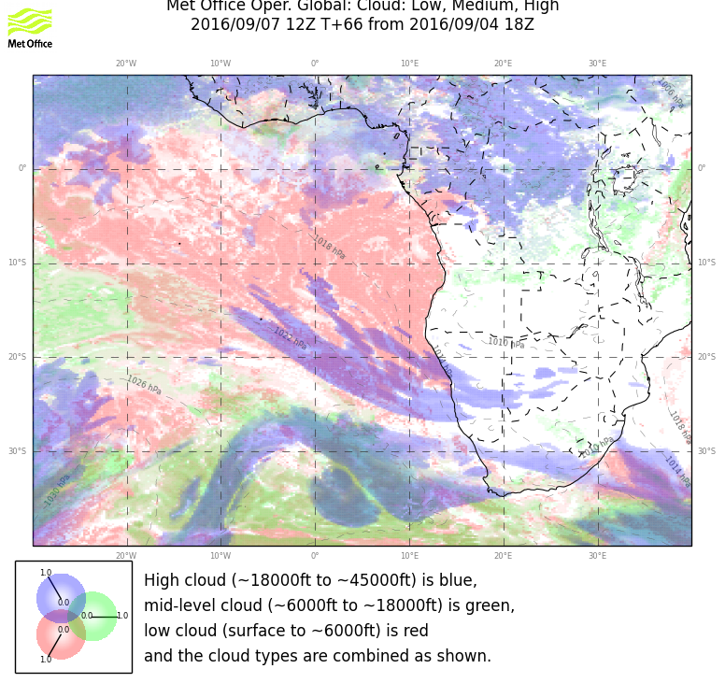
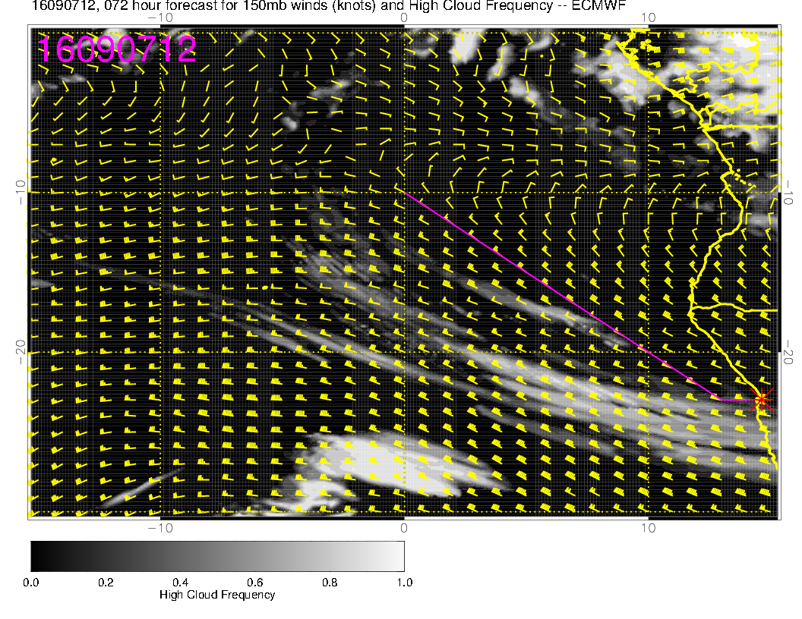
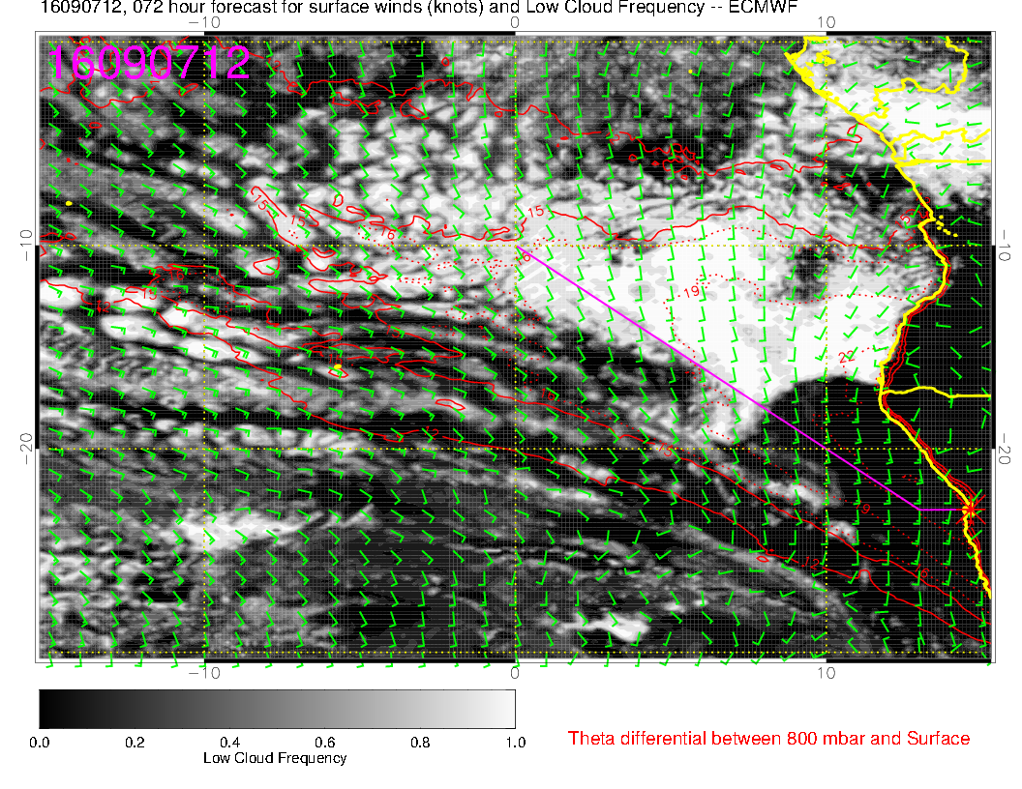
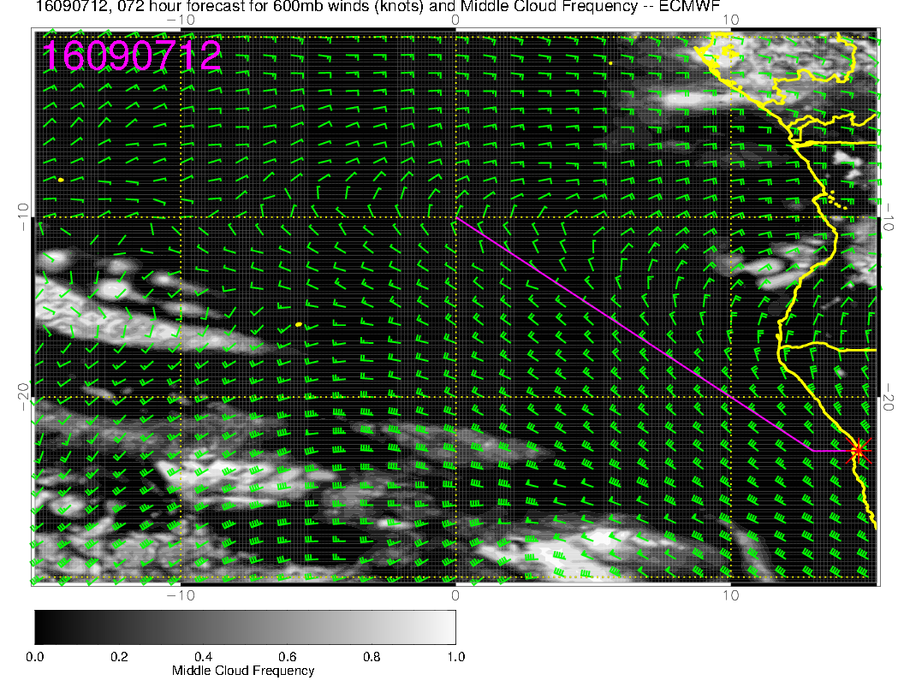
Start to see some
model divergence
in the low and mid cloud.
Expect less clearing
than EC forecasts
near coast. I see
the same kink in
the wind direction
at low levels, so expect
different character to
SC south of 15. Based
on track record, and
stronger westward
600mb flow, will have
some mid cloud

Slide 14
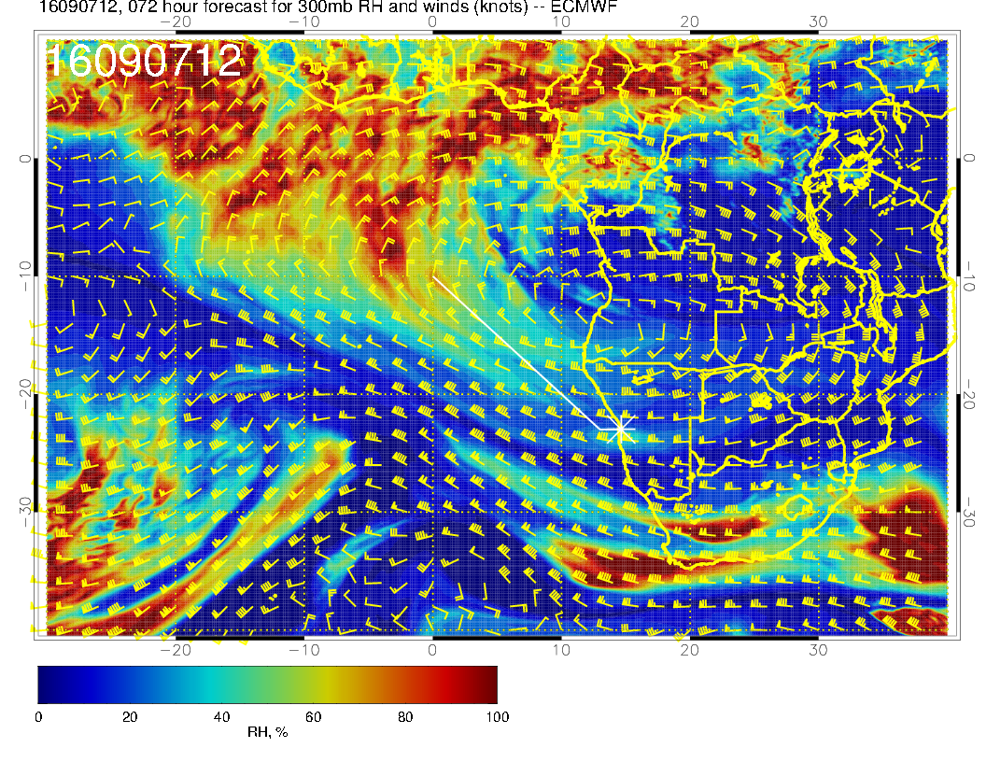
Non climo
anticyclone position,
80+ knot westerlies
over us

Slide 15
Forecast for Thursday
No midlevel cloud
Ample Sc north of 20S
Some cirrus over us but waning

Slide 16
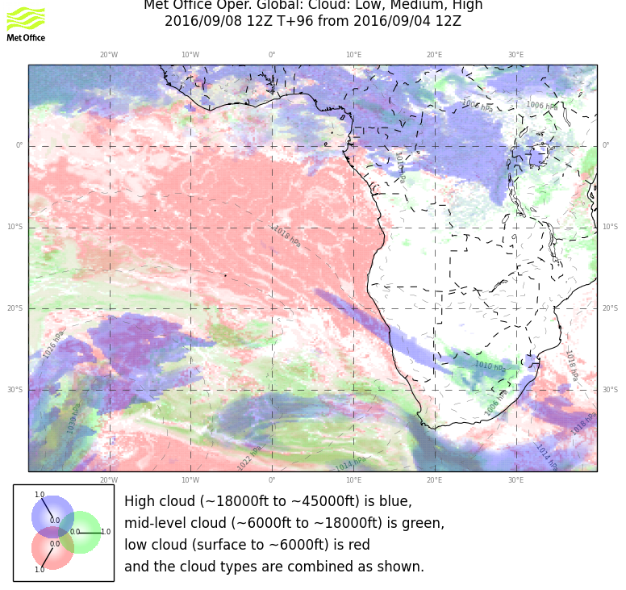
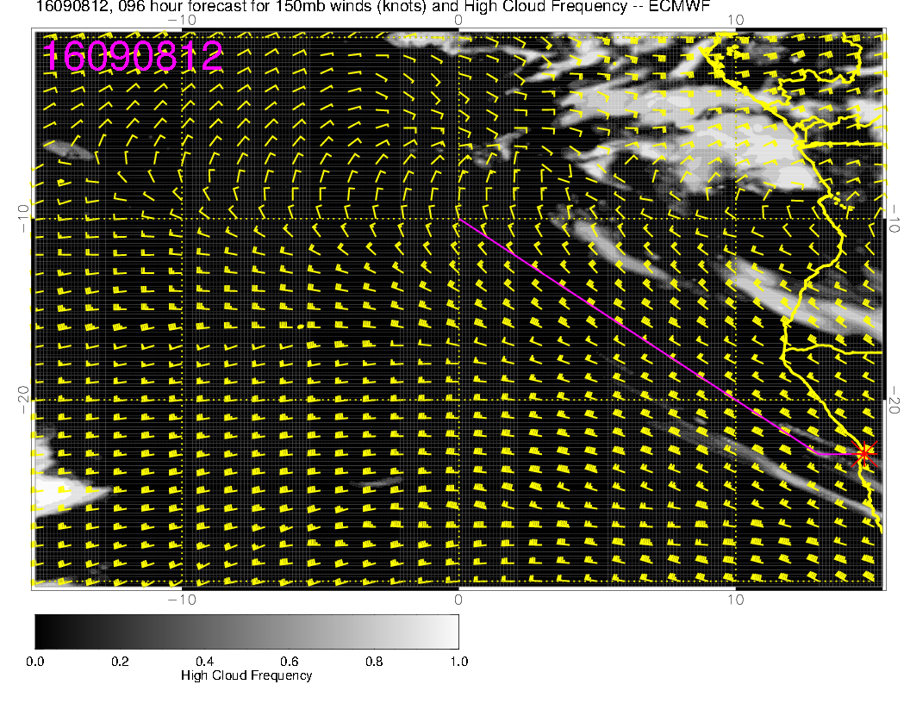
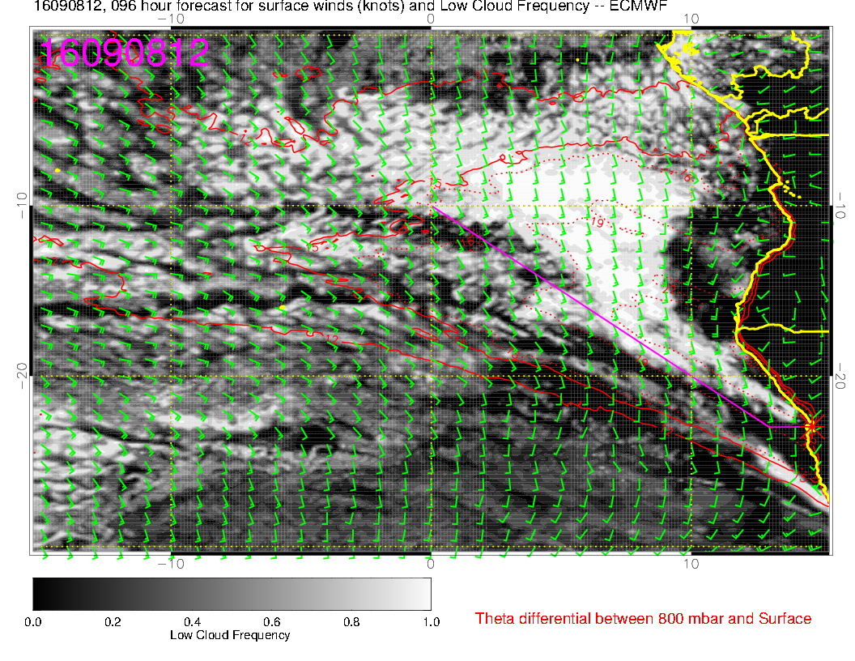
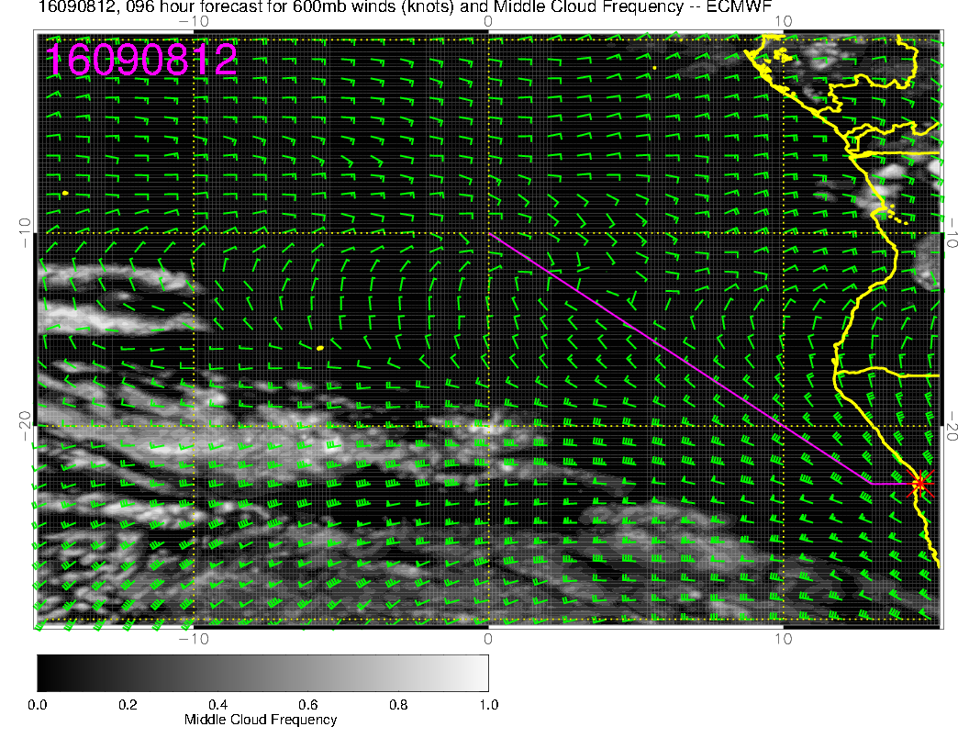
Still expect some cirrus
and models are in basic
agreement.
Cloud clearing off of
Angola in EC is overdone.
Low level flow is steady
southerly, and water is
warmer, but EC RH
is suppressed, not sure
why.
No cloud at mid levels

Slide 17
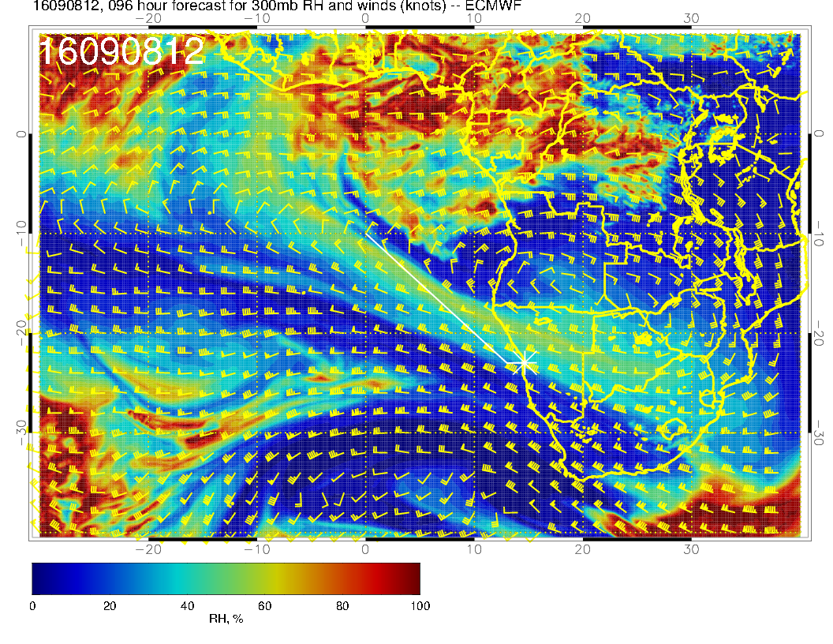
Anticyclone moves
SEward at 300mb,
and flow of air from
convective zones north
of the equator is pushed
northward.

Slide 18
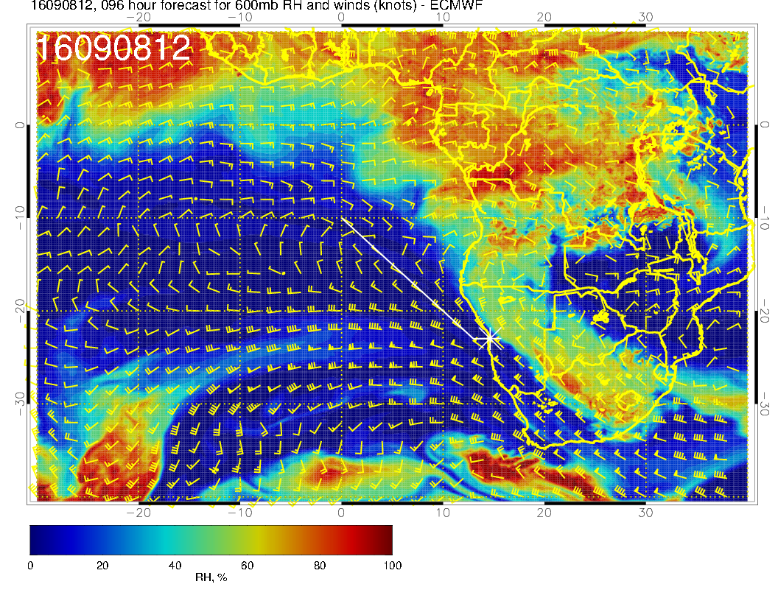
Midlatitude trought
extending northward and
fairly weak recirculation.

Slide 19
Forecast for Friday
Model divergence at upper levels
Ample Sc north of 20S
Minimal mid level cloud.

Slide 20
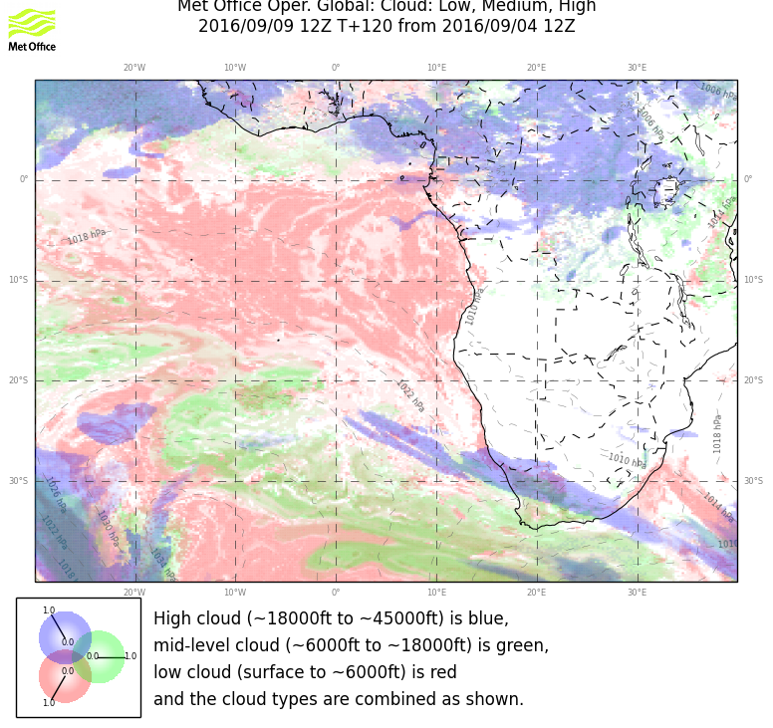
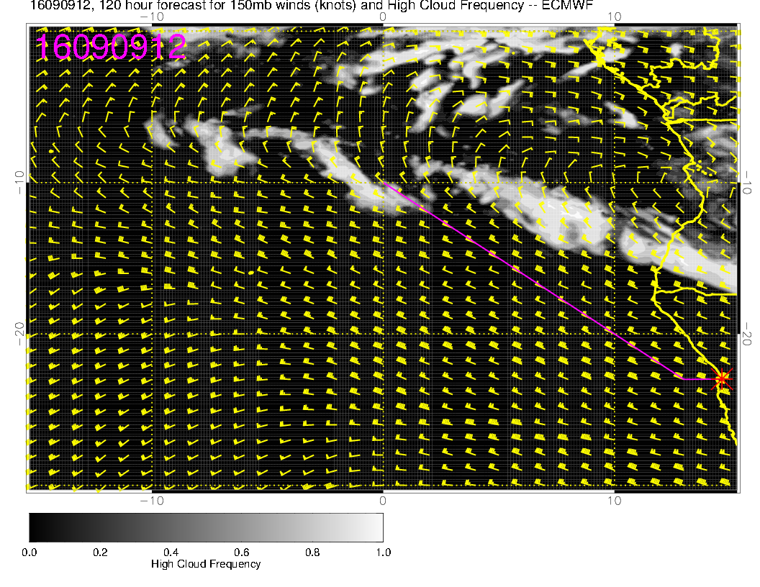
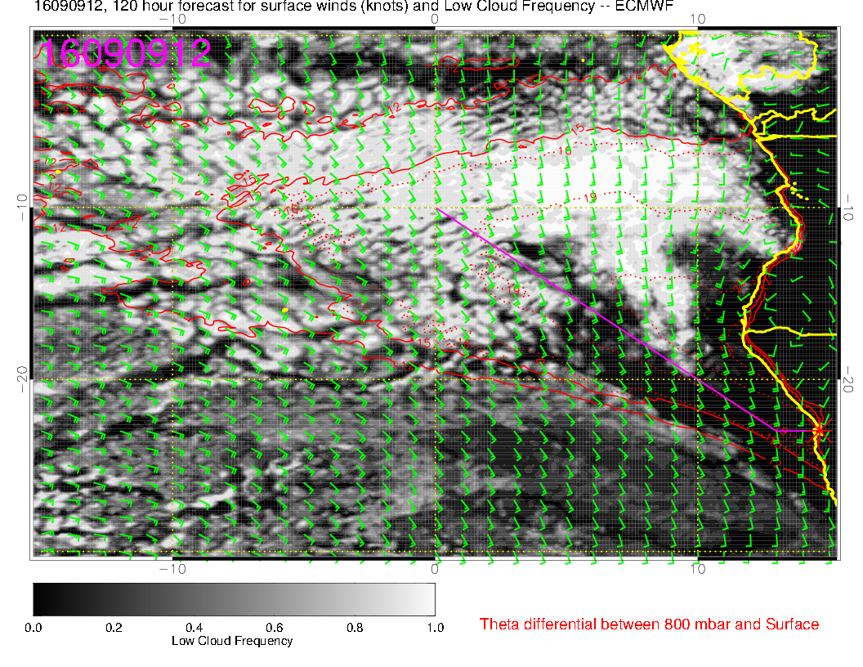
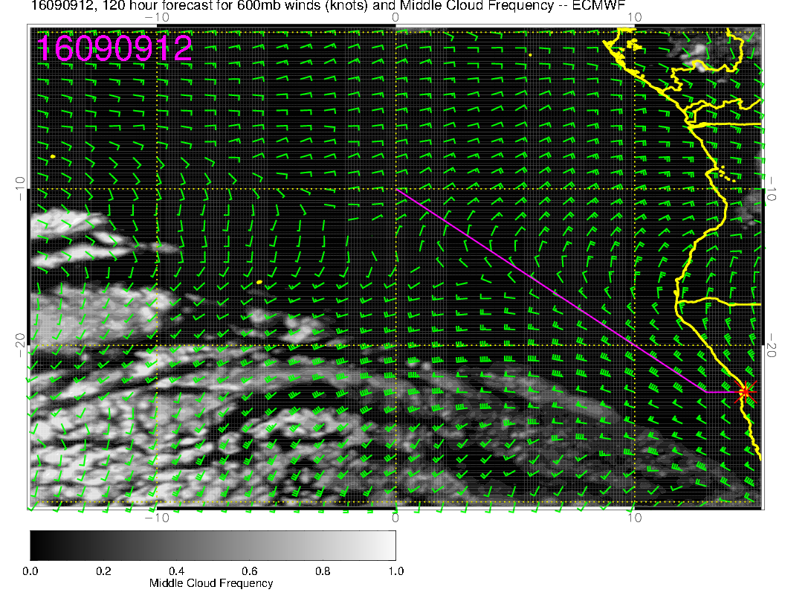
Models diverge by
this time. Cirrus near
SA/Namib border
makes some sense.
I don’t believe the
Southern Angola cloud
probably similar to the
feature from a few days
ago that did not
verify.
SC ample north of 20S.
No middle cloud
expected.

Slide 21
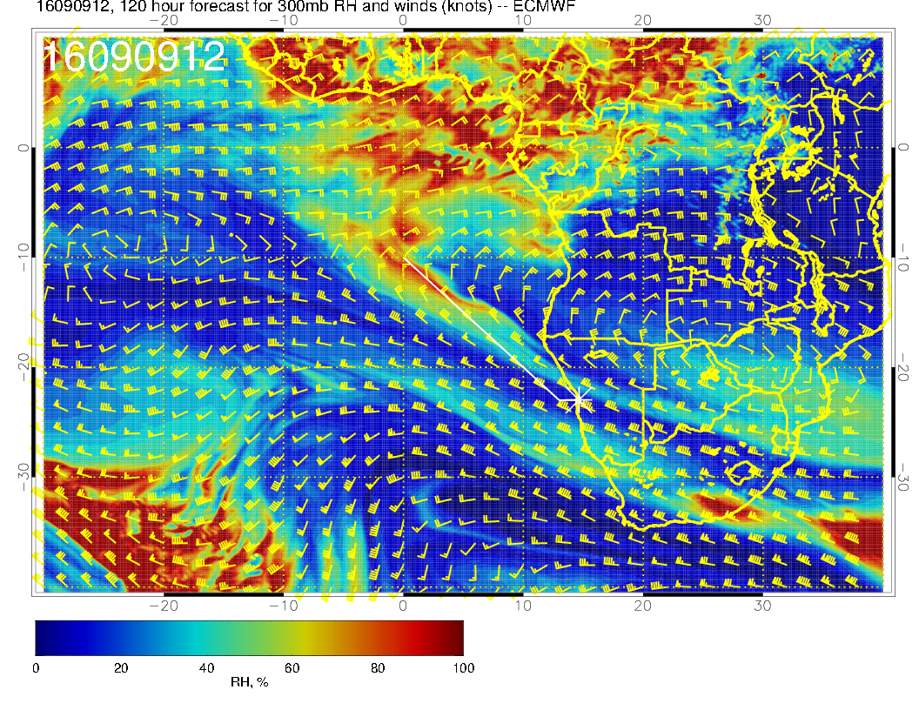
Weakening cross
equator circulation.
Might get some cirrus
over us.
SA/Namib border is
STJ jet stream cirrus.

