Slide 1
ORACLES forecasting Briefing Aerosols
05-09-2016

Slide 2
Sept 4 2016 (model evaluation)

Slide 3
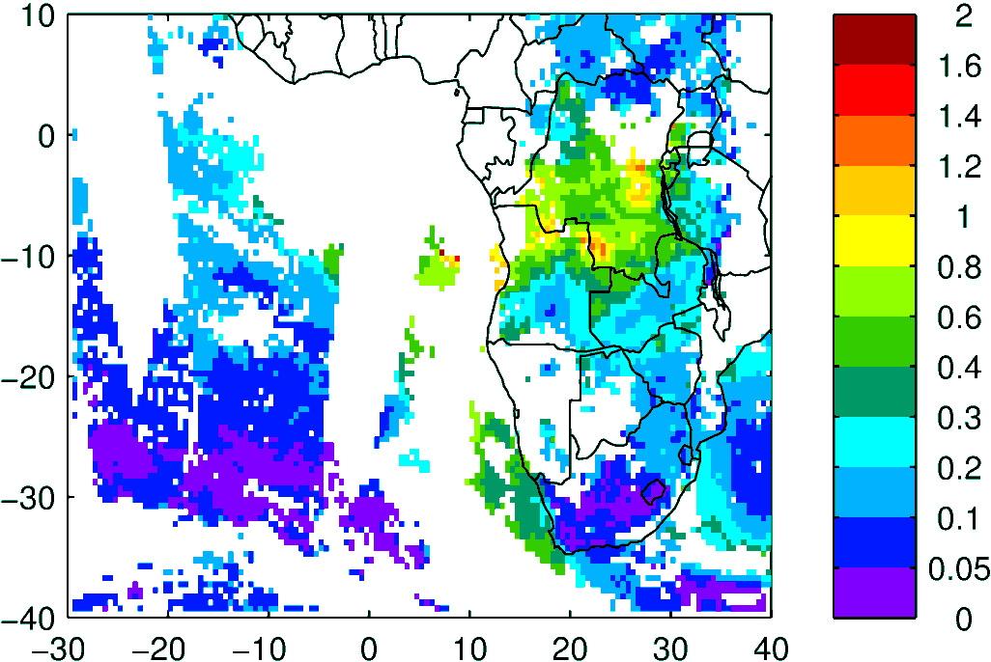
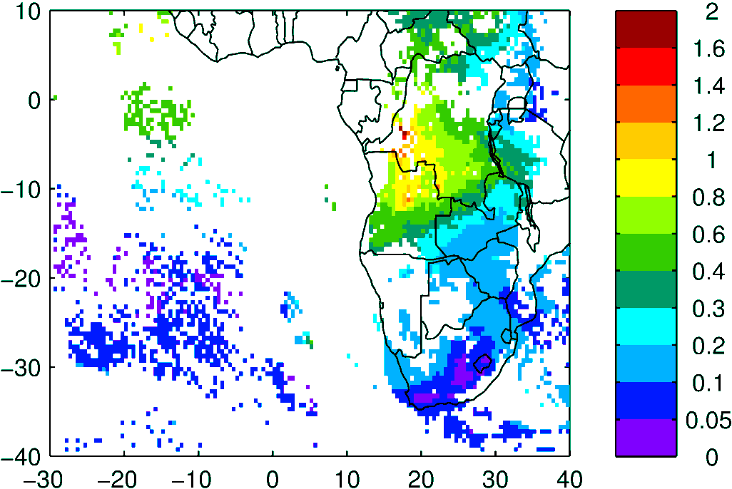
Terra & Aqua AOD (clear-sky)
MODIS NNR
WRF-AAM

Slide 4
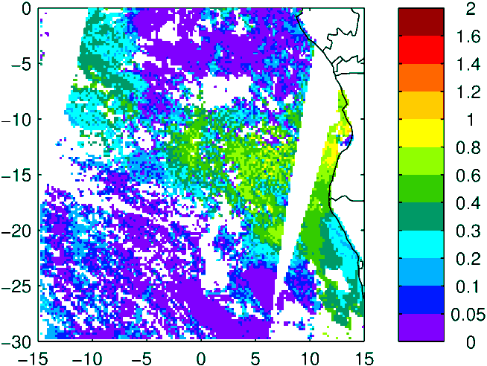
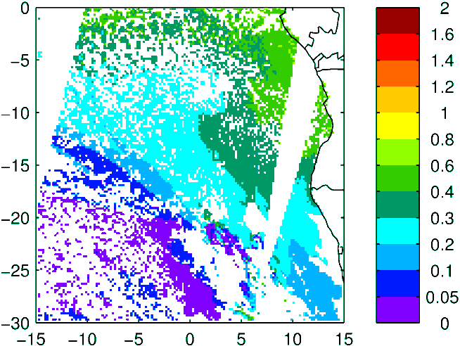
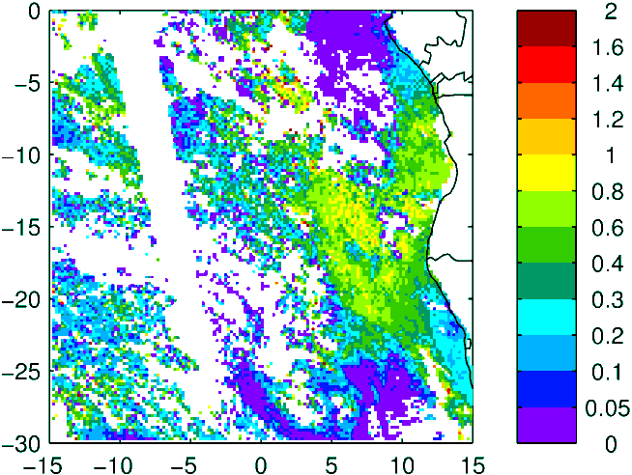
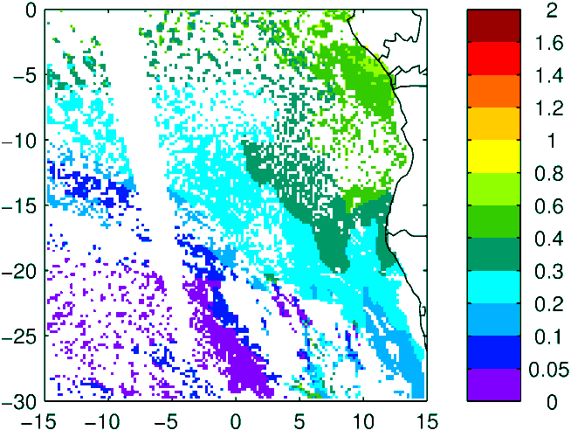
Above Cloud AOD (thanks Kerry!)
Observation
Model (WRF-AAM)
Terra
Aqua

Slide 5
Sept 5 2016

Slide 6
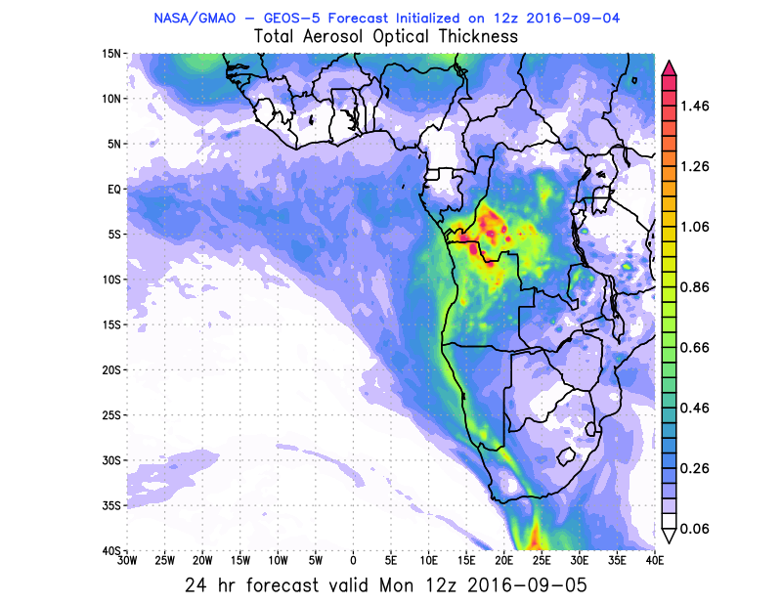
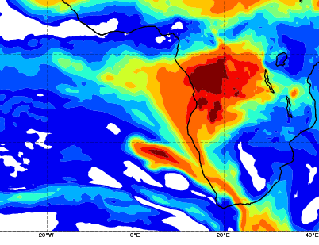
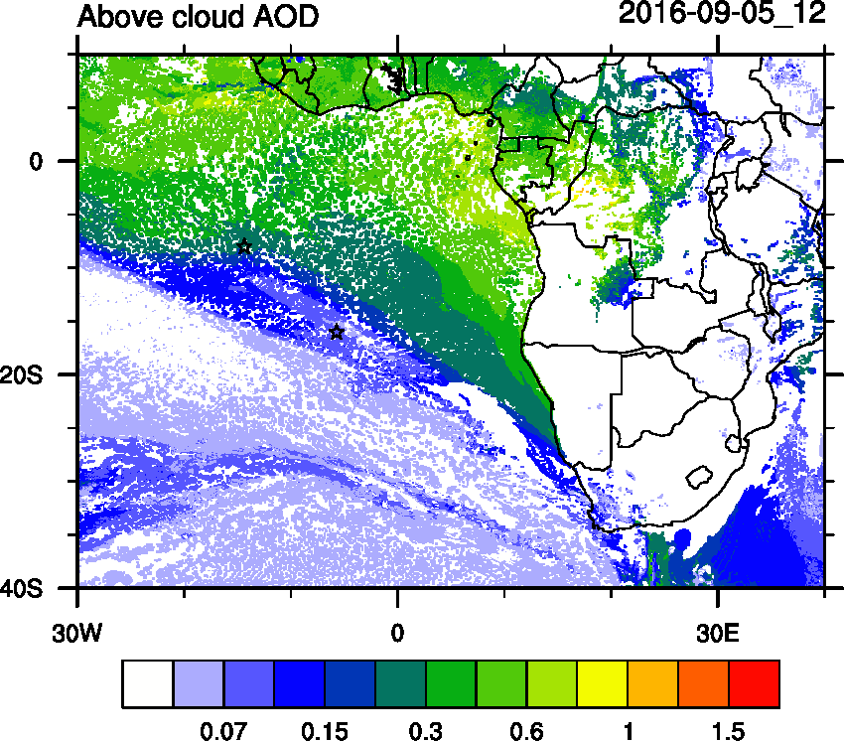
AOD 12 UTC
WRF
CAMS
GEOS5

Slide 7
Sept 6 2016

Slide 8
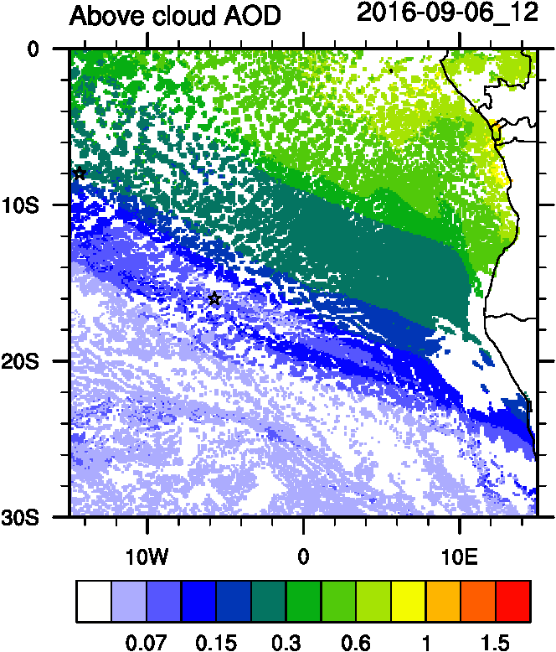
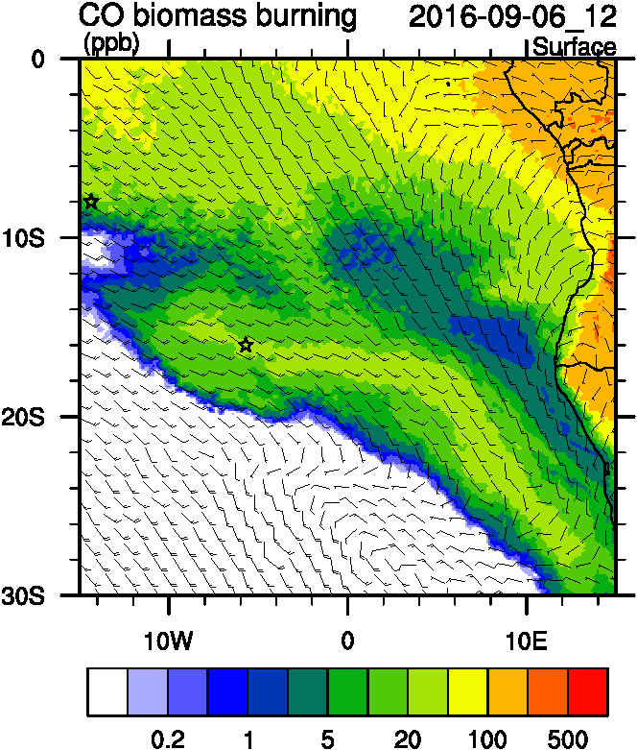
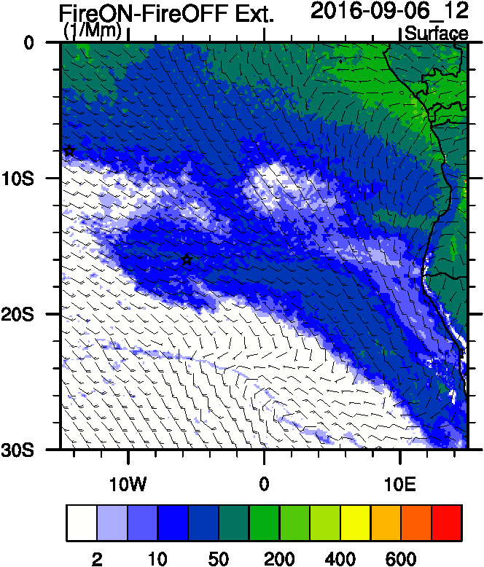
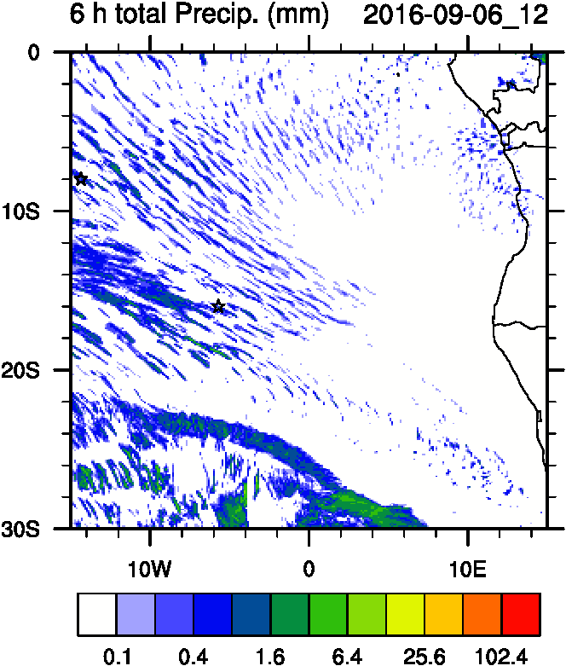
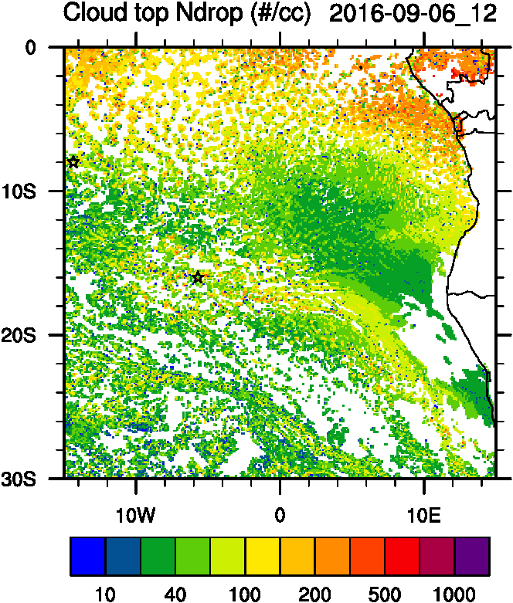
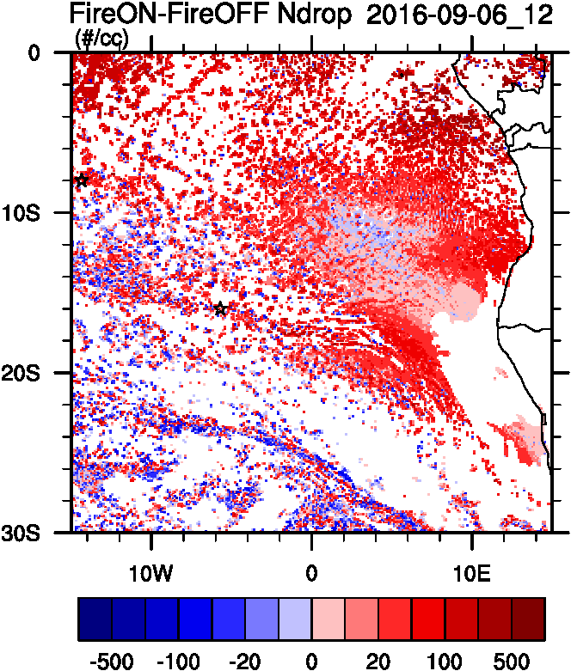
Aerosol-cloud interactions
Smoke Ext
Ndrop: Number droplet concentration
Diff: Differences between simulations turning on and off fires
AC AOD
tracer
Ndrop Diff
Cld Top
Ndrop

Slide 9
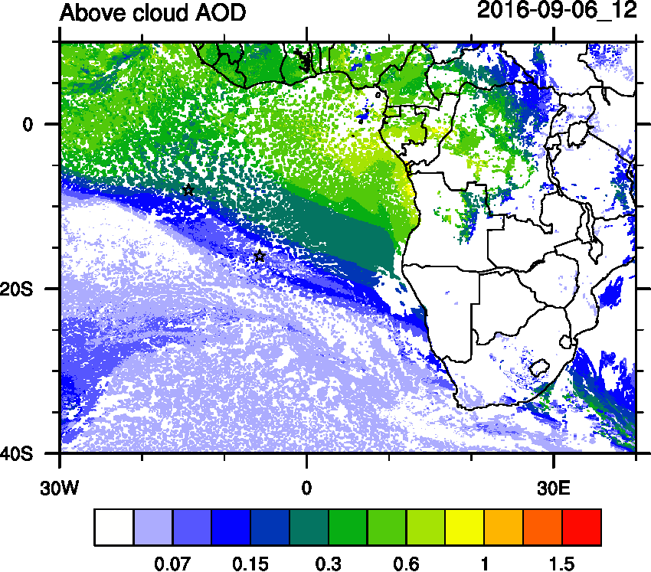
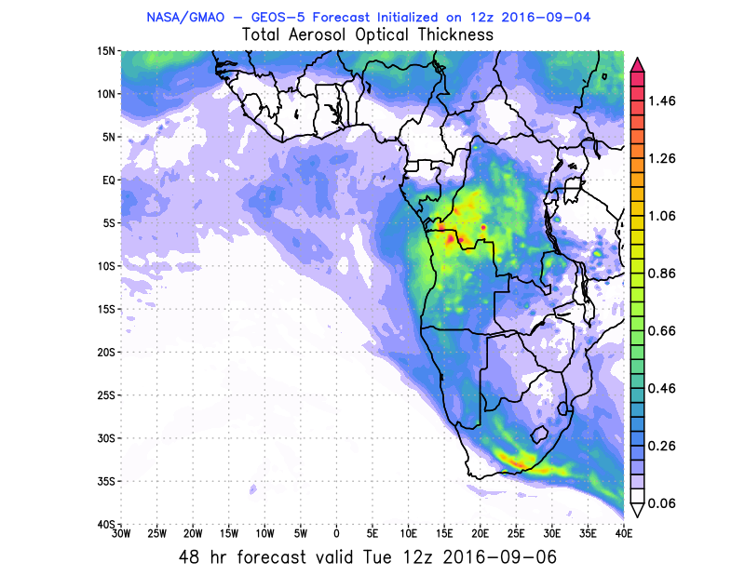
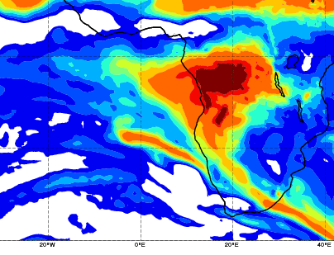
AOD 12 UTC
WRF
GEOS5
CAMS

Slide 10
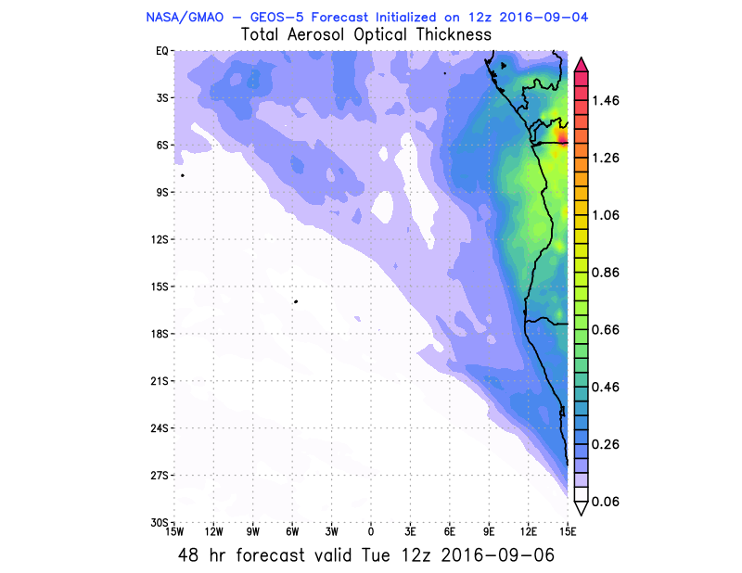
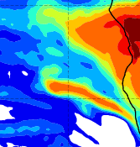
AOD 12 UTC
WRF
GEOS5
CAMS

Slide 11
CAMS evolution

Slide 12
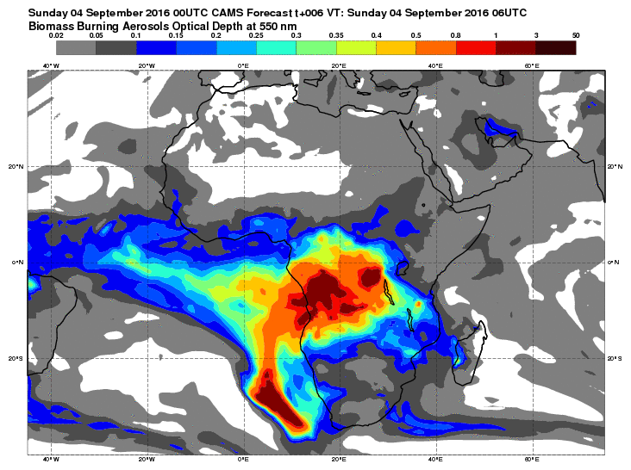

Slide 13
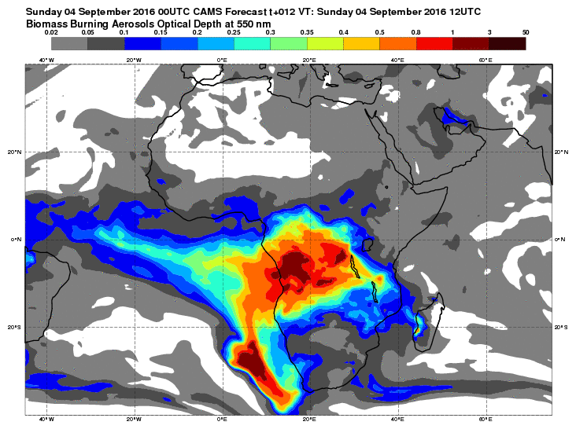

Slide 14
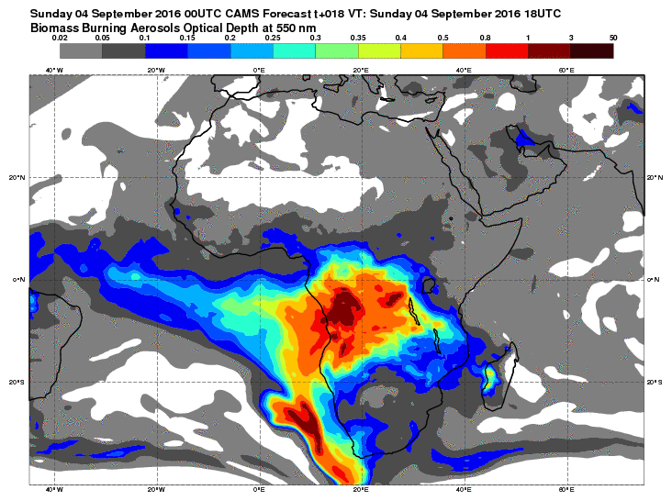

Slide 15
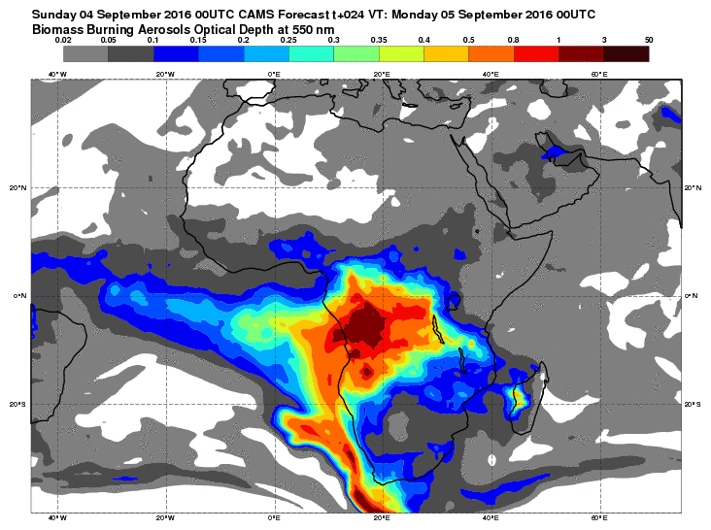

Slide 16
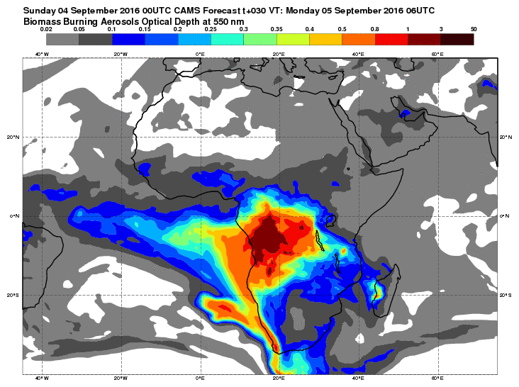

Slide 17
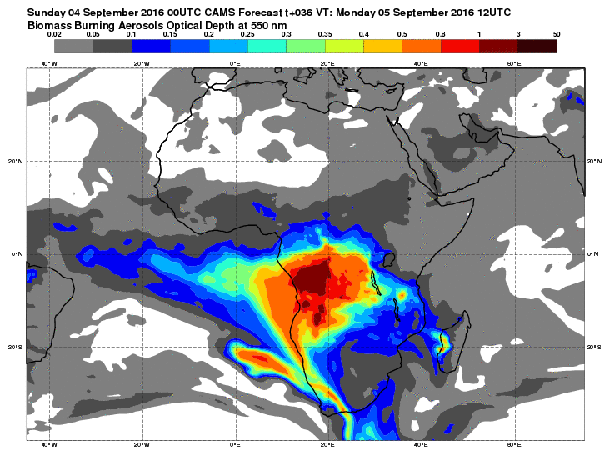

Slide 18
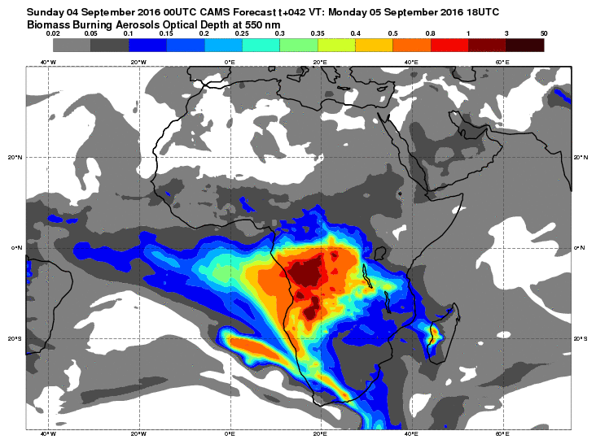

Slide 19
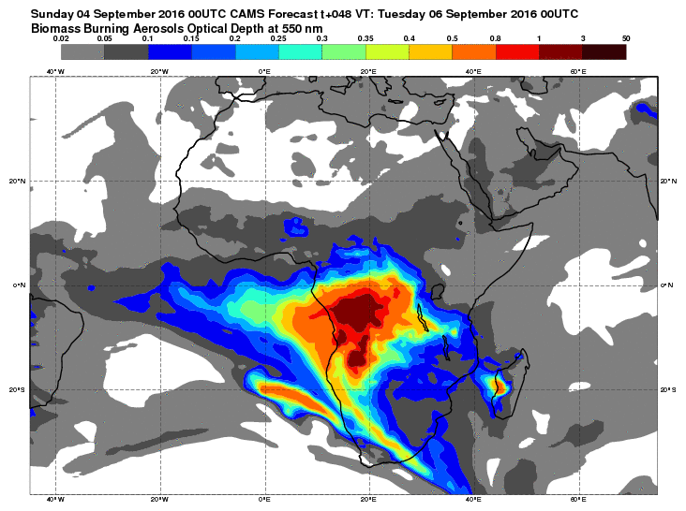

Slide 20
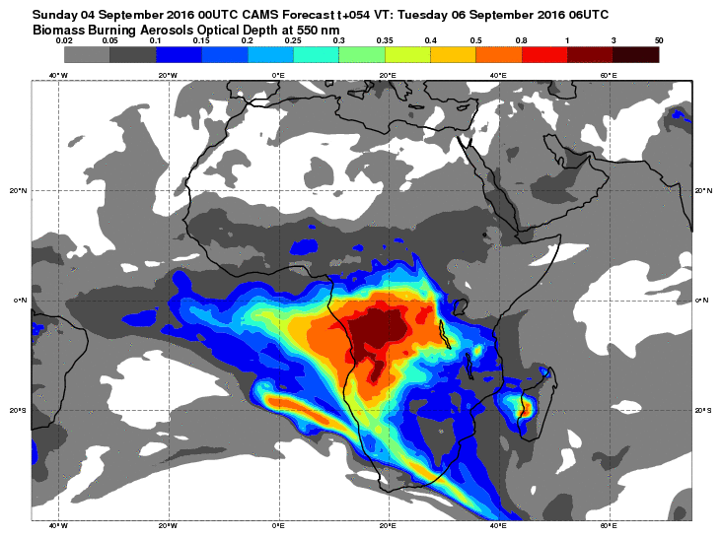

Slide 21
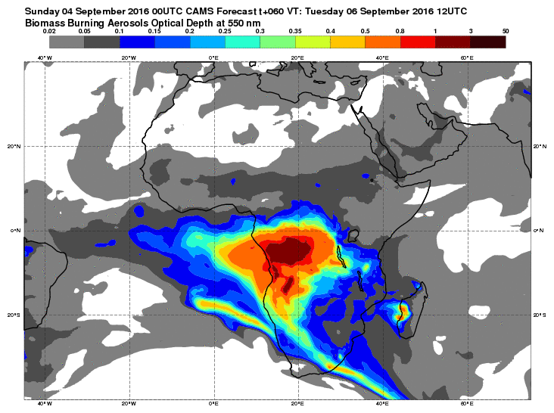

Slide 22
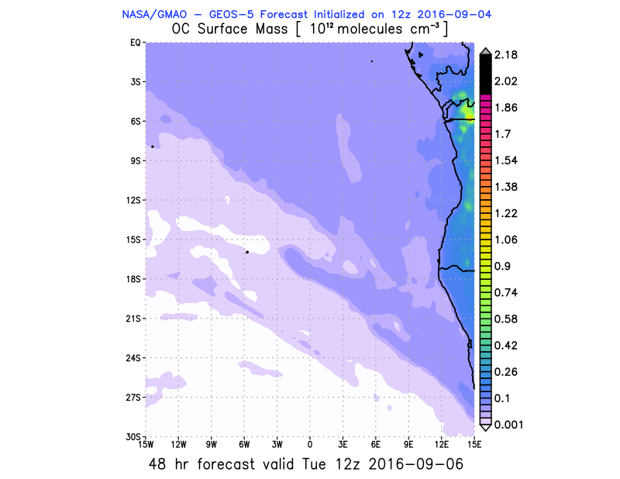
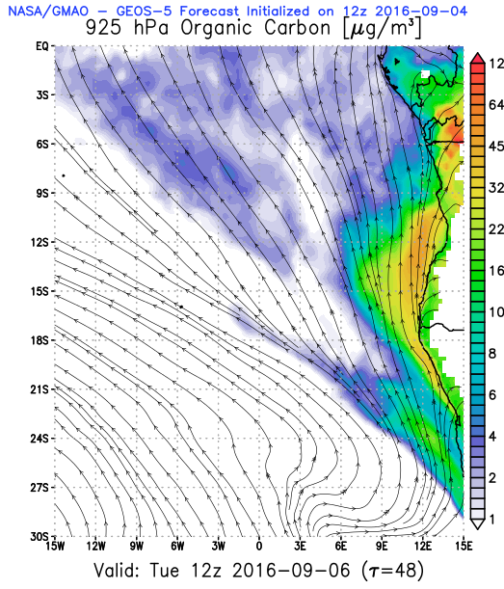
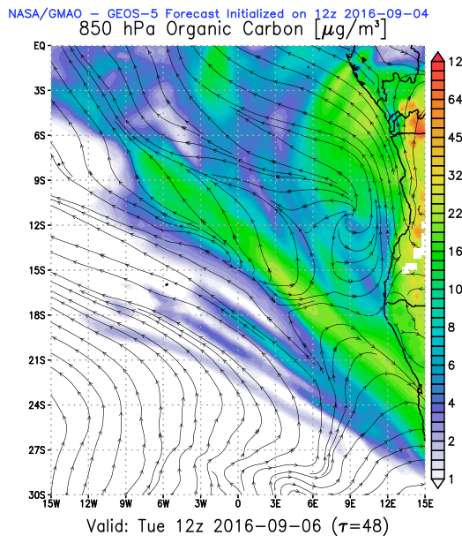
Low level GEOS5

Slide 23
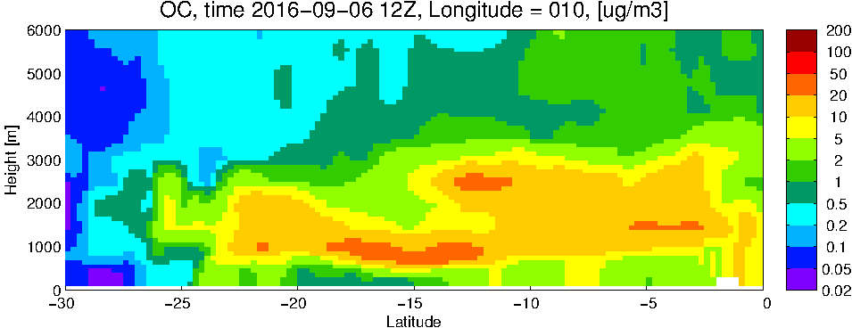
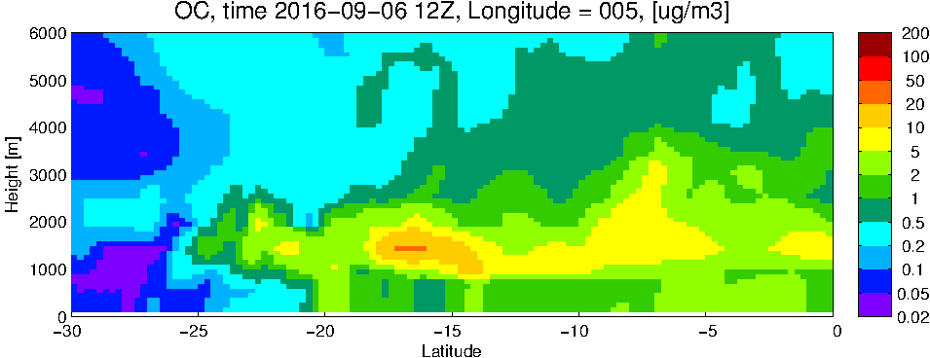
GEOS5 OC curtains
10 E
5 E

Slide 24
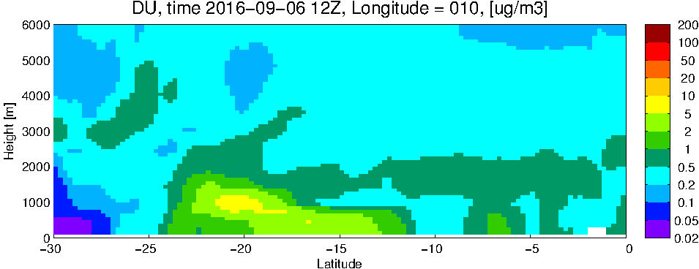
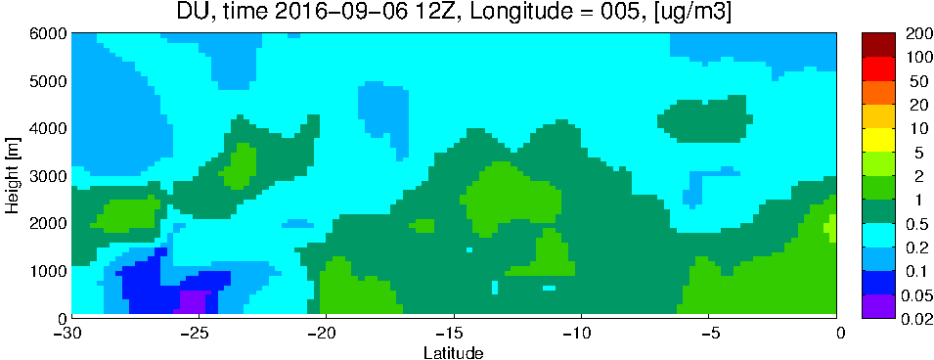
GEOS5 DUST curtains
10 E
5 E

Slide 25
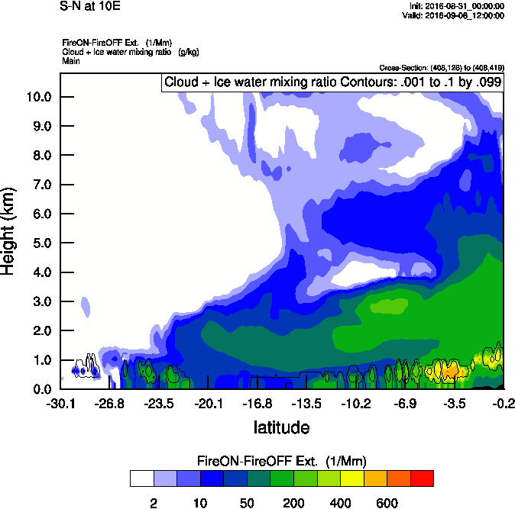
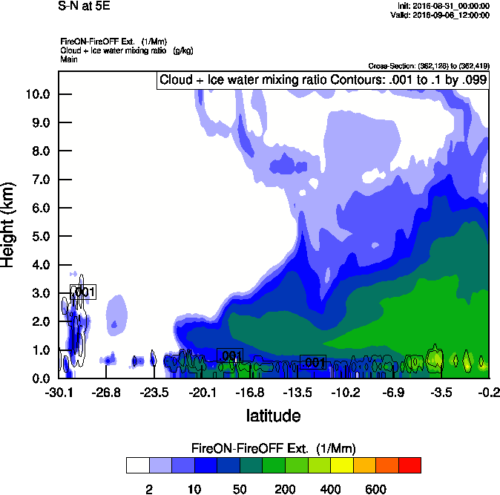
Vertical cross-section South to North
Smoke Ext WRF
Smoke Ext WRF
10 E
5 E

Slide 26
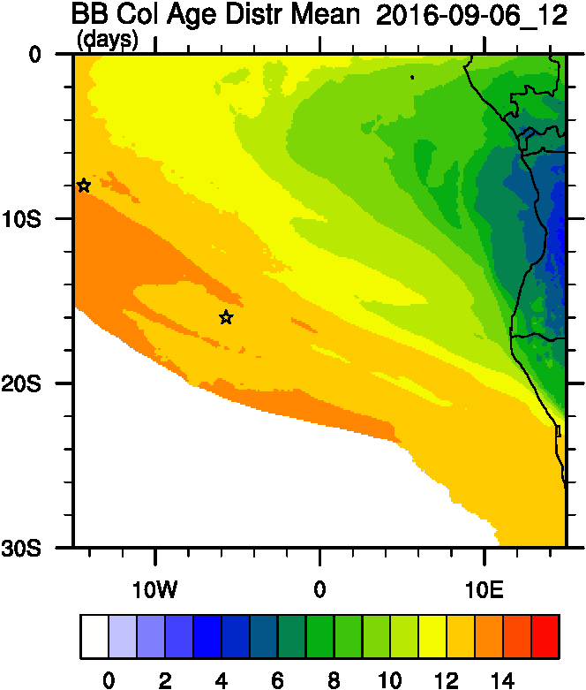
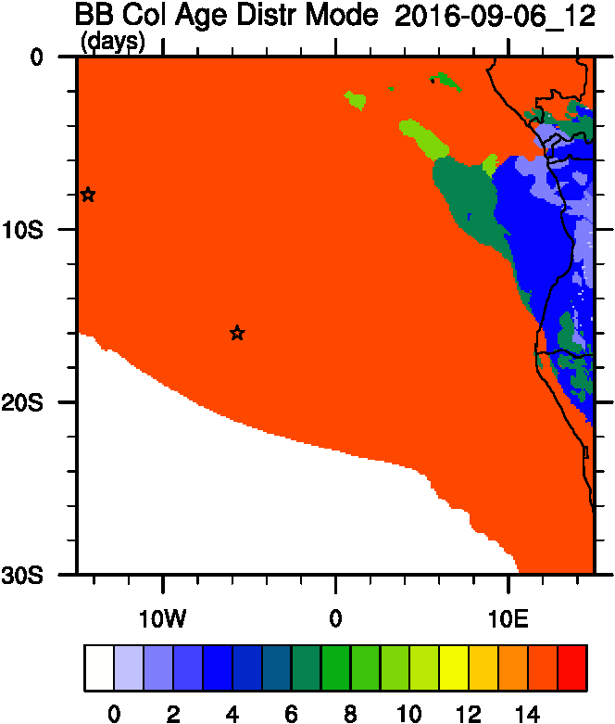
Smoke Age distribution
Mean Age
Mode Age

Slide 27
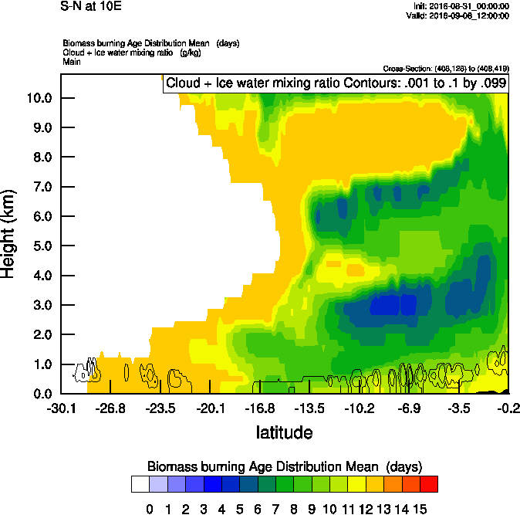
Vertical cross-section routine flight
Smoke Ext WRF
Age mean

Slide 28
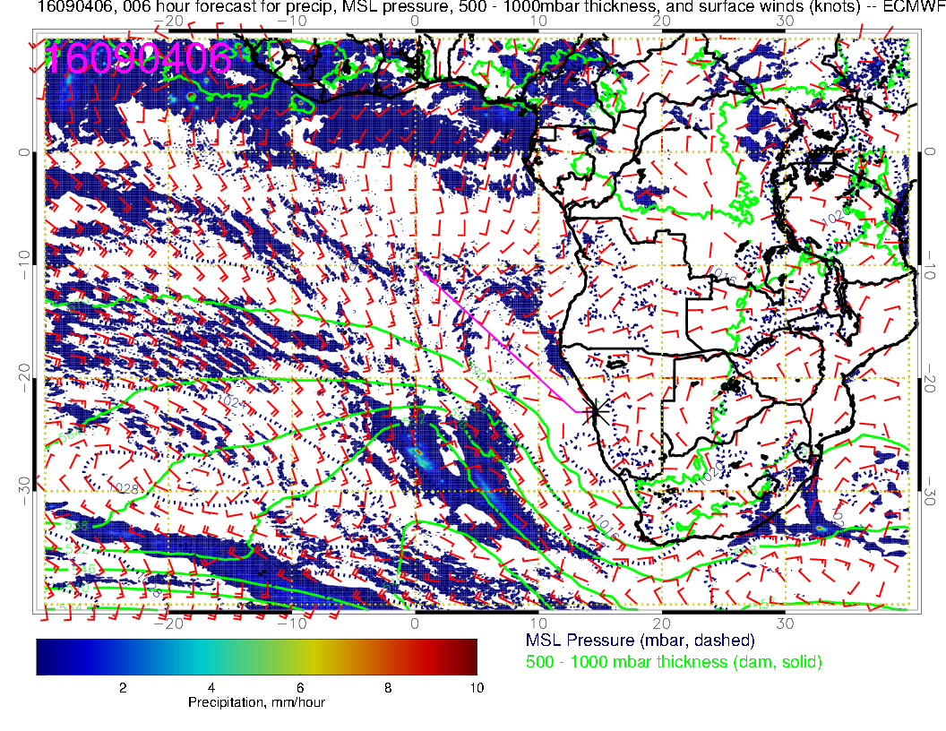
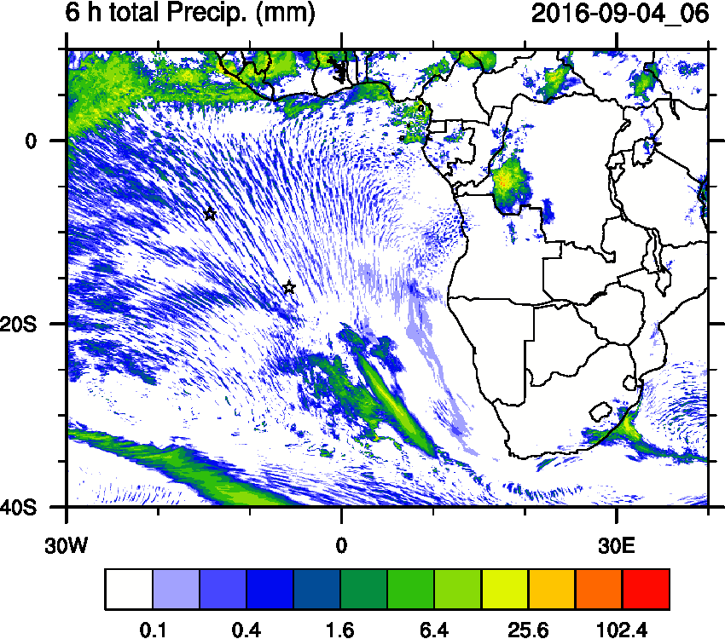
Precipitation during entrainment

Slide 29
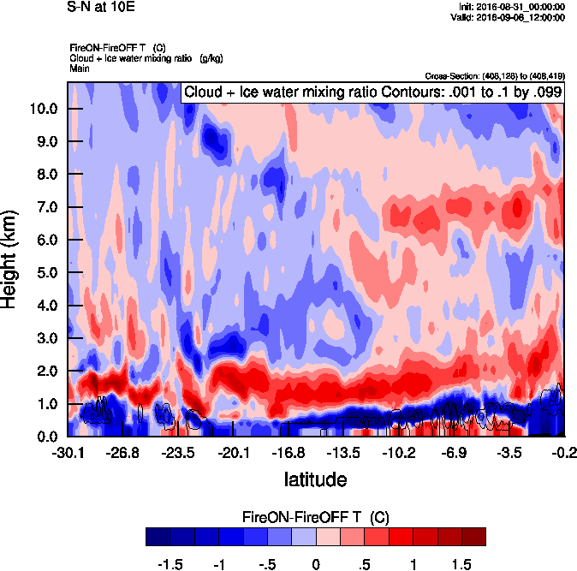
Vertical cross-section South to North
Smoke Ext WRF
T diff

Slide 30
Sep 07 2016 Wednesday

Slide 31
AOD 12 UTC
GEOS-5
GEOS-5
CAMS
WRF
84 h – 7 Sep
72 h – 07 Sep

Slide 33
72 h – 07 Sep
96 h – 08 Sep

Slide 34
Sep 08 2016 Thurday

Slide 35
AOD 12 UTC
GEOS-5
108 h – 07 Sep
96 h – 08 Sep

Slide 37
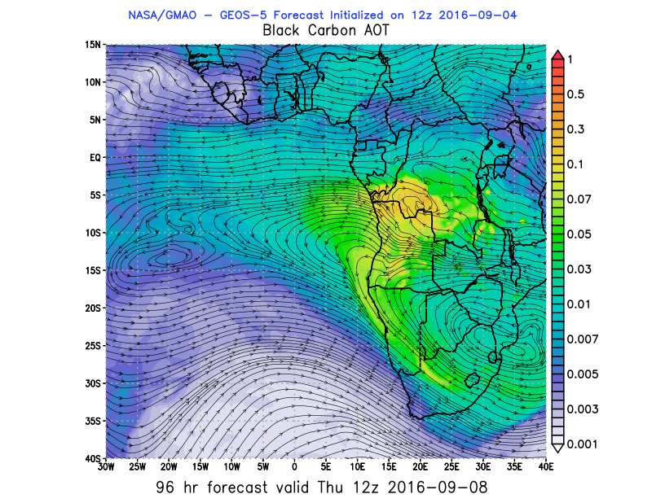

Slide 38
