Slide 1
ORACLES forecasting Briefing Aerosols
04-09-2016

Slide 2
Sept 3 2016 (model evaluation)

Slide 3
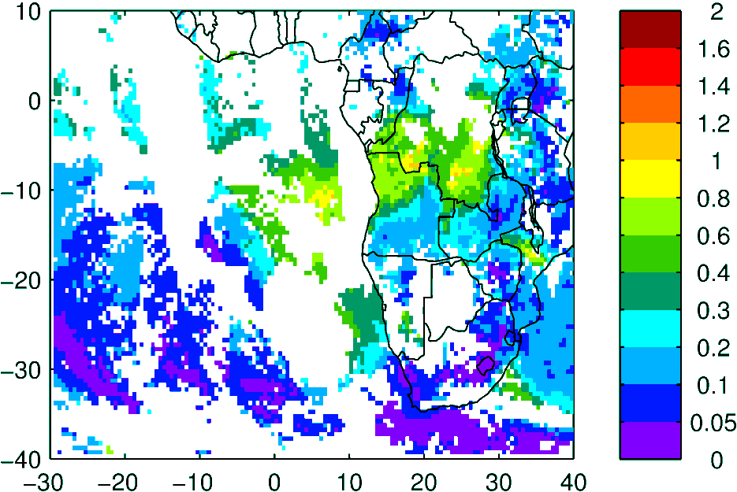
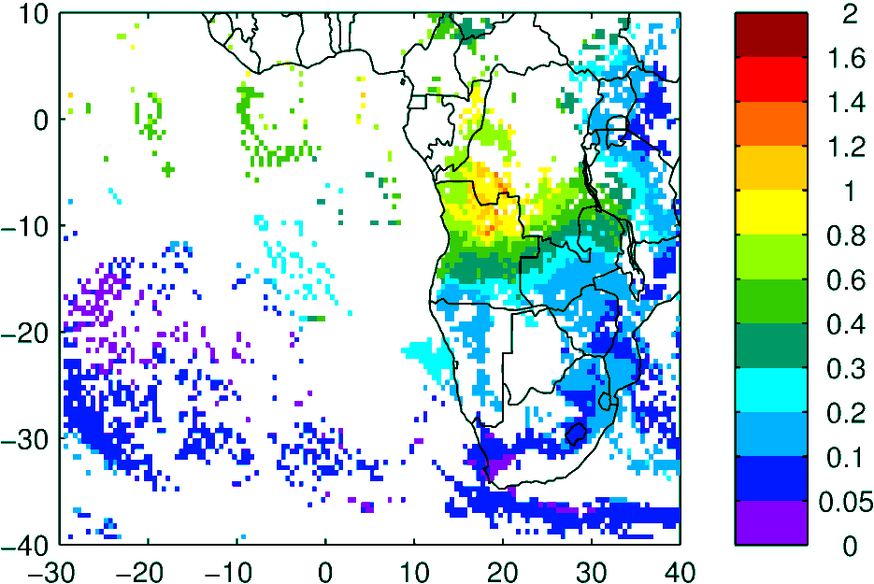
Terra & Aqua AOD (clear-sky)
MODIS NNR
WRF-AAM

Slide 4
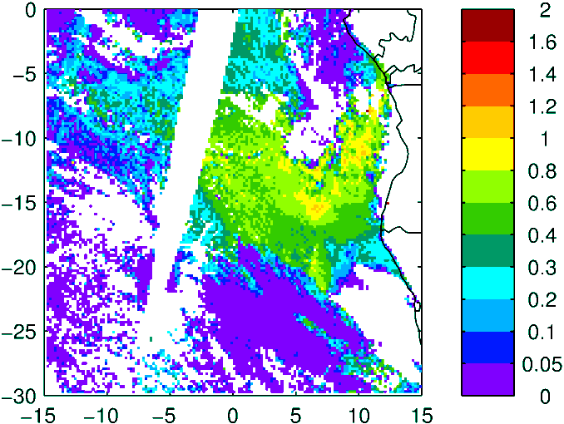
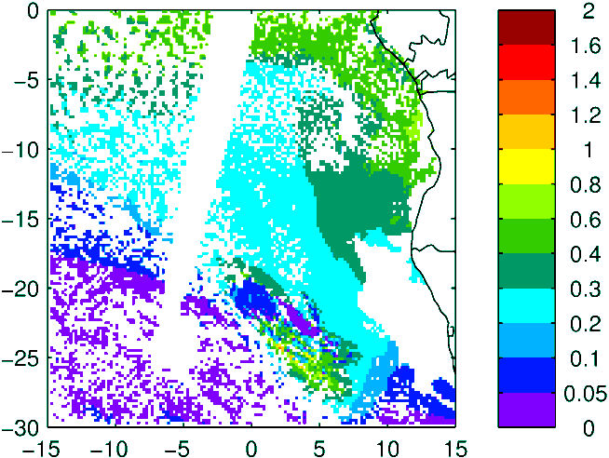
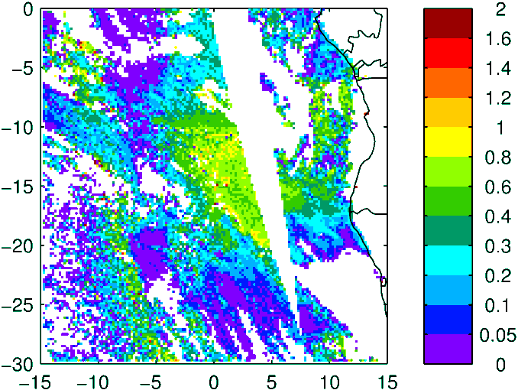
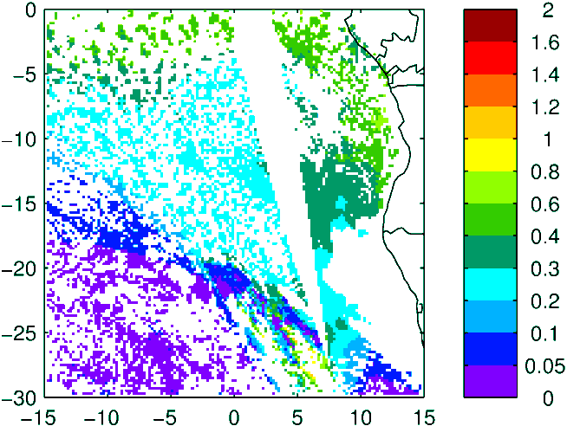
Above Cloud AOD (thanks Kerry!)
Observation
Model (WRF-AAM)
Terra
Aqua

Slide 5
Sep 04 2016 Sunday

Slide 6
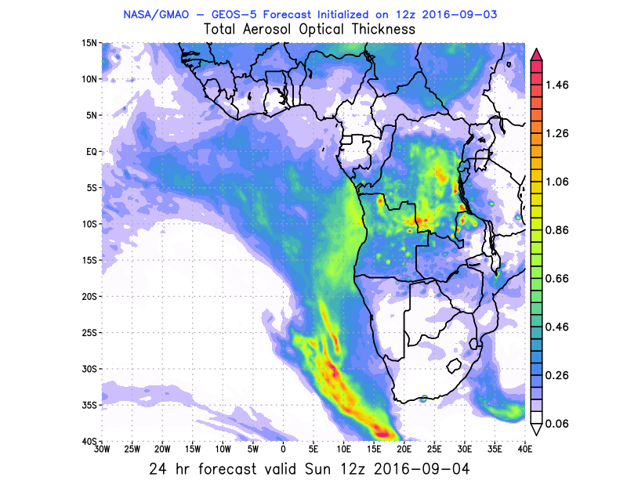
GEOS-5
CAMS
WRF
84 h – 04 Sep
72 h – 04 Sep
72 h – 04 Sep
24 h – 04 Sep
36 h – 04 Sep
24 h – 04 Sep

Slide 7
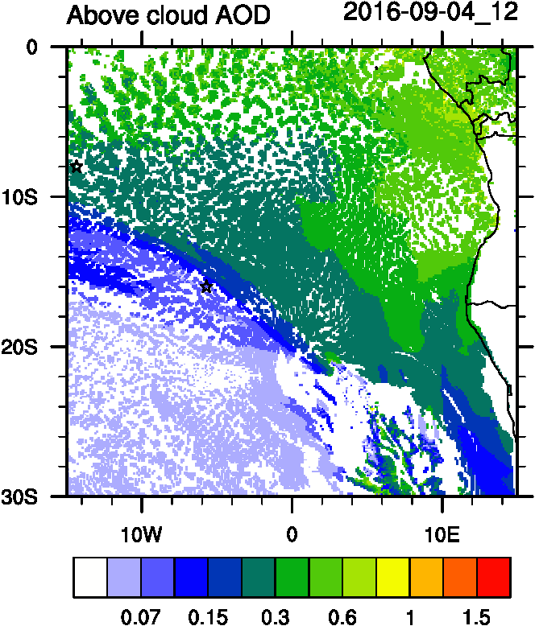
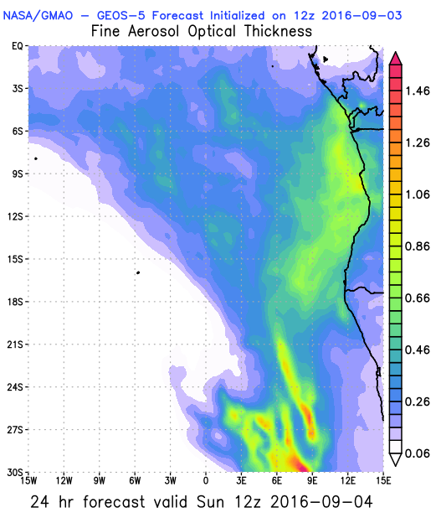
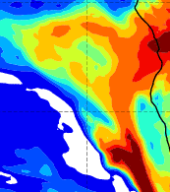
Sept 4 2016 (current conditions)

Slide 8
Sept 5 2016

Slide 9
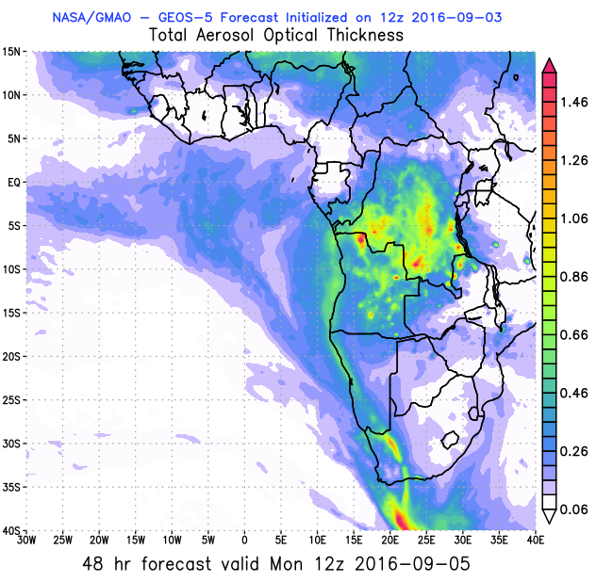
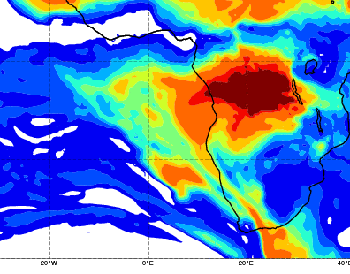
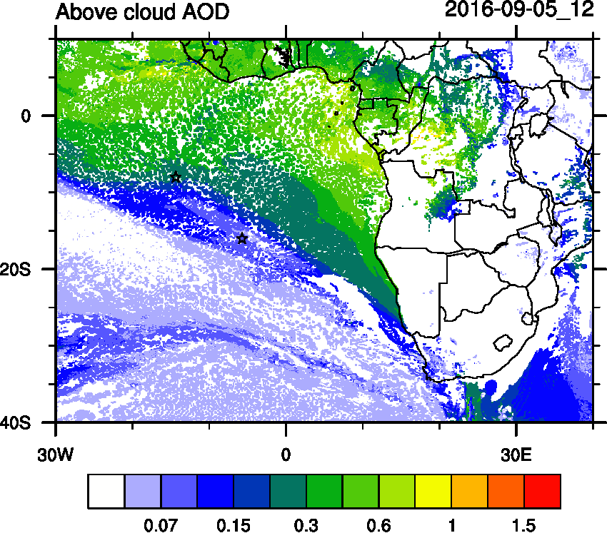
AOD 12 UTC
WRF
CAMS
GEOS5

Slide 10
Sept 6 2016

Slide 11
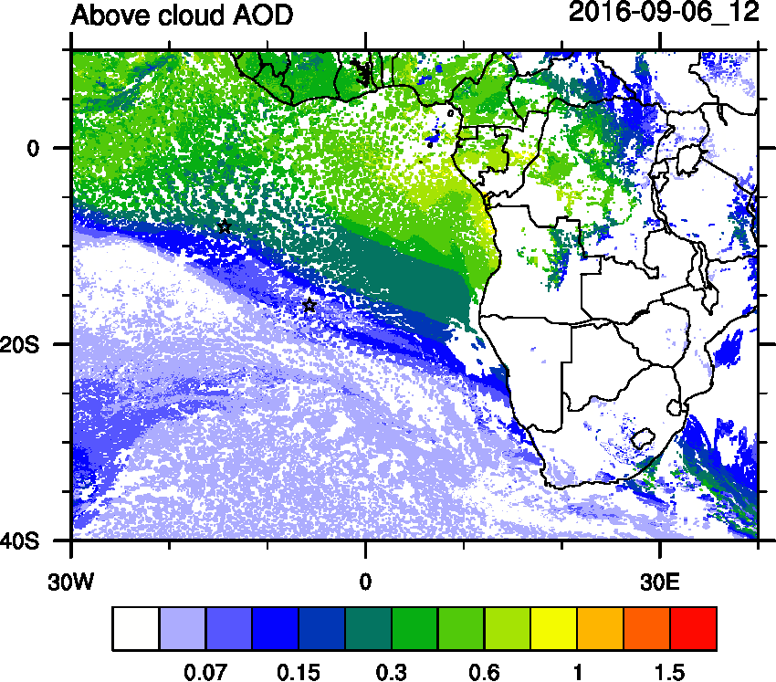
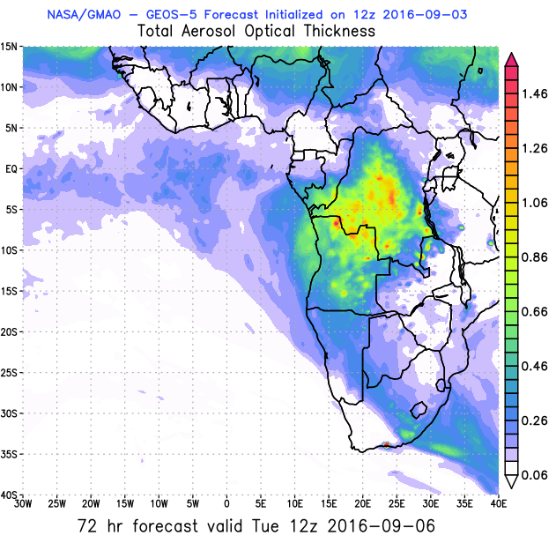
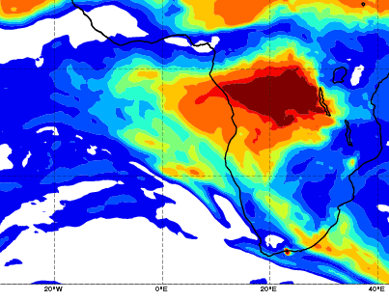
AOD 12 UTC
WRF
CAMS
GEOS5

Slide 12
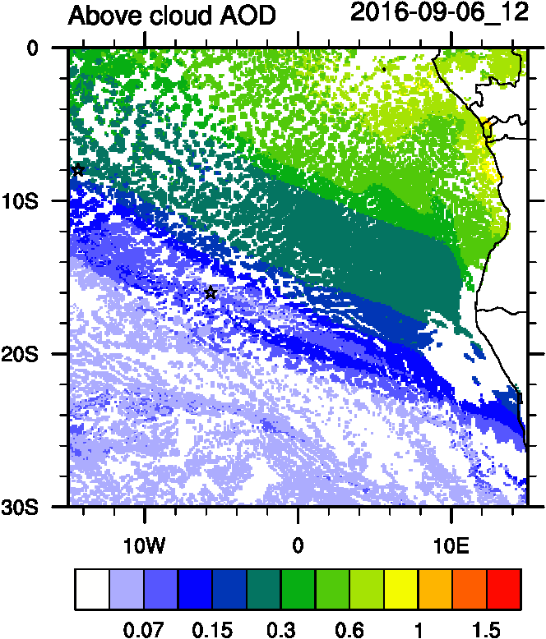
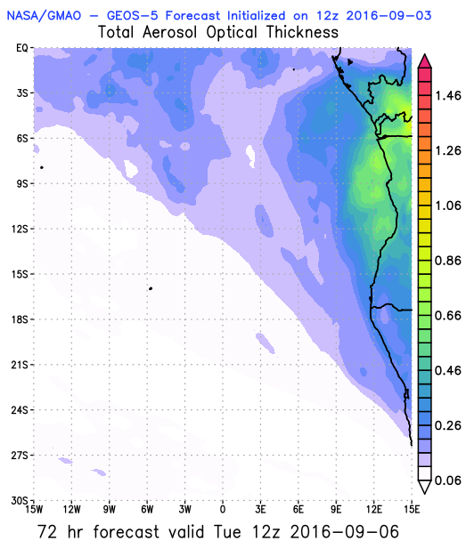
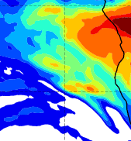
AOD 12 UTC

Slide 13
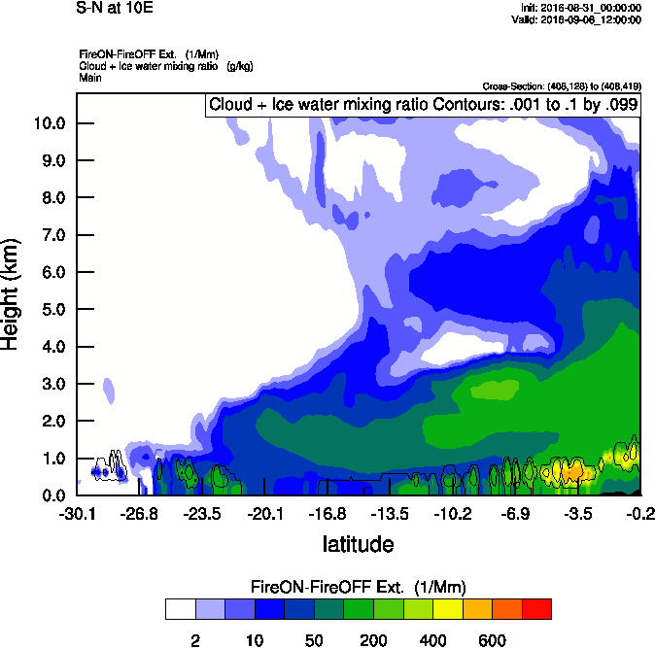
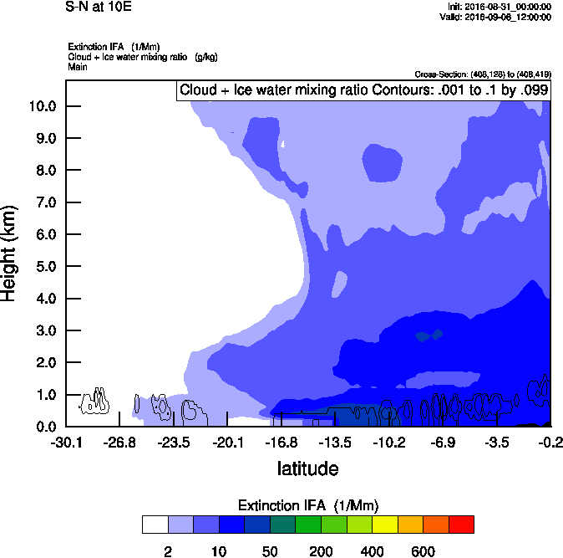
Vertical cross-section South to North
IWA Ext WRF
Smoke Ext WRF

Slide 14
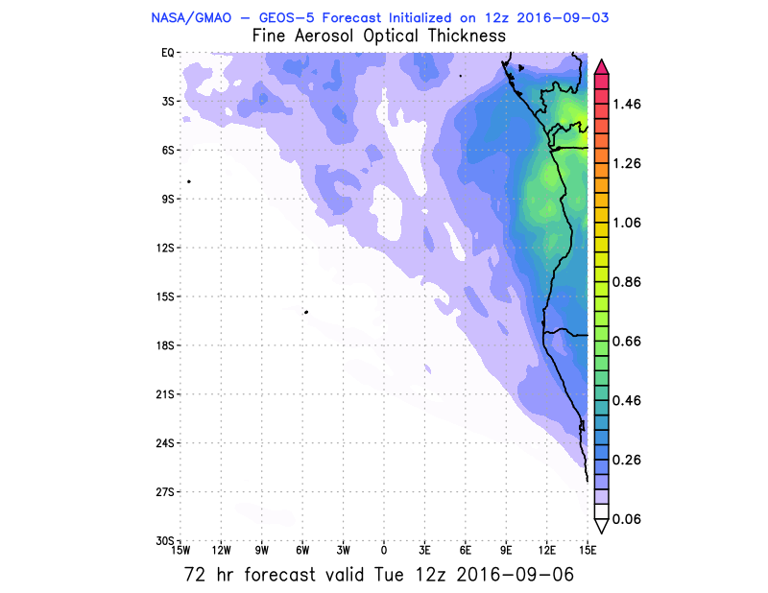
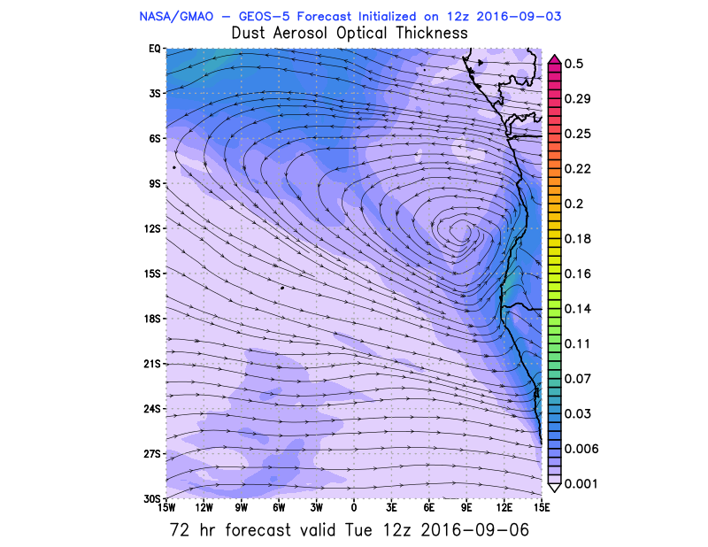
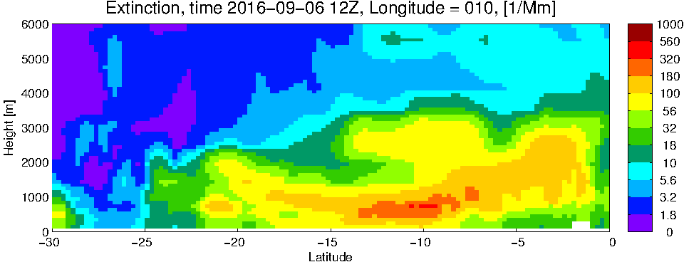
GEOS5 Fine and Dust AOD

Slide 15
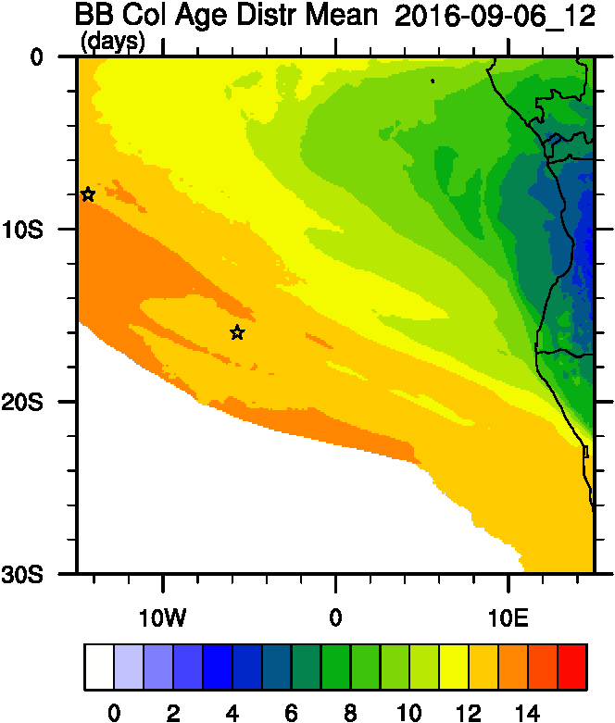
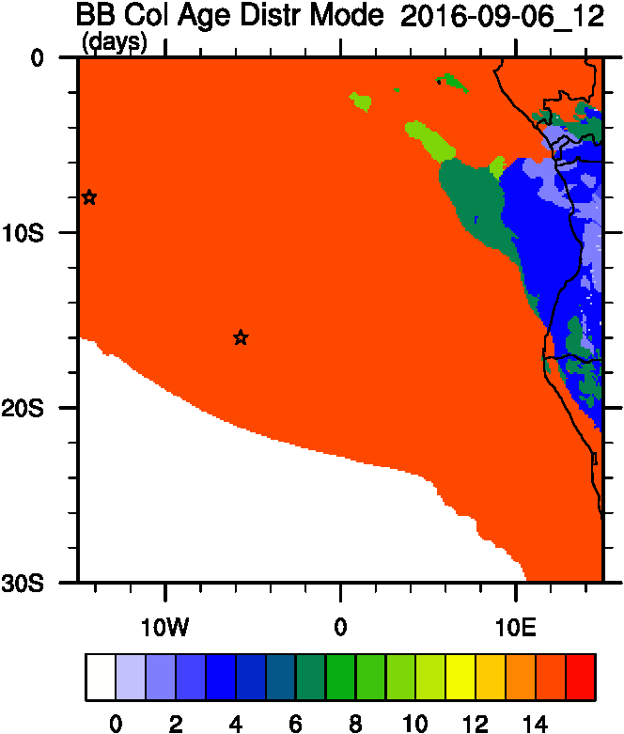
Smoke Age distribution
Mean Age
Mode Age

Slide 16
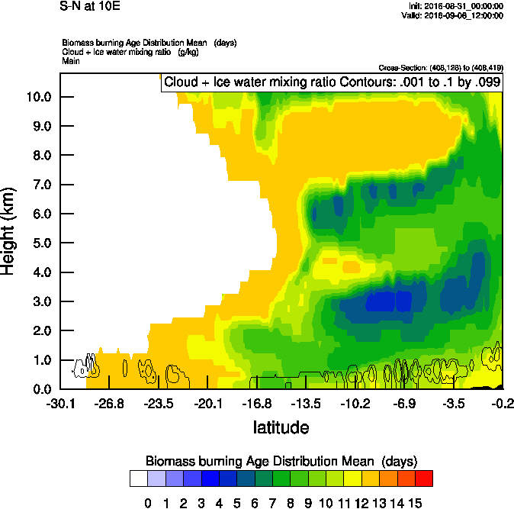
Vertical cross-section routine flight
Smoke Ext WRF
Age mean

Slide 17
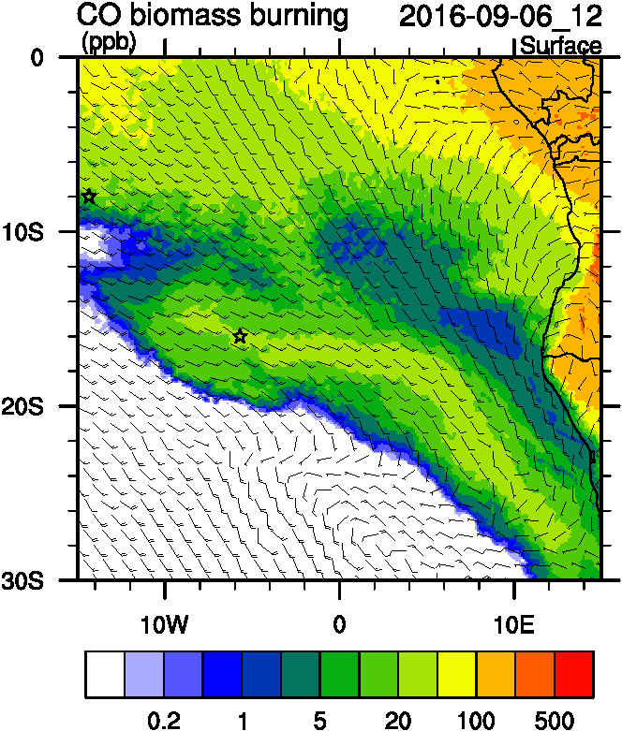
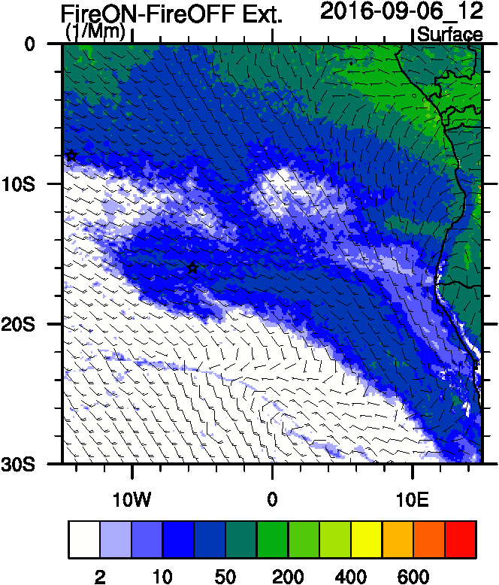
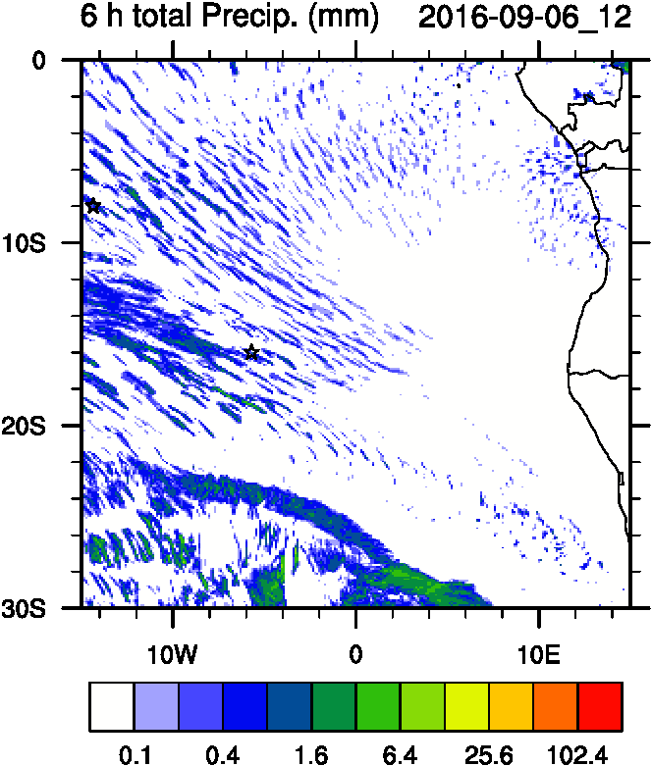
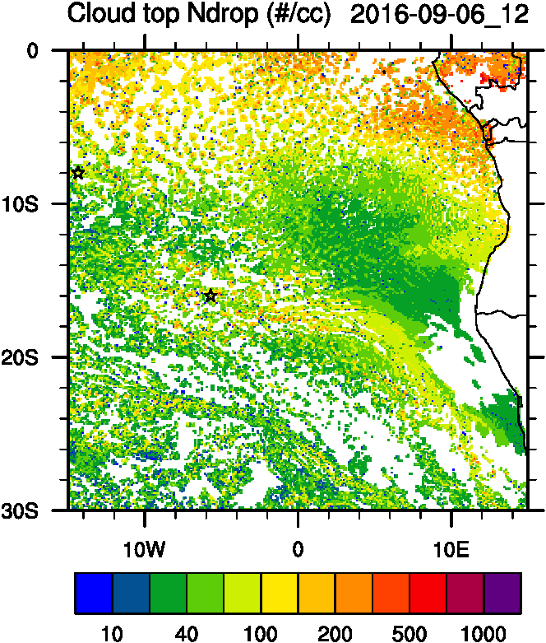
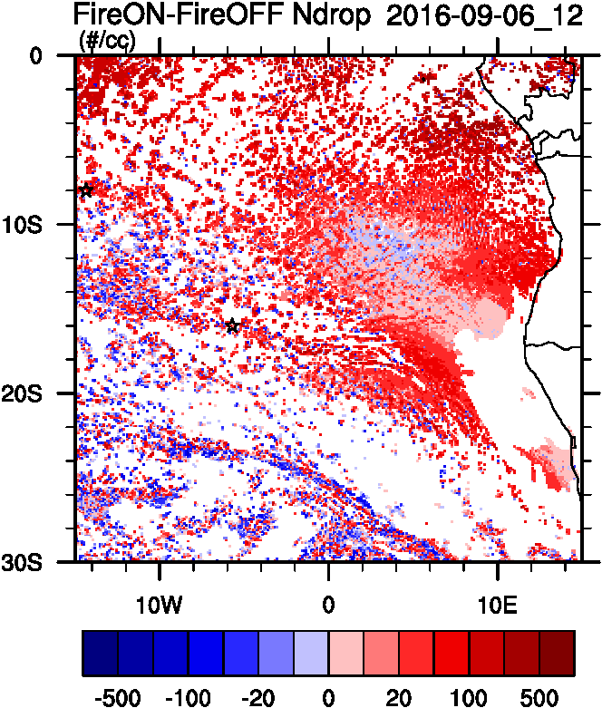
Aerosol-cloud interactions
Smoke Ext
Ndrop: Number droplet concentration
Diff: Differences between simulations turning on and off fires
Smoke AOD
tracer
Ndrop Diff
Cld Top
Ndrop

Slide 18
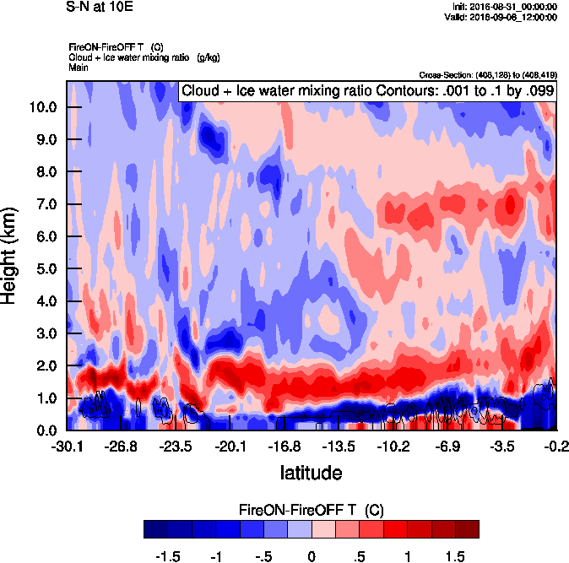
Vertical cross-section South to North
Smoke Ext WRF
T diff

Slide 19
Sep 07 2016 Wednesday

Slide 20
AOD 12 UTC
GEOS-5
GEOS-5
CAMS
WRF
108 h – 04 Sep
96 h – 07 Sep
96 h – 07 Sep
96 h – 07 Sep

Slide 21
12UTC flavors of AOD

Slide 22
Sep 08 2016 Thurday

Slide 23
AOD 12 UTC
GEOS-5
GEOS-5
120 h – 08 Sep

