Slide 1
ORACLES forecasting Briefing Meteorology
02-09-2016
Lenny Pfister, Susanne Bauer

Slide 2
Satellite movie
From 20160831 0Z (first flight) until now.
Shows fast moving cirrus and near stationary mid level cloud during flight
Digging trough moves high westward, expanding SC region near us, and we can see it reform.

Slide 3
Forecast run sequences
Low level. Note the widening and then narrowing of SC region south of 20 as the previous trough passes and a new one comes in.
Mid level: 600mb circulation extends out today and tomorrow, but tightens and retreats later
Upper level: Shows current trough moving on, and a weaker one developing behind it. Jet stream type cirrus expected associated with the high level RH.

Slide 4
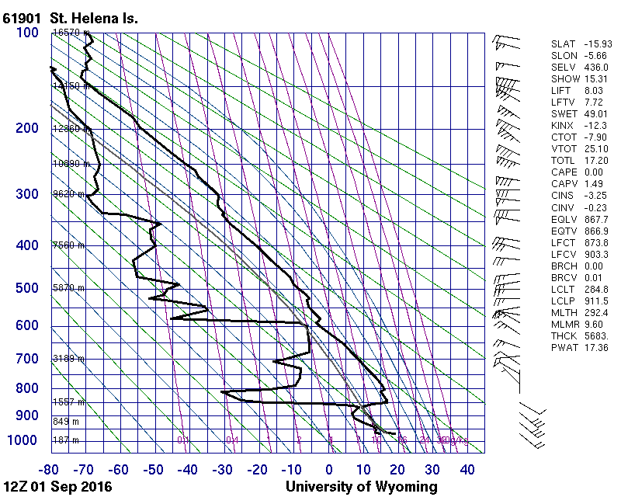

Slide 5
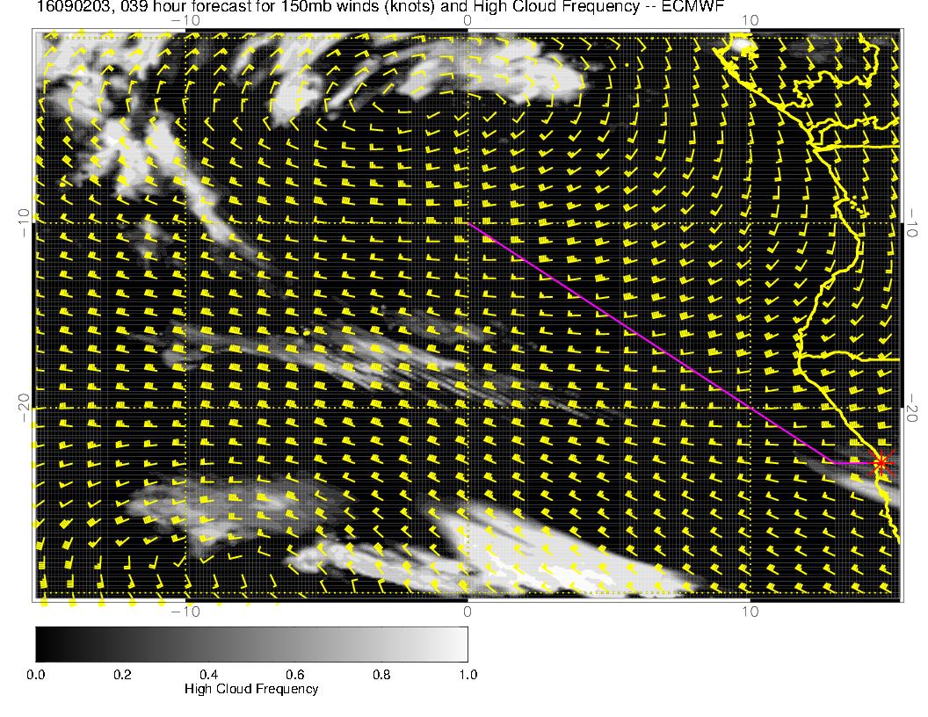
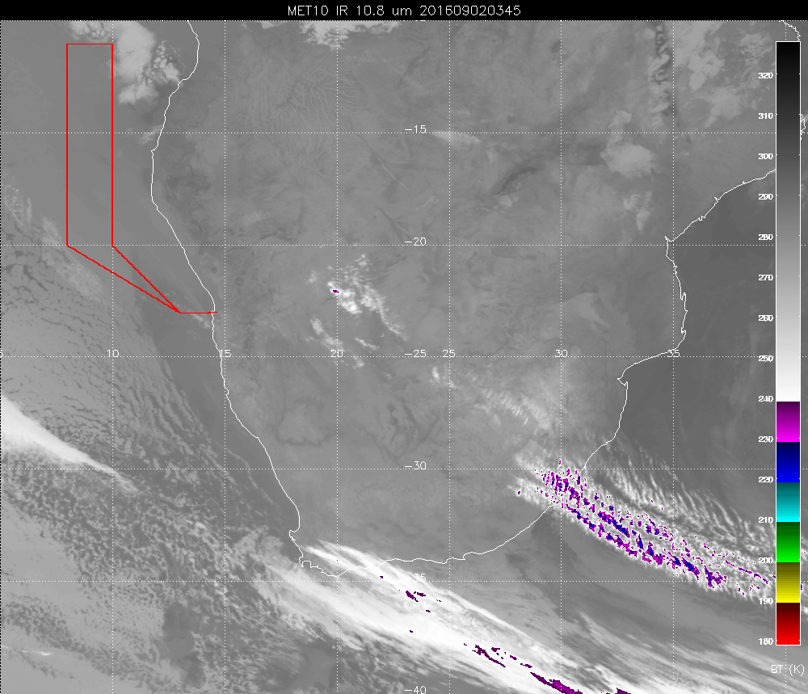
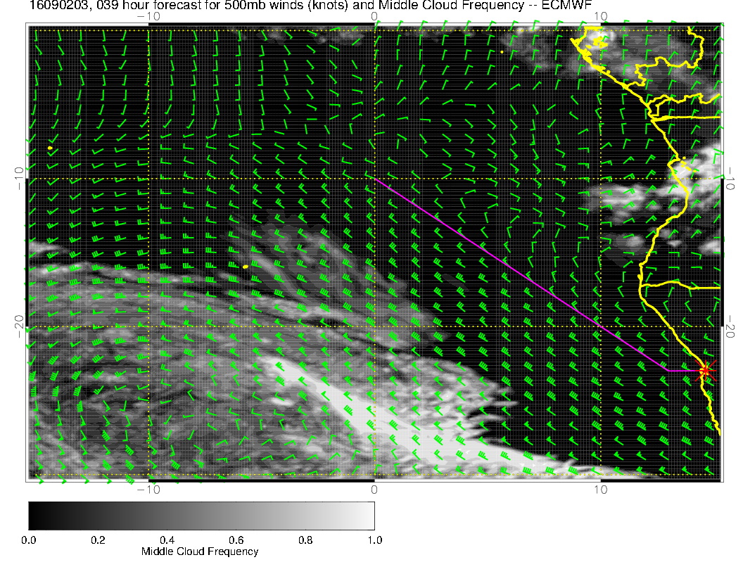
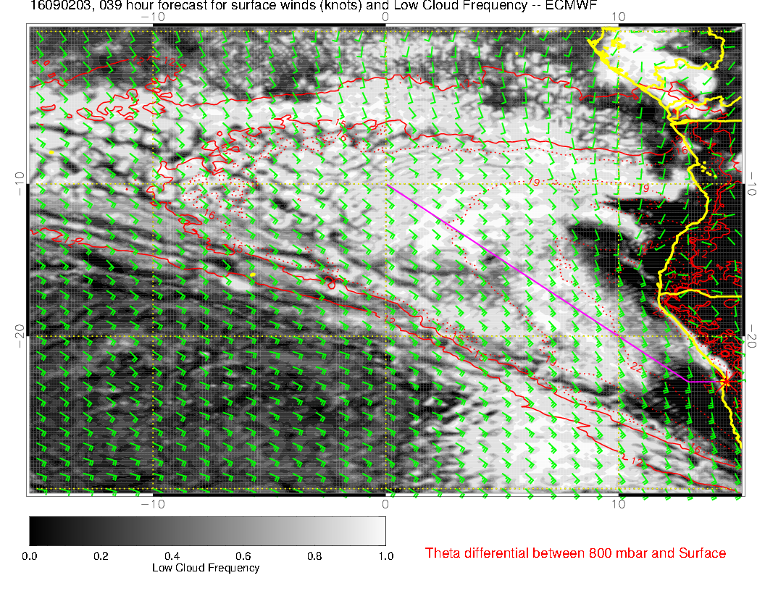
COMPARE FORECAST RUN USED YESTERDAY MORNING FOR TODAY’S FLIGHT TO
IR 3Z PIX. ALL FCSTS
VALID AT 2016090203

Slide 6
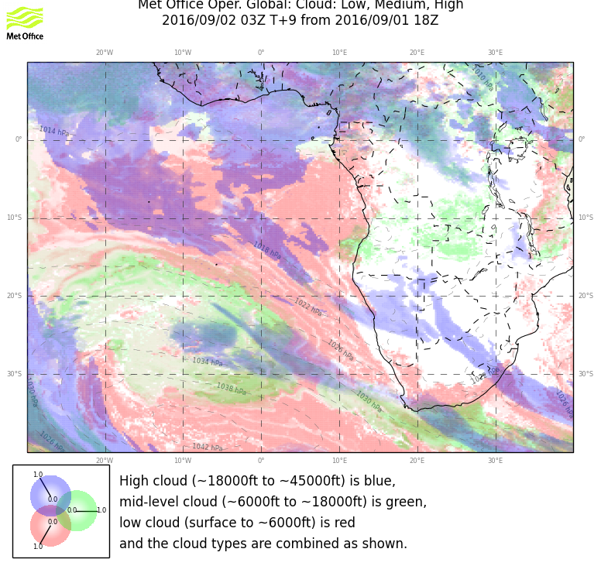
COMPARE FORECAST RUN USED YESTERDAY MORNING FOR TODAY’S FLIGHT TO
IR 3Z PIX. ALL FCSTS
VALID AT 2016090203

Slide 7
Sunday

Slide 8
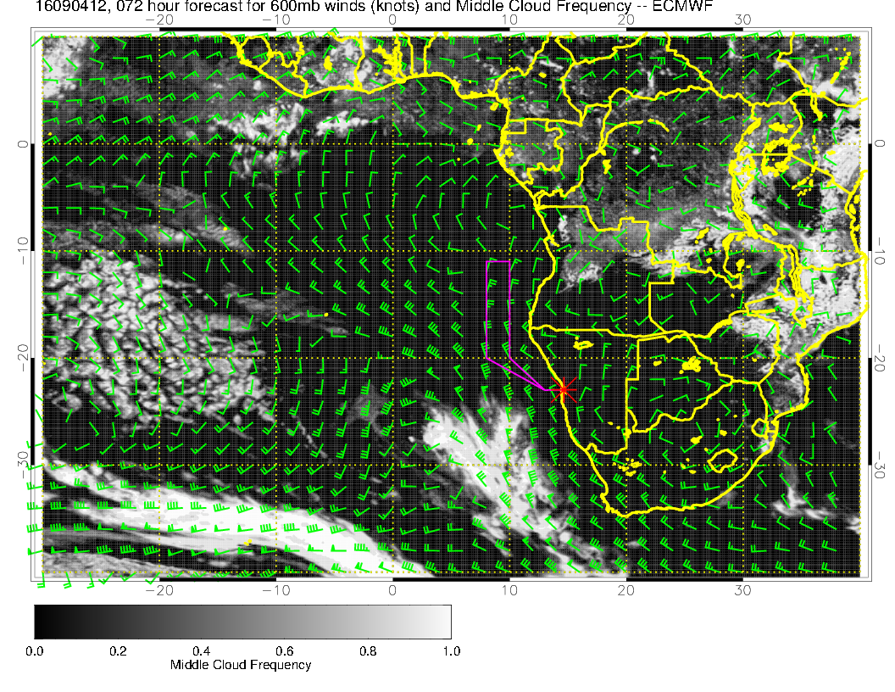
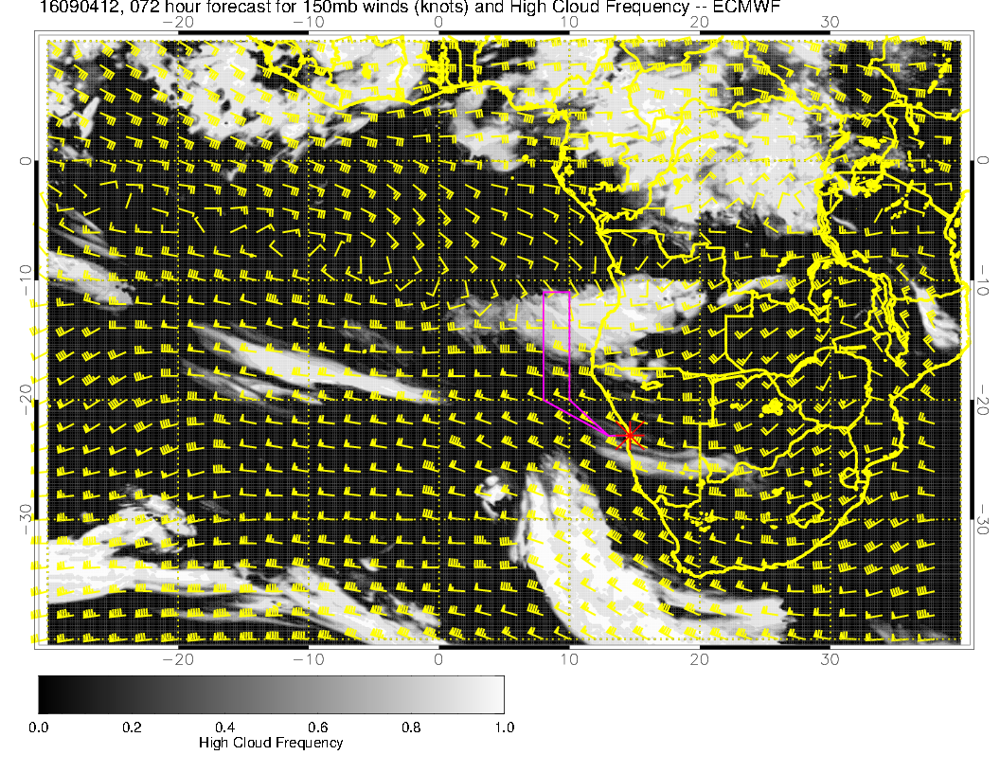
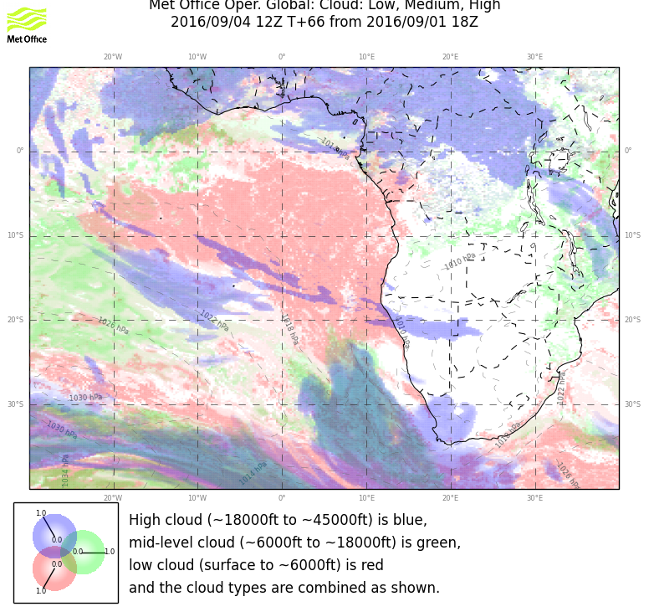
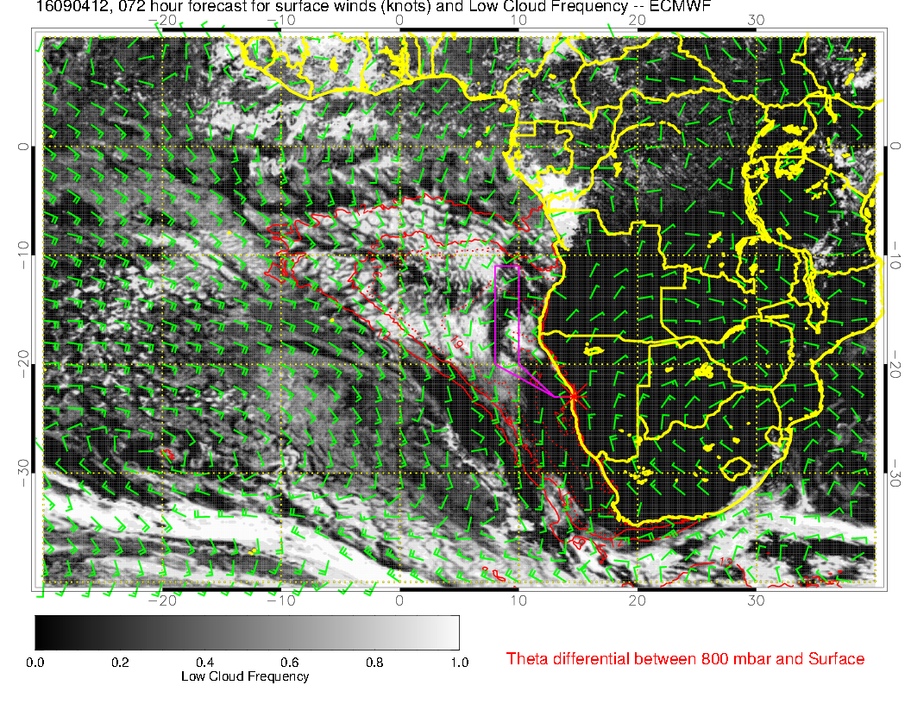
SUNDAY, 12Z
HIGH
MID
??:
Previous EC run
also has this.
The model runs are bouncing around on locating this feature. Feature is moving south with each model run in
both models. Likely to
be wispy
LOW

Slide 9
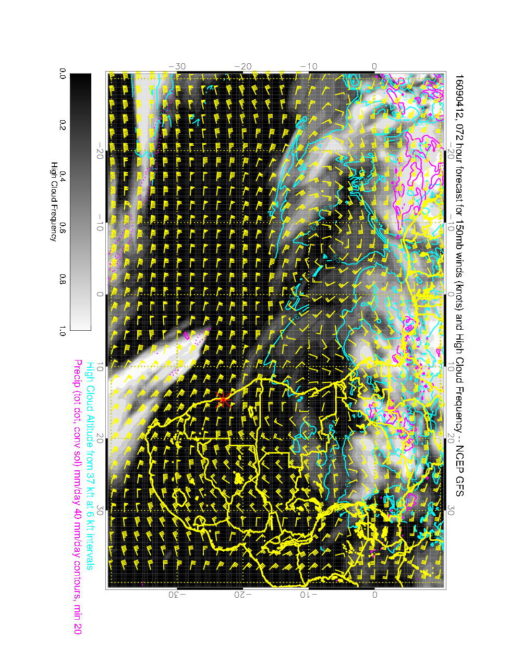
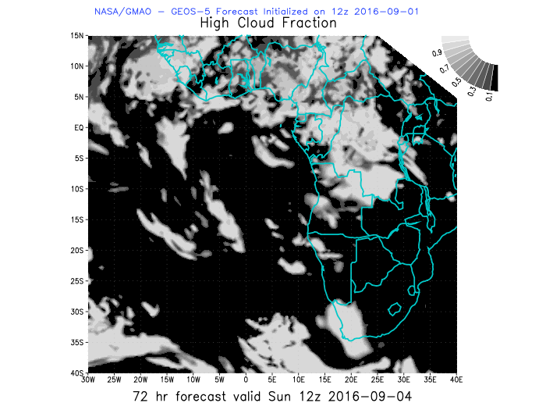
GEOS5 (left) and GFS (right) for Sunday, high cloud. Neither model has this
feature. I can’t see the physics (RH), so am inclined to discount it.

Slide 10
Forecast summary for Sunday
Ample low cloud stratocumulus down to about Walvis Bay. Some opening off of the Angolan coast, but not significant.
600mb recirculation confined near coast near Angolan, Congo coast. No middle cloud expected.
High cloud poses a forecast problem. Best estimate is that we will have some wispy cirrus over us but not to the north. Strong feature forecast by EC near 12S does not appear in other models. Do not recommend making plans based on high cloud EC forecast at this time.

Slide 11
Looking at other days, tomorrow, Monday, and Tuesday in that order

Slide 12
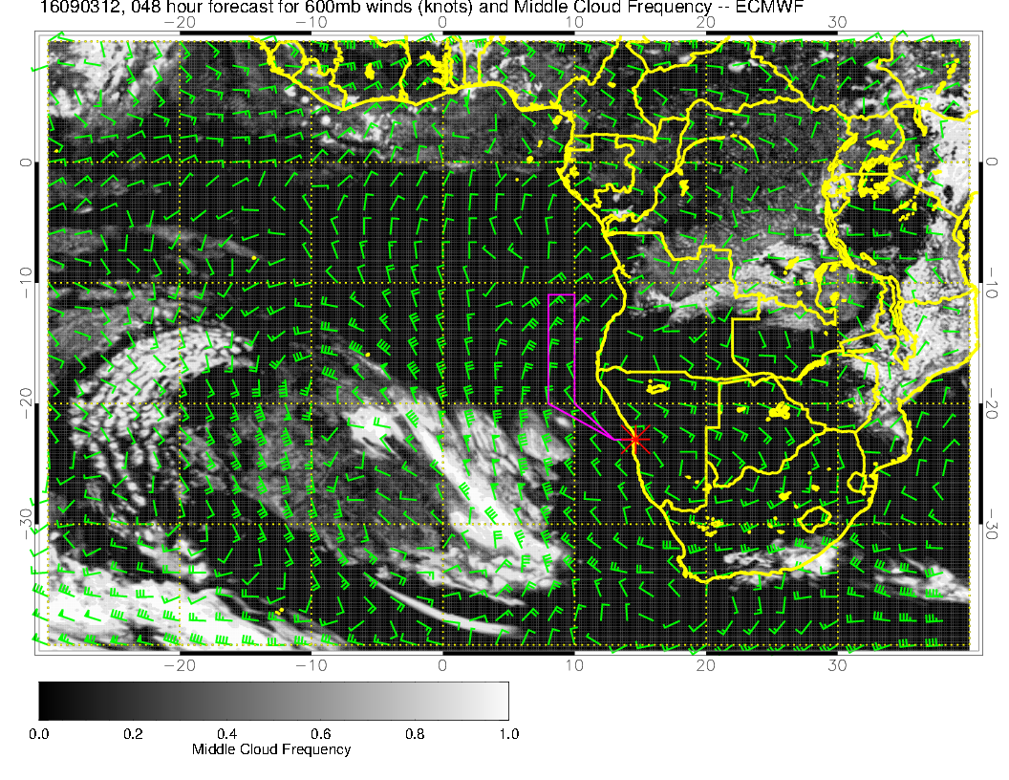
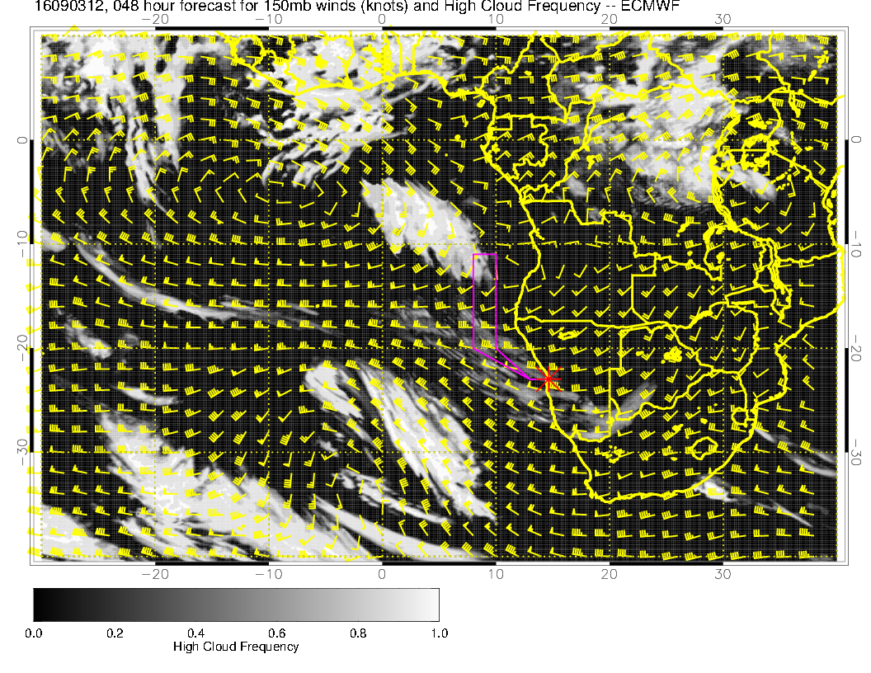
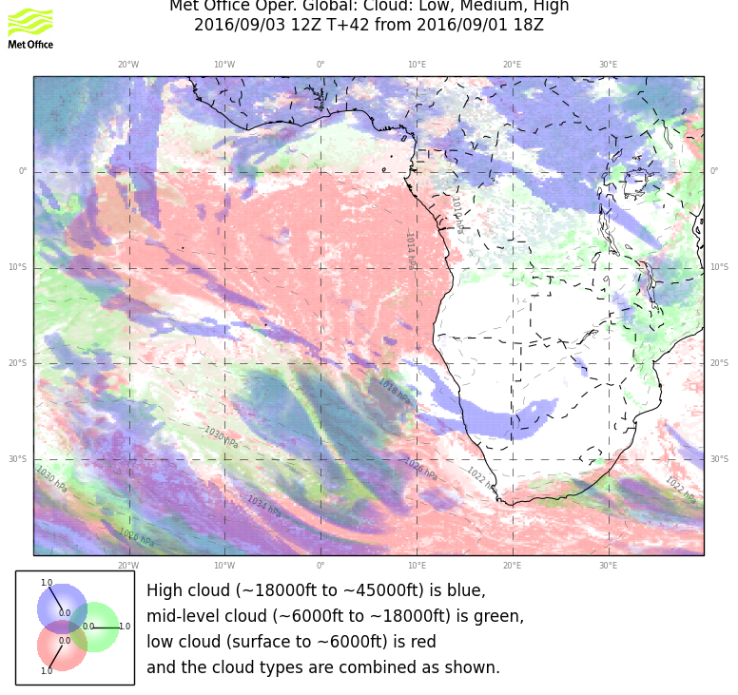
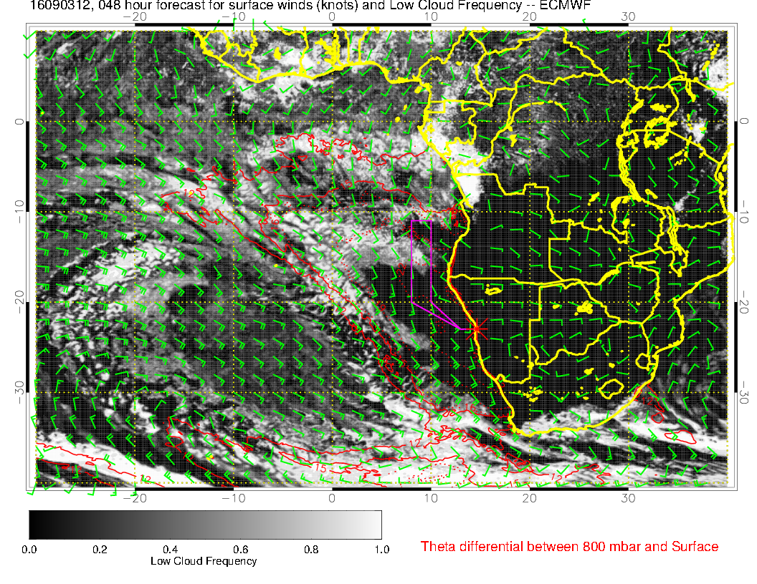
Saturday, 12Z
HIGH
MID
More high cloud over
us, less mid cloud in
the north. EC opens
up too much, but
expect little SC (?) south of 20S (so less than today).
LOW

Slide 13
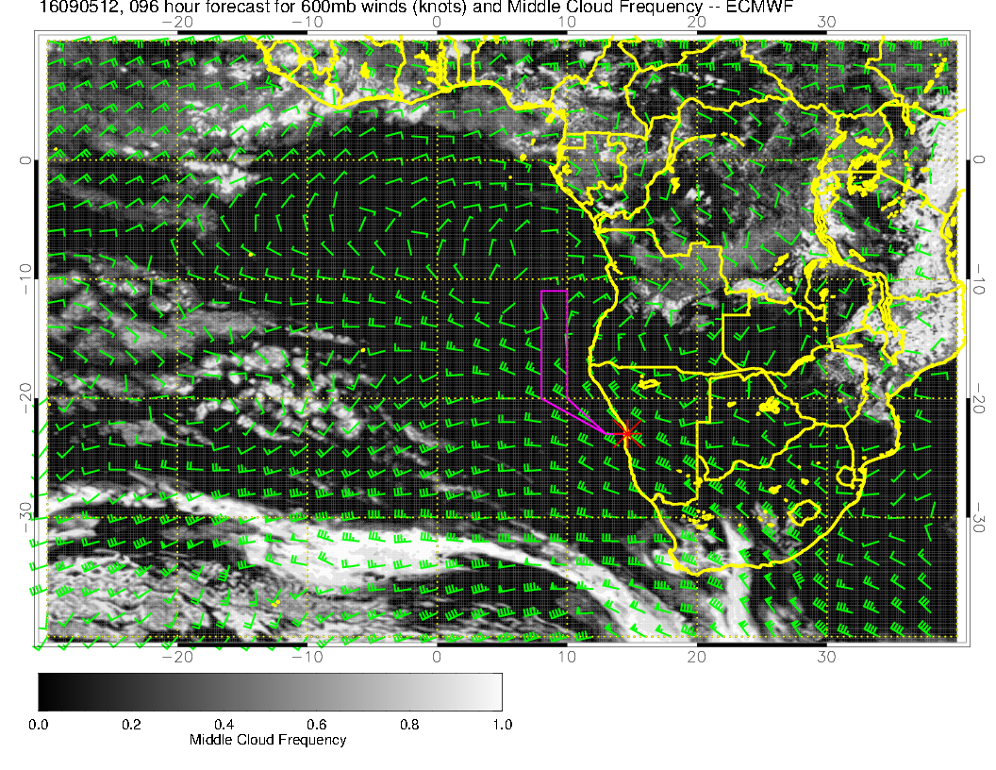
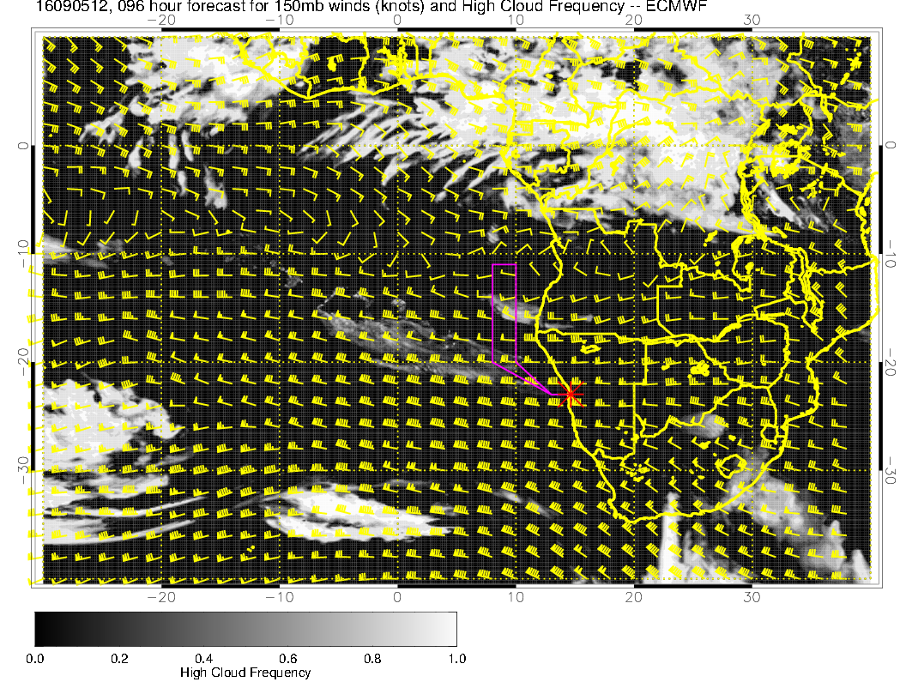
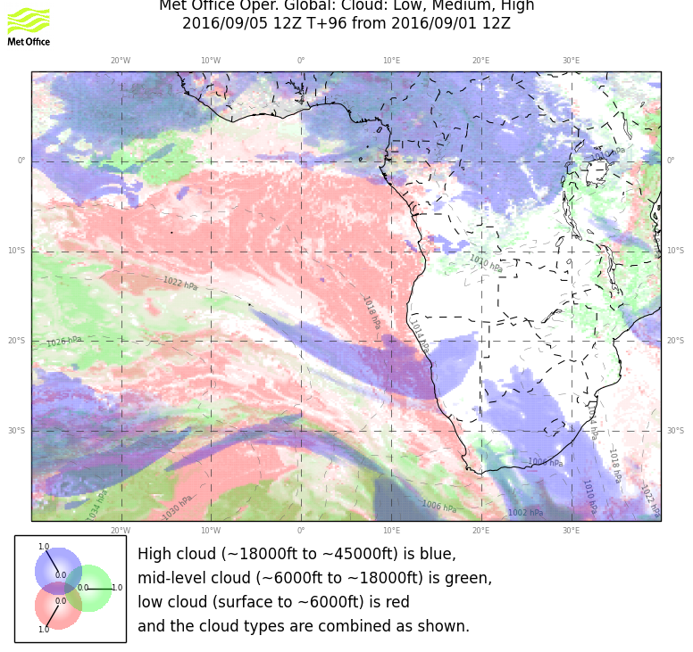
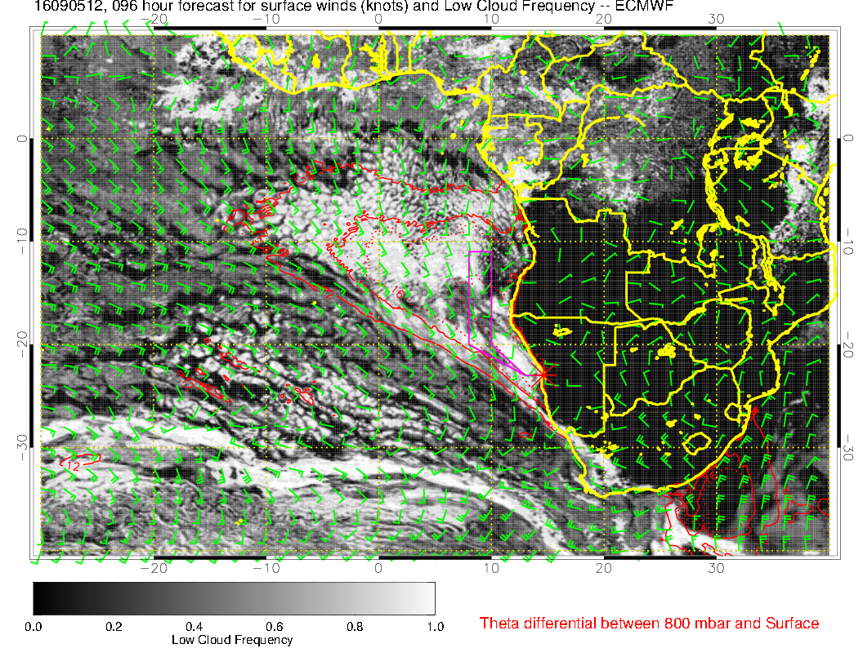
Monday, 12Z
HIGH
MID
Getting a bit far
out, but the
moving high is
squeezing the SC
region. Would need
to watch the cirrus
associated with the
trough on the STJ.
LOW

Slide 14
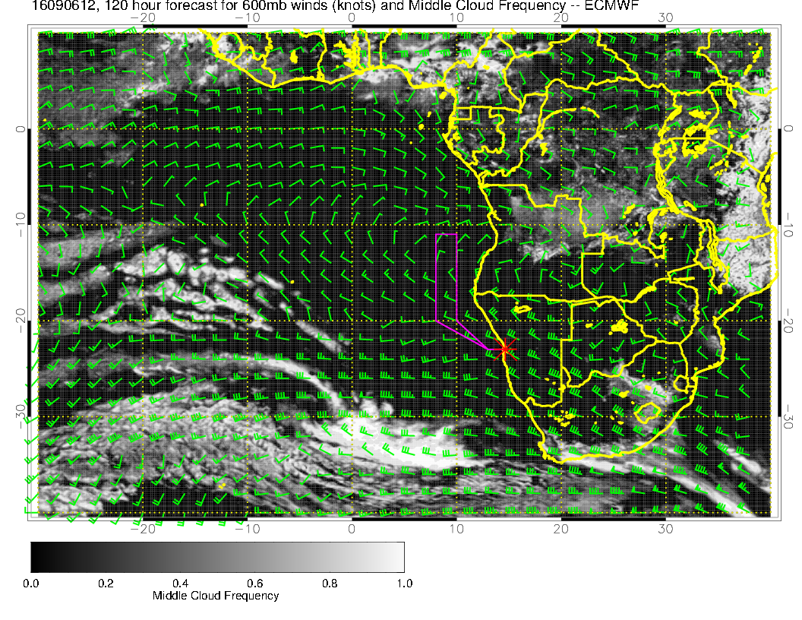
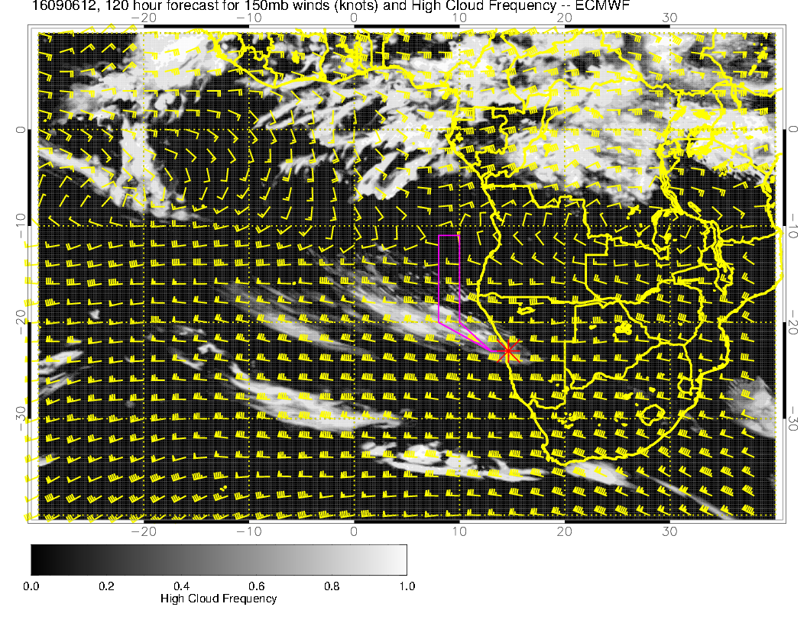
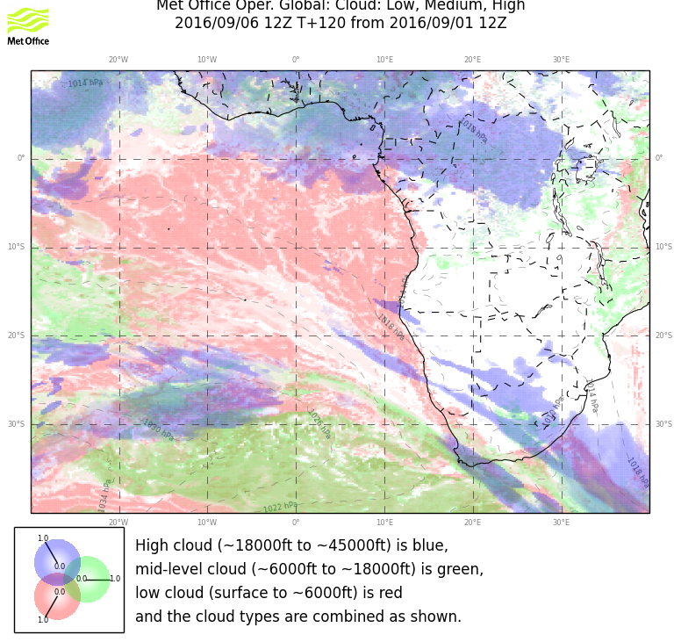
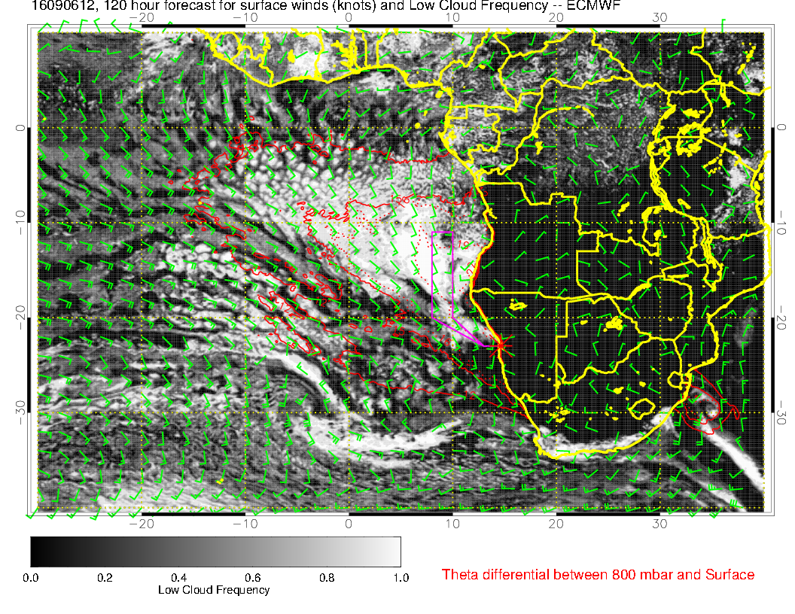
Tuesday, 12Z
HIGH
No mid-level cloud
forecast. A reasonable
consensus on the cirrus
SC region is pushed north
in both models. More
clearing in the UK
model. EC has a wave
developing at 30S, 0E
which I do not see in
UKMO model.
MID
LOW

Slide 15
Summary for tomorrow, Monday, Tuesday
Tomorrow would suggest same flight plan as today, but more cirrus (over us), and less SC
Monday we come under the influence of a developing trough (not as strong as the last one) which will generate some over us that needs to be watched.
Cirrus problem increases Tuesday as trough approaches. SC region could be quite narrow depending on whether the EC wave develops or not.

