Slide 1
ORACLES forecasting Briefing Aerosols
02-09-2016

Slide 2
Sept 1 2016 (model evaluation)

Slide 3
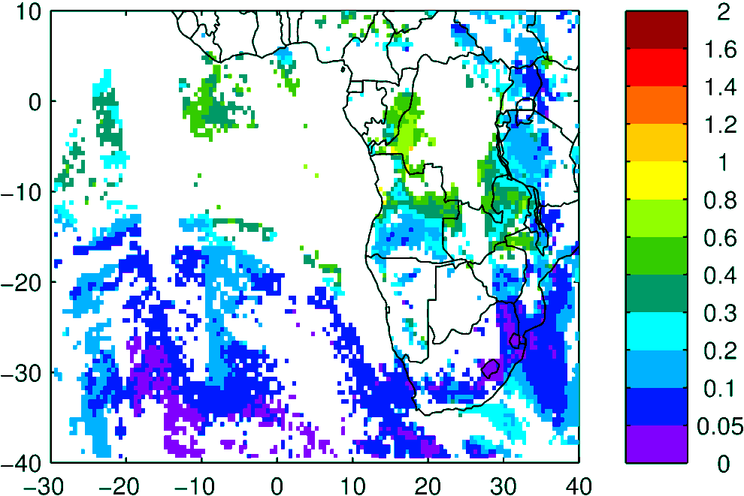
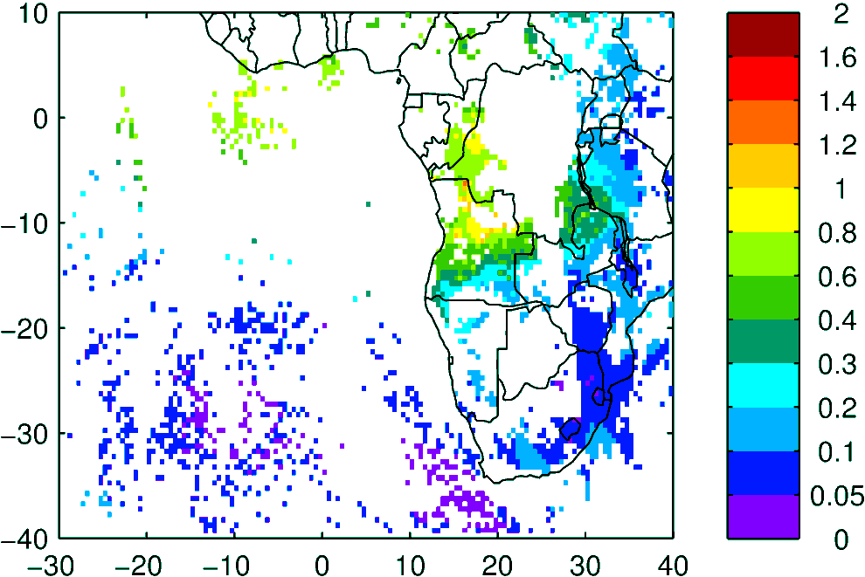
Terra & Aqua AOD (clear-sky)
MODIS NNR
WRF-AAM

Slide 4
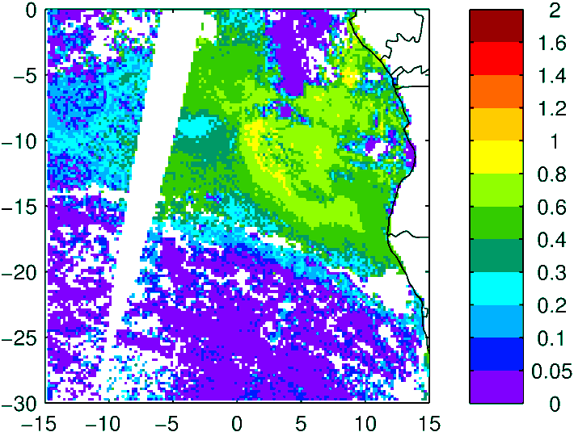
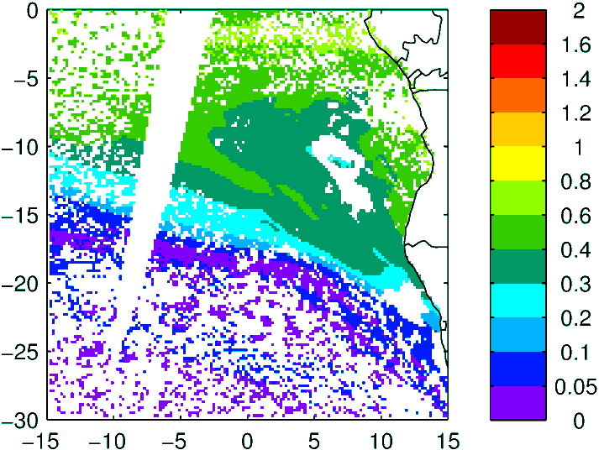
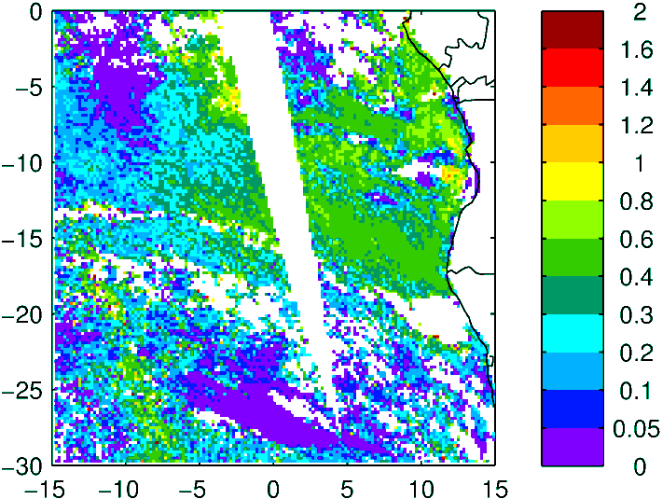
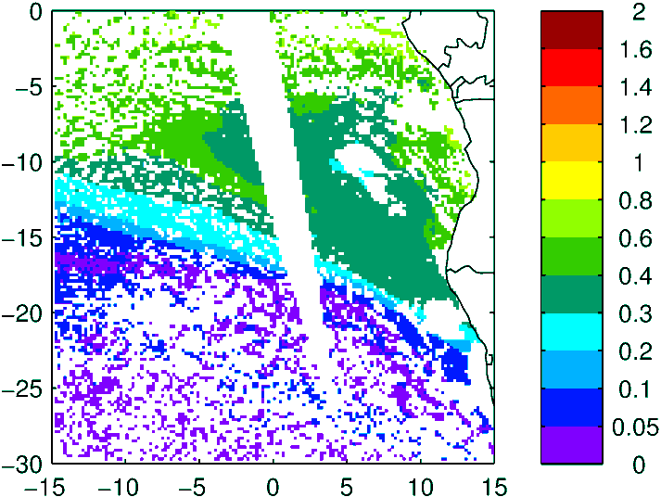
Above Cloud AOD (thanks Kerry!)
Observation
Model (WRF-AAM)
Terra
Aqua

Slide 5
Sep 02 -03 2016 Friday - Saturday

Slide 6
GEOS-5
CAMS
WRF
24 h – 02 Sep
36 h – 02 Sep
24 h – 02 Sep
48 h – 03 Sep
60 h – 03 Sep
48 h – 03 Sep

Slide 7
Sep 04 2016 Sunday

Slide 8
AOD 12 UTC
GEOS-5
GEOS-5
CAMS
WRF
84 h – 04 Sep
72 h – 04 Sep
72 h – 04 Sep

Slide 10
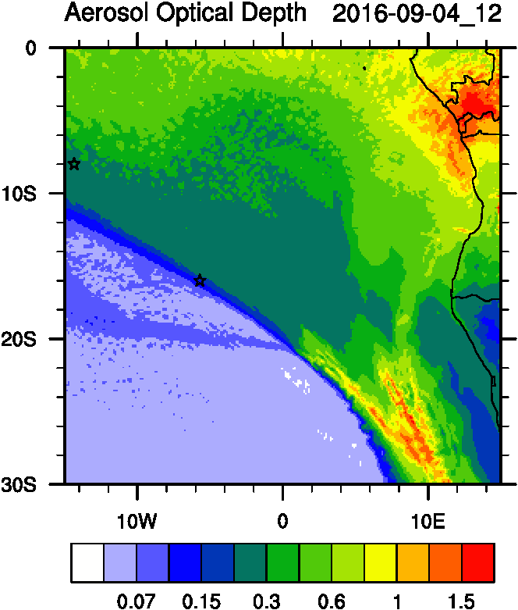
AOD
ACAOD
12UTC flavors of AOD
AOD smoke
AOD dust

Slide 11
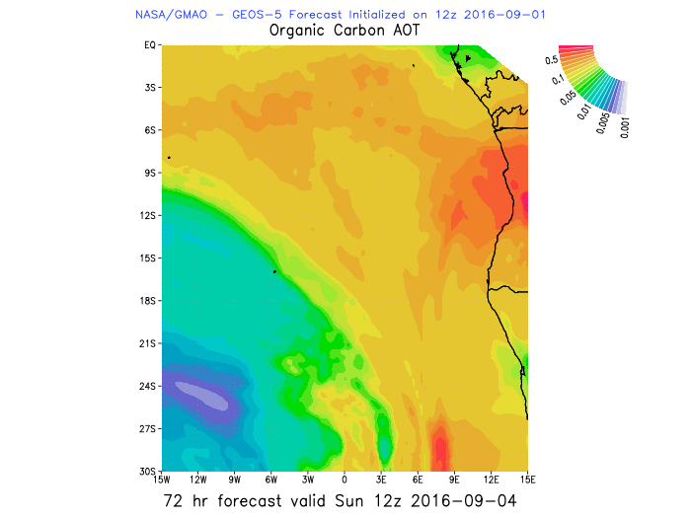
AOD
OC-AOD
12UTC flavors of AOD
DUST AOD

Slide 12
Smoke Age distribution

Slide 13
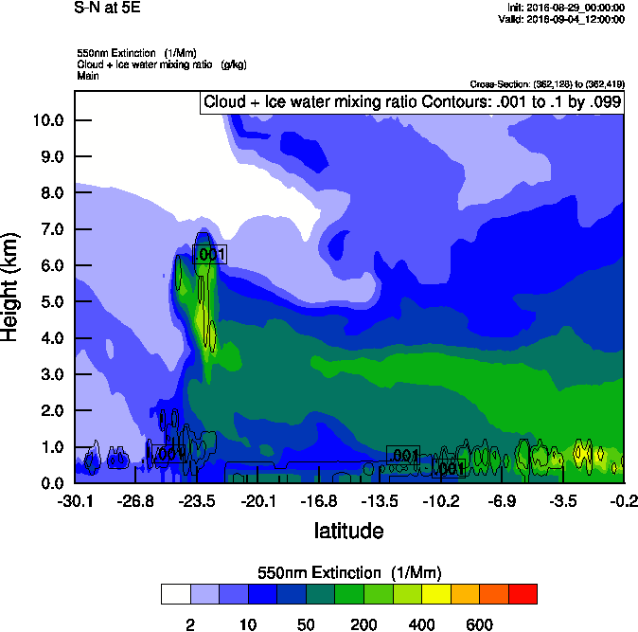
Vertical cross-section
5E
10E
Smoke AOD

Slide 14
Vertical cross-section routine flight
Smoke Ext
Smoke AOD

Slide 15
Vertical cross-section routine flight
Smoke Ext
Age mean
Smoke AOD

Slide 16
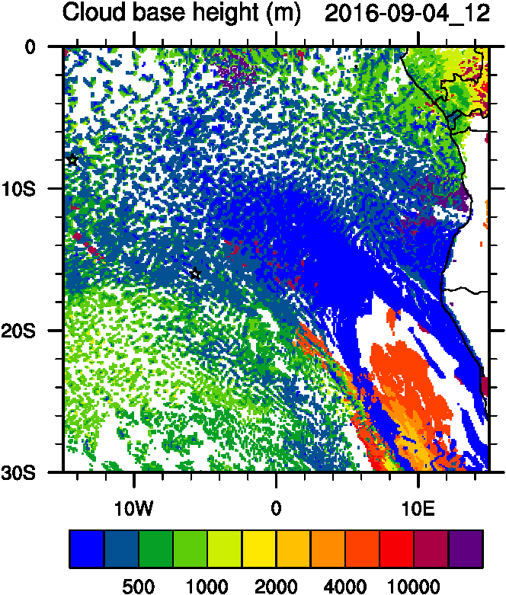
Aerosol-cloud interactions
Ndrop: Number droplet concentration
Diff: Differences between simulations turning on and off fires
Smoke AOD
Cld base
Cld Top
Ndrop
Ndrop Diff

Slide 17
RH
PBL

Slide 18
Aerosol-radiation interactions
Smoke Ext
T diff
Smoke AOD

Slide 19
Vertical cross-section routine flight
Smoke AOD
Ext
Temp diff

Slide 20
Wavis Bay-smoke
Wavis Bay-dust
Namibe
Bonanza

Slide 21
Ascension
Sta Helena

Slide 22
Sept 5 2016

Slide 23
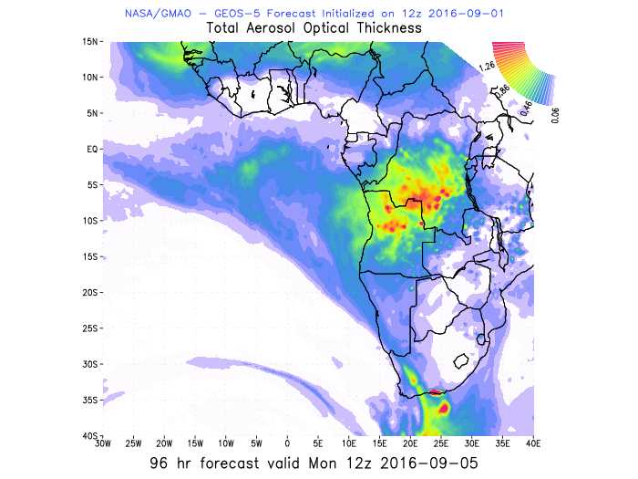
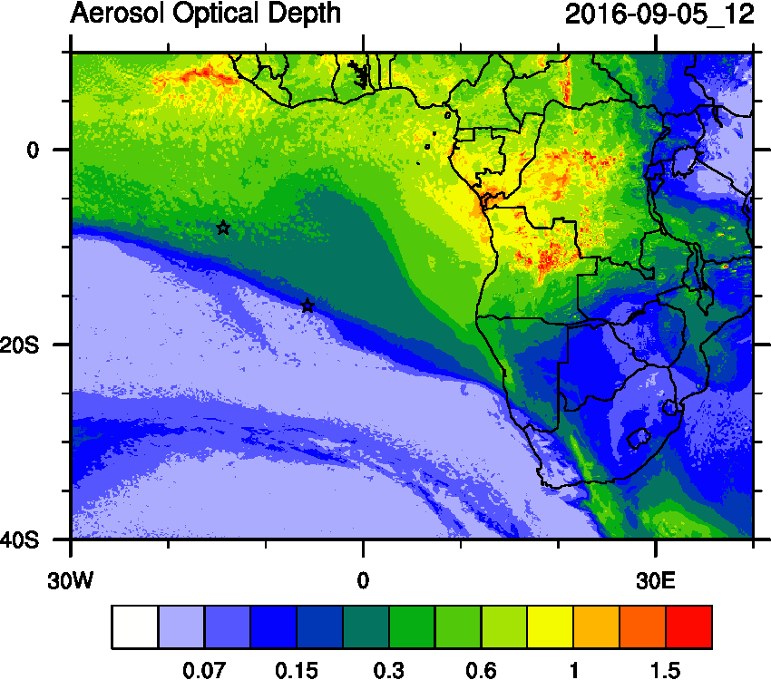
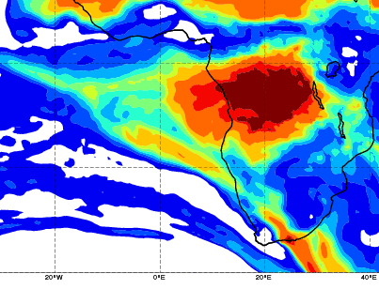
WRF
GEOS5
CAMS

Slide 24
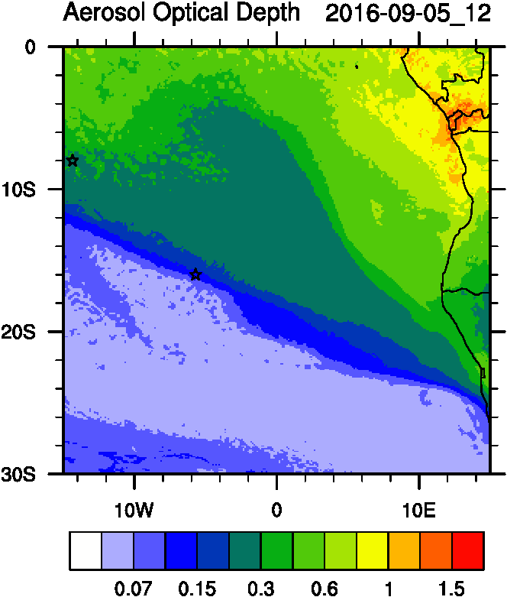
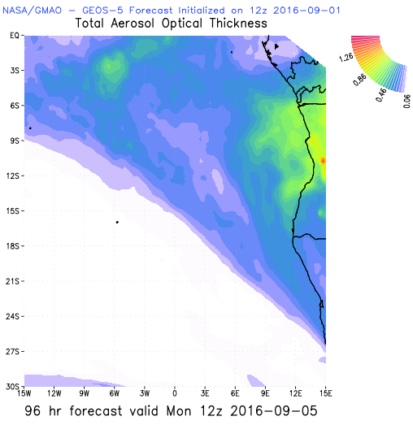
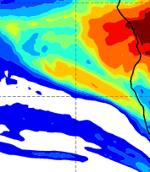
AOD 12 UTC
GEOS5
CAMS
WRF

Slide 25
Sept 5 2016

Slide 26
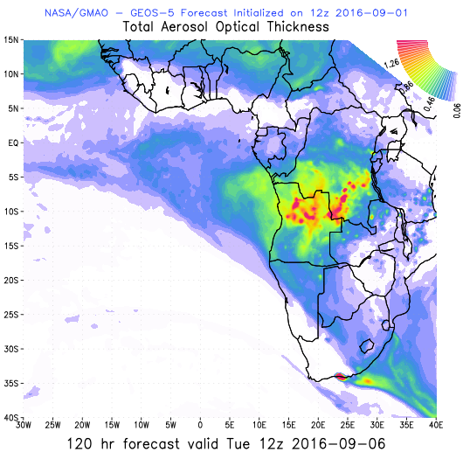
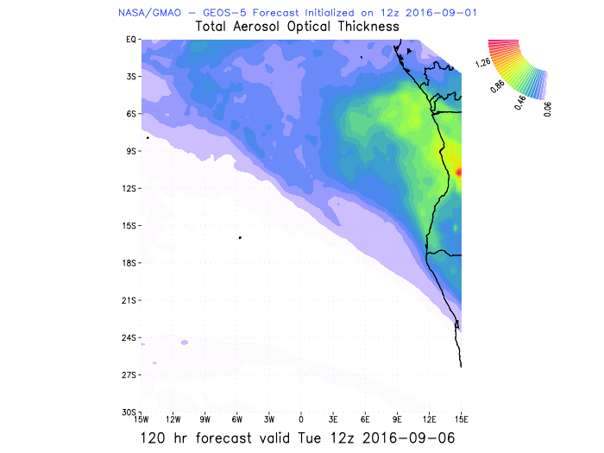
GEOS5 AOD

Slide 27
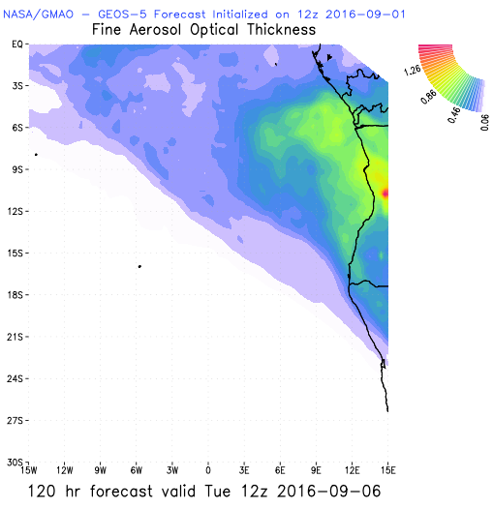
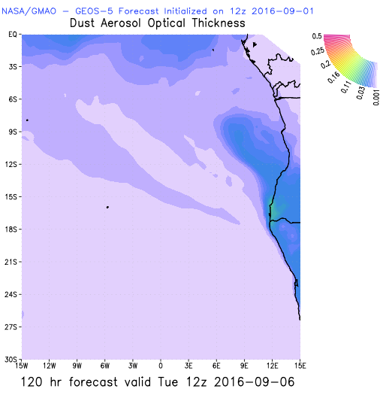
GEOS5 Fine and Dust AOD

