Slide 1
ORACLES forecasting Briefing Meteorology
Briefing on 01-09-2016 8am
Forecasting for flight target opt #1 on 02-09-2016

Slide 2
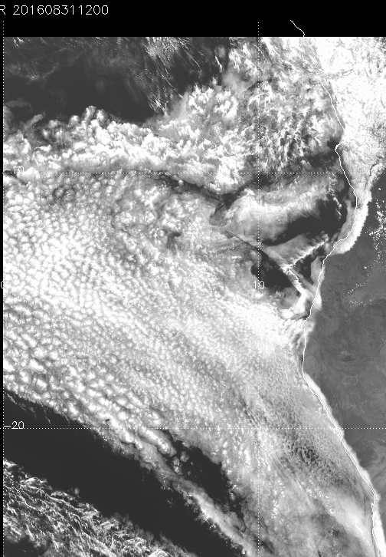
Yesterdays Flight AUG31 12z compared to T24 forecasts
Satellite
UKMET
ECMWF

Slide 3
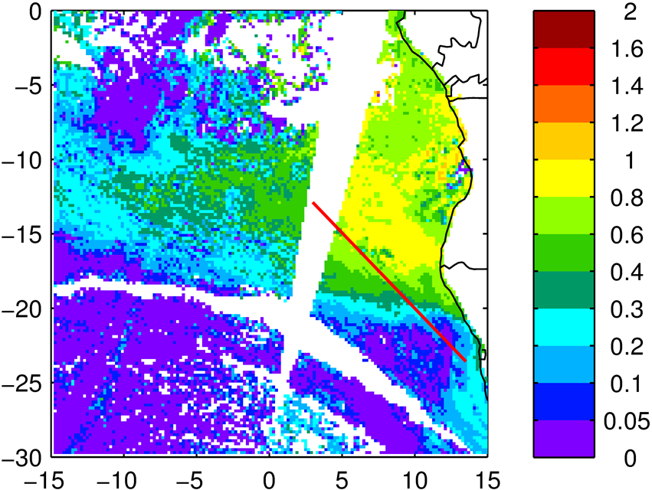
Yesterdays: Above cloud AOD

Slide 4
High Cloud Image and Forecasts

Slide 5
Forecast

Slide 6
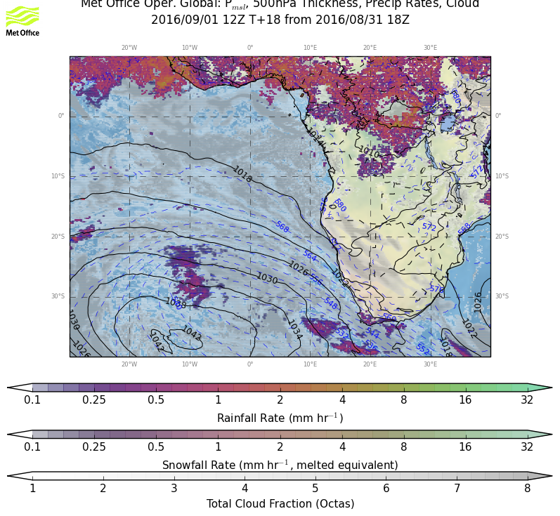
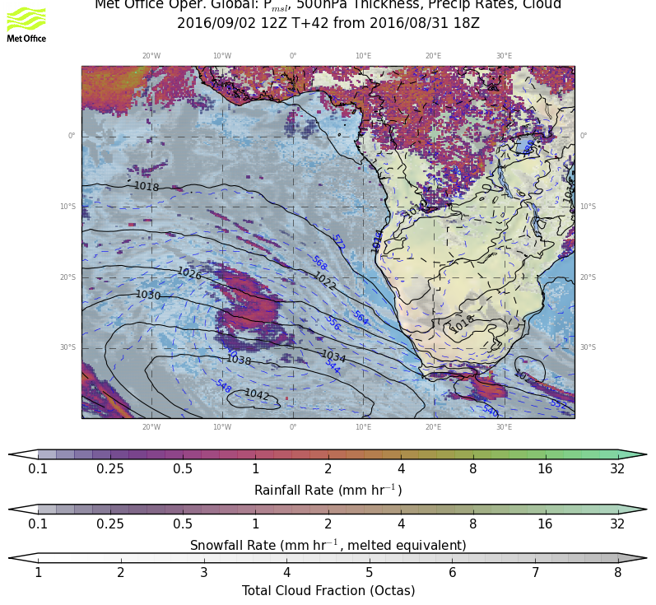
General Conditions Thu & Fri

Slide 7
Thursday Wind 950 hPa

Slide 8
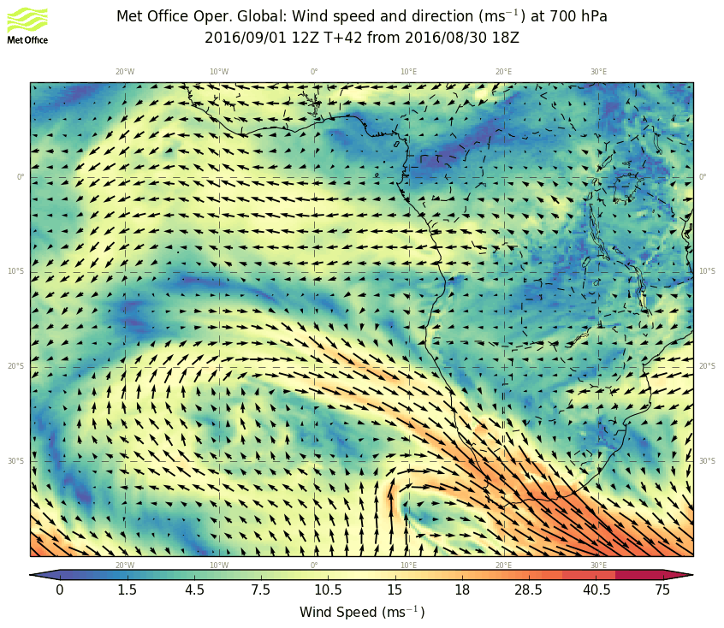
Thursday Wind 950, 700 hPa

Slide 9
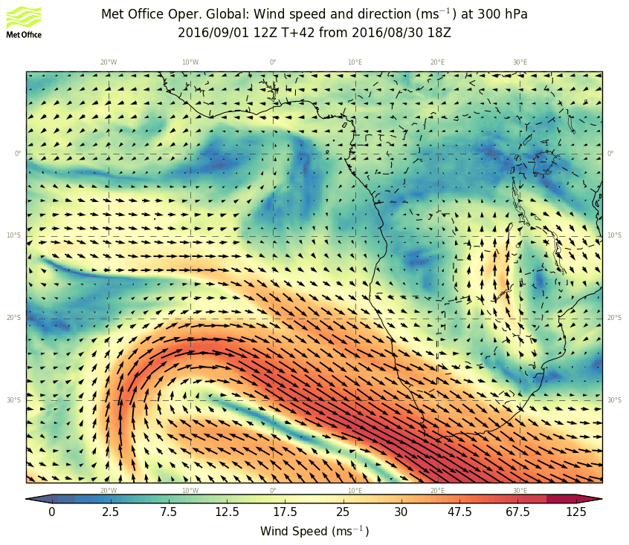
Thursday Wind 950, 700, 300 hPa

Slide 10
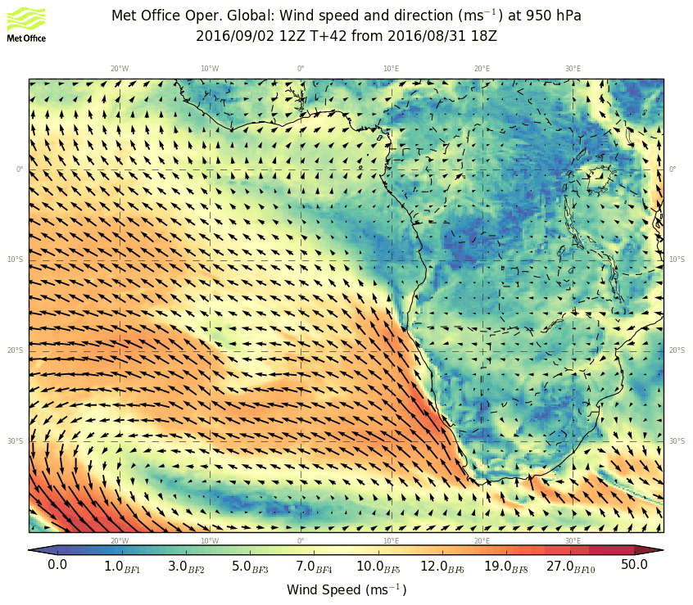
Friday Wind 950 hPa

Slide 11
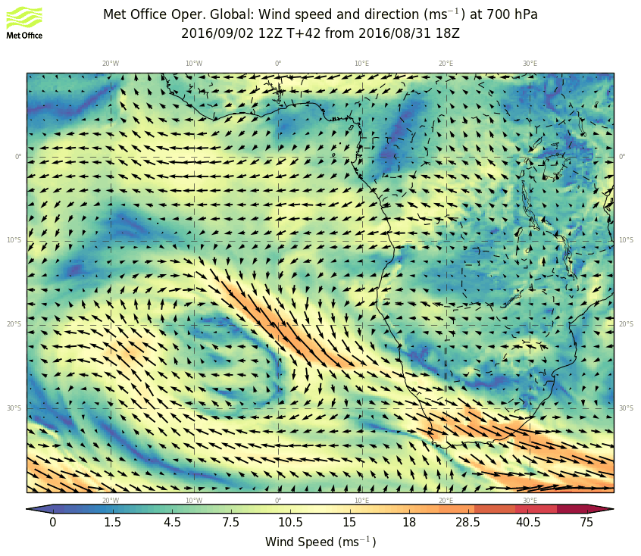
Friday Wind 950, 700 hPa

Slide 12
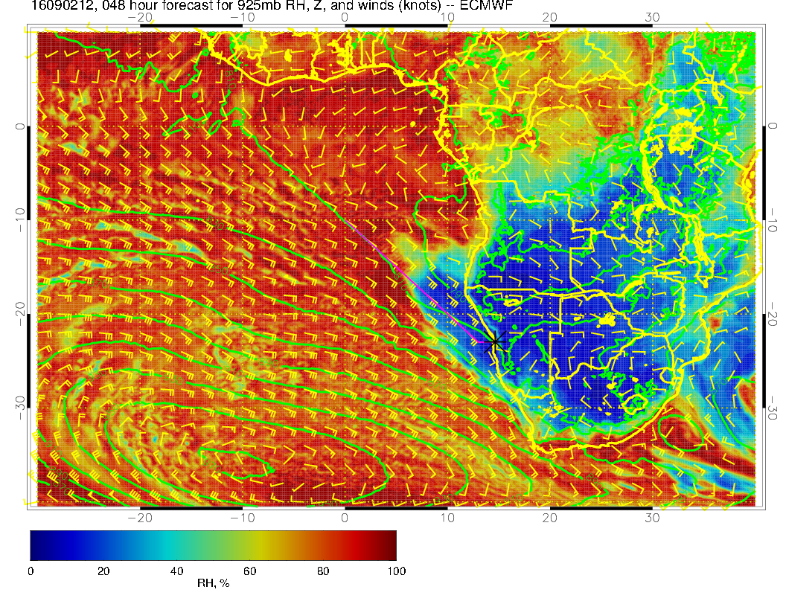
Friday Wind 950, 600, 300 hPa

Slide 13
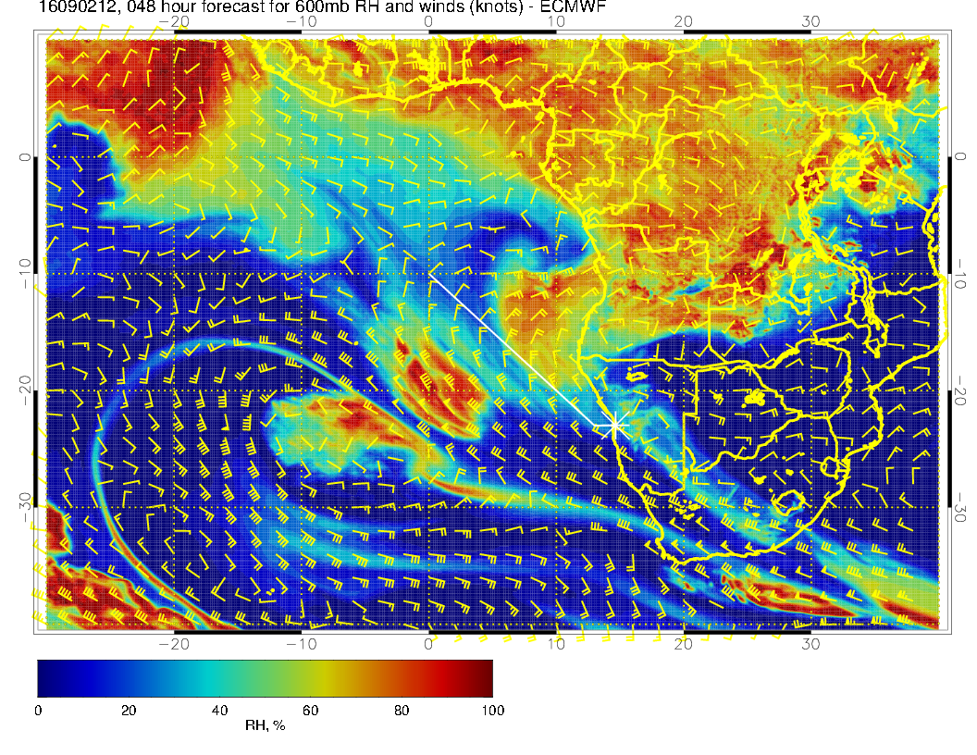
Friday Wind 950, 600 hPa

Slide 14
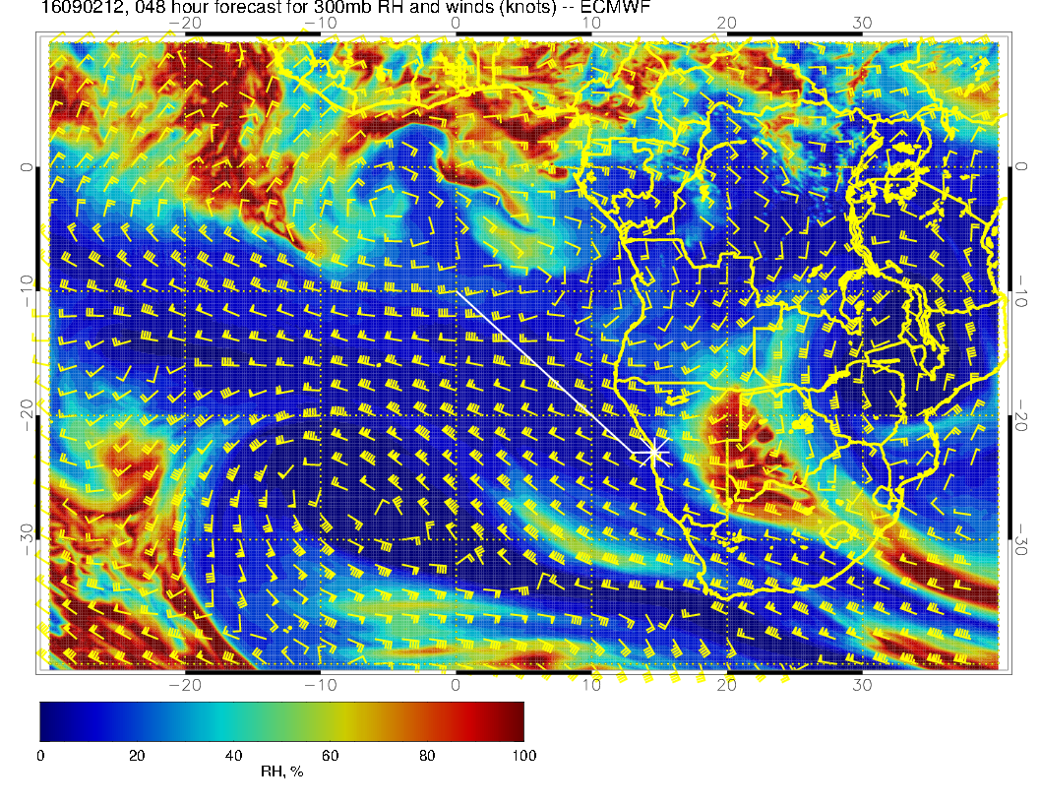
Friday Wind 300 hPa

Slide 15
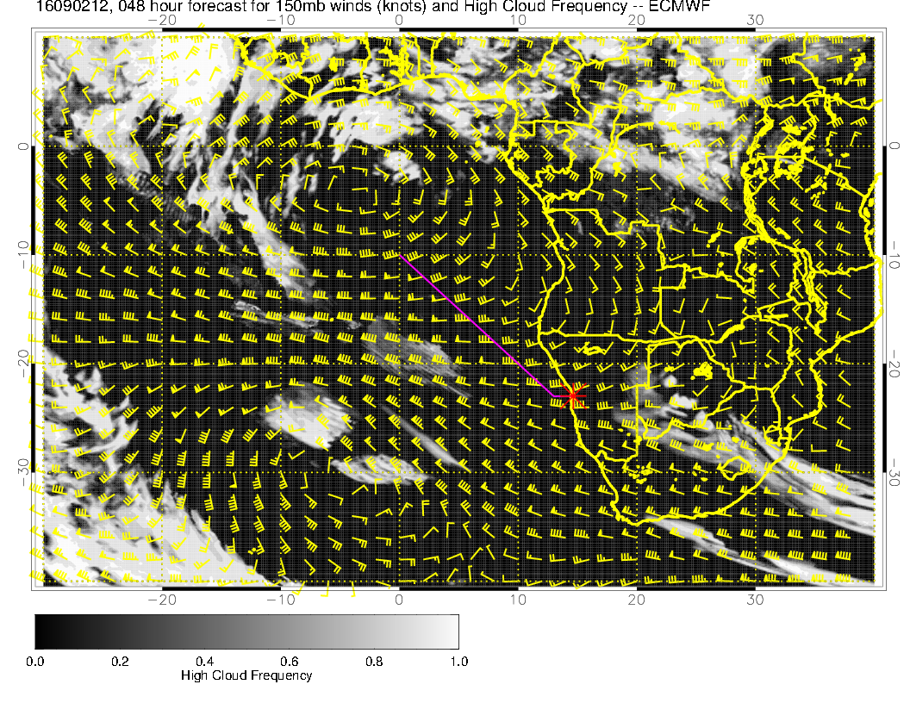
High Level Clouds 2/9

Slide 16
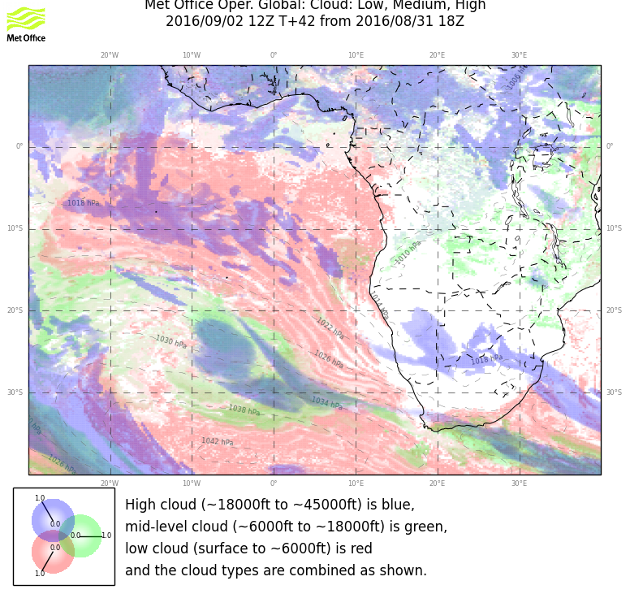
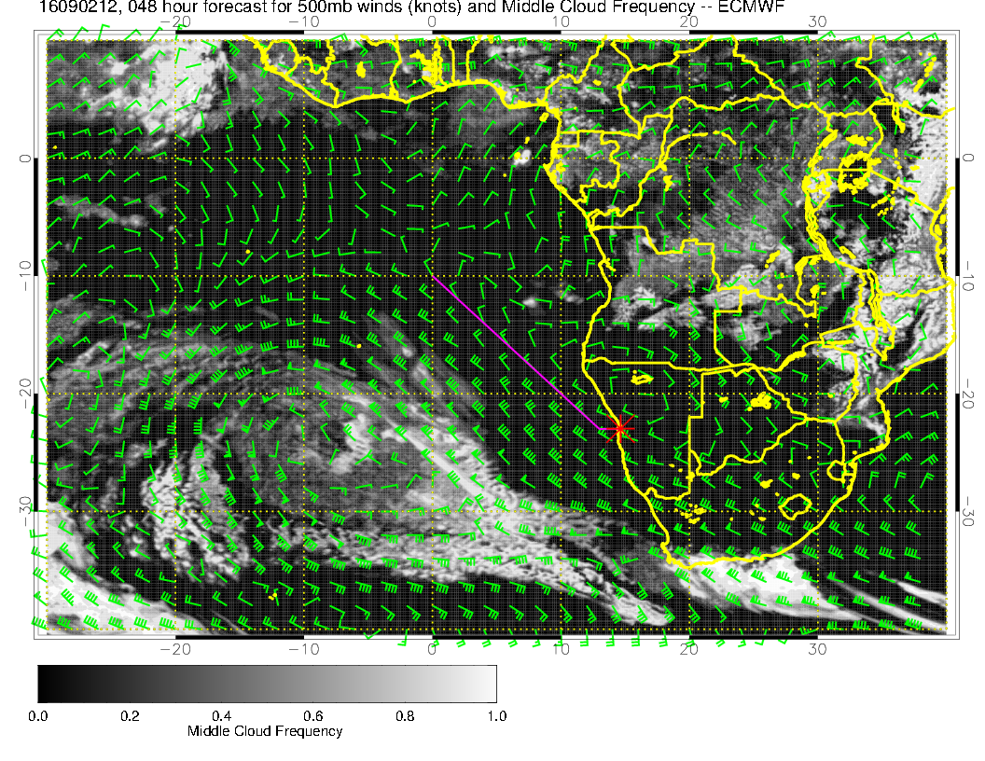
Mid Level Clouds 2/9

Slide 17
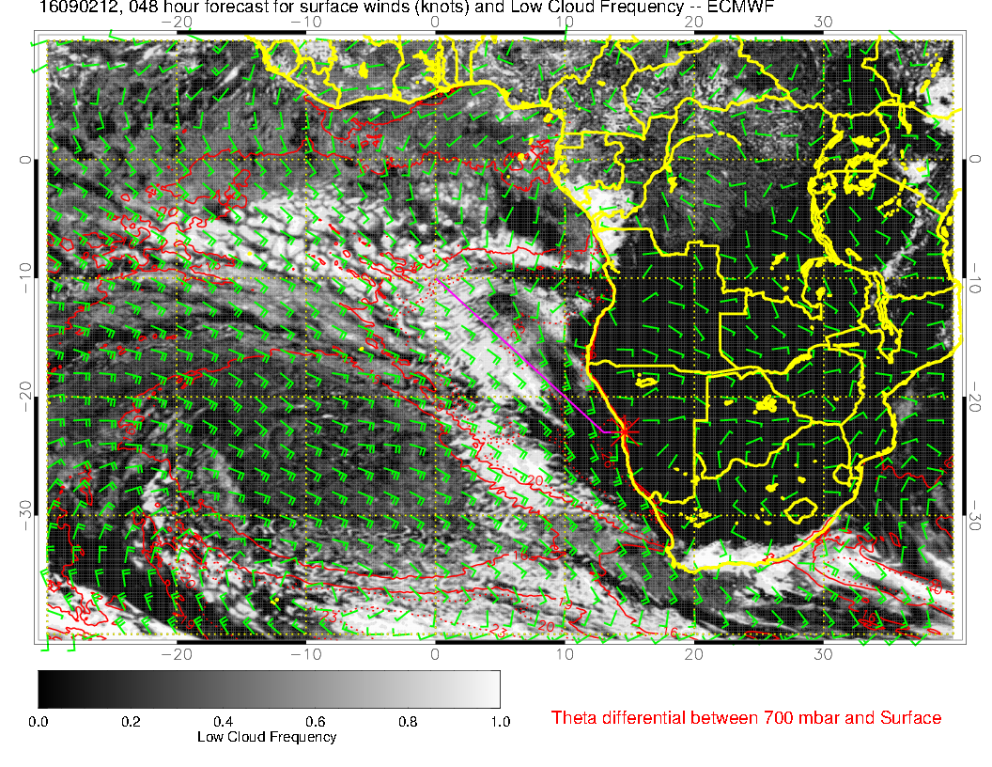
Low Level Clouds 2/9

Slide 18
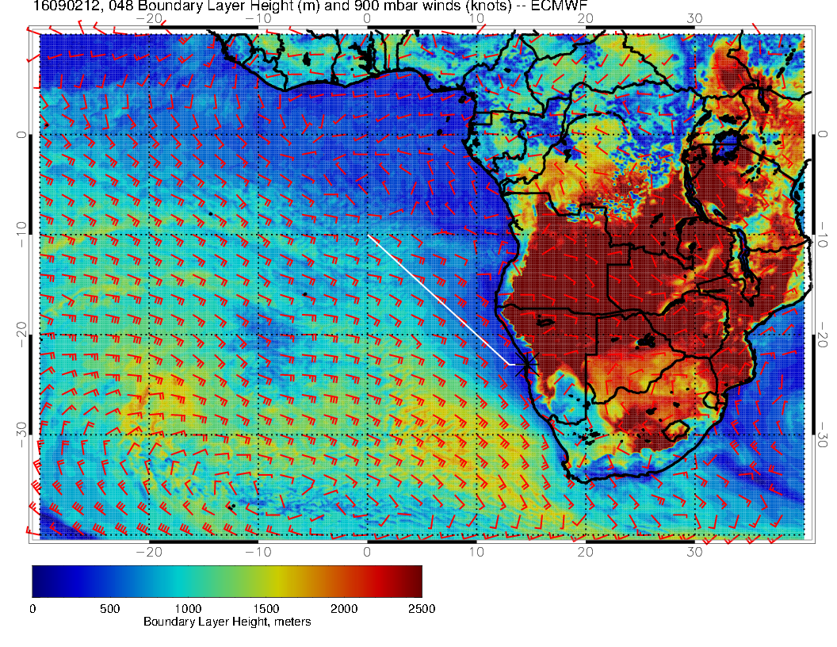
Boundary Layer Height Thursday and Friday

Slide 19
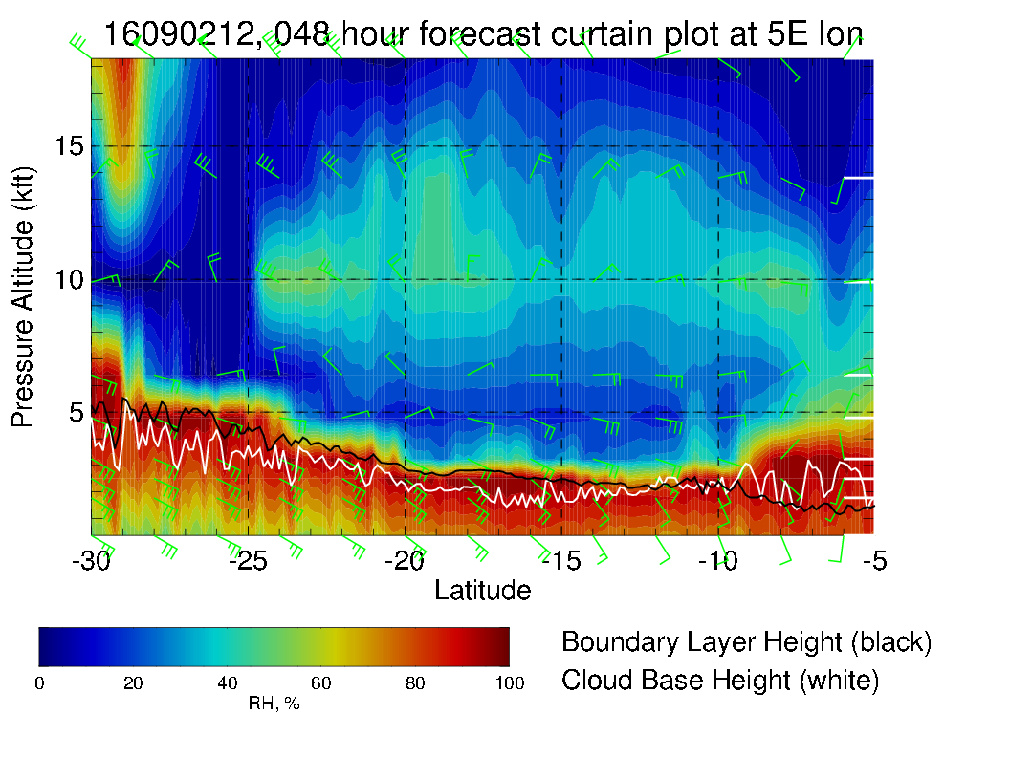
Cross Sections

Slide 20
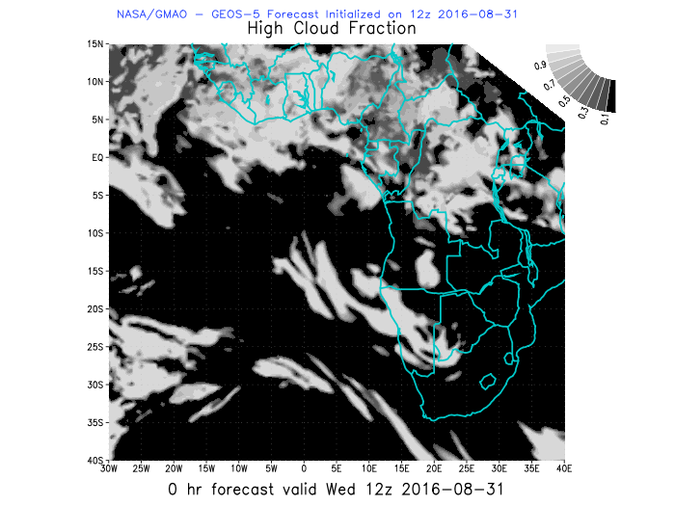
Model Performance

Slide 21
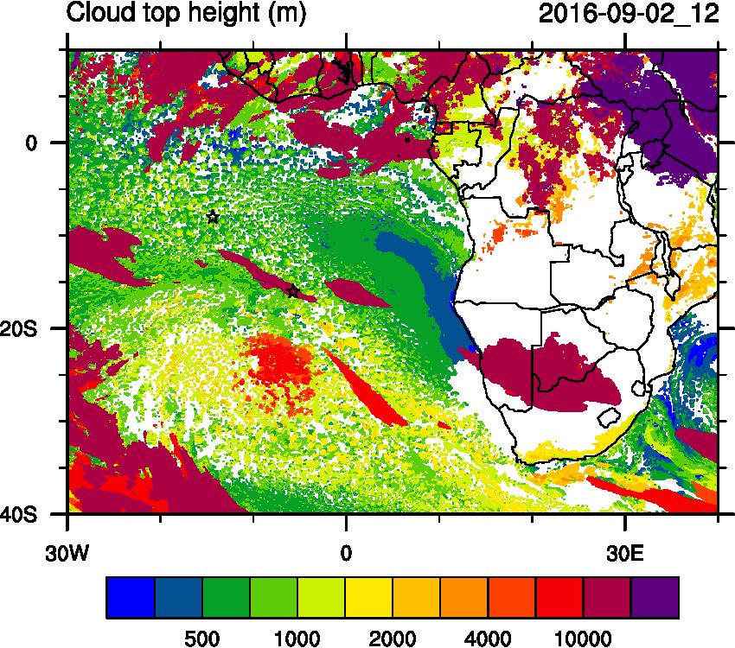
Model Performance

Slide 22
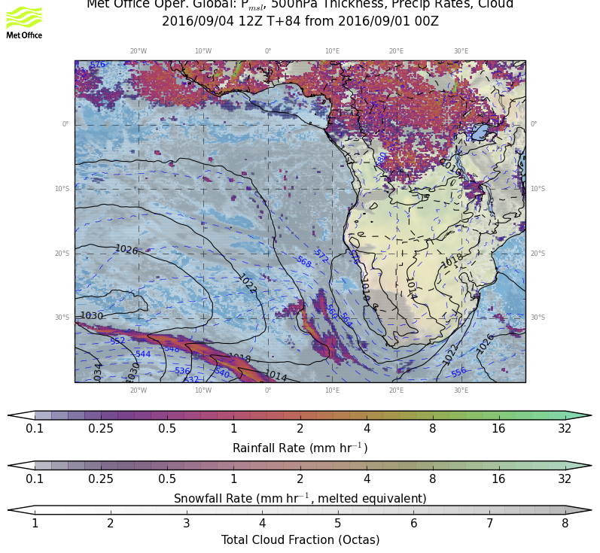
Outlook Sat and Sun

Slide 23
Summary
Stable Weather conditions: The mid-latitude high pressure system, that was forming the trough is stagnant for the next two days, pushing against the stable strati-form cloud system in our study region. Both systems meet in front of the Namibian coast line, ‘potentially’ leading to some open sky regions.

