Slide 1
ORACLES forecasting Briefing Meteorology
31-08-2016
Lenny Pfister, Susanne Bauer

Slide 2
Summary
Midlatitude trough to our west will have a strong impact, especially on the extent and nature of low cloud at our latitudes.
High cloud may be an issue for the next few days.
By Sunday, a more “climo” pattern is likely to reestablish itself.
Do not expect any flying issues in forecast period

Slide 3
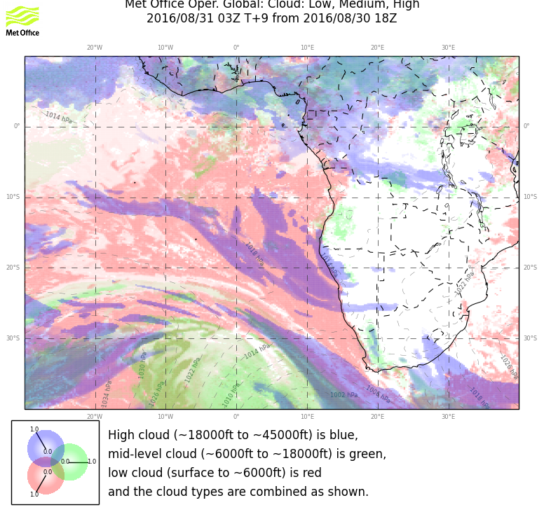
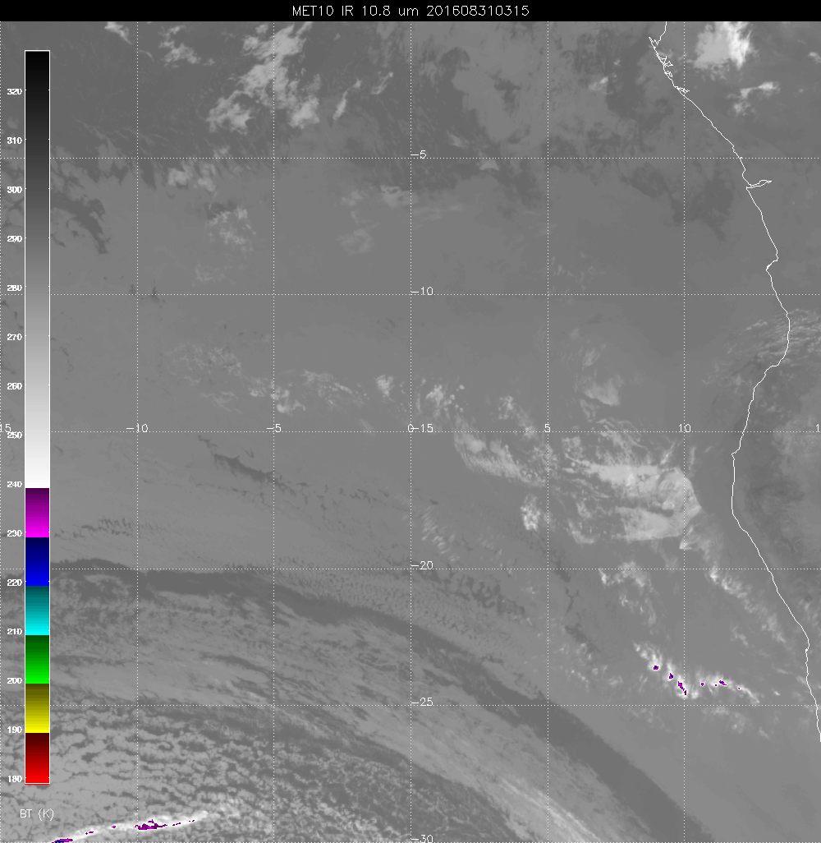

Slide 4
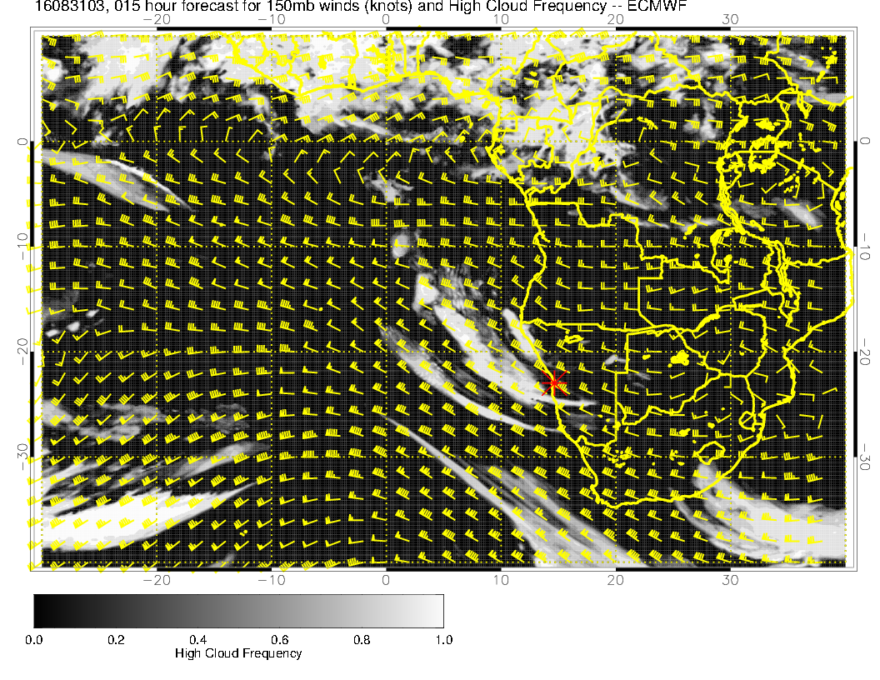

Slide 5
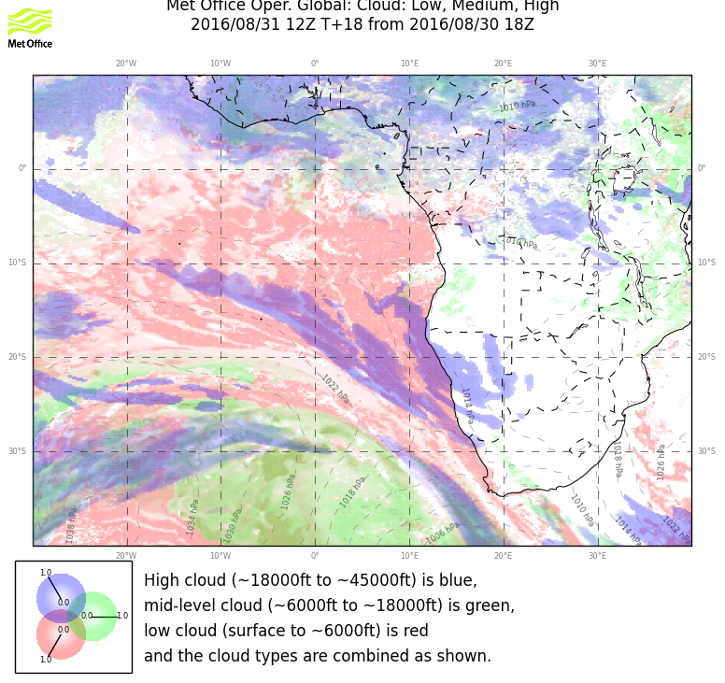

Slide 6
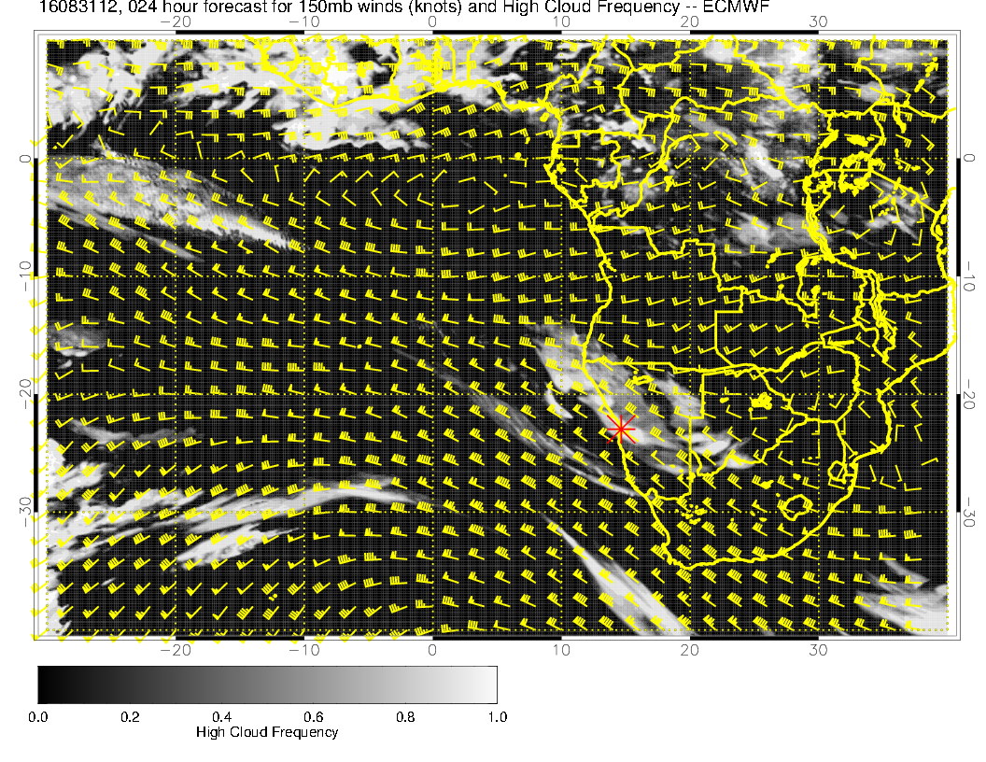

Slide 7
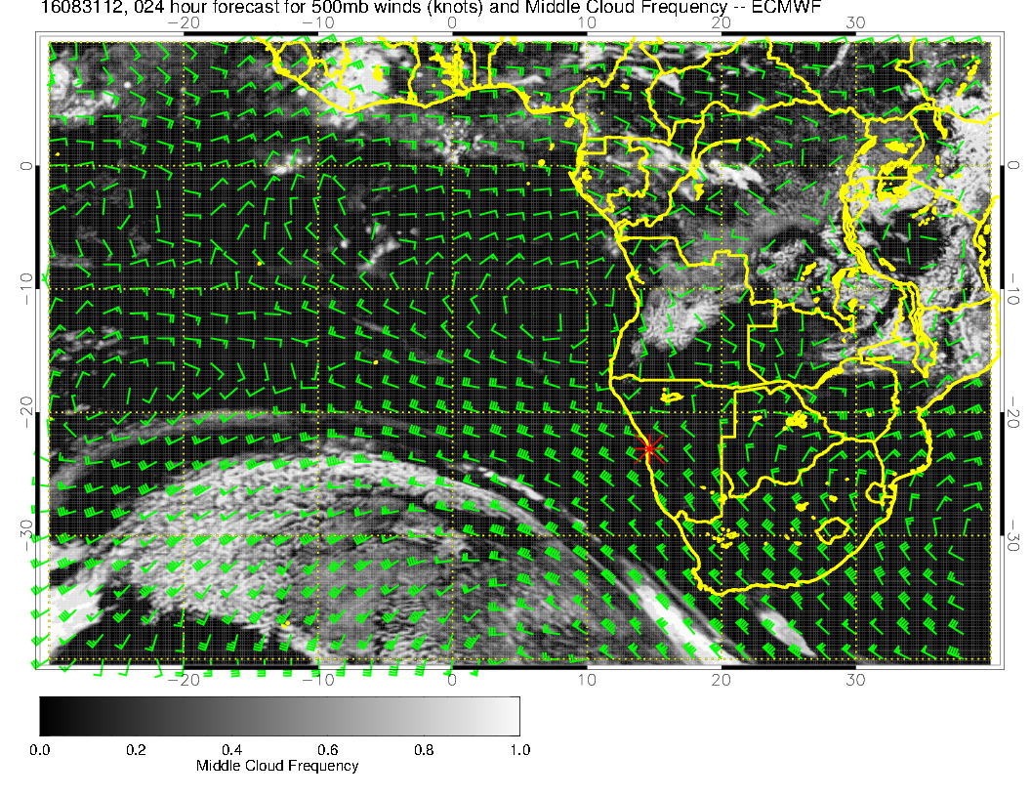

Slide 8
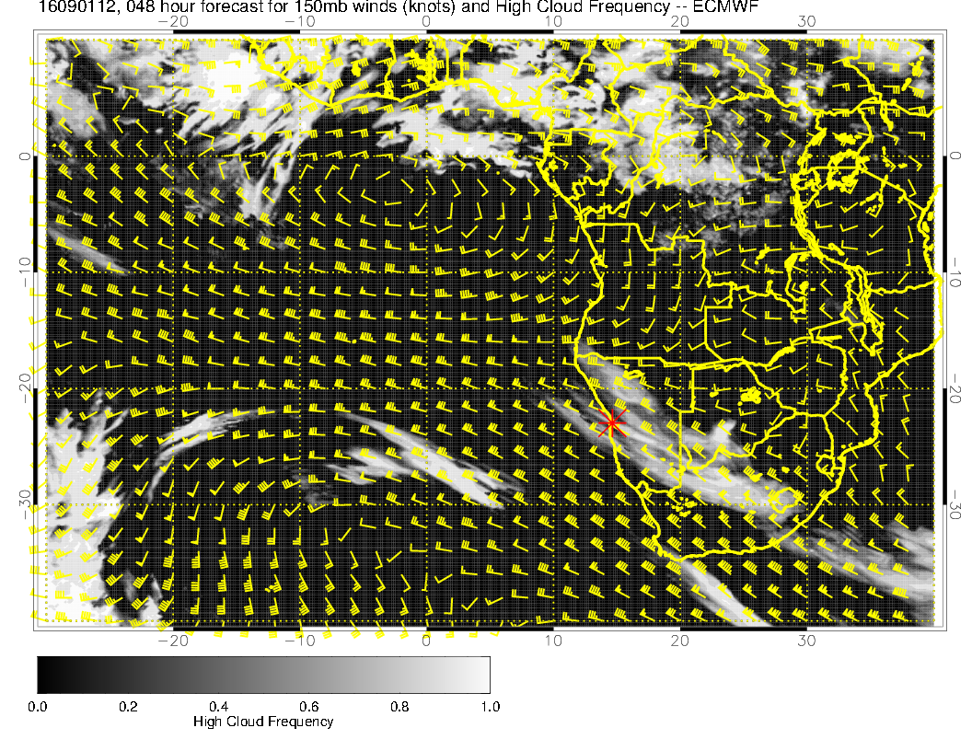
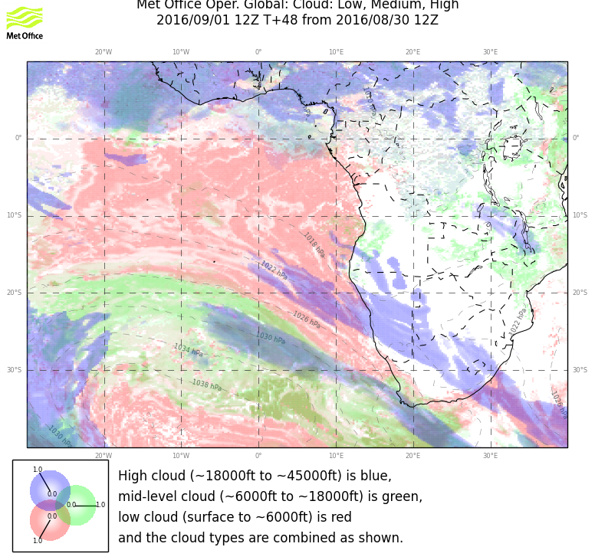
Forecast for tomorrow. Treatment of circulation shows no major differences (at 300mb),
indicates how a derived quantity like clouds can look quite different. Basic features
are similar.

Slide 9
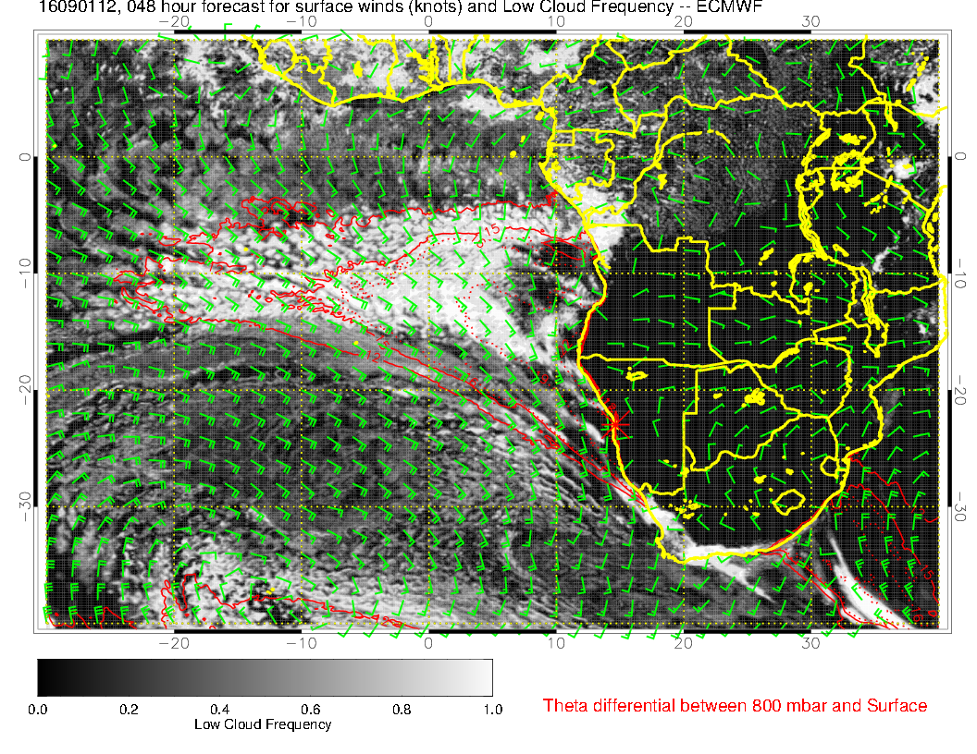
Forecast for tomorrow. Front begins to penetrate. Southerly winds offshore accelerate
and the stratocumulus region becomes narrow at our latitudes.

Slide 10
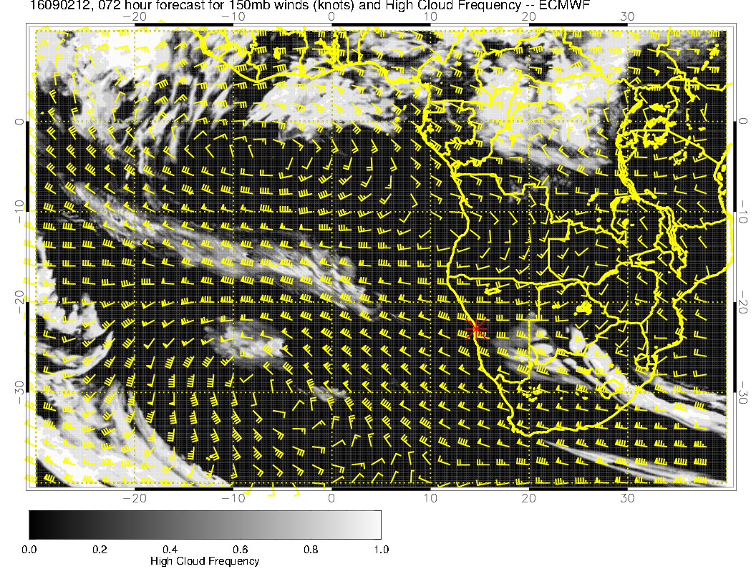
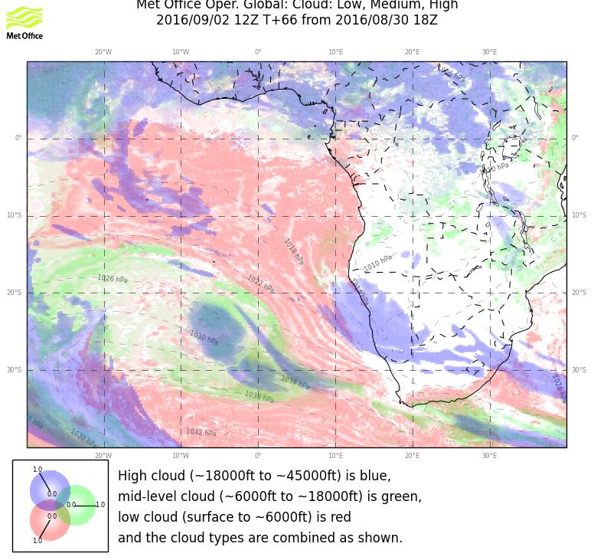
Midlatitude trough in upper troposphere is similarly placed in both models. Broad
similarity in high cloud field.

Slide 11
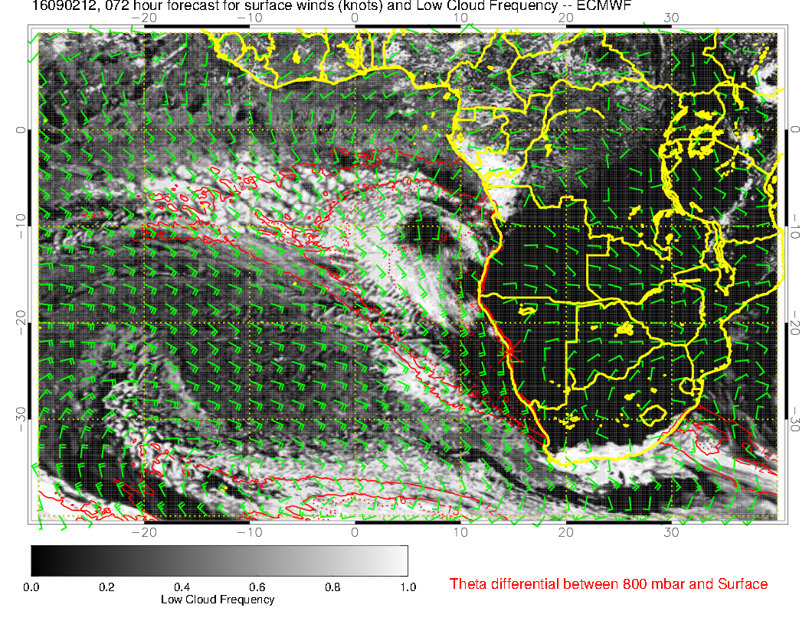
As indicated earlier, Friday the midlatitude trough begins to “dig.” Surface winds
are still strong. We still have stability in our region, and the stable region actually
widens. Both models show a clear spot in our region.

Slide 12
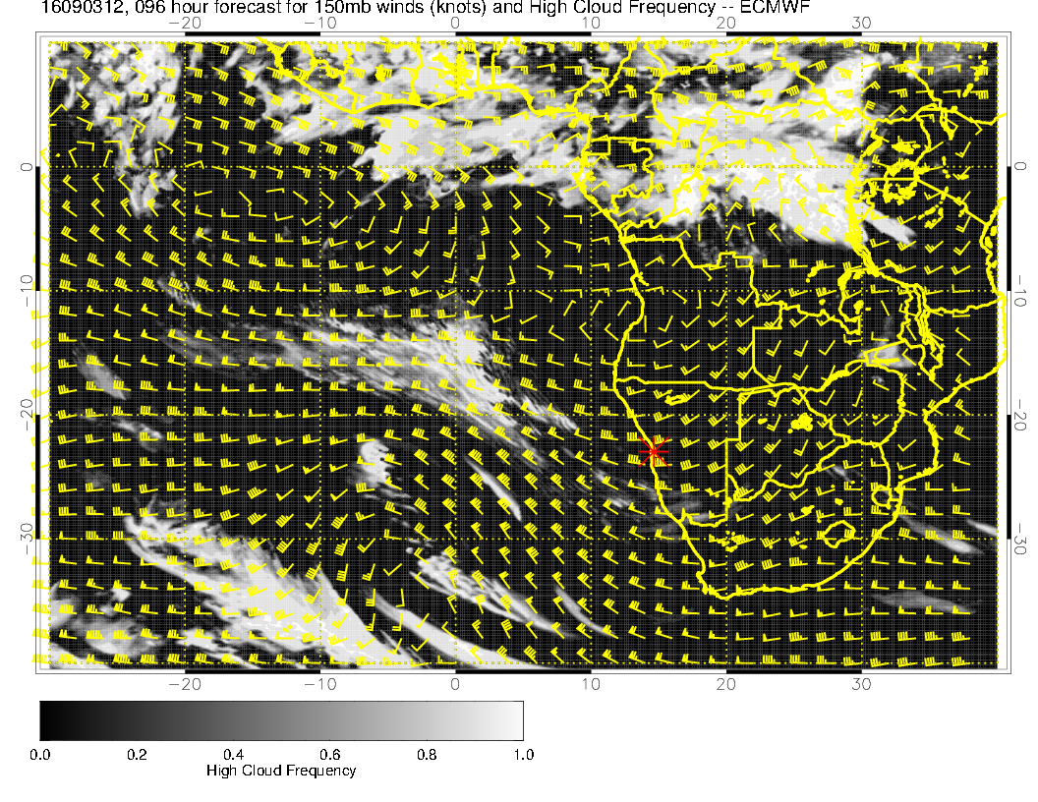
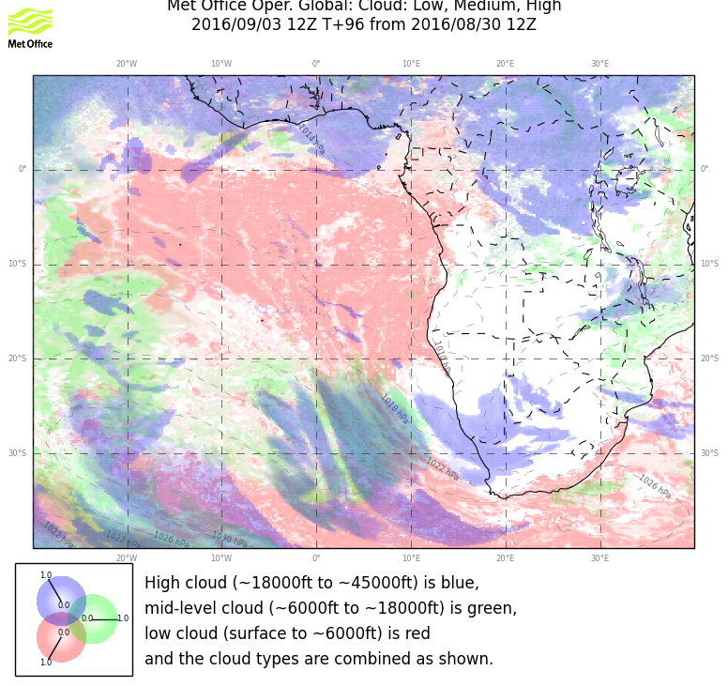
Saturday, the high cloud pattern is very different. Upper tropospheric midlatitude
trough in EC has a much stronger NW-SE tilt than UK.

Slide 13
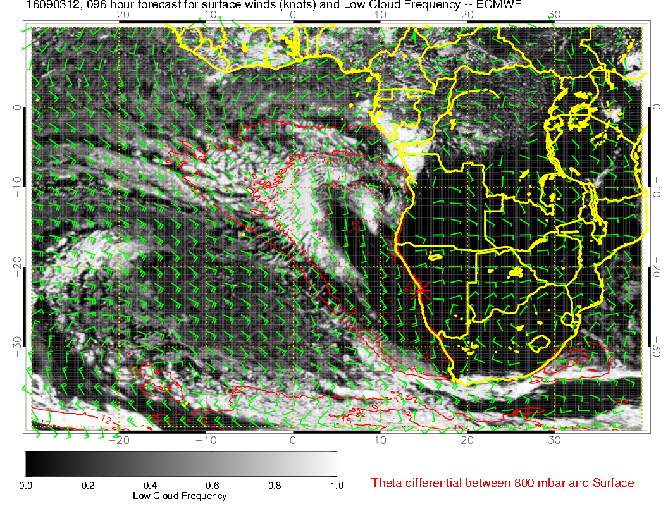
Saturday, the main trough stalls. Expect minimal low level cloud at our latitudes.

Slide 14
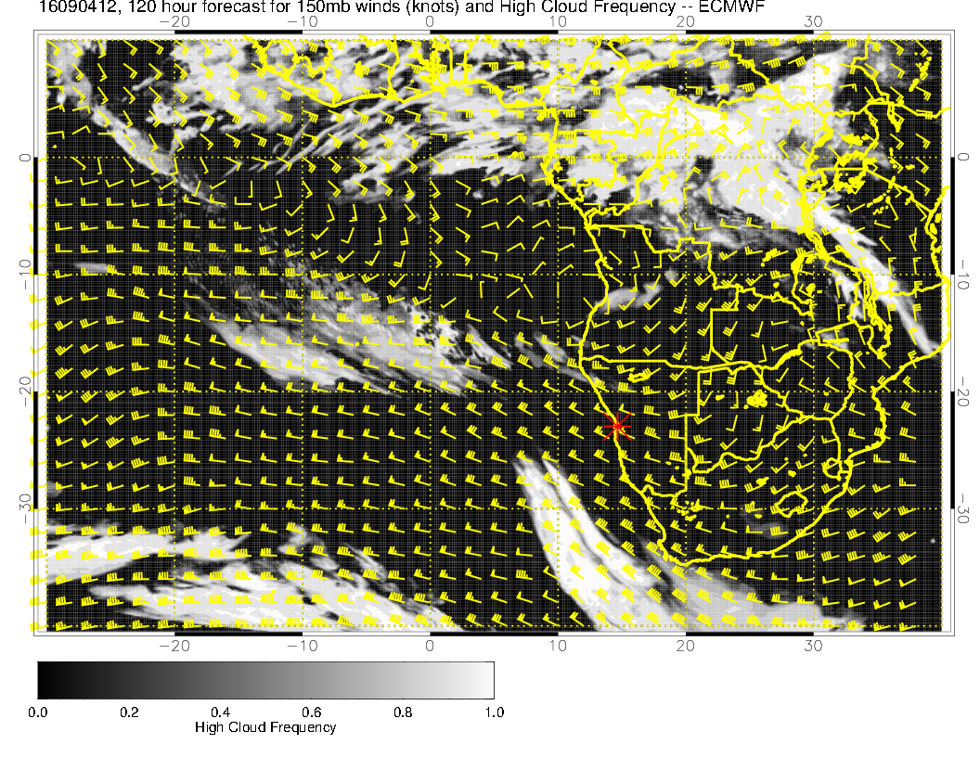
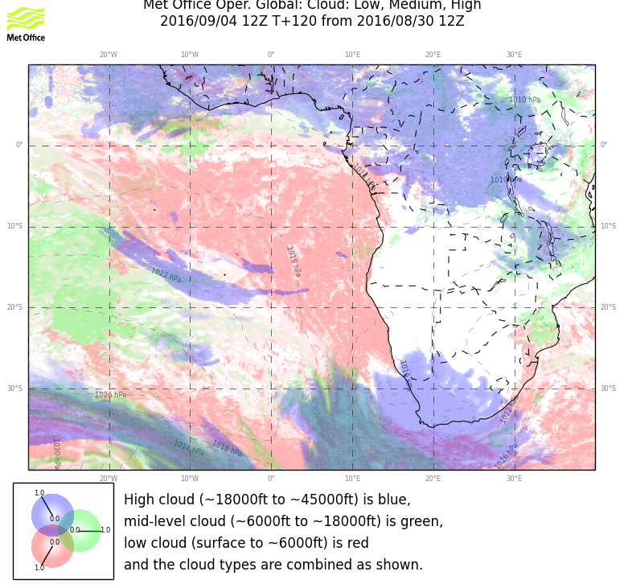
Both models have upper level moisture
mostly west of 0. Circulation features are
present in both models, with different placement.
Lesson – don’t trust details like this for 5 day forecasts (duh).

Slide 15
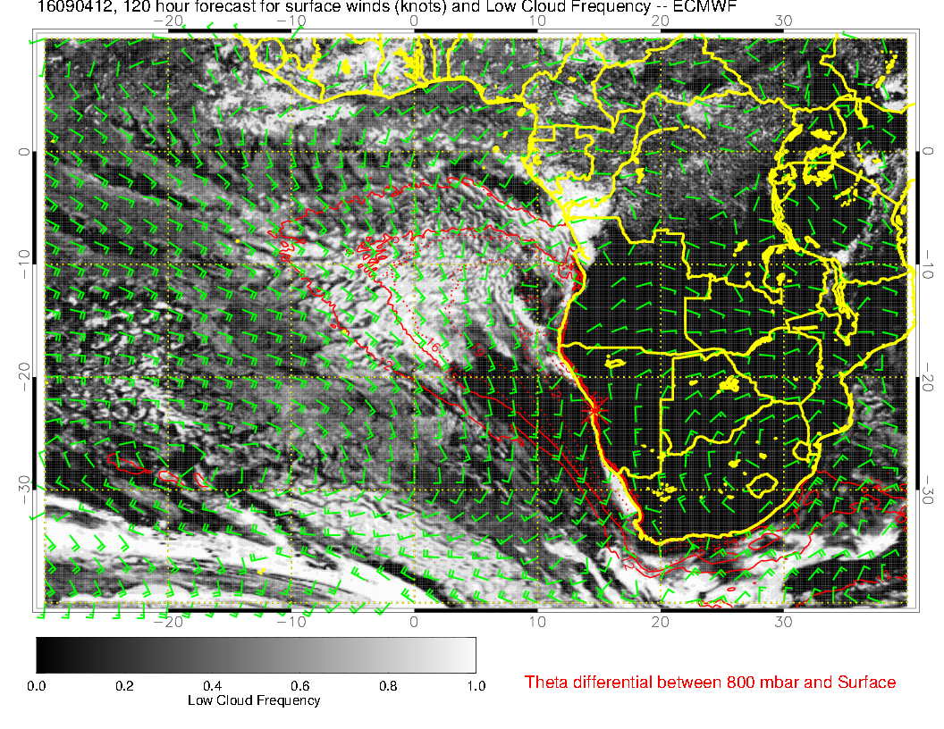
A more climatological pattern (standard
high, southerly flow not quite as strong)
begins to reestablish itself. Low cloud “latitudinal boundary” moves south.

Slide 16
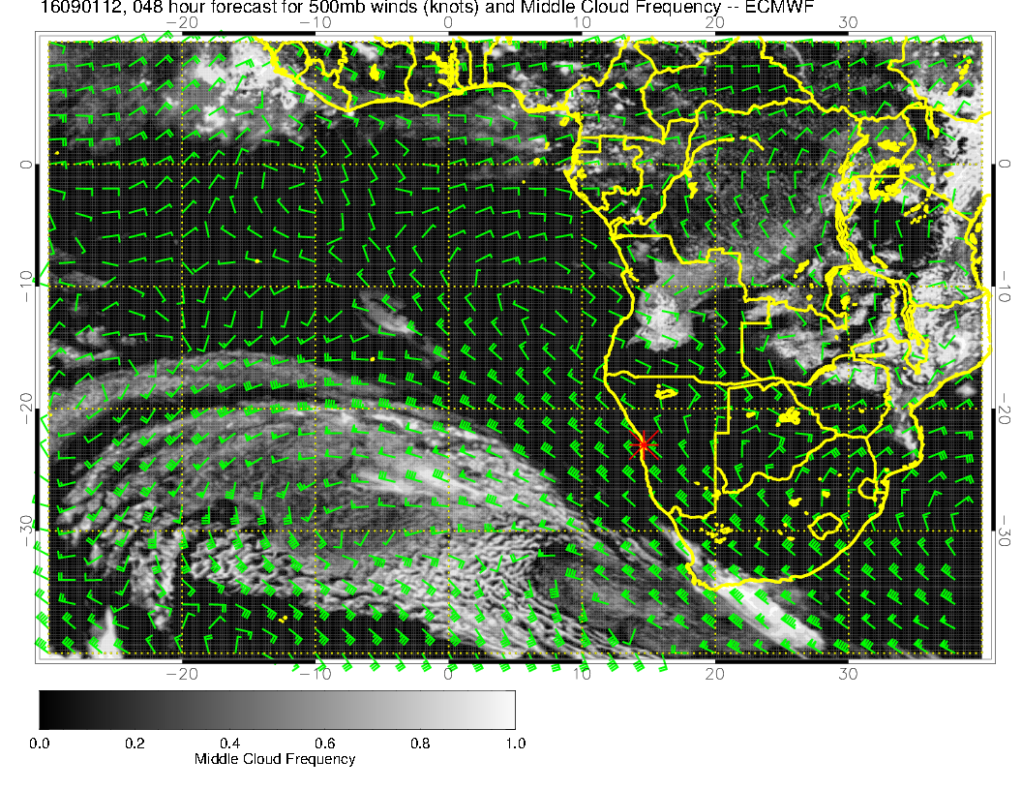
Some mid level cloud north of Saint Helena in both models. This is associated with moisture
from westward moving 600mb anticyclone and lifting associated with deepening trough.
Little evidence of middle cloud for Friday, Saturday, or Sunday in either model.

