Slide 1
ORACLES forecasting Briefing Aerosols
31-08-2016

Slide 2
Aug 30 2016 (model evaluation)

Slide 3
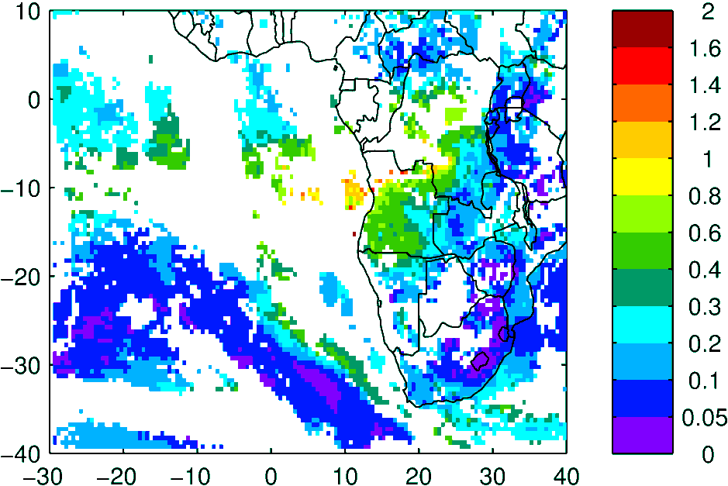
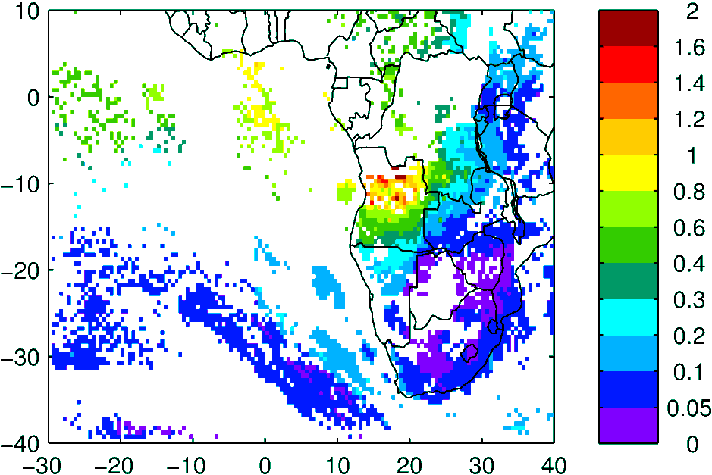
Terra & Aqua AOD (clear-sky)
MODIS NNR
WRF-AAM

Slide 4
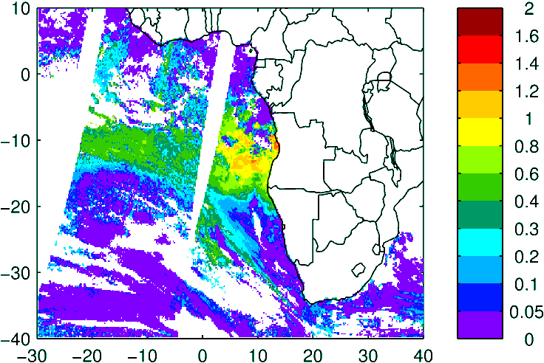
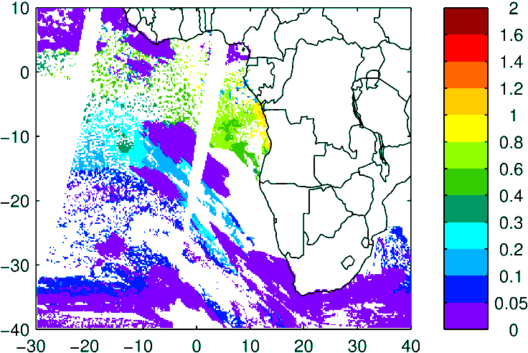
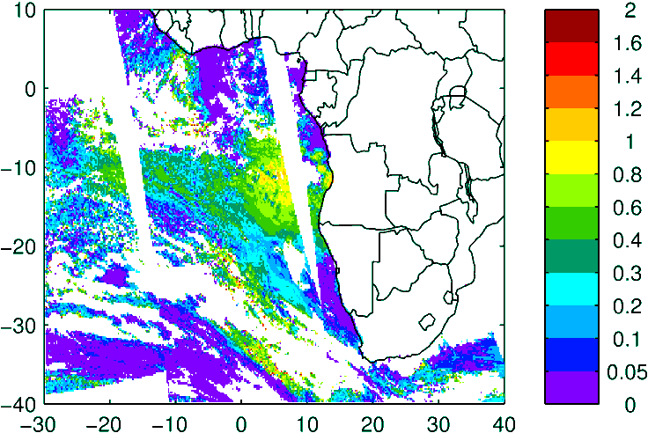
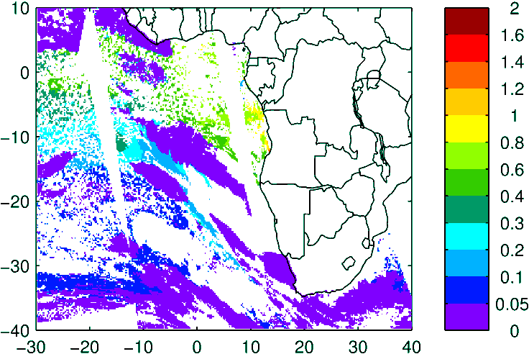
Above Cloud AOD (thanks Kerry!)
Model (WRF-AAM)
Observation
High lvl Cld
Terra
Aqua

Slide 5
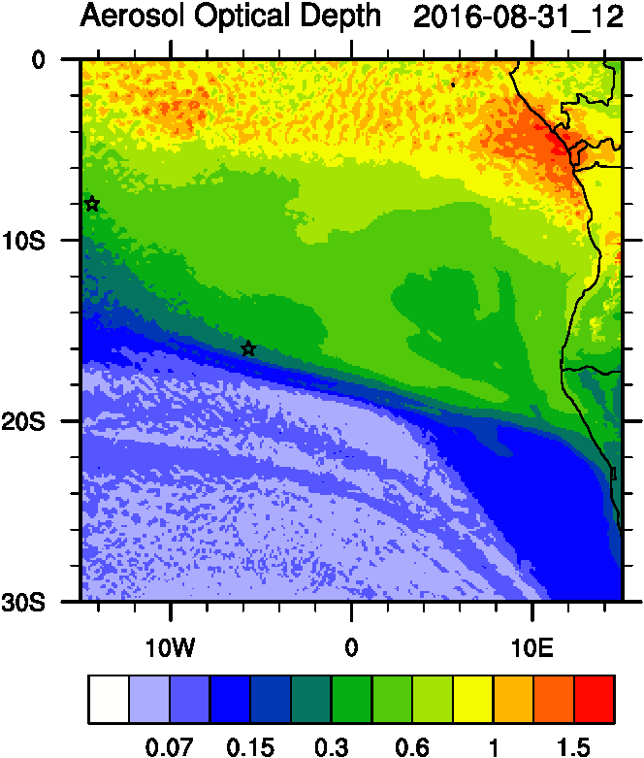
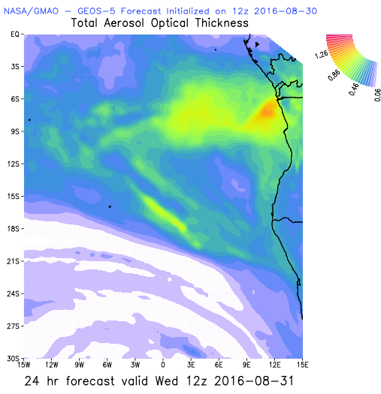
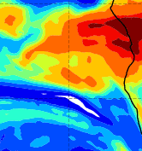
Aug 31 2016 (current conditions)

Slide 6
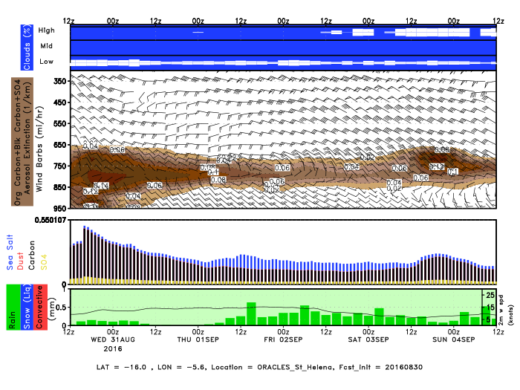
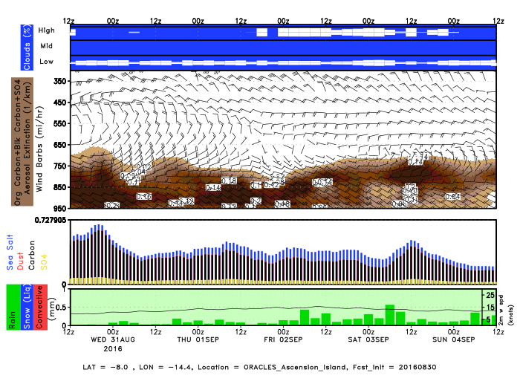
GEOS5 Envirograms
St Helena
Ascension

Slide 7
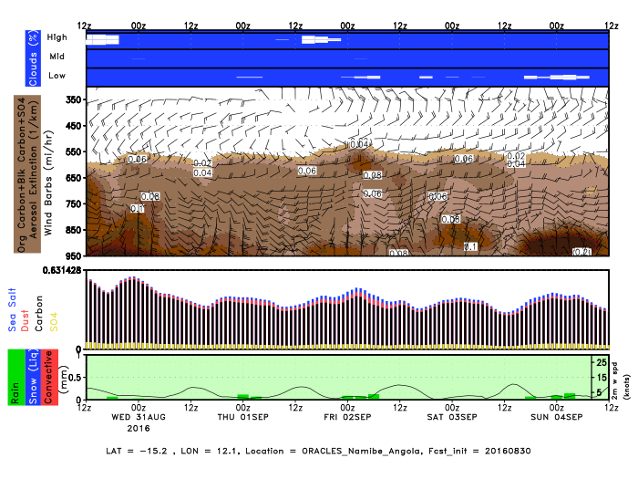
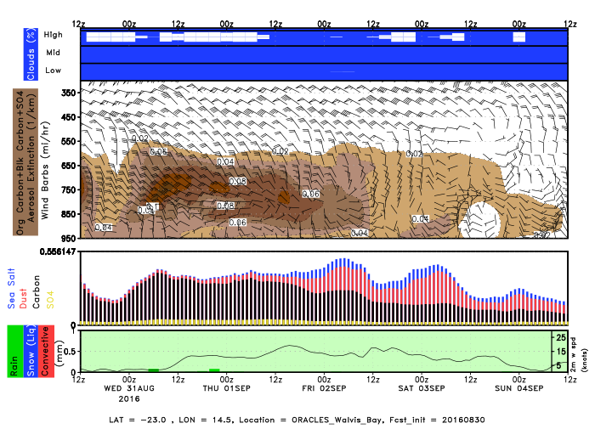
GEOS5 Envirograms
Namibe Angola
Walvis Bay

Slide 8
Sep 01 2016

Slide 9
AOD 12 UTC
GEOS-5
CAMS
WRF
48 h
48 h
60 h
1.5
0.5
0.8
1
3
1
>1.5
0.8
0.5
<0.4
0.3-0.4
0.5-0.6
0.5

Slide 10
SMOKE
AOD
ACAOD
12UTC flavors of AOD
WFA=Water Friendly Aerosol
IFA=Ice Friendly aerosol
IFA AOD
WFA AOD

Slide 11
AOD
BC-AOD
OC-AOD
12UTC flavors of AOD
SULF-AOD
DUST AOD

Slide 12
Vertical cross-section routine flight
Smoke AOD
Smoke Ext

Slide 13
Vertical cross-section routine flight
Smoke AOD

Slide 14
Biomass burning and Anthropogenic tracers
(300-500 ppm)
75-90%
~50% (150 ppbv)
~300-500 mb
Total CO
Africa CO
South America CO

Slide 15
Wavis Bay
Ascension
Luanda
Sta Helena

Slide 16
Wavis Bay-smoke
Wavis Bay-dust
Henties Bay-smoke
Henties Bay-dust

Slide 17
Smoke Age distribution

Slide 18
Vertical cross-section routine flight
Smoke AOD
Smoke ext
Smoke age mode

Slide 19
Sept 2 2016

Slide 20
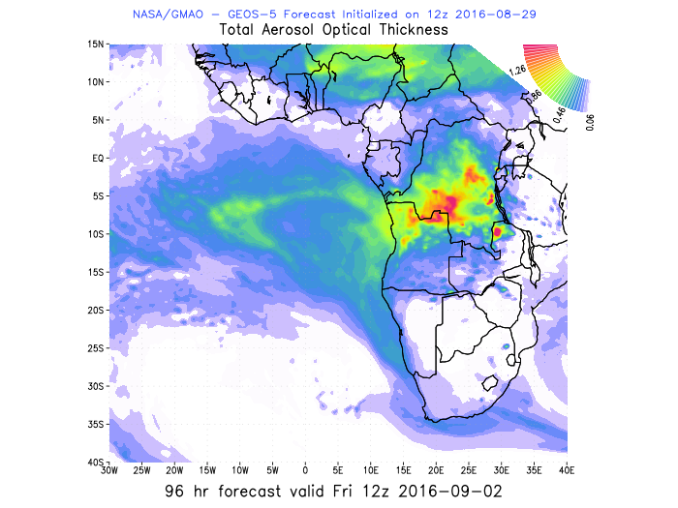
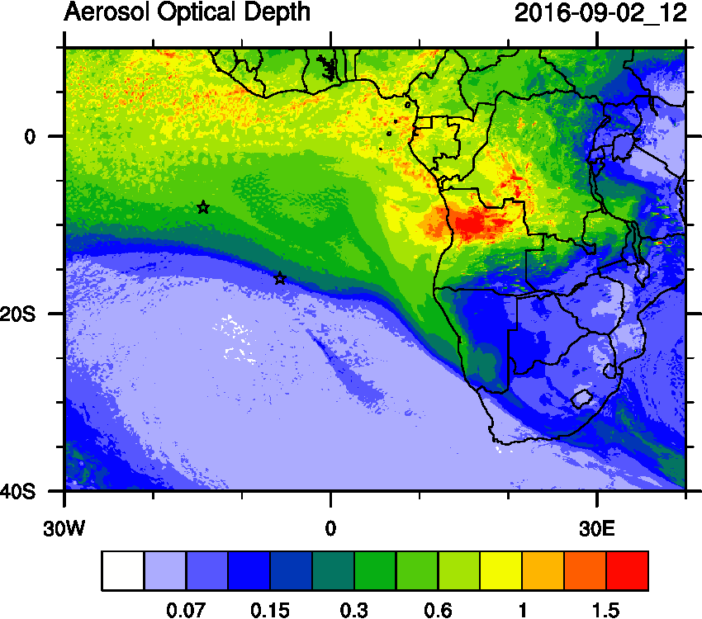
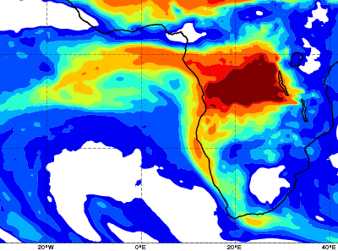
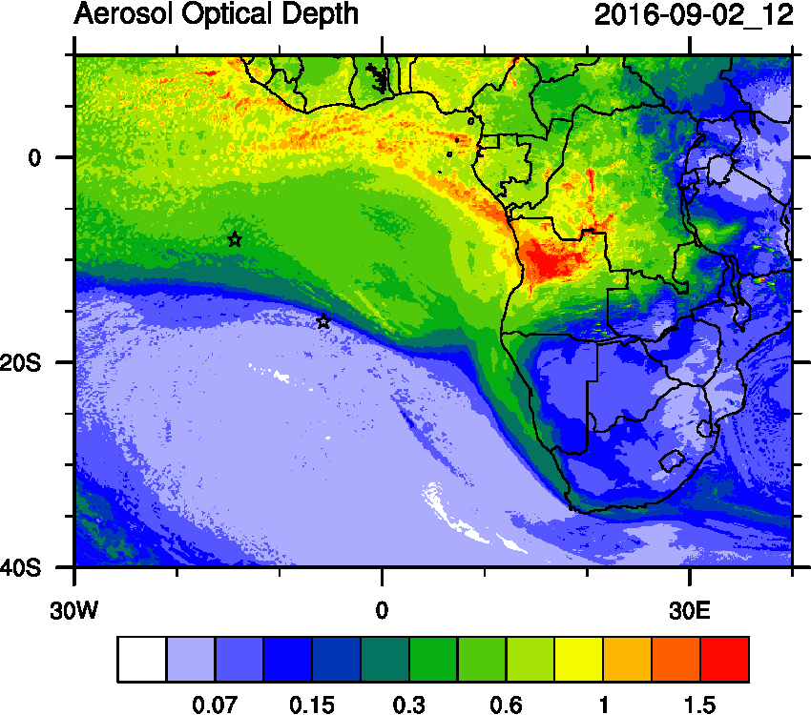
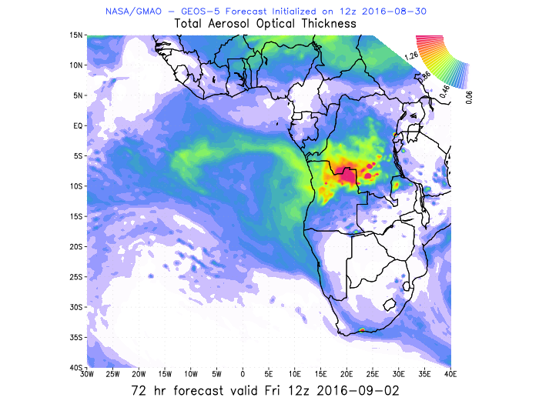
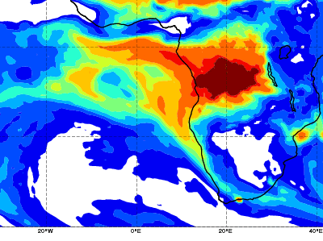
YESTERDAY
CAMS
WRF
GEOS5
TODAY
WRF
CAMS
GEOS5

Slide 21
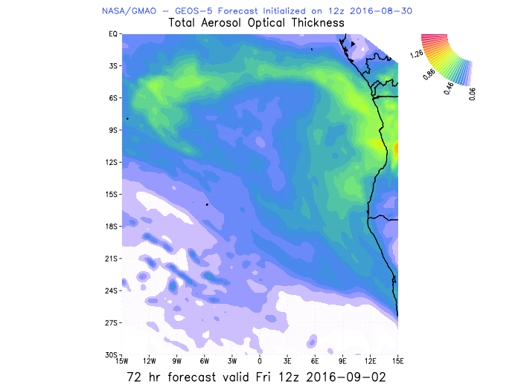
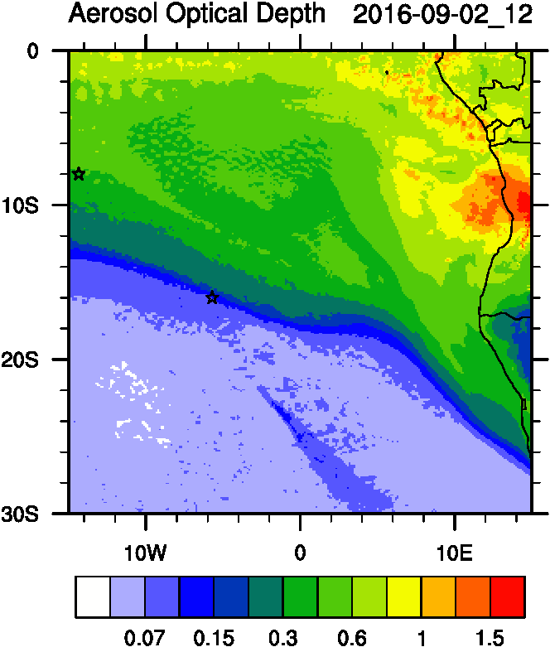
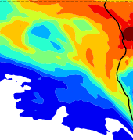
AOD 12 UTC
GEOS5
CAMS

Slide 22
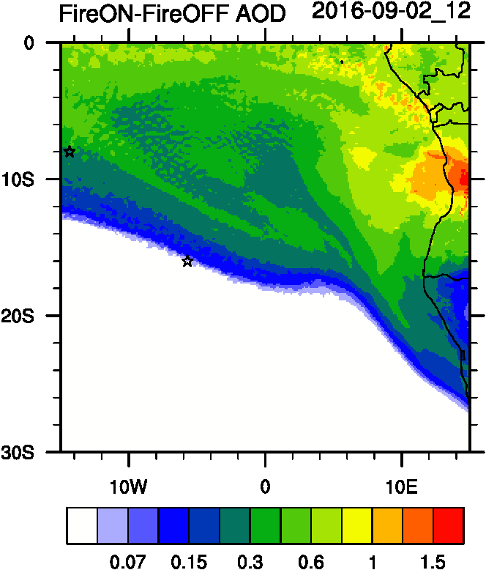
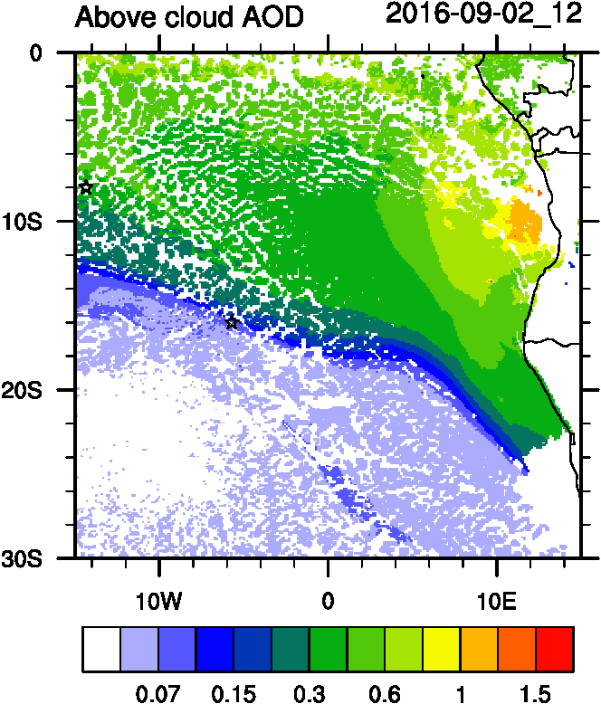
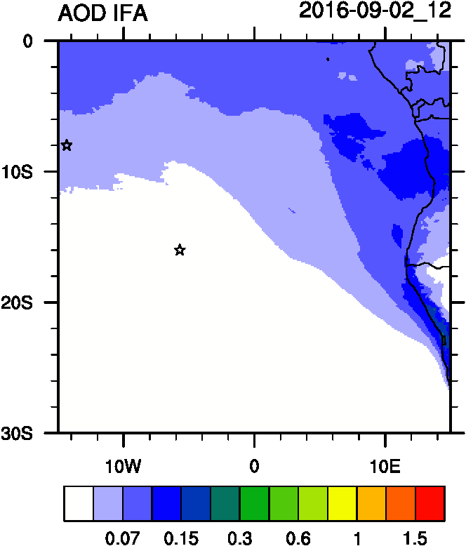
Smoke AOD
ACAOD
AOD IFA

Slide 23
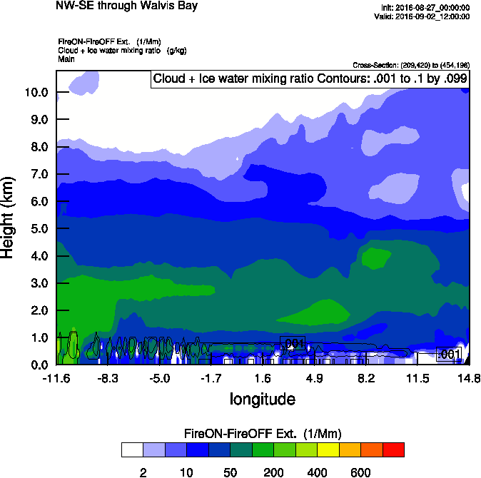
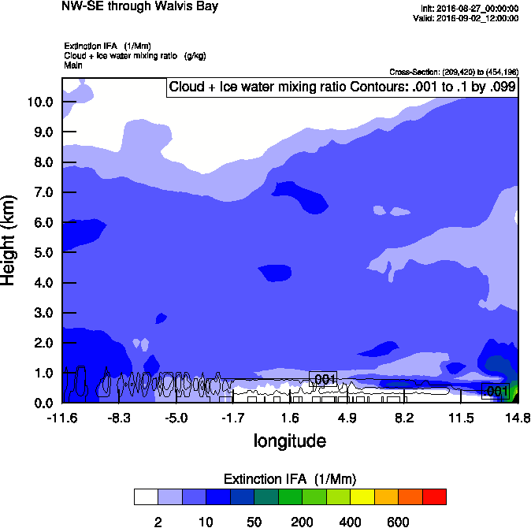
Vertical cross-section routine flight
Smoke Ext WRF
IWA Ext WRF
Smoke AOD

Slide 24
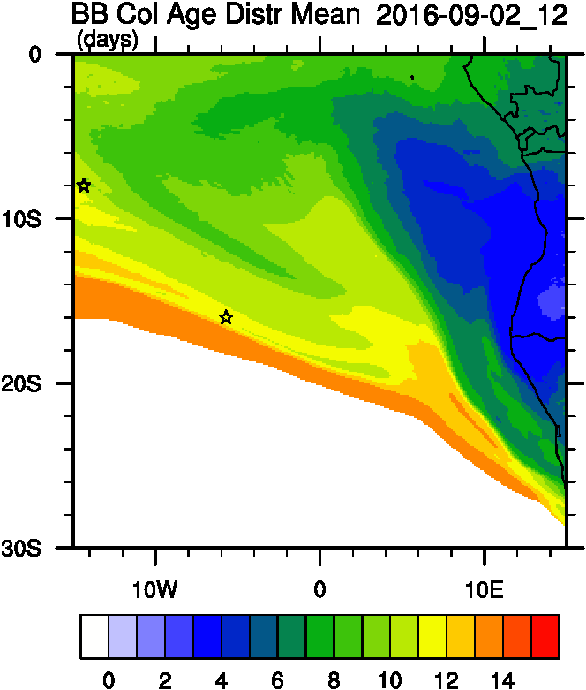
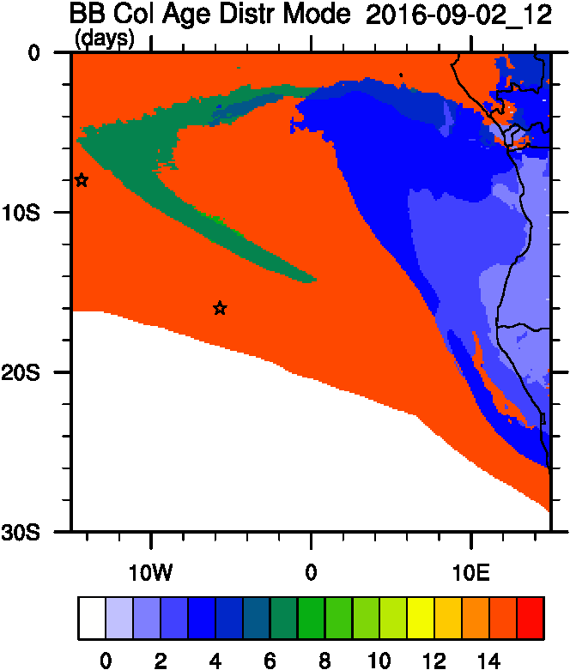
Smoke Age distribution
Smoke AOD
Mean Age
Mode Age

Slide 25
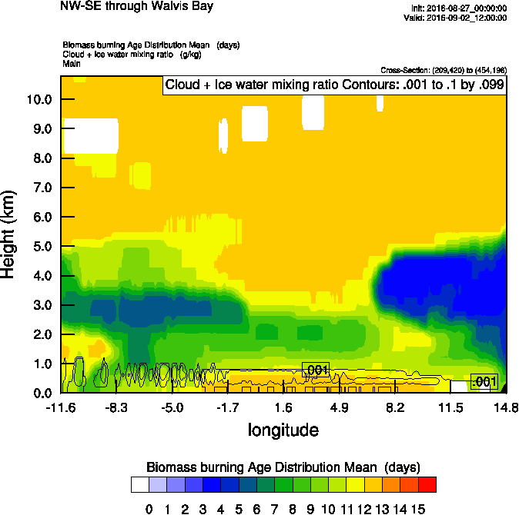
Vertical cross-section routine flight
Smoke Ext WRF
Age mean
Smoke AOD

Slide 26
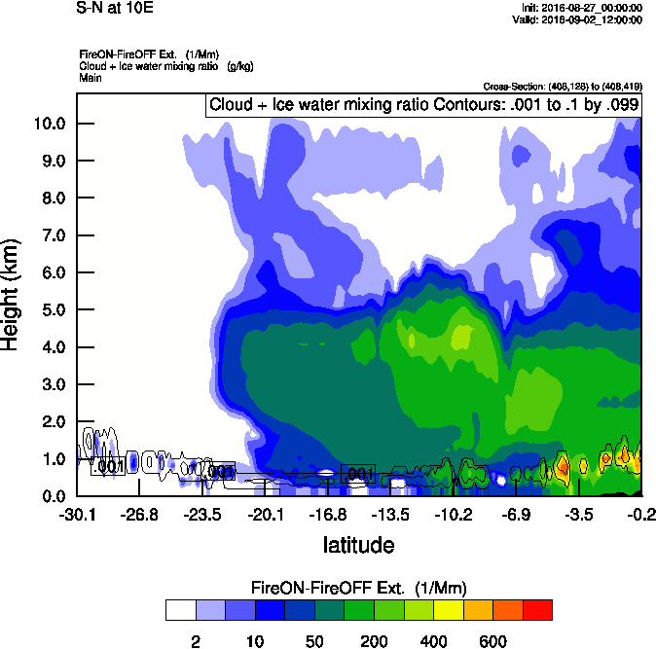
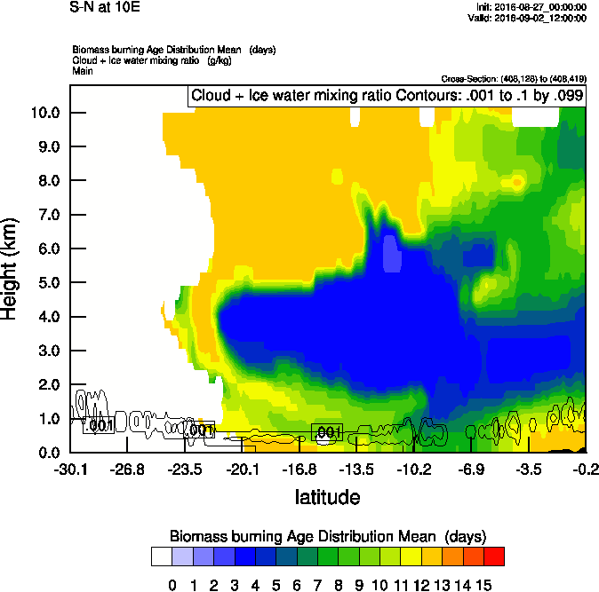
Vertical cross-section South to North
Smoke Ext WRF
Age mean
Smoke AOD

Slide 27
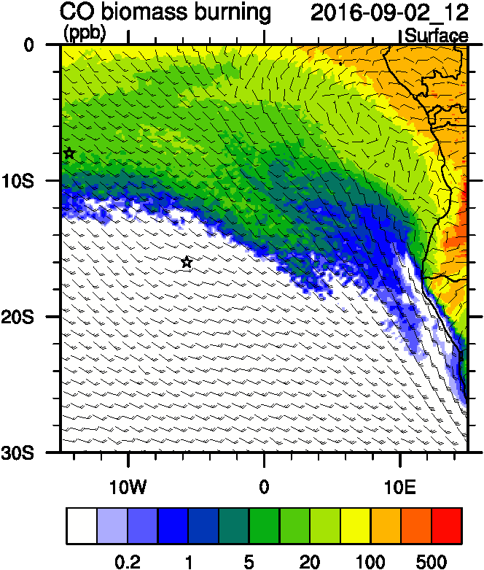
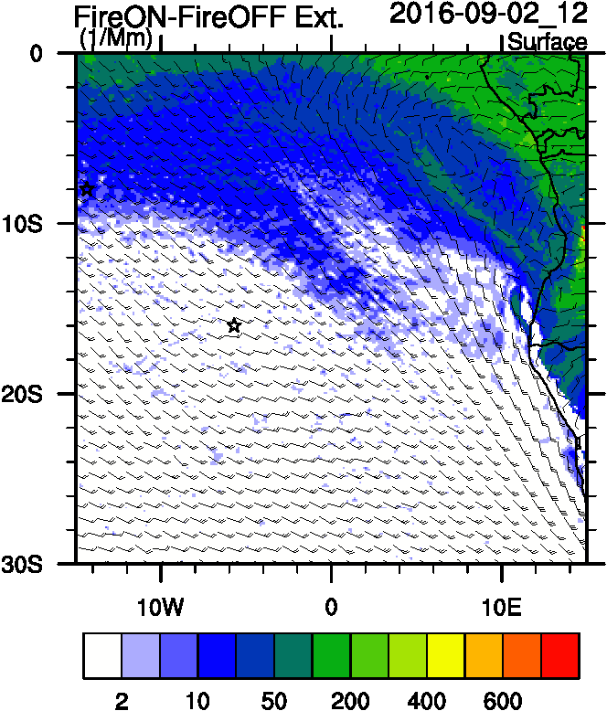
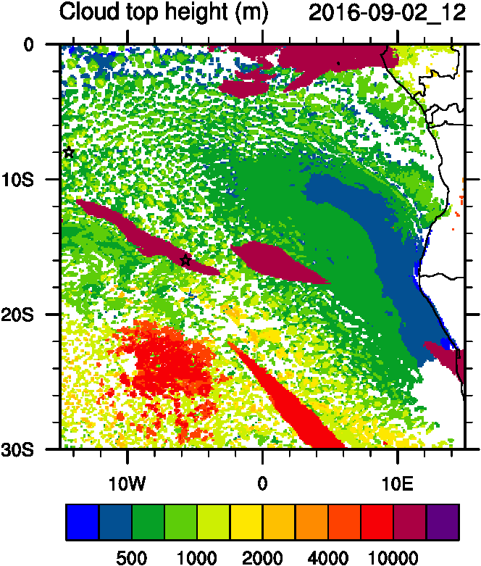
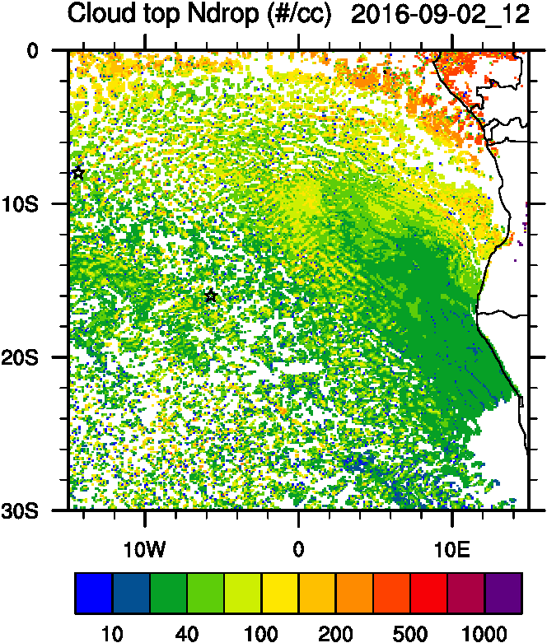
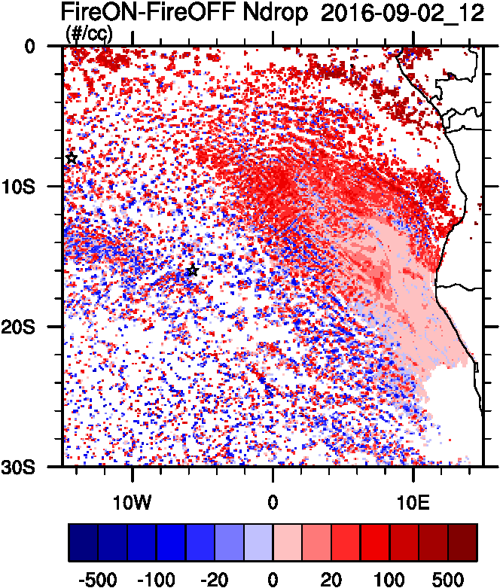
Aerosol-cloud interactions
Smoke Ext
Ndrop: Number droplet concentration
Diff: Differences between simulations turning on and off fires
Smoke AOD
tracer
Ndrop Diff
Cld Top
Ndrop

Slide 28
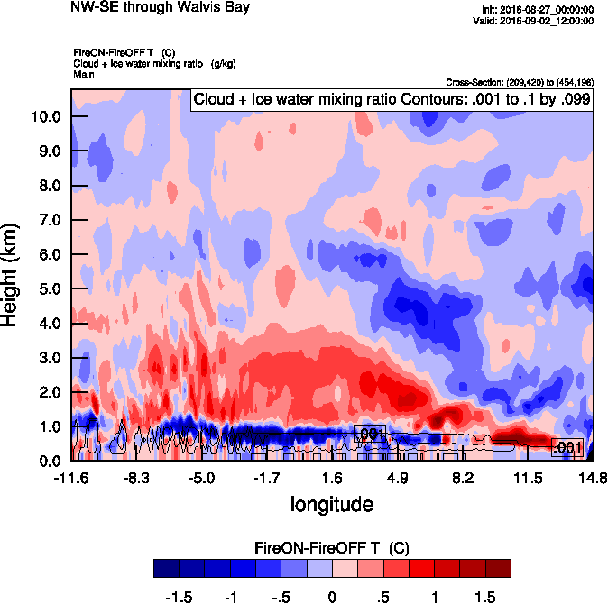
Vertical cross-section routine flight
T diff
Smoke Ext WRF
Smoke AOD

Slide 29
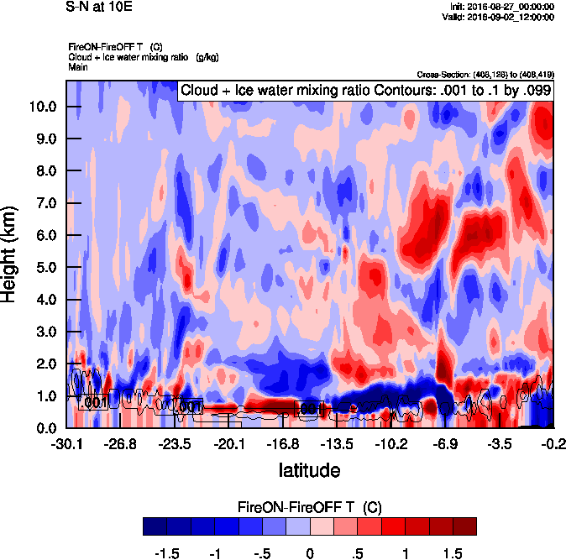
Vertical cross-section South to North
T diff
Smoke Ext WRF
Age mean
Smoke AOD

Slide 30
Sept 3 2016

Slide 31
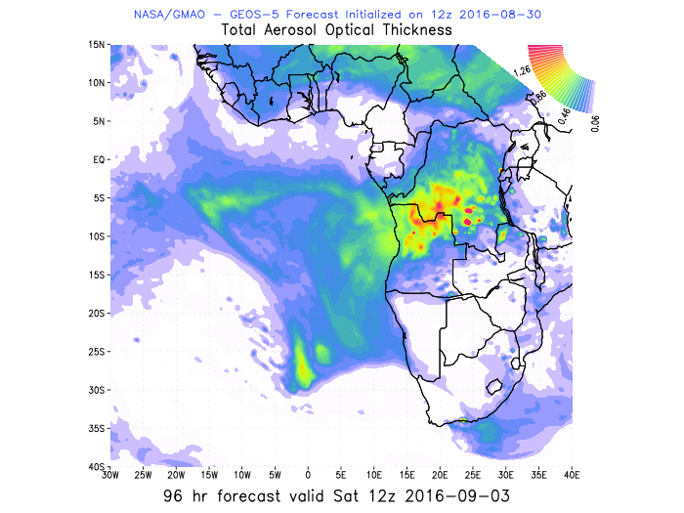
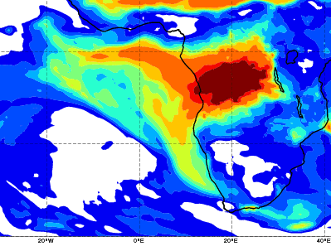
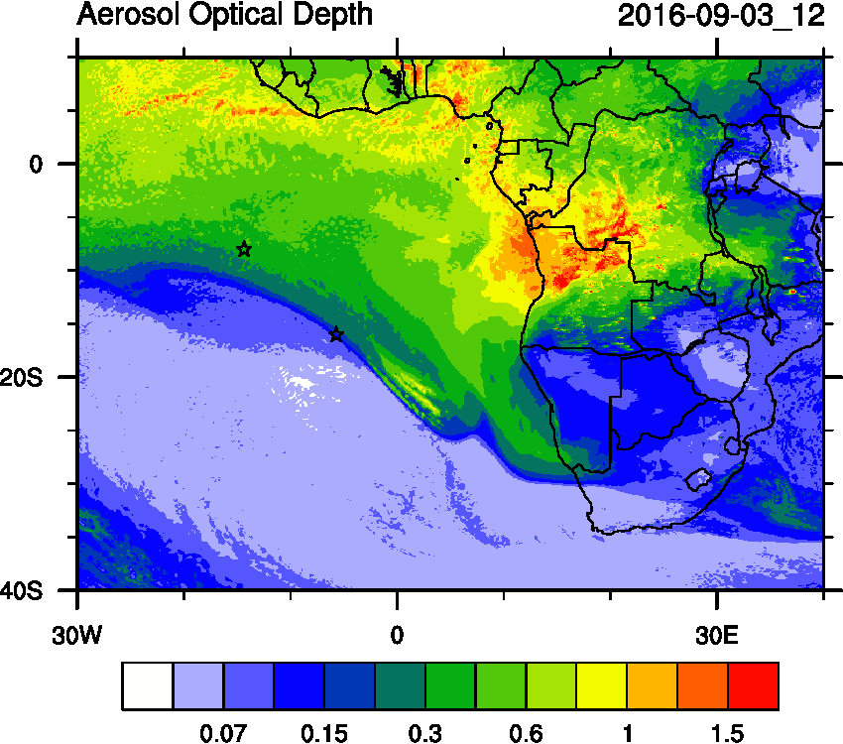
AOD 12 UTC
WRF
CAMS
GEOS5

Slide 32
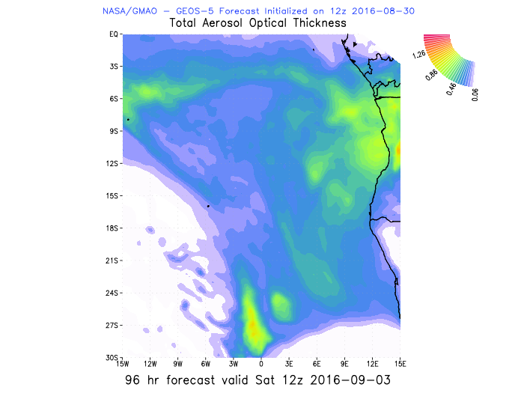
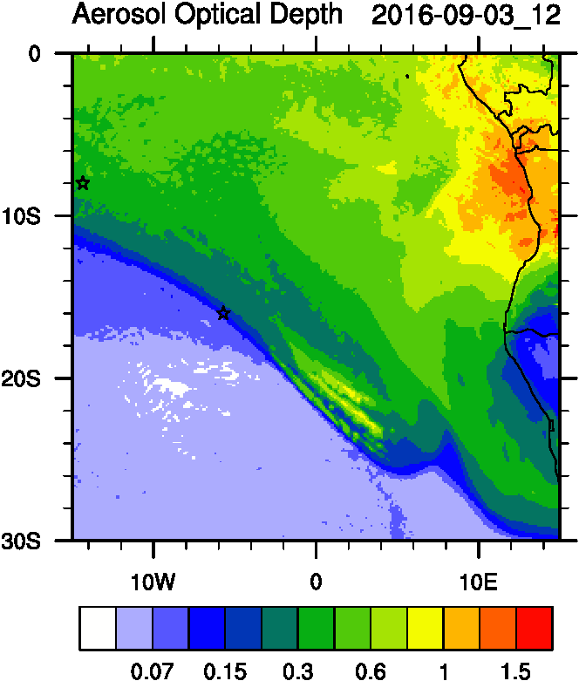
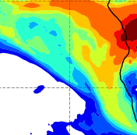
AOD 12 UTC
GEOS5
CAMS

Slide 33
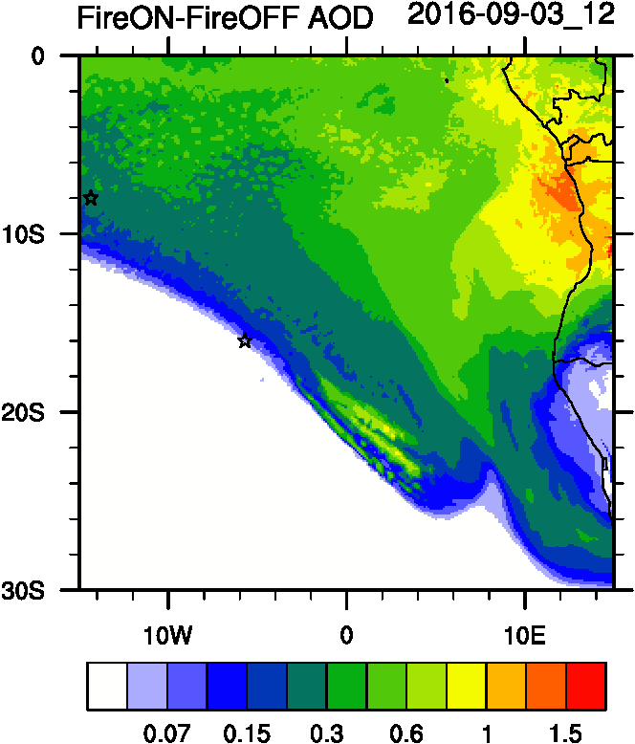
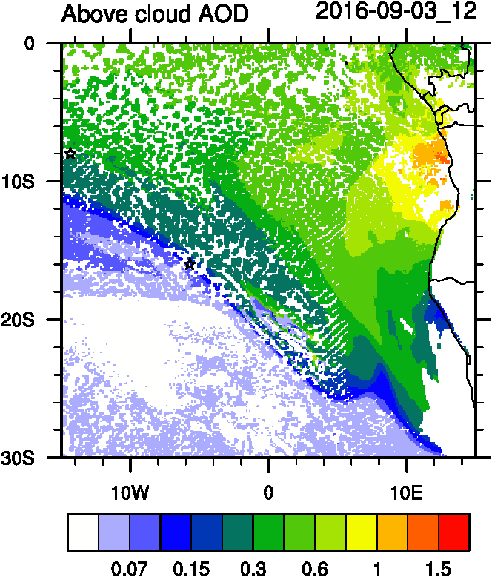
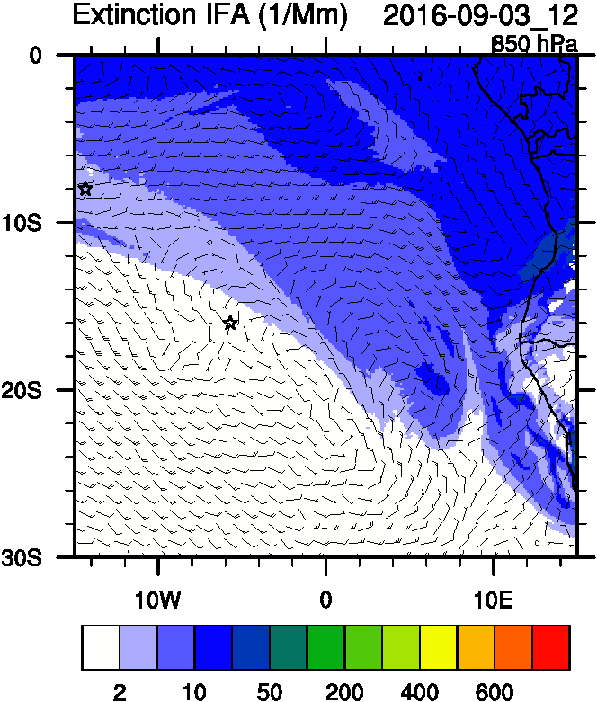
Smoke AOD
ACAOD
AOD IFA

Slide 34
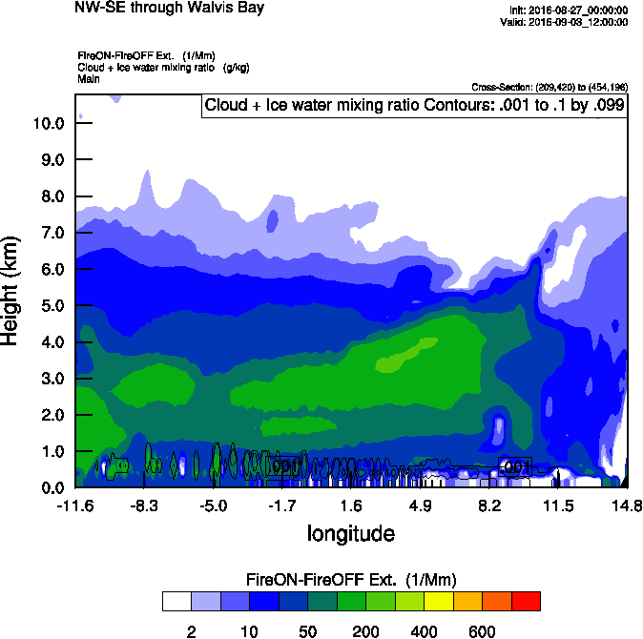
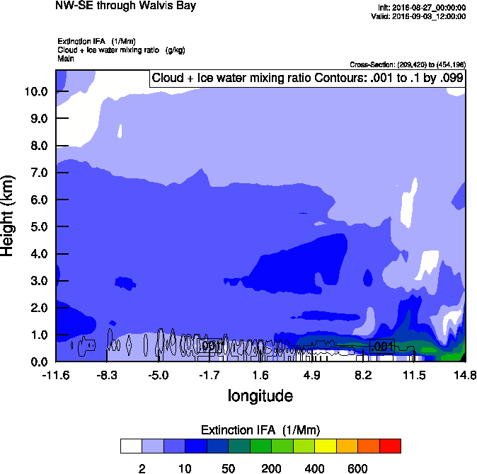
Vertical cross-section routine flight
Smoke Ext WRF
IWA Ext WRF
Smoke AOD
Smoke AOD

Slide 35
Smoke Age distribution
Smoke AOD
Smoke AOD
Mean Age
Mode Age

Slide 36
Vertical cross-section routine flight
Smoke Ext WRF
Age mean
Smoke AOD
Smoke AOD

Slide 37
Sept 4 2016

