Slide 1
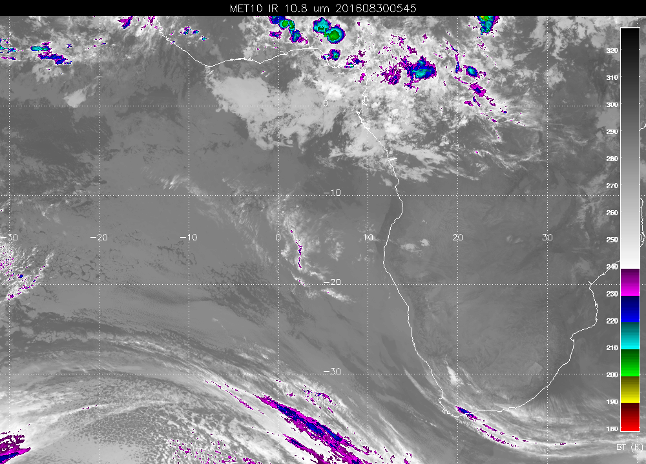
This morning. Sure enough, there’s the cirrus! As forecast, slightly SW of track, but will
still see some.

Slide 2
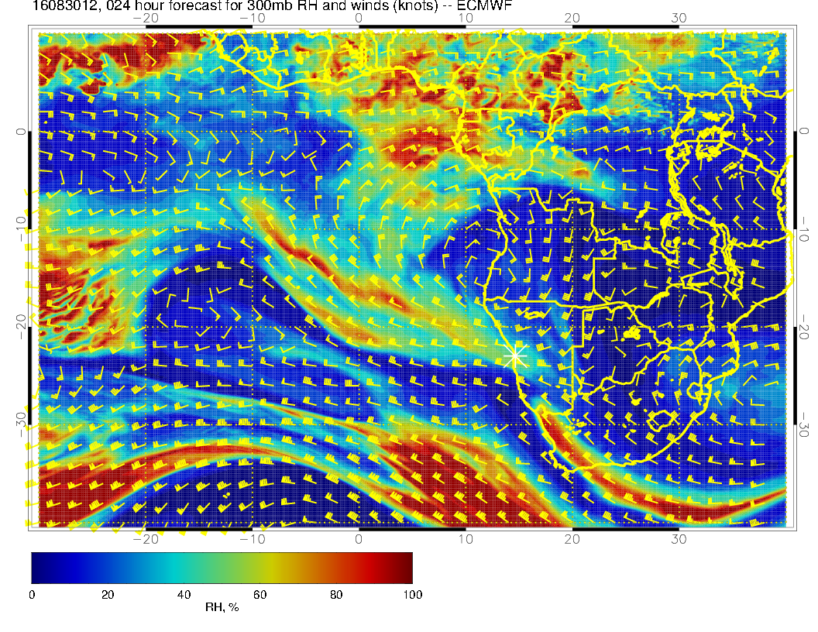

Slide 3
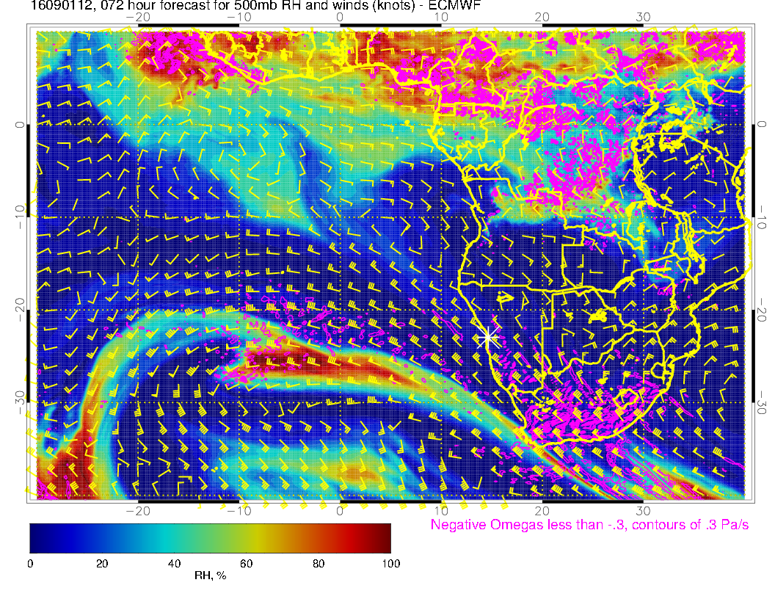
500mb forecast
Trough has backed off a bit by about 3 degrees since last forecast. There is a moving anticyclone
to the north, moving westward. African easterlies are bent northward by this anticyclone.

Slide 4
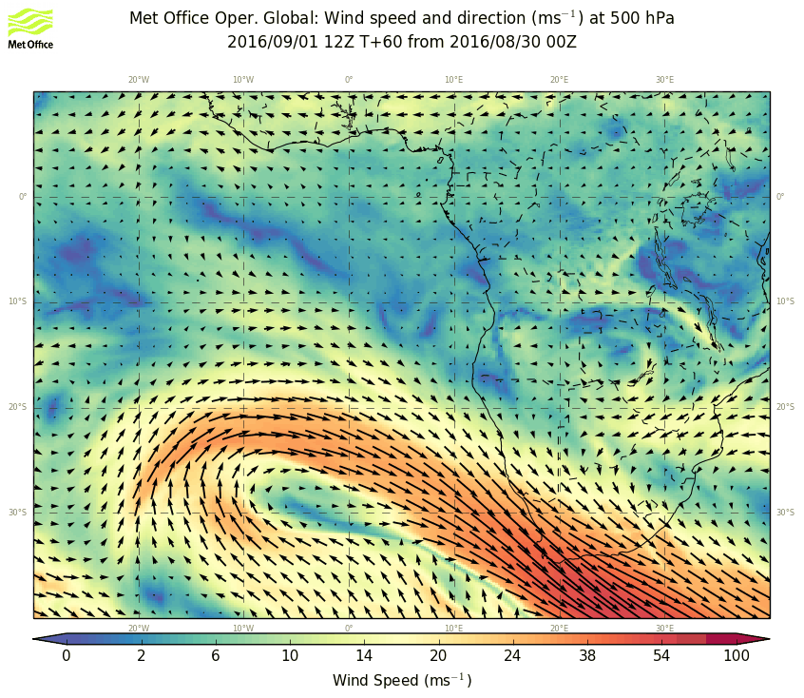
Same thing
in UKMO

Slide 5
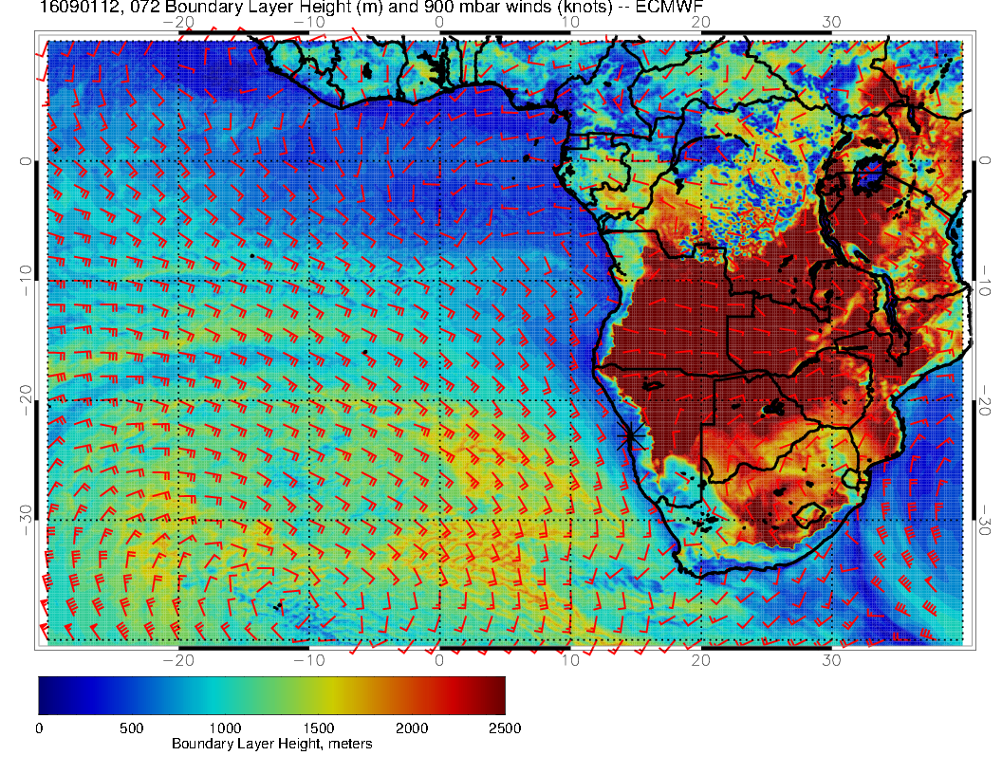

Slide 6
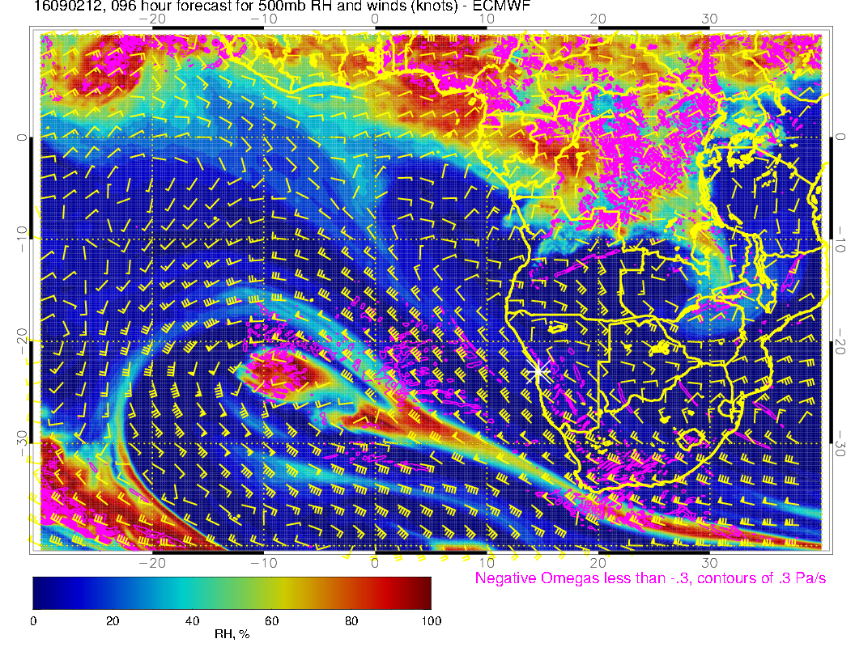
Trough begins to stall.

Slide 7
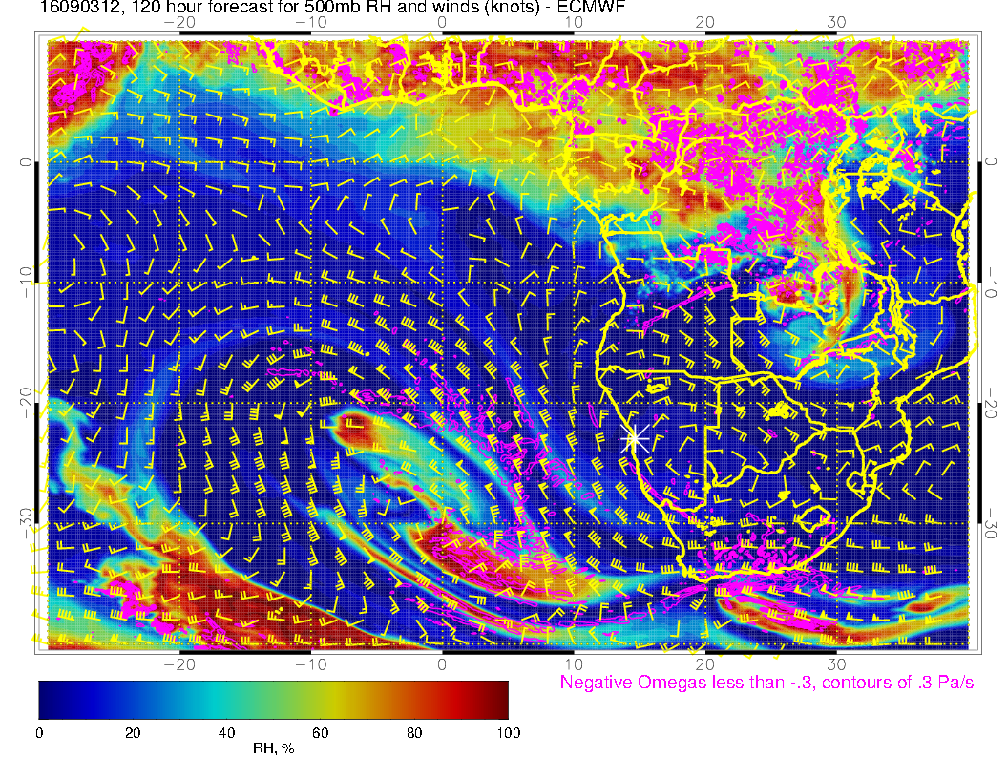
Closed circulation develops by Saturday

Slide 8
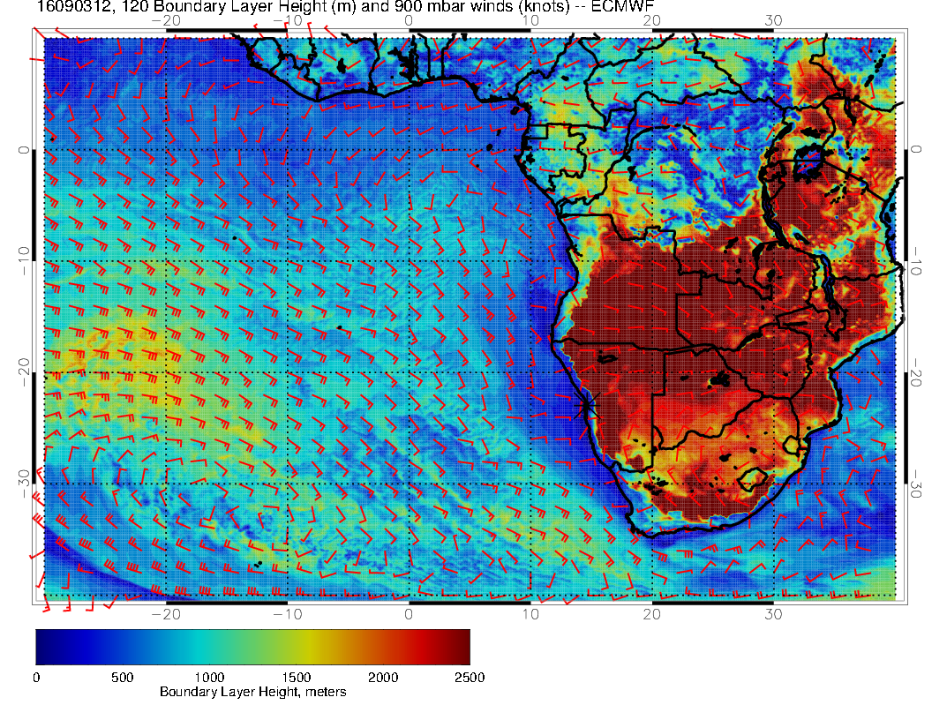
Saturday, stalling trough increases size of thin boundary layer region near our coast. I would
argue that the stratus region increases near our coast

Slide 9
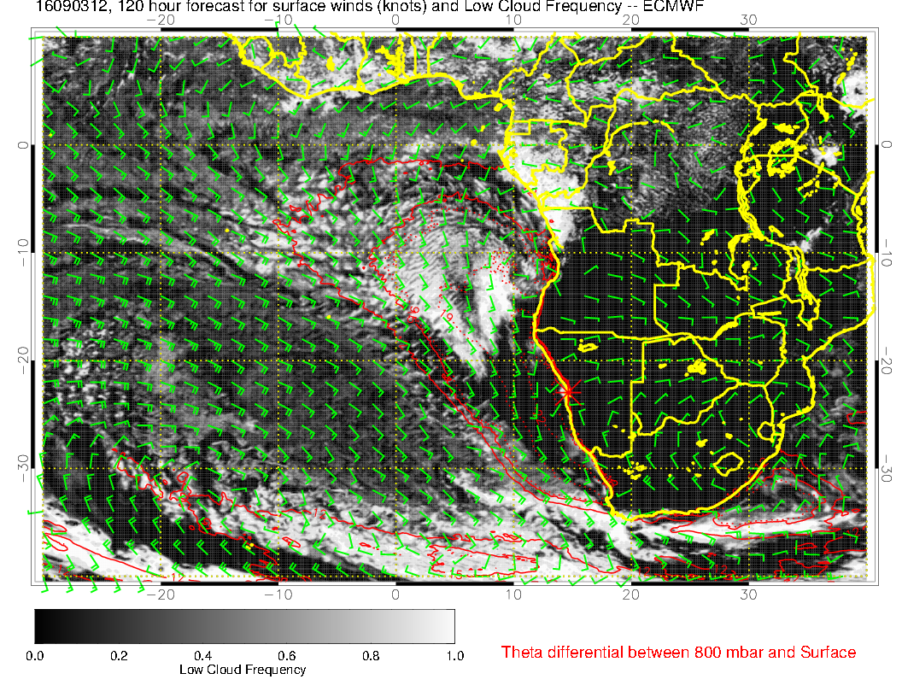
UKMO has low cloud down to Walvis.

