Slide 1
ORACLES forecasting Briefing Aerosols
30-08-2016

Slide 2
Aug 29 2016 (model evaluation)

Slide 3
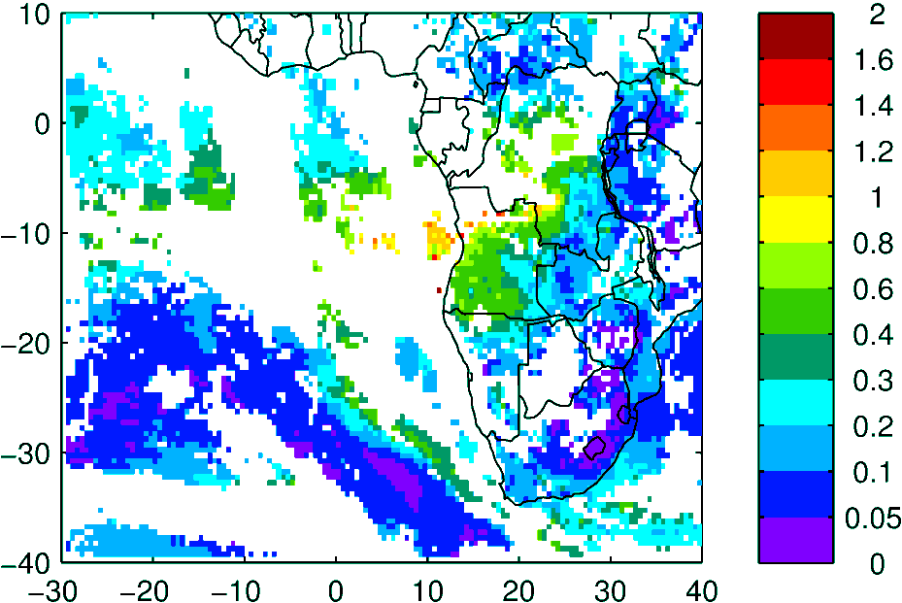
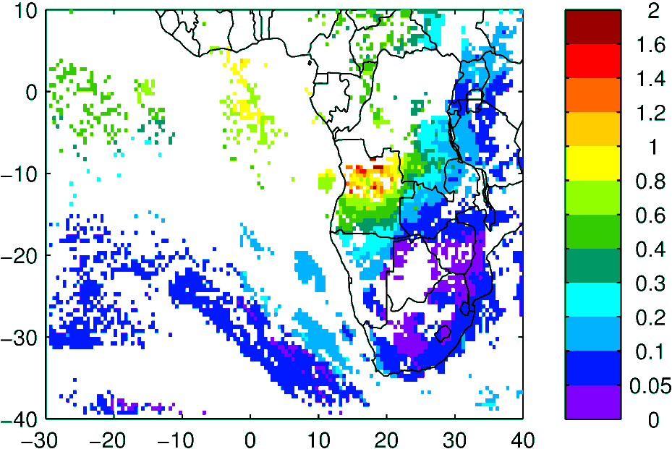
AOD (clear-sky)
MODIS NNR Terra & Aqua
WRF-AAM Terra & Aqua

Slide 4
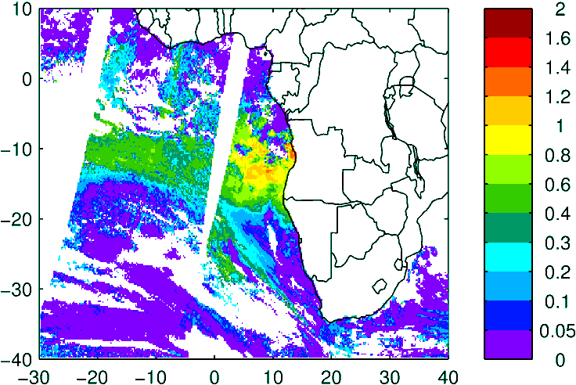
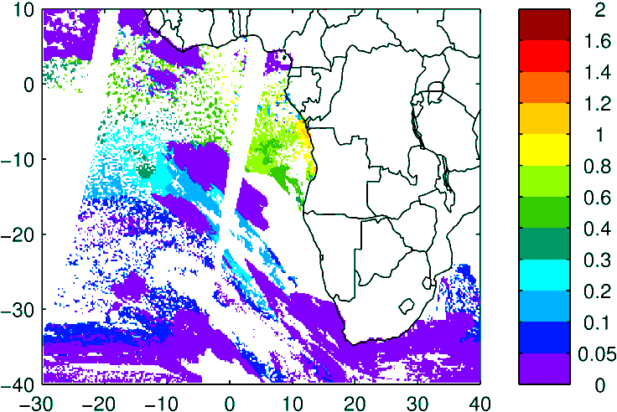
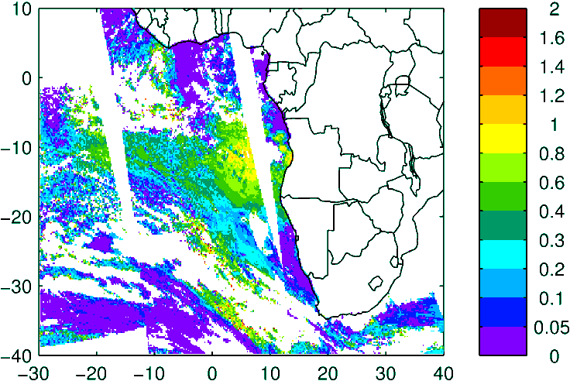
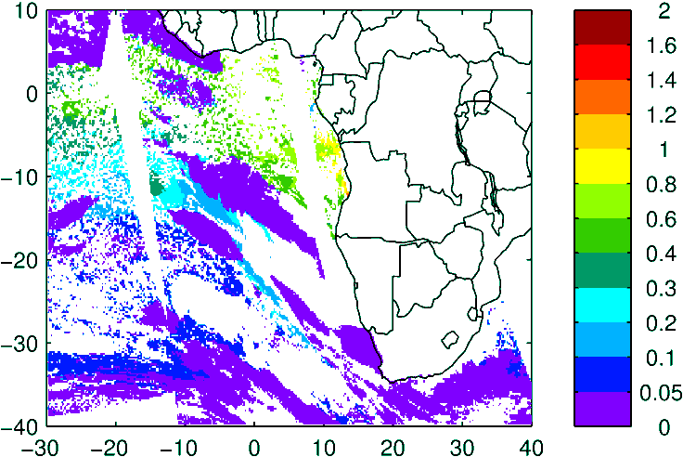
Above Cloud AOD (thanks Kerry!)
Model (WRF-AAM)
Observation
High lvl Cld
Terra
Aqua

Slide 5
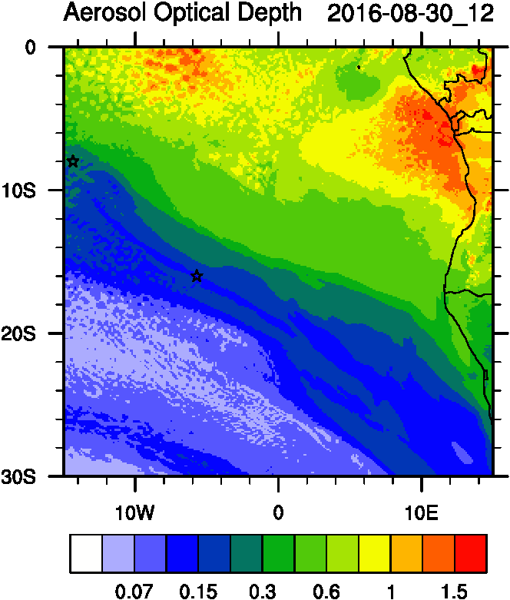
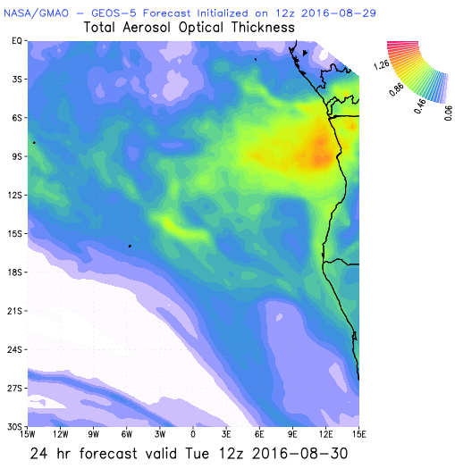
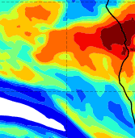
Aug 30 2016 (current conditions)

Slide 6
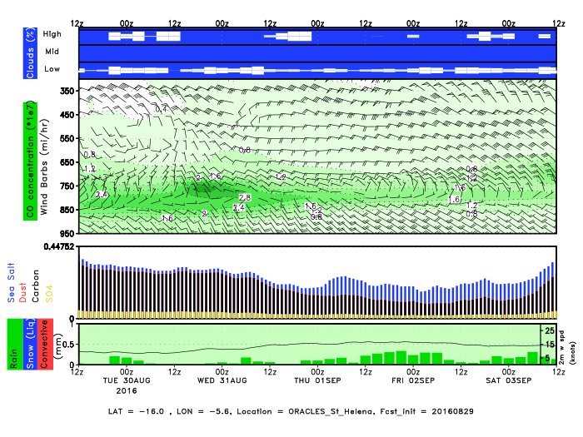
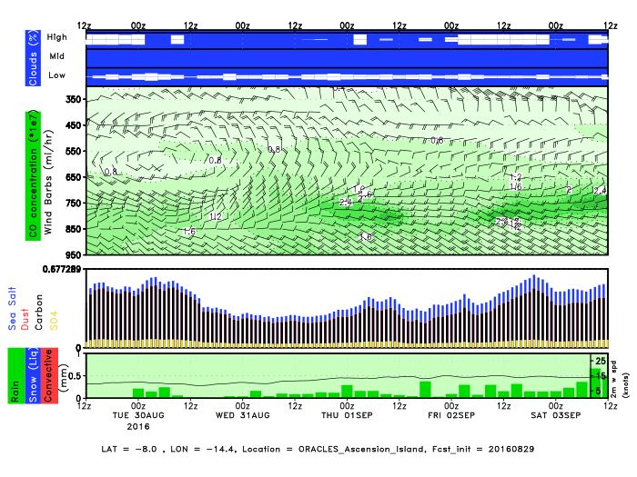
GEOS5 Envirograms
St Helena
Ascension

Slide 7
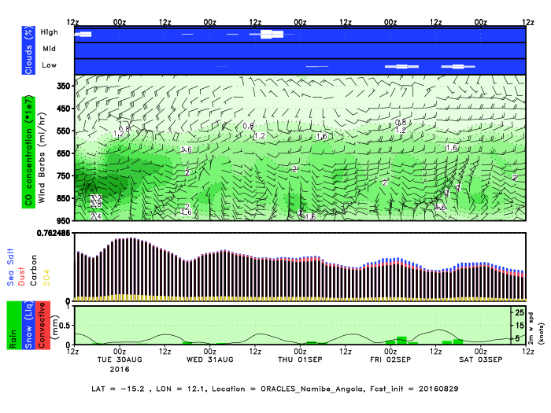
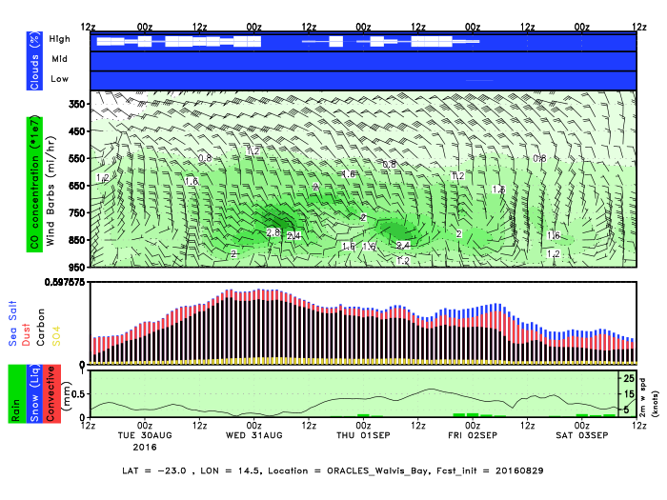
GEOS5 Envirograms
Namibe Angola
Walvis Bay

Slide 8
Sep 01 2016

Slide 9
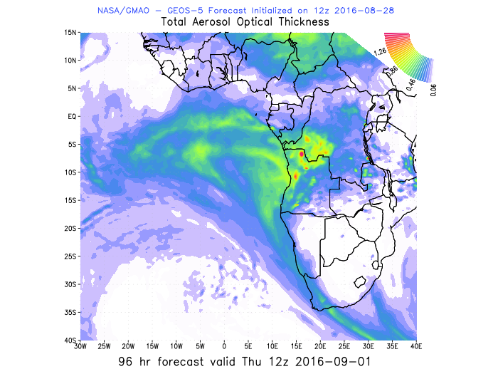
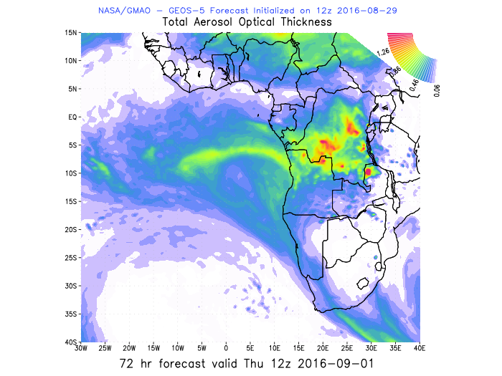
AOD 12 UTC
GEOS5
CAMS
WRF
96 h
72 h

Slide 10
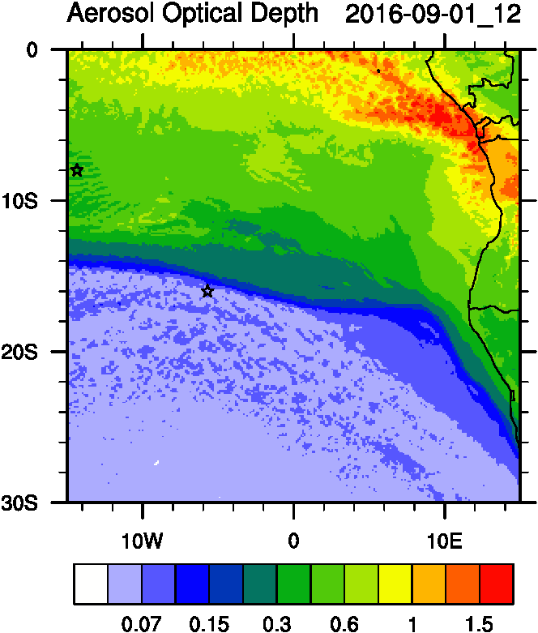
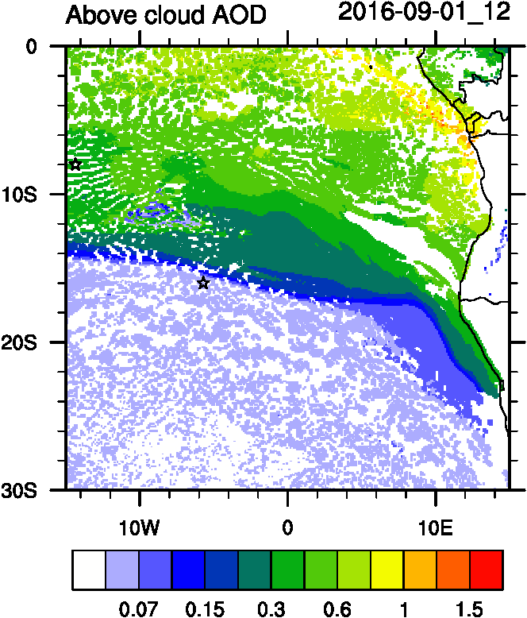
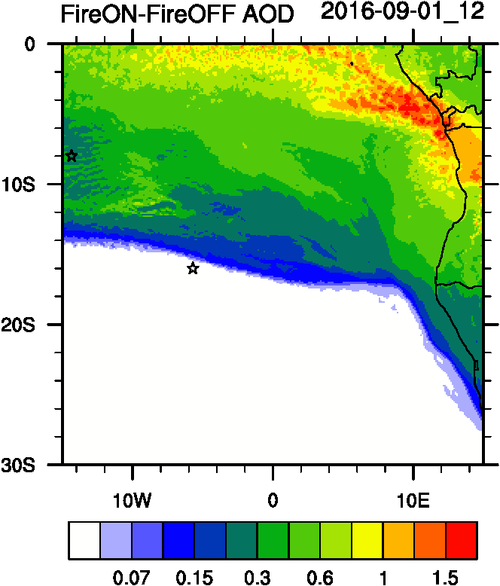
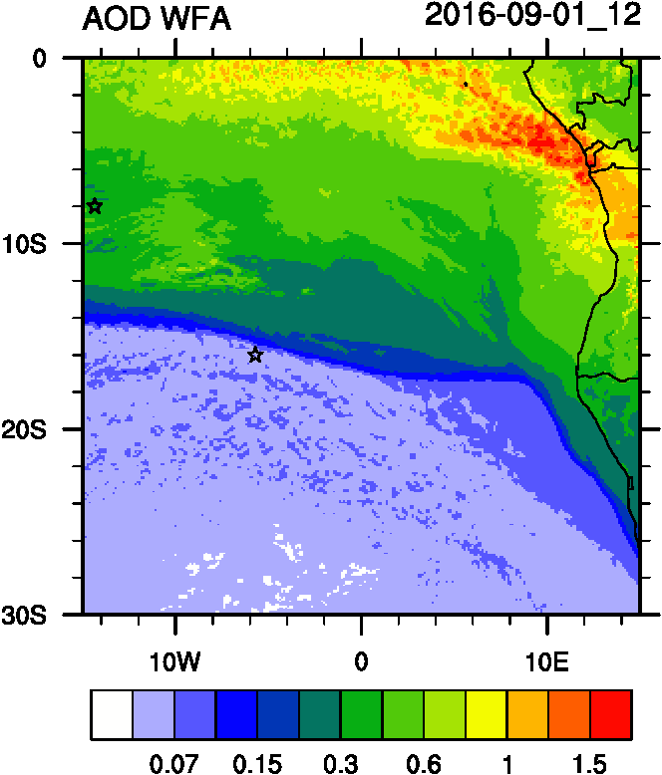
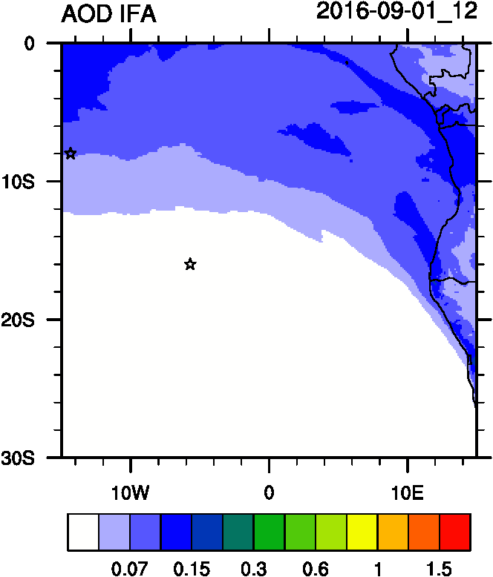
AOD
ACAOD
Smoke AOD
12UTC flavors of AOD
WFA=Water Friendly Aerosol
IFA=Ice Friendly aerosol
WFA AOD
IFA AOD

Slide 11
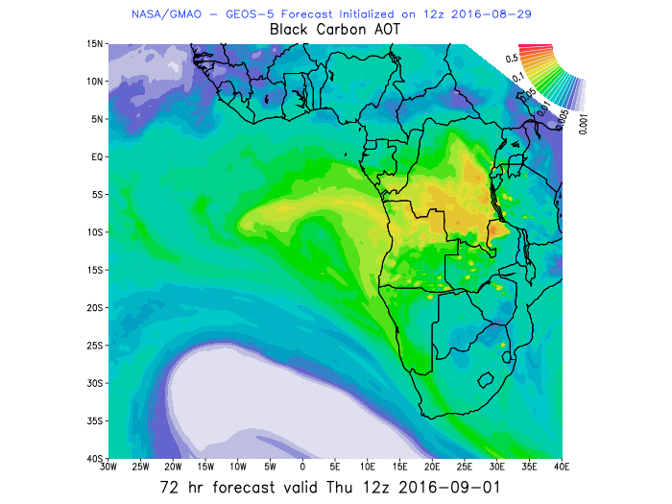
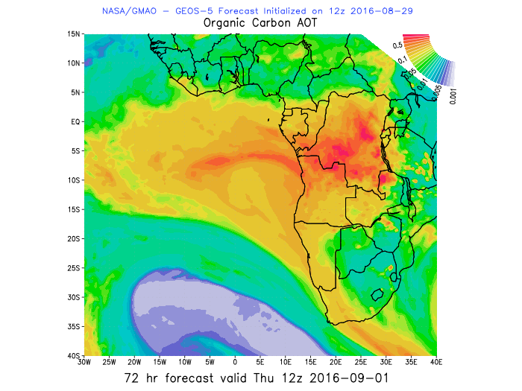
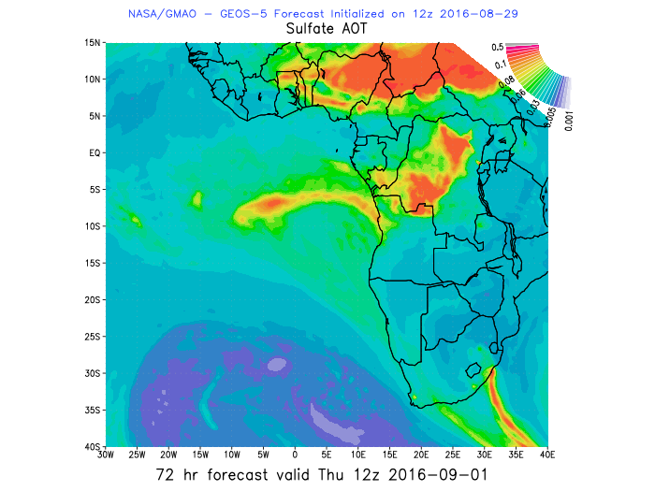
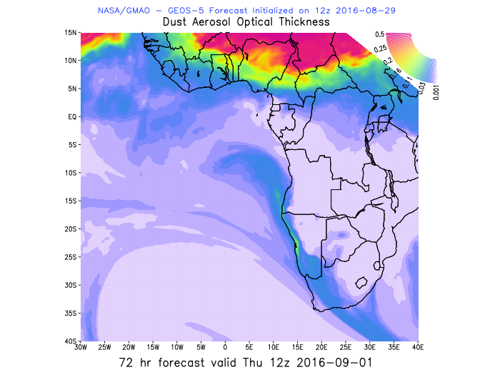
0.8
1.3
12%
80%
14%
70%
0.4
12-14%
70%
AOD
BC-AOD
OC-AOD
12UTC flavors of AOD
15-35
50-80%
15
15%
10%
10%
3%
30%
SULF-AOD
DUST AOD
50%

Slide 12
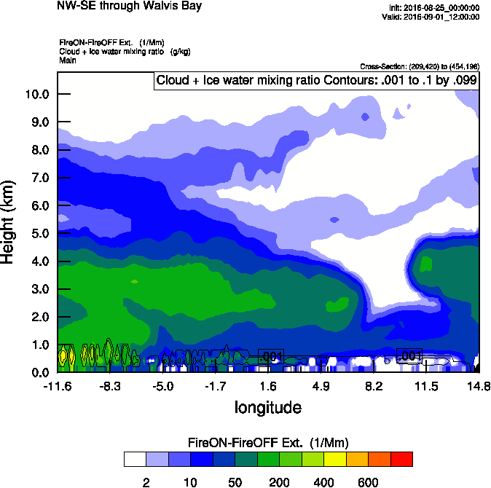
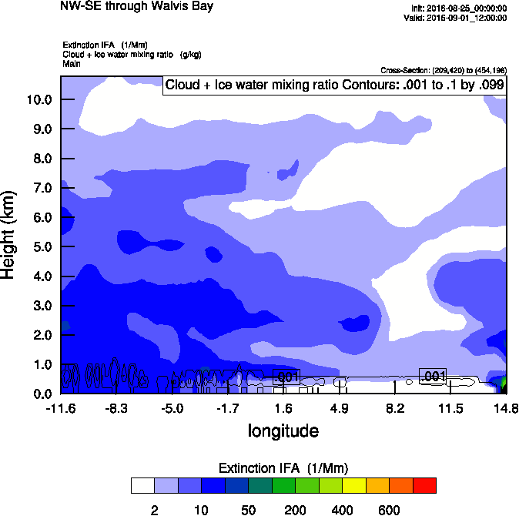
Vertical cross-section routine flight
Smoke Ext
Dust Ext
Smoke AOD

Slide 13
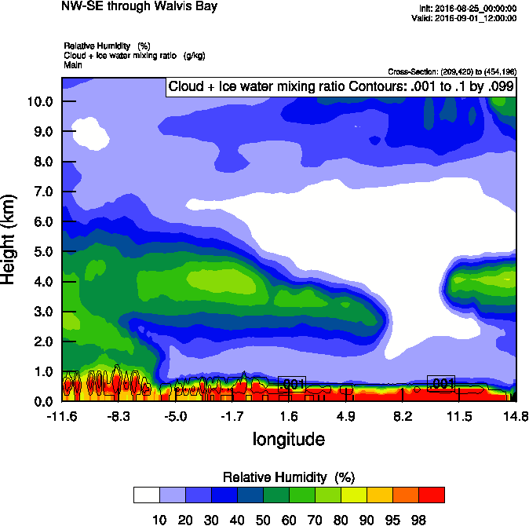
Vertical cross-section routine flight
Smoke Ext
RH
Smoke AOD

Slide 14
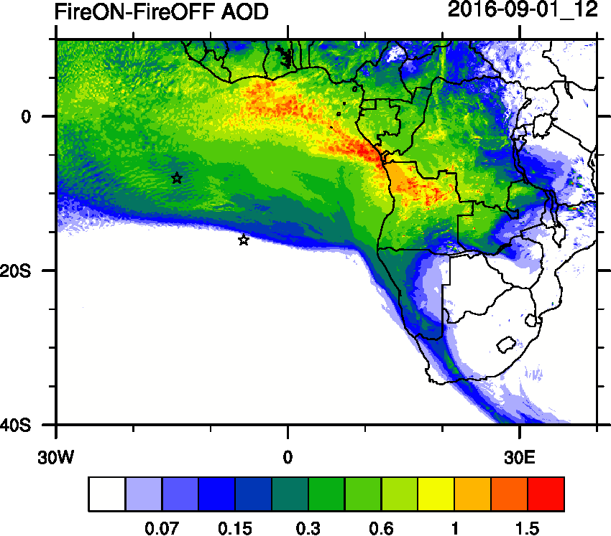
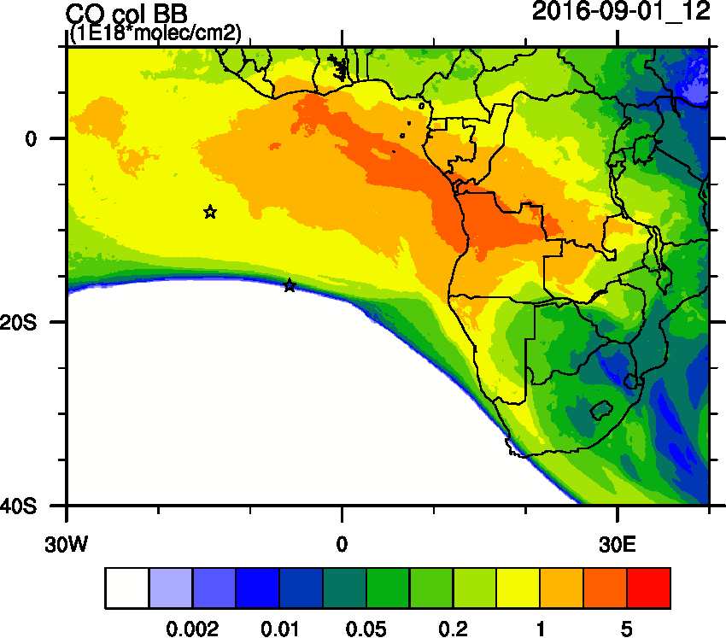
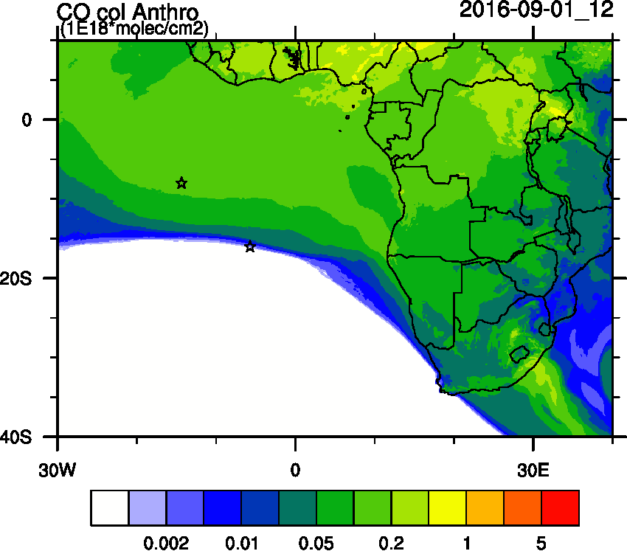
Biomass burning and Anthropogenic tracers
Smoke AOD
CO BB
CO Anthro

Slide 15
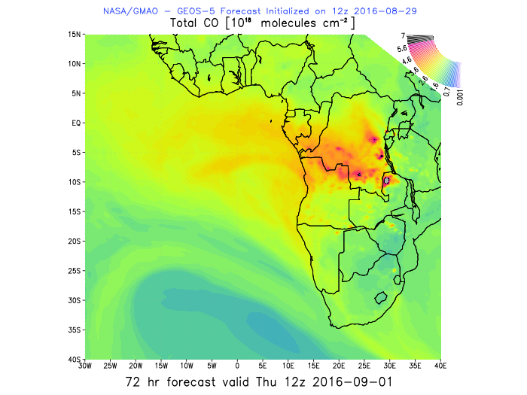
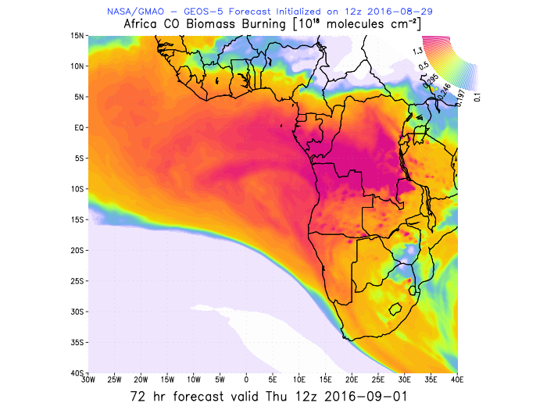
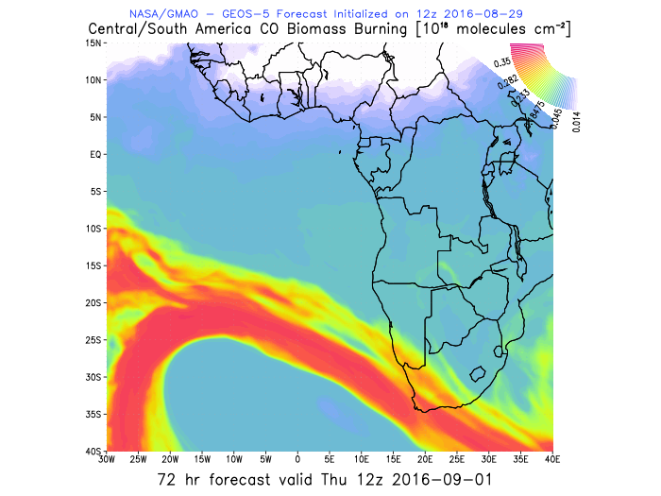
Biomass burning and Anthropogenic tracers
(350-800 ppm)
75-90%
~40% (90 ppbv)
~300-500 mb
Total CO
Africa CO
South America CO
~40% (150 ppbv)
~700-800 mb

Slide 16
Wavis Bay
Ascension
Simonstown
Sta Helena

Slide 17
Smoke daily tracers

Slide 18
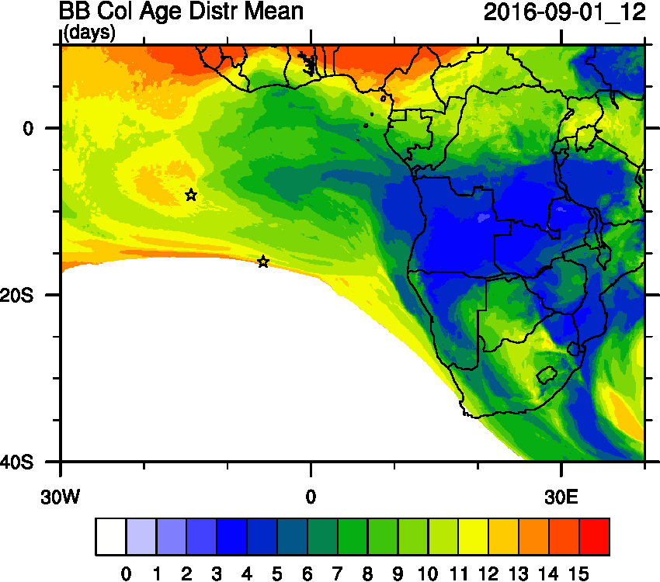
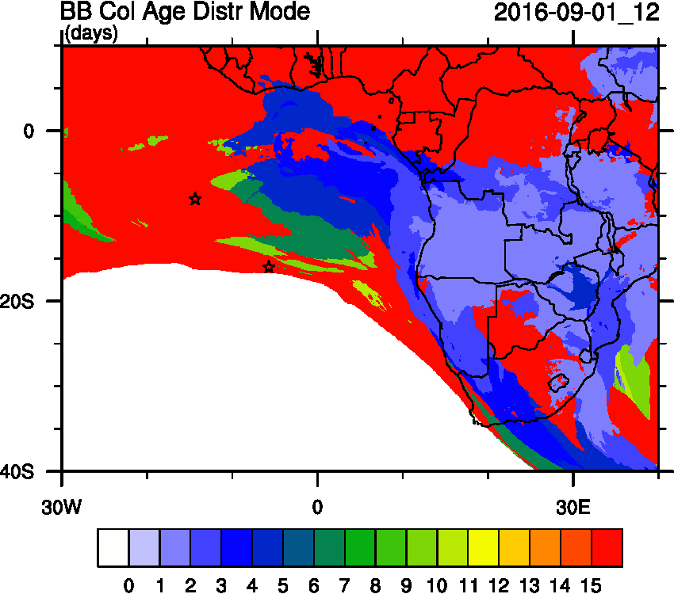
Smoke Age distribution

Slide 19
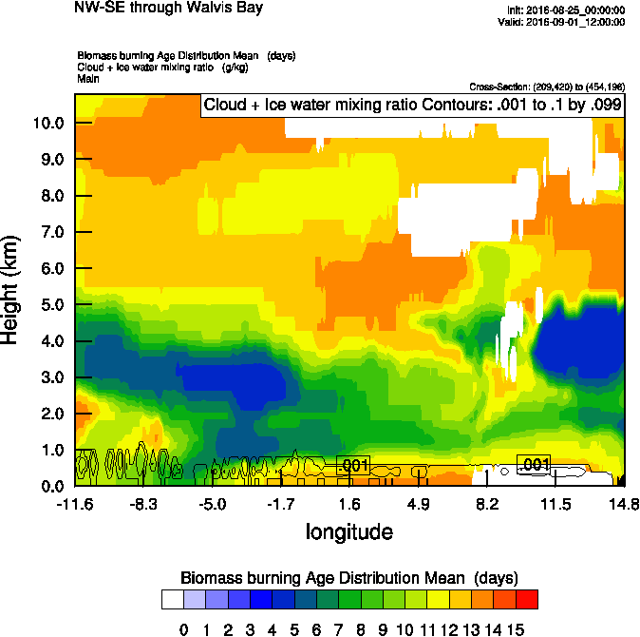
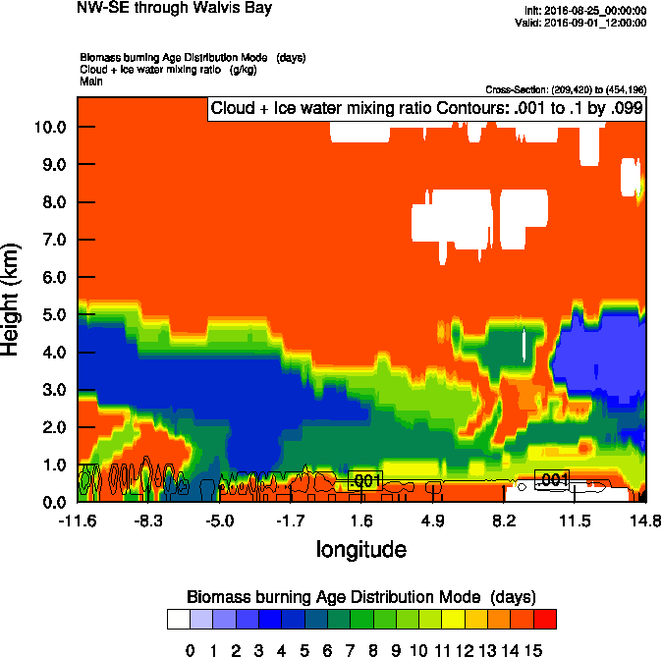
Vertical cross-section routine flight
Smoke AOD
Smoke age mean
Smoke age mean

Slide 20
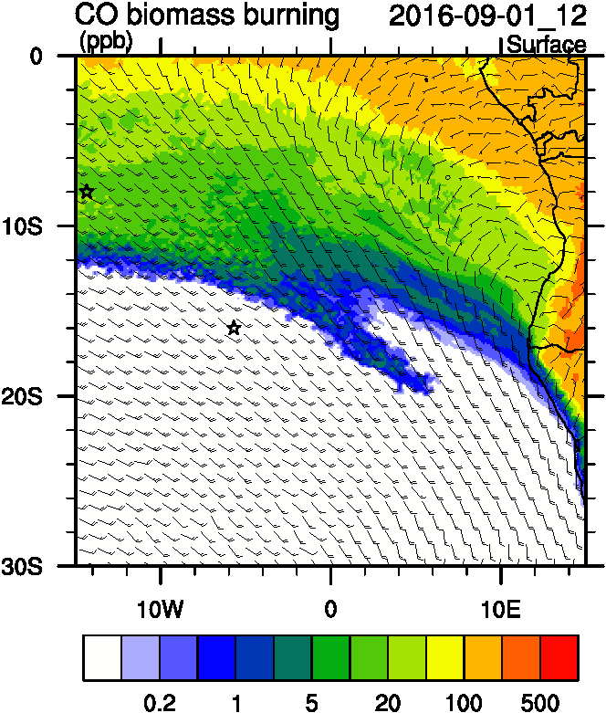
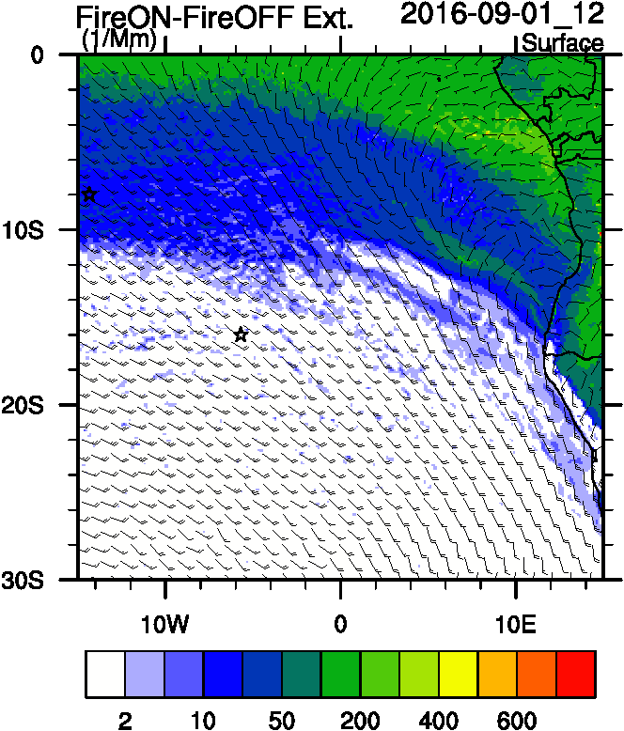
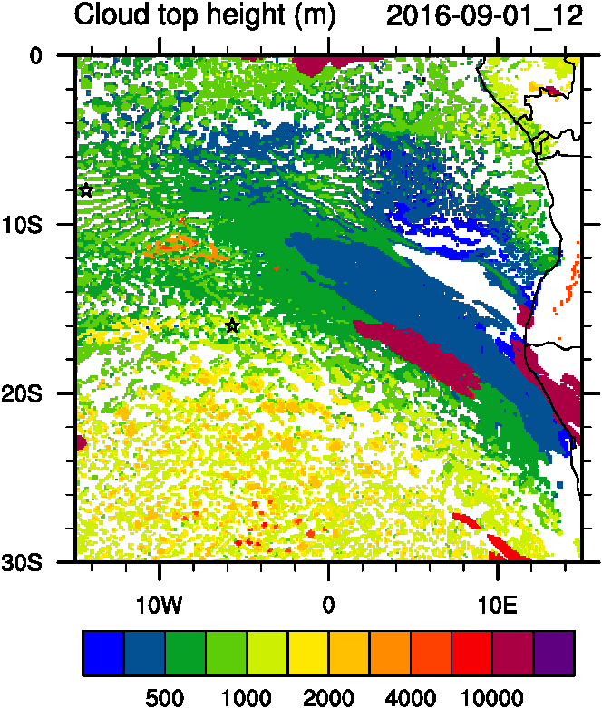
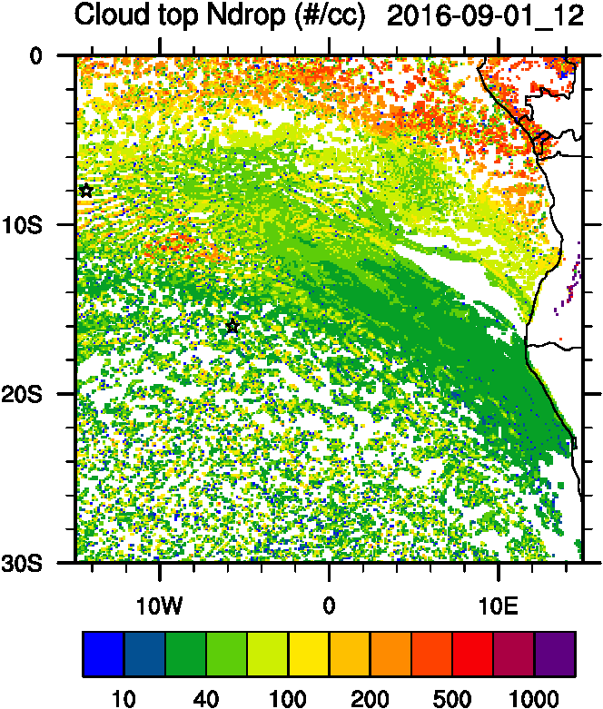
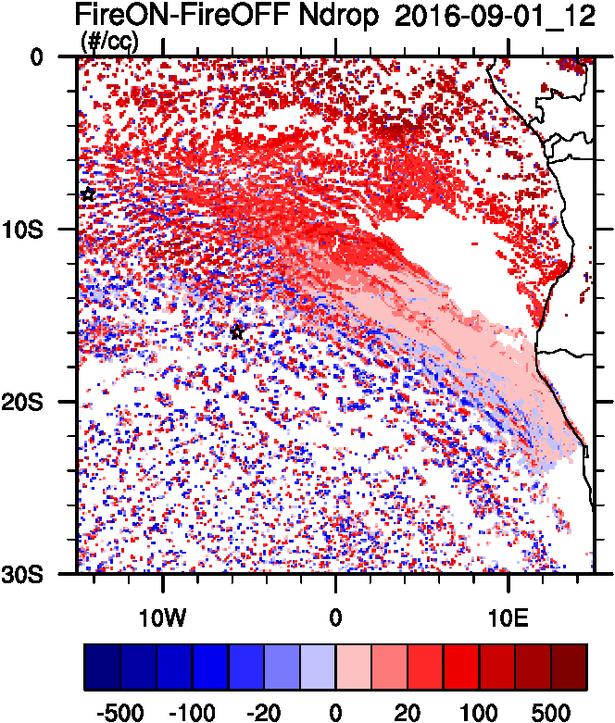
Aerosol-cloud interactions
Smoke AOD
Smoke Ext
Ndrop: Number droplet concentration
Diff: Differences between simulations turning on and off fires
tracer
Cld Top
Ndrop
Ndrop Diff

Slide 21
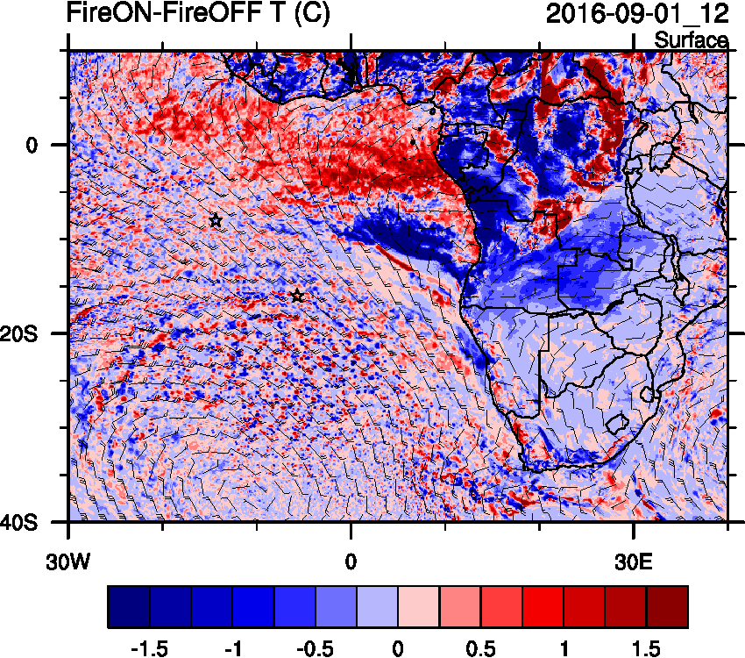
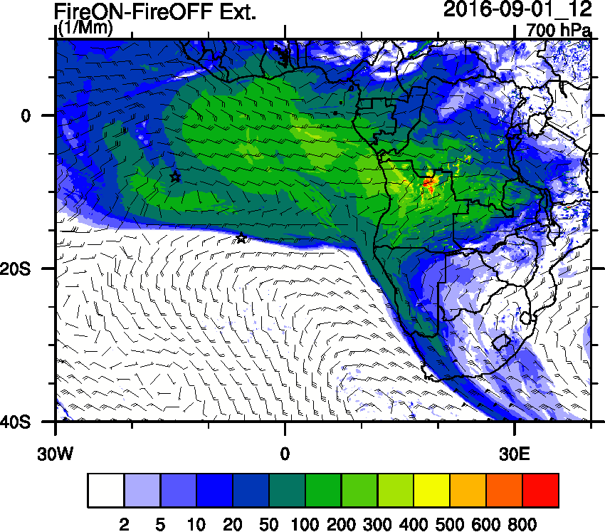
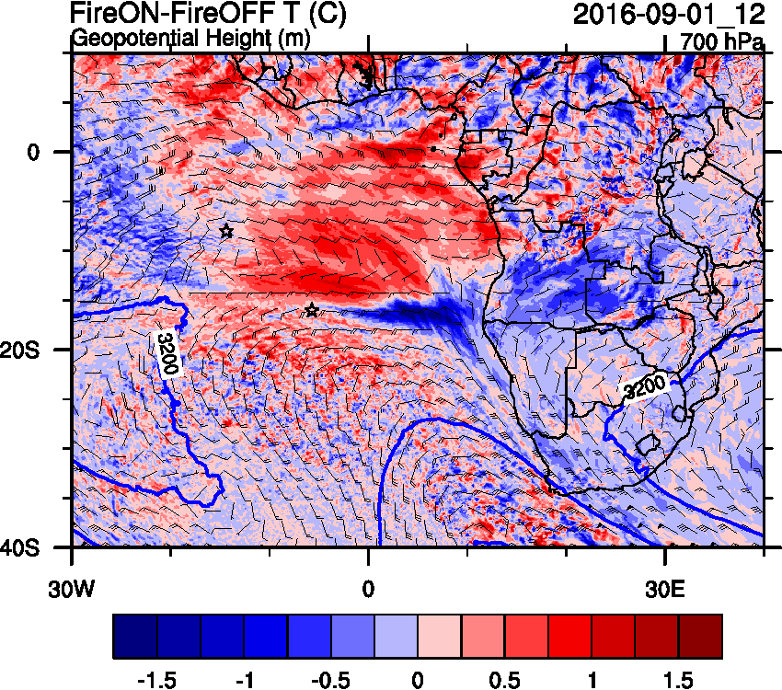
Aerosol-radiation interactions
T diff
Smoke AOD
Smoke Ext
Smoke AOD

Slide 22
Sept 2 2016

Slide 23
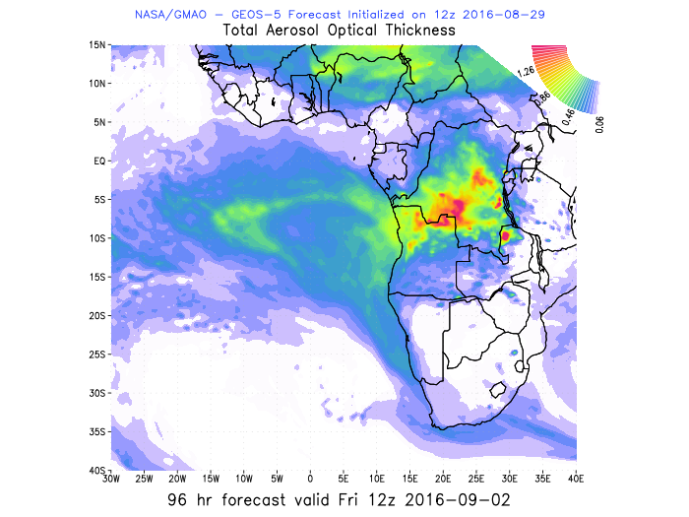
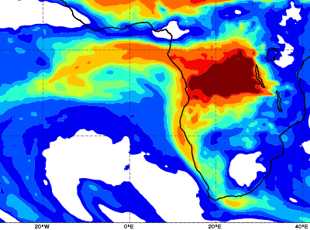
AOD 12 UTC
GEOS5
CAMS

Slide 24
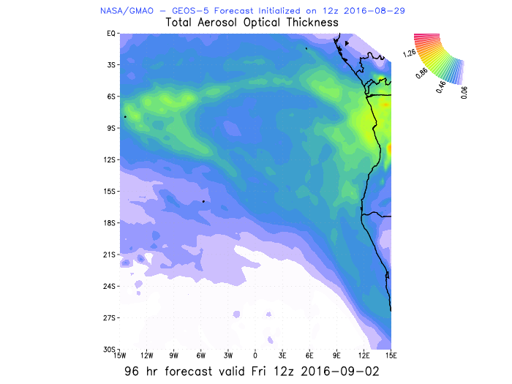
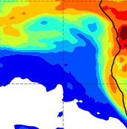
AOD 12 UTC
GEOS5
CAMS

Slide 25
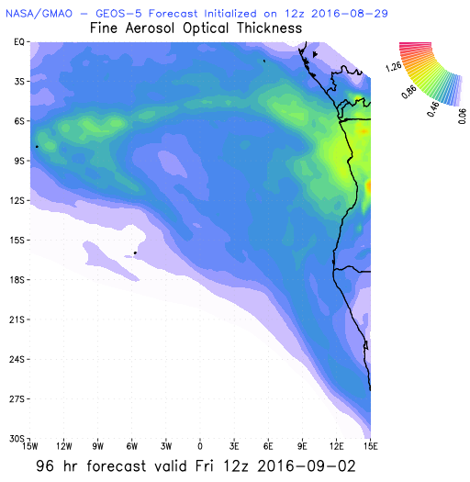
Aerosol Speciation

Slide 26
Smoke vertical distribution

Slide 27
Extinction Cross-sections

Slide 28
Sept 3 2016

Slide 29
AOD 12 UTC
AOD 00 UTC
CAMS
GEOS5

Slide 30
AOD
ACAOD
Smoke AOD
12UTC flavors of AOD
WFA=Water Friendly Aerosol
IFA=Ice Friendly aerosol
WFA AOD
IFA AOD

Slide 31
Vertical cross-section routine flight
Smoke Ext
Dust Ext
Smoke AOD

Slide 32
Vertical cross-section routine flight
Smoke Ext
RH
Smoke AOD

Slide 33
Vertical cross-section 15 S
Smoke AOD
GEOS-5
WRF-AAM

Slide 34
Anthro and Biomass burning tracers
WRF-AAM
BB
AOD
Anthro
GEOS5
BB

Slide 35
Smoke daily tracers

Slide 36
>-10d
-9d
-7d
-5d
-3d
-1d
+1d
+3d

Slide 37
Smoke Age distribution
Smoke AOD
Mean Age
Mode Age

Slide 38
Vertical cross-section routine flight
Smoke Ext
Age mean
Smoke AOD

Slide 39
Aerosol-cloud interactions
Smoke Ext
Ndrop: Number droplet concentration
Diff: Differences between simulations turning on and off fires
Smoke AOD
tracer
Ndrop Diff
Cld Top
Ndrop

Slide 40
Aerosol-radiation interactions
Smoke AOD
Smoke Ext
T diff

Slide 41
Vertical cross-section routine flight
Smoke Ext
T diff
Smoke AOD

