Slide 1
ORACLES forecasting Briefing Meteorology
29-08-2016
Lenny Pfister, Susanne Bauer

Slide 2
Summary
Stronger than normal WH-WVB pressure gradient yields good flying conditions (no low clouds expected at WVB. Rest of week looks good.
Weather dominated by approaching front, which will gradually “scrunch” the stratocumulus region during the forecast period.
Convection over the Congo (not typical) and neighboring anticyclone gives us likelihood of cirrus for next few days.
Shallow BL within 5-10 degrees of coast yields significant low cloud model disagreements.

Slide 3
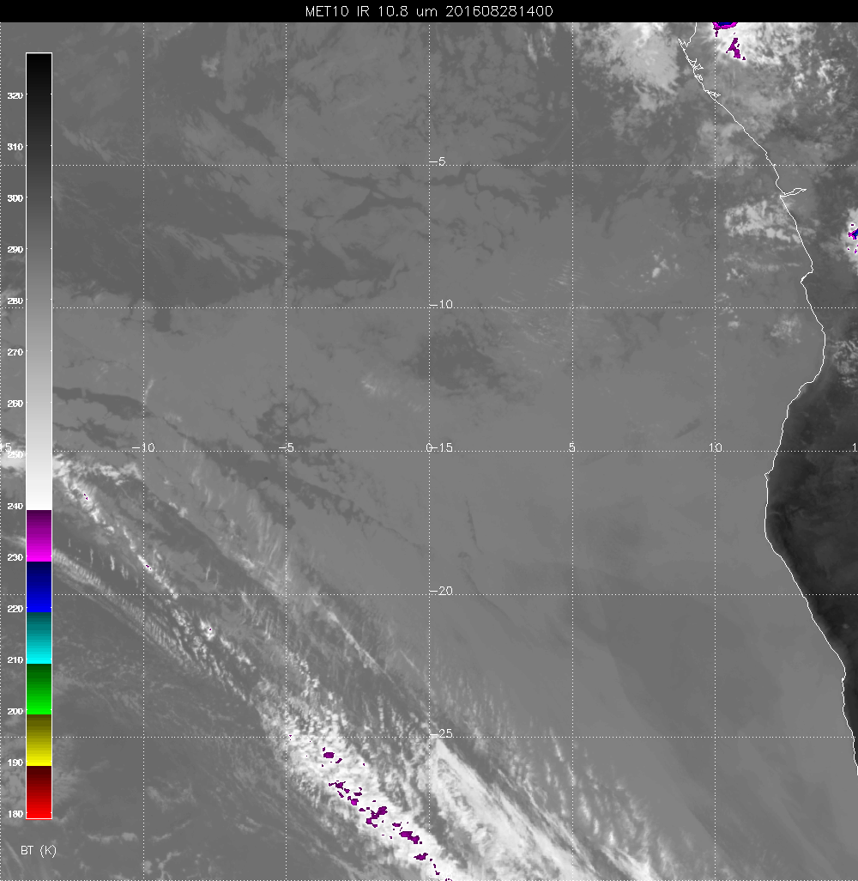
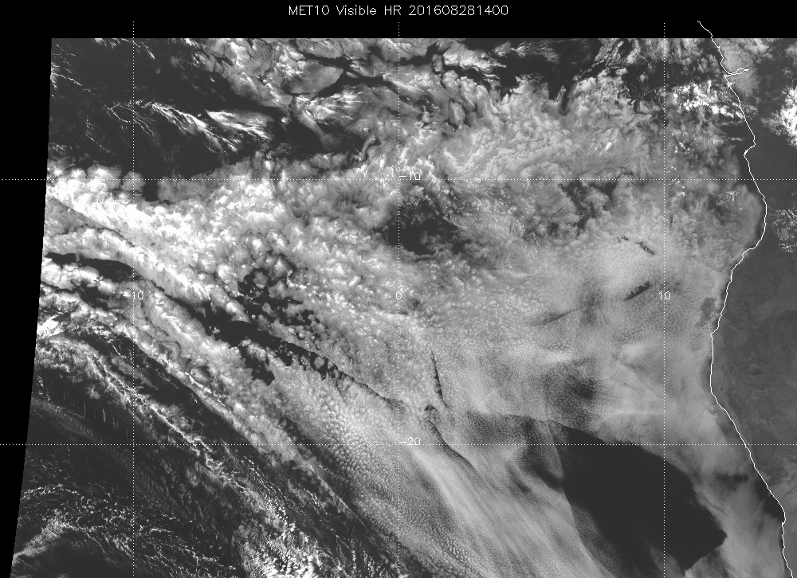

Slide 4
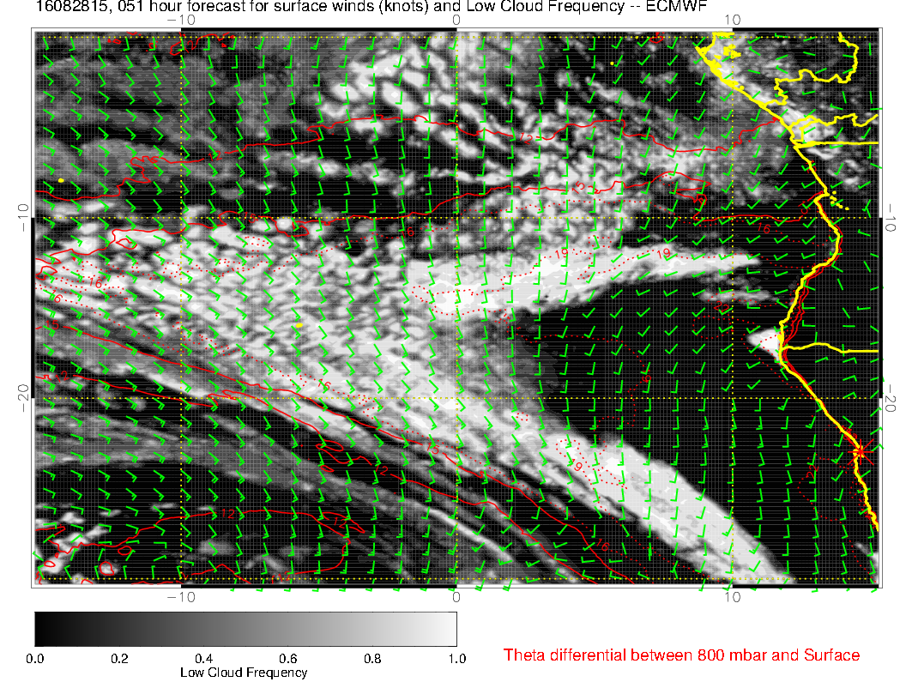

Slide 5
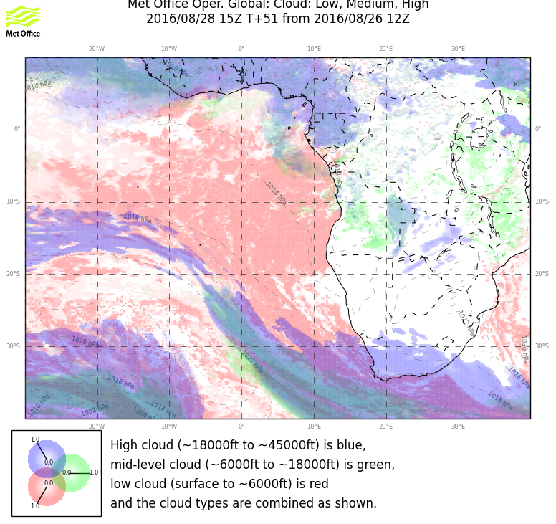

Slide 6
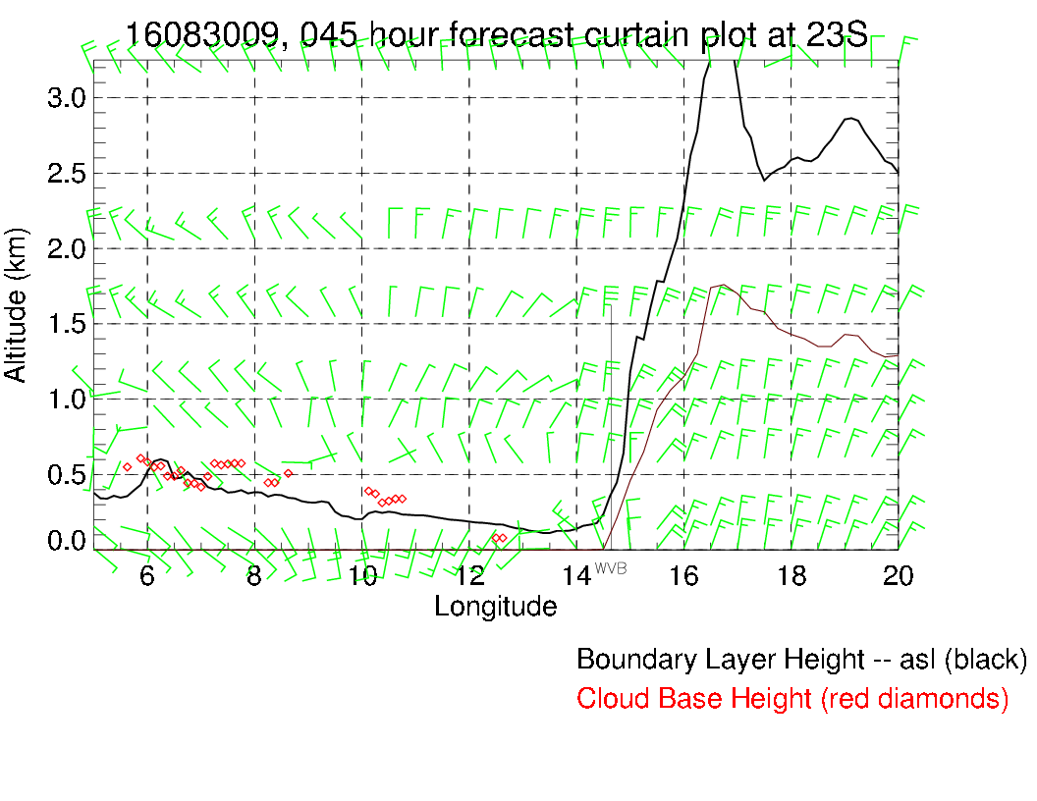
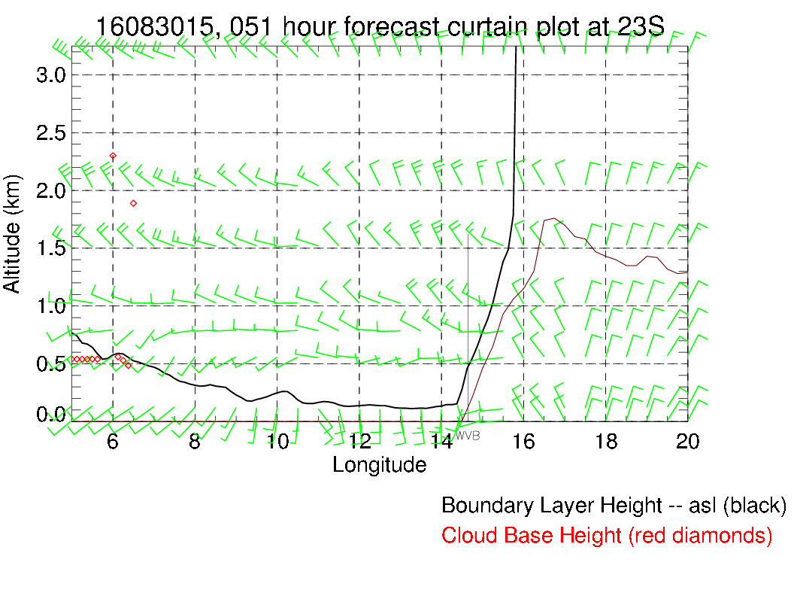
Takeoff time: NNW 10, clear
Landing time: WSW 10, clear

Slide 7
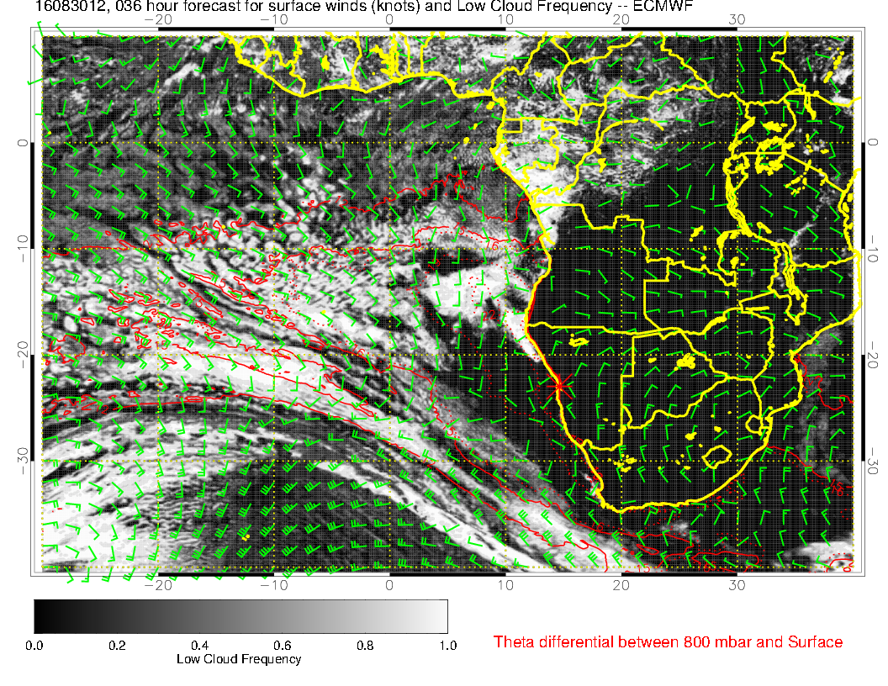
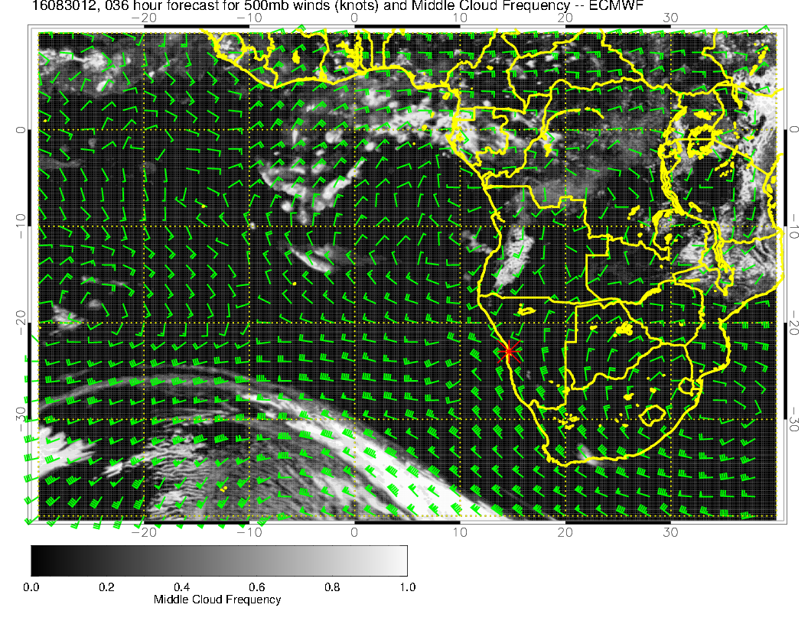
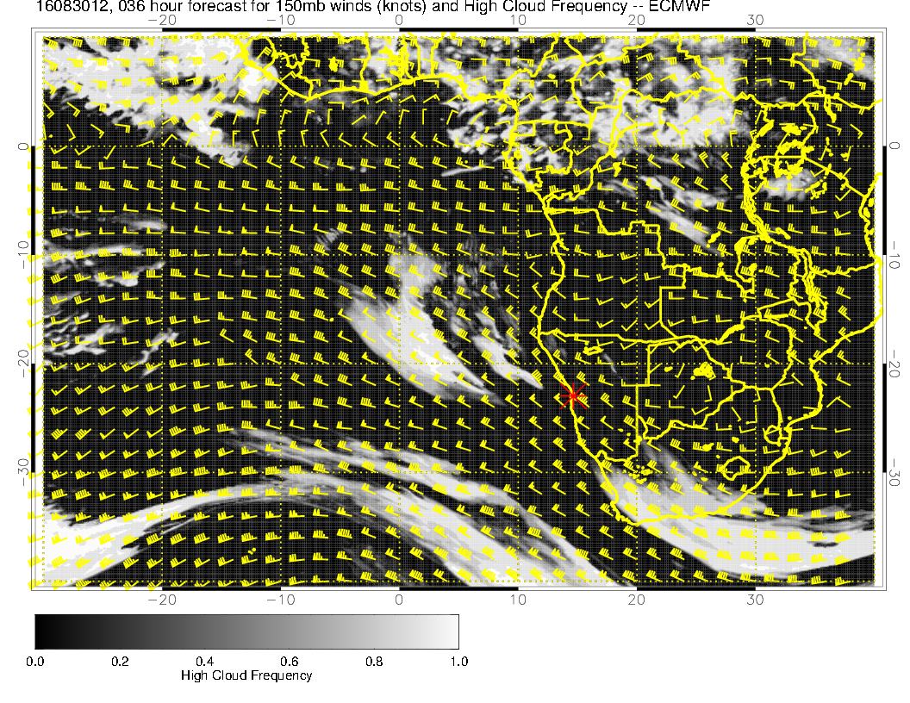
Note significant cirrus
at or just SW of track.
Stratocu is probably
underestimated.

Slide 8
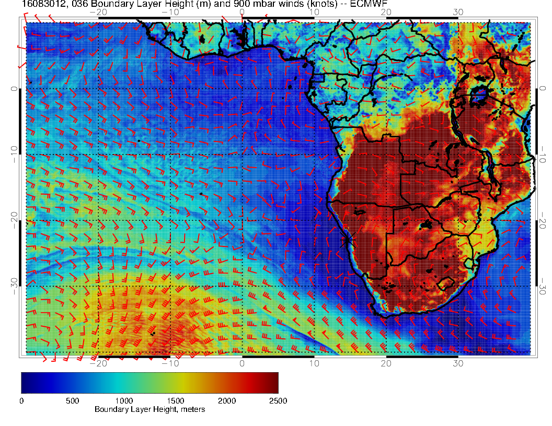
Very thin (200-400 m) BL
near coast. EC model has
demonstrated problems
getting this right.

Slide 9
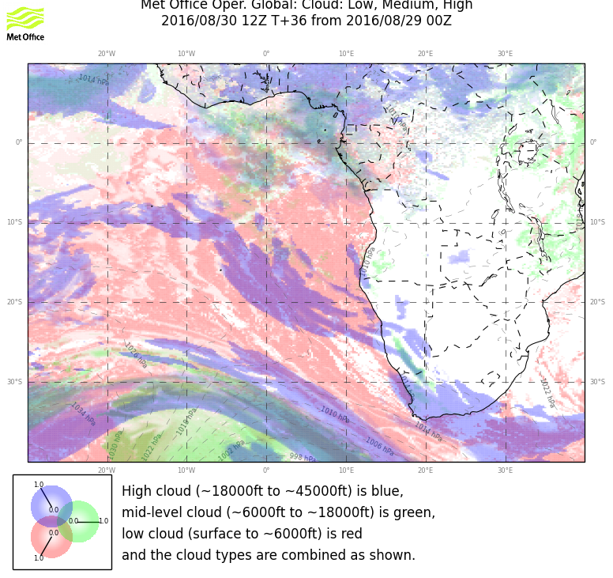
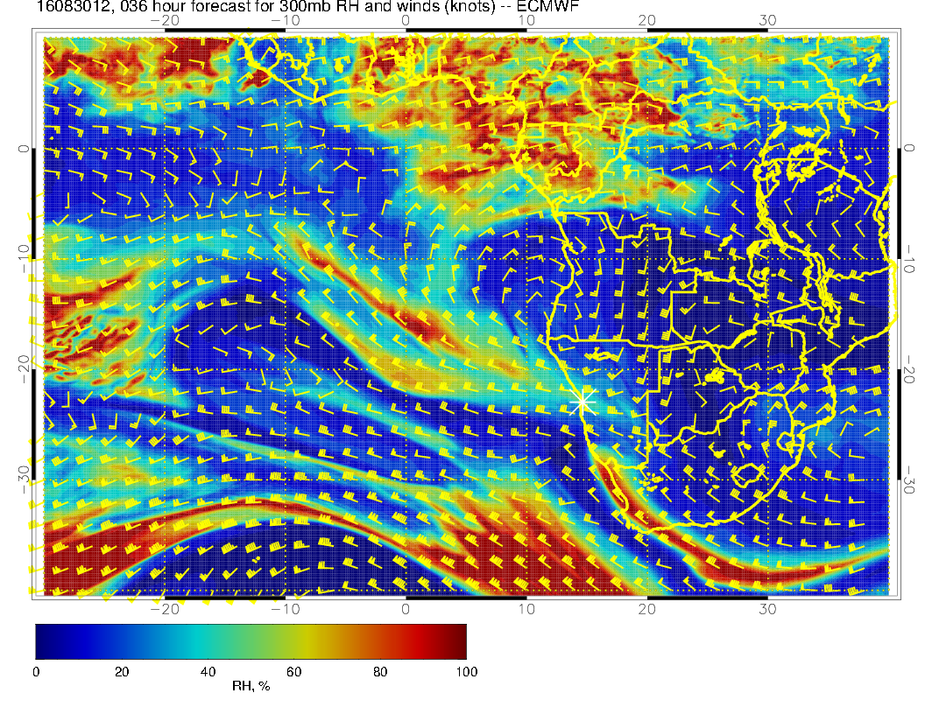
High cloud is likely to verify. Unseasonable strong
convection over Congo coupled with sharp anticyclone (west of usual place) drags moisture southward. Main trough (upward motion) yields cloud

Slide 10
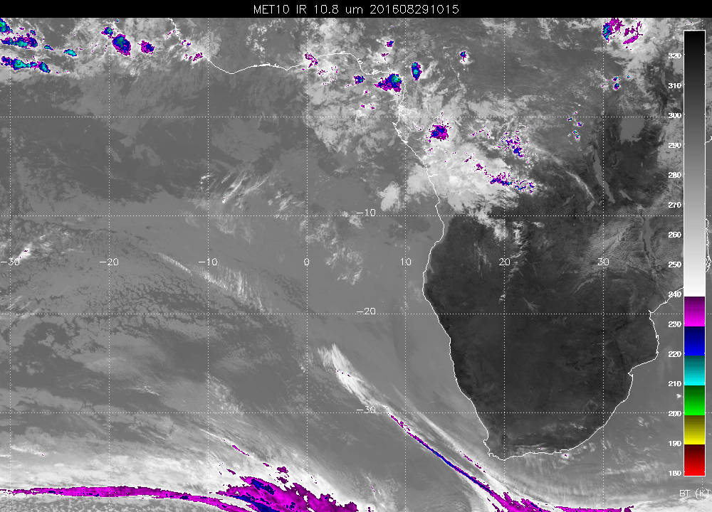
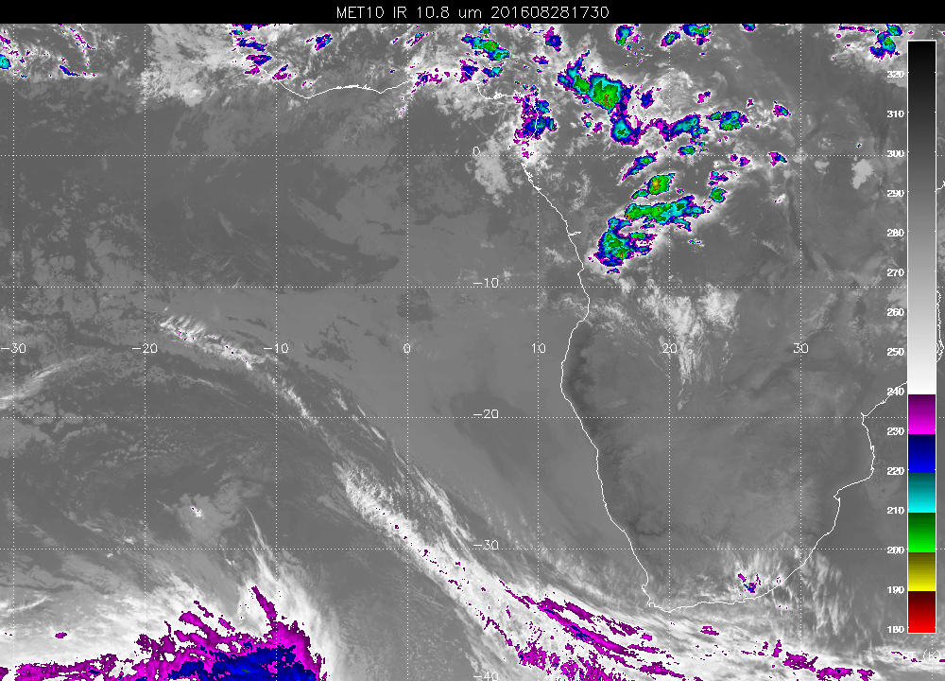
Strong convection over Congo (not typical this time of year) yesterday (right) and brewing
today (as forecast in model – not shown)

Slide 11
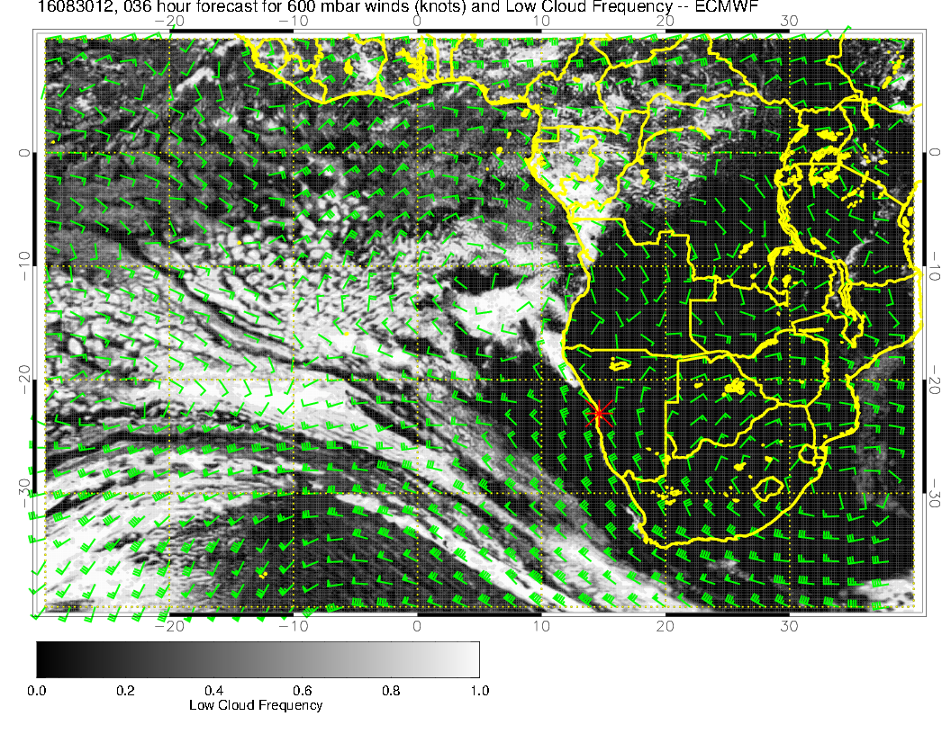
600mb flow at about 5S, but
strongest over the ocean, not
the continent.

Slide 12
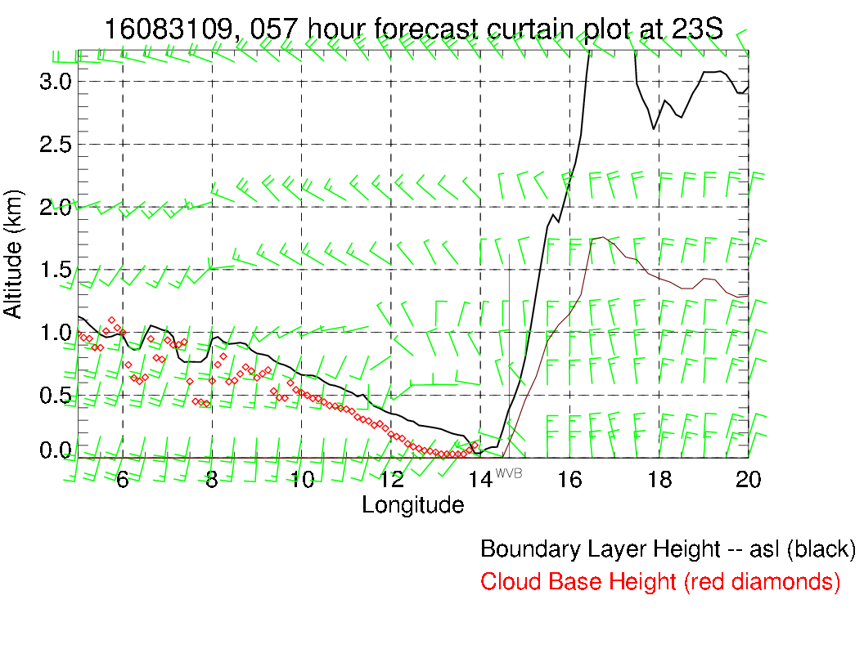
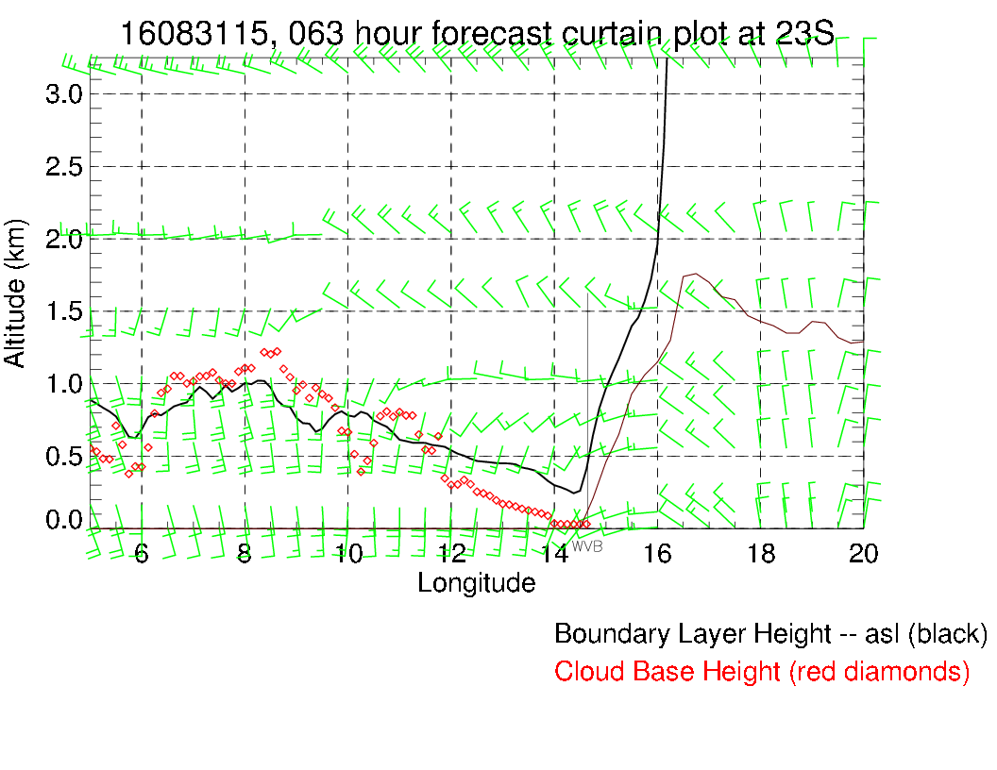
Takeoff: NW winds at 5 knots, possible high cirrus (wispy)
Landing: WSW at 10 knots, possible high cirrus (wispy)

Slide 13
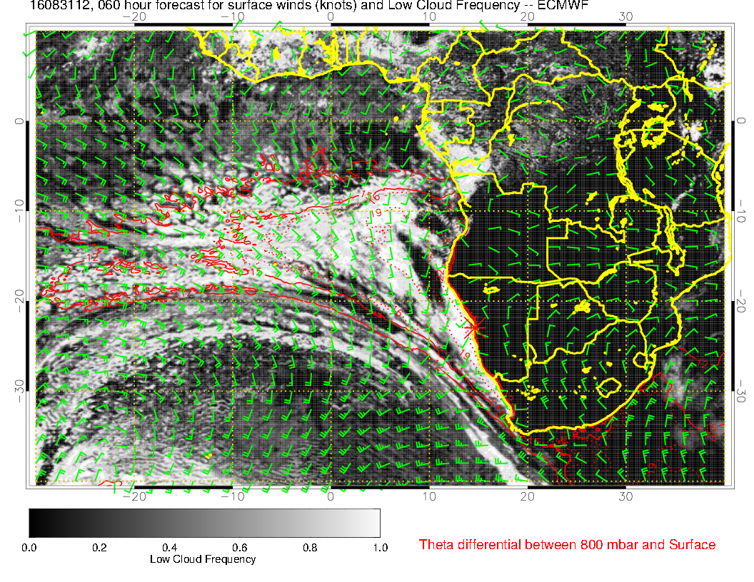
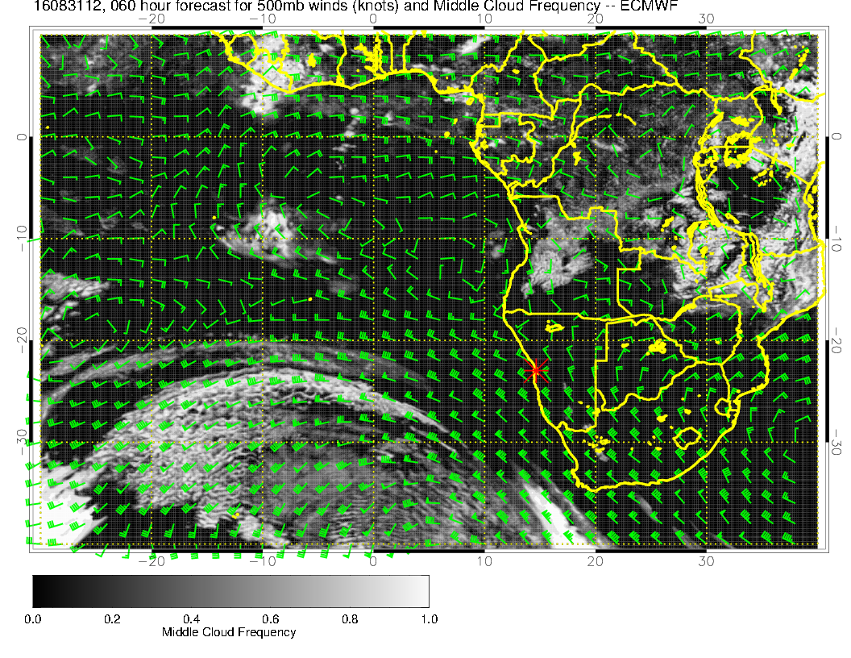
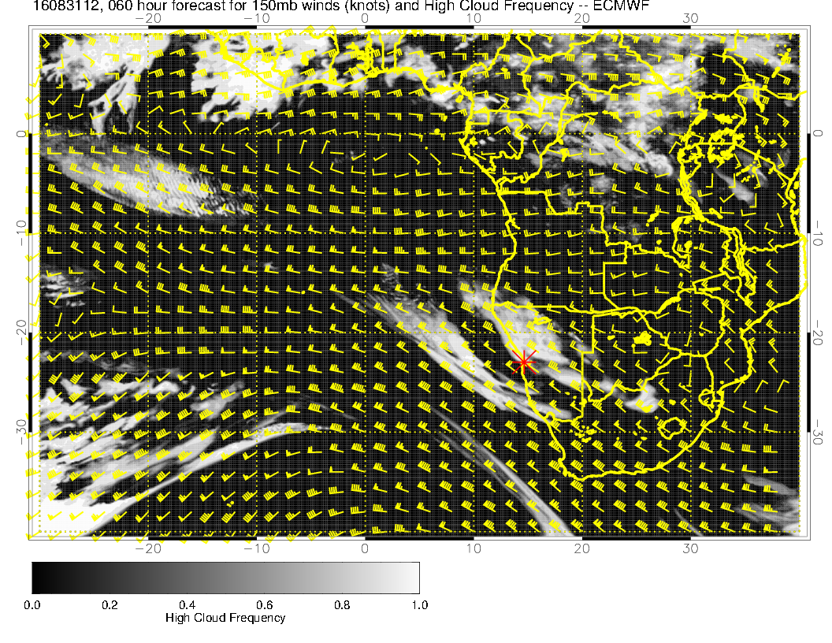

Slide 14
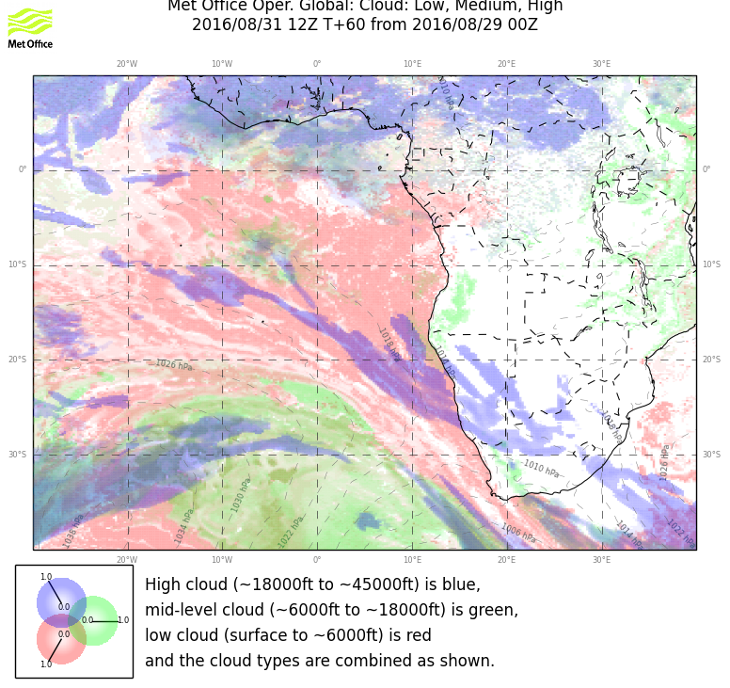

Slide 15
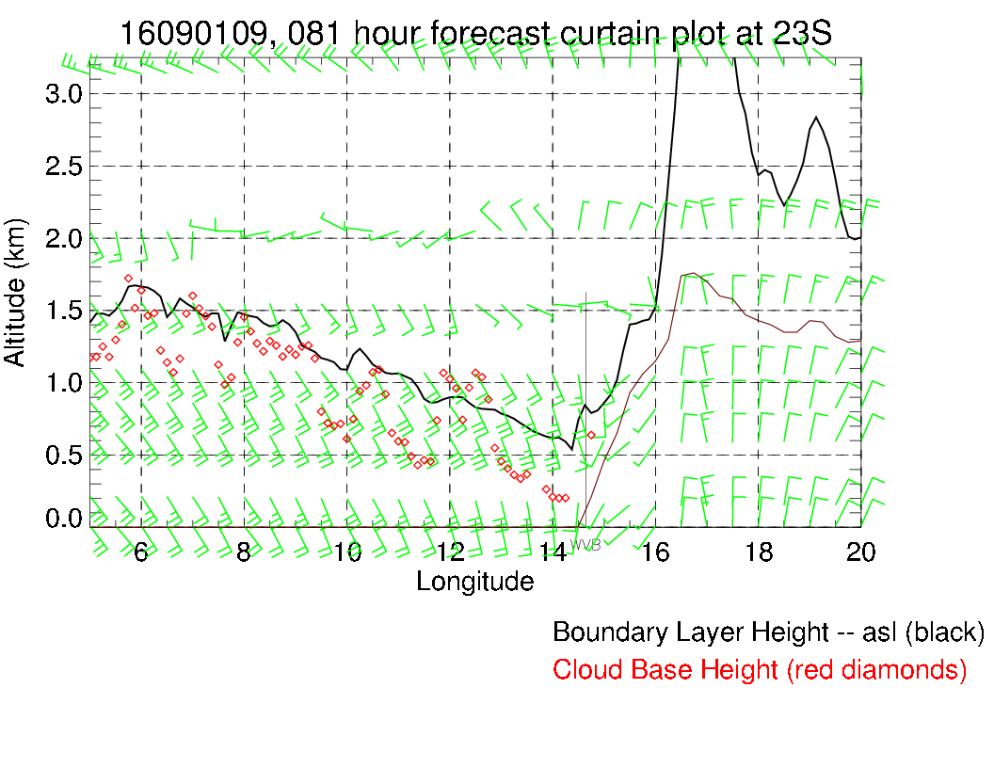
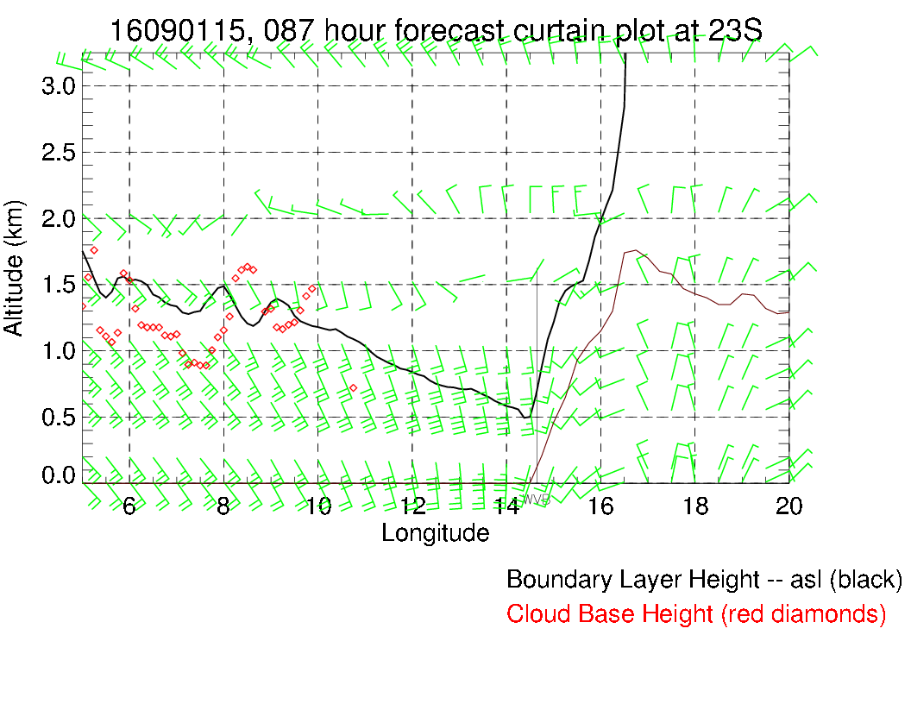
Takeoff: SW 5 knots; 600 foot ceiling, high cirrus
Landing: SSW 10 knots; high cirrus

Slide 16
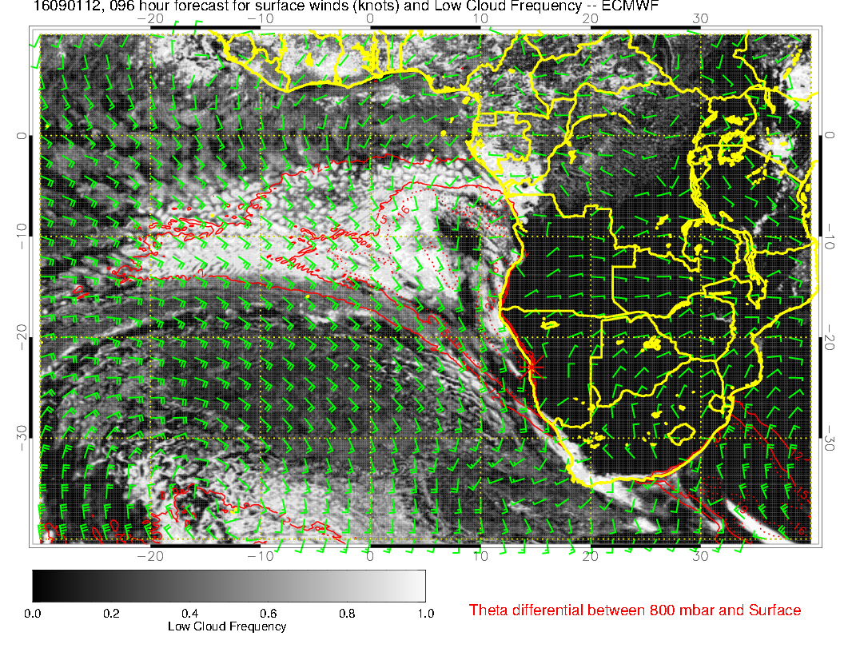
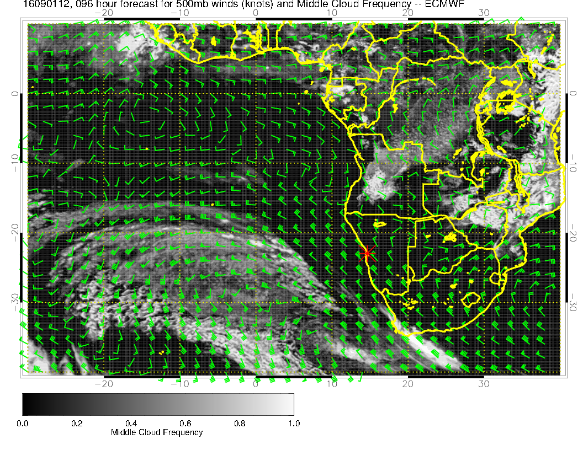
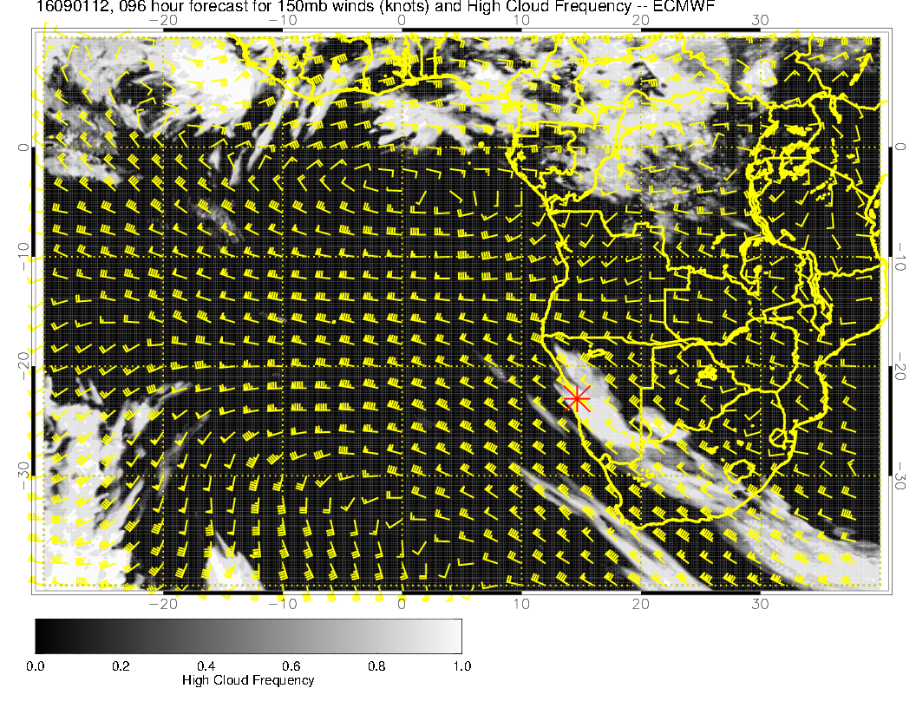

Slide 17
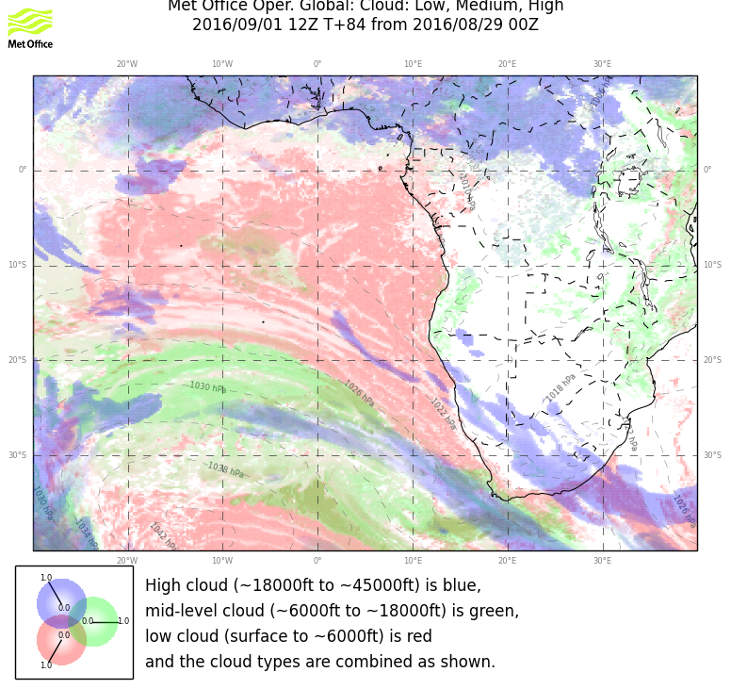

Slide 18
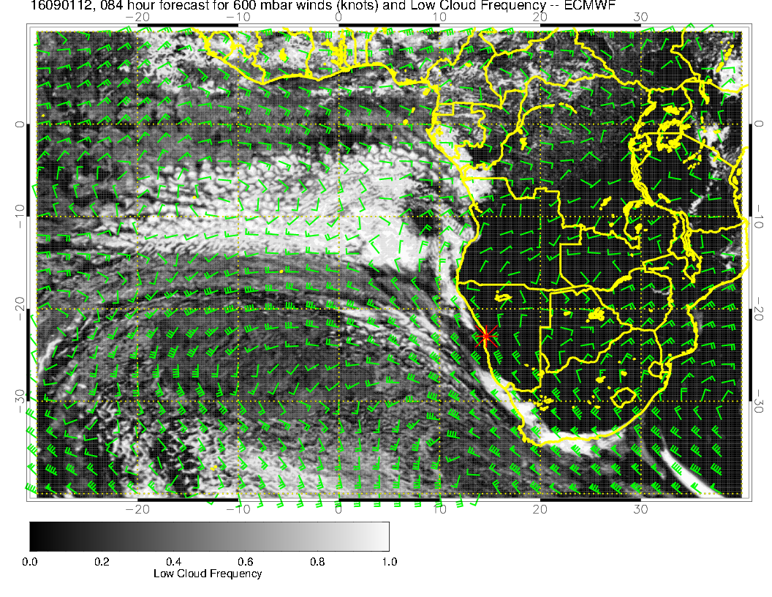
600mb flow starting
to reform over the continent.

Slide 19
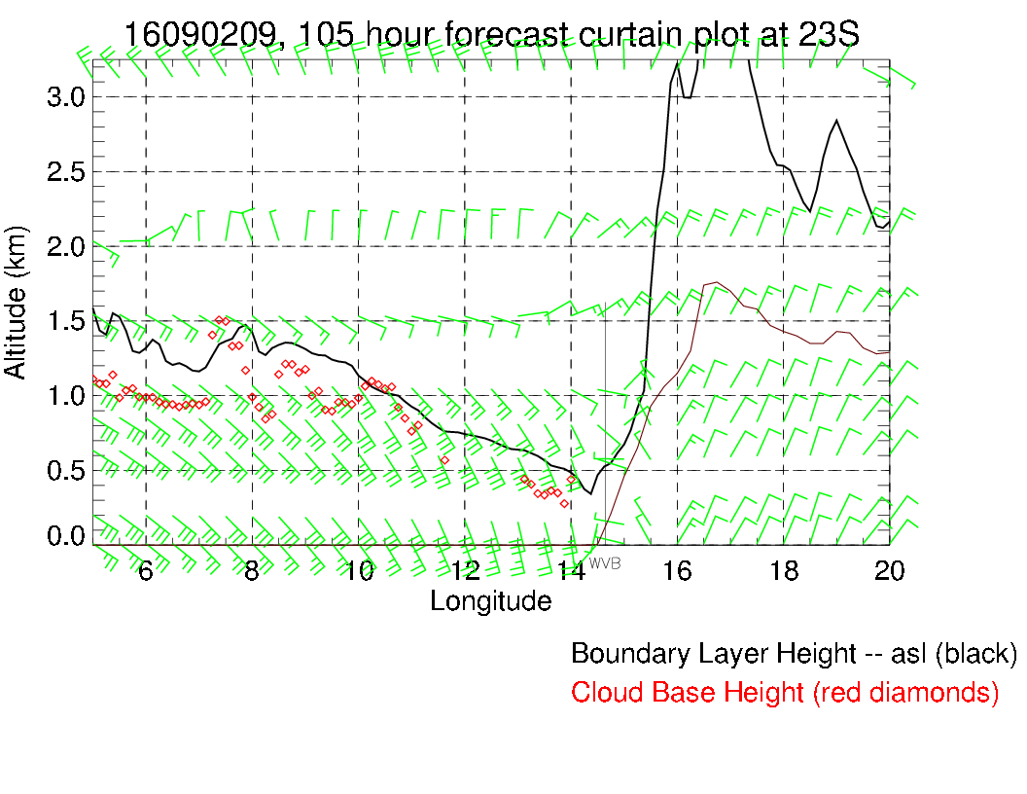
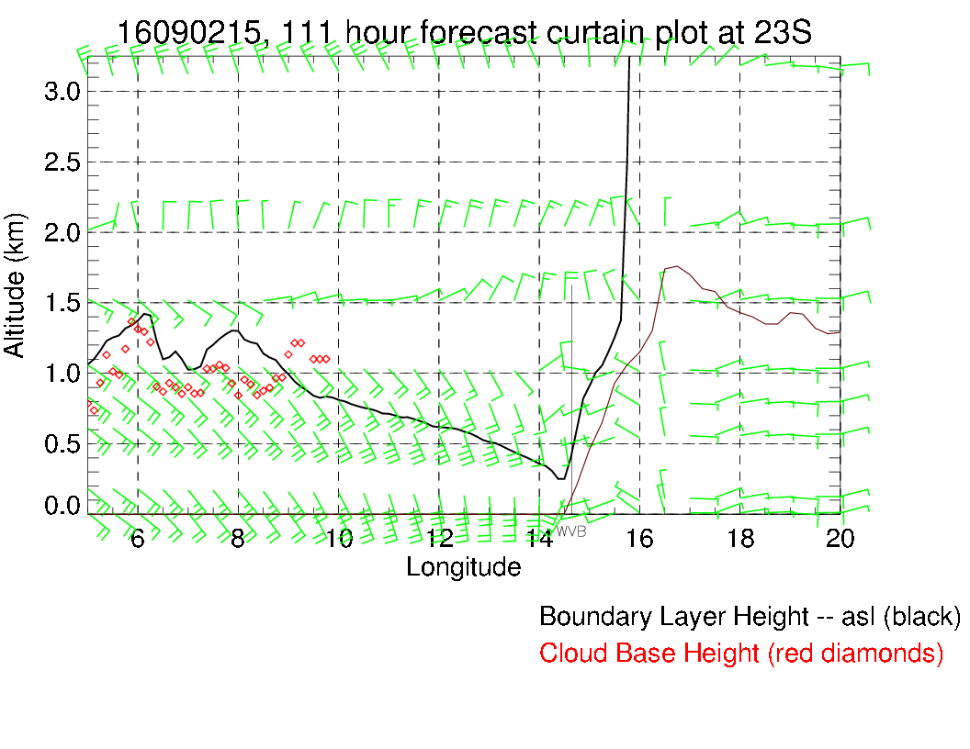
Takeoff: WNW at 5 knots, 600 foot ceiling
Landing: SW 10 knots, unlimited

Slide 20
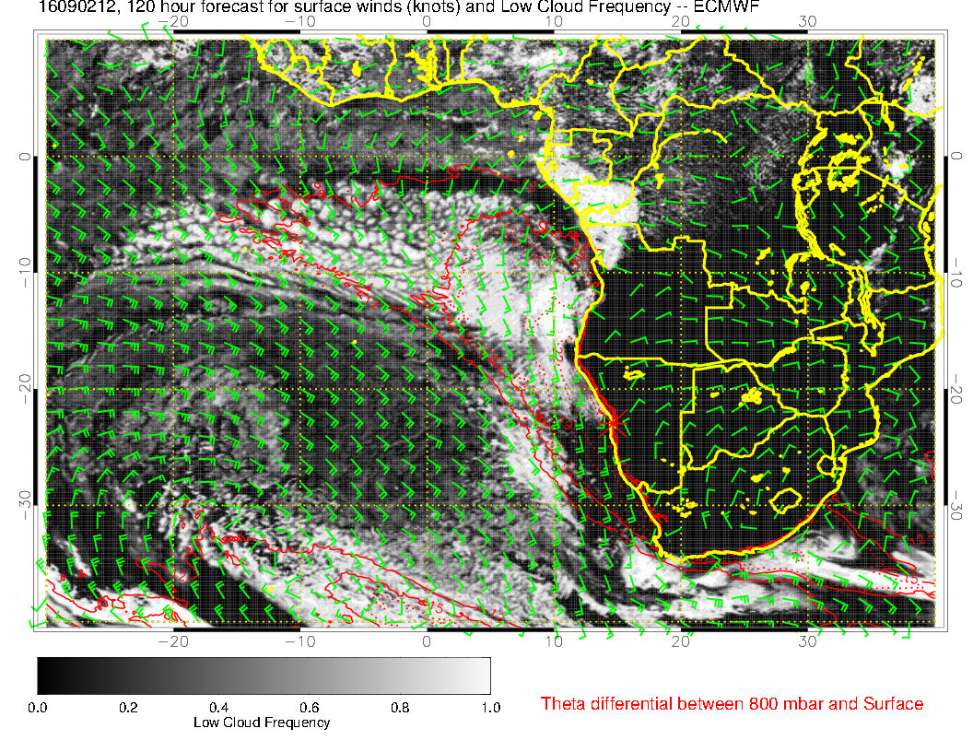
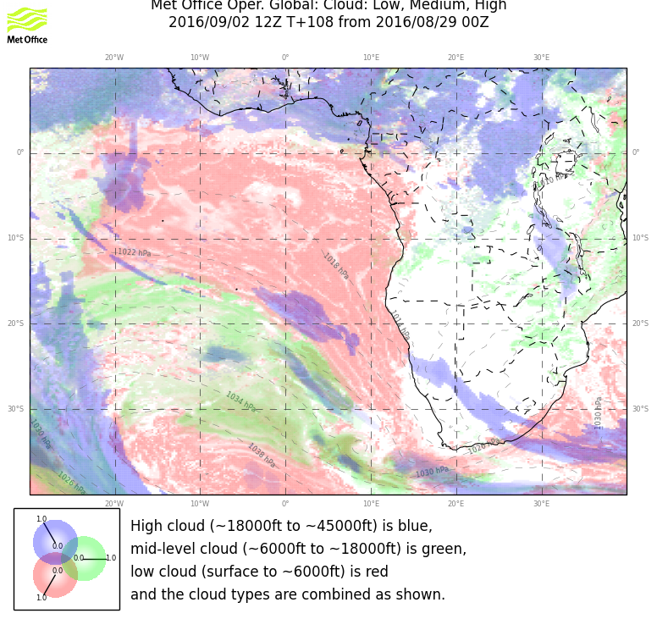

Slide 21
backup

Slide 22
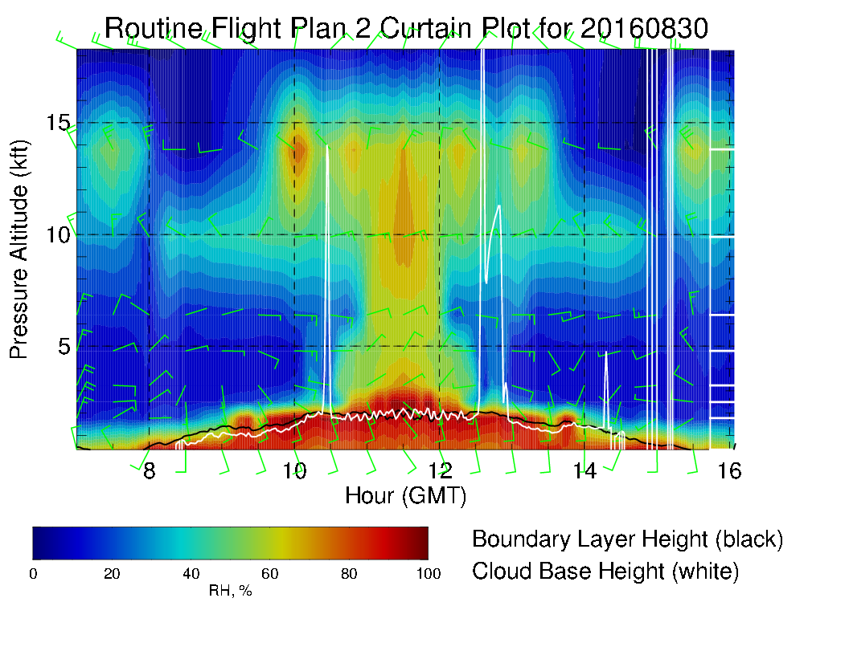

Slide 23
