Slide 1
ORACLES forecasting Briefing Aerosols
29-08-2016

Slide 2
Aug 28 2016 (model evaluation)

Slide 3
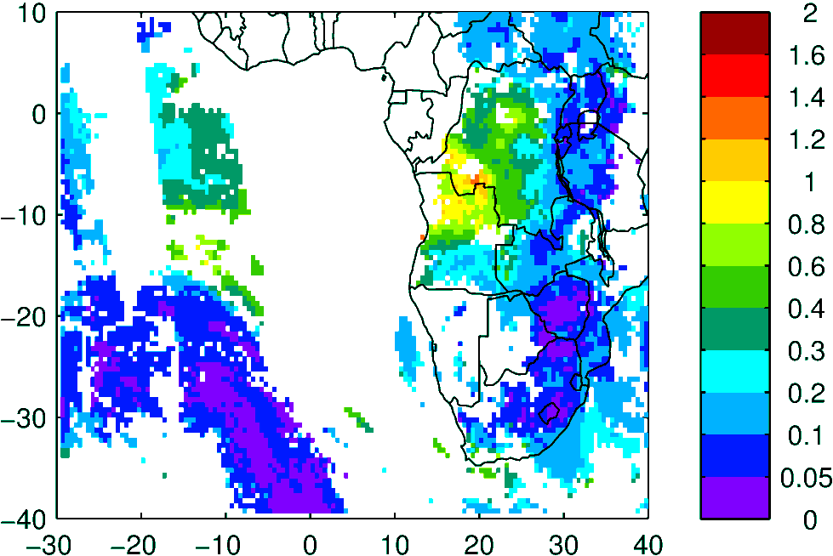
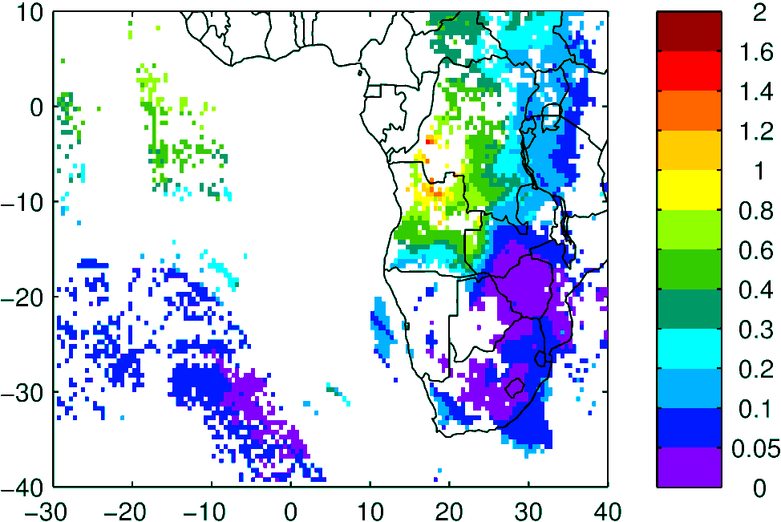
AOD (clear-sky)
MODIS NNR Terra & Aqua
WRF-AAM Terra & Aqua

Slide 4
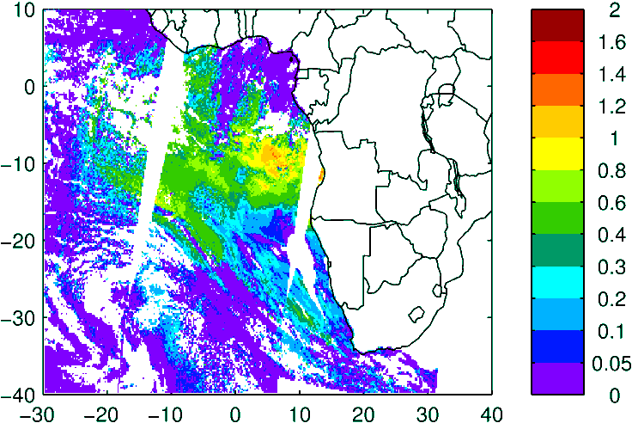
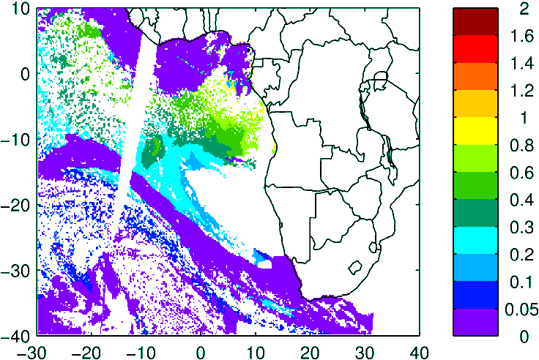
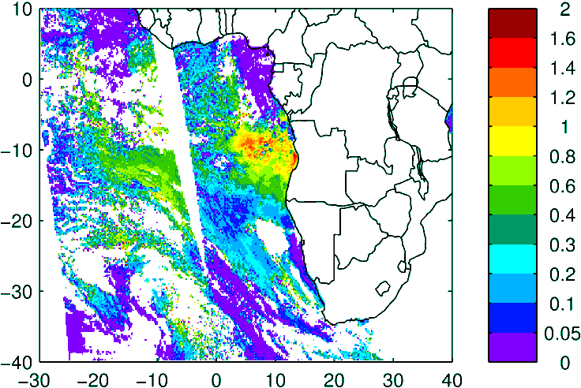
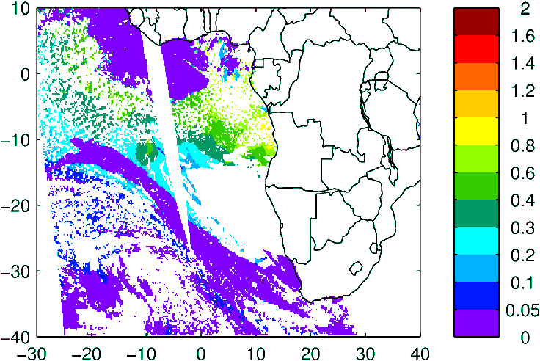
Above Cloud AOD (thanks Kerry!)
Model (WRF-AAM)
Observation
Terra
High lvl Cld
Aqua

Slide 5
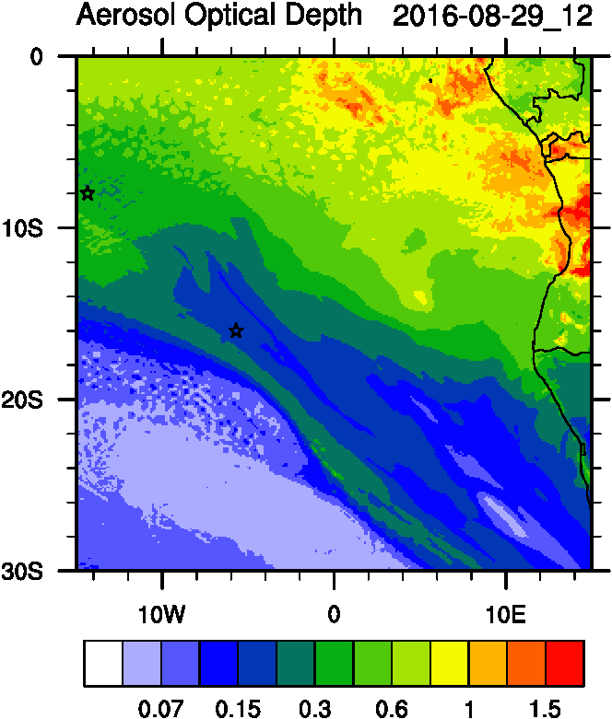
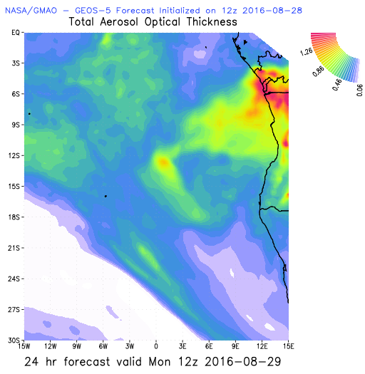
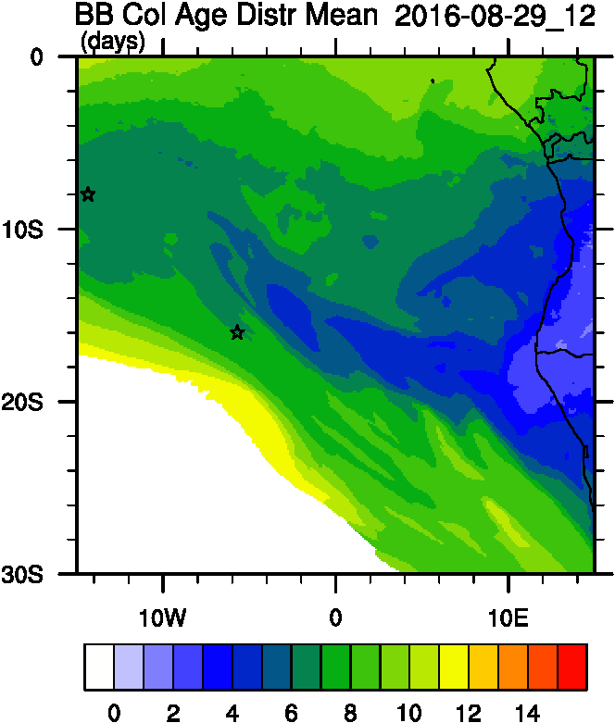
Aug 29 2016 (current conditions)

Slide 6
Aug 30 2016

Slide 7
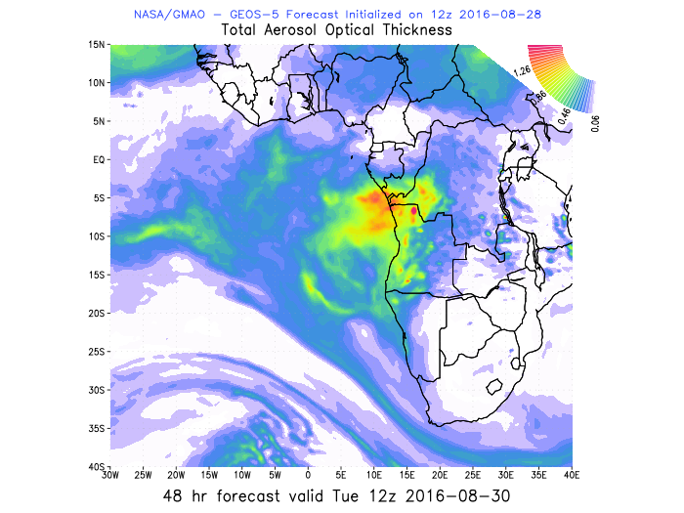
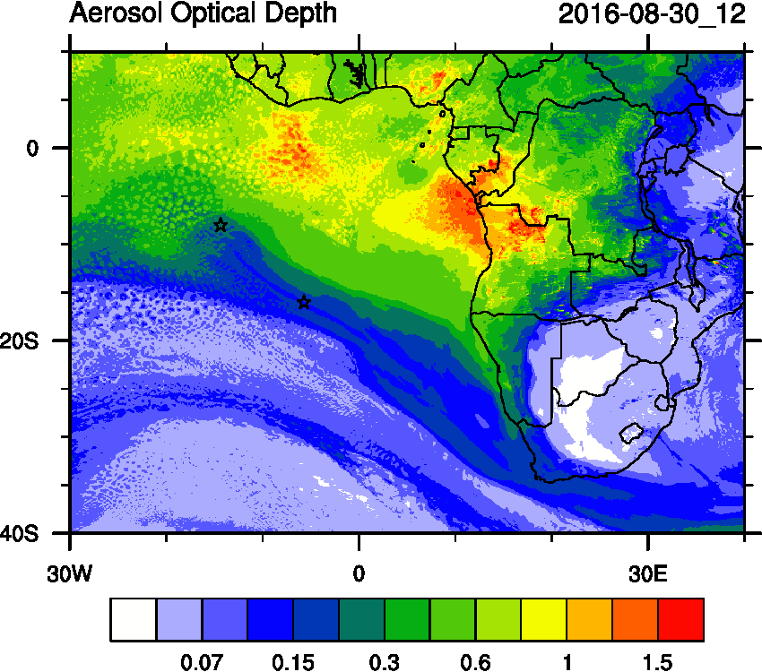
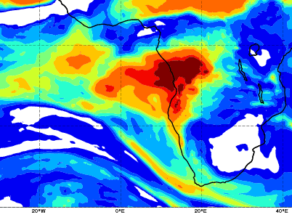
AOD 12 UTC
CAMS
WRF-AAM
GEOS5

Slide 8
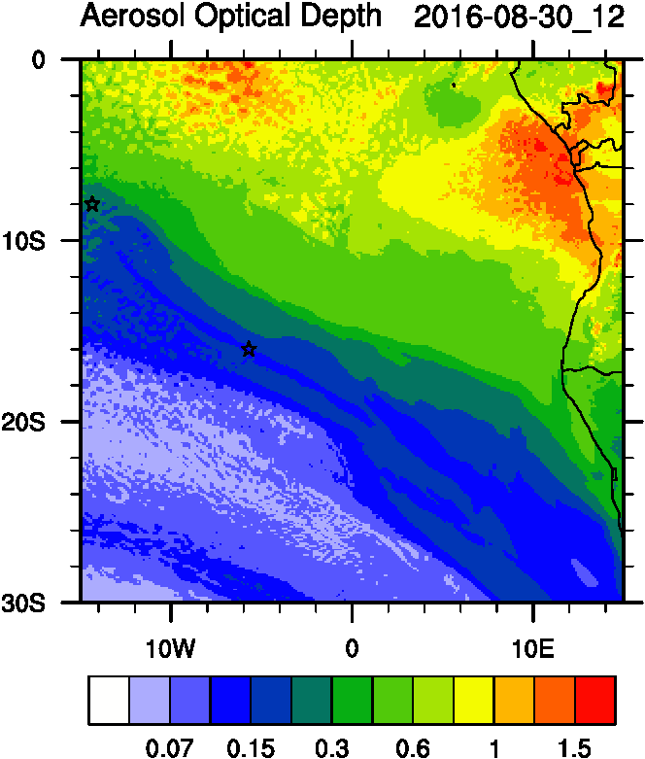
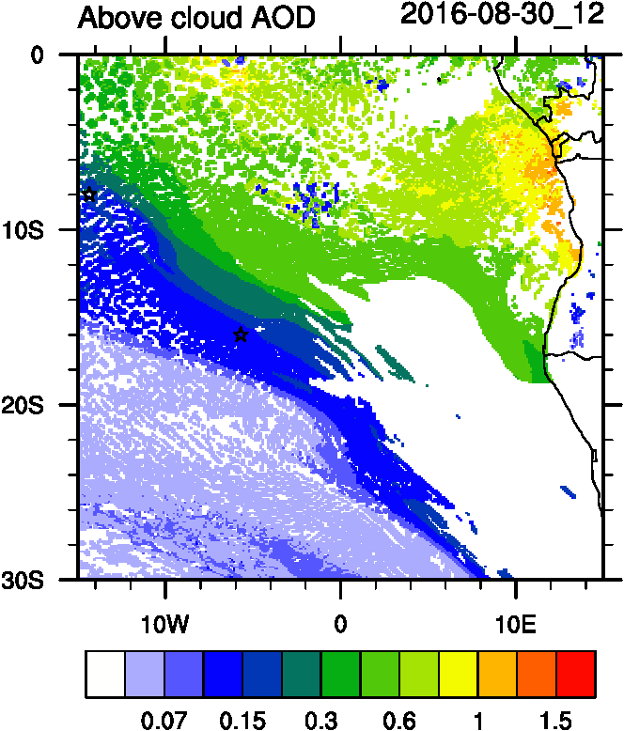
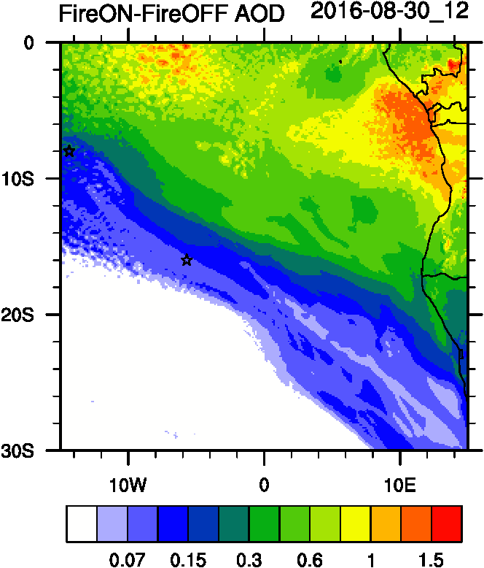
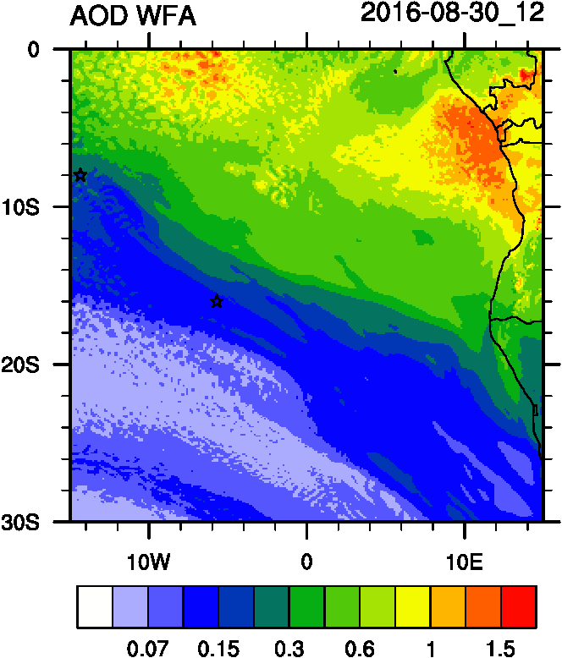
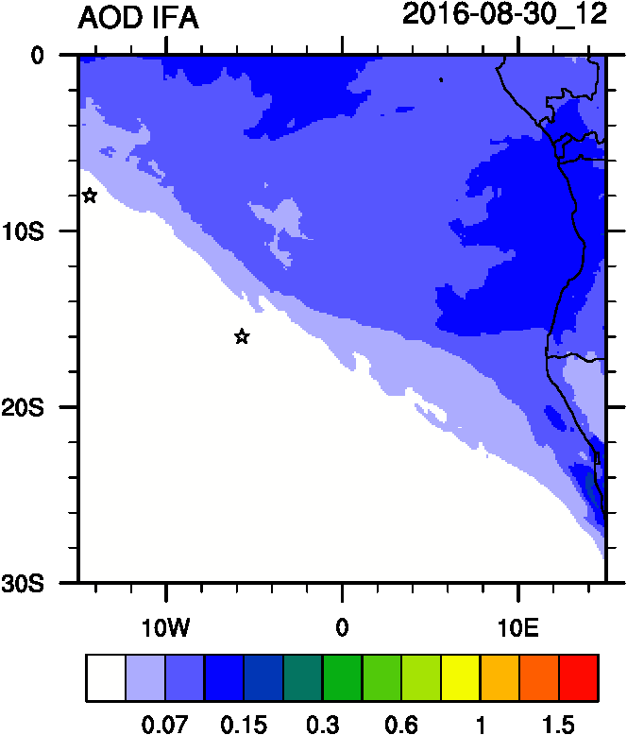
AOD
ACAOD
Smoke AOD
12UTC flavors of AOD
WFA=Water Friendly Aerosol
IFA=Ice Friendly aerosol
WFA AOD
IFA AOD

Slide 9
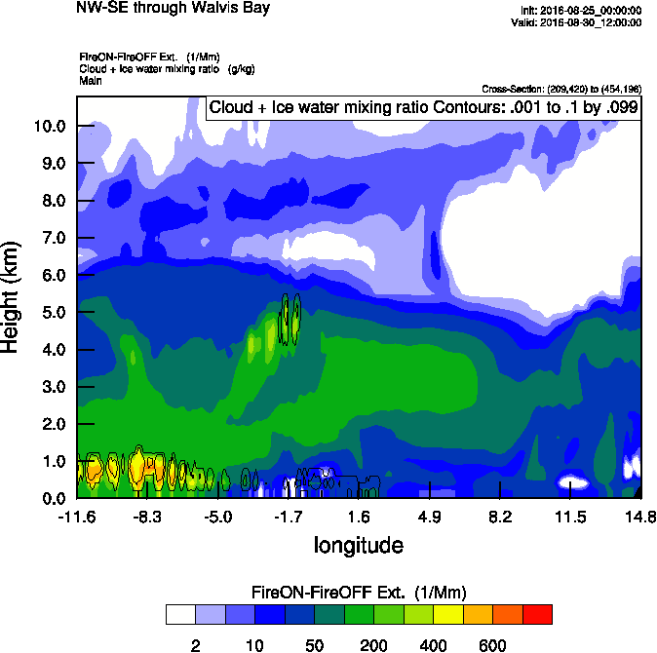
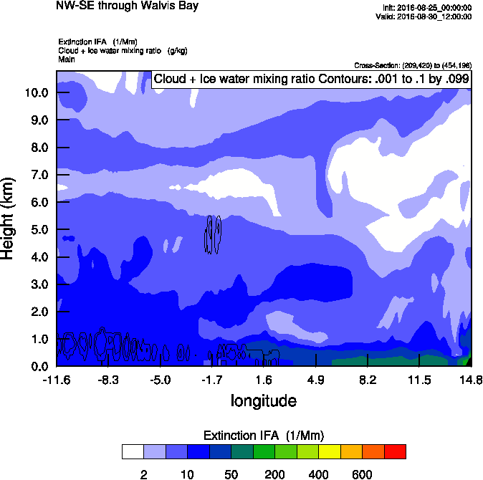
Vertical cross-section routine flight
Smoke Ext
Dust Ext
Smoke AOD

Slide 10
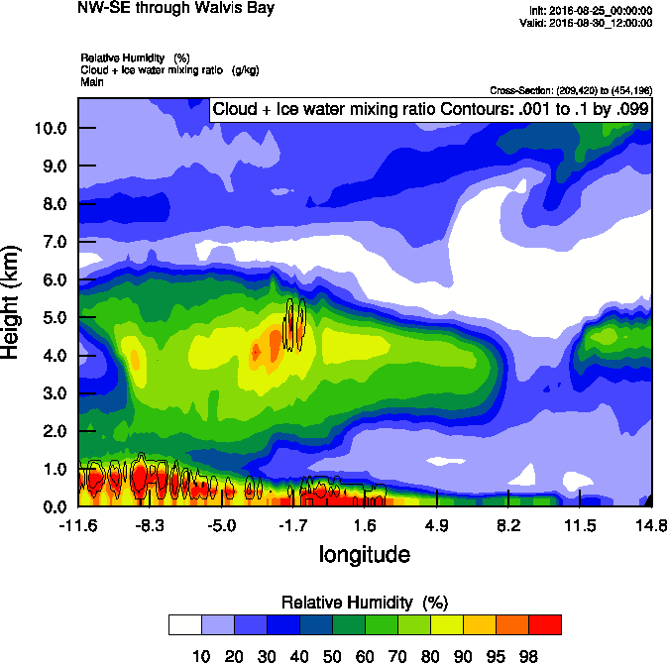
Vertical cross-section routine flight
Smoke Ext
RH
Smoke AOD

Slide 11
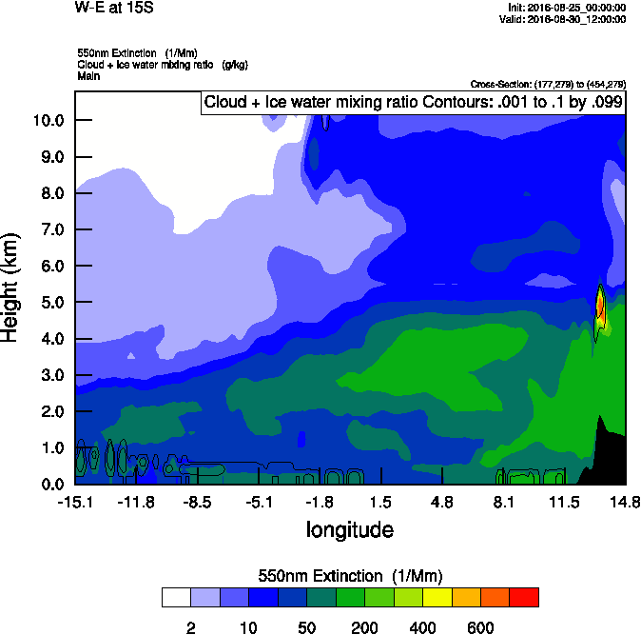
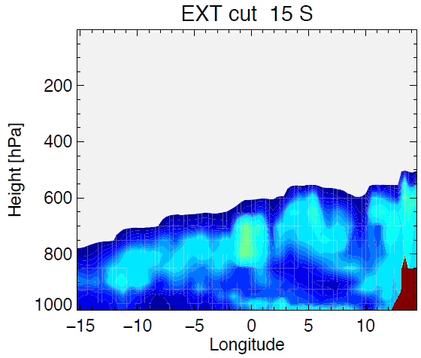
Vertical cross-section 15 S
Smoke AOD
GEOS-5
WRF-AAM

Slide 12
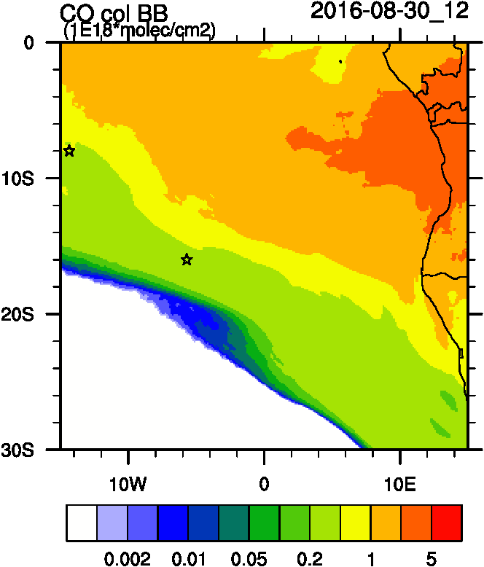
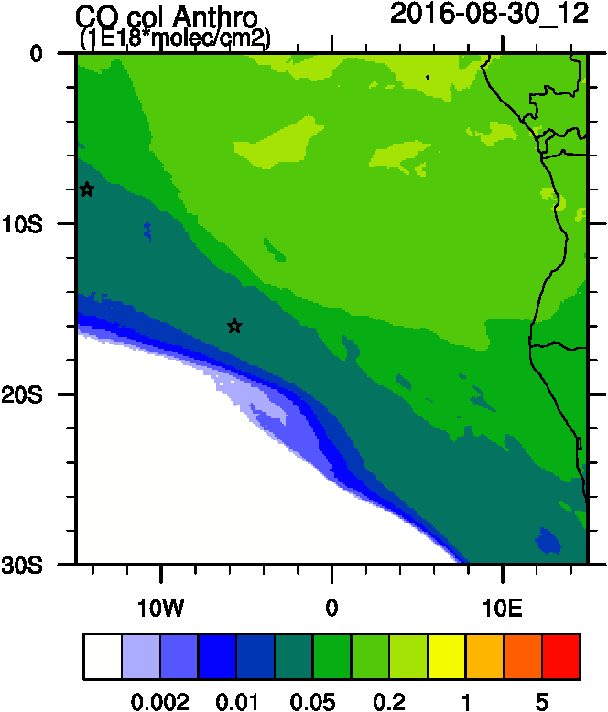
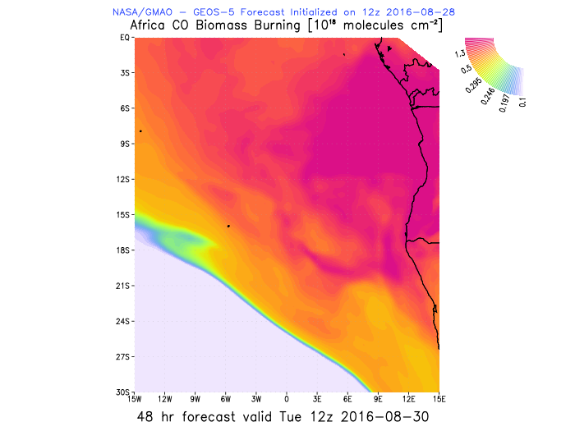
Anthro and Biomass burning tracers
WRF-AAM
BB
AOD
Anthro
GEOS5
BB

Slide 13
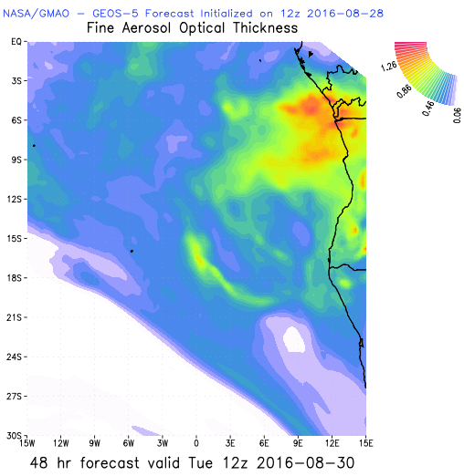
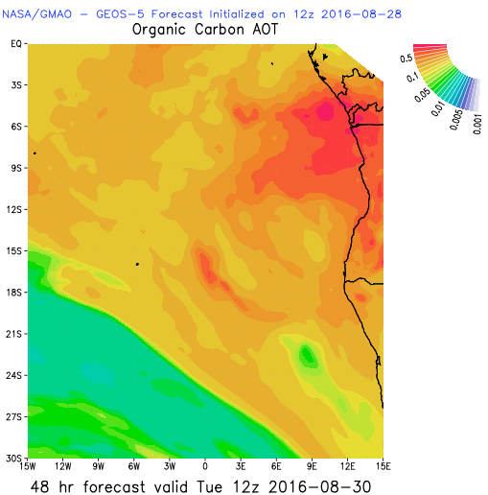
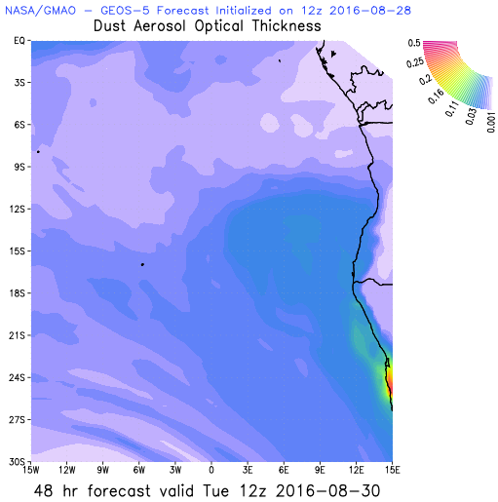
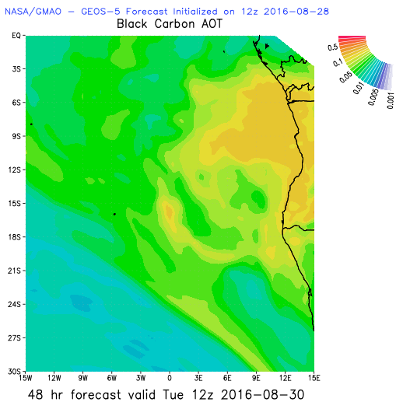
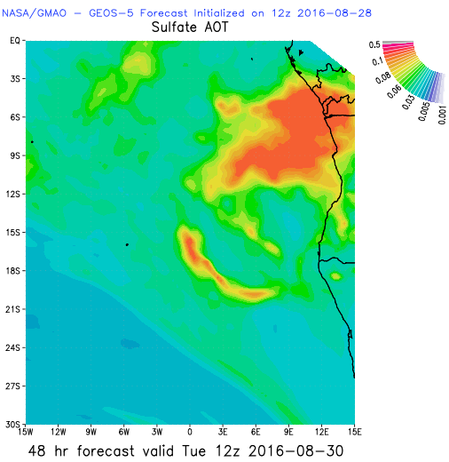
Aerosol Speciation

Slide 14
Smoke daily tracers

Slide 15
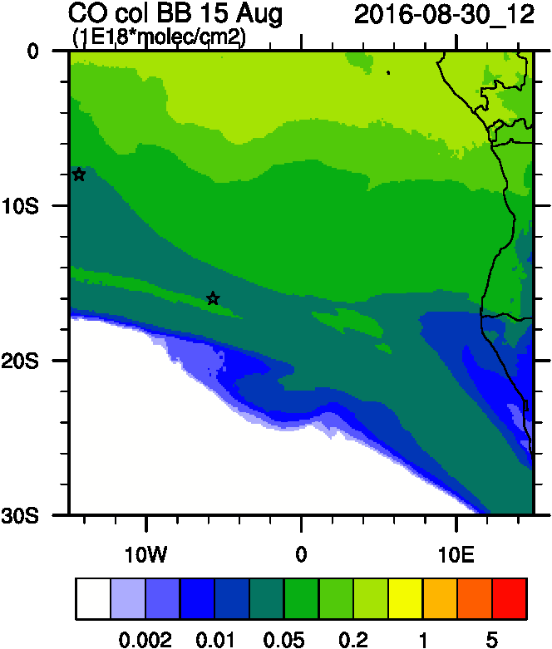
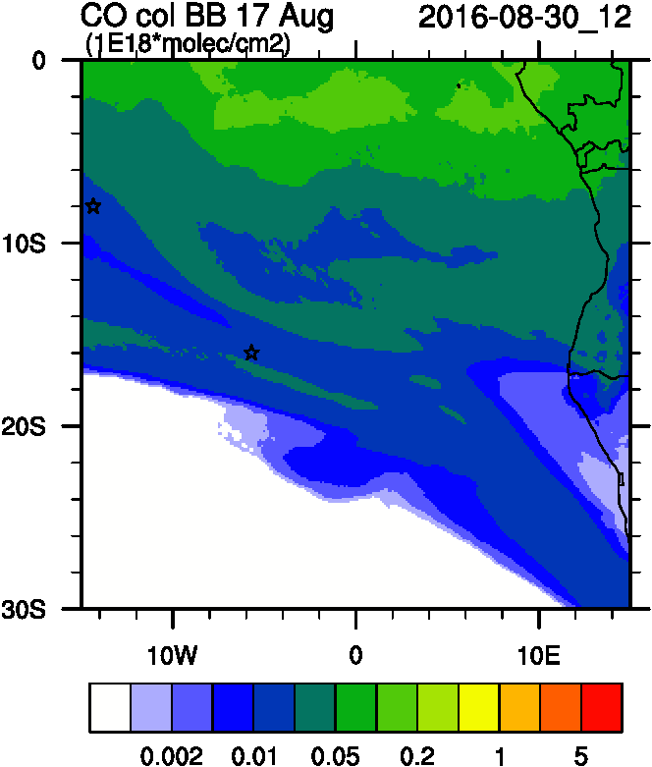
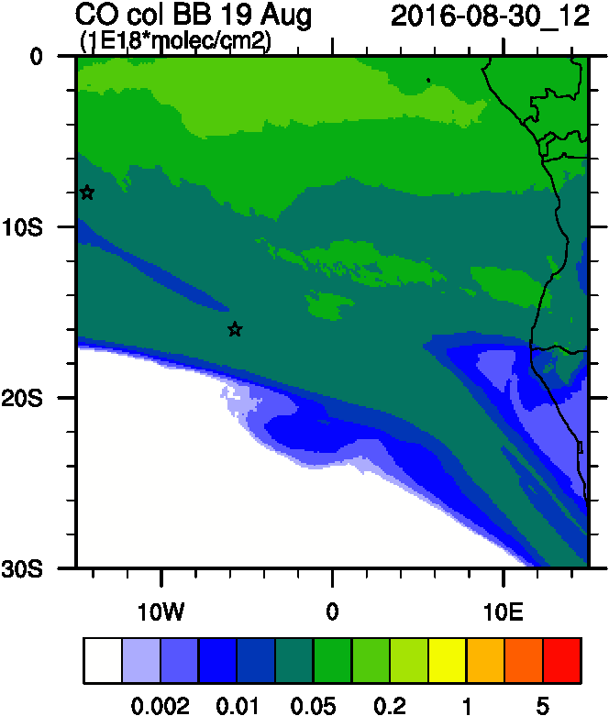
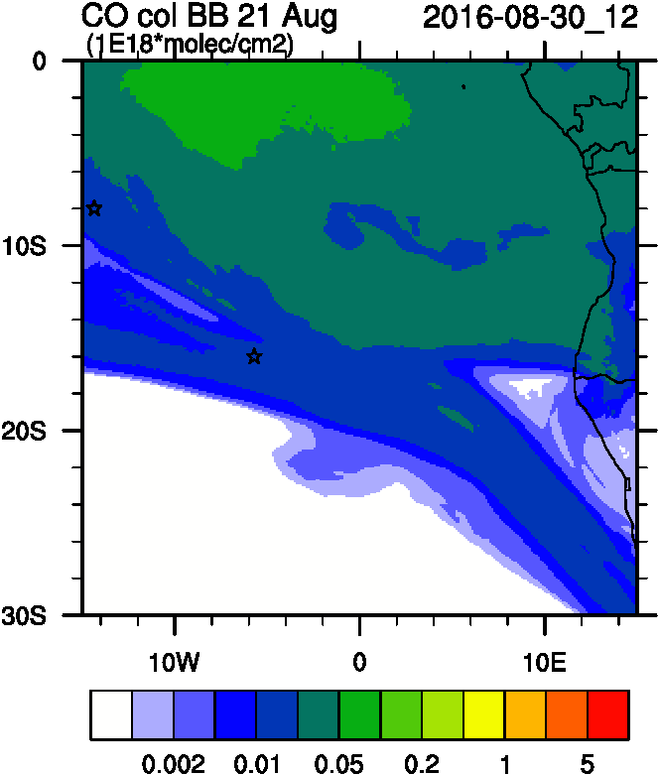
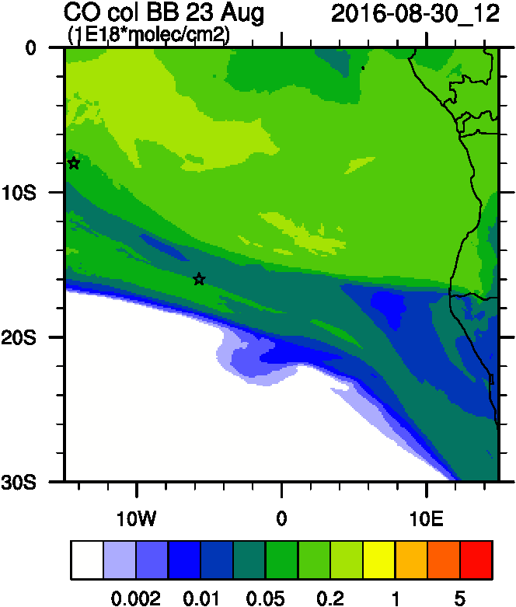
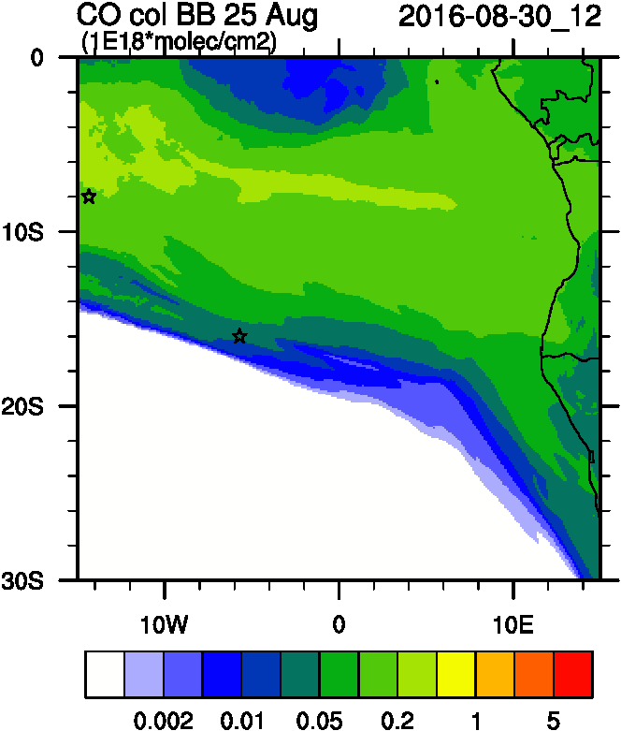
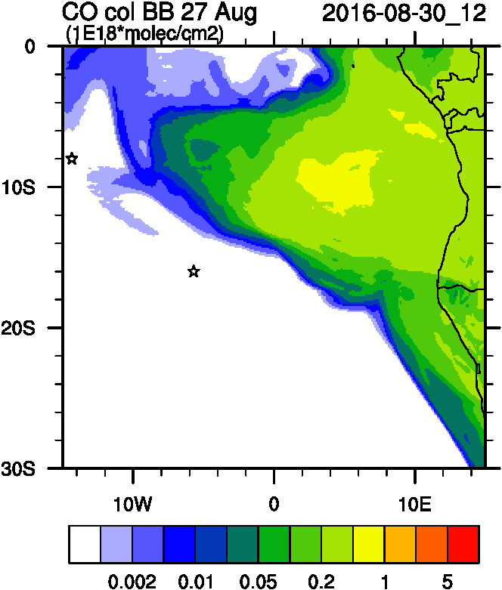
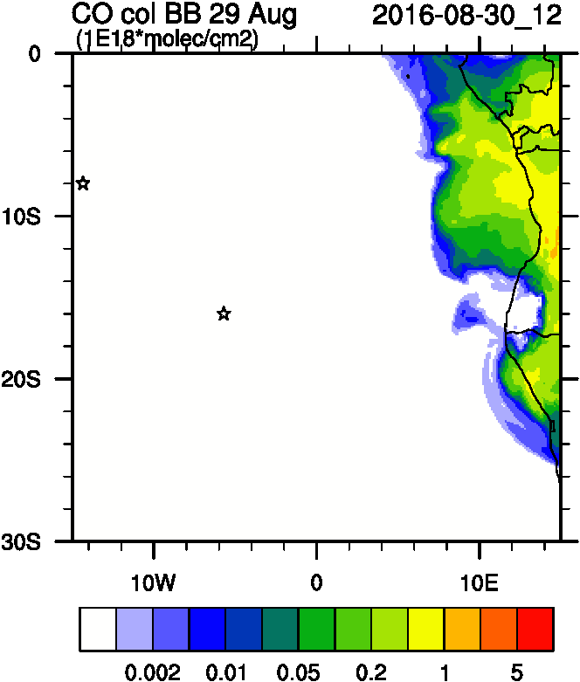
>-10d
-9d
-7d
-5d
-3d
-1d
+1d
+3d

Slide 16
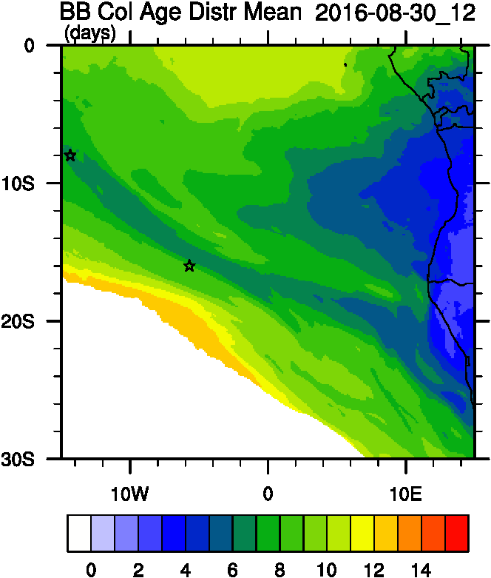
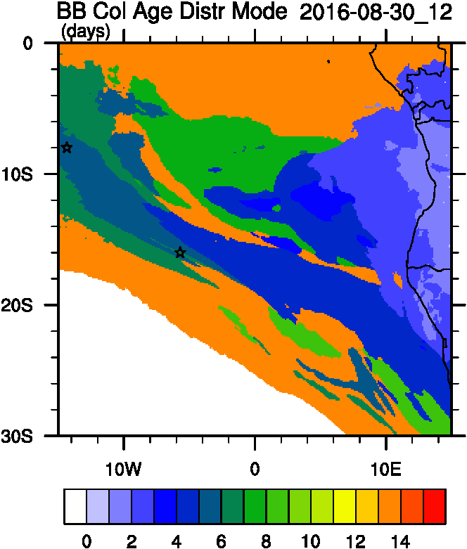
Smoke Age distribution
Smoke AOD
Mean Age
Mode Age

Slide 17
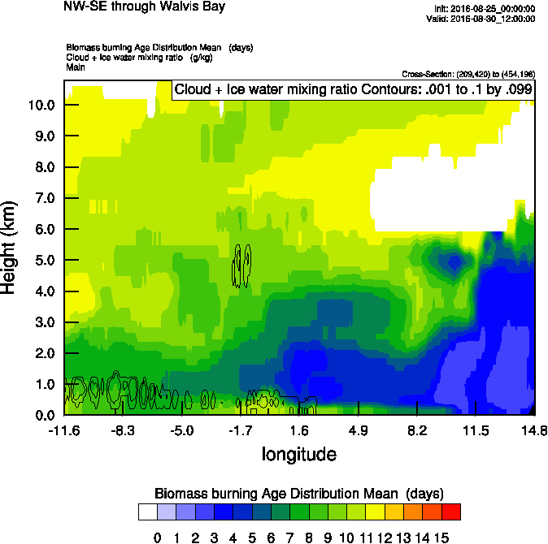
Vertical cross-section routine flight
Smoke Ext
Age mean
Smoke AOD

Slide 18
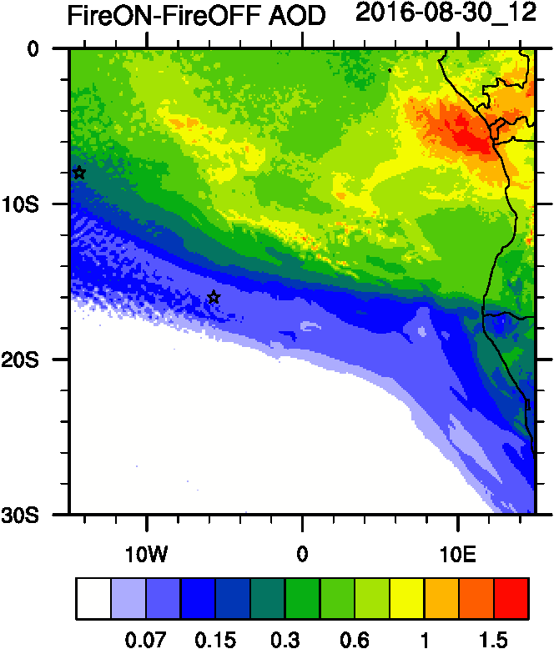
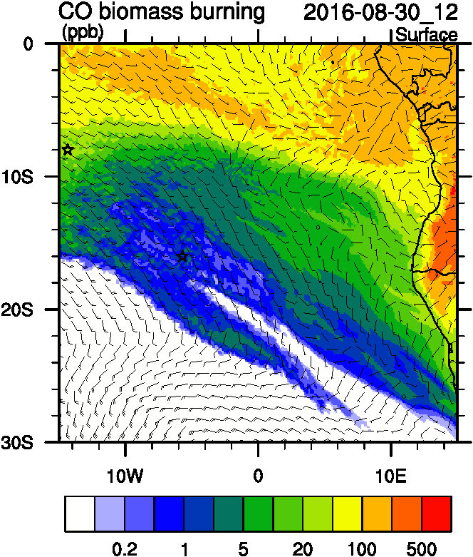
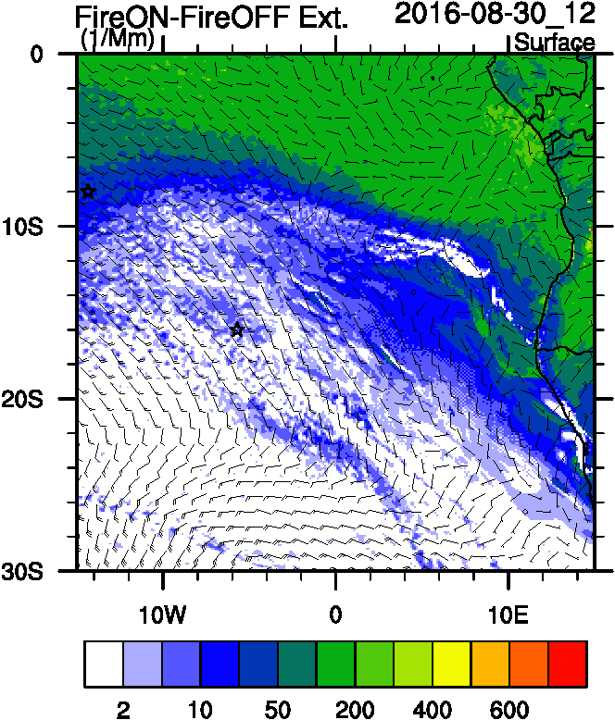
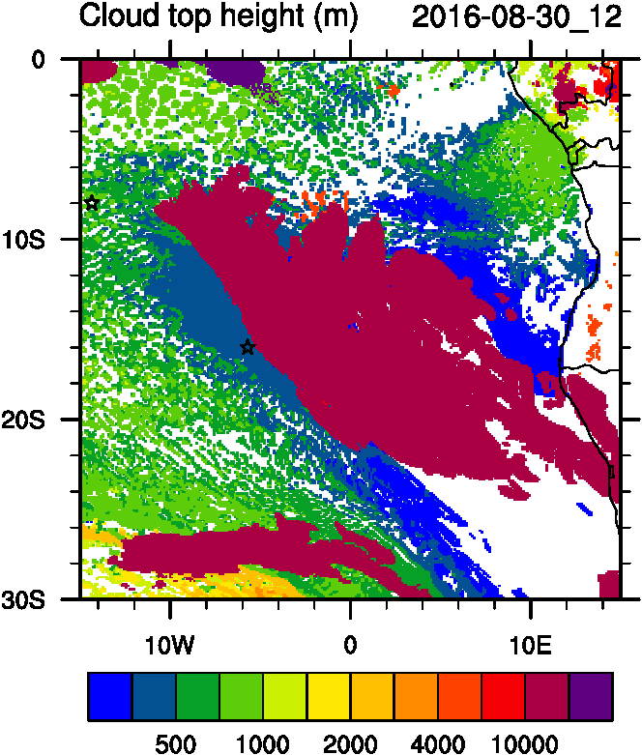
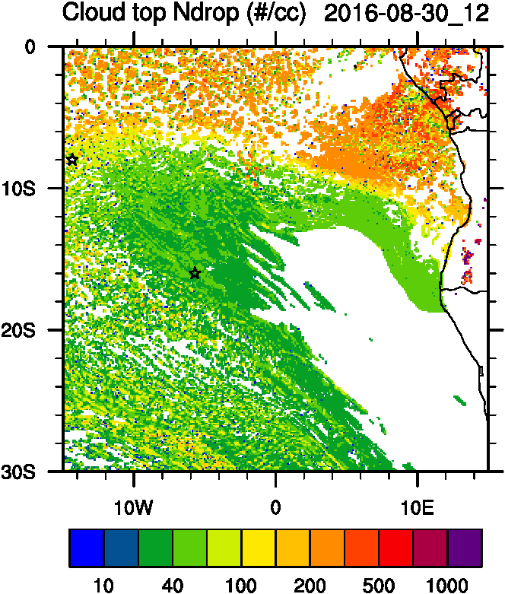
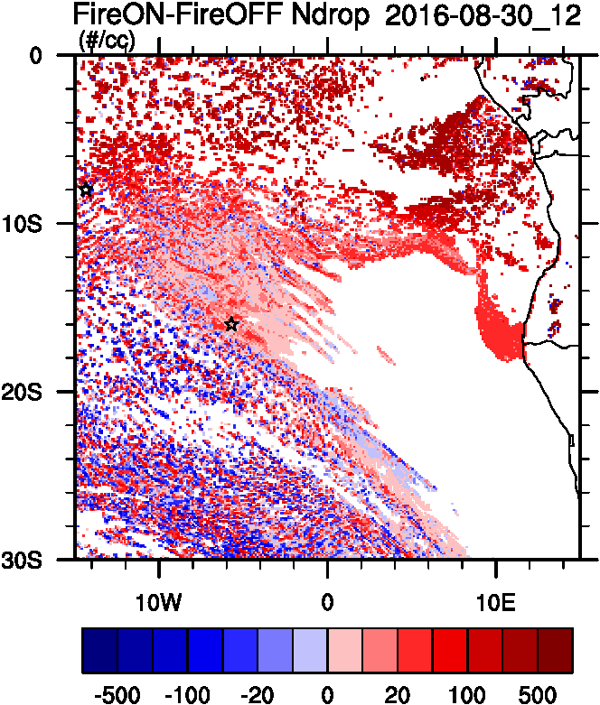
Aerosol-cloud interactions
Smoke Ext
Ndrop: Number droplet concentration
Diff: Differences between simulations turning on and off fires
Smoke AOD
tracer
Ndrop Diff
Cld Top
Ndrop

Slide 19
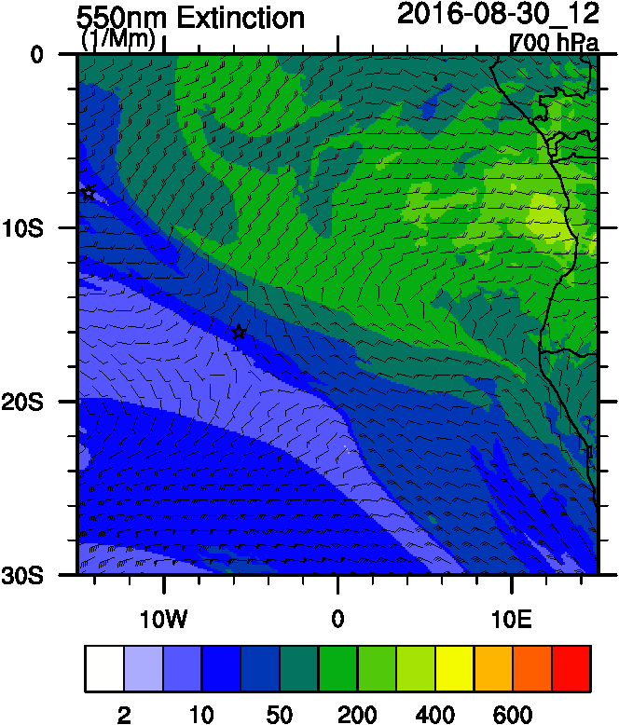
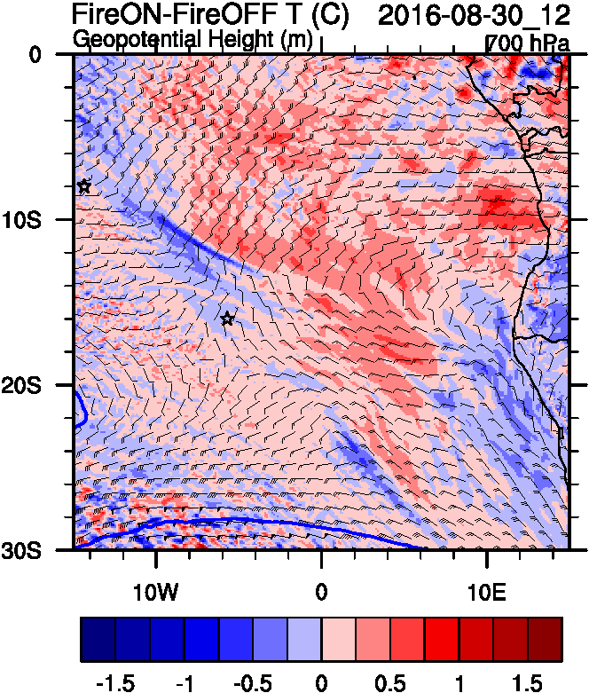
Aerosol-radiation interactions
Smoke AOD
Smoke Ext
T diff

Slide 20
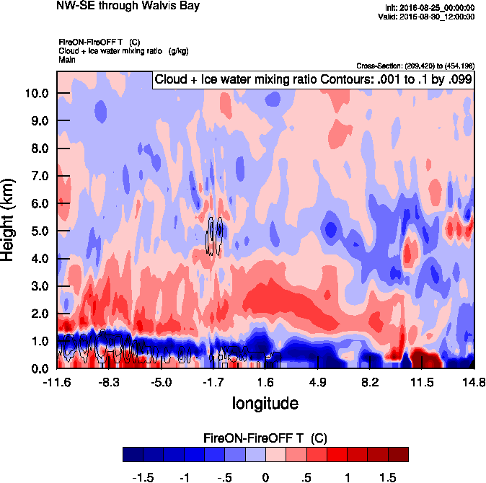
Vertical cross-section routine flight
Smoke Ext
T diff
Smoke AOD

Slide 21
Sep 01 2016

Slide 22
AOD 12 UTC
WRF
GEOS5
CAMS

Slide 23
AOD
ACAOD
Smoke AOD
12UTC flavors of AOD
WFA=Water Friendly Aerosol
IFA=Ice Friendly aerosol
WFA AOD
IFA AOD

Slide 24
AOD
BC-AOD
OC-AOD
12UTC flavors of AOD
SULF-AOD
DUST AOD

Slide 25
Vertical cross-section routine flight
Smoke Ext
Dust Ext
Smoke AOD

Slide 26
Vertical cross-section routine flight
Smoke Ext
RH
Smoke AOD

Slide 27
Biomass burning and Anthropogenic tracers
Smoke AOD
CO BB
CO Anthro

Slide 28
Biomass burning and Anthropogenic tracers
Total CO
Africa CO
South America CO

Slide 29
Smoke Age distribution

Slide 30
Vertical cross-section routine flight
Smoke AOD
Smoke age mean
Smoke age mean

Slide 31
Aerosol-cloud interactions
Smoke AOD
Smoke Ext
Ndrop: Number droplet concentration
Diff: Differences between simulations turning on and off fires
tracer
Cld Top
Ndrop
Ndrop Diff

Slide 32
Aerosol-radiation interactions
T diff
Smoke AOD
Smoke Ext
Smoke AOD

