Slide 1
Met Briefing, 20160827 Lenny Pfister, NASA ARC
Yesterday’s flight passed over both very thin quasi-laminar, low clouds and downstream higher BL, stratocumulus.
Offshore flow event of 8/24-8/25 has passed, clouds reformed offshore
Next several days are dominated by very thin boundary layer in the vicinty of Namibia to about 10-15S, so low clouds will be very thin or nonexistent
August 30 is forecast to have significant middle and even high cloud activity near 10-15 S
August 31, trough comes in, reducing the “stratocumulus region”

Slide 2
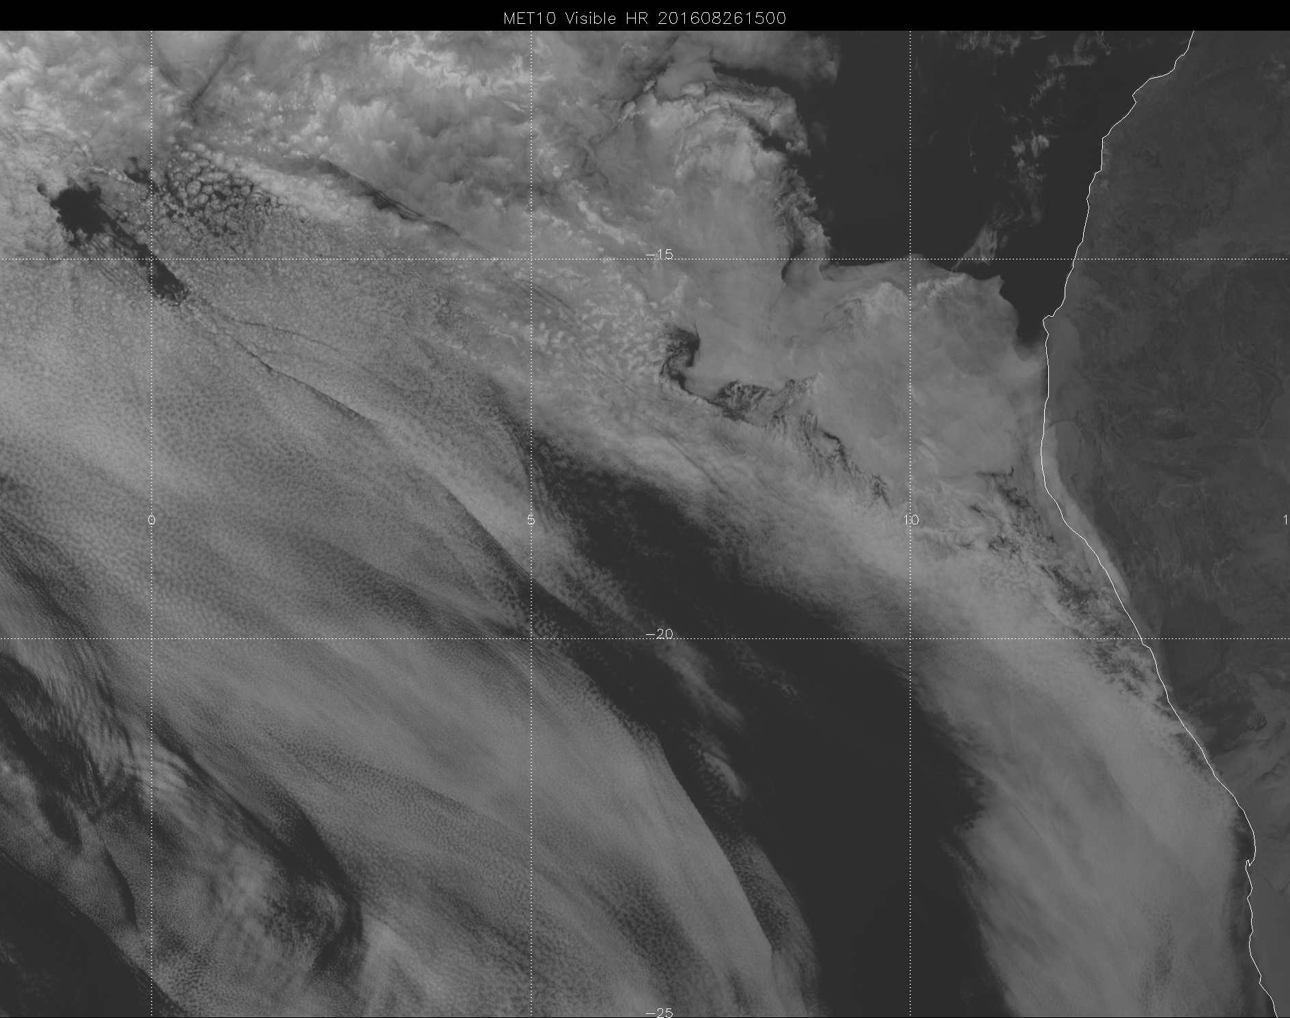

Slide 3
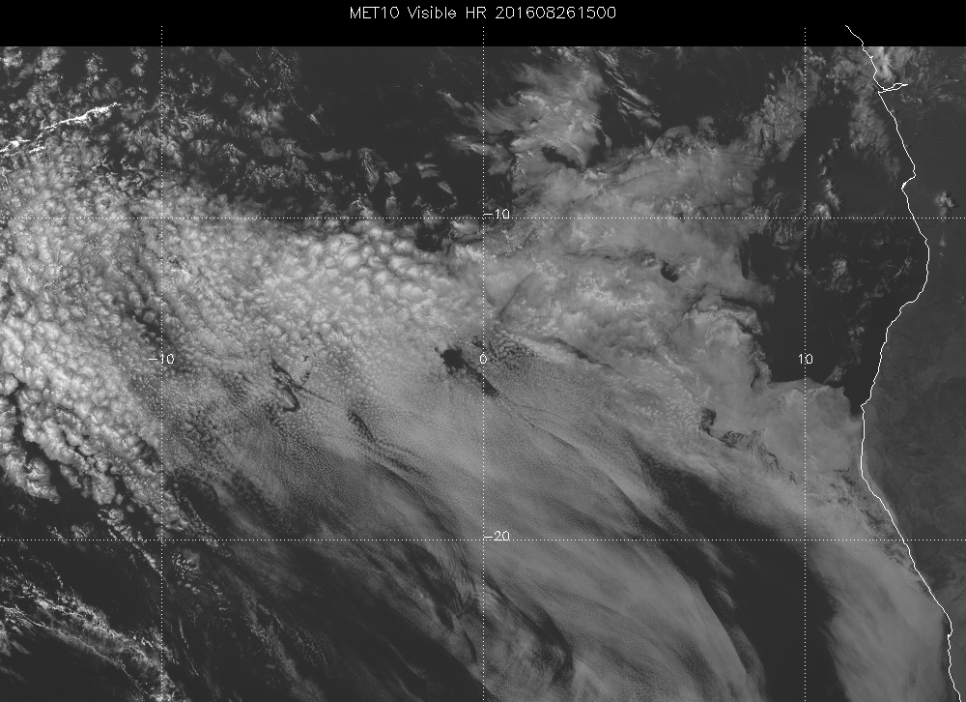

Slide 4
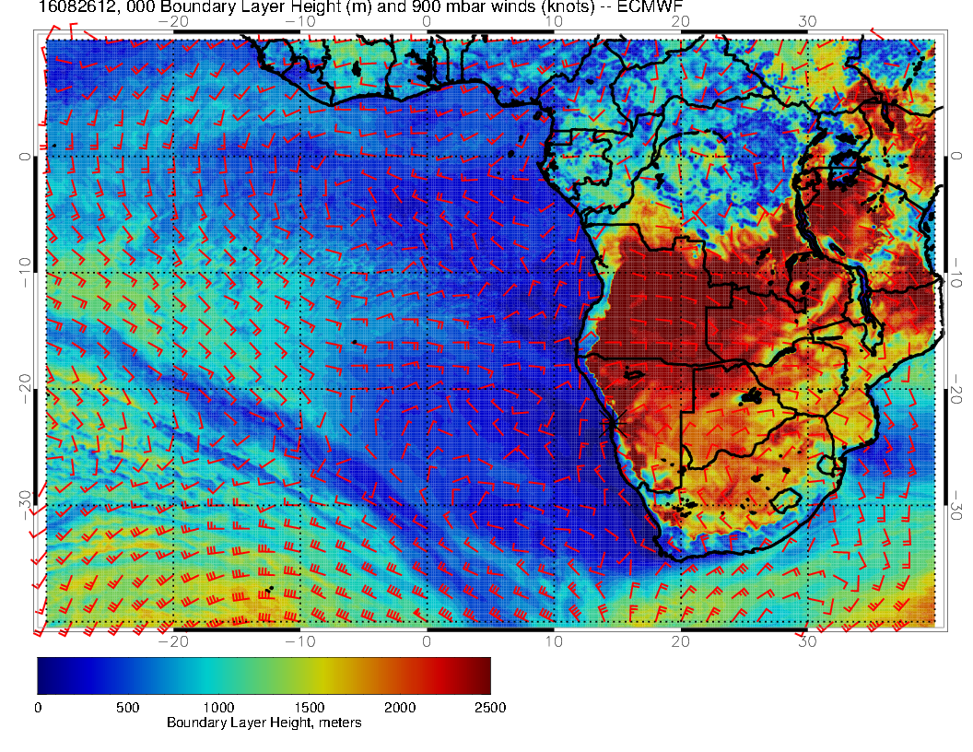

Slide 5
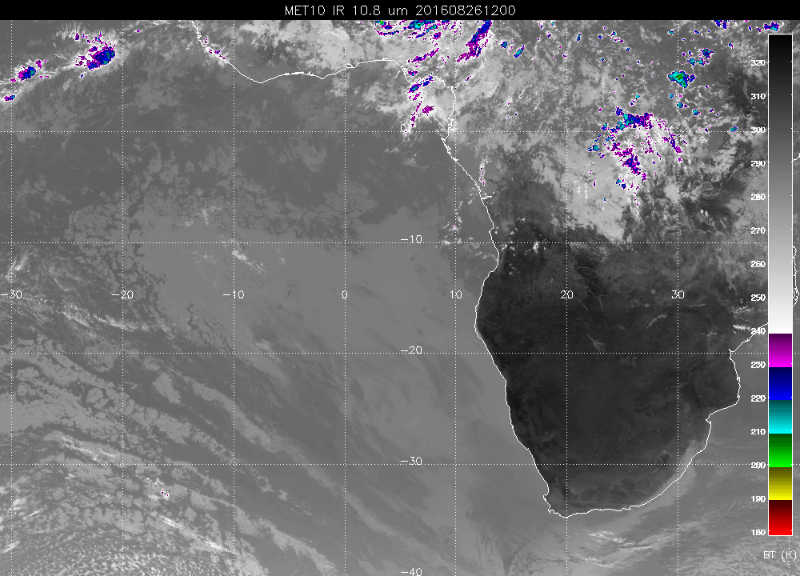

Slide 6
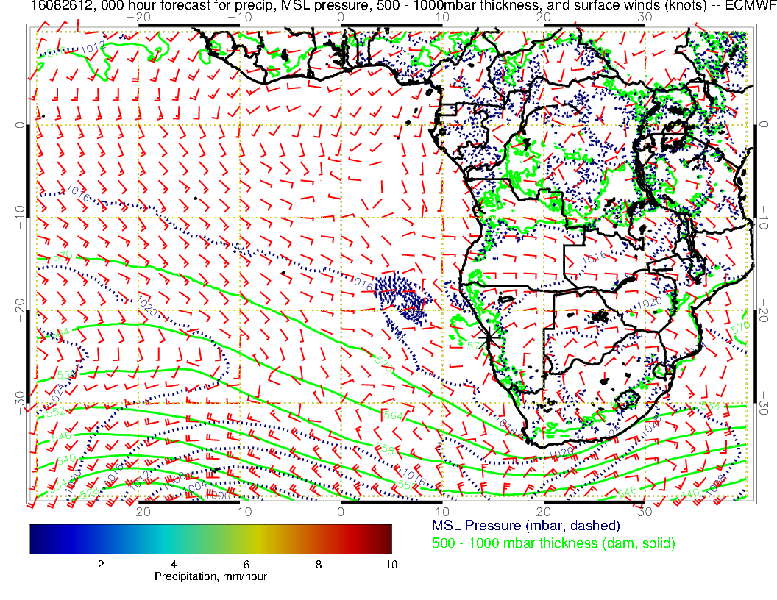

Slide 7
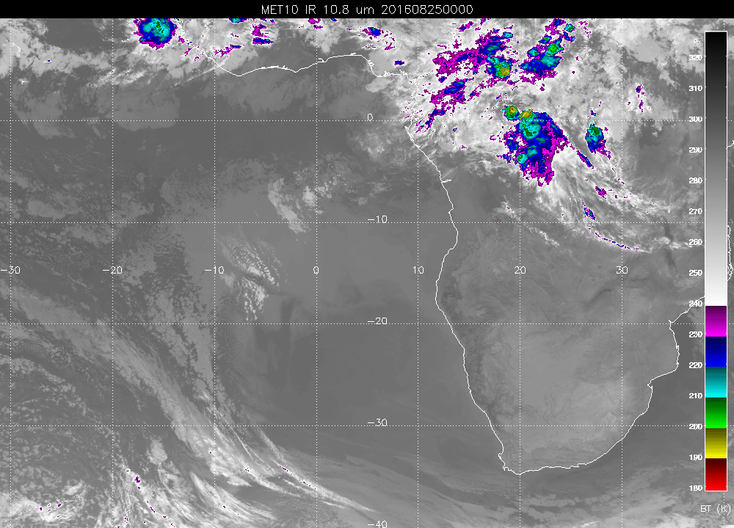

Slide 8
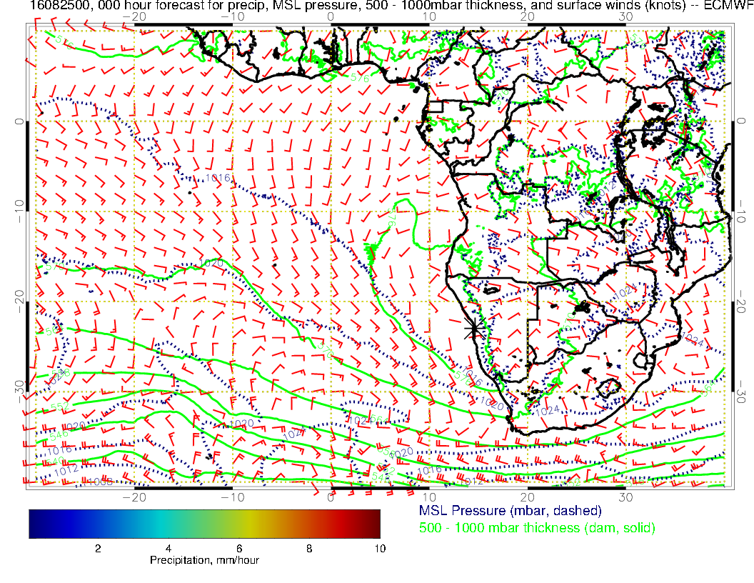

Slide 9
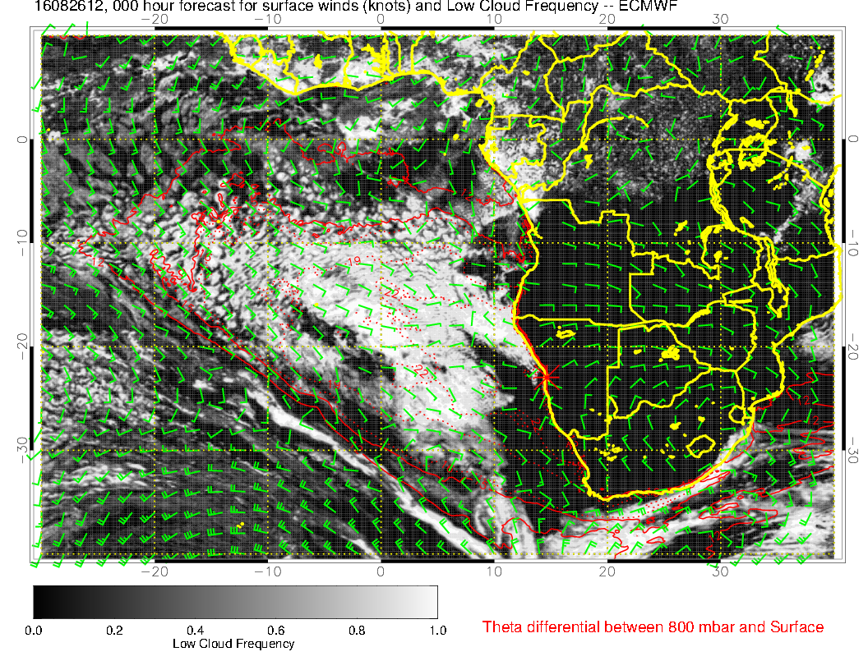

Slide 10
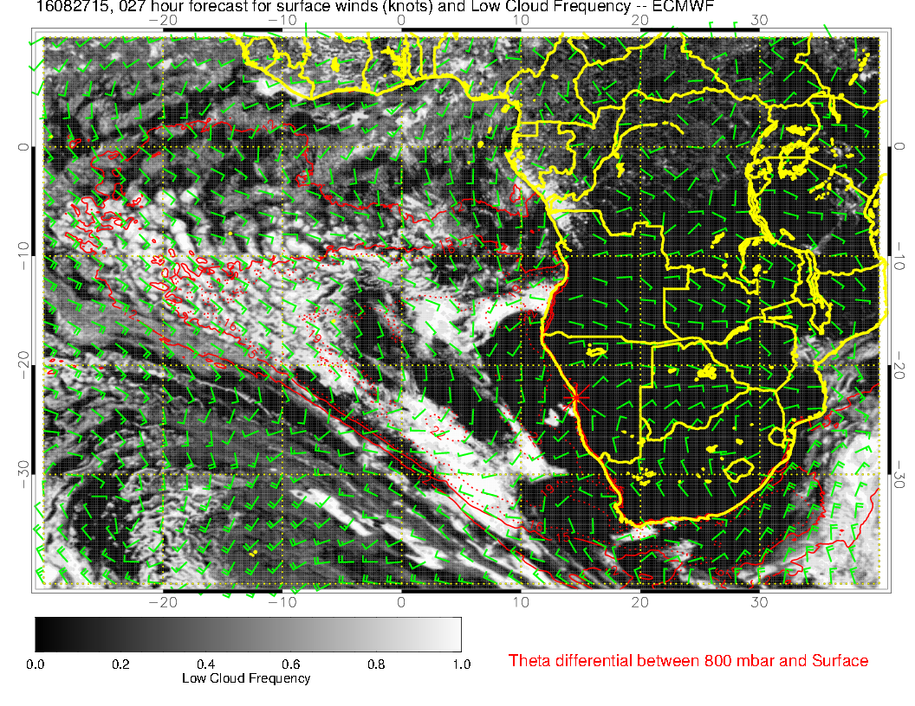

Slide 11
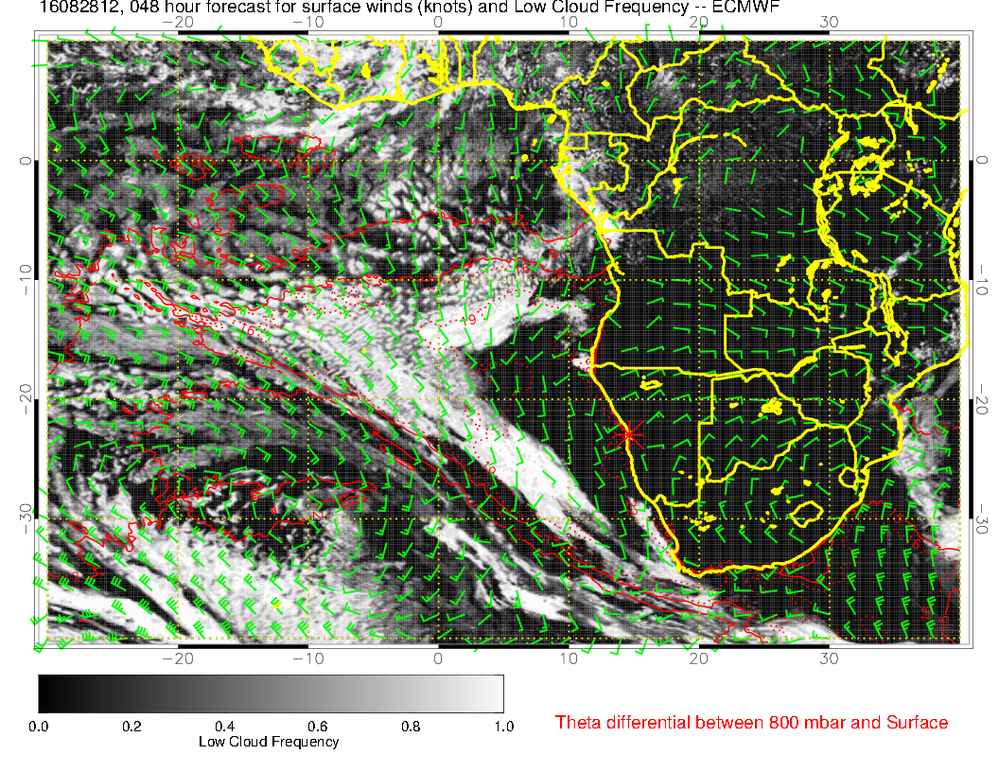

Slide 12
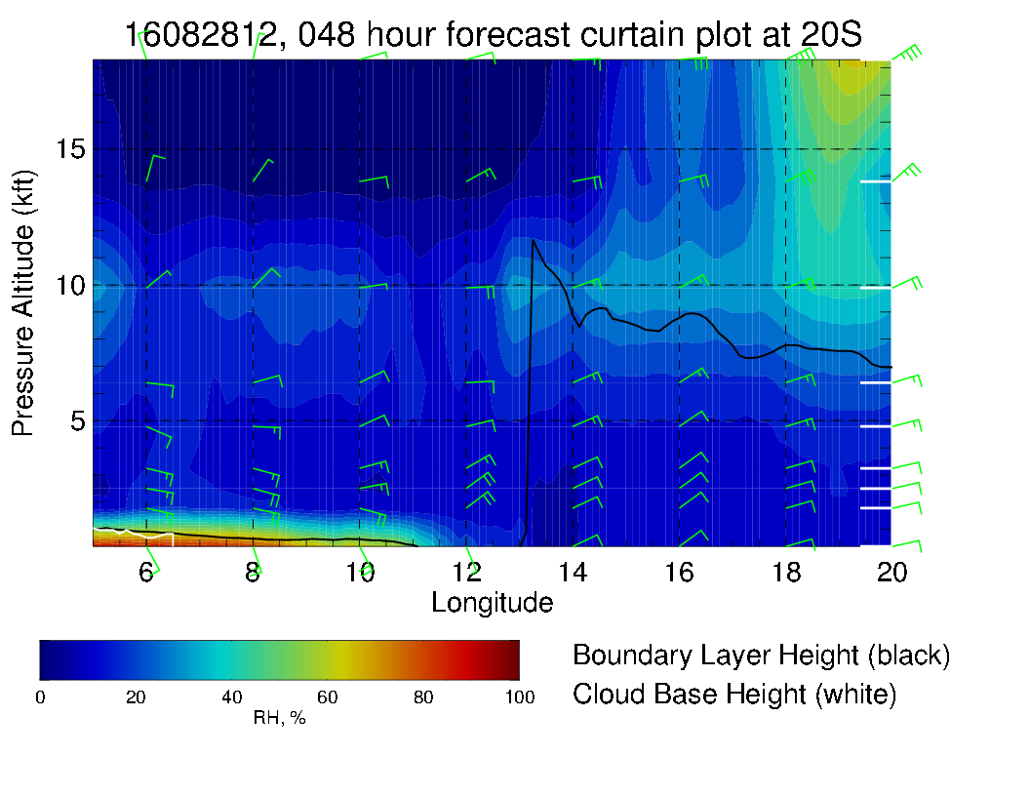

Slide 13
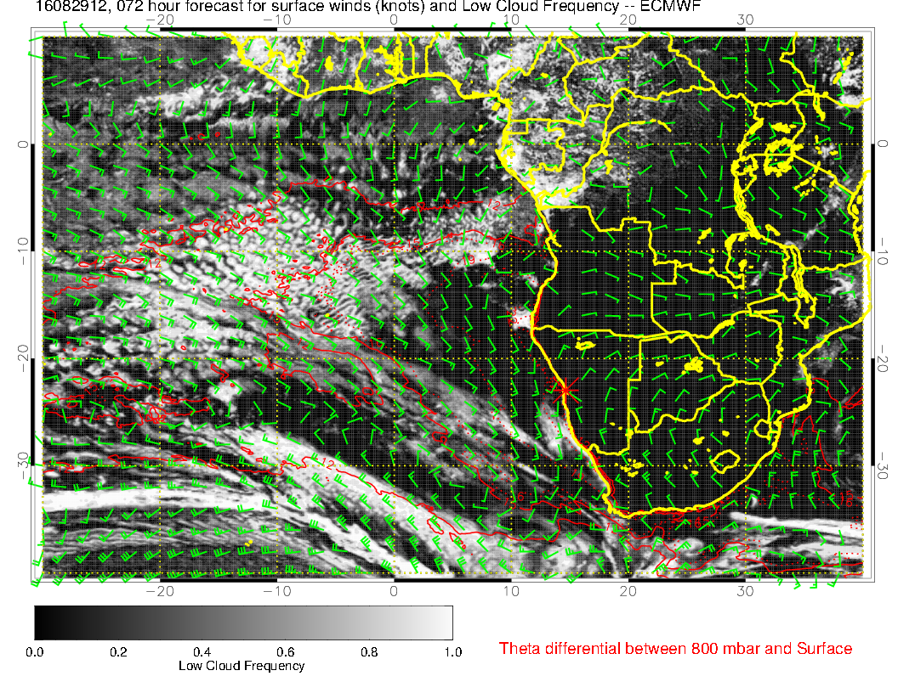

Slide 14
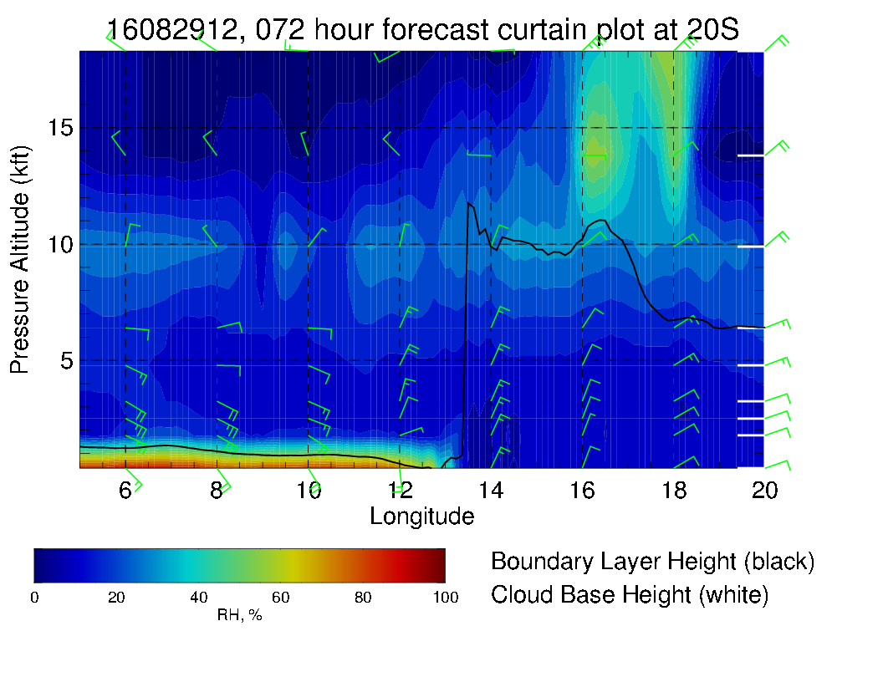

Slide 15
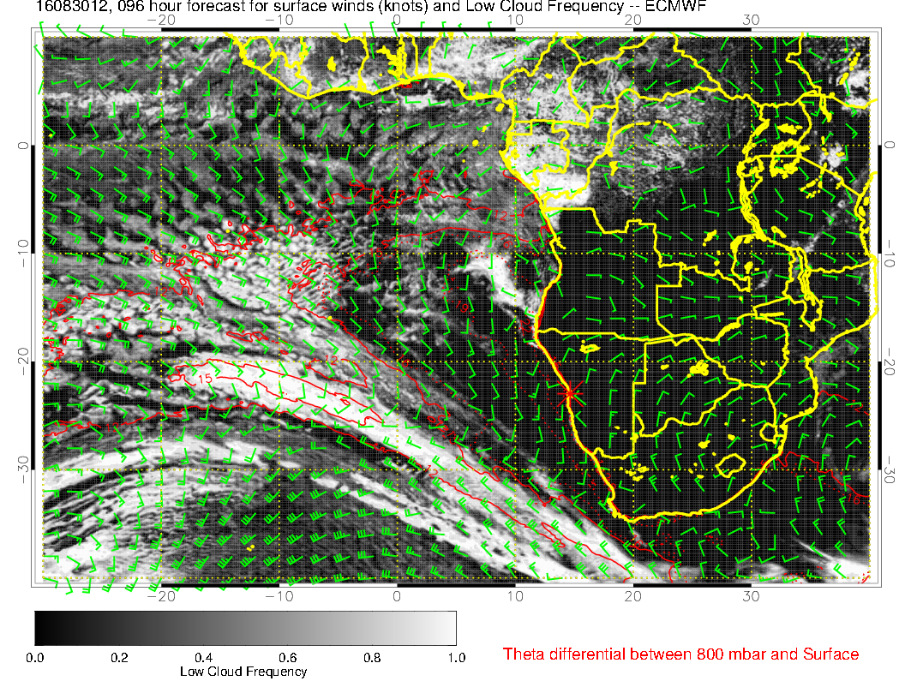

Slide 16
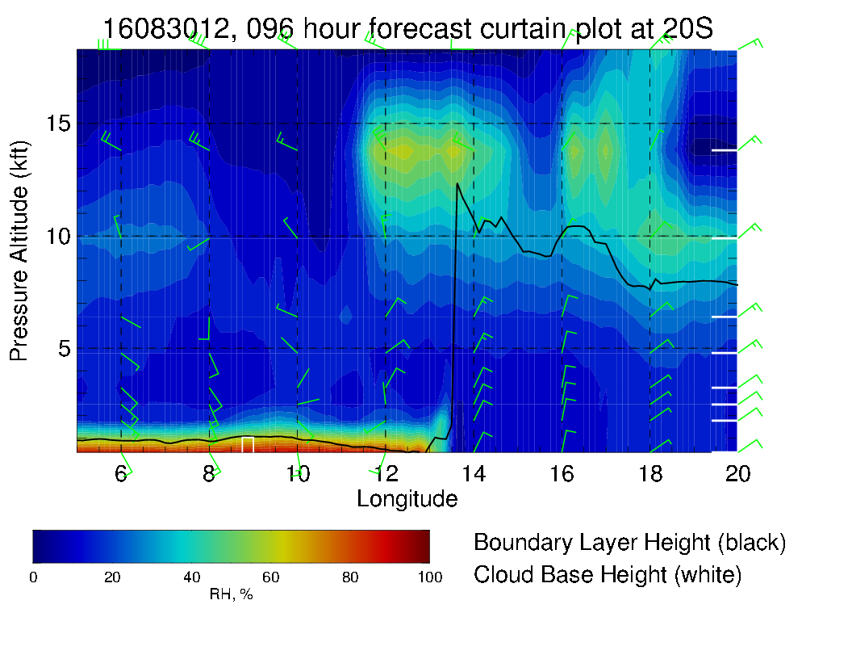

Slide 17
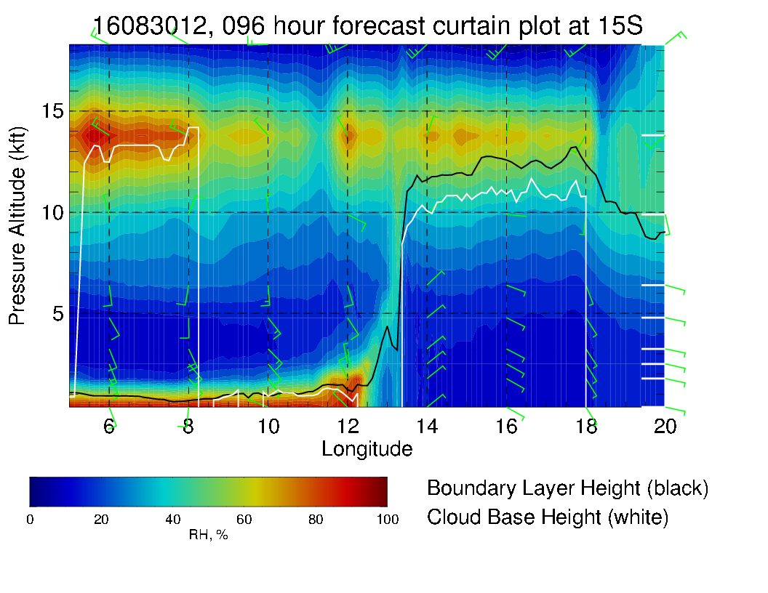

Slide 18
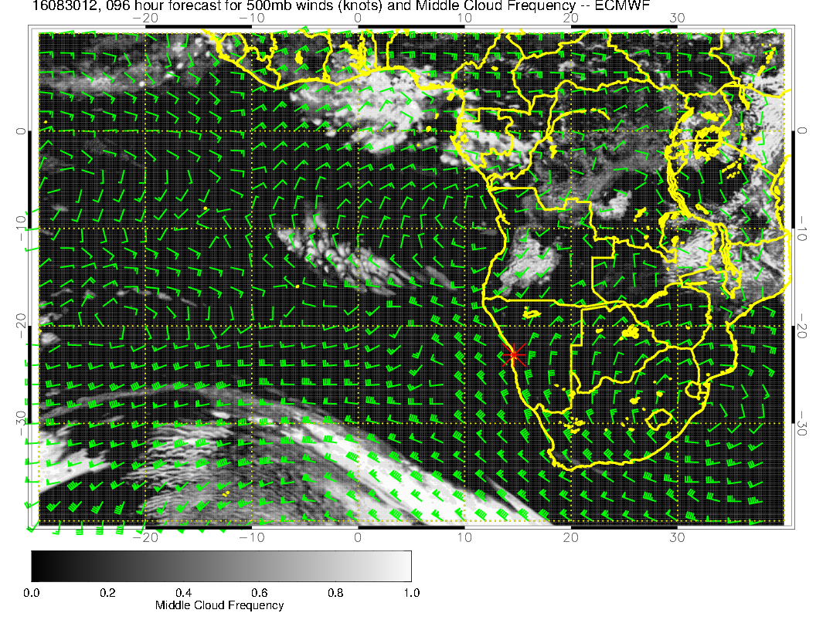

Slide 19
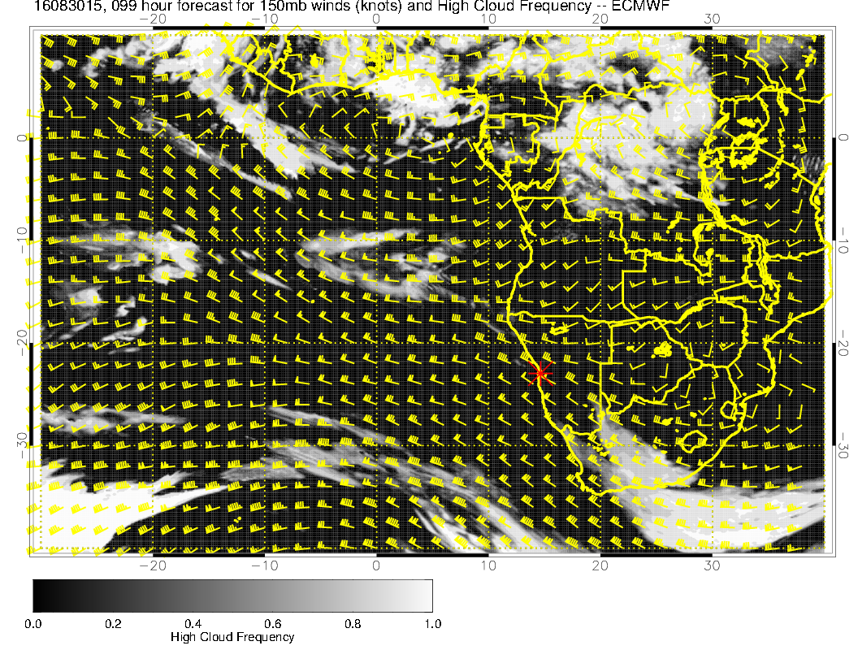

Slide 20
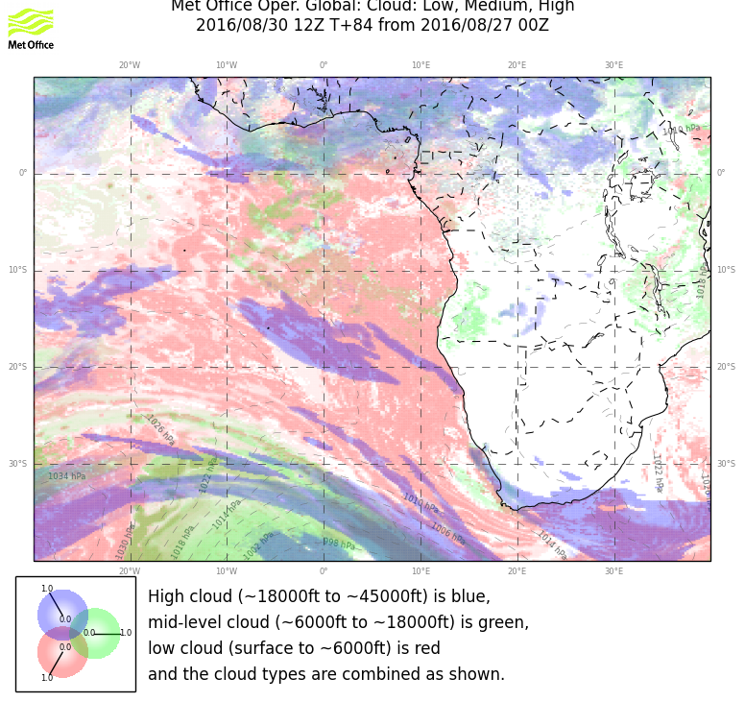

Slide 21
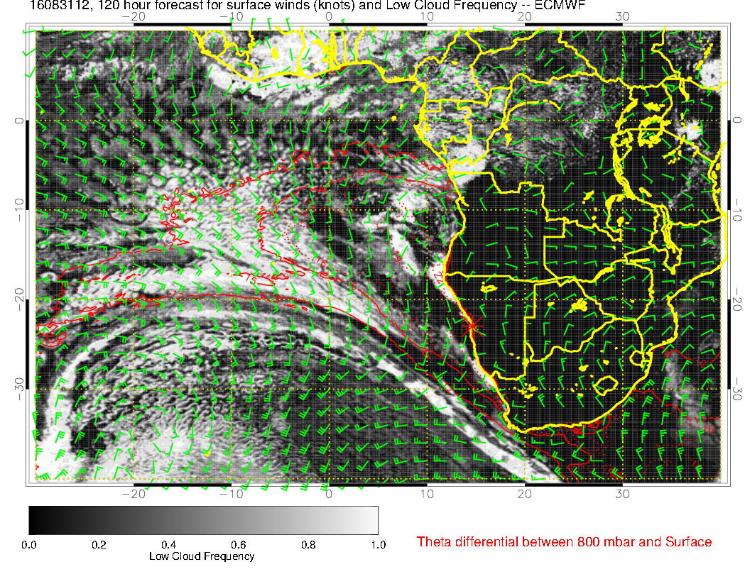

Slide 22
