Slide 1
ORACLES forecasting Briefing Aerosols
27-08-2016

Slide 2
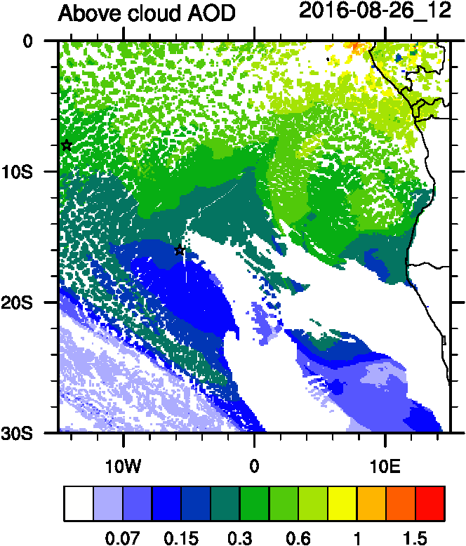
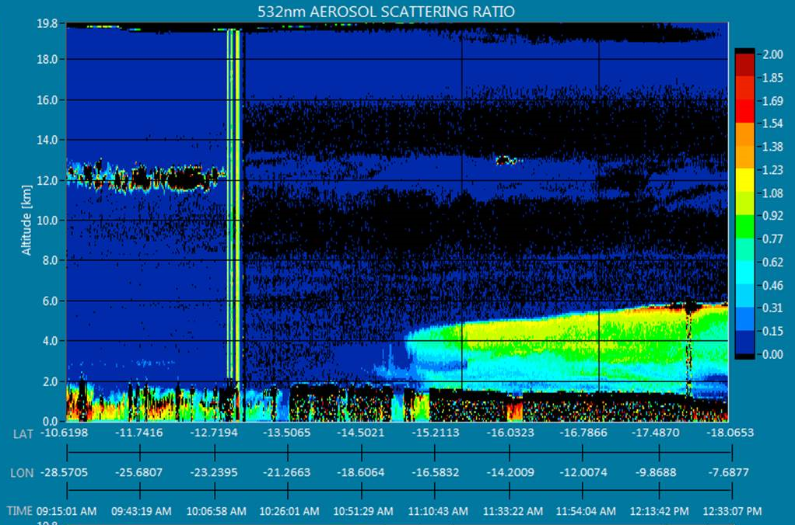
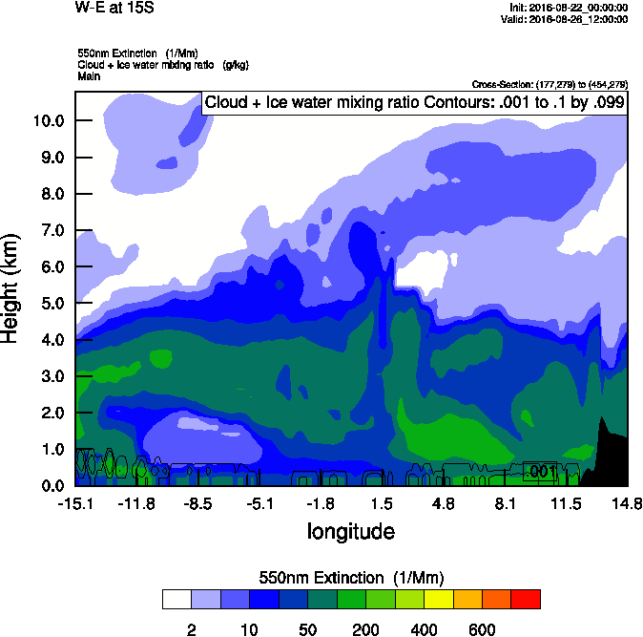
Smoke vertical extent evaluation (ER-2 transit)

Slide 3
Aug 30 2016

Slide 4
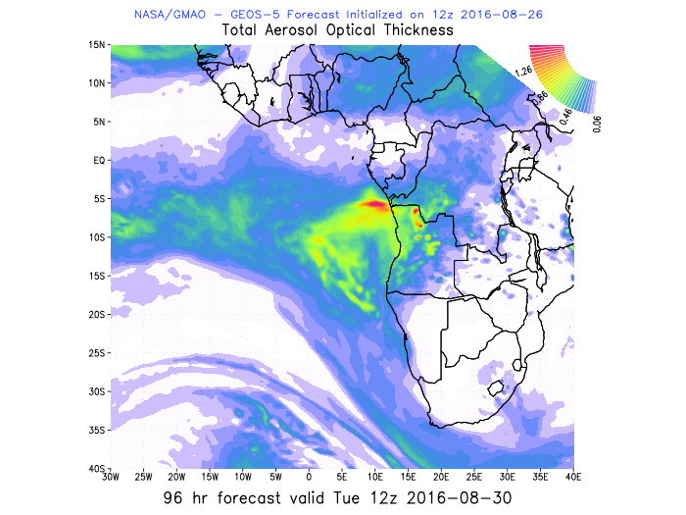
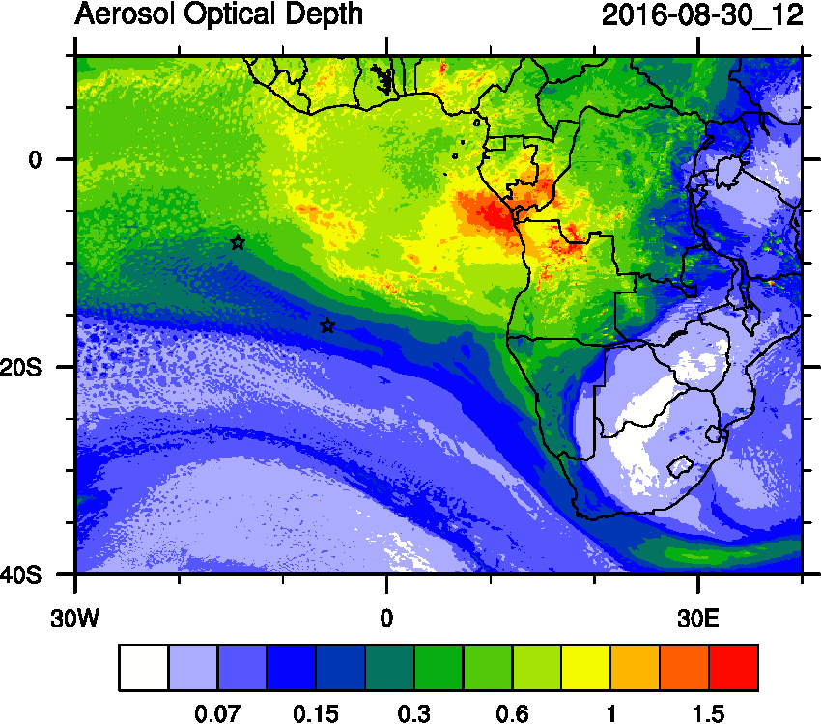
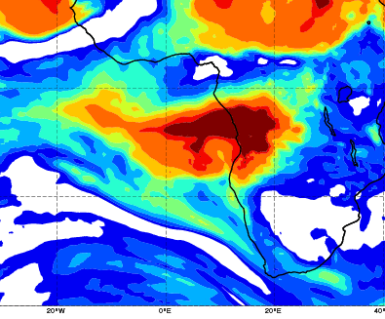
AOD 12 UTC
CAMS
WRF-AAM
GEOS5

Slide 5
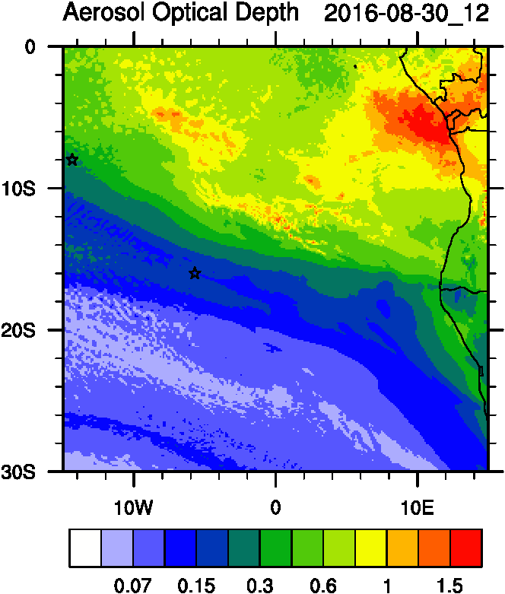
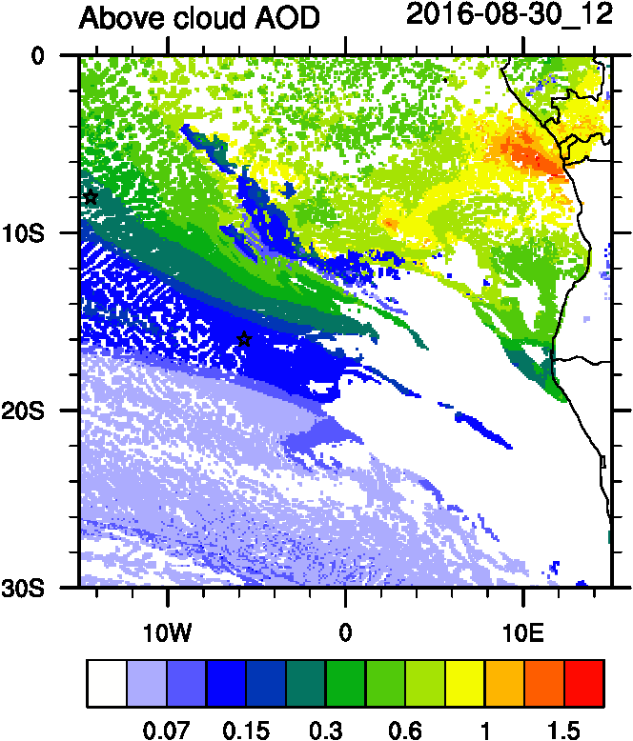
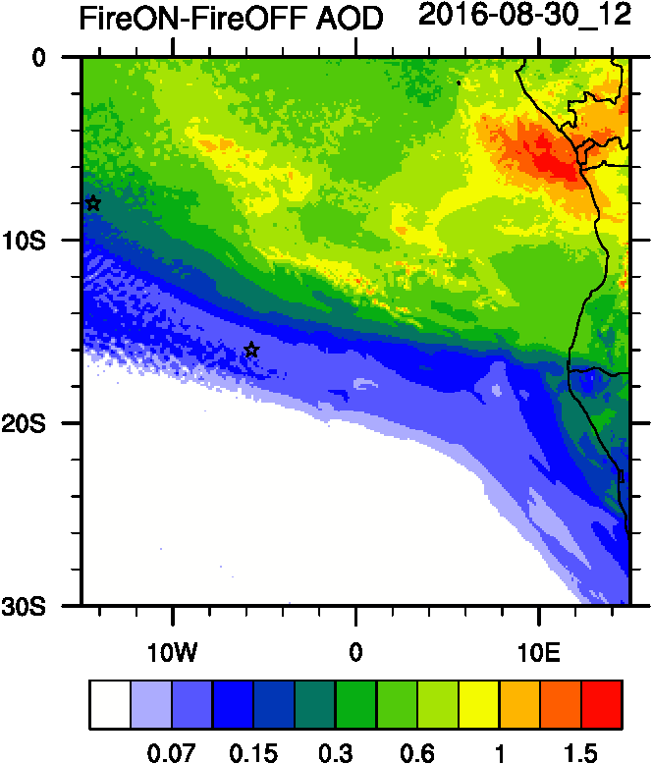
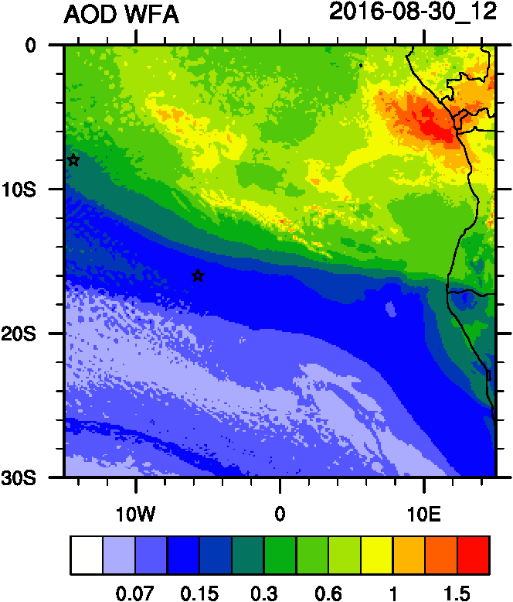
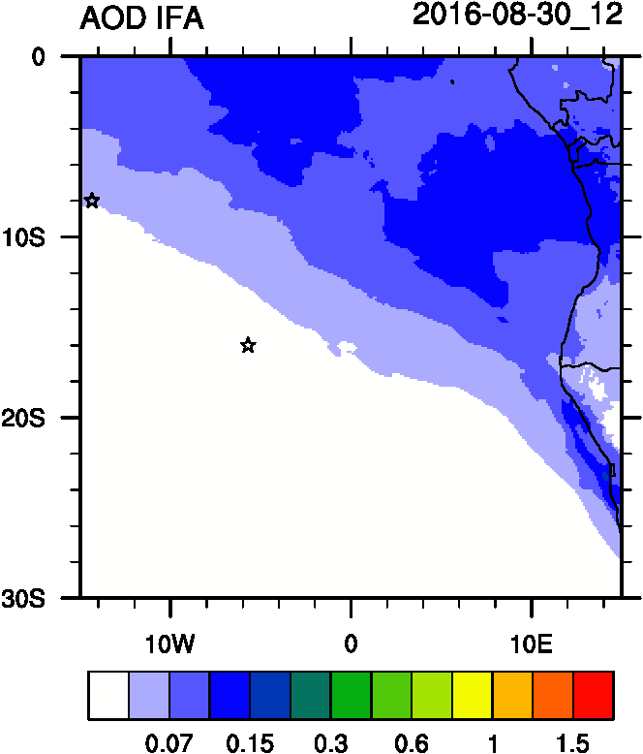
AOD
ACAOD
Smoke AOD
12UTC flavors of AOD
WFA=Water Friendly Aerosol
IFA=Ice Friendly aerosol
WFA AOD
IFA AOD

Slide 6
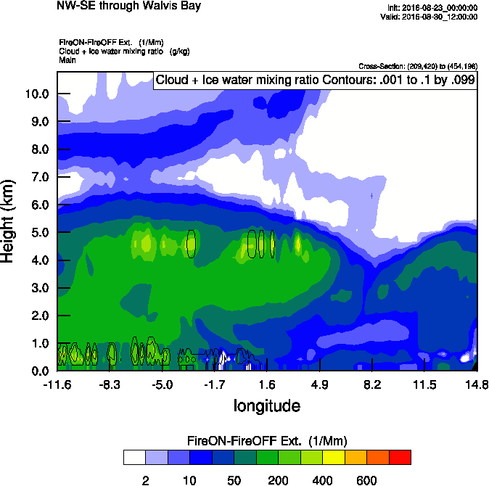
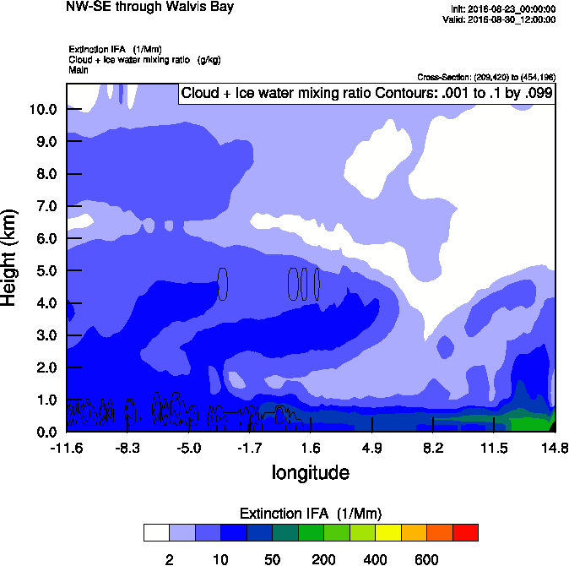
Vertical cross-section routine flight
Smoke Ext
Dust Ext
Smoke AOD

Slide 7
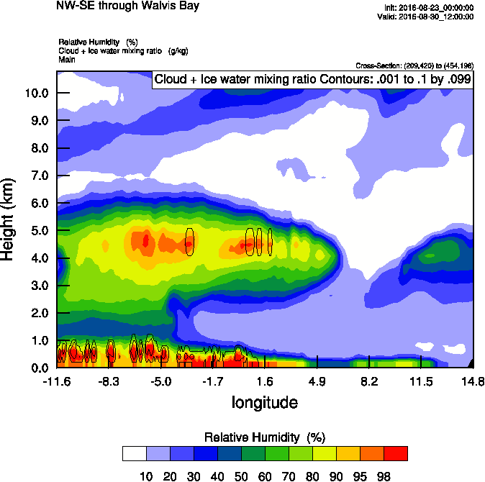
Vertical cross-section routine flight
Smoke Ext
RH
Smoke AOD

Slide 8
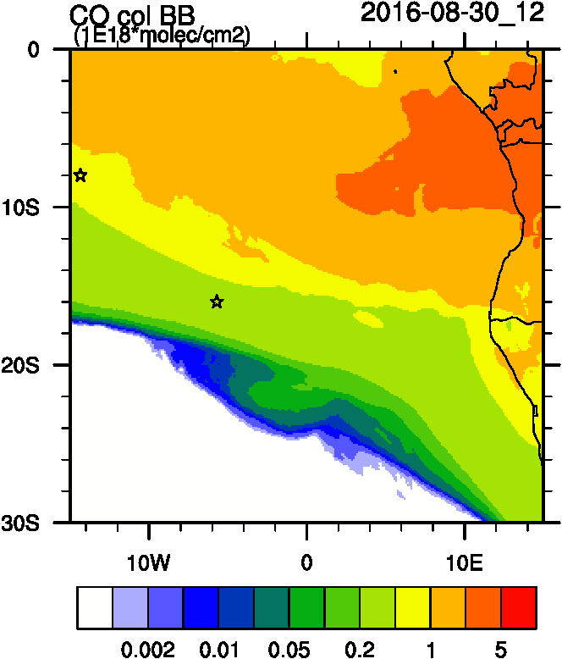
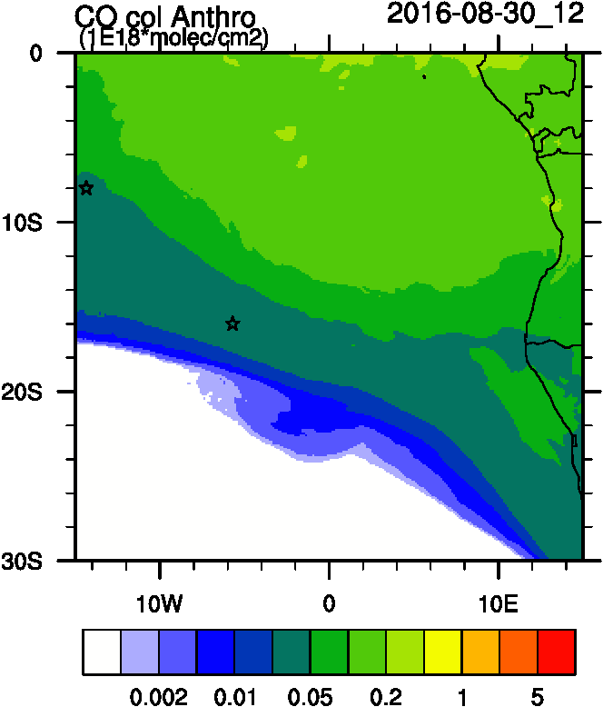
Biomass burning and Anthropogenic tracers

Slide 9
Smoke daily tracers

Slide 10
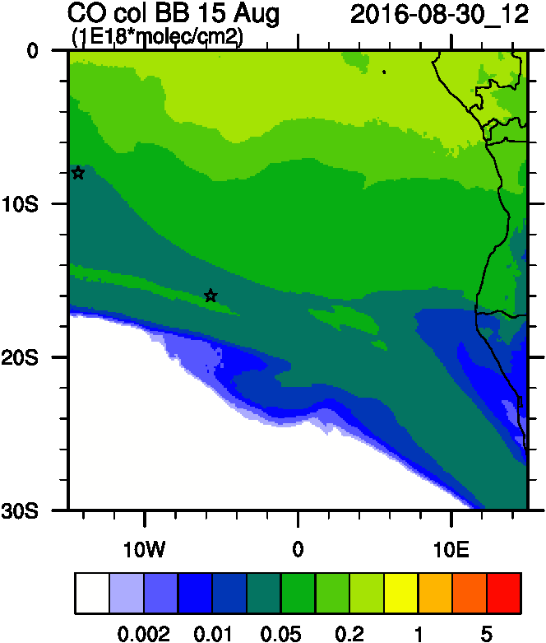
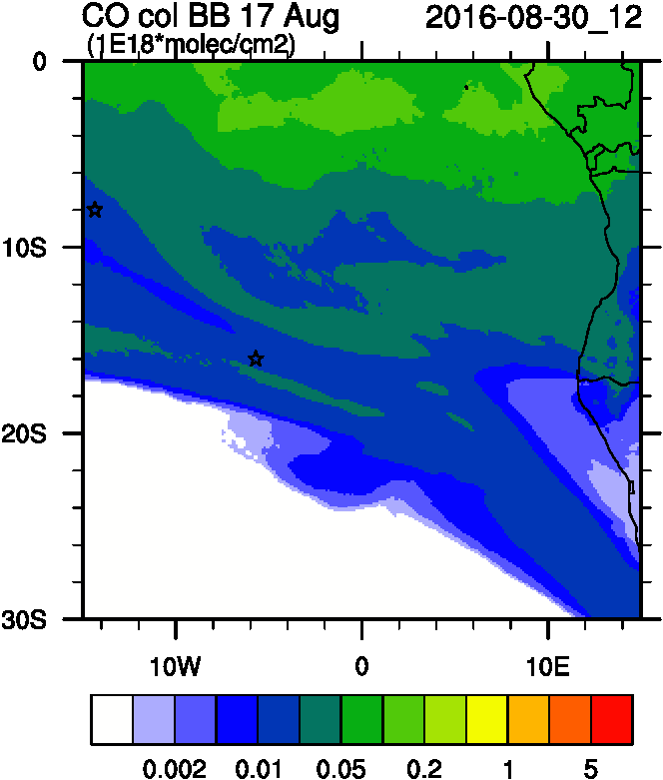
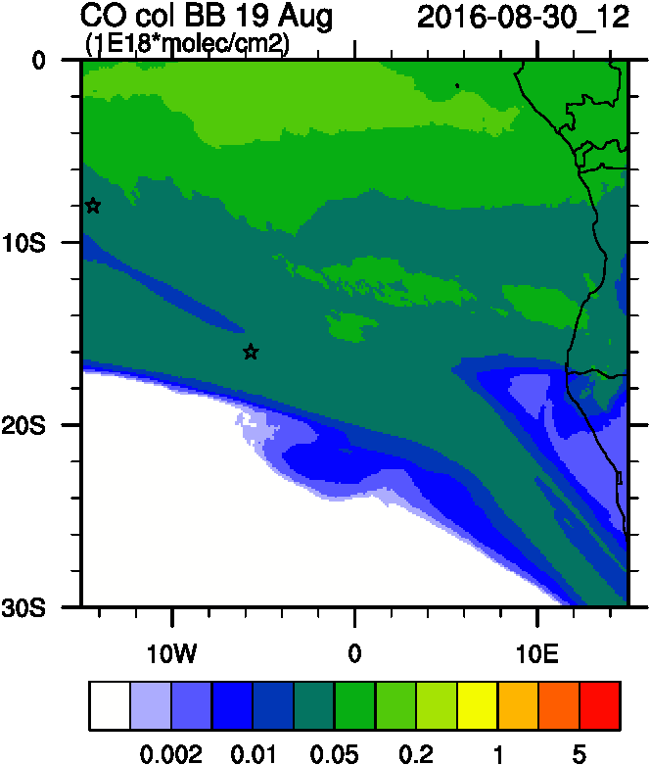
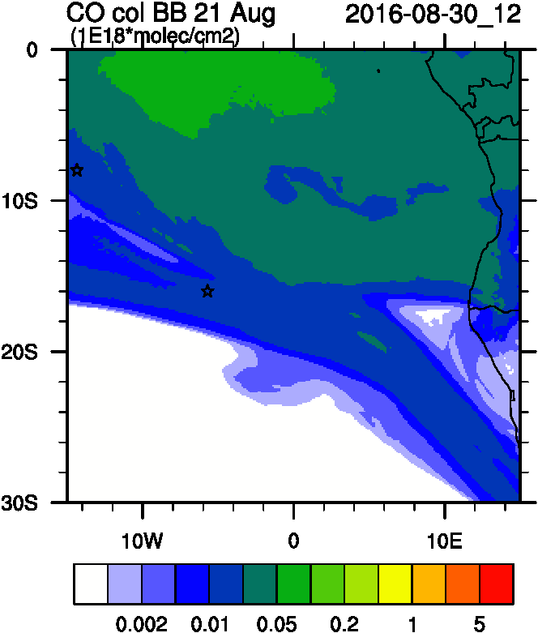
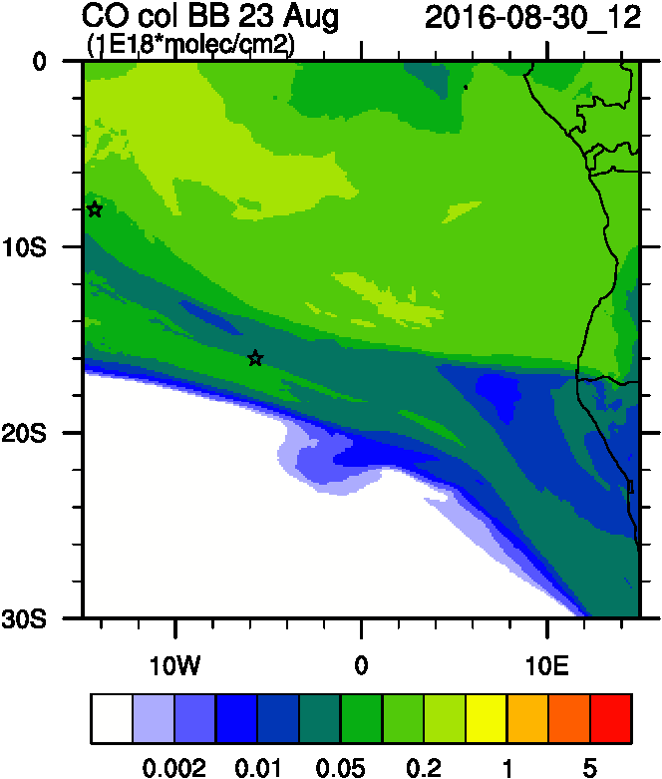
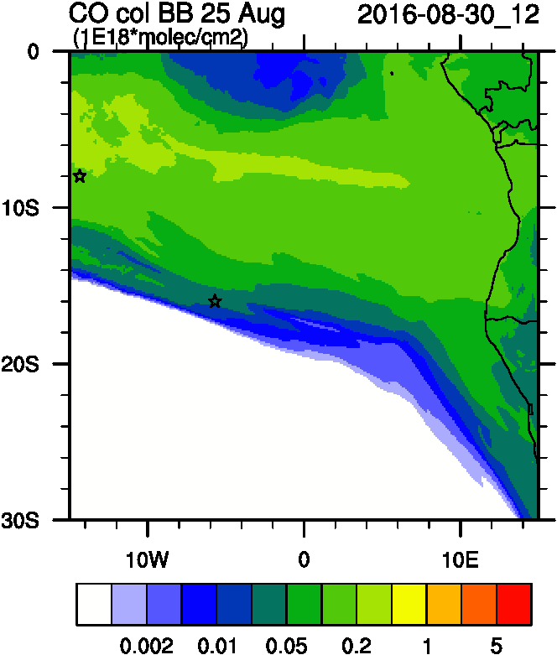
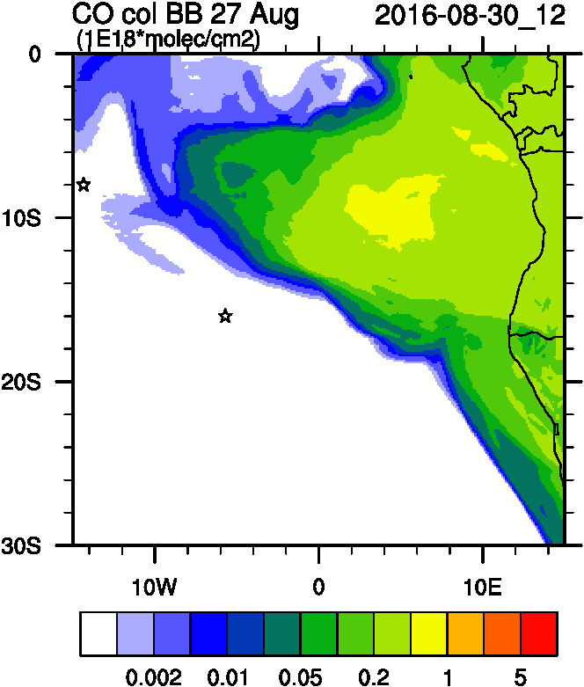
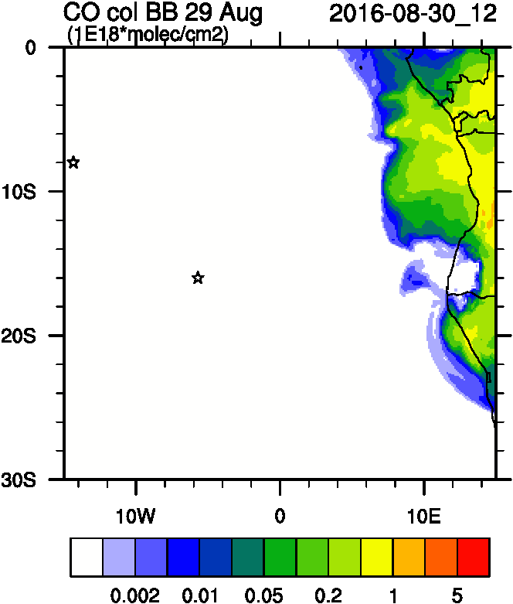
>-10d
-9d
-7d
-5d
-3d
-1d
+1d
+3d

Slide 11
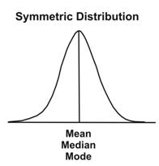
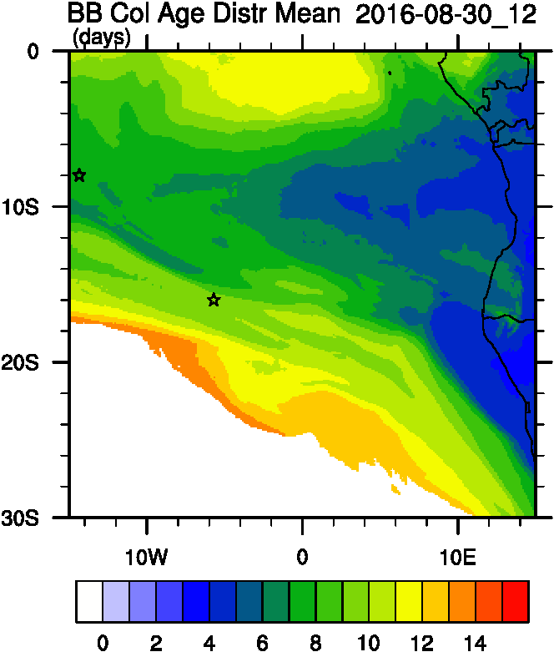
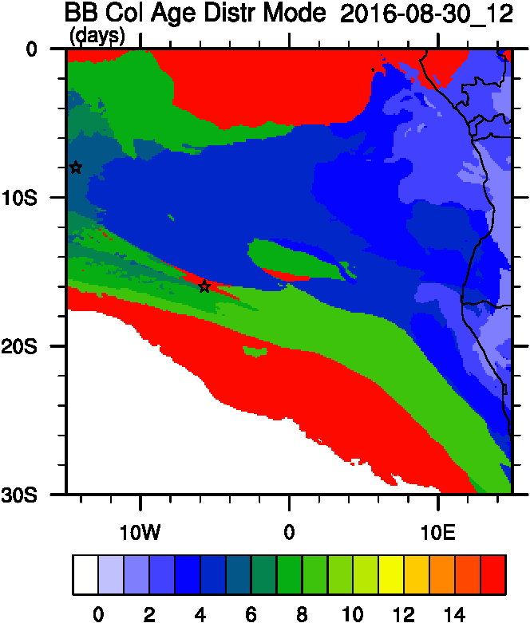
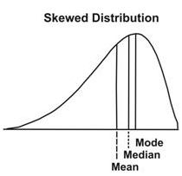
Smoke Age distribution

Slide 12
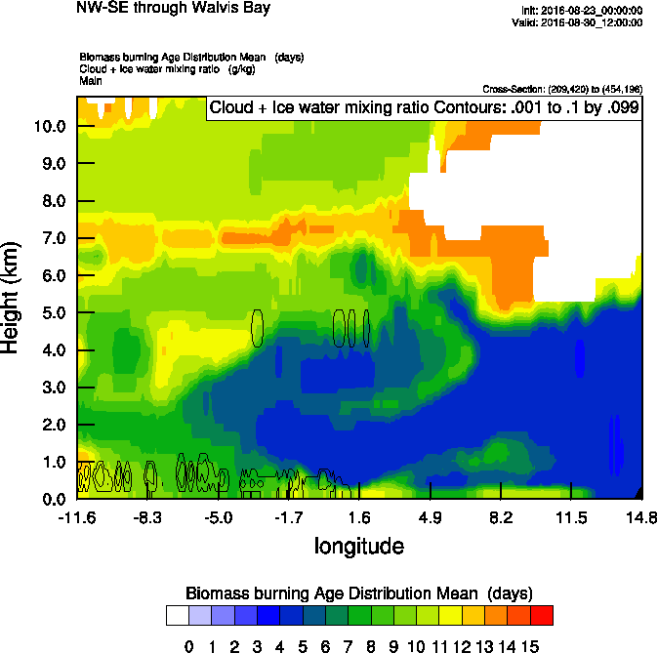
Vertical cross-section routine flight
Smoke Ext
Age mean
Smoke AOD

Slide 13
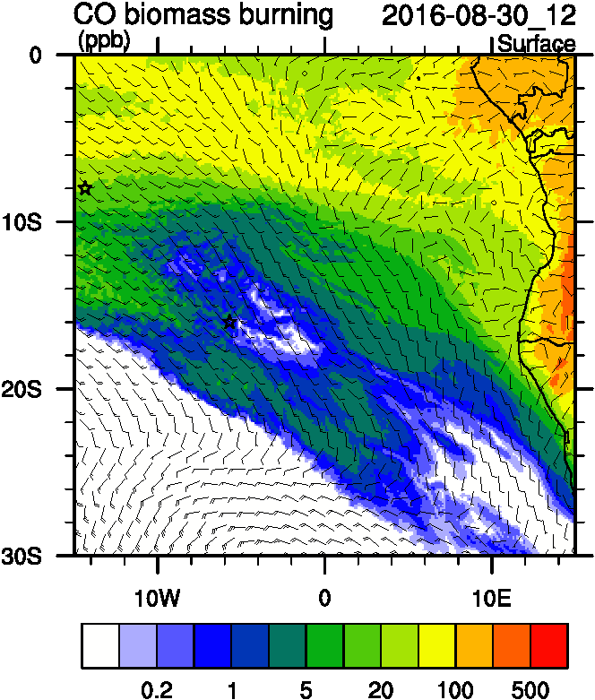
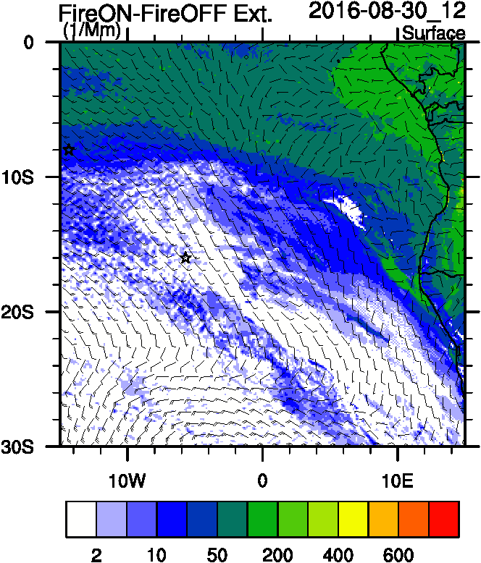
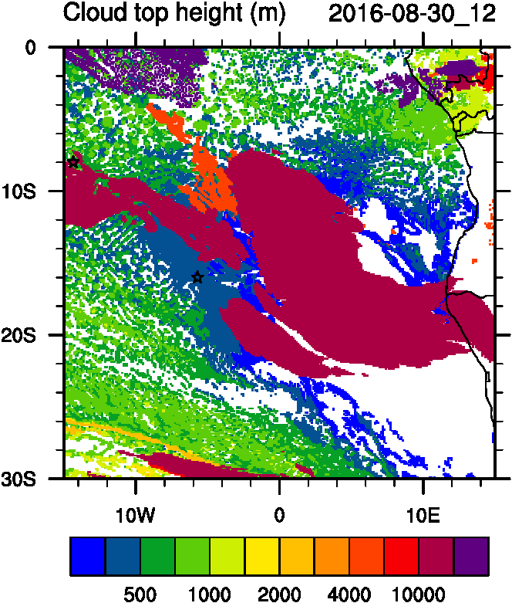
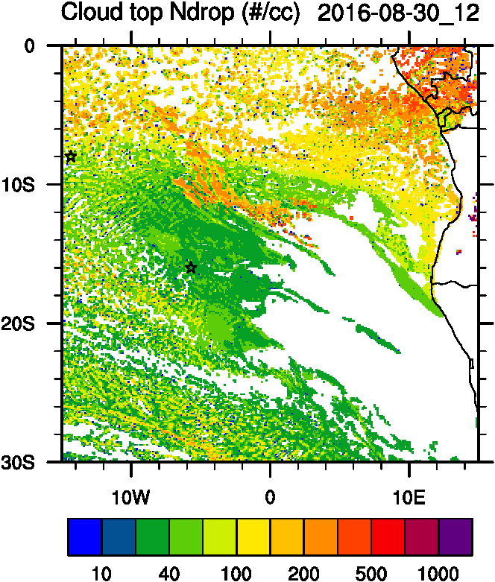
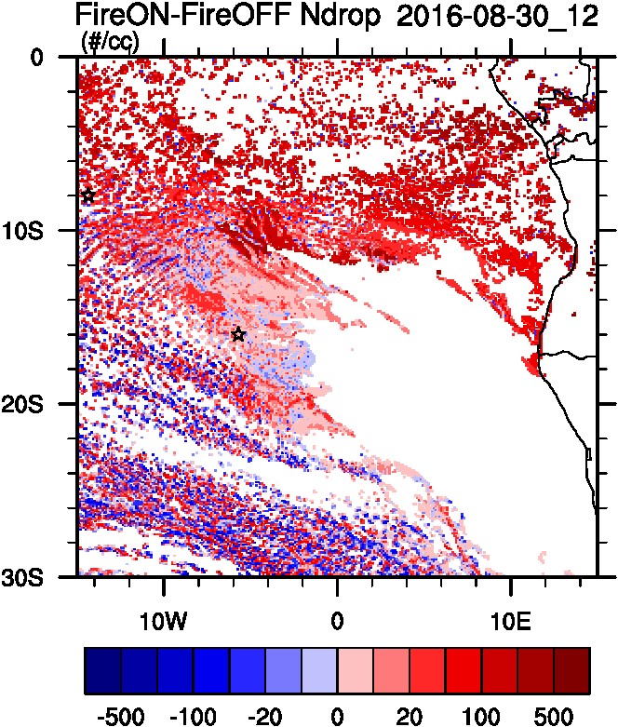
Aerosol-cloud interactions
Smoke Ext
Ndrop: Number droplet concentration
Diff: Differences between simulations turning on and off fires
Smoke AOD
tracer
Ndrop Diff
Cld Top
Ndrop

Slide 14
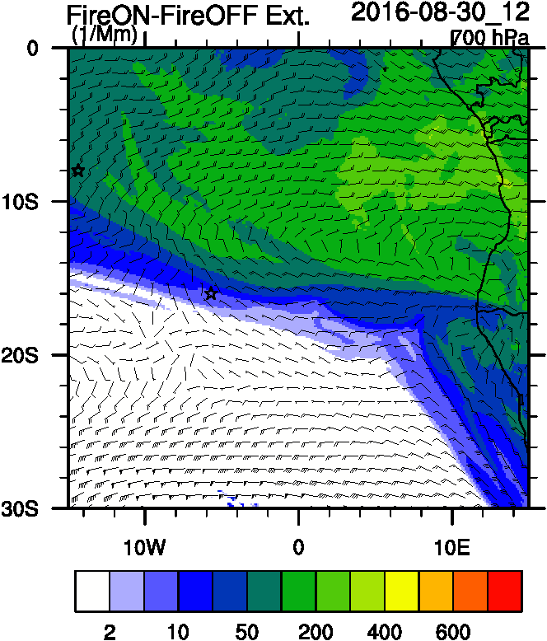
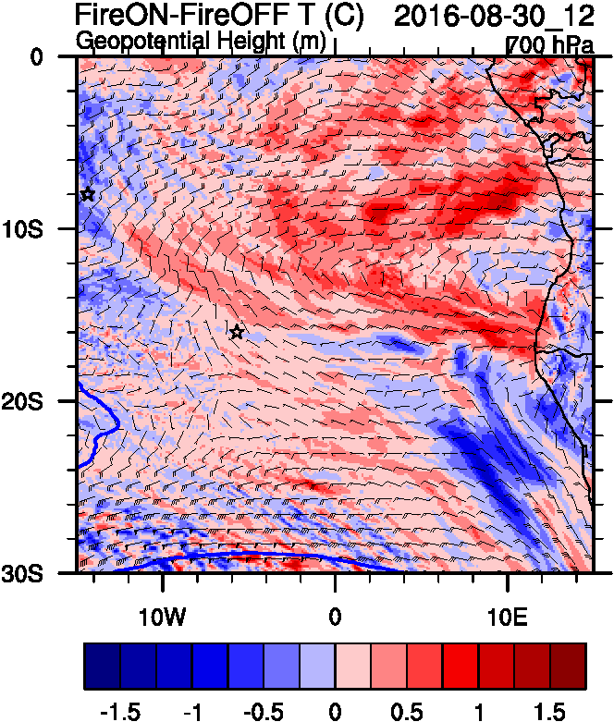
Aerosol-radiation interactions
Smoke AOD
Smoke Ext
T diff

Slide 15
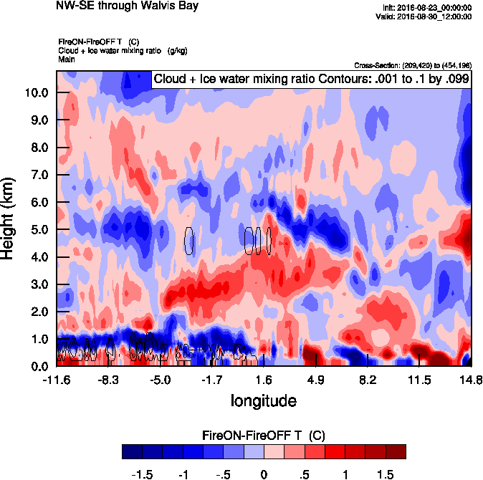
Vertical cross-section routine flight
Smoke Ext
Age mean
Smoke AOD

Slide 16
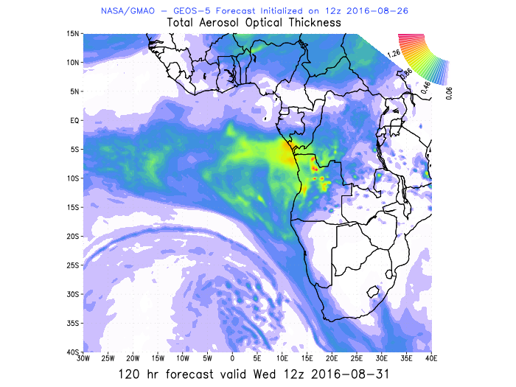
Next few days
Tuesday
Wednesday

Slide 17
Aug 27 2016 (today’s P3 transit!)

Slide 18
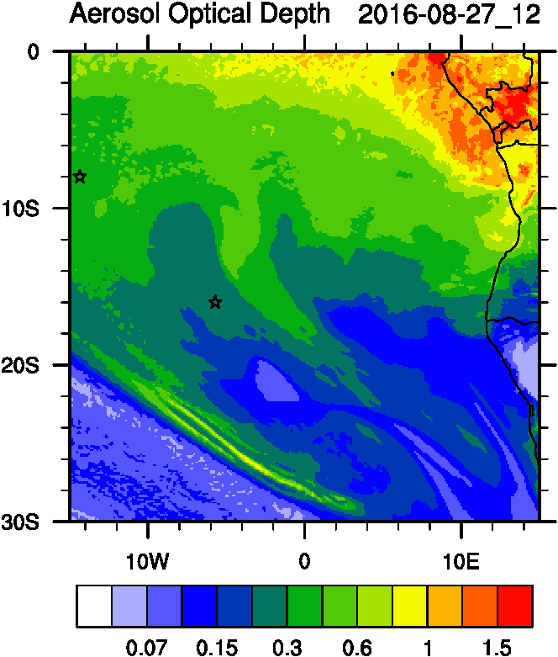
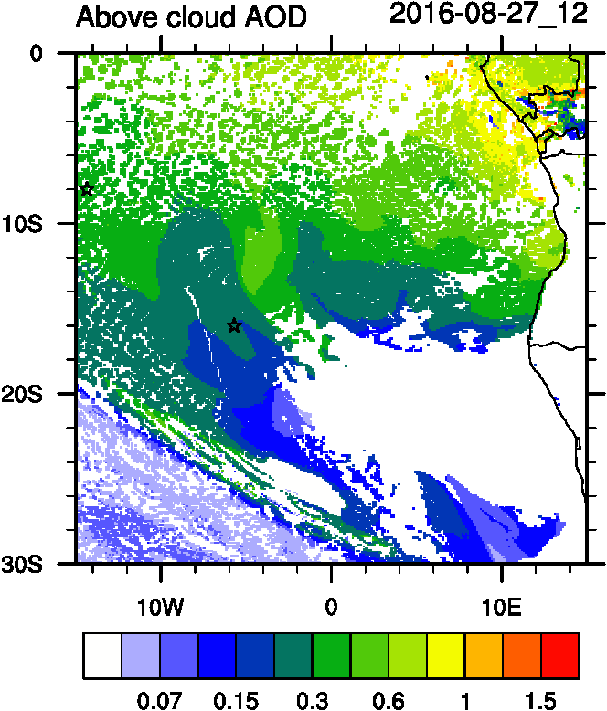
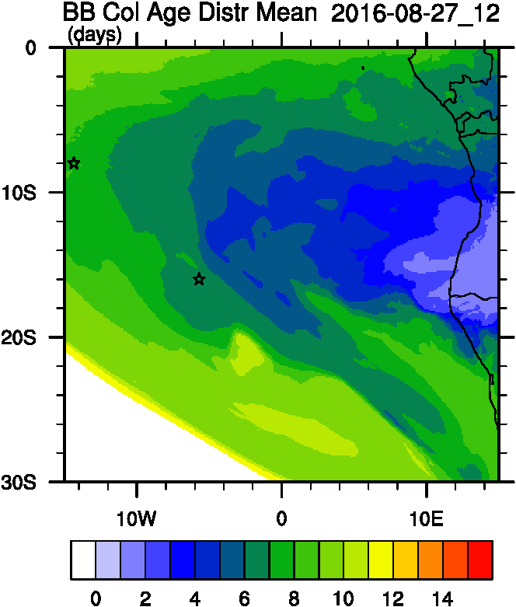
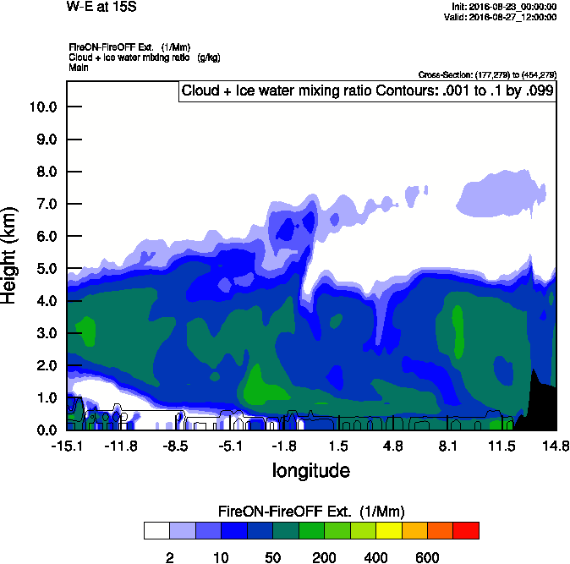
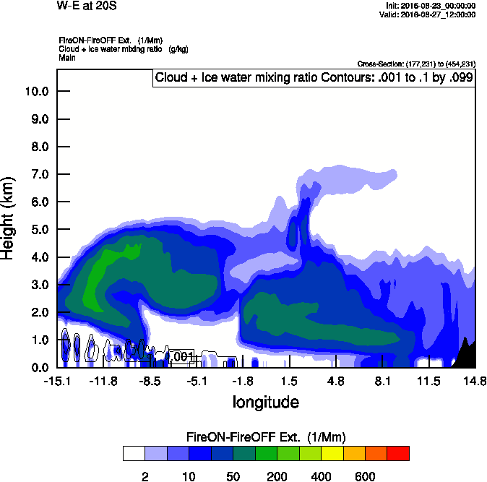
AOD
ACAOD
Age
15 S Smoke Ext
20 S Smoke Ext

