Slide 1
Weather Briefing, 20160826
SE Atlantic Stratus reforming off our coast
Another Wave expected to come through over the weekend, pushing stratus to the north.
Wave stalls in face of strong high over SA, looking at very thin BL near our coast, temporary breakup of the Atlantic high, and limited stratocumulus.

Slide 2
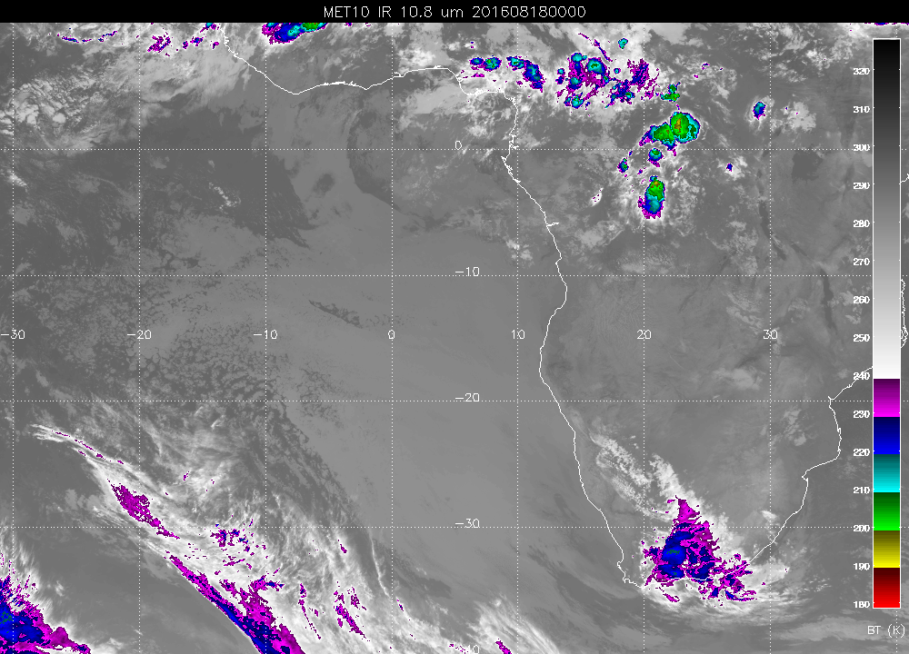

Slide 3
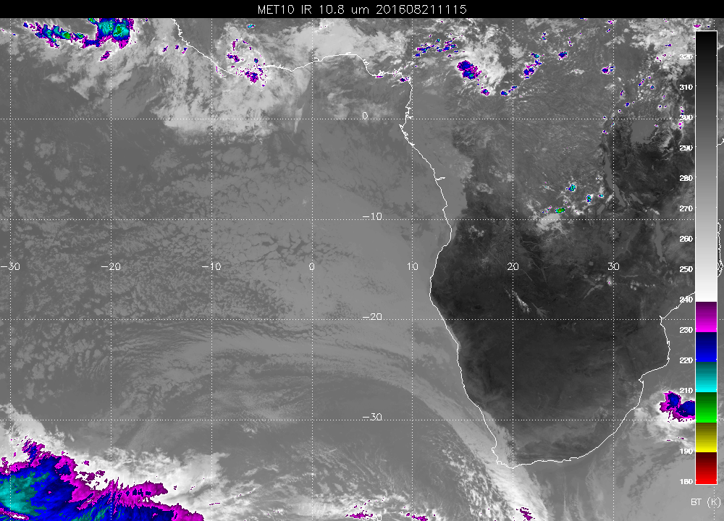

Slide 4
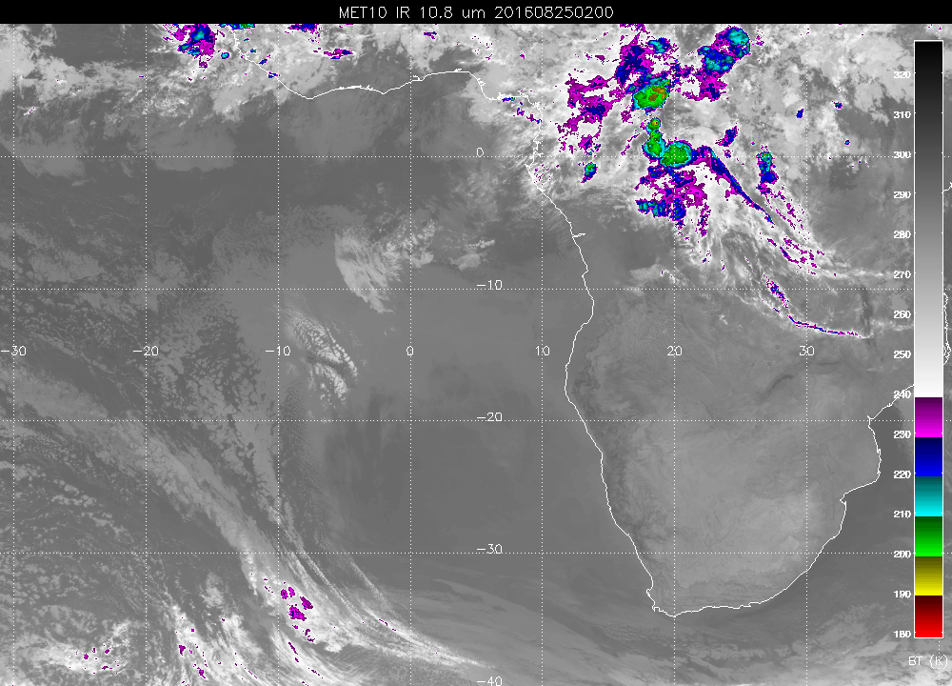

Slide 5
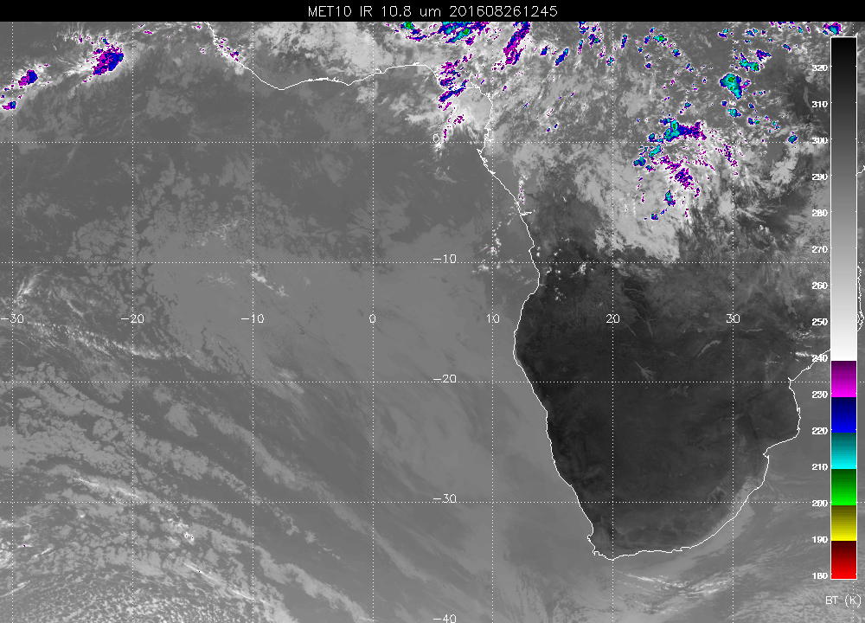

Slide 6
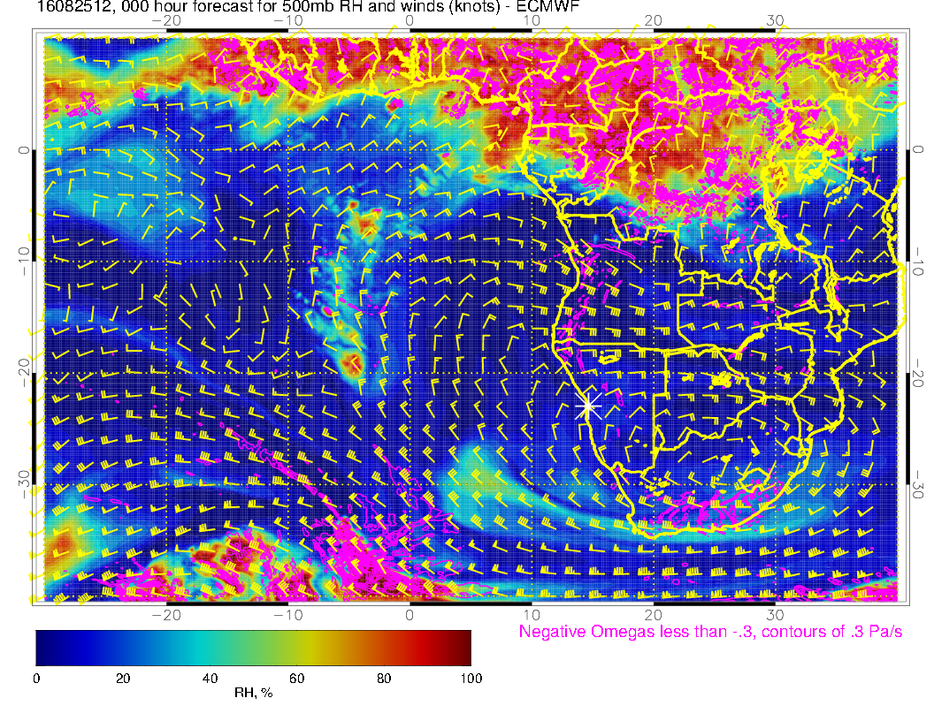

Slide 7
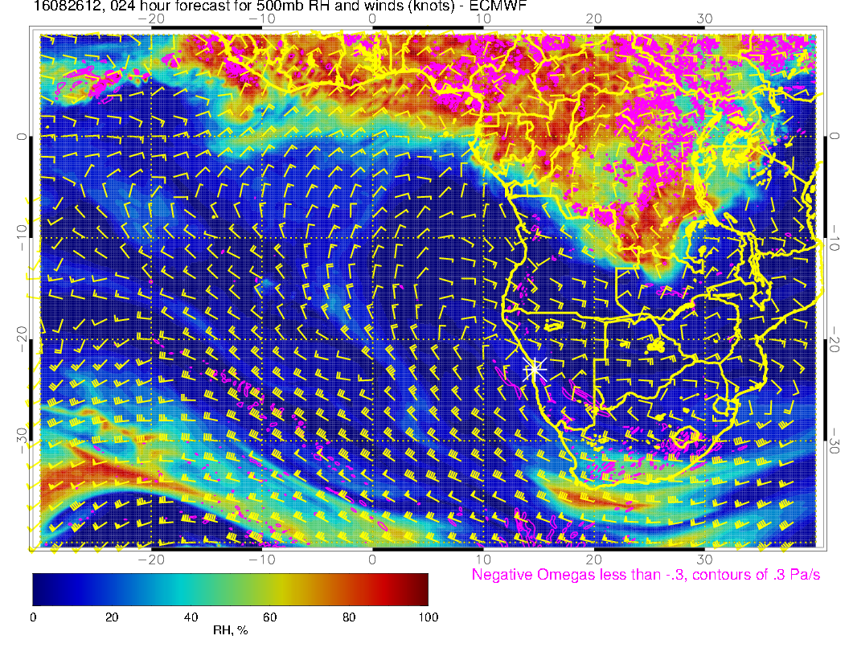

Slide 8
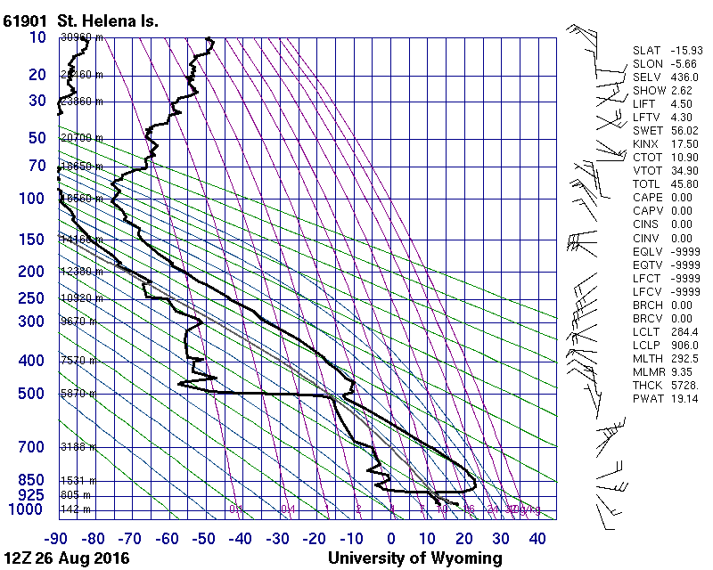

Slide 9
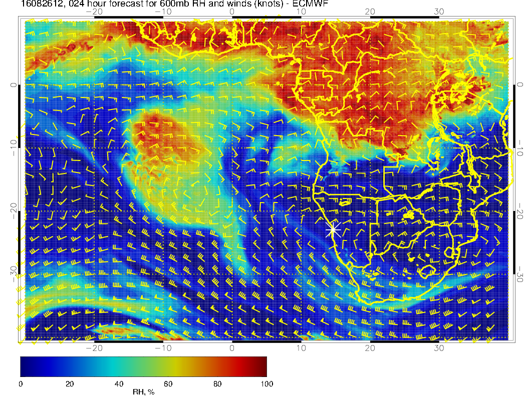

Slide 10
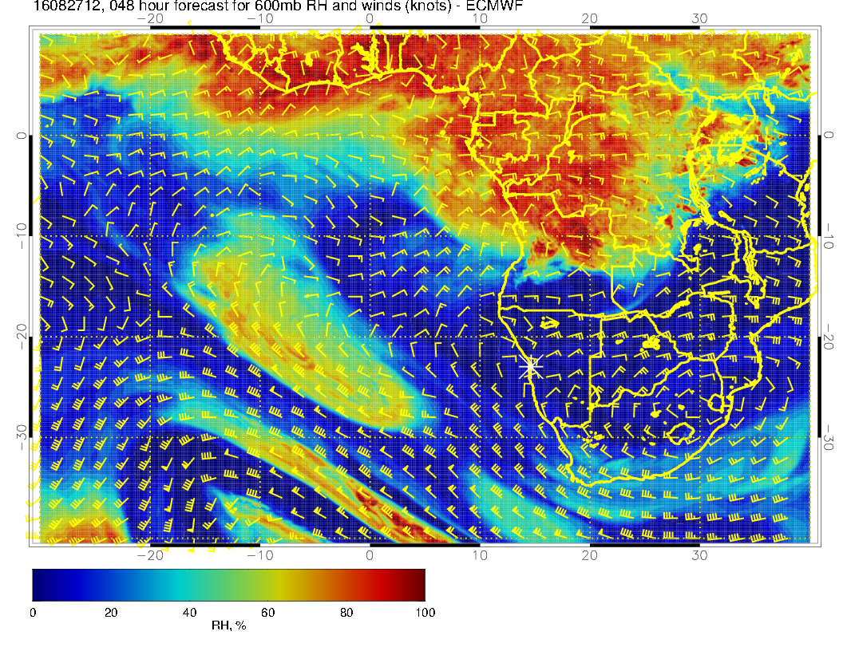

Slide 11
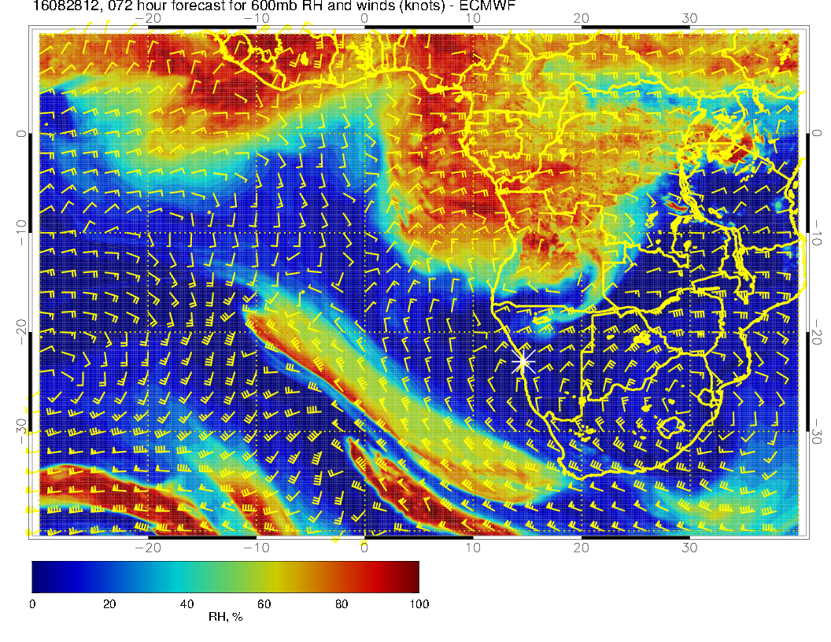

Slide 12
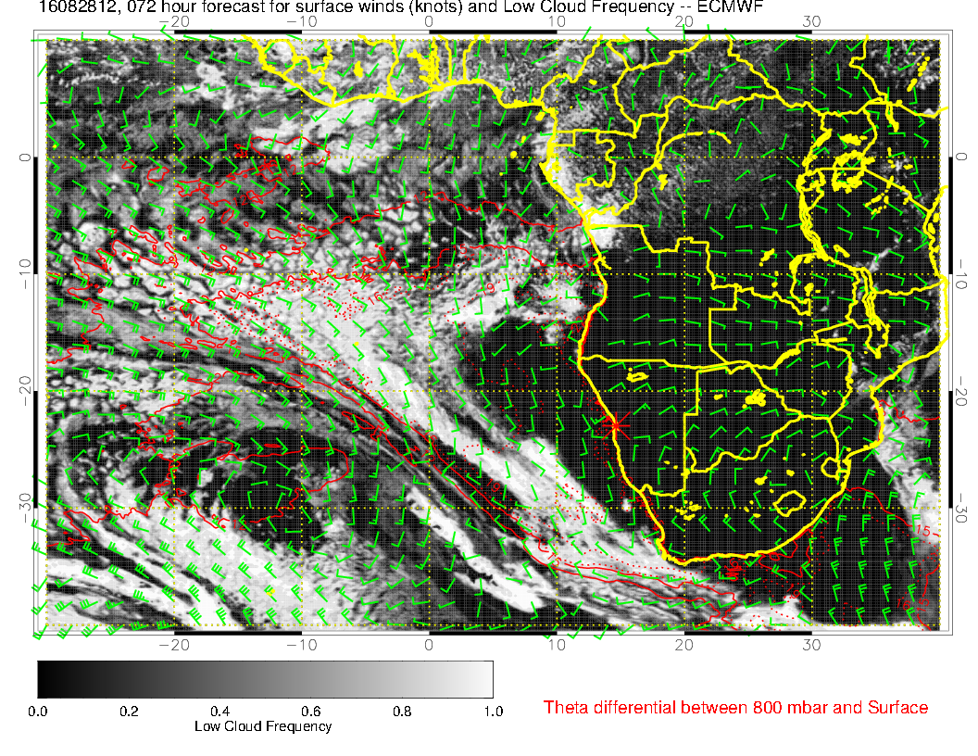

Slide 13
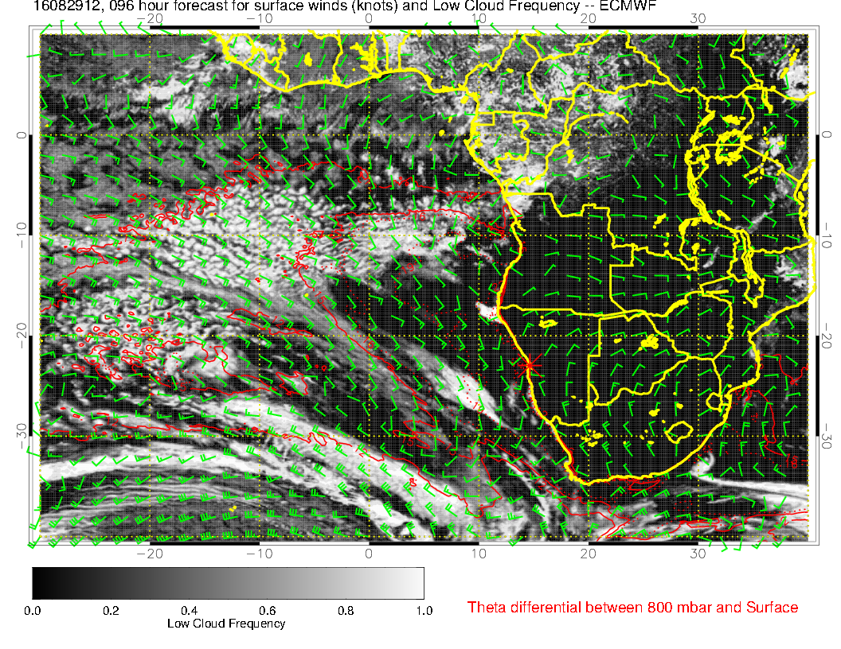

Slide 14
