Slide 1
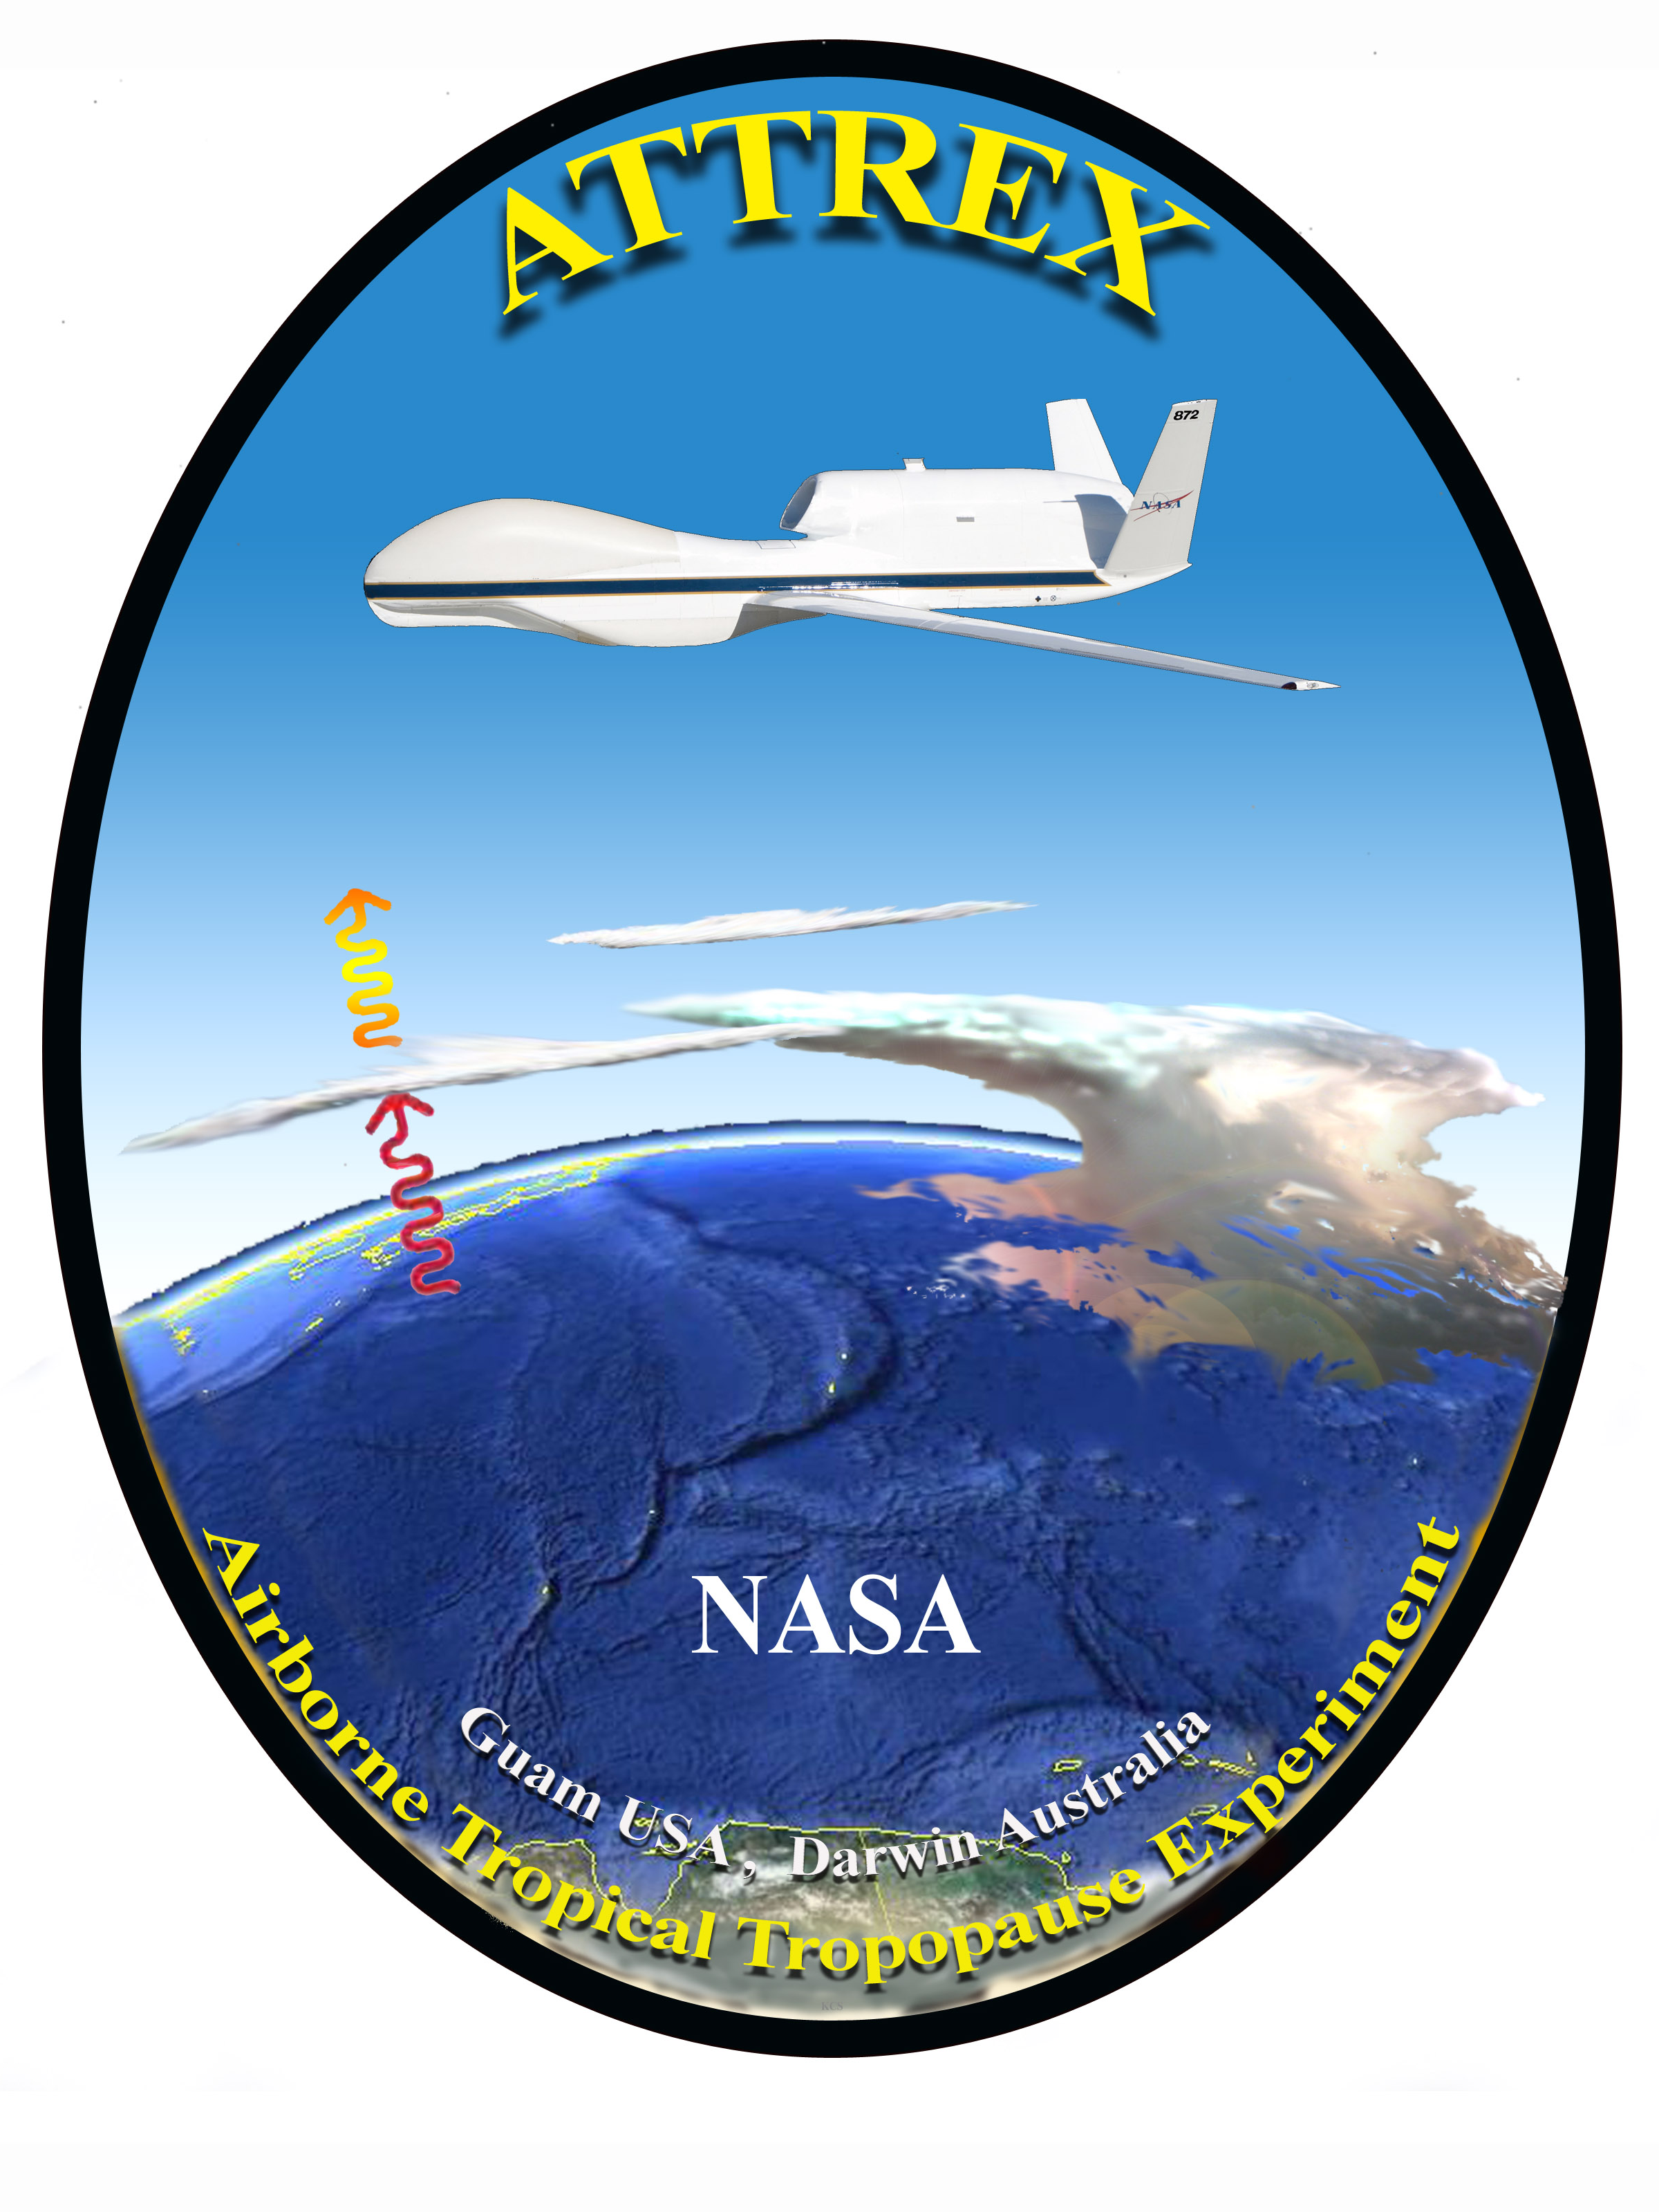
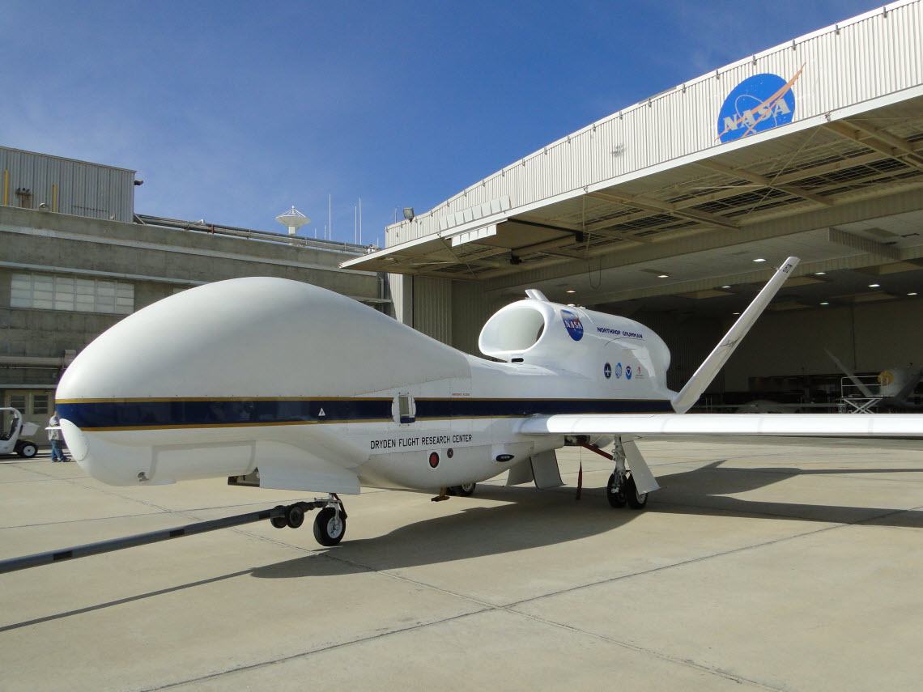
Airborne Tropical Tropopause Experiment (ATTREX)
Leonhard Pfister (Deputy Principal Investigator)
NASA Ames Research Ctr., Mtn. View, CA
Eric Jensen (Principal Investigator)
Dave Jordan (Project Manager)
NASA Ames Research Ctr., Mtn. View, CA

Slide 2
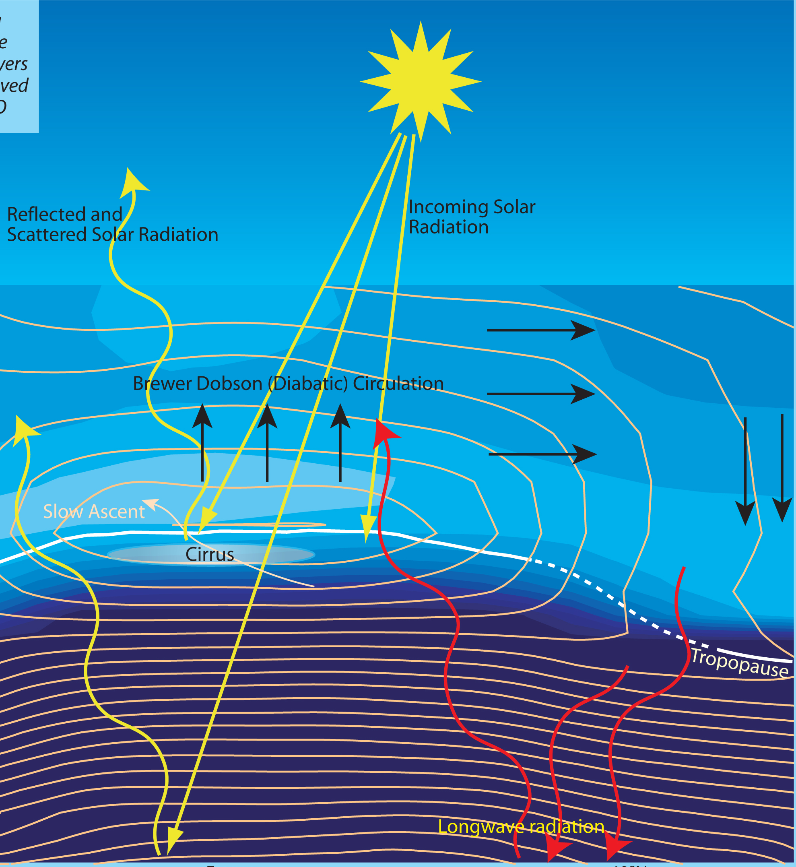
Why are we interested in stratospheric water vapor?
Water vapor is a powerful greenhouse gas
Stratospheric water vapor affects the ozone layer
Water vapor near the tropopause may change in the future
Stratosphere
Tropopause
Troposphere
10 miles

Slide 3
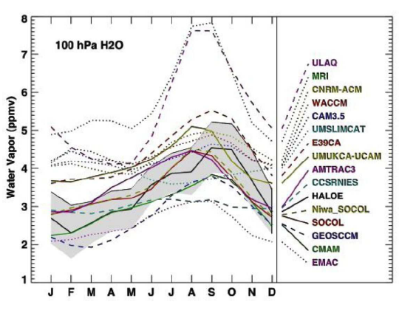
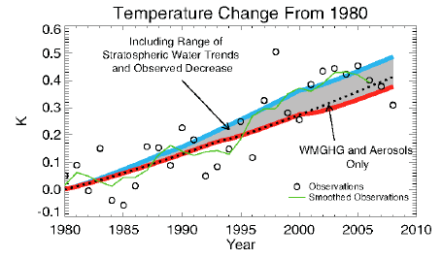
Stratospheric Water Vapor and temperature trends
Temperature trend differences due to ~1 ppmv stratospheric water vapor change
(left – red vs blue curve). Climate model calculations of tropical lower stratospheric
water (right).

Slide 4
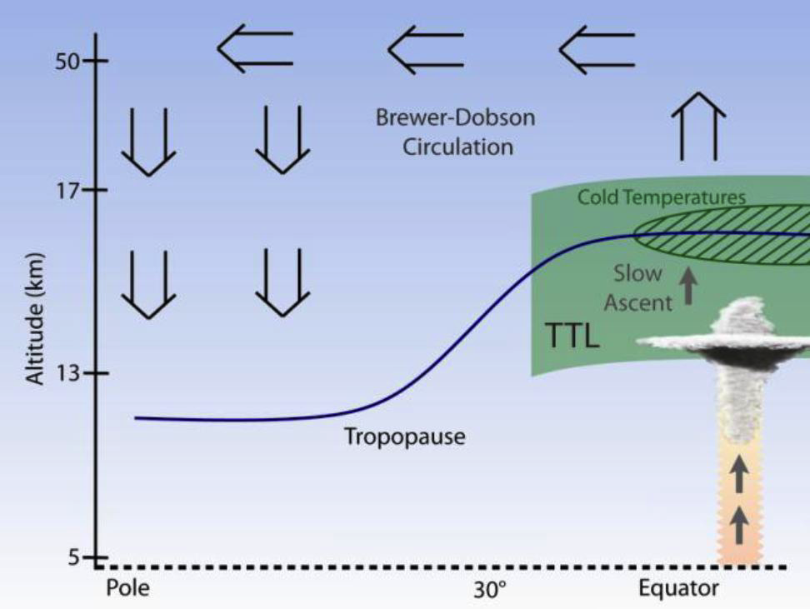
The Tropical Tropopause Layer (TTL) is the Gateway to the Stratosphere
The TTL is a cold trap: vapor condenses on ice crystals which then fall, limiting the humidity of air reaching the stratosphere.
Stratosphere
Troposphere
Latitude
Need to understand TTL clouds, transport, waves, and radiation
Ultimate goal: improve models and climate predictions

Slide 5
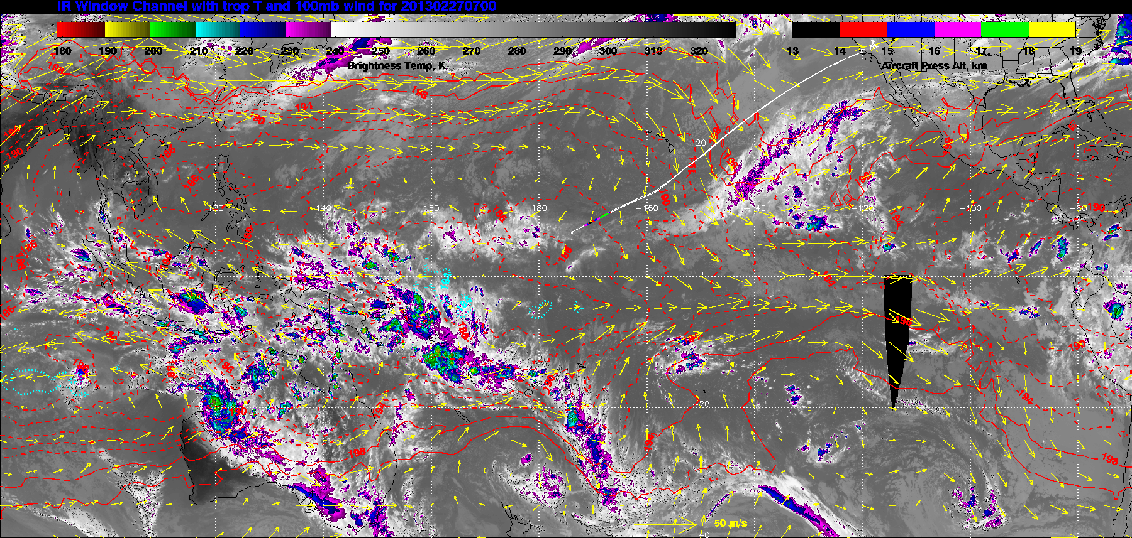

Slide 6
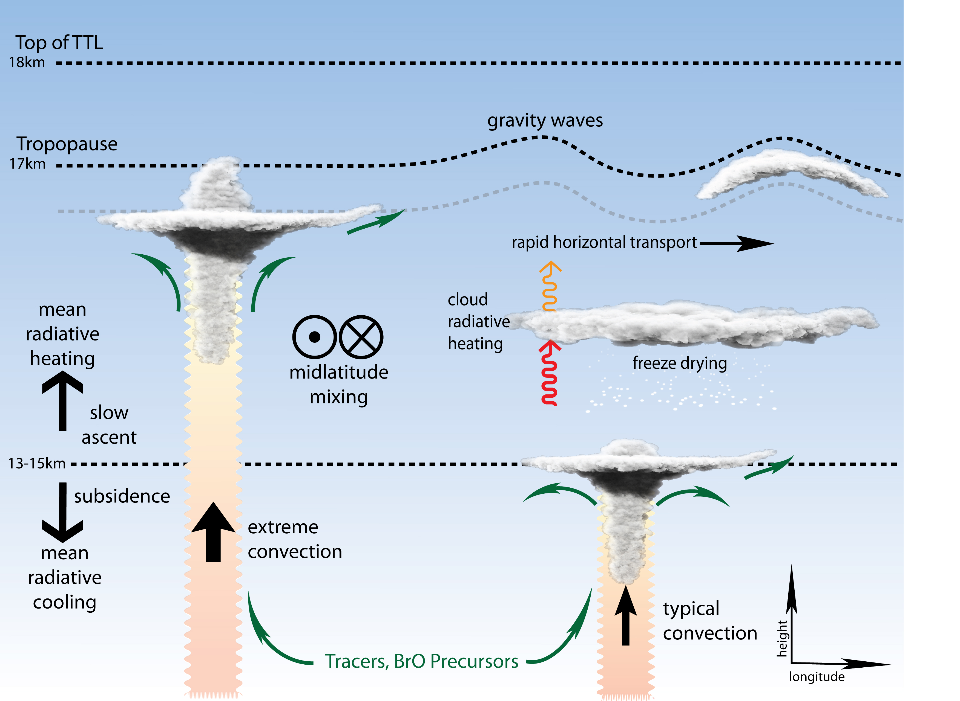
What physical mechanisms affect water vapor in the tropical stratosphere?

Slide 7
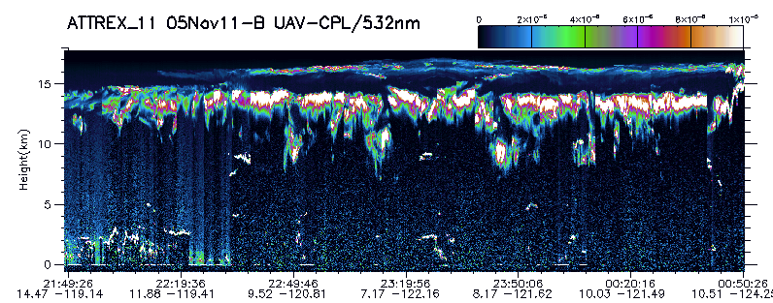
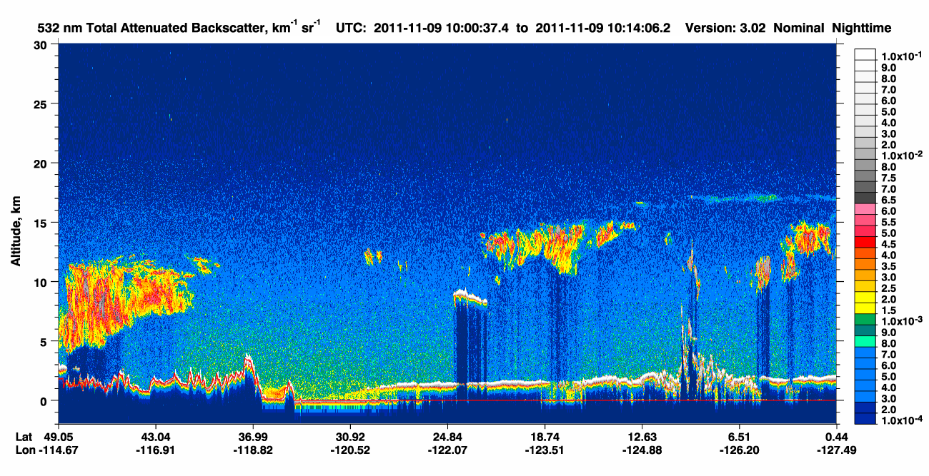
Downward pointing
Lidar aboard our
aircraft

Slide 8
How are we doing this?
Instrumentation
Flight ops
Flight patterns

Slide 9
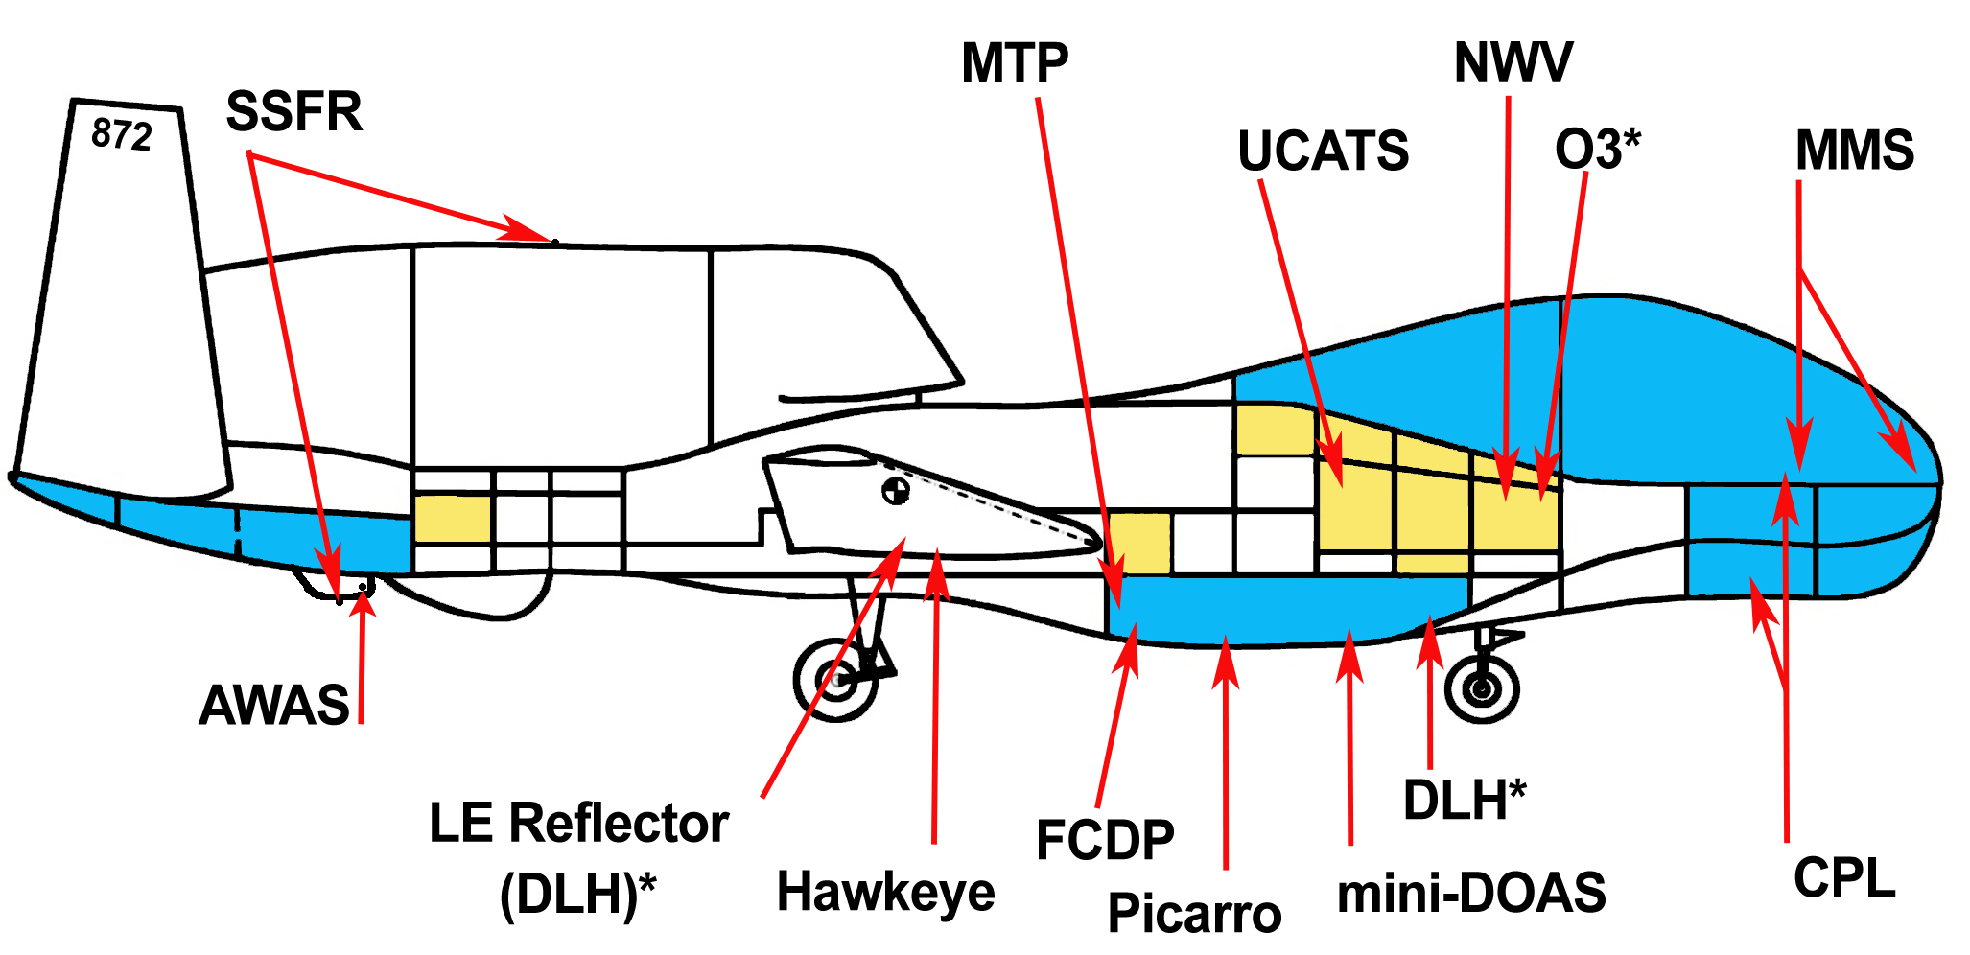
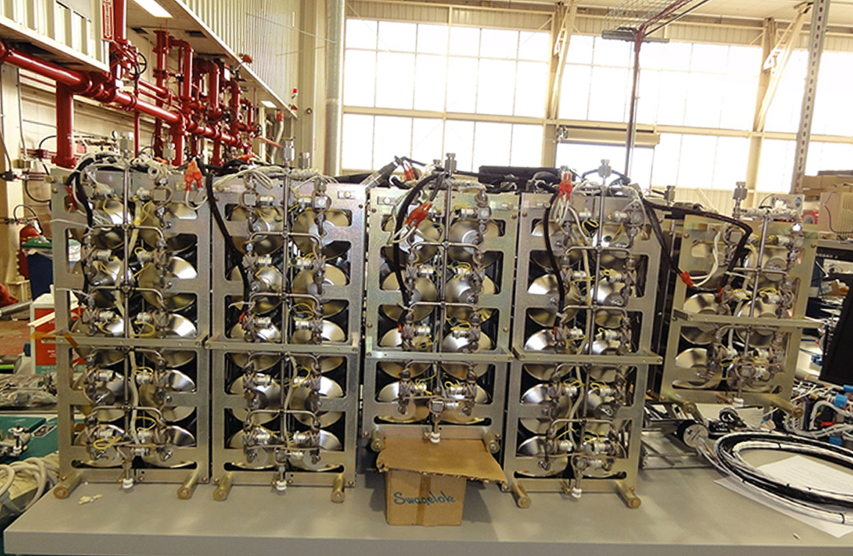
ATTREX Payload Measurements
State-of-the-art instruments measuring:
  Water vapor under cold, dry conditions
  Gases and particles
  Temperature and winds
  Radiation
Whole air sampler

Slide 10
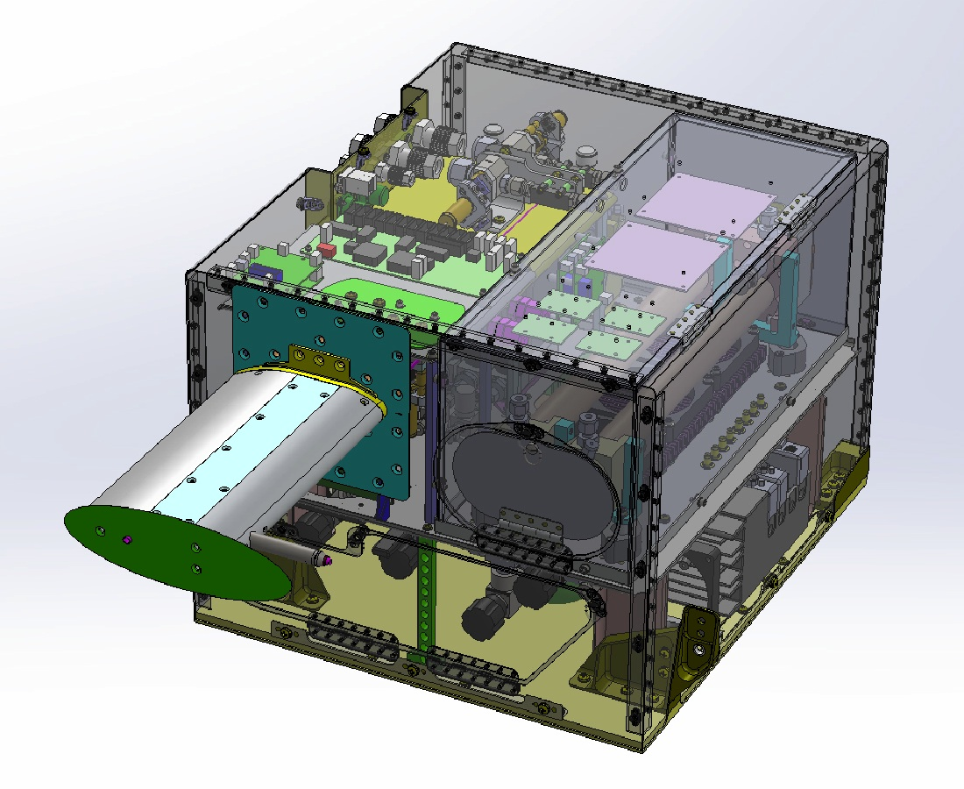
NOAA Water Vapor Instrument
Provides a precise and accurate measurement of water vapor every second from air that is pumped through the instrument.

Slide 11
Operations description

Slide 12
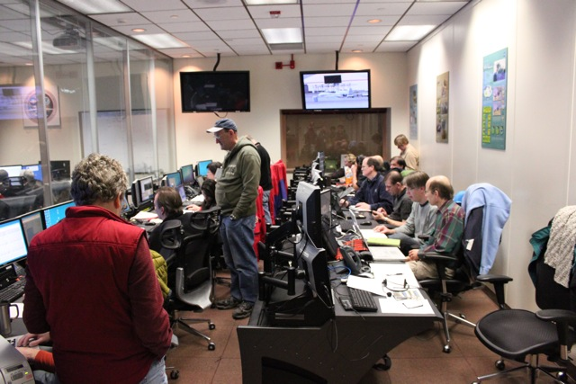
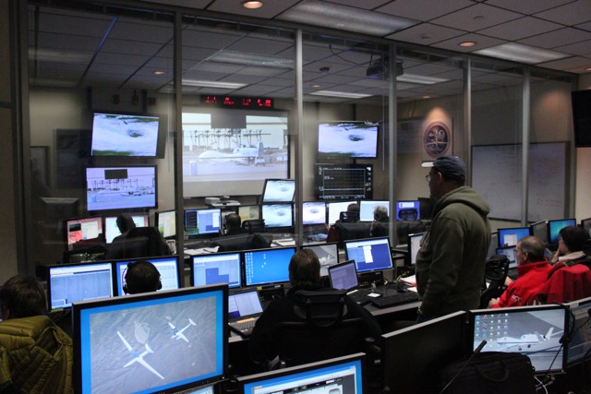
Flights: Global Hawk Operations Center
High-speed satellite link gives us real-time data in the control room
Decisions about where to send the aircraft are made in real time during the flights

Slide 13
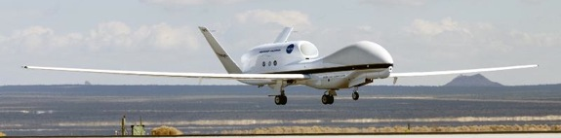
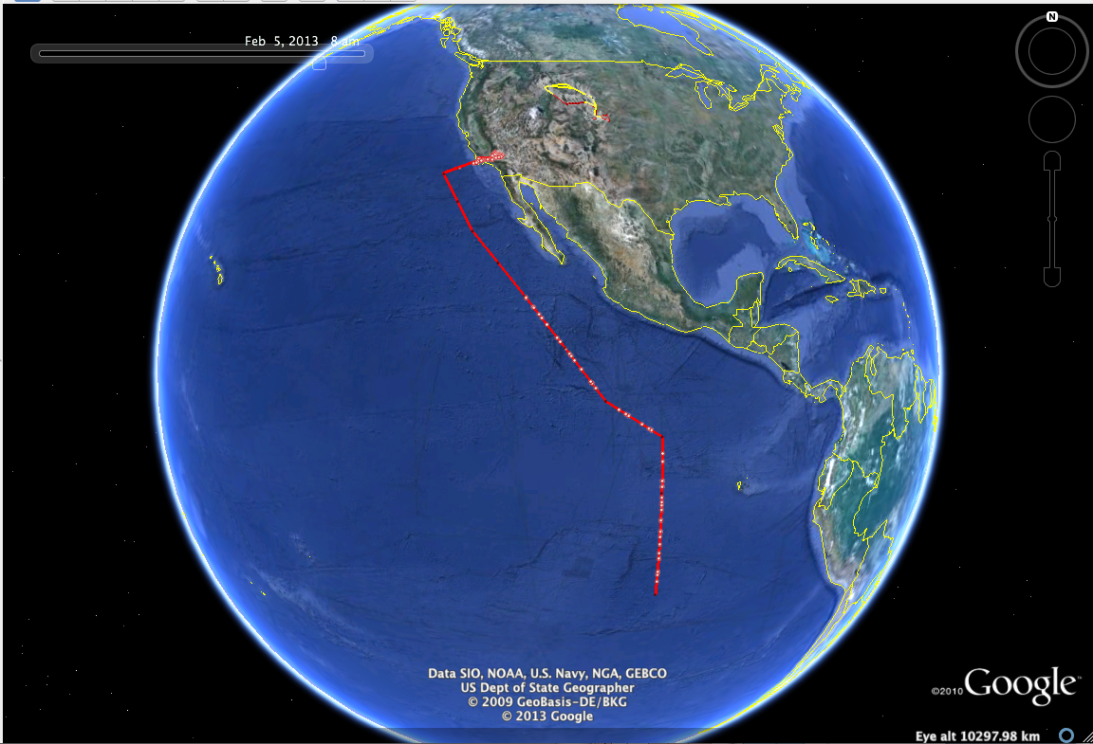
The Global Hawk Unmanned Aircraft is ideal for sampling the tropics and tropopause Region
45,000−65,000 feet altitude
  Commercial aircraft below 45,000 feet
Up to 30 hours duration
  Manned aircraft < 10 hours
Long range (12,500 miles) allows us to sample the tropics with flights from California
Flight of 21-22 Feb 2013

Slide 14
Flights and results
Fall, 2011 flight series (DFRC) – temperatures are cooling rapidly overall, so should see clouds and dehydration
Winter, 2013 flight series (DFRC) – temperatures reach minimum in winter, so air gets dry. Winter most important because the ascent rate is highest (cold air
Winter, 2014 flight series (Guam) – Western Pacific has the coldest temperatures, which means the driest air AND the most ascent into the stratosphere – key region

Slide 15
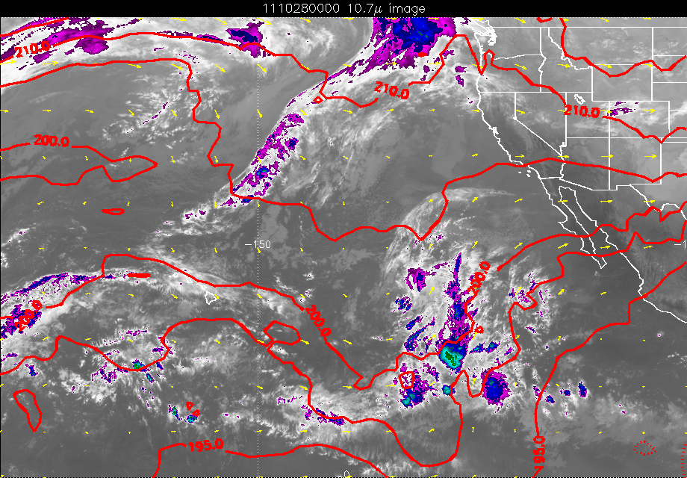

Slide 16
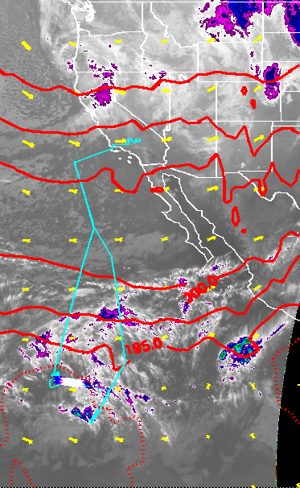
Some Results from the fall 2011 flight series
Plot shows “cutout” of water vapor
near 16.5 km (green), coinciding with cold
temperatures (blue), and high ice crystal
counts. (red) We also see regions outside
the cutout that have ice and are supersaturated
Aircraft did vertical profiles in cold region
at south end

Slide 17
Same flight, with the overview from the overflying
lidar. Note regions with low ice concentration
(blue). These regions have high supersaturation
(right). We believe significant supersaturated air
can get into the stratosphere, resulting in
moister conditions.

Slide 18
Winter, 2013 (DFRC based) results

Slide 19
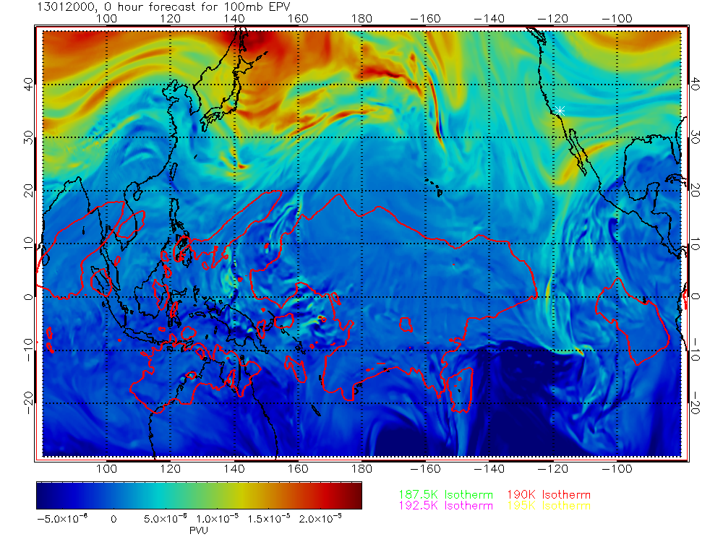

Slide 20
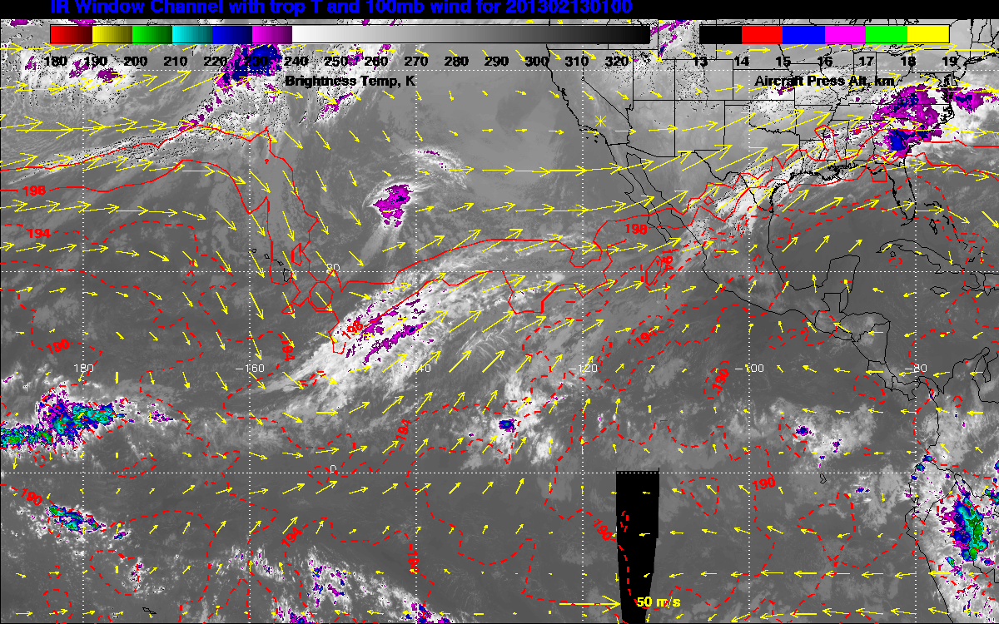

Slide 23
Winter 2014 Guam Deployment

Slide 24
ATTREX-Guam science flights
6 Guam local flights + 1.5 transits
~100 hours of TTL sampling
~180 TTL vertical profiles (GWAS samples on ascents)
ATTREX totals:
>200 hrs of TTL sampling
~300 TTL vertical profiles
Notes:
Thickness of the flight tracks corresponds to altitude ranging from about 45 and 60 kft.
RF02 (the cyan dot near Guam) was a flight on which the satellite communications failed, and we just went up and down over Guam for 18 hours.

Slide 25
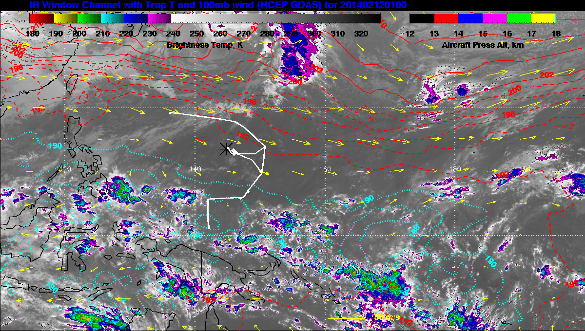

Slide 26
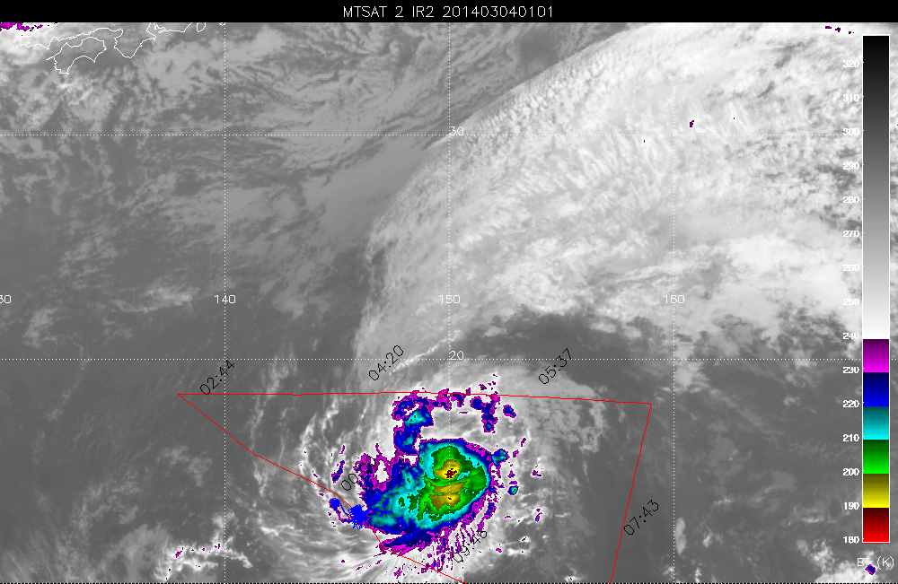

Slide 27
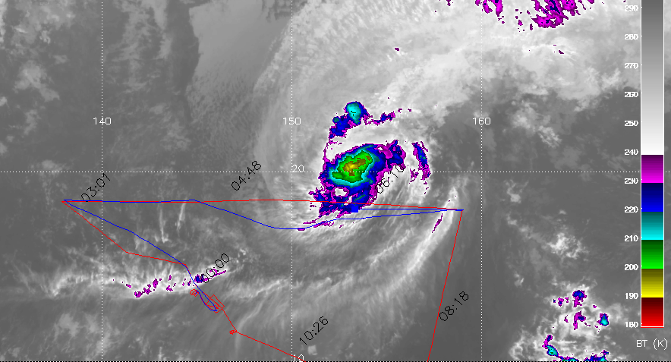
Quantifying TTL convective influence
CO₂
J. Pittman, B. Daube, S. Wofsy
Tropical cyclones Faxai and Lusi strongly perturbed the western Pacific TTL composition.
These measurements will be used to evaluate models of vertical transport in deep convective systems.
Notes:
We had two flights near typhoons that provide unique information about perturbation of the upper tropospheric composition by these cloud systems.
The figure on the right shows The CO2 concentration versus altitude, with the points color coded by latitude. The blue profile shows the CO2 profile near Guam; further north there was a strong enhancement in CO2 (and various other tracers) associated with the typhoon.

Slide 28
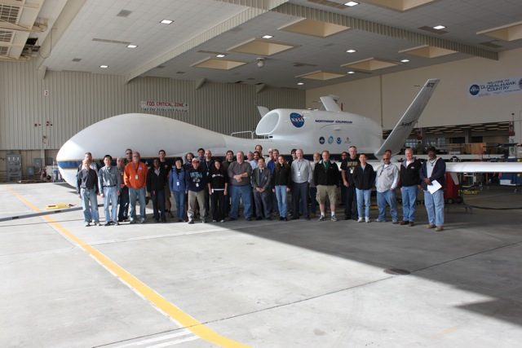
ATTREX Science and Operations Team
ATTREX multi-disciplinary investigators from NASA, NOAA, universities, private companies, and Europe

