Slide 1
Met brief for Sun Feb 23
22 Feb 10 AM
Rennie Selkirk with Lenny Pfister and Lynn Harvey
Upper levels continue to moisten from disturbance near Chuuk
sounding less stable though expect CAPE to decrease
Feel Andersen TAF too pessimistic
 | wind | cloud cover (base) | precip
Sun takeoff 3 AM (2215) | E015 | SCT020 SCT180 Cirrus 300 | isolated TS | CAPE decreasing
midflight 10 AM – 3 PM | - isolated TS in UA zone - current trop T ~-85 (188K) @ 53 kft - expect trop to move up but similar to slightly colder
Landing (14-18 hrs) 5-9 PM (2307-11) | ENE015 | SCT020 | isolated TS Slt chc thndr

Slide 2
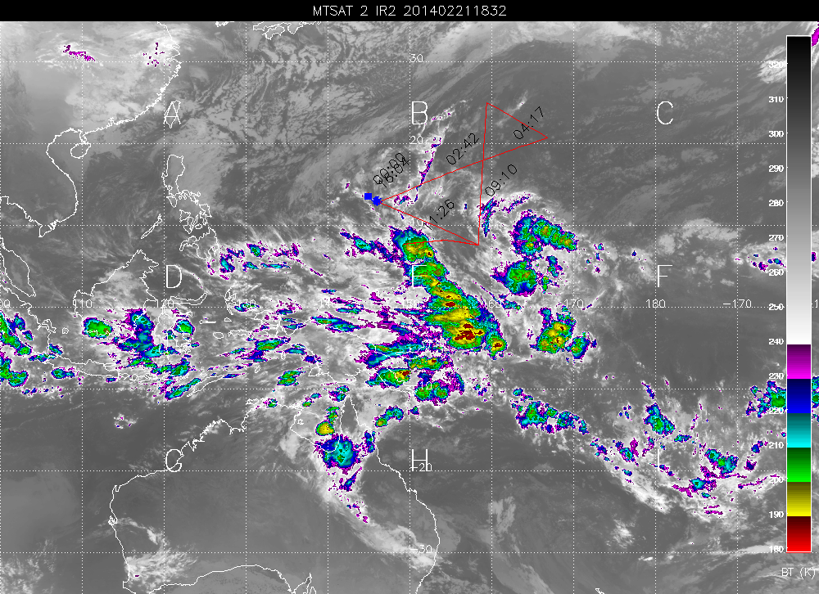
Current IR: 1832 UT 21 Feb
Line of convection formed in Eq zone, from Chuuk to SSE

Slide 3
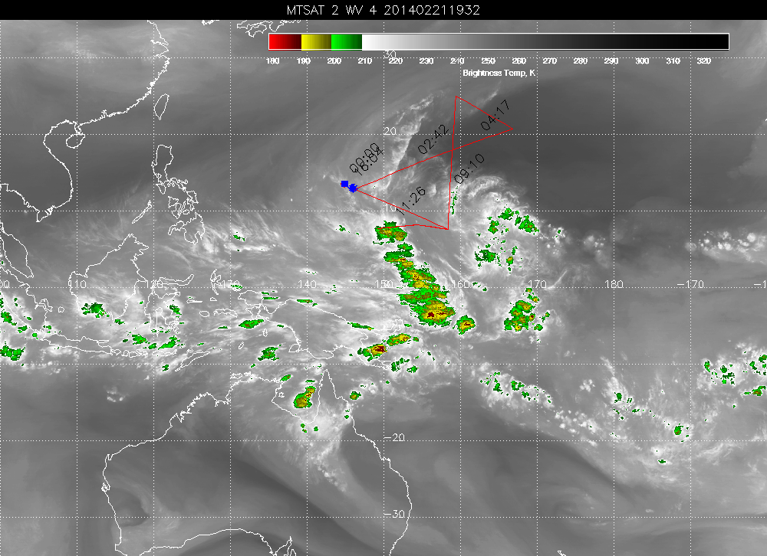
Current WV: 1932 UT 21 Feb
Guam remains under

Slide 4
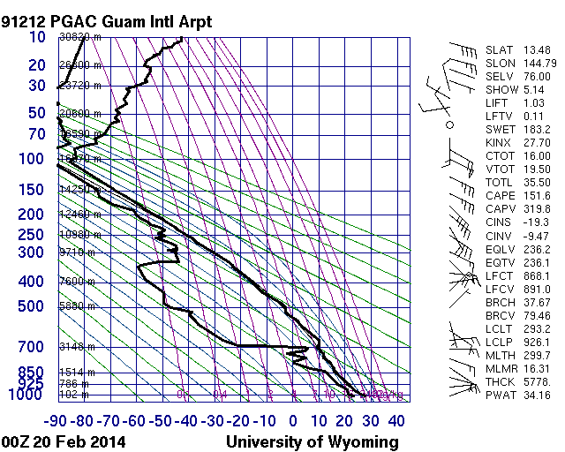
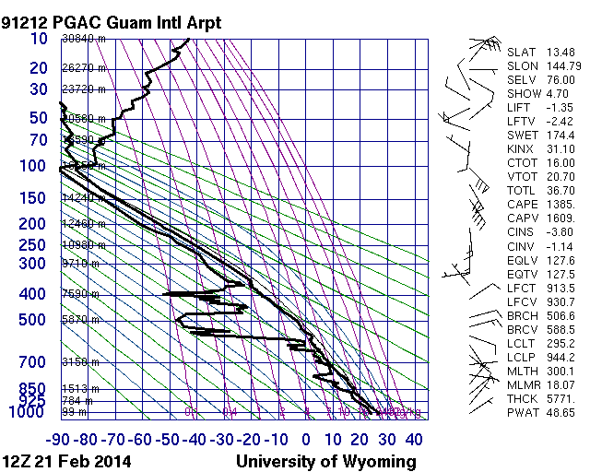
Big change in PGAC sounding last two days
Thu AM
Fri PM
MOISTER, LESS STABLE
Precip. Water : 34 to 49 mm
Lifted index = -1.35 (unstable)
CAPE = 1385

Slide 5
GFS surface fcsts
takeoff / landing
22 Feb 12 UT (T-3hr)
23 Feb 12 UT (10 PM)
Line of convection formed in Eq zone, from Chuuk to SSE

Slide 6
Ceiling: from GFS 850 hPa fcsts
22 Feb 12 UT (T-3hr)
23 Feb 12 UT (10 PM)
Guam is in relative dry slot => ceilings not as bad as in TAF

Slide 7
Mid-trop moisture: 500 hPa RH
Forecasts drying out
22 Feb 12 UT (T-3hr)
23 Feb 12 UT (10 PM)
Guam is in relative dry slot => ceilings not as bad as in TAF

