Slide 1
Met brief for Thursday, Feb 6 flight
Take off (7 am)
Cloud base at 950 mb (1500 – 1700 ft), Cloud coverage scattered at 4 am, becoming less through the day.
Isolated showers prior to take off, drying out during the course of the day.
Winds out of the East to Northeast between 10 – 15knots
Forecast sounding is dry above 10kft, no icing issues.
Convection (pink contours on high cloud map) located along eastern half of the flight track. Will need to be monitored during the flight.
Landing (9 pm)
The shear line stalling just north of us, leaving us with isolated showers.
Winds are more Northeasterly at 10 – 15 knots
Cloud coverage – scattered, cloud base 1500-2000 feet.
Note: the flight track on these weather maps is outdated

Slide 2
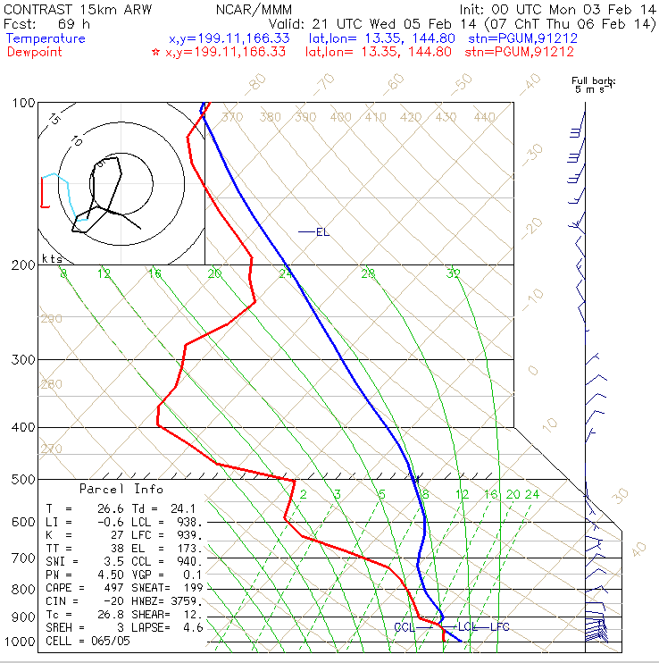
Thursday (Feb 6, 2014) at 7 am local time sounding
Cloud base at about 950 mb (1500-1700 ft)
Mostly dry

Slide 3
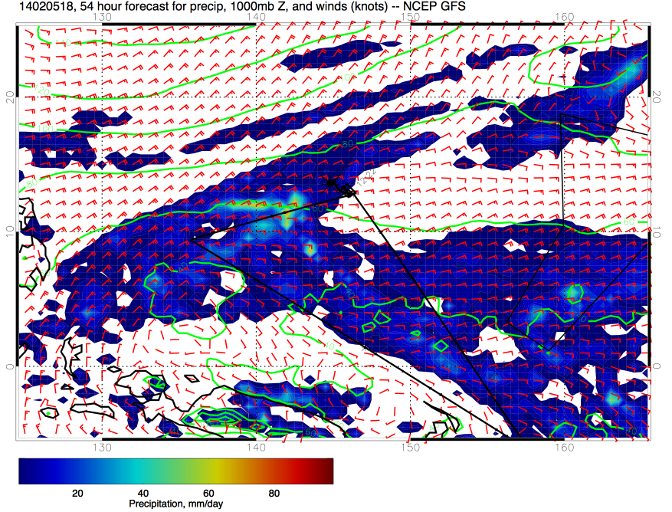
1000 mb Precip, Thursday 4 am

Slide 4
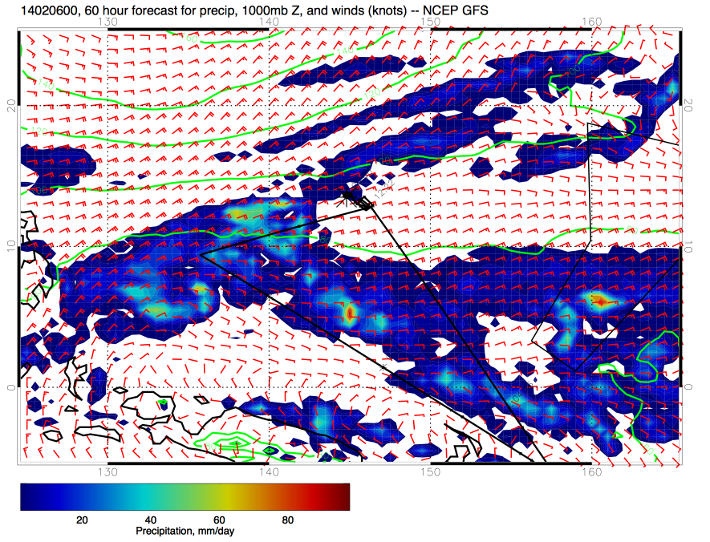
1000 mb Precip, Thursday 10 am

Slide 5
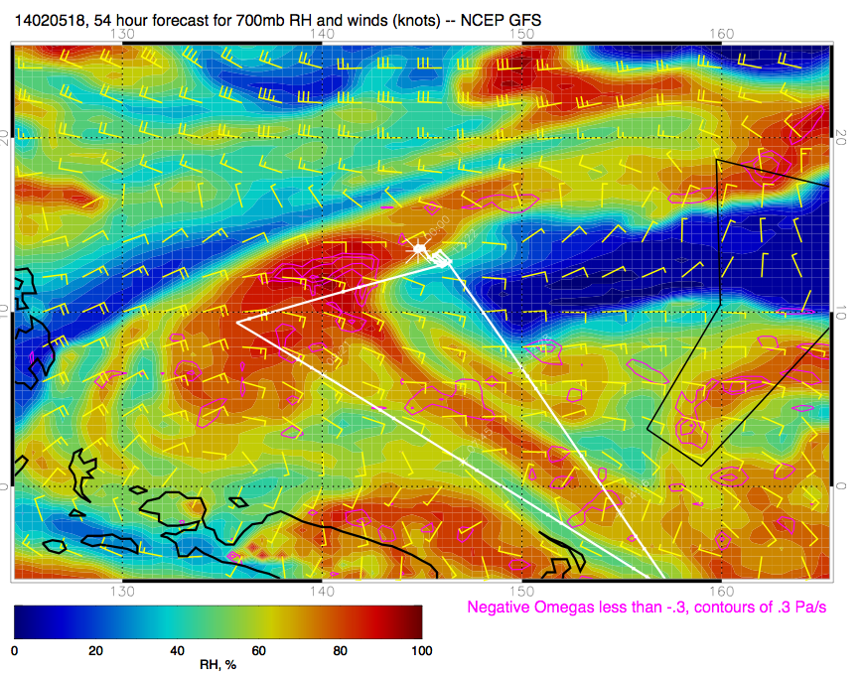
700 mb RH, Thursday 4am

Slide 6
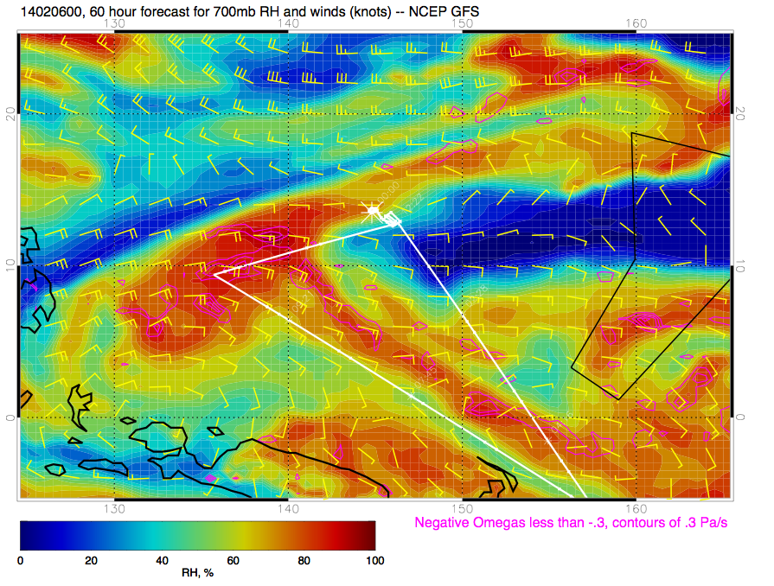
700 mb RH, Thursday 10 am

Slide 7
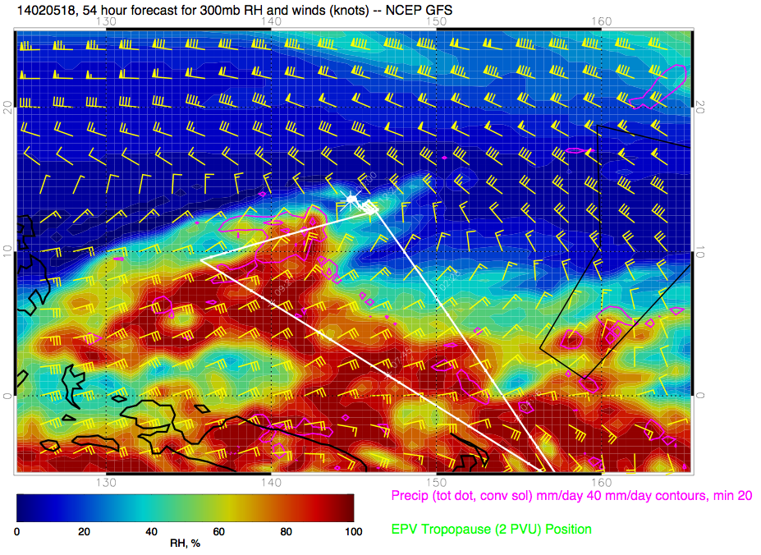
300 mb RH, Thursday 4 am

Slide 8
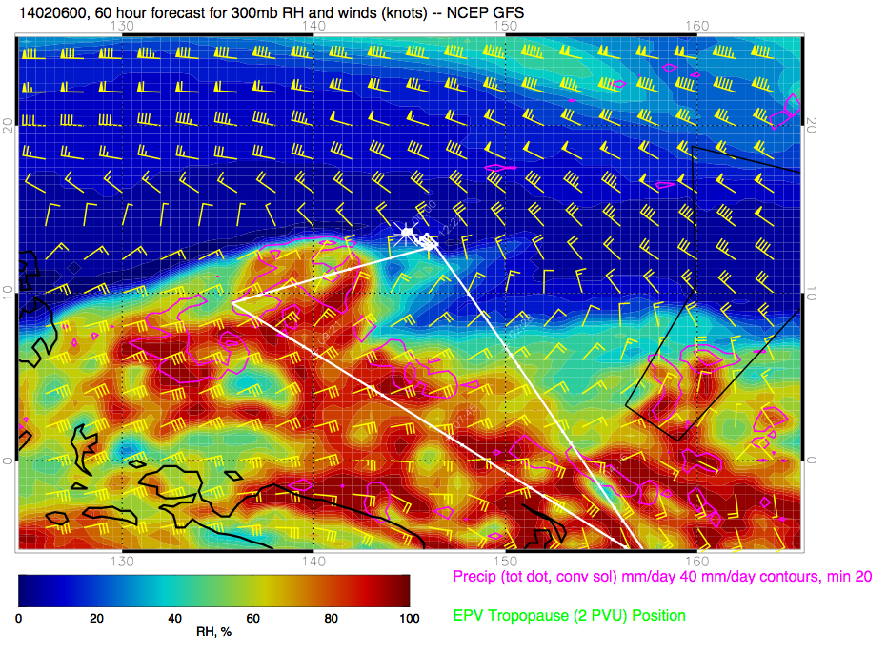
300 mb RH, Thursday 10 am

Slide 9
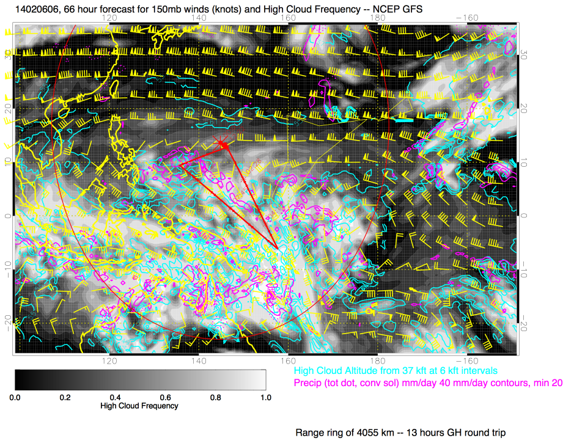
Mid-flight, high cloud top and convection (4pm)

Slide 10
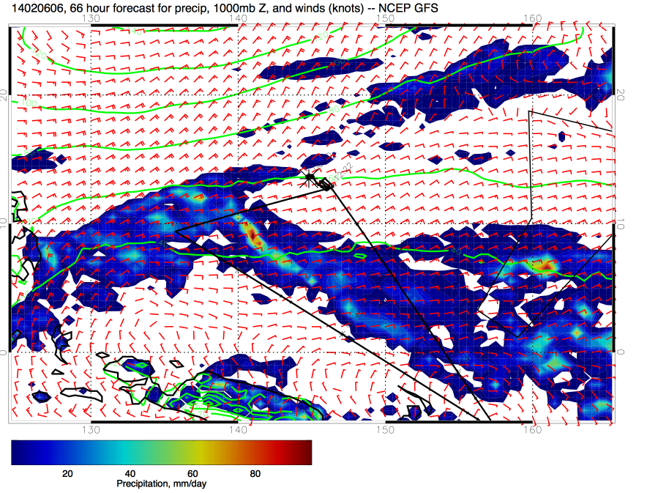
1000 mb Precip, Thursday 4pm (Landing)

Slide 11
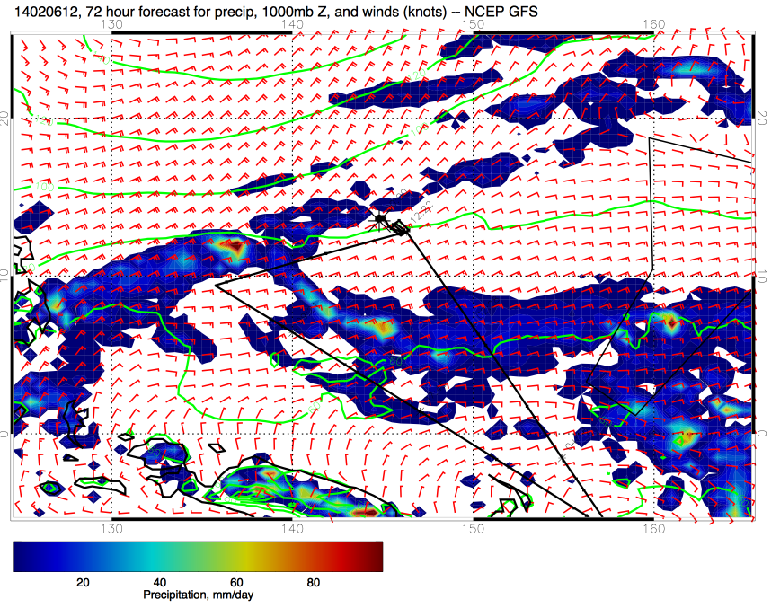
1000 mb Precip, Thursday 10 pm

Slide 12
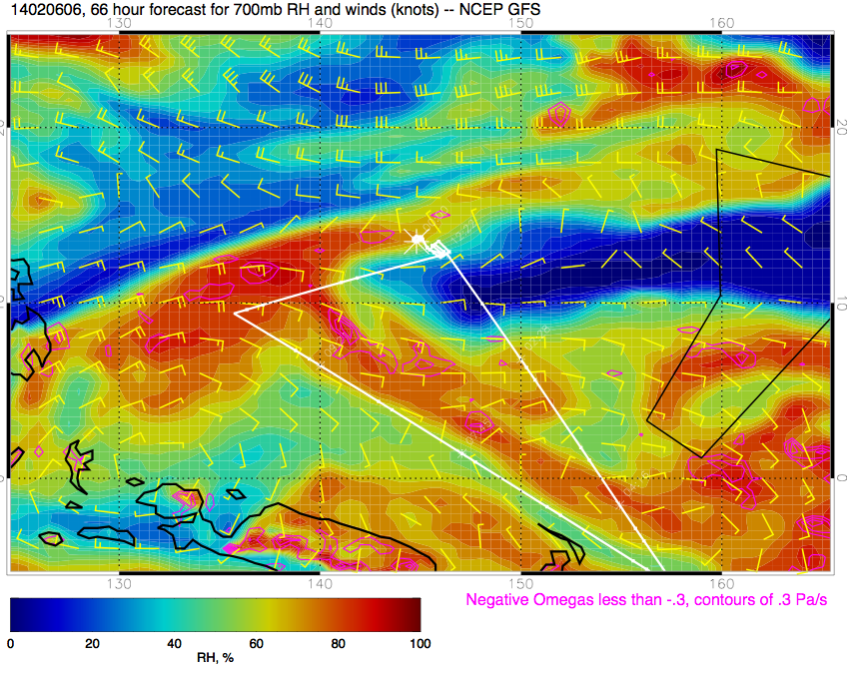
700 mb RH, Thursday 4pm

Slide 13
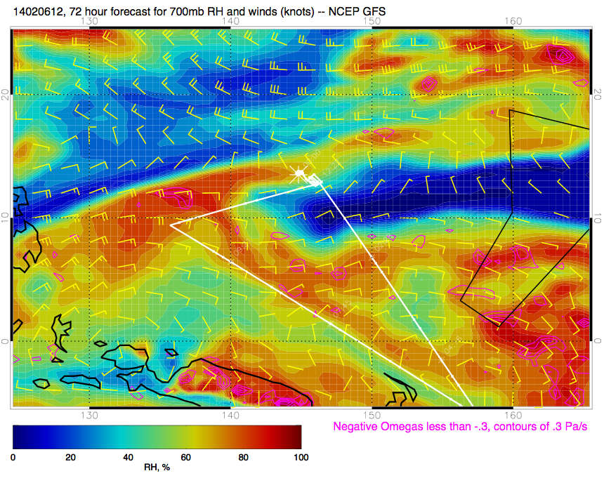
700 mb RH, Thursday 10 pm

Slide 14
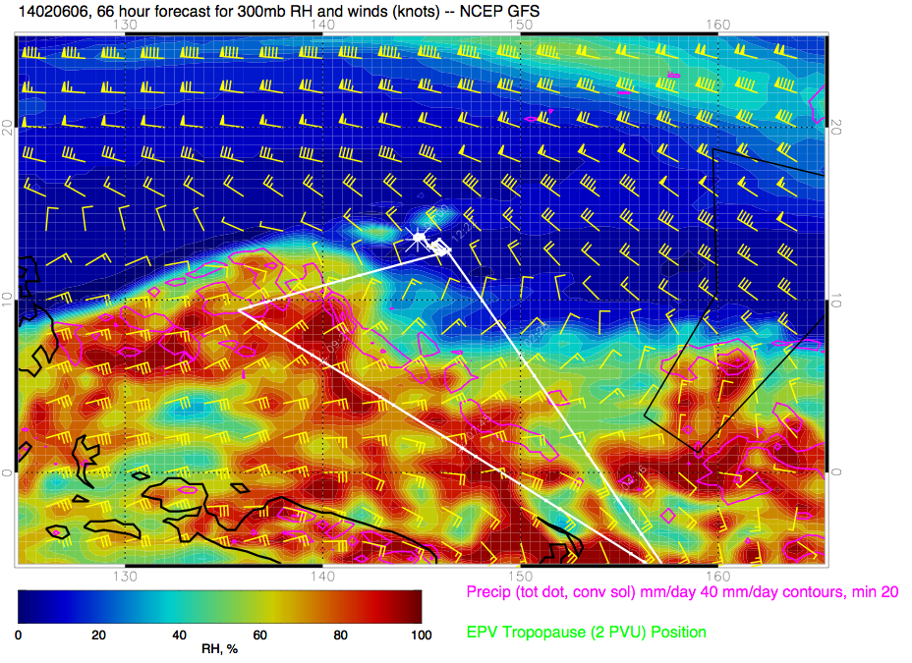
300 mb RH, Thursday at 4pm

Slide 15
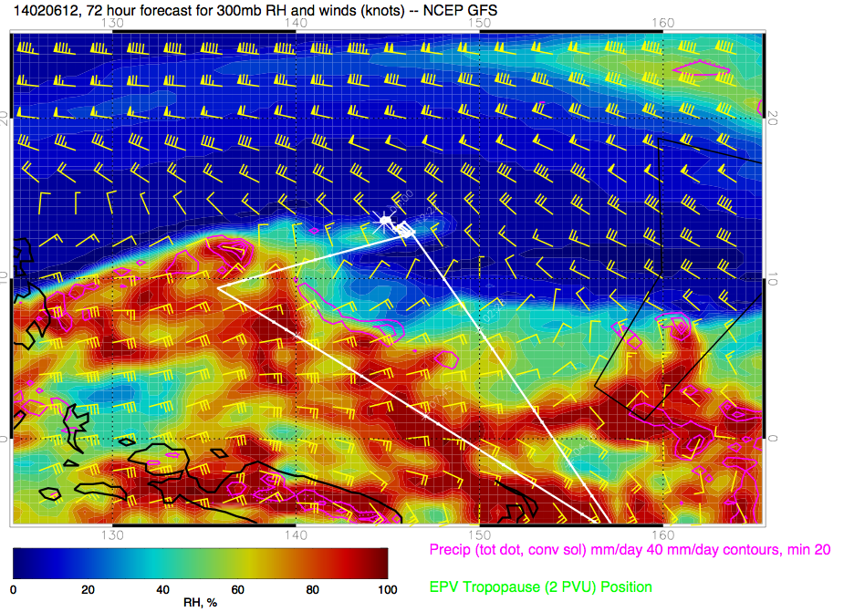
300 mb RH, Thursday at 10pm

