Slide 1
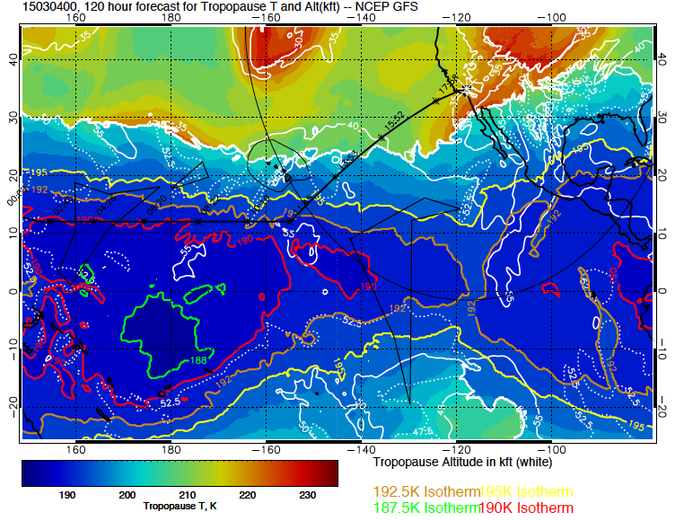
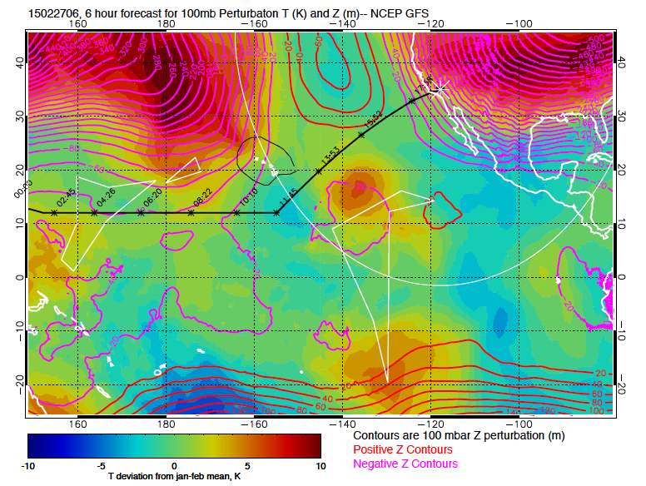
The coldest (188 on this scale) Ts
are out of reach at 4 PM Tuesday,
but the cold tropics are closest
in the east. Temperatures are
colder than a J-M average south
of Acapulco. GEOS-5 shows the
same basic picture

Slide 2
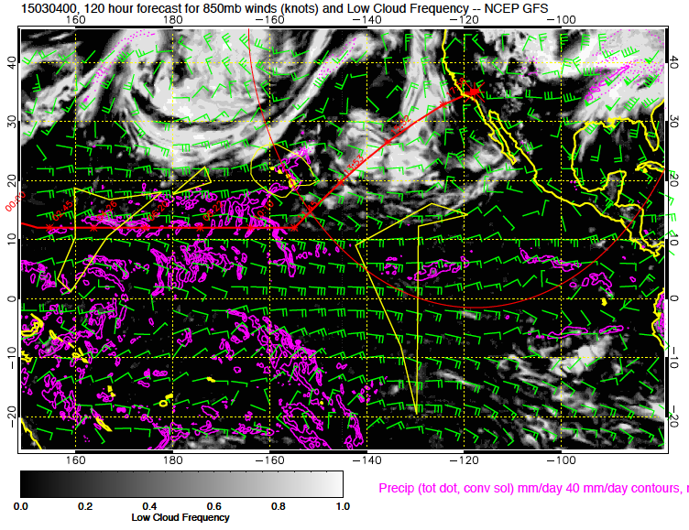
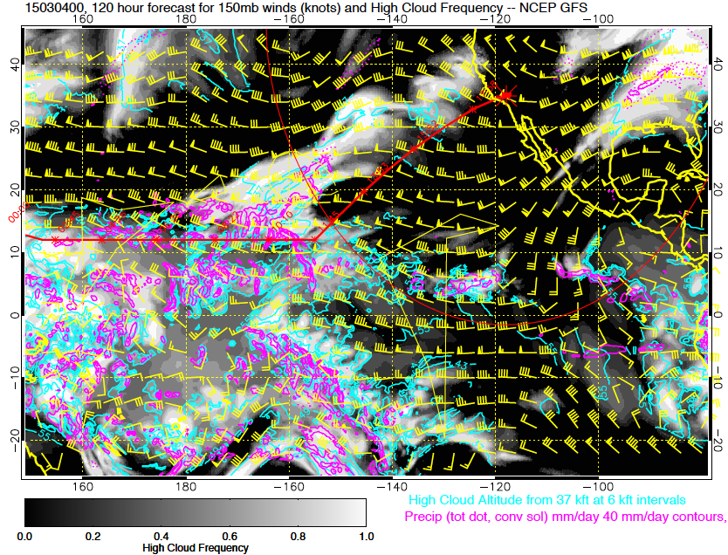
Clouds and convection (low clouds above,
high clouds to the right) show us generally
free of convection at reachable latitudes.
Most of the active stuff is forecast to be
Hawaii westward, except for an ITCZ in
the east at about 5N or so. Much of the
area along the Mexican coast is forecast
to be cloud free.

Slide 3
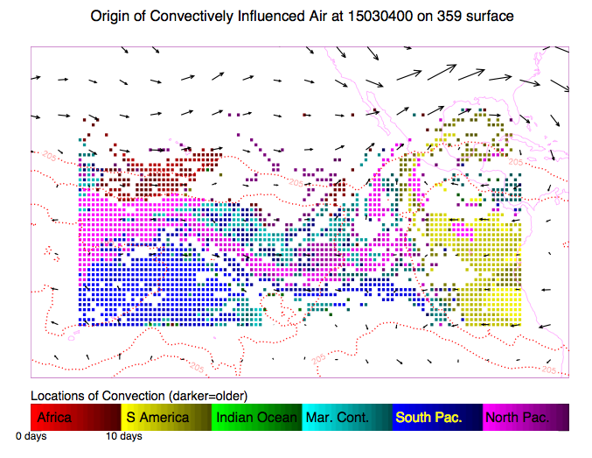
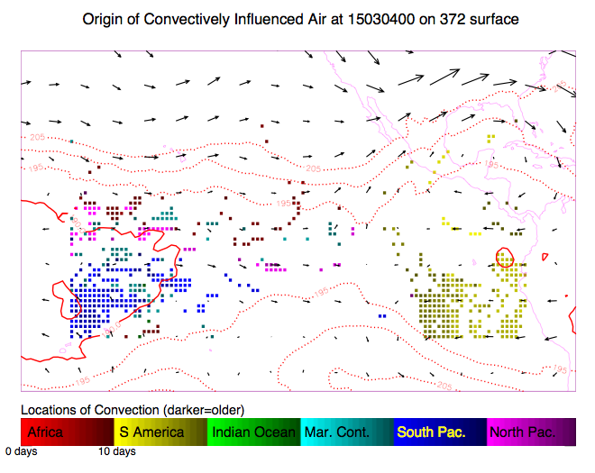
Convective influence in last 14 days. Eastern
Path suggests an interesting mix at 47kft
(359K) of air from different regions. Not
Much within reach at the higher level.
Some African air (!) to the SSW.

Slide 4
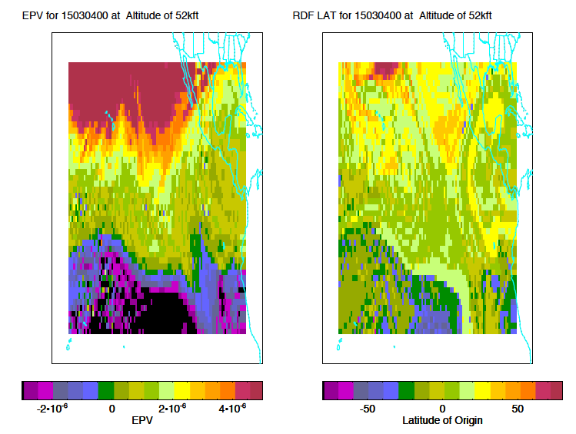
RDF plot shows interesting strong gradients on the eastern side, both in EPV and
latitude of origin (they should line up, more or less). At 47kft,

Slide 5
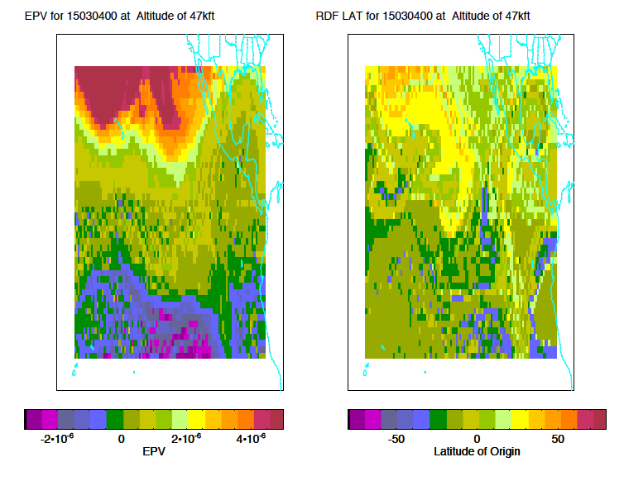
Note air from ~30S well north of the equator. May be hard to reach if we stay
near the Mexican coast.

Slide 6
TO/Landing wx
Evening takeoff only
Upper level low passes over our area this weekend – showery conditions
Another disturbance follows on Monday
Saturday and Monday disturbances tracking further over the ocean – more rain south of us, but a different wind history expected
At this time, forecasts do not indicate a crosswind concern at either TO or landing because of the change in track

