Slide 1
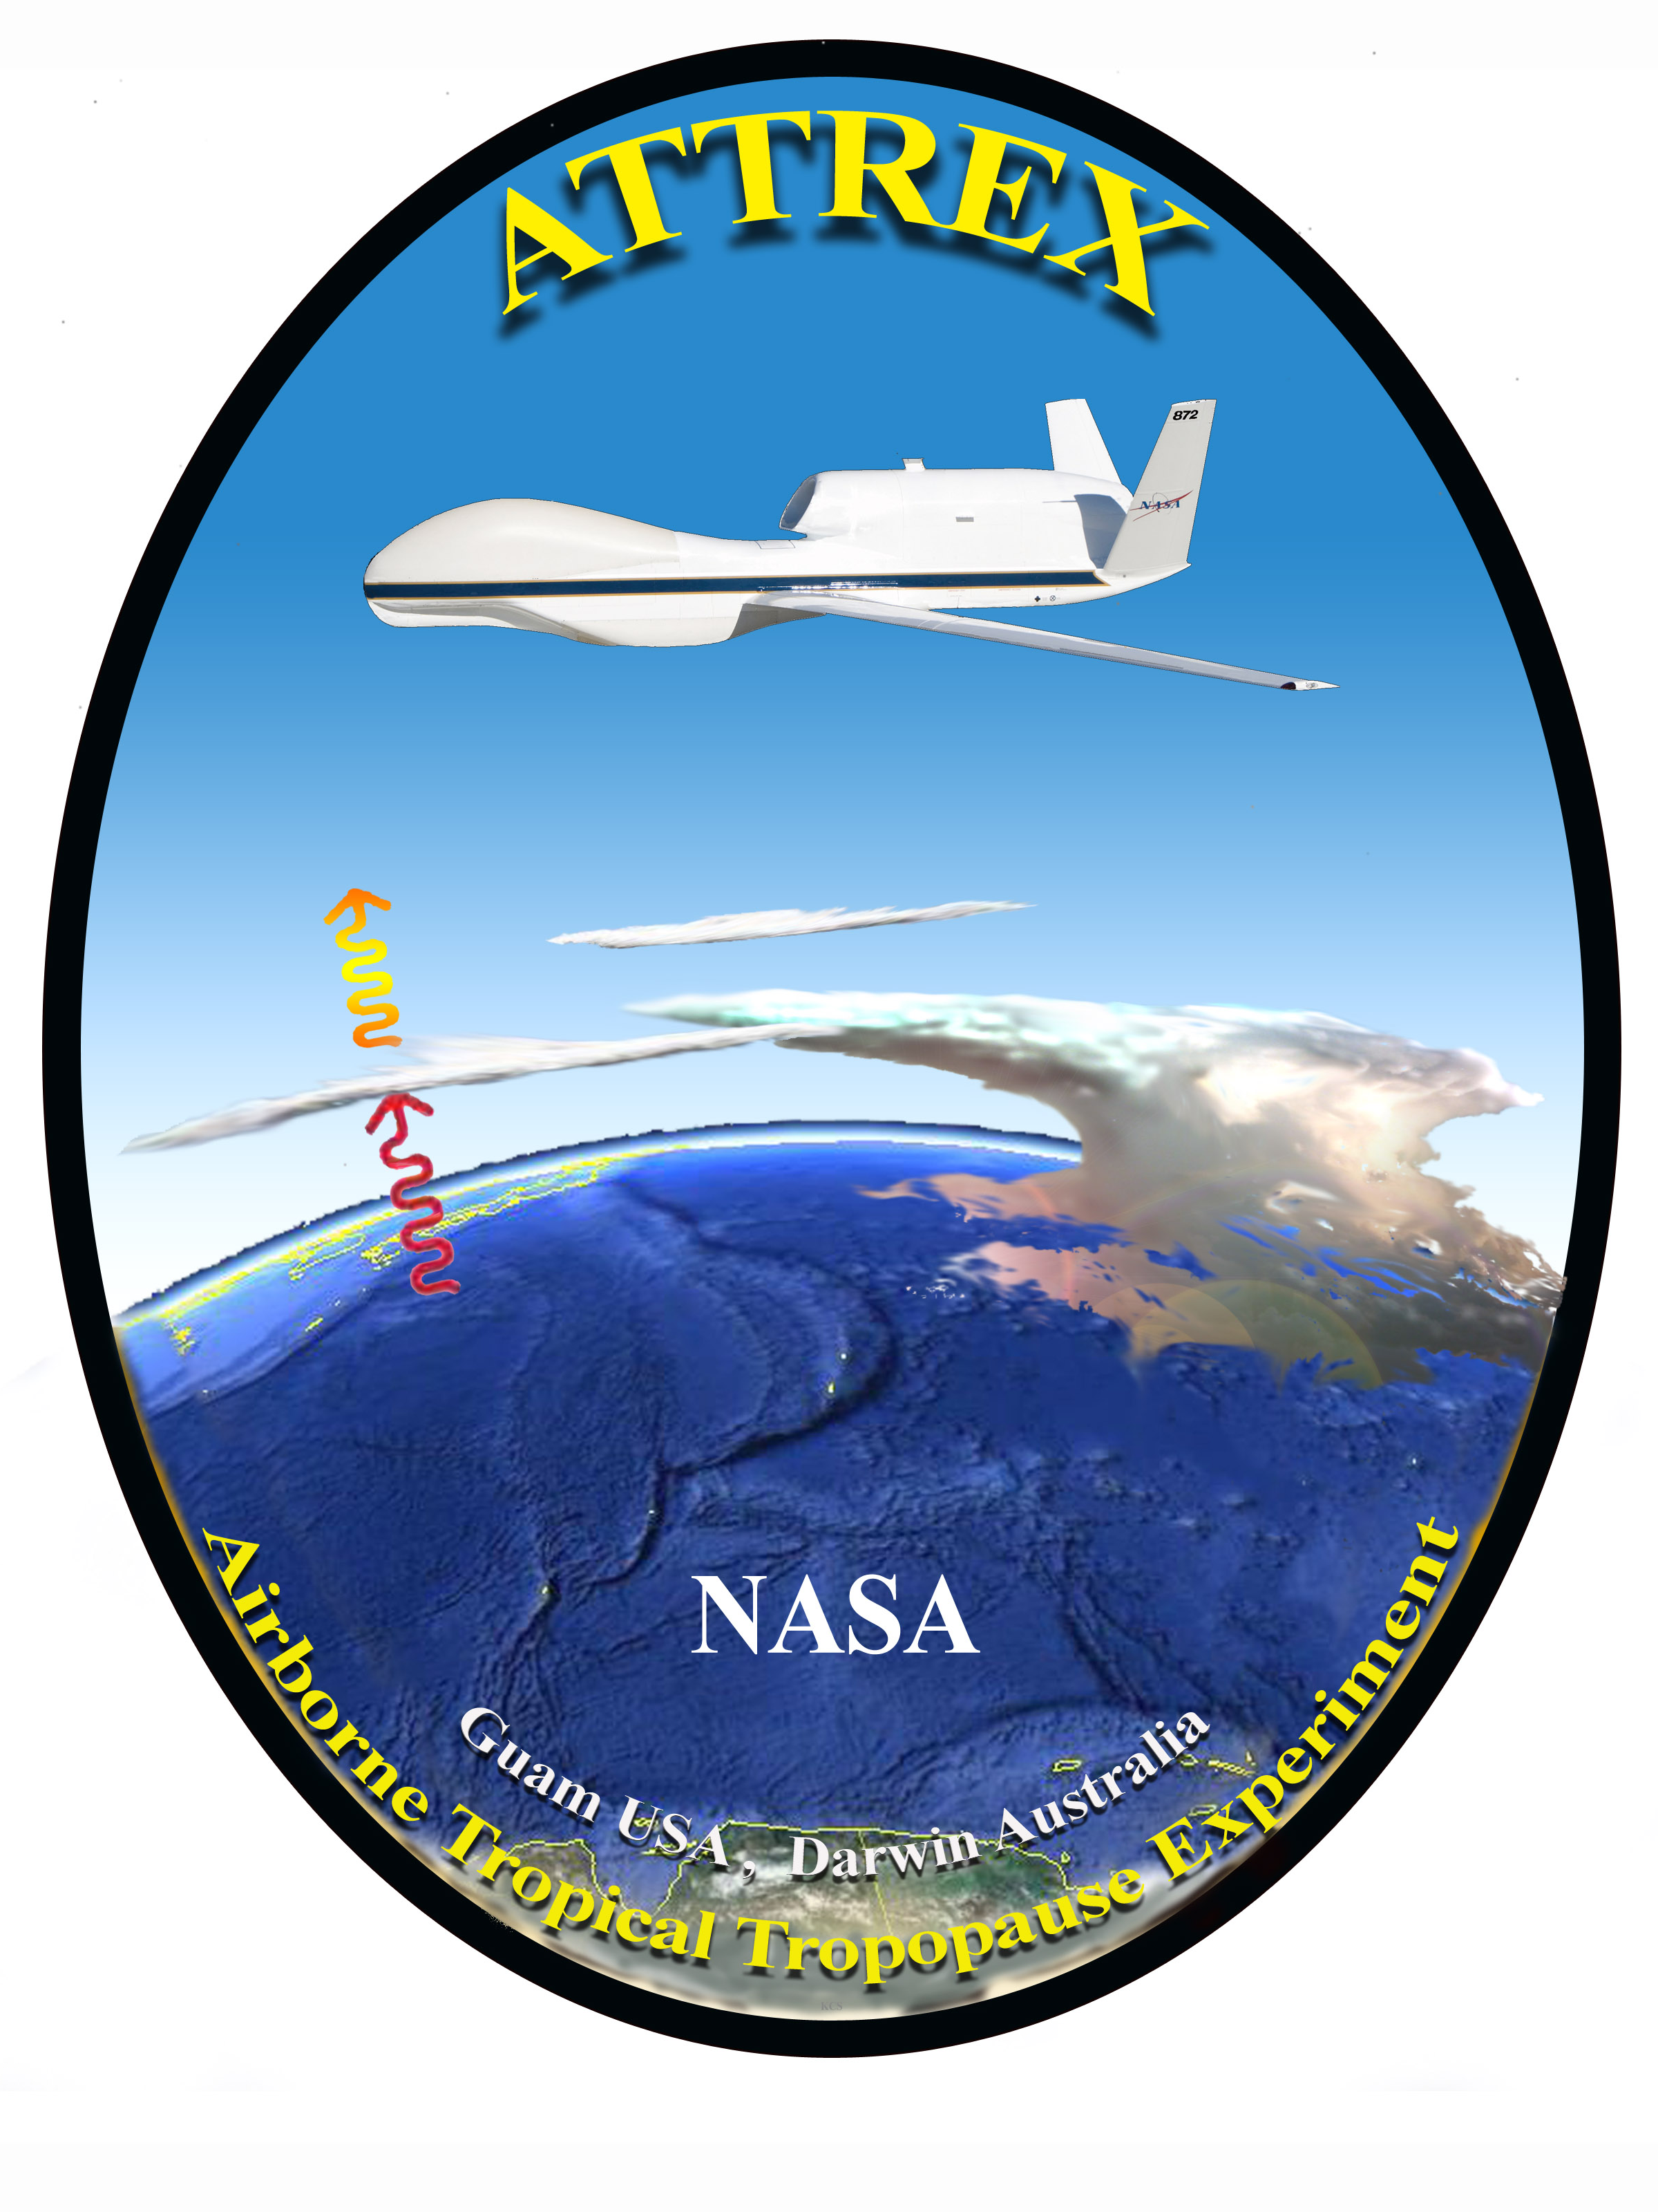
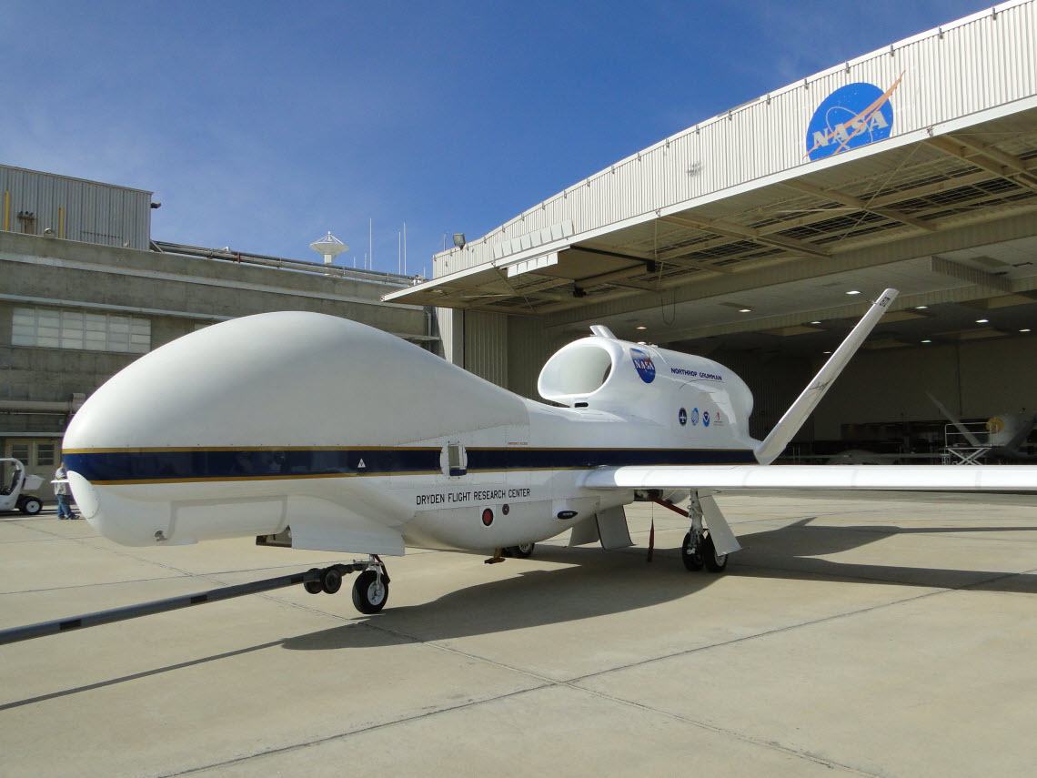
Airborne Tropical Tropopause Experiment (ATTREX)
Leonhard Pfister (Deputy Principal Investigator)
NASA Ames Research Ctr., Mtn. View, CA
Eric Jensen (Principal Investigator)
Dave Jordan (Project Manager)
NASA Ames Research Ctr., Mtn. View, CA

Slide 2
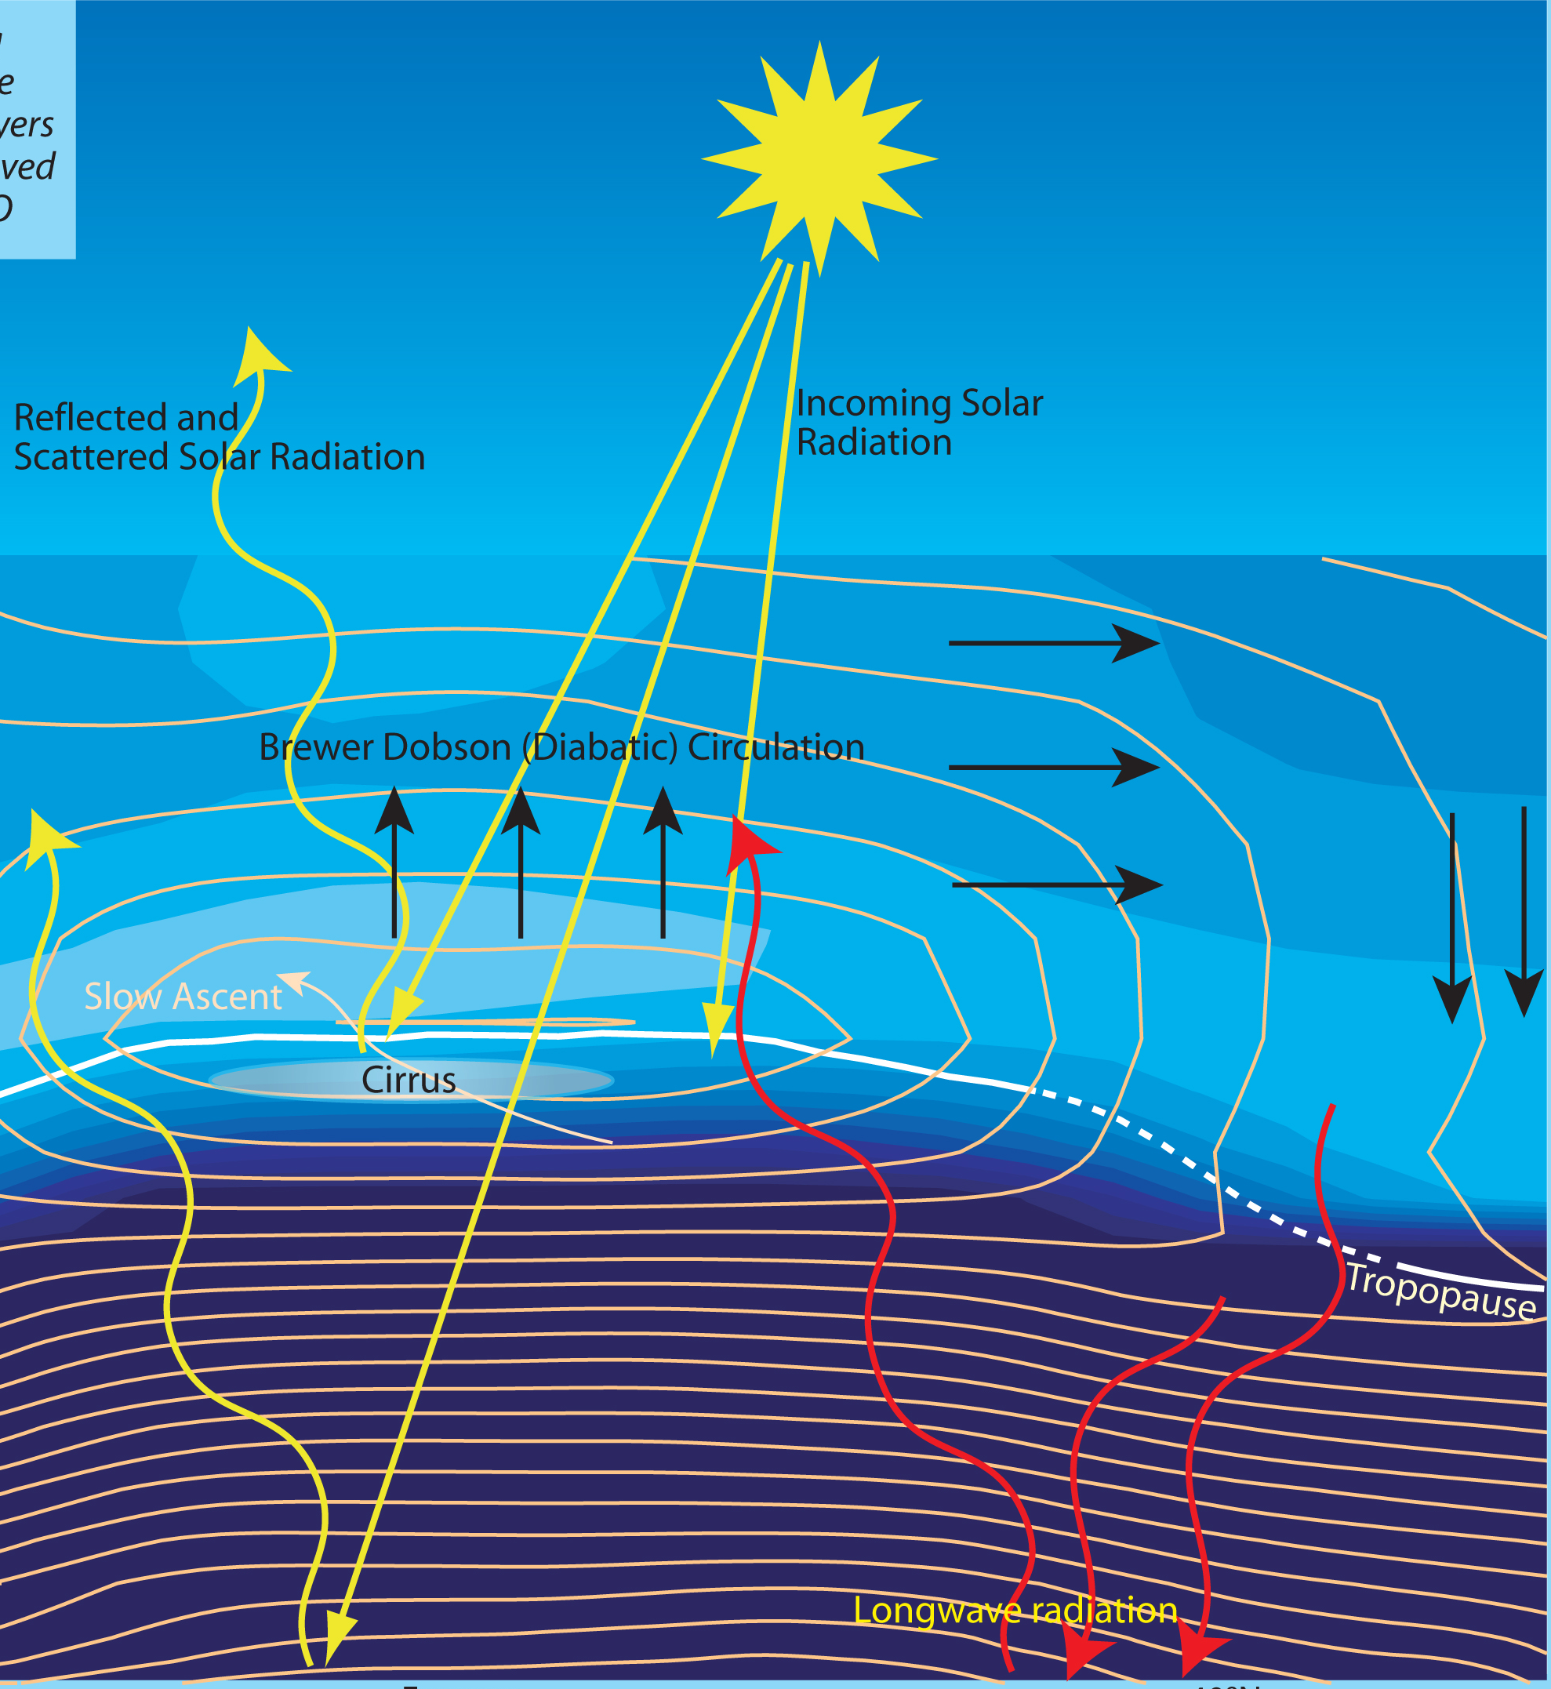
Why are we interested in stratospheric water vapor?
Water vapor is a powerful greenhouse gas
Stratospheric water vapor affects the ozone layer
Water vapor near the tropopause may change in the future
Stratosphere
Tropopause
Troposphere
10 miles

Slide 3
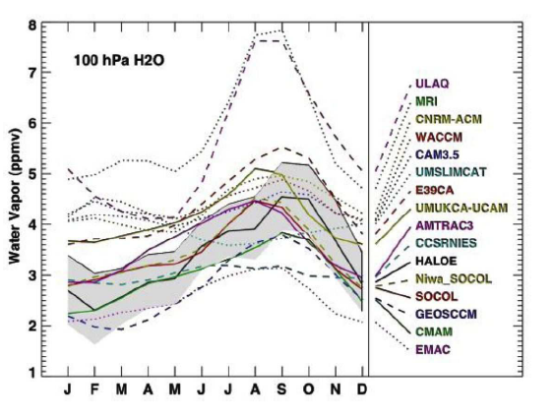
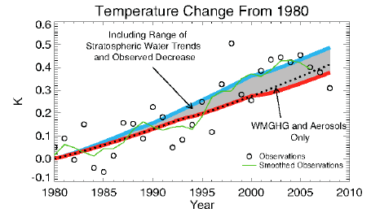
Stratospheric Water Vapor and temperature trends
Temperature trend differences due to ~1 ppmv stratospheric water vapor change
(left – red vs blue curve). Climate model calculations of tropical lower stratospheric
water (right).

Slide 4
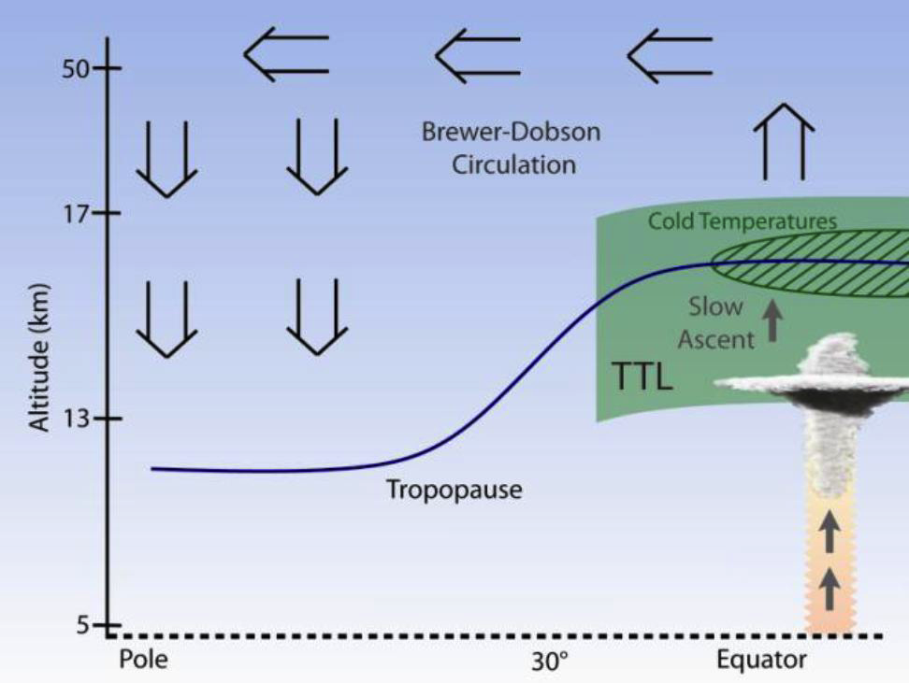
The Tropical Tropopause Layer (TTL) is the Gateway to the Stratosphere
The TTL is a cold trap: vapor condenses on ice crystals which then fall, limiting the humidity of air reaching the stratosphere.
Stratosphere
Troposphere
Latitude
Need to understand TTL clouds, transport, waves, and radiation
Ultimate goal: improve models and climate predictions

Slide 5
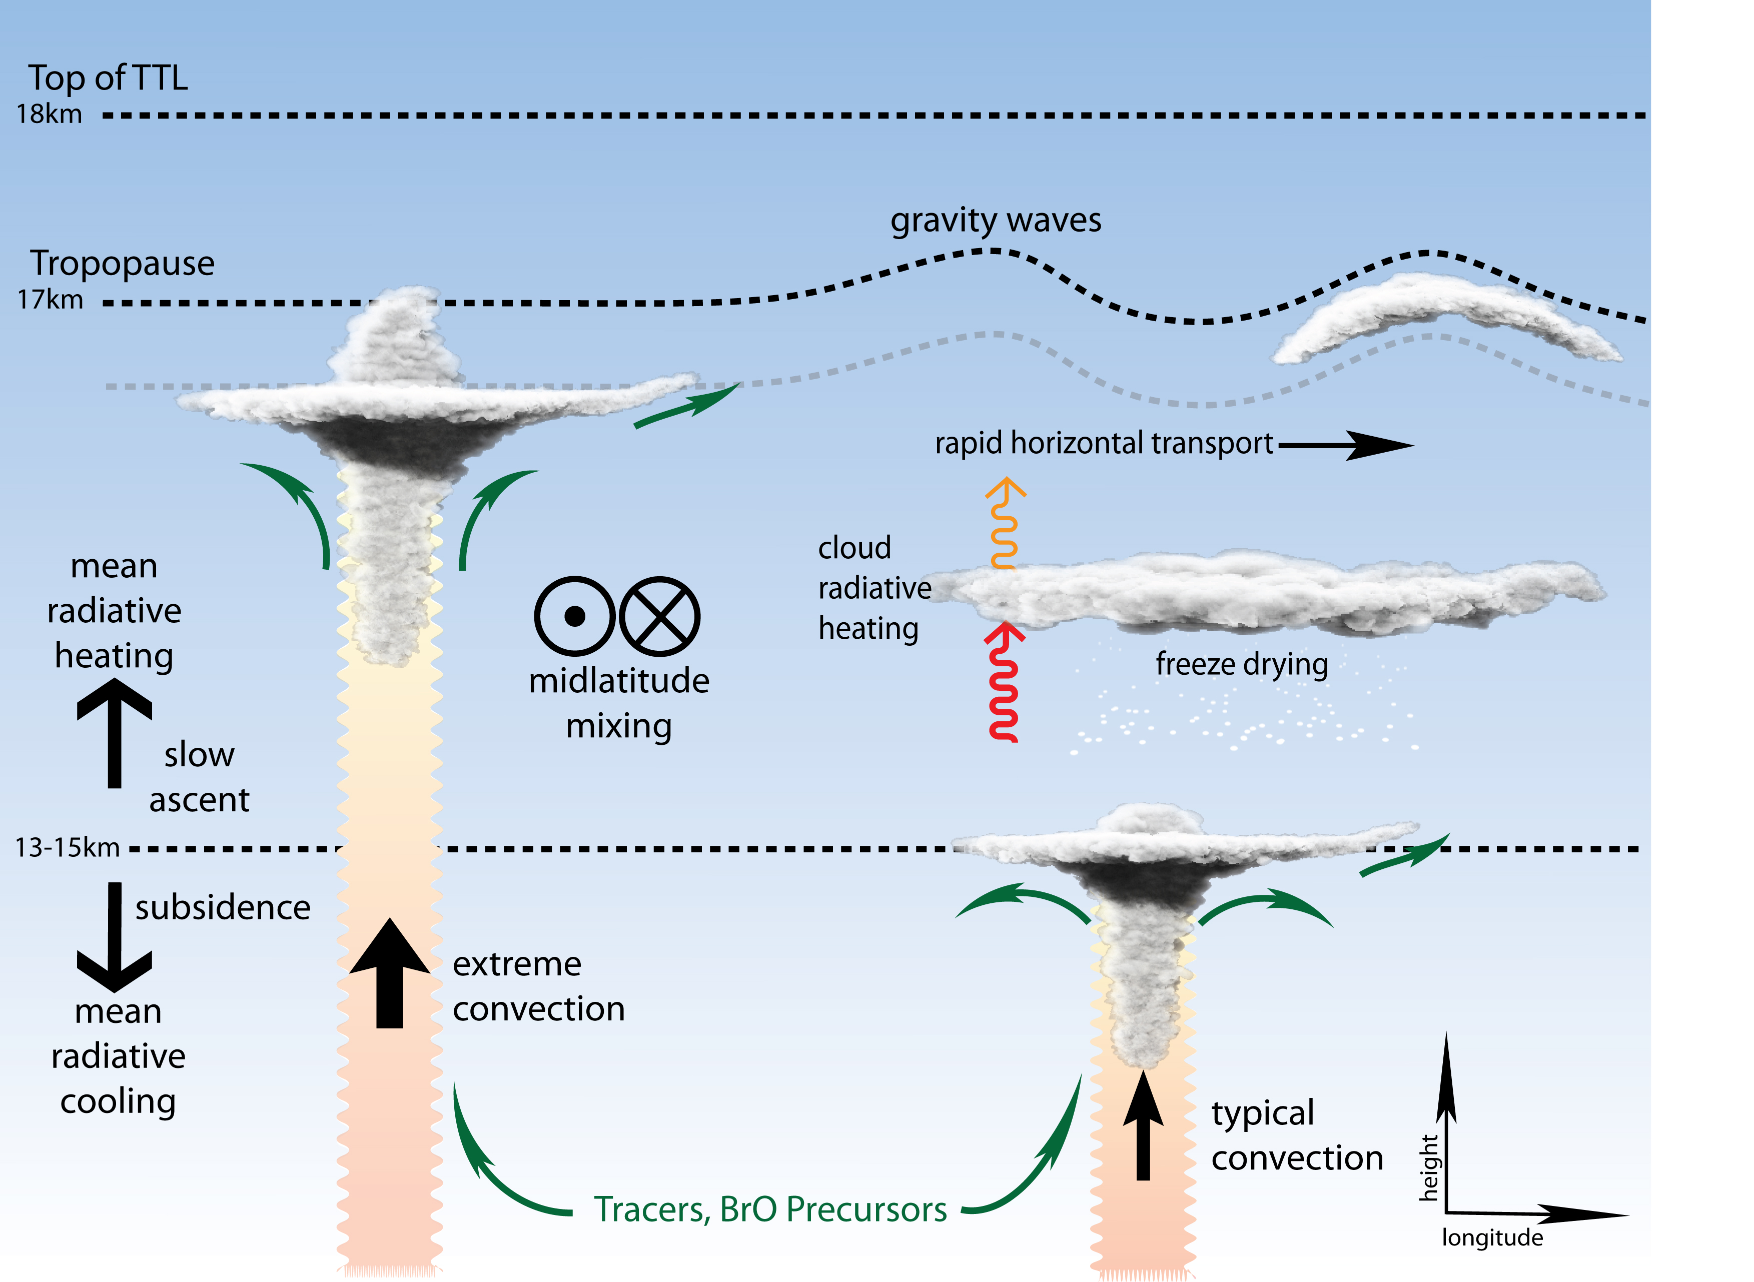
What physical mechanisms affect water vapor in the tropical stratosphere?

Slide 6
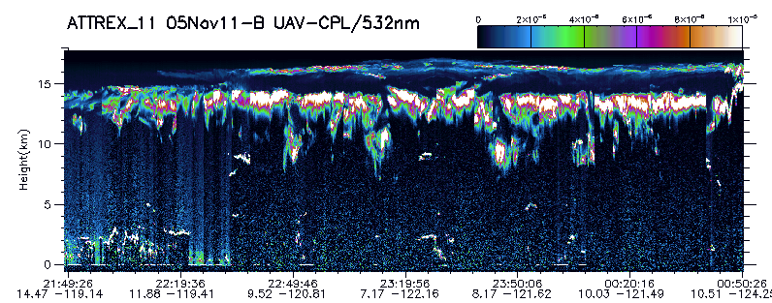
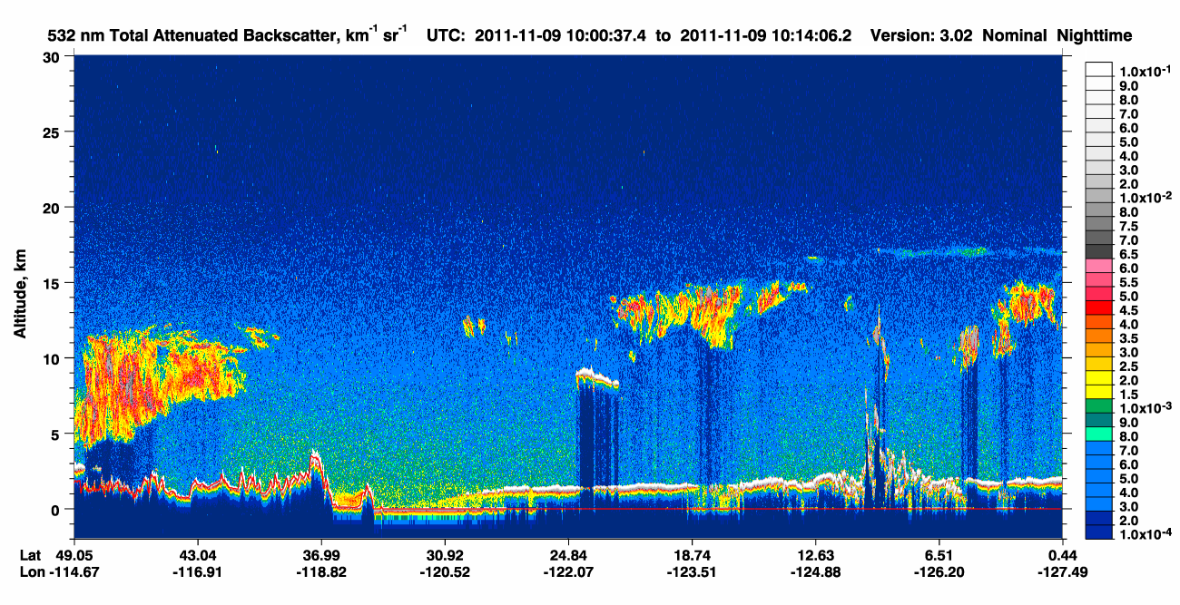
Downward pointing
Lidar aboard our
aircraft

Slide 7
How are we doing this?
Instrumentation
Flight ops
Flight patterns

Slide 8
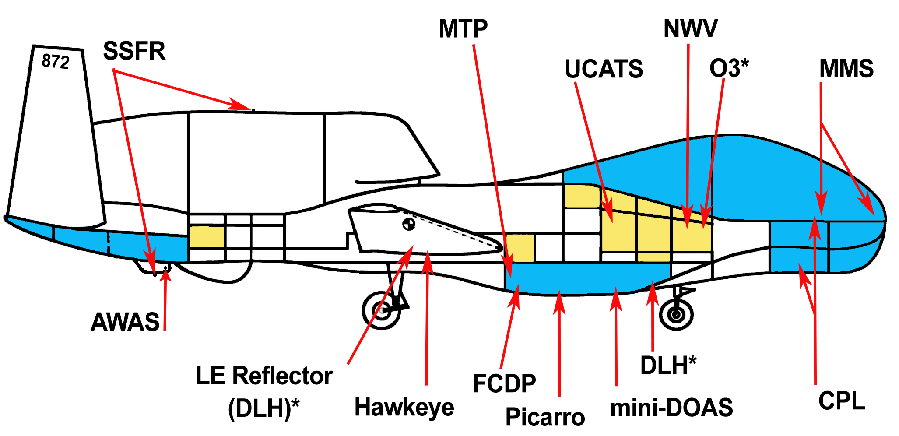
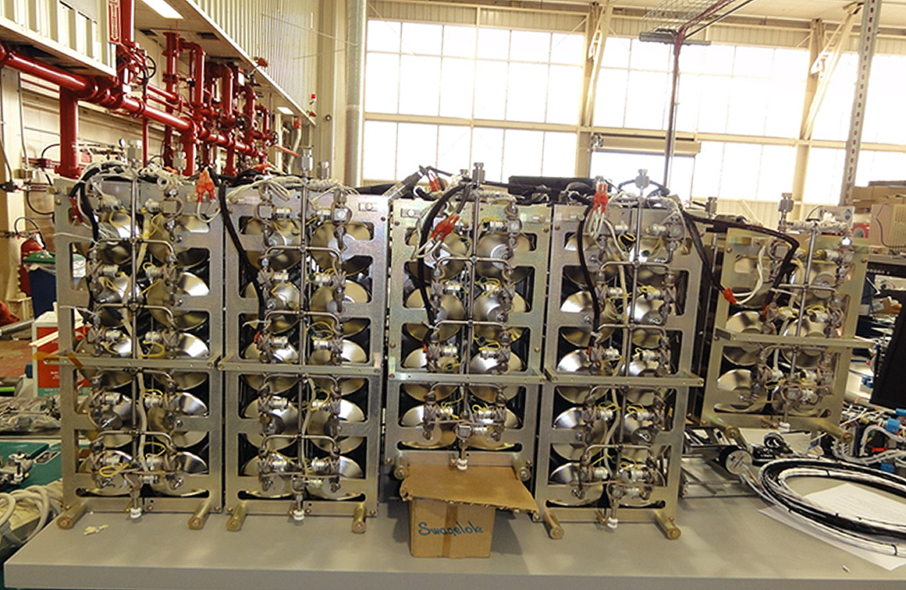
ATTREX Payload Measurements
State-of-the-art instruments measuring:
  Water vapor under cold, dry conditions
  Gases and particles
  Temperature and winds
  Radiation
Whole air sampler

Slide 9
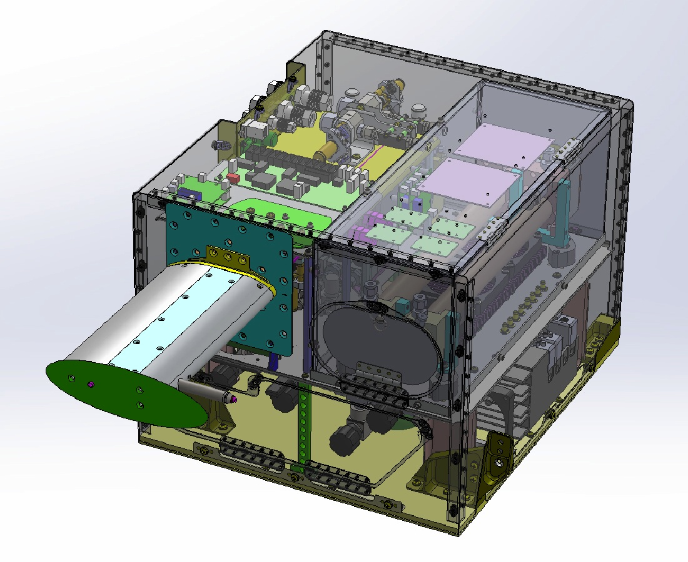
NOAA Water Vapor Instrument
Provides a precise and accurate measurement of water vapor every second from air that is pumped through the instrument.

Slide 10
Operations description

Slide 11
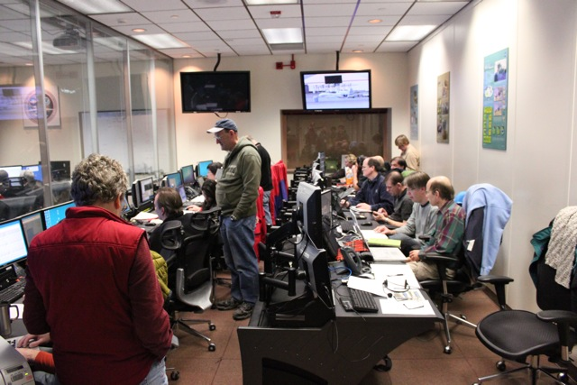
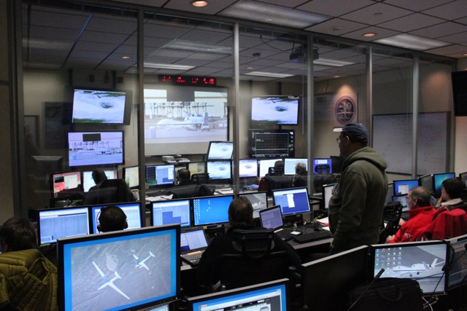
Flights: Global Hawk Operations Center
High-speed satellite link gives us real-time data in the control room
Decisions about where to send the aircraft are made in real time during the flights

Slide 12
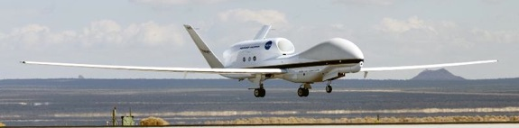
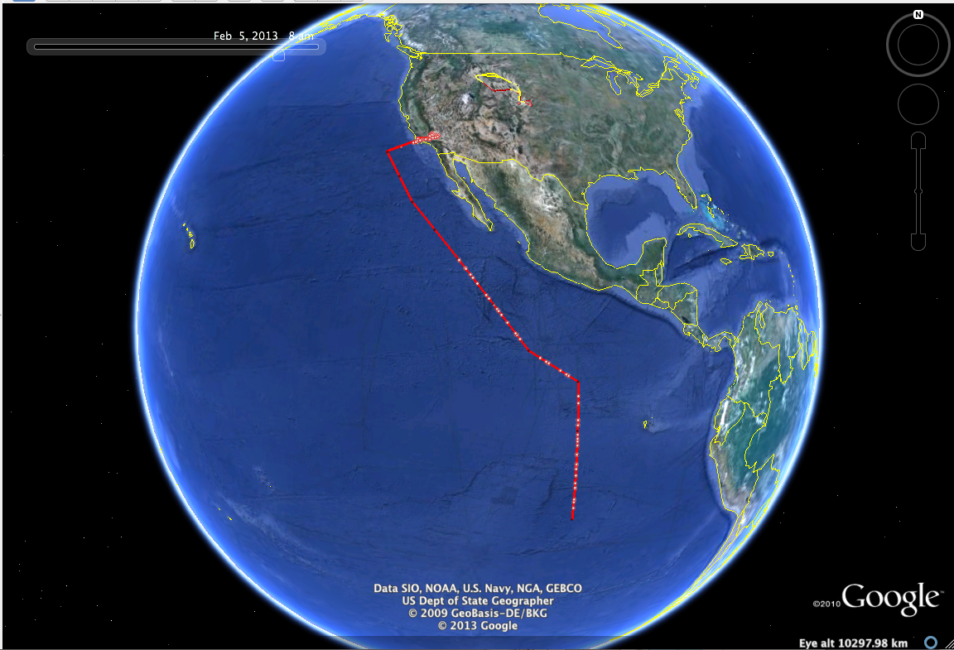
The Global Hawk Unmanned Aircraft is ideal for sampling the tropics and tropopause Region
45,000−65,000 feet altitude
  Commercial aircraft below 45,000 feet
Up to 30 hours duration
  Manned aircraft < 10 hours
Long range (12,500 miles) allows us to sample the tropics with flights from California
Flight of 21-22 Feb 2013

Slide 13
Flights and results
Fall, 2011 flight series – temperatures are cooling rapidly overall, so should see clouds and dehydration
Winter, 2013 flight series – temperatures reach minimum in winter, so air gets dry. Winter most important because the ascent rate is highest

Slide 14
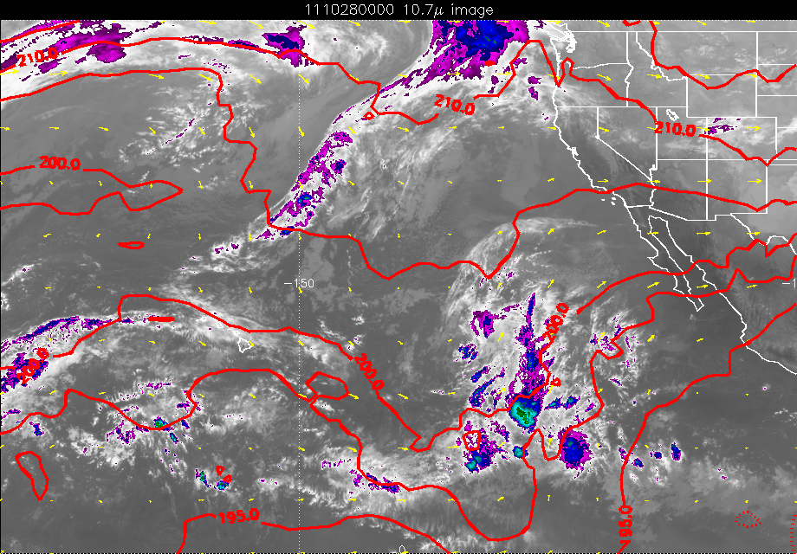

Slide 15
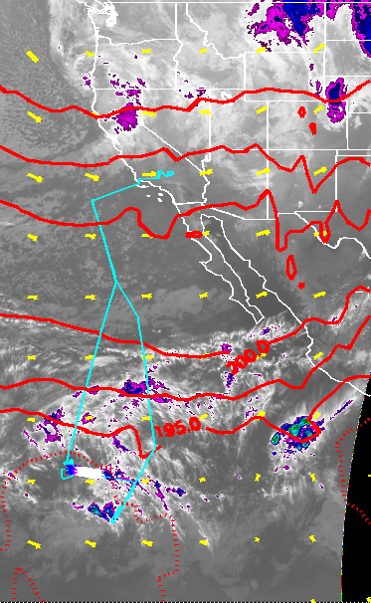
Some Results from the fall flight series
Plot shows “cutout” of water vapor
near 16.5 km (green), coinciding with cold
temperatures (blue), and high ice crystal
counts. (red)
Aircraft did vertical profiles in cold region
at south end

Slide 16
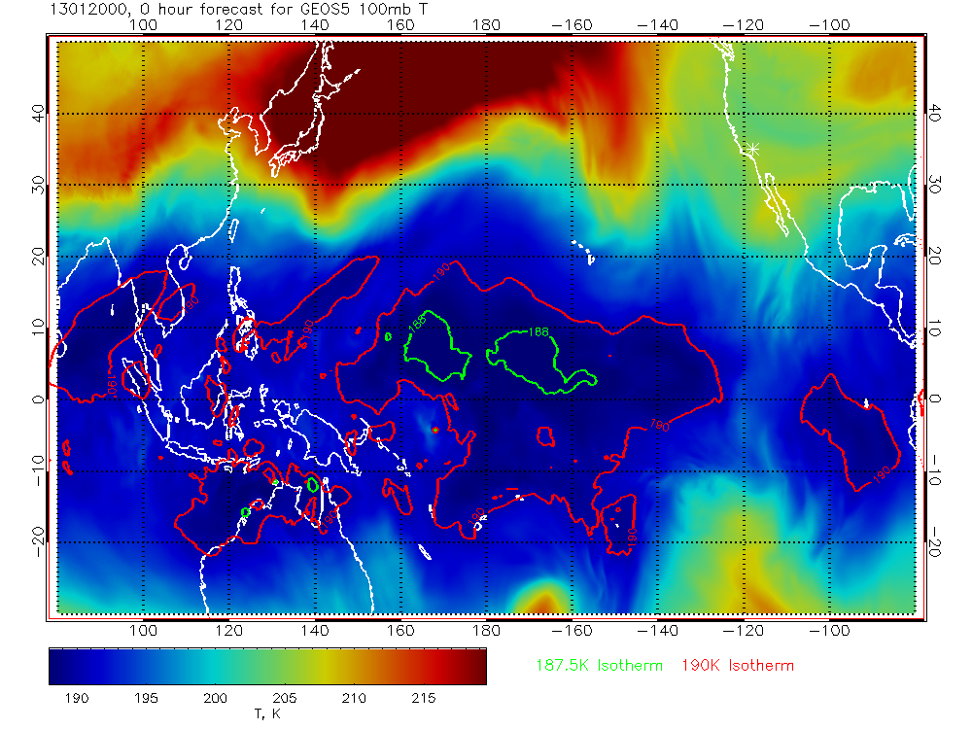

Slide 17
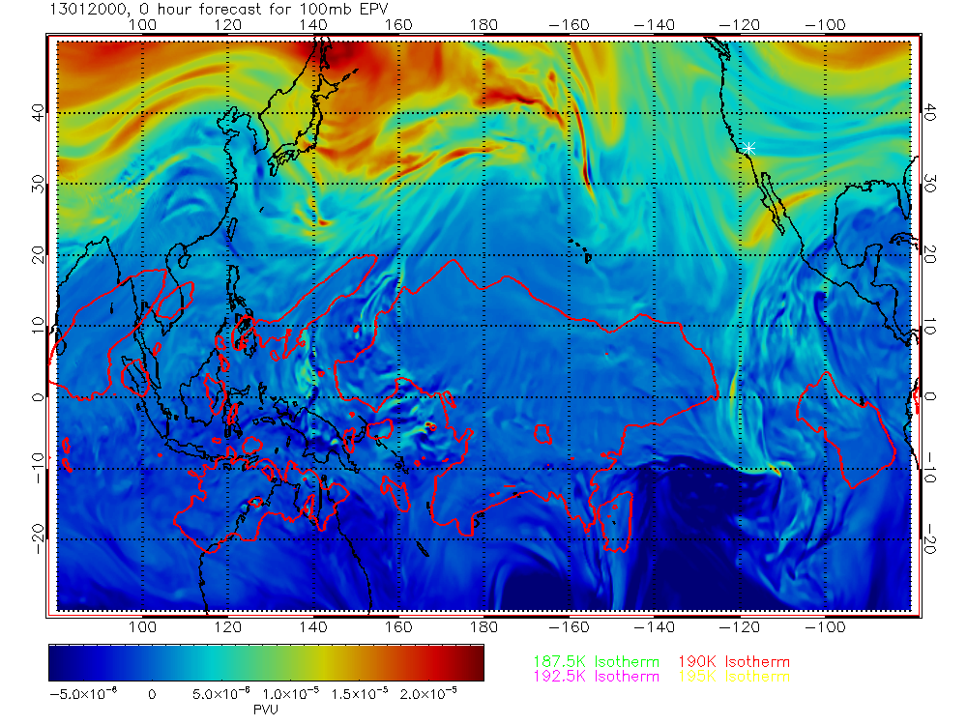

Slide 19
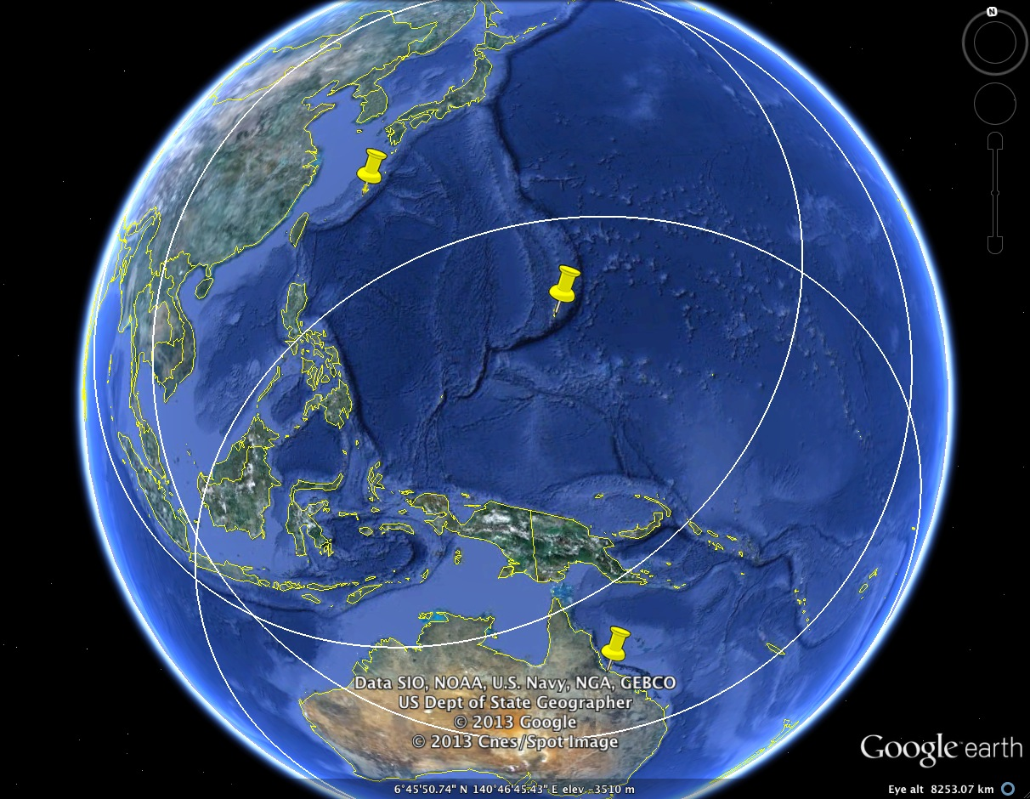
Future ATTREX Deployments
Kadena, June-July 2014 (alternate)
Guam, Jan-Feb 2014
Townsville, June-July 2014

Slide 20
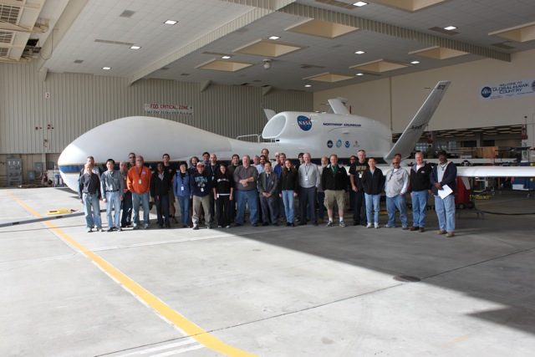
ATTREX Science and Operations Team
ATTREX multi-disciplinary investigators from NASA, NOAA, universities, private companies, and Europe

