Slide 1
ATTREX Met Briefing for flight of January 29
Local WX and impact on flight ops
Temperature and EPV fields for Jan 29 flight
Tropical temperature trends
MJO forecast

Slide 2
Local wx – through Wednesday
From Los Angeles Area Forecast Discussion:
  “wet and unsettled” pattern over the region as colder/drier trough moves through between Sunday and Monday
  Cold front pushing through between Monday night and Wednesday: possible frost/freeze issues on lee side of system
Large-scale model outlook:
  In GFS, 500 hPa trough passage early Monday AM but slow moving
  moist northerly flow behind trough a concern for mid-level clouds and icing through takeoff time on Tuesday
  Wednesday looks good however
  GEOS-5 forecasts significantly drier – but also slower moving
  All models except NAM showing things clearing out Tuesday
  NAM has retrograding cutoff low over SoCal on Tuesday

Slide 3
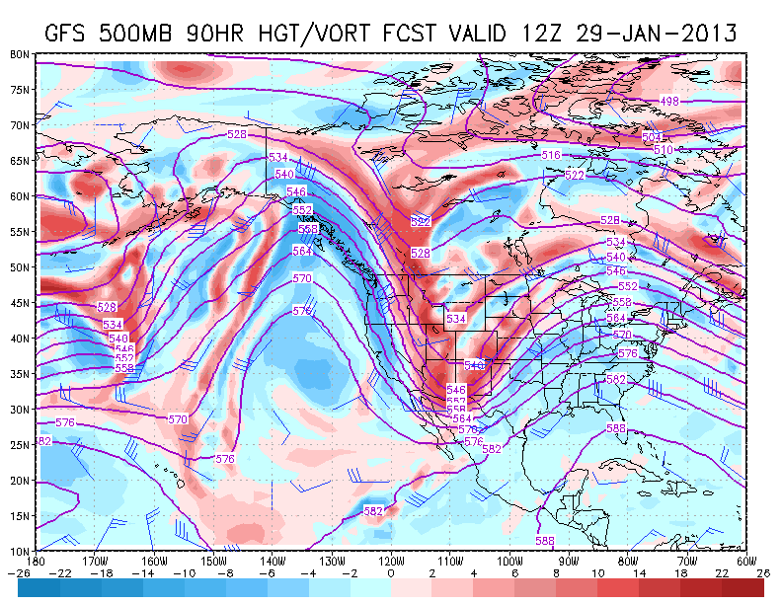
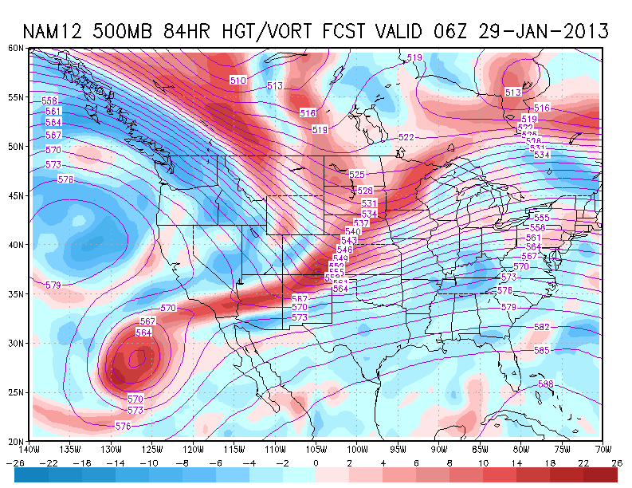
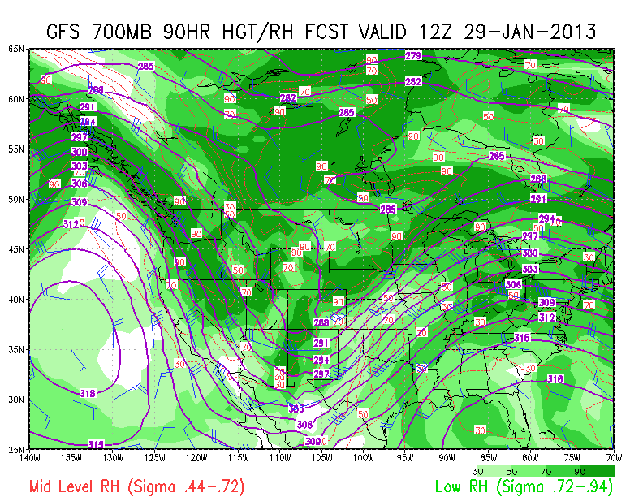
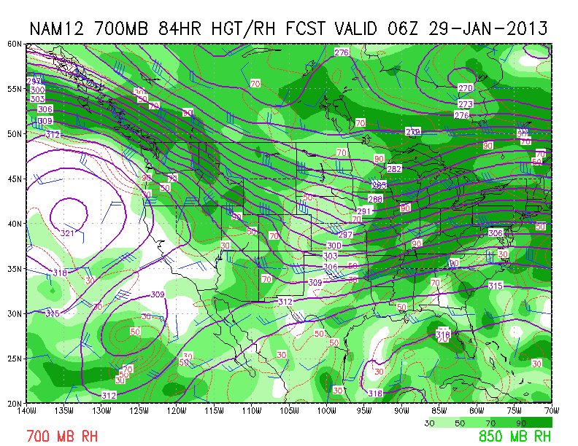
GFS 0400 Tue
NAM 2200 Mon
500 hPa
Hgts and Vort
700 hPa
Hgts & RH
NAM solution is odd man out this morning, but worth watching

Slide 4
GFS 100 hPa Temp - 4 PM Tuesday

Slide 5
GFS 100 hPa Temp - 4 AM Wednesday

Slide 6
EPV at 380 K
0129 18UT
0130 00UT
Hawaii
Hawaii
0130 06UT
0130 12UT
Hawaii
Hawaii

Slide 7
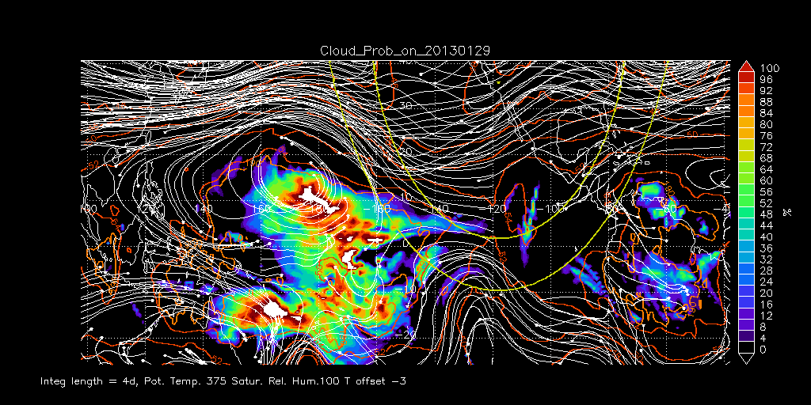
RDF Water Vapor

Slide 8
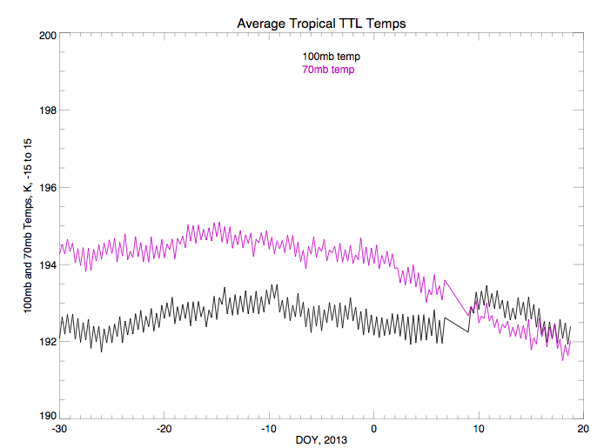
Note how 70mb temperature drops starting around January 1. Tropopause
(which is between 70 and 100mb) is getting cooler, and it is rising as
a result of the warming.

Slide 9
Temperatures at both 70 hPa and 100 hPa have reached bottom and are starting
to warm up. However, 70 hPa is still slightly colder than 100 hPa

Slide 10
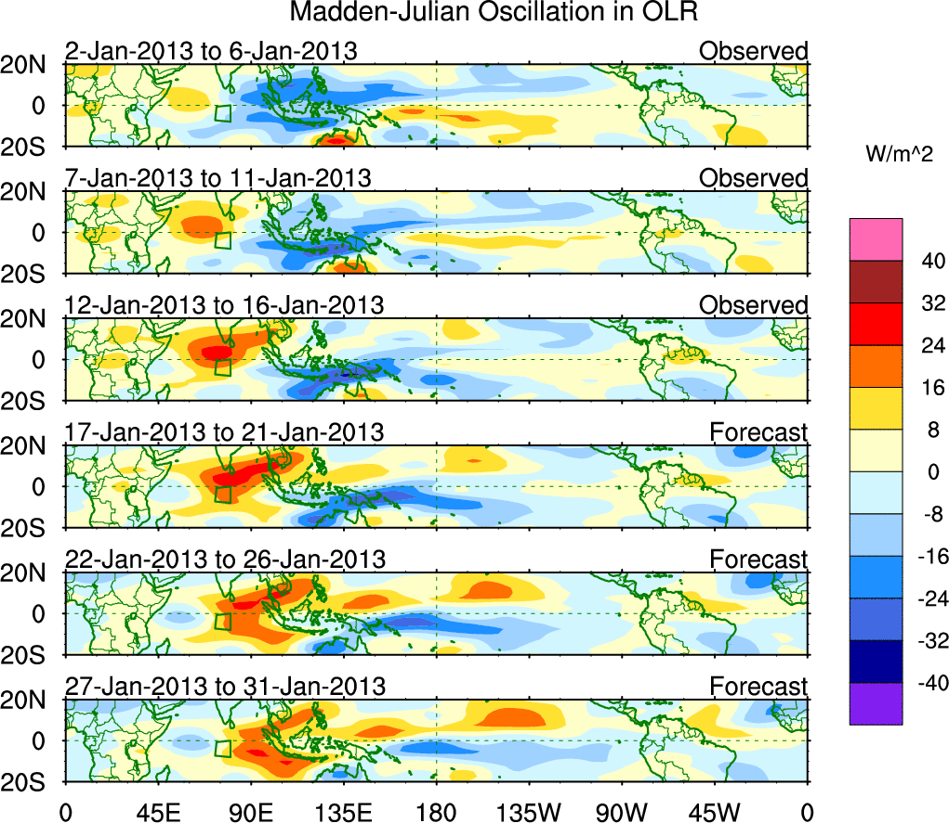
CFS forecast here shows that the NE tropical Pac Ocean is entering max warm phase of MJO as opposed to early this month

