Slide 1
ATTREX Met Briefing for flight of January 29
Rennie Selkirk
28 Jan 2013
Local WX and impact on flight ops
Temperature and EPV fields for planned flight
Comparisons between GFS and GEOS-5, and forecast-to-forecast comparisons of GFS EPV

Slide 2
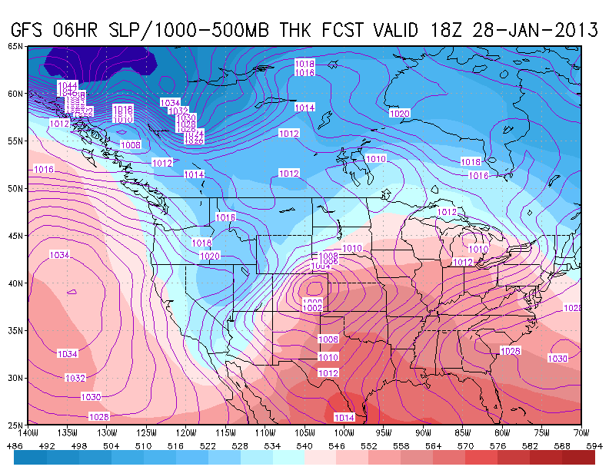
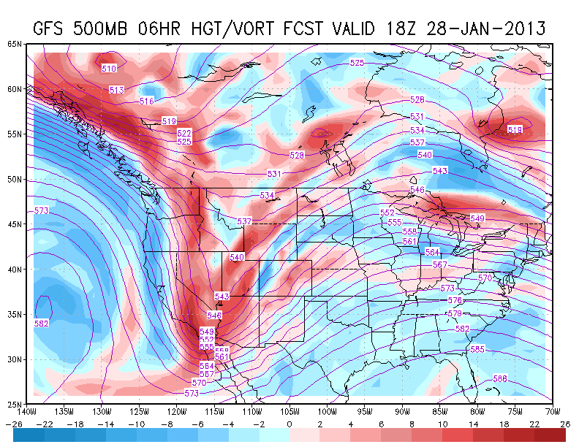
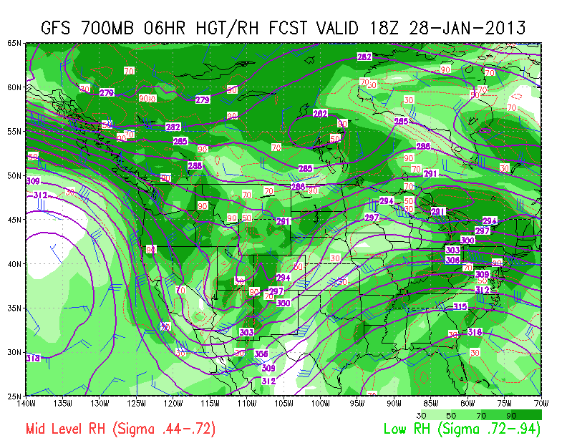
10 AM Today (GFS 06HR)
C
A
B
ANALYSIS
Cold (thickness <540 dam) [A] and deep 500 hPa trough axis has just passed east of us this AM [B]
Negative vorticity [C, blue] dominates 500 hPa flow
700 hPa RH relatively dry [D, light green] – skies clear this AM – but spot a little wetter upstream [E, dark green]
from NWS Forecast Discussion:
  “TROUGHS WITH PLENTY OF COLD AIR ALOFT AND LIMITED MOISTURE [sometimes can] EFFICIENTLY ACT UPON LIMITED MOISTURE TO CREATE SHOWERS AND THUNDERSTORMS IN UNSTABLE AIR”
E
D

Slide 3
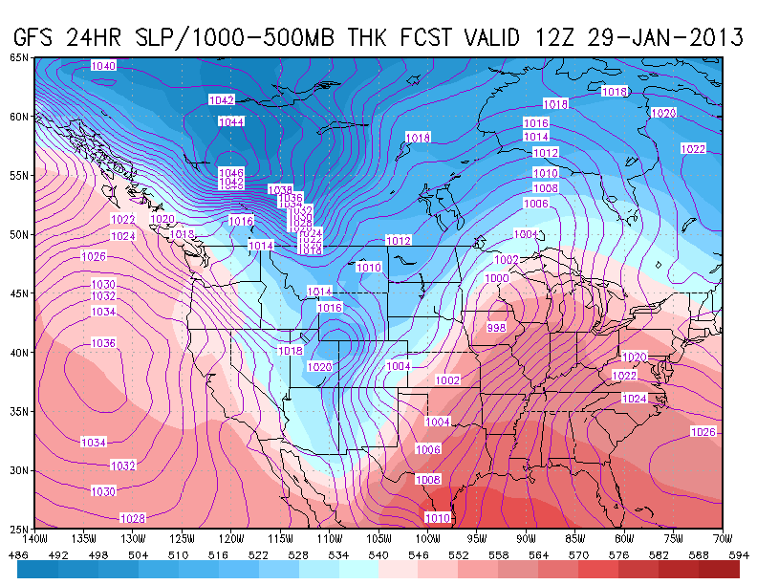
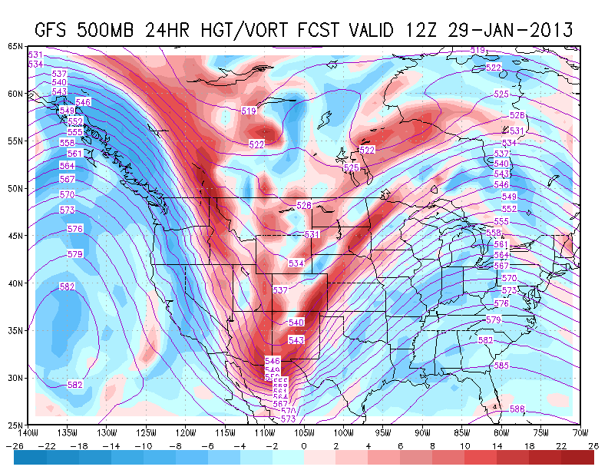
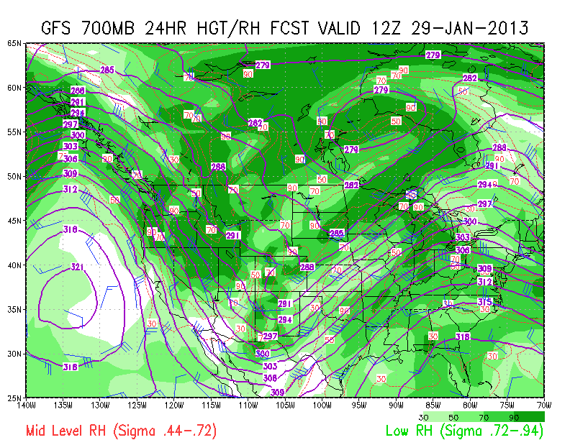
4 AM Tuesday – GFS 24HR
H
J
F
G
DISCUSSION
Warmer (thickness >546 dam) [F] but with 500 hPa trough digging southward > eastward [G] due to stronger winds behind trough
Negative vorticity advection [H, blue] dominates 500 hPa flow inducing subsidence
700 hPa RH remains relatively dry [I]
Only wrinkle is narrow positive vorticity feature [J] – but well upstream in this forecast
OUTLOOK: clear skies and warming into Tuesday
  .
I

Slide 4
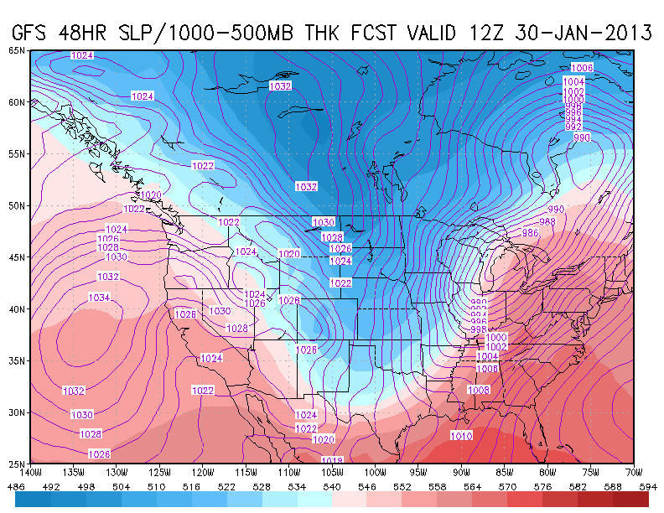
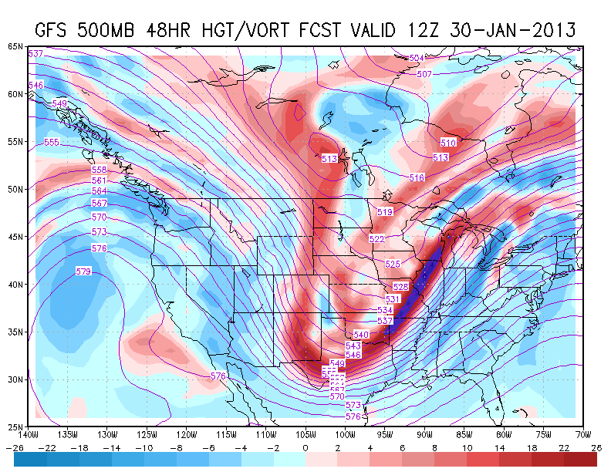
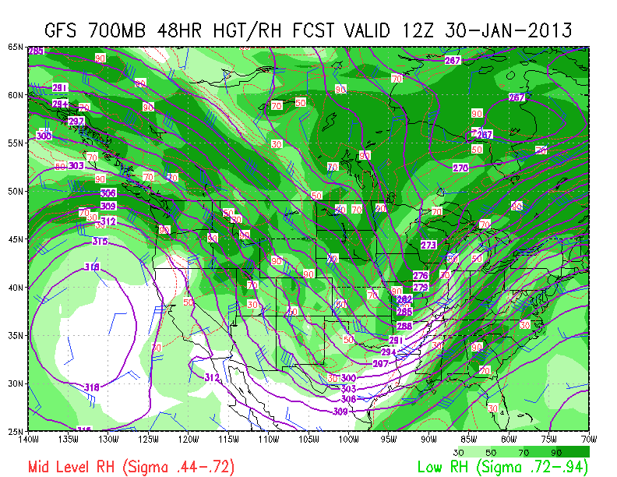
4 AM Wednesday – GFS 48HR
L
K
DISCUSSION
Continued warmer (thickness >552 dam) [K]
Weak positive vorticity advection [L, blue] – weakening subsidence
700 hPa RH drying out over region[M]
LONG-RANGE OUTLOOK: clear skies and progressive throughout week with weak ridging – agreement between GFS and ECMWF
GREAT FLYING WEATHER!!
  .
M

Slide 5
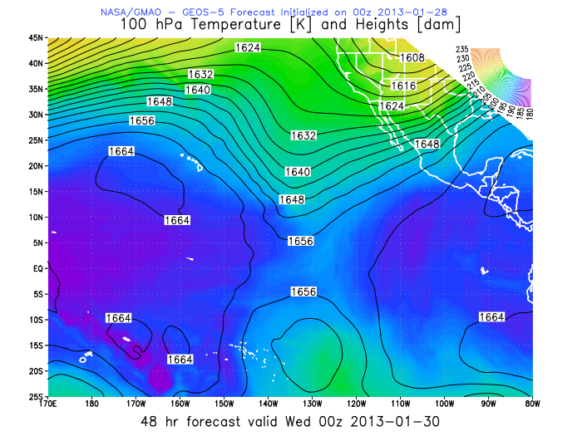
100 hPa - GFS (left) vs GEOS-5 mid-flight (00UT 30 Jan)
Trough feature in mid EPO in GEOS-5 is more sharply defined

Slide 6
EPV at 380 K – 00 UT 30 Jan
Hawaii
96 hr forecast
36 hr forecast

