Slide 1
Met Briefing for ATTREX Flight 4, Feb 21
Rennie Selkirk
20 Feb 2013
Weather for flight ops
  Tomorrow: good; backup Fri/Sat also OK
  Outlook for next week
Conditions in flight region for Thu/Fri
  100 hPa temperature field during flight
  Large-scale EPV pattern
  WV RDF results
Temperature evolution
  Hovmöller plots at 100 hPa and 70 hPa
  Pfister plot

Slide 2
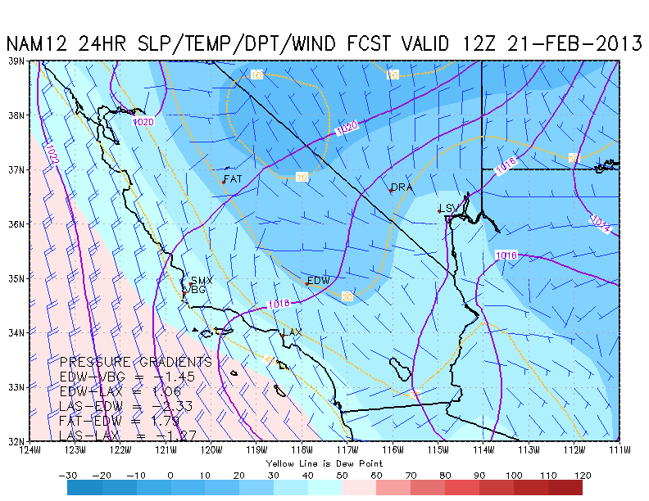
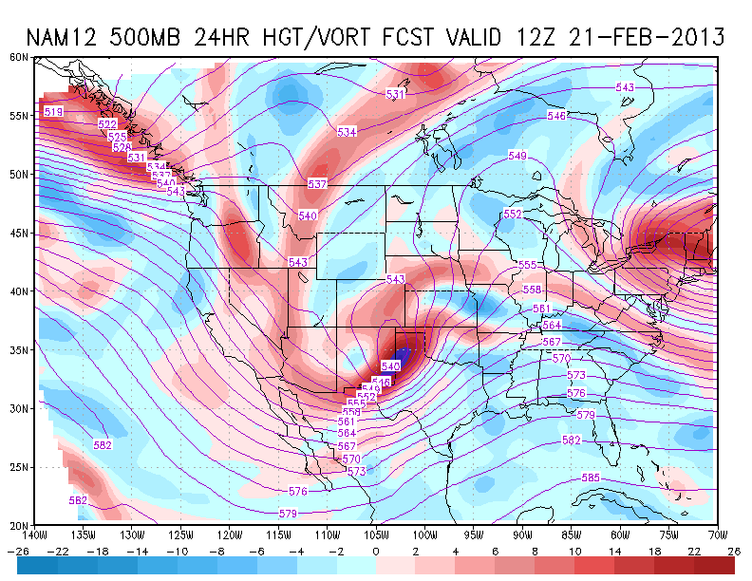
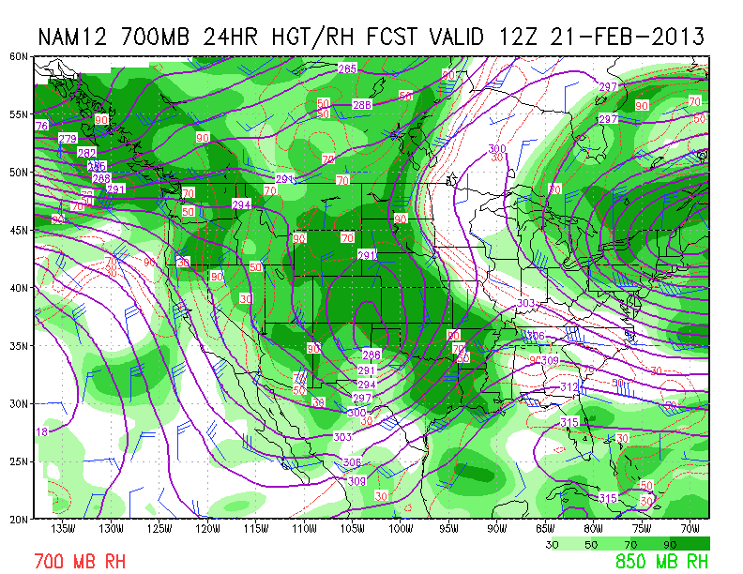
4 AM Thursday – 21 Feb 12UT / NAM 24HR
A
B
DISCUSSION
Overall, looks good for 7 AM takeoff:
  Weak surface winds, but increasing to 10 kts from NE by mid-morning
  Northwesterly flow aloft
  RH @ 700 hPa <30%: stable, descending air; ~40% low cloudiness
C

Slide 3
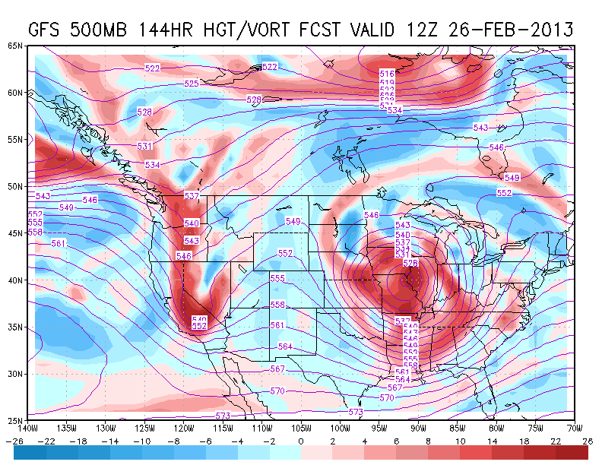
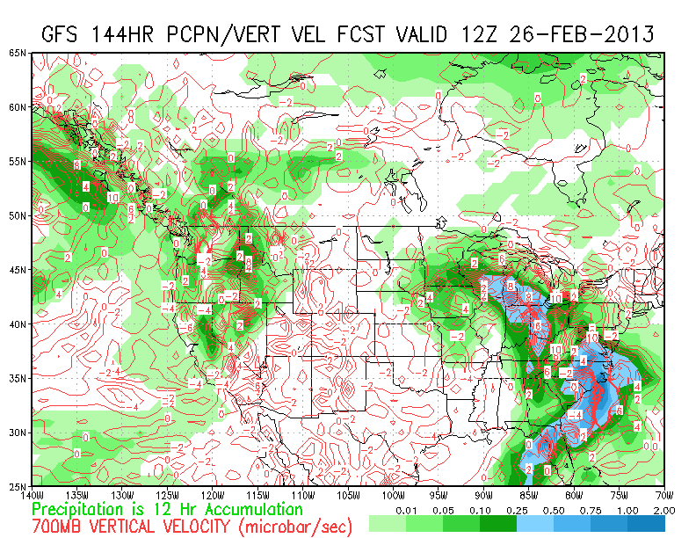
Long range outlook
G
H
TUESDAY, 2/26
Tuesday looks problematic
  Short-wave trough passing through
  Likely precipitation
Later on….
  500 hPa ridge passage Friday, so positive outlook after Tuesday

Slide 4
100 hPa Temperatures and winds

Slide 5
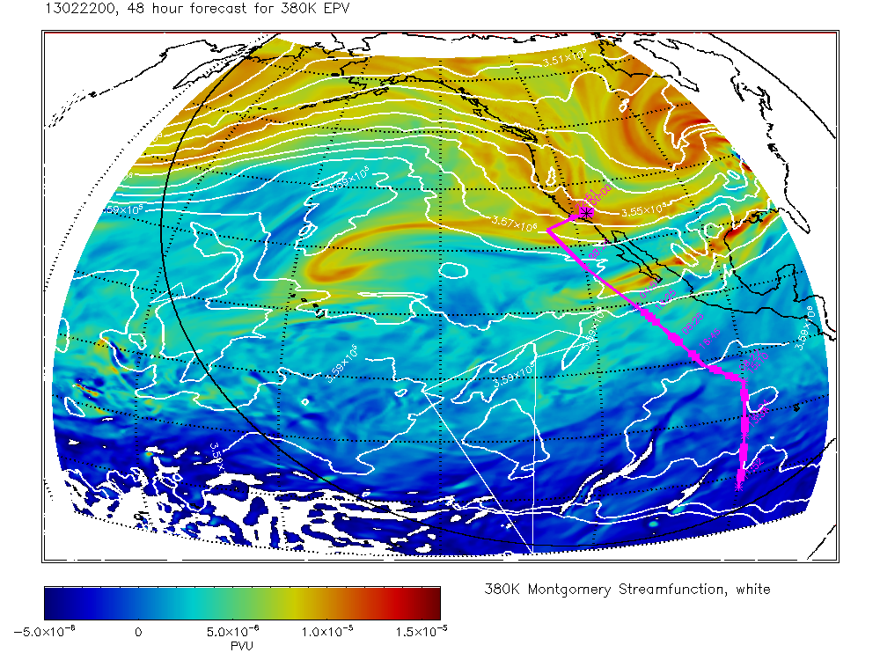
380 K EPV – GEOS-5
Mid-flight 22 Feb 00UT
We will be deep into tropical air from about 12°N southward

Slide 6
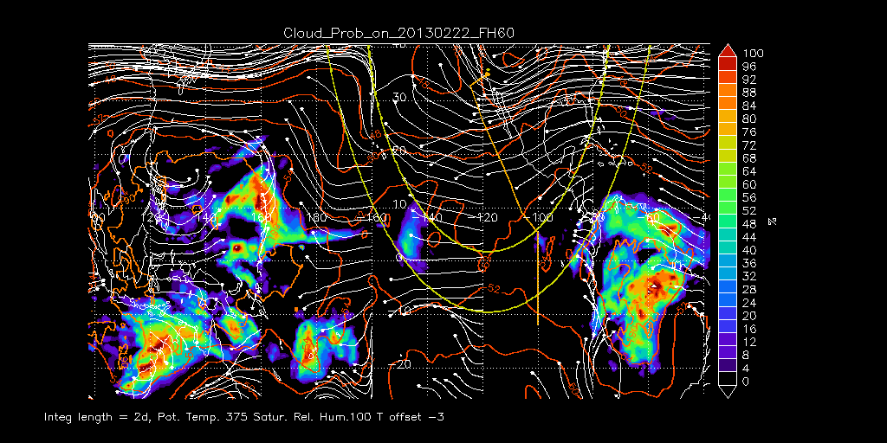
RDF Results – 22 Feb
Cloud probability or zones of dehydration
Possible thin cirrus along track near 5°N

Slide 7
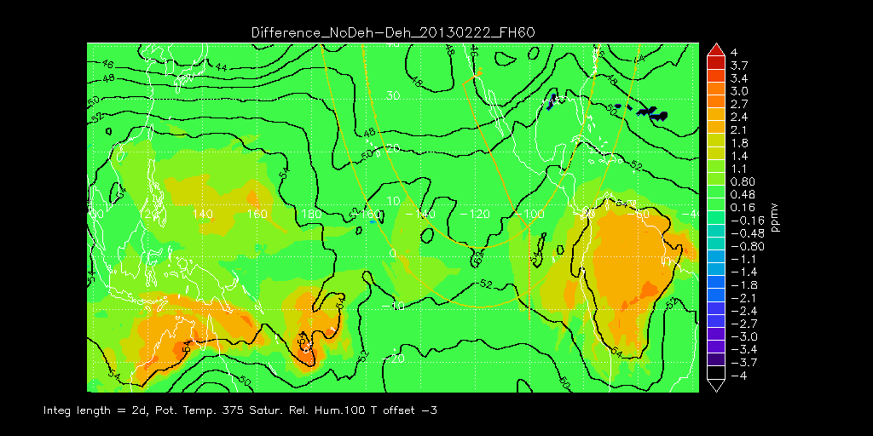
RDF Results – 22 Feb
Net dehydration
South of 10°N, the track traverses region of weak dehydration (0.8 to 1.1 ppmv)

Slide 8
Hovmöller diagram at 0° – 100 hPa T
(Very) approx. time-longitude flight window
Eastern Pacific warming up

Slide 9
Hovmöller diagram at 0° – 70 hPa T
(Very) approx. time-longitude flight window
Traveling wave features more prominent

Slide 10
100 hPa T and 70following upward trend in 70 hPa T since
Temperatures at both levels still approx. 2 K below 20-year averages

