Slide 1
ATTREX Met Briefing for flight of Feb 5
Rennie Selkirk
04 Feb 2013
Weather for flight ops
  Tomorrow: good; backup Wed/Thu also OK
  A bit of rain Thursday evening into Friday; request to USAF for airfield open on Sunday
Conditions in flight region for Tue/Wed
  Convection along the track
  Large-scale EPV pattern
  Longer-term evolution of 100 mb T
  Change of T near track through the period
  WV RDF results

Slide 2
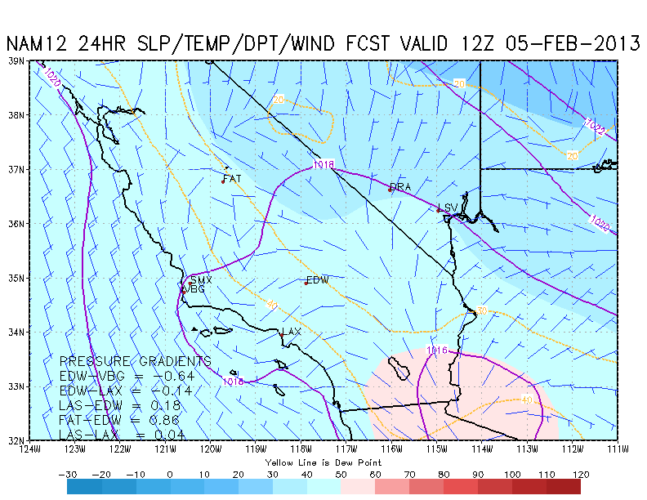
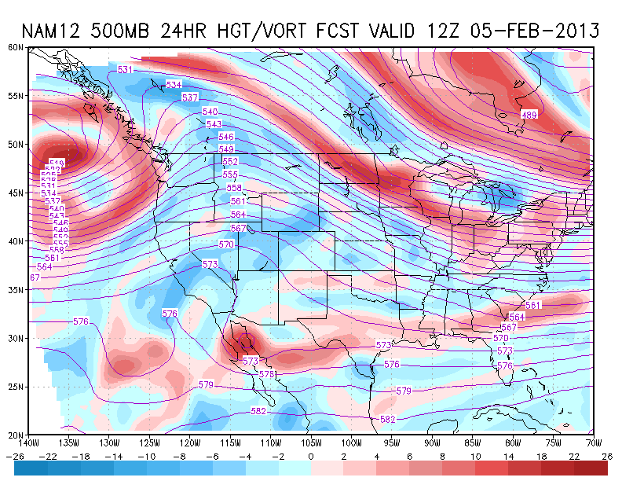
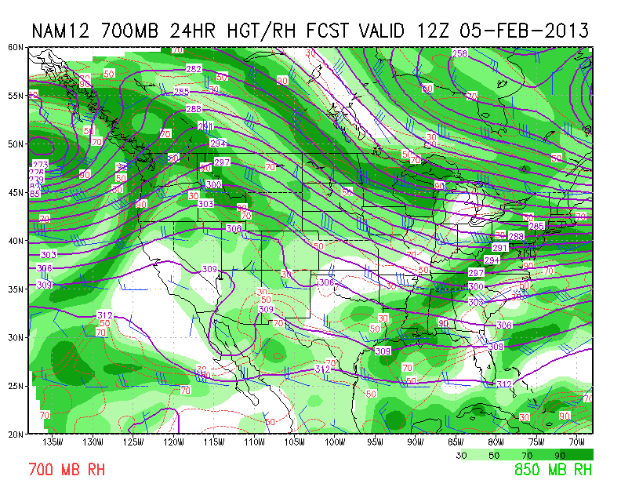
4 AM Tuesday – 06 Feb 12UT / NAM 24HR
L
K
DISCUSSION
Overall, looks good for takeoff
  “Little trof” with vort max feature [L] has passed through
  Winds easterly, weak
  Middle-level moisture feature [M] may produce some middle level cloudiness tonight, but should not be a factor for flight.
M

Slide 3
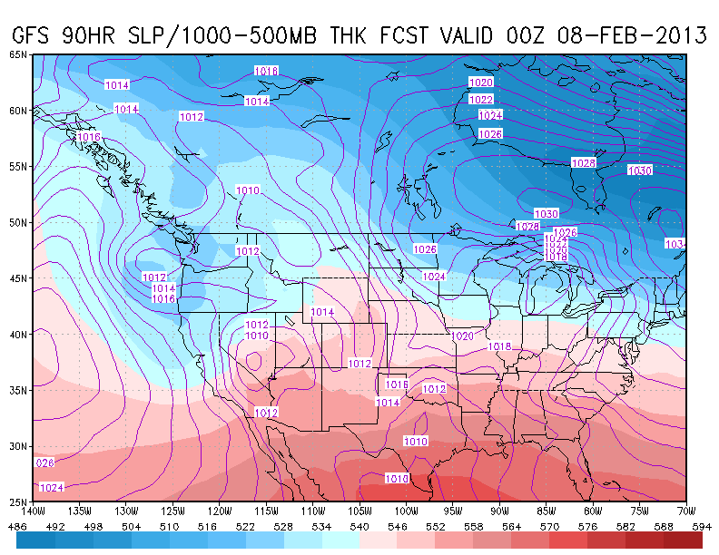
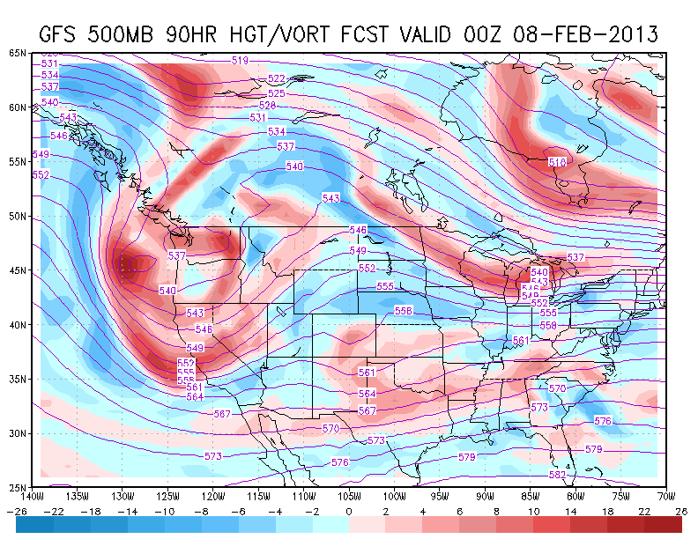
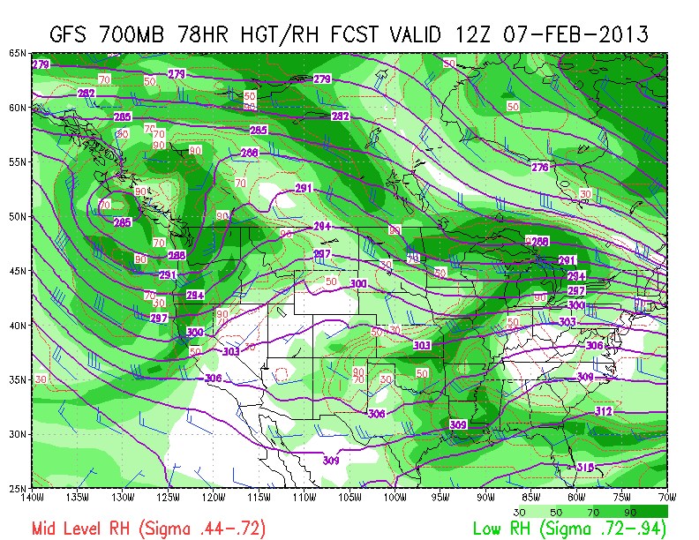
Rain begins Thursday evening
P
Q
DISCUSSION
OK for landing of backup on Thursday AM
But surface trough [P] passes through in the afternoon, driven by generous PVA in upper level trof [Q].
NWS forecasts rain to start at 4 PM. Won’t be heavy, but should be wet enough to prevent a Friday take-off
O

Slide 4
No convection forecast along flight track

Slide 5
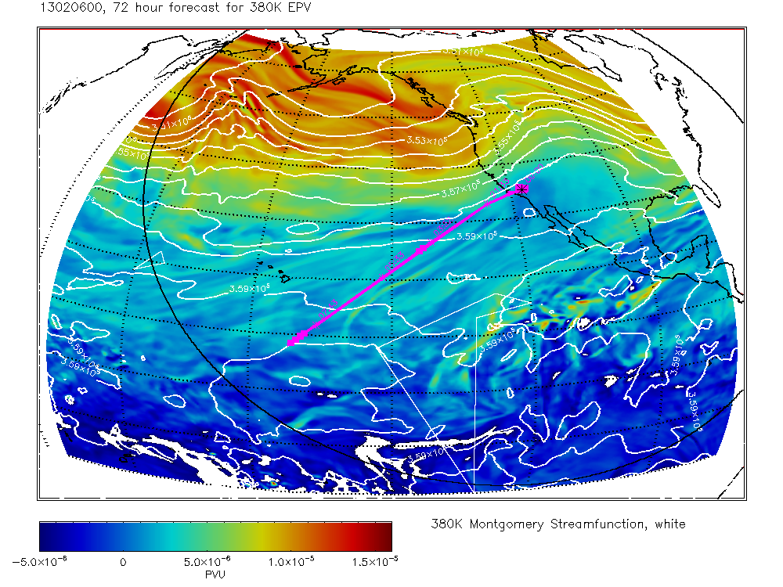
380 K EPV – GFS (left), GEOS-5 (right)
Mid-flight 06 Feb 00UT
Both models show flight plan almost along axis of tongue of tropical EPV extending into mid latitude at this level
Tongue also apparent at 355 K

Slide 6
Hovmöller diagram – 10°N – 100 hPa T
(Very) approx. time-longitude flight window
Cold region extending eastward
Associated with tongue of tropical air?

Slide 7
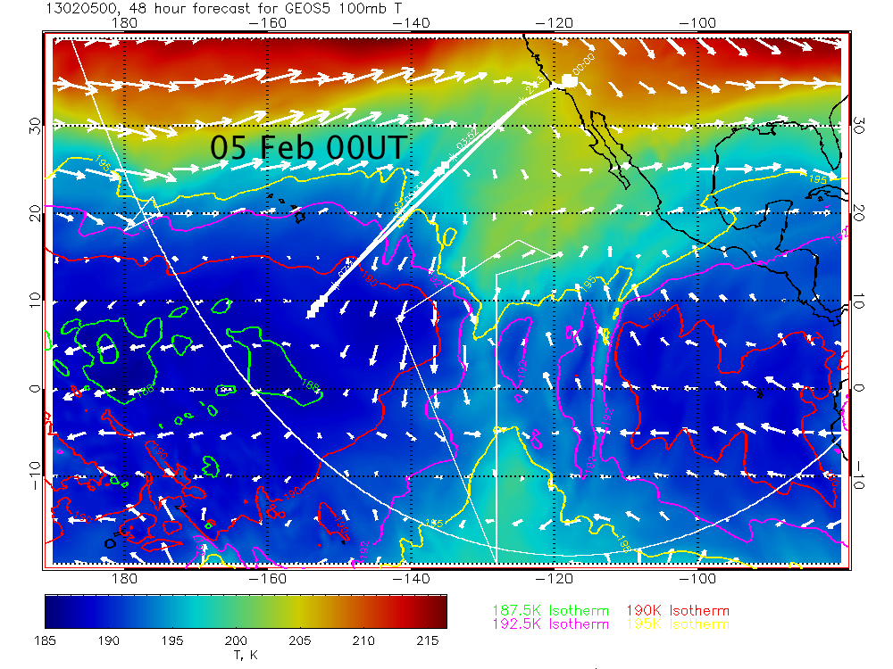
100 hPa Temperature evolution – GEOS-5
The skin temperature (189.5K) crossing point on the flight track holds fairly steady at the 100 hPa level

Slide 8
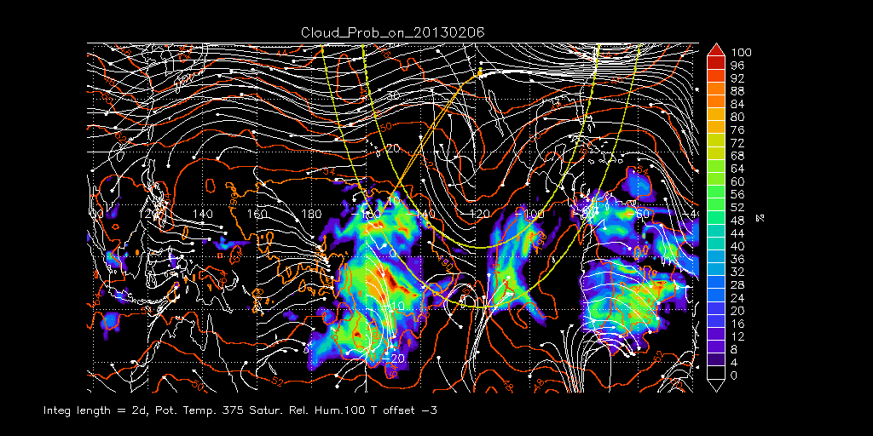
RDF Results – 06 Feb
Cloud probability or zones of dehydration
Some thin high cirrus may be encountered at far end of flight track

Slide 9
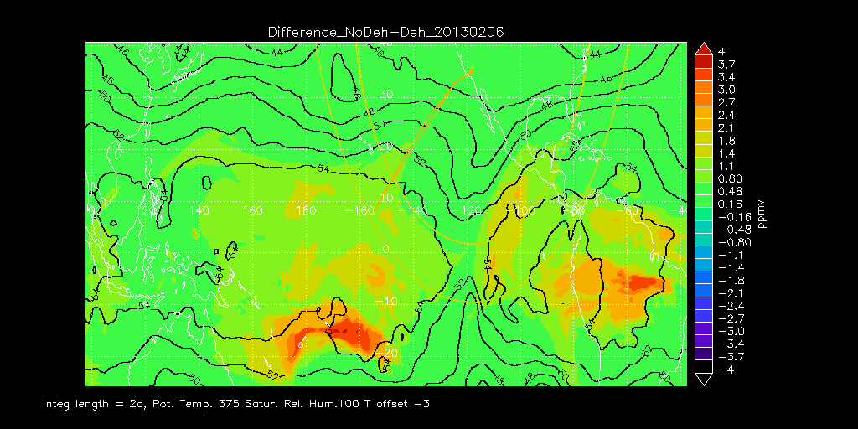
RDF Results – 06 Feb
Net dehydration
Most of track will be in tropical “tongue” with up to 1.4 ppmv of net dehydration in previous 48 hours

Slide 10
Extra slides

Slide 11
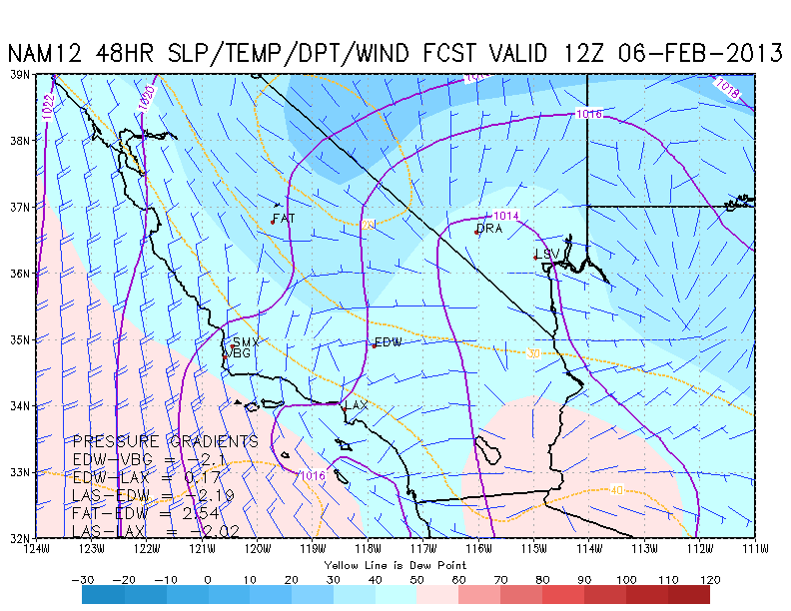
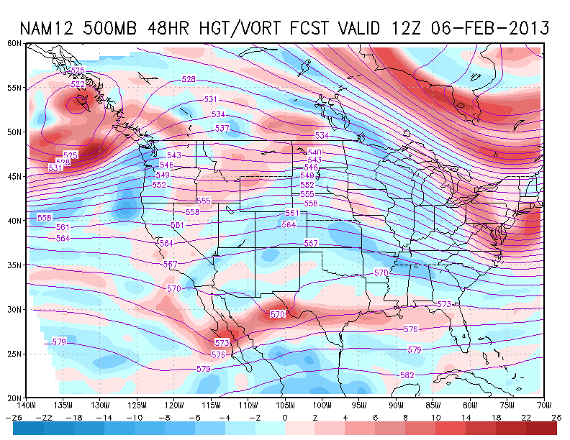
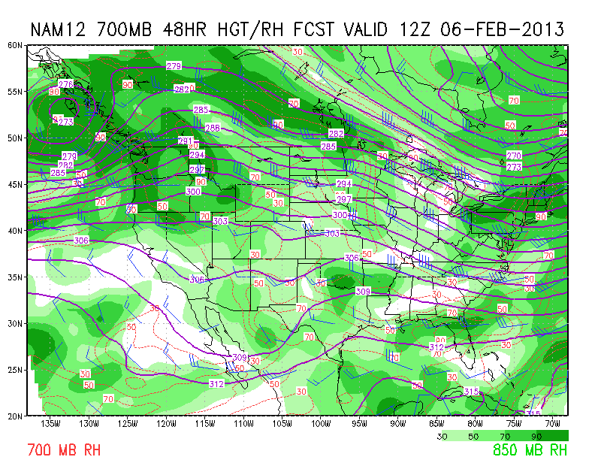
4 AM Wednesday – 06 Feb 12UT / GFS 54HR
N
DISCUSSION
Looks good for return Wed AM as well
Light winds from the west at EDW
Weak trof/vort max feature [N] passing through
Some middle-level moisture [O] but not enough to be a problem
O

Slide 12
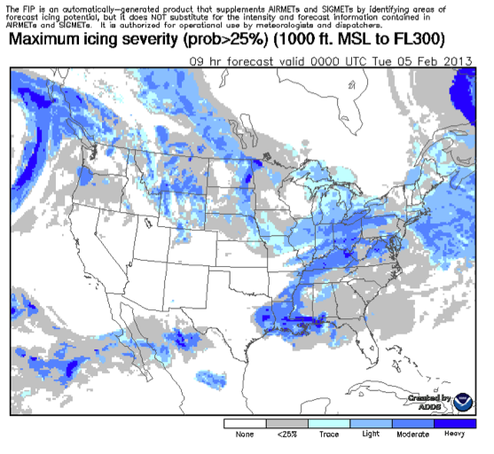
Proxy forecasting for icing
NWS Icing probability – 05 Feb 00UT
GFS 500 hPa RH – 05 Feb 00UT
Rationale
Icing forecast only out to 12 hr
But, RH at 500 hPa highly correlat

Slide 13
Icing not a factor for Tuesday T/O
GFS 500 hPa RH – 05 Feb 00UT
GFS 500 hPa RH – 05 Feb 12UT
Rationale
Icing forecast only out to 12 hr
But, RH at 500 hPa highly correlat

