Slide 1
ATTREX Flight Conditions Briefing for flight of January 31
Rennie Selkirk
30 Jan 2013
Review of weather for flight ops
Temperature conditions in flight region
  Forecast fields
  Hovmöller plots [Newman]
Moisture conditions in tropopause-level flow
  RDF water vapor [Schoeberl]

Slide 2
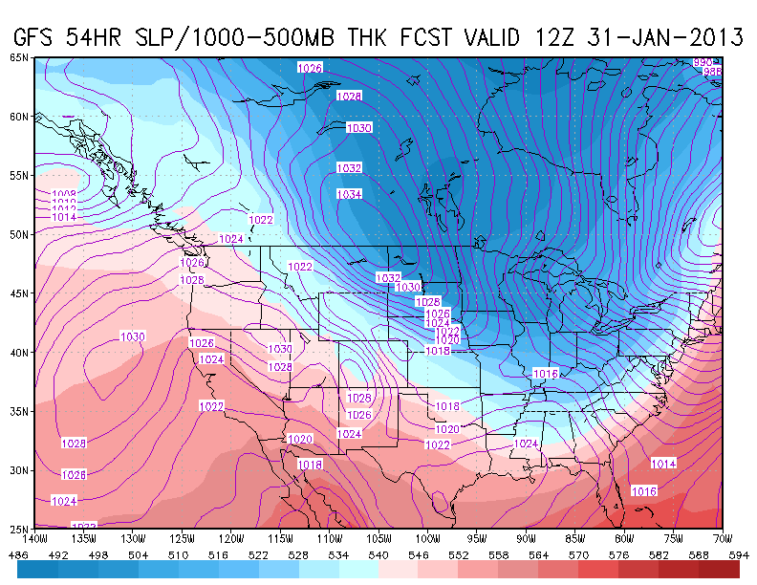
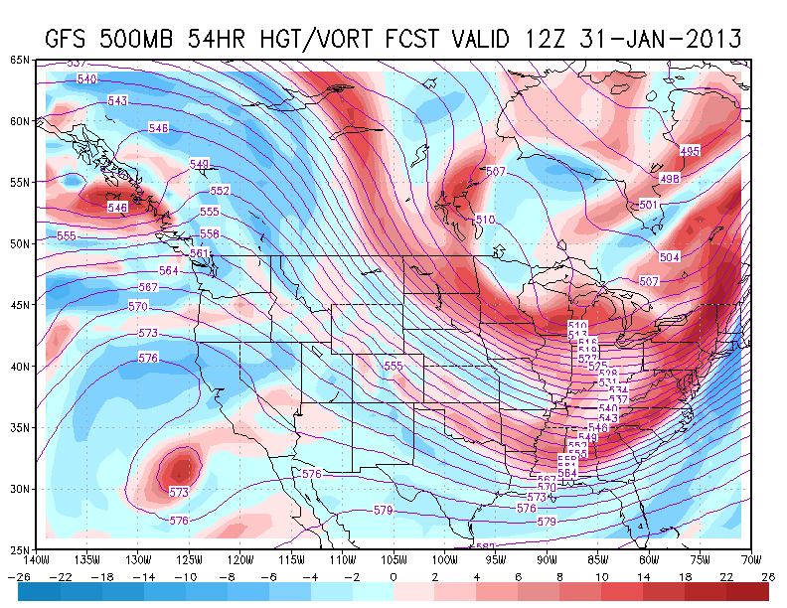
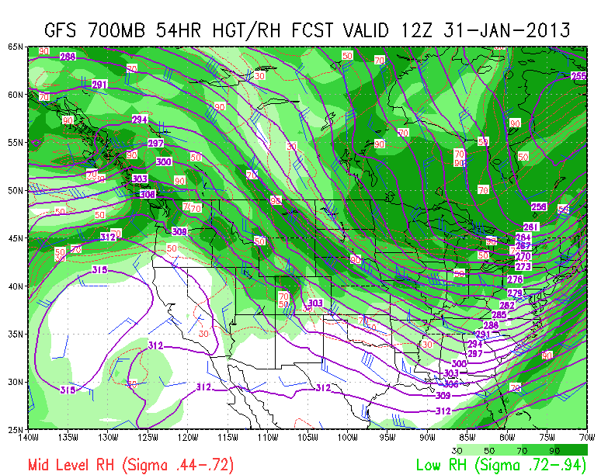
4 AM Thursday – 31 Jan 12UT / GFS 54HR
L
K
DISCUSSION
Continued warmer (thickness >552 dam)
Hi pressure [K] still offshore
Weak vort max feature [L]from cut-off low may produce some upper level cloudiness as RH forecast at 500 hPa in this feature is wet (next slide)
Otherwise atmosphere is fairly dry over region[M]
CONTINUED GREAT FLYING WEATHER!!
  .
M

Slide 3
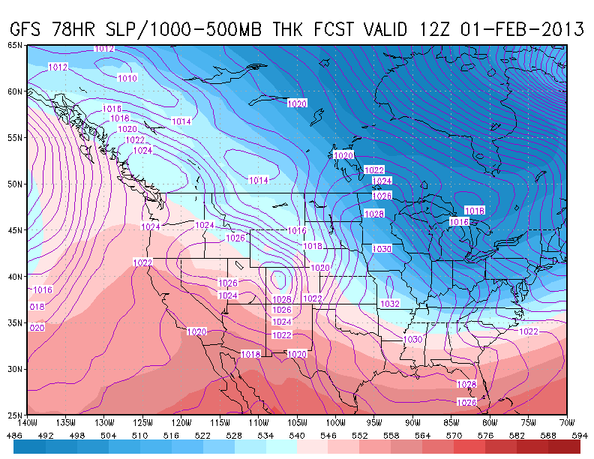
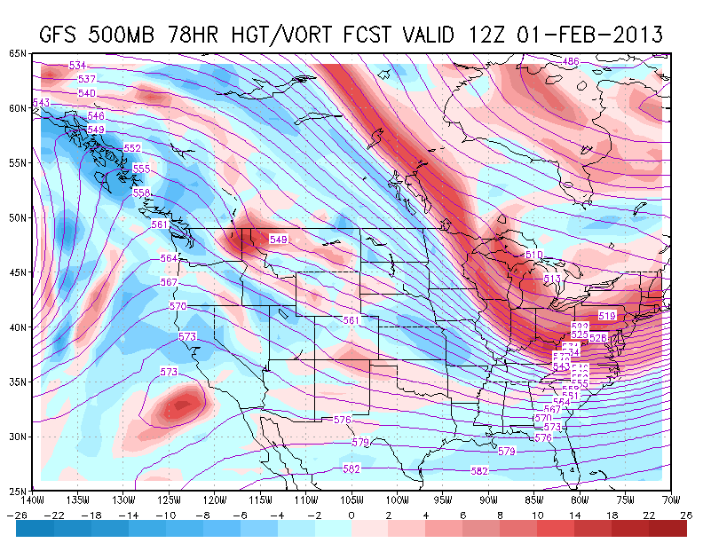
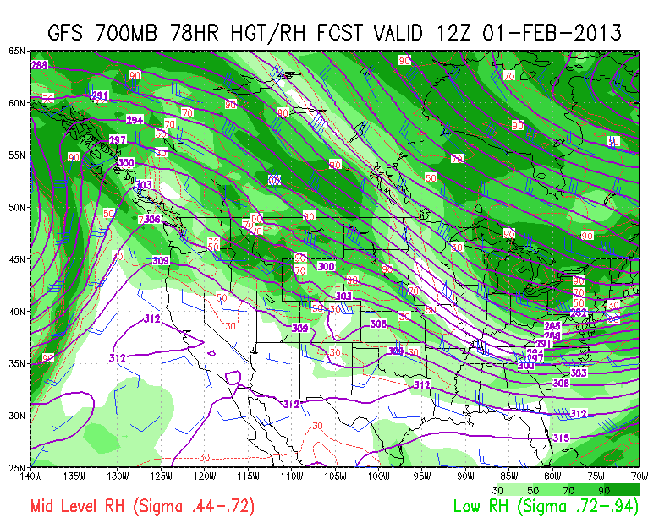
4 AM Friday – 01 Feb 12UT / GFS 78HR
N
O
DISCUSSION
Ridge building in [N]; warm (thickness > 552 dam)
Cut off low [O] may induce some high cloudiness
Though atmosphere remains dry at 700 hPa, RH at 500 hPaover region[P]
CONTINUED GREAT FLYING WEATHER!!
P

Slide 4
4 PM Tomorrow – 01 Feb 00UT
100 hPa Temperature evolution
4 AM Today – 30 Jan 12 UT – FH12
Cooling off in target region:
190 K isotherm much closer to W02
Southern leg W03 to W04 now crosses 190 K halfway down
Shift entire pattern east? How much room?

Slide 5
100 hPa Temperature evolution
Eastward extension of cold region

Slide 6
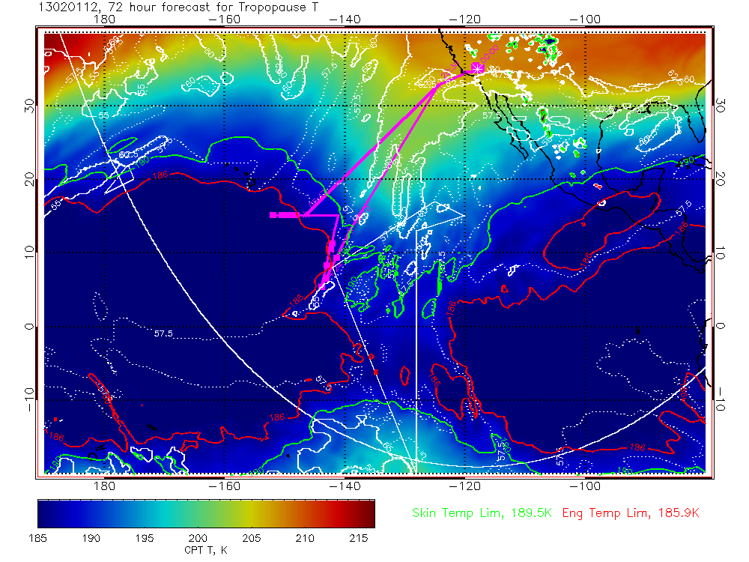
Trop/min Temperature – mid-flight – 01 Feb 00UT
GFS – FH48
GEOS-5 – FH72
In GEOS-5, skin temp limit (189.5K) reached sooner on approach to W01
GEOS-5 lowest temps – accounting for different isotherms on these plots – are lower in target region

Slide 7
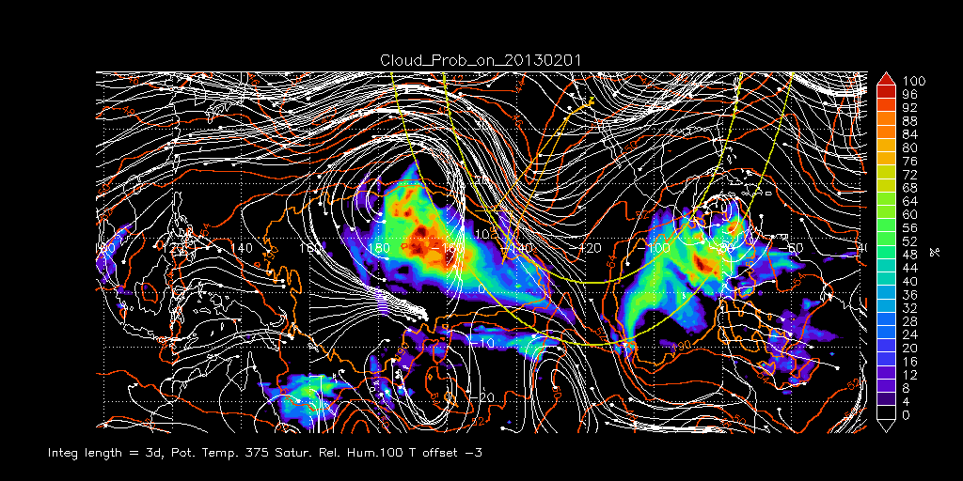
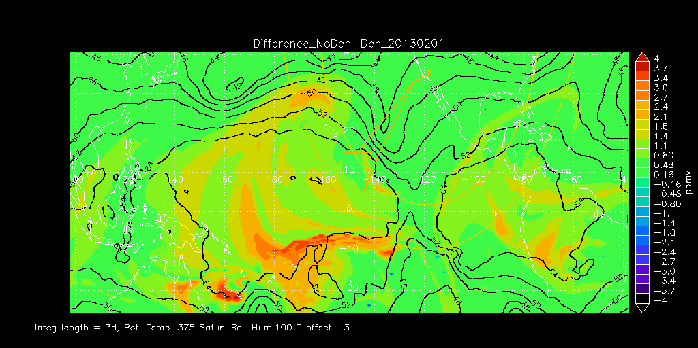
RDF Results – 01 Feb (Day 2)
Cloud probability
Net dehydration

