Slide 1
ATTREX Met Briefing for flight of January 30
Rennie Selkirk
29 Jan 2013
Local WX through Friday
100 hPa Temperature field for mid-flight
Comparisons between GFS and GEOS-5 EPV at 380 K

Slide 2
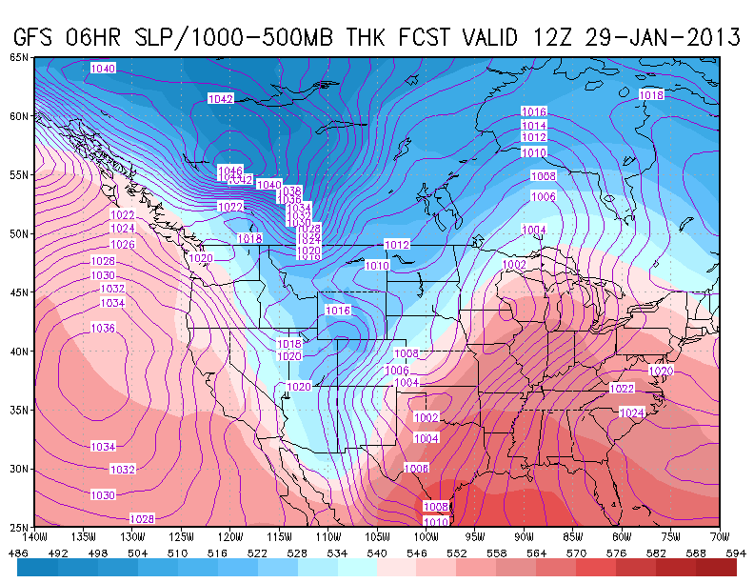
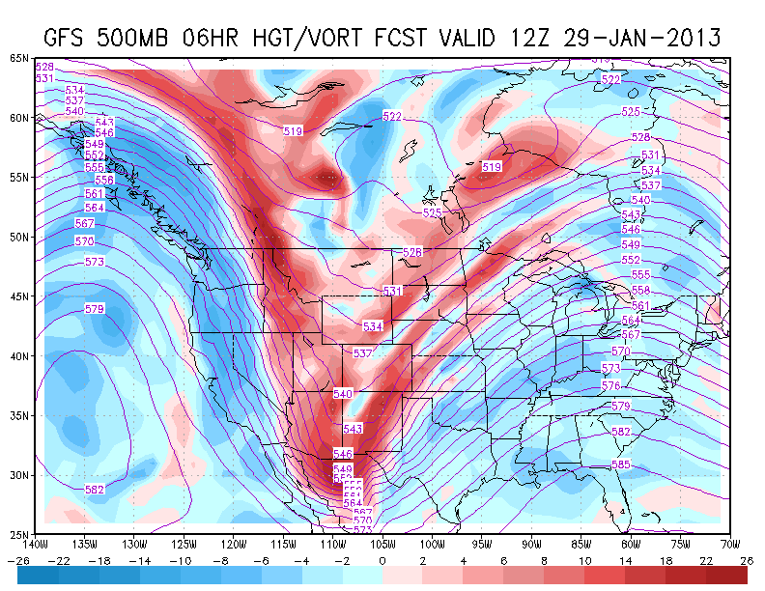
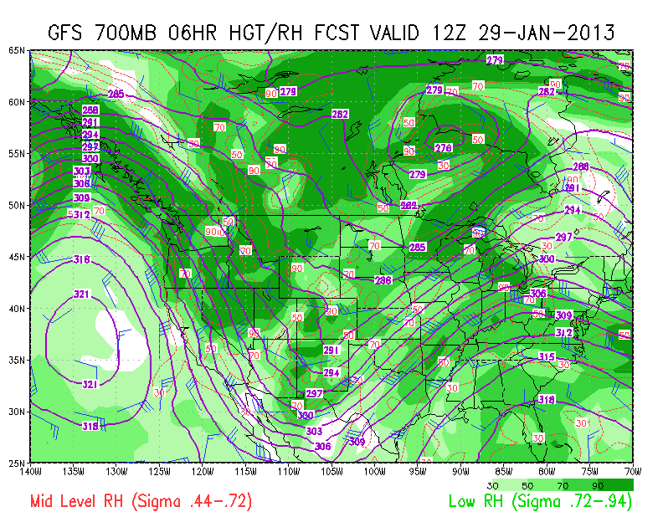
4 AM Today (29 Jan 12UT / GFS 12 HR)
C
B
A
ANALYSIS
Warming (thickness >546 dam) [A] and deep 500 hPa trough axis is now well to the east of us this AM [B]
Broad pulse of negative vorticity advection [C, blue] stabilizing atmosphere over most of California
700 hPa RH overhead a little moister than yesterday’s forecast dry [D, light green] – and there is some cirrus about this AM
D

Slide 3
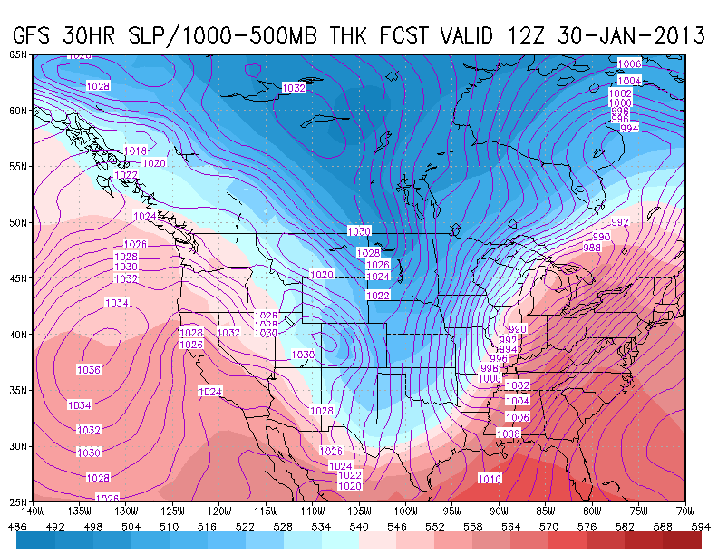
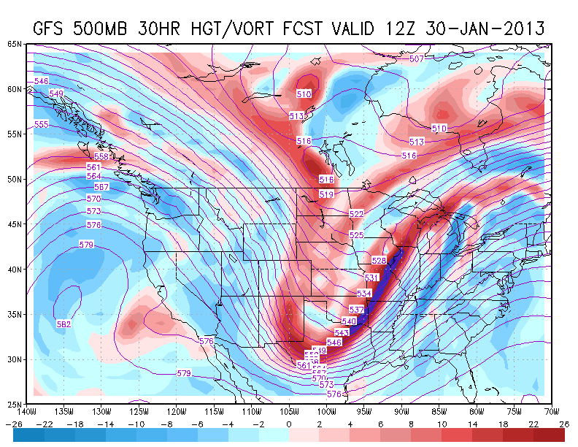
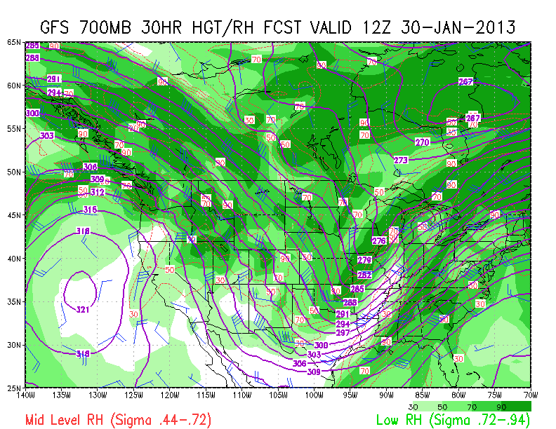
4 AM Wednesday – 30 Jan 12UT / GFS 30HR
G
F
DISCUSSION
Continued warming (thickness >552 dam) [F]
Negative vorticity advection [G] no longer a factor as on Tuesday
700 hPa RH remains relatively dry [H], but enough moisture above to produce cirrus
OUTLOOK: clear skies and warming into Tuesday
  .
H

Slide 4
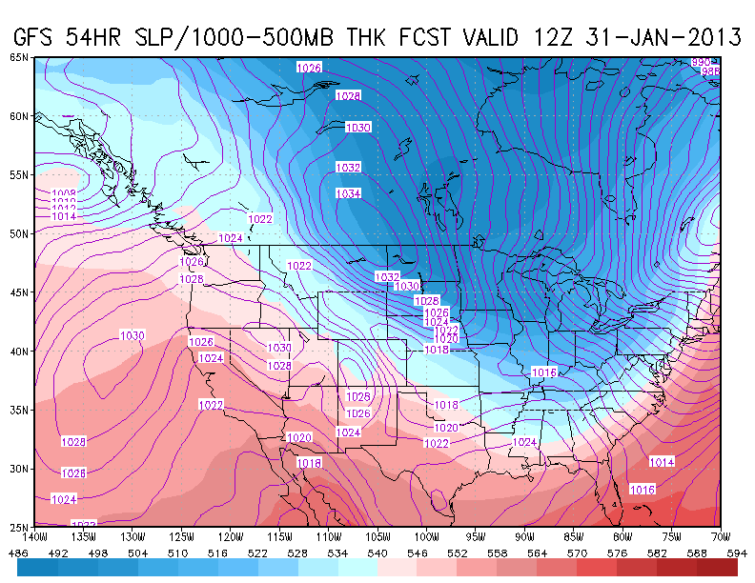
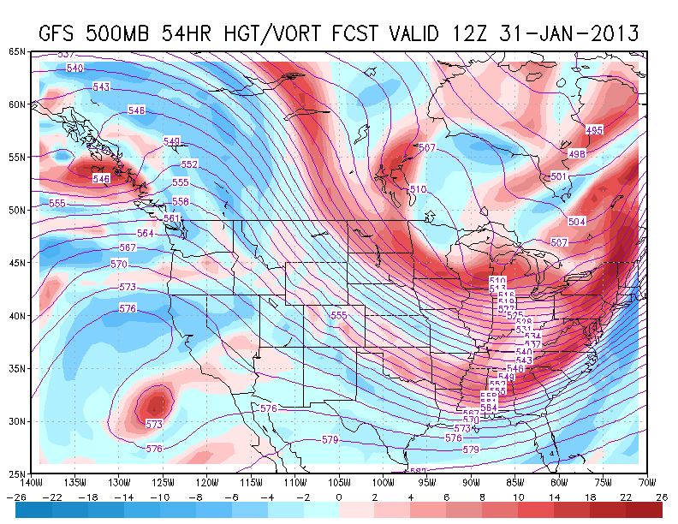
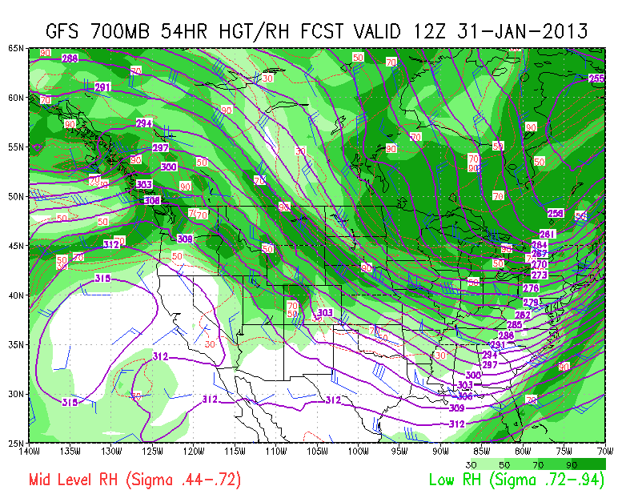
4 AM Thursday – 31 Jan 12UT / GFS 54HR
L
K
DISCUSSION
Continued warmer (thickness >552 dam)
Hi pressure [K] still offshore
Weak vort max feature [L]from cut-off low may produce some upper level cloudiness as RH forecast at 500 hPa in this feature is wet (next slide)
Otherwise atmosphere is fairly dry over region[M]
CONTINUED GREAT FLYING WEATHER!!
  .
M

Slide 5
GFS 500 hPa – RH and winds – 31 Jan 12 UT

Slide 6
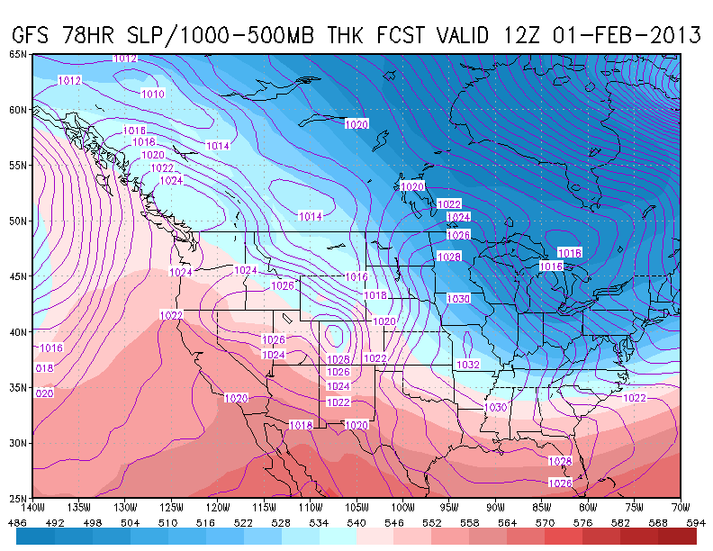
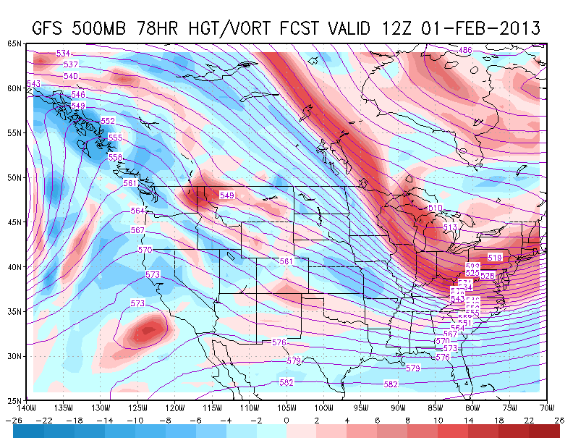
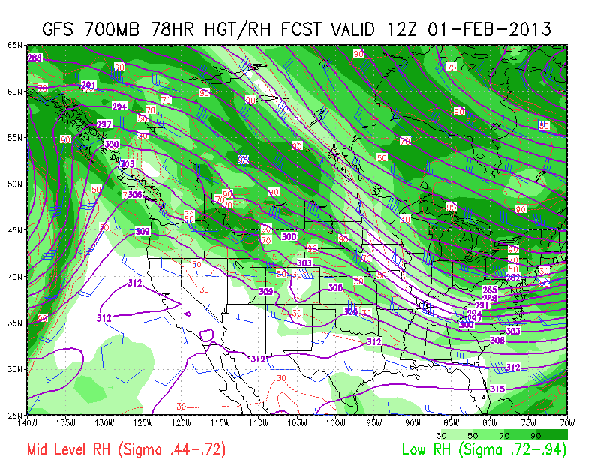
4 AM Friday – 01 Feb 12UT / GFS 78HR
N
O
DISCUSSION
Ridge building in [N]; warm (thickness > 552 dam)
Cut off low [O] may induce some high cloudiness
Though atmosphere remains dry at 700 hPa, RH at 500 hPaover region[P]
CONTINUED GREAT FLYING WEATHER!!
P

Slide 7
100 hPa – GFS 36HR – 31 Jan 00UT

Slide 8
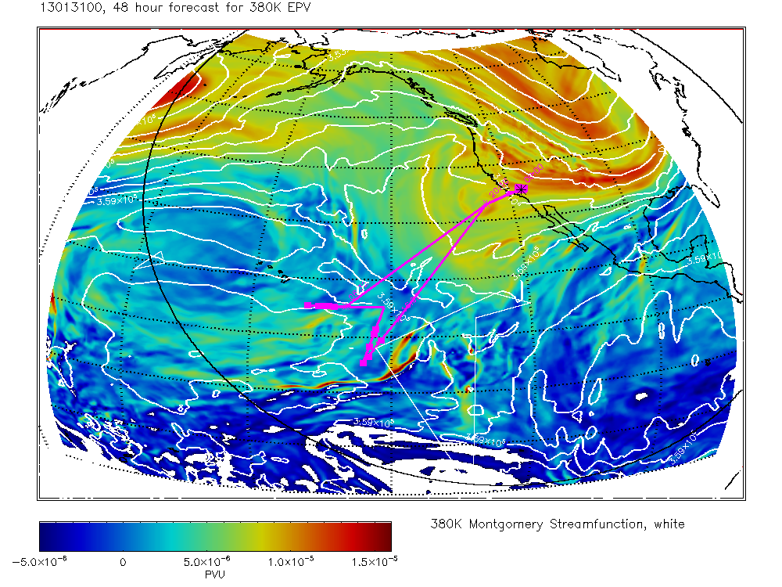
EPV at 380 K – 00 UT 31 Jan
GFS
GEOS-5
Hawaii
36 hr forecast
48 hr forecast

