Slide 1
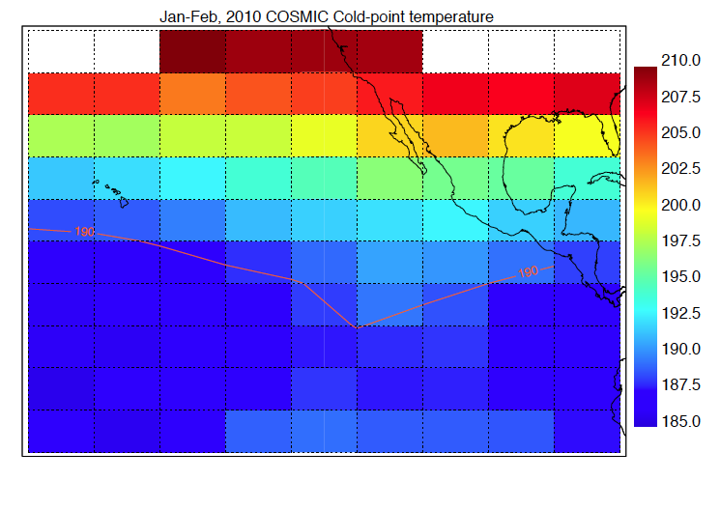
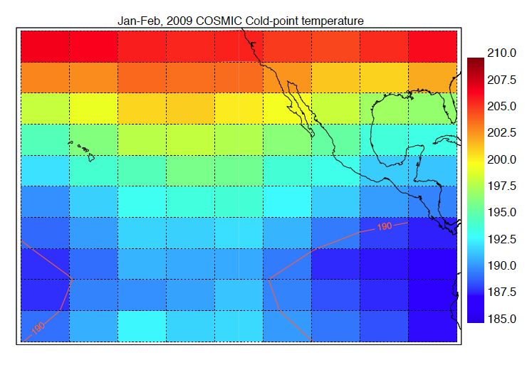
Where can we profile through the TTL?
Based on forecasts of ENSO and QBO phasing, we will likely encounter temperatures somewhere between 2009 and 2010.
On some flights, we will be able to profile across the cold point in the deep tropics.
We will not be able to fly in the coldest regions.
We could fly downwind of cold regions to look for evidence of dehydration (long flights)

Slide 2
ATTREX Flight Modules
TTL profiling: thin cirrus and water vapor
Likely won’t be able to profile through coldest temperatures
Perhaps sample dissipating clouds
TTL profiling: water vapor concentration downwind of thin cirrus
Combine with CPL data from leg above thin cirrus
TTL profiling: tracer measurements
Latitudinal surveys as far south as possible
TTL profiling: anvil cirrus sampling
Particularly high cloud tops (unique data)
Range of ages since detrainment
Long cruise-altitude legs for wave measurements
Is the cruise-altitude slow ascent a problem?
Intrusion sampling
Flight patterns?
What stages of intrusion evolution?

Slide 3
ATTREX Flight Modules: required forecast products
TTL profiling: thin cirrus and water vapor
Cold-point temperature, relative humidity, wind fields
Thin cirrus forecasts
TTL profiling: water vapor concentration downwind of thin cirrus
Cold-point temperature, relative humidity, wind fields
TTL profiling: tracer measurements
Temperature fields (to avoid coldest regions)
Convective influence
TTL profiling: anvil cirrus sampling
Deep convection and winds
Long cruise-altitude legs for wave measurements
?
Intrusion sampling
Potential vorticity RDFs

Slide 4
Flight plan changes (during flights)
Complete redesign forced by satellite communications problems
Redirection to avoid cold temperatures
Additional waypoints and dip locations needed
Moving locations of dips based on real-time information

Slide 5
Real-time Global Hawk measurements needed
CPL curtains and plan-view representation
MTP curtains and minimum temperature along flight track
MMS (temperature and winds) along flight track
H₂O, O₃, (other tracers?) along flight track
FCDP particle concentration
Access to data for tracer-tracer correlations
Need to enforce participation of instrument investigators

Slide 6
Forecasting/flight-planning approach
Should we have daily, formal weather briefs?
Not on flight days
Part of science team meetings when they occur
Include discussion of plans over next several days
Post flight plans and updates on mission tools suite (MTS)
Send email to team whenever flight plan changes

